Slide 1
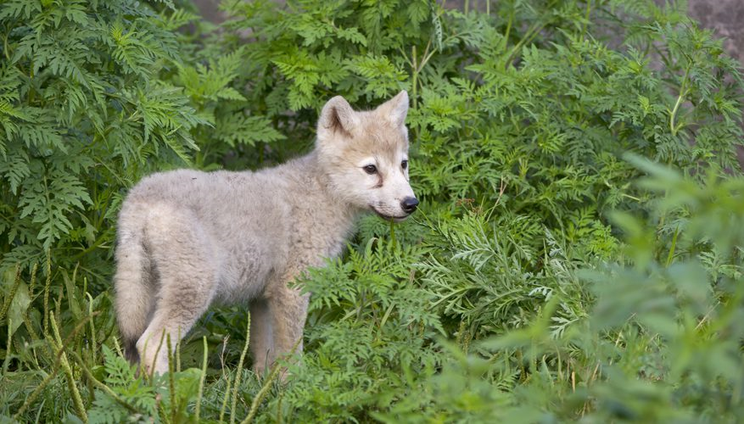
An Introduction to Cubs
History, Ceremonies and Expectations

Slide 2
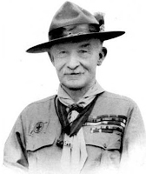
The Start of Scouting
Scouting was started by Lord Robert Baden-Powell, who was an Officer in the British Army.
At first, only boys over the age of eleven were allowed to become Scouts. He organised the very first Scout Camp in 1907. It took place on Brownsea Island in Dorset and a group of older boys tried out all sorts of exciting activities.
As only boys over the age of eleven were allowed to become Scouts their younger brothers weren't too happy about this because they also wanted to join in with all the fun!

Slide 3
Wolf Cubs and The Jungle Book
In 1914 Lord Baden-Powell started an experimental scheme for younger boys. Lord Baden-Powell was good friends with Rudyard Kipling, the author of the Jungle Book.
The programme for his Wolf Cubs was based on the Seonnee wolf pack from this book. This is why our leaders have names like Akela and Bagheera. When a new Cub Scout joins the Pack, he is like Mowgli entering the Seonnee wolf pack.

Slide 4
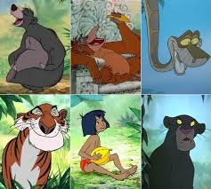

Slide 5
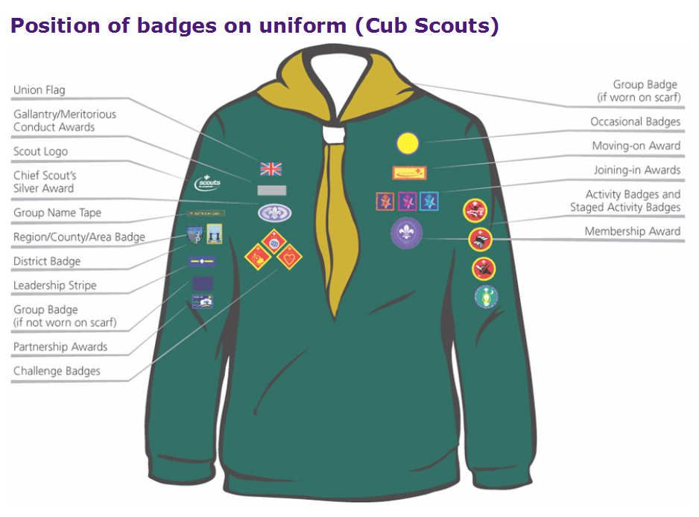
The First Cub Scouts
In 1916 a Wolf Cub wore either a blue or green knitted jumper, a knotted scarf, shorts, long socks and a green cap with yellow piping. Stars were worn on the cap and Sixer and Seconder stripes were worn on the arm.
The Cubs who gained both stars could work towards the proficiency badges and there was a Leaping Wolf Badge to help Cubs move up to Scouts.
In 1966 the Wolf Cubs changed their name to Cub Scouts. Instead of working for stars, they worked for three Arrow Badges. In 1991 more changes were made, with the badges being updated and girls being allowed to join for the first time. Most Groups now have girls in their Cub Packs. There are still some Packs which just have boys but, from 1 January 2007, all Scout Groups have to let girls join if they want to.

Slide 6
The Membership Badge

Slide 7
Ceremonies: Grand Howl Flag Break
One Cub Scout ceremony that you will see every week is the Grand Howl. This is a special greeting that the Pack gives to the Leaders at the start of the Pack meeting.
You will be shown how to take part in this when you join the Pack. The Grand Howl helps you remember you Promise to "Do Your Best".
The first Grand Howl took place in 1916.
At the opening ceremony, after the Grand Howl, all the Cubs face the flag. One Six will lead the ceremony each week and the Sixer in charge will pull on a rope to let the Union Flag fly freely. This is called "breaking the flag". At the end of the meeting the same Sixer will lower the flag.
The Flag ceremonies give you a chance to think about your Promise and also about the Queen and the country you live in.

Slide 8
Ceremonies Continued
Your Investiture is a special ceremony where you officially become a Cub Scout. You will gain your Membership Award and you will be presented with your Membership Badge. Before your Investiture, Bagheera will help you practise so that you know exactly what you need to do. She will also help you with remembering the Cub Scout Promise and Law. All of the Leaders and the other Cubs in your Pack will be at your Investiture. You can also invite your family and some friends along if you want to.
Before Your Investiture you will learn :
The Cub Scout Promise, Law and Motto
The Cub Scout Handshake
The Scout Salute and Sign

Slide 9
The Scout Promise The Scout Law The Scout Motto
I promise that I will do my best
To do my duty to God
And to the Queen,
To help other people
And to keep the Cub Scout Law
Cub Scouts always do their best.
Think of others before themselves
And do a good turn every day
Be prepared

Slide 10
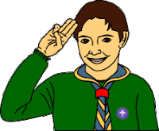
The Scout Salute is made with the right hand. It is used during the opening ceremony on Pack night and also at other special times – such as when you are presented with a badge.
The Scout Salute
The three fingers that you hold up should remind you of your promise to:
Do your duty to God and to the Queen
Help other people
Keep the Cub Scout Law

Slide 11
The Scout Sign
When you make your promise during your investiture you make a special kind of salute called the Scout Sign. It is the same as the salute except that you hold your hand at shoulder height instead of putting it up to you head.
You also make the Scout Sign whenever you are renewing your promise, for example at a parade on when another Cub Scout is invested.

Slide 12
The Scout Handshake
Cub Scouts (and everyone else in the Scout family) shake hands with their left hand. Why do they do this?
You also make the Scout Sign whenever you are renewing your promise, for example at a parade on when another Cub Scout is invested.

Slide 13
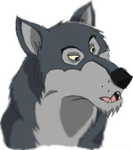
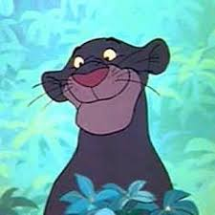
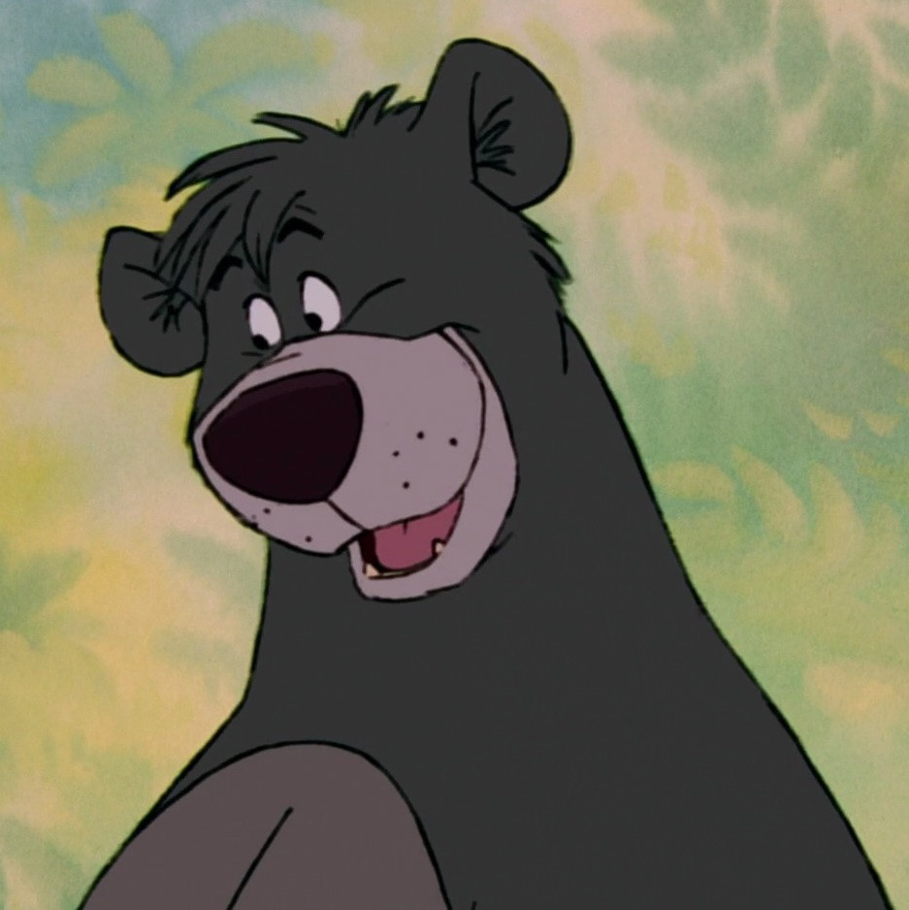
Your Leaders
Akela
Baghera
Baloo

