Slide 2
ANSWER SMASH

Slide 3
ANSWER SMASH
This is the final round. You’ll see a photo at the top of the screen, and a question below it. You need to ‘SMASH’ the two answers together, and tell me the complete phrase
For Example:
HARRY POTTURKEY
A large bird, commonly eaten at Christmas

Slide 4
SATELLITE BULB
SOMETHING YOU MIGHT SCREW IN TO MAKE THE ROOM BRIGHTER

Slide 5
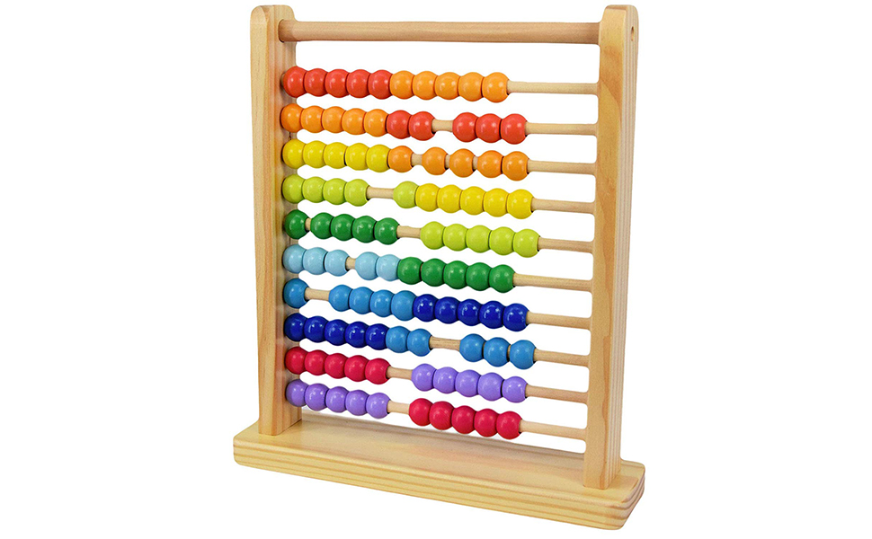
ABACUSTARD
YELLOW LIQUID YOU MIGHT EAT

Slide 6
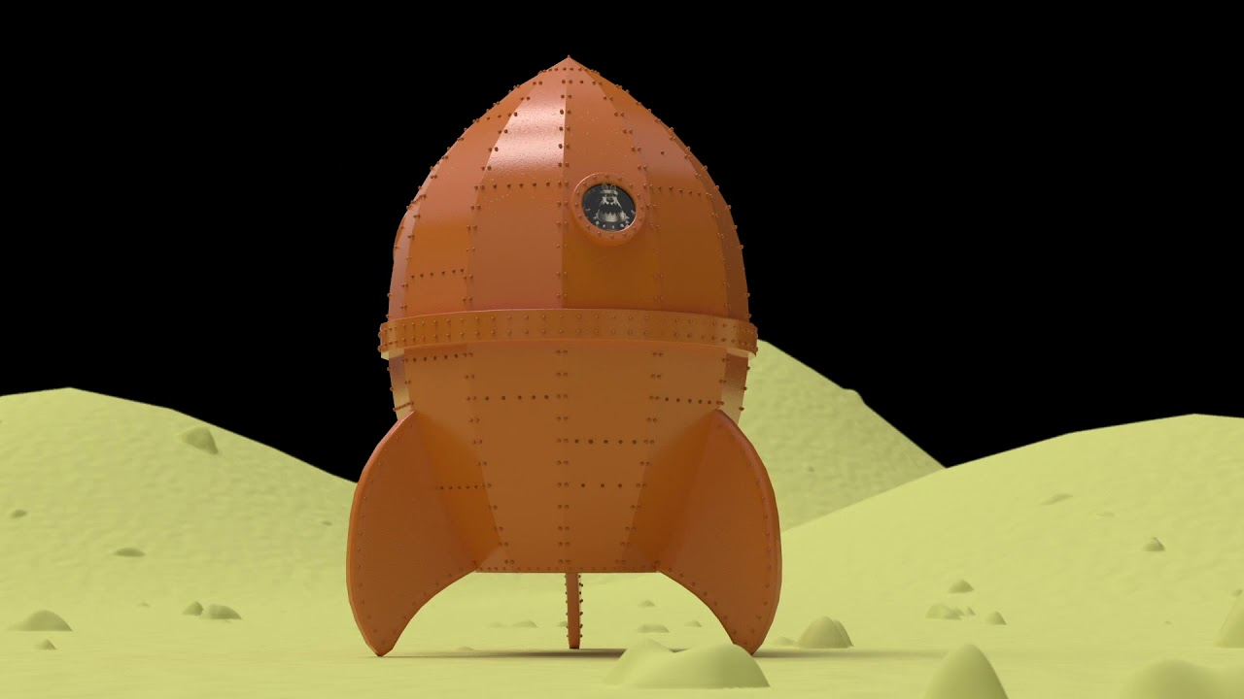
ROCKETCHUP
A SAUCE YOU MIGHT PUT ON YOUR CHIPS

Slide 7
COMETRO
THE PARISIAN VERSION OF THE TUBE

Slide 8
STARBUCKINGHAM PALACE
WHERE THE QUEEN LIVES

Slide 9
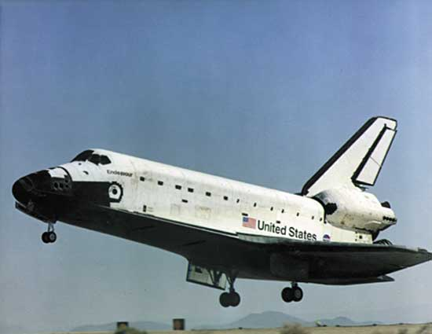
SPACE SHUTTLE-SCOPE
EQUIPMENT TO VIEW FARAWAY STARS AND PLANETS

Slide 10
PARKING ARTHUR
A LEGENDARY BRITISH KING

Slide 11
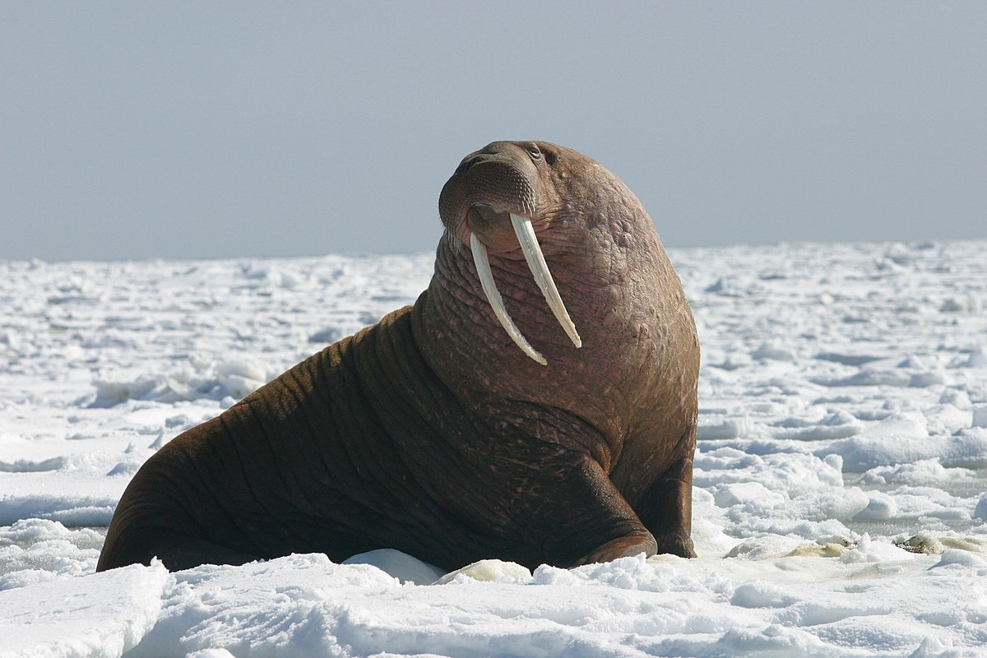
WALRUSSIA
A LARGE COUNTRY IN ASIA (AND EUROPE)

Slide 12
CLOVE HITCHIKER
SOMEONE WHO MIGHT THUMB A LIFT

Slide 13
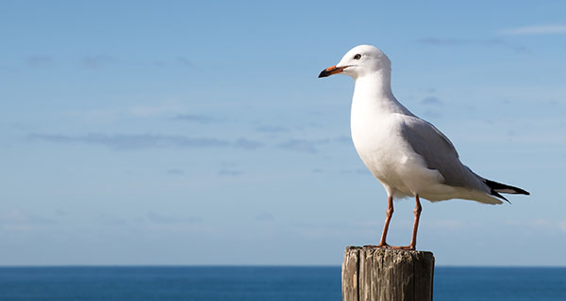
SEAGULLIBLE
BELIEVING RIDICULOUS THINGS

Slide 14
SETTEETOWEL
WHAT YOU USE TO DRY THE DISHES

Slide 15
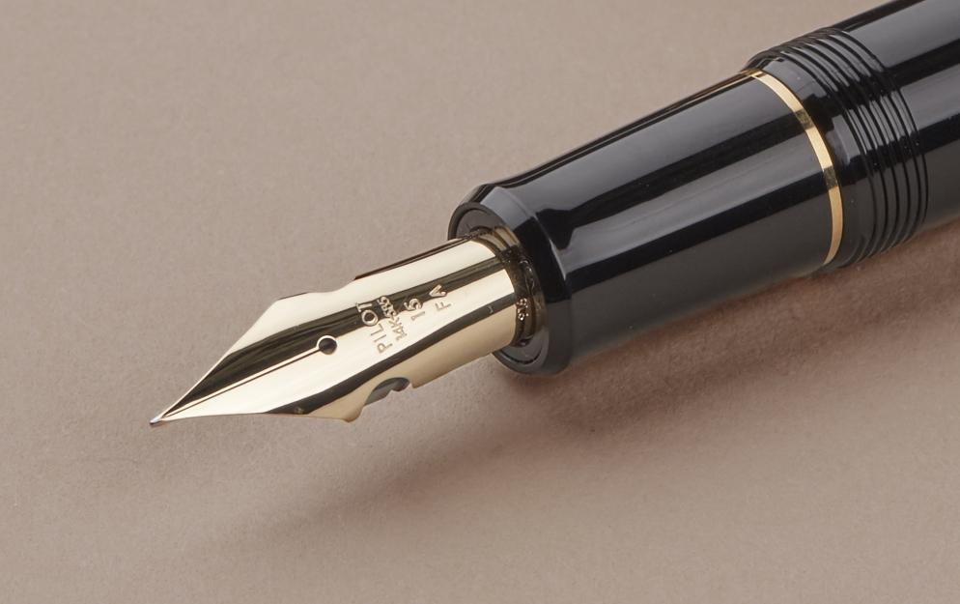
FOUNTAIN PENGUIN
A FLIGHTLESS BIRD THAT EATS FISH

Slide 16
MAGNETWORK
THE OLDEST SECTION IN SCOUTING (AGES 18-25)

Slide 17
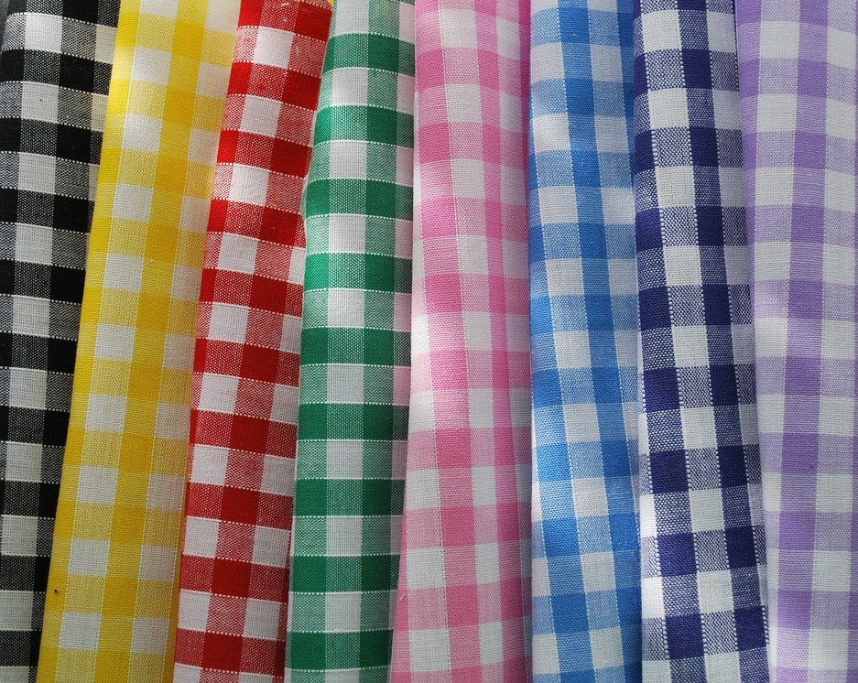
GINGHAMBURGER
FOOD SUCH AS A BIG MAC OR A WHOPPER

Slide 18
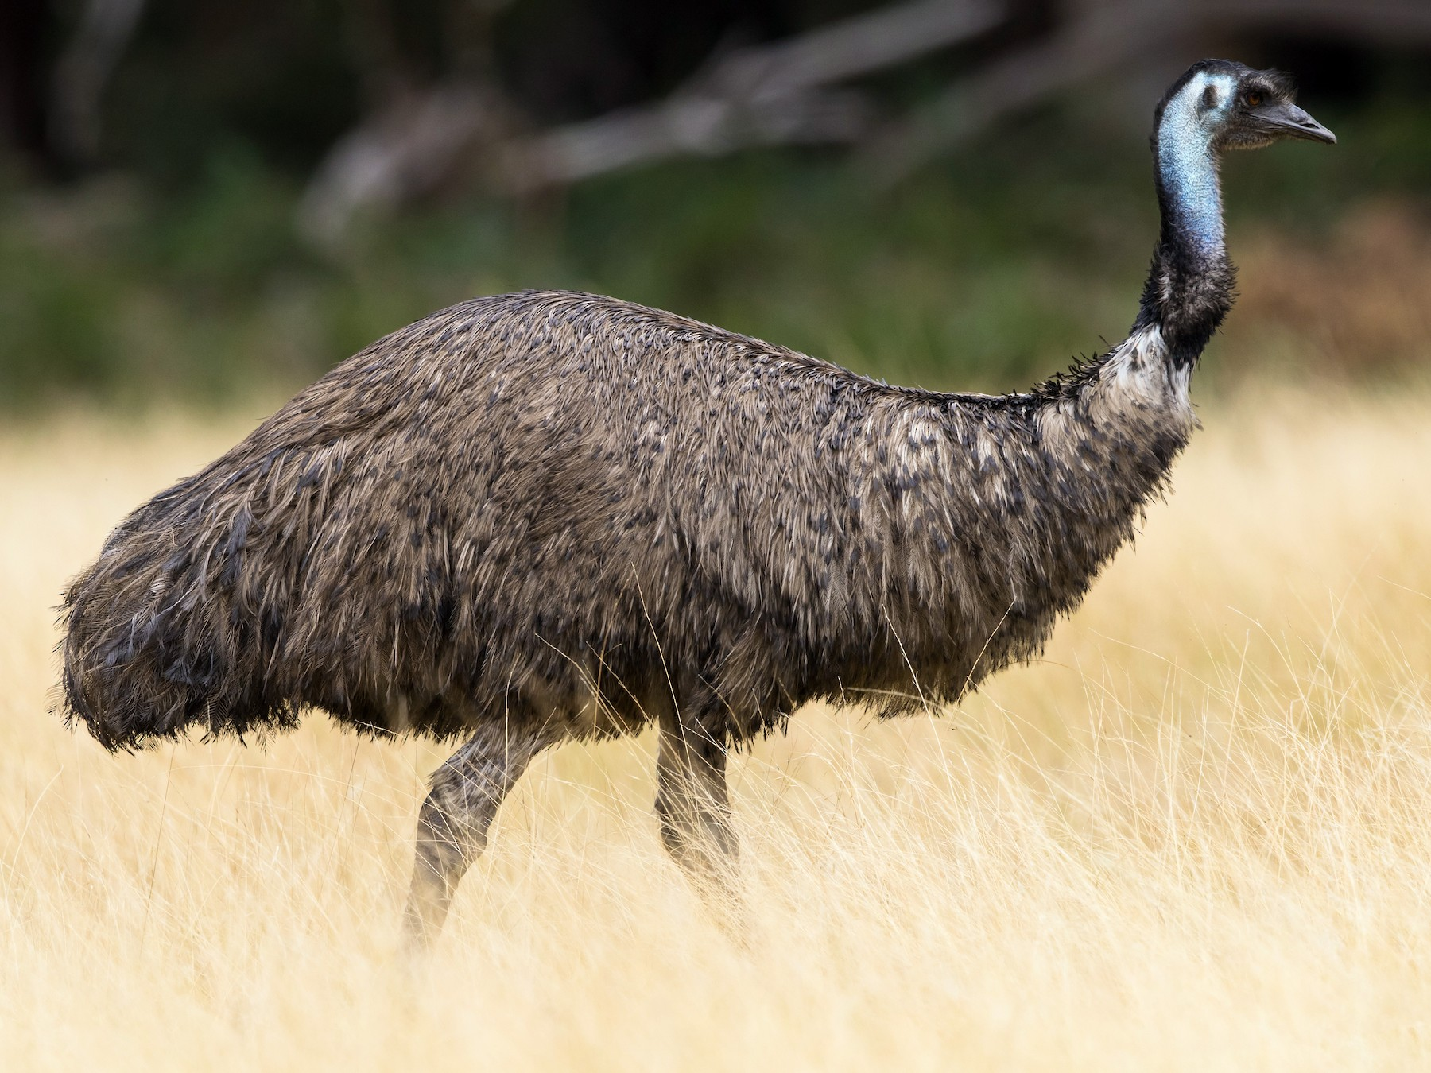
EMUTE
WHEN NO-ONE CAN HEAR YOU ON ZOOM

Slide 19
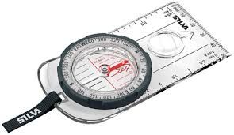
COMPASSPORT
A document you need to get into another country

Slide 20
FLAGPOLAND
A country in eastern Europe

Slide 21
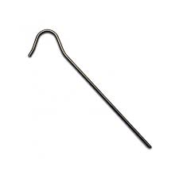
TENTPEG-LEG
What a one-legged pirate has

Slide 22
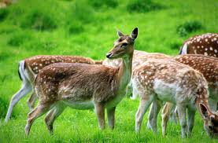
DEERIE
Spooky or mysterious

Slide 23
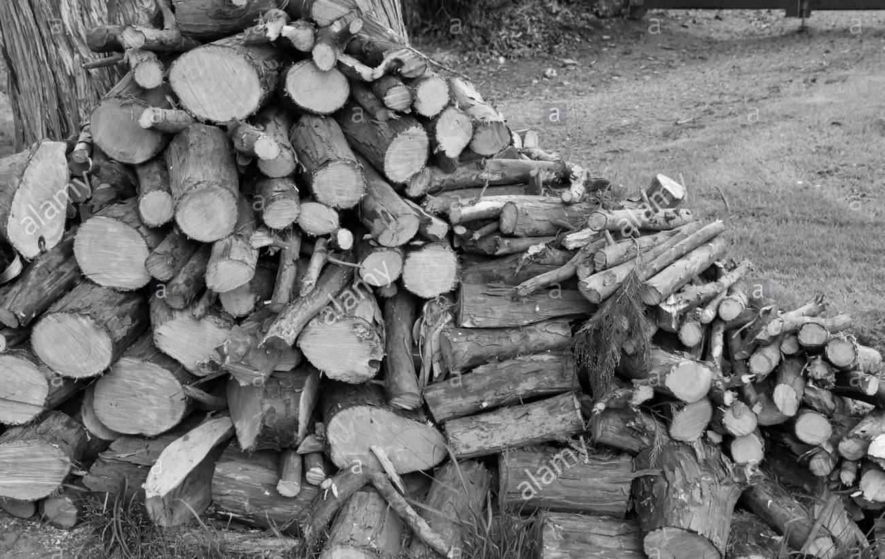
WOODPILE-UP
A BIG CRASH ON A MOTORWAY

Slide 24
TESCOCONUT
LARGE TROPICAL FRUIT THAT GROWS ON PALM TREES

Slide 25
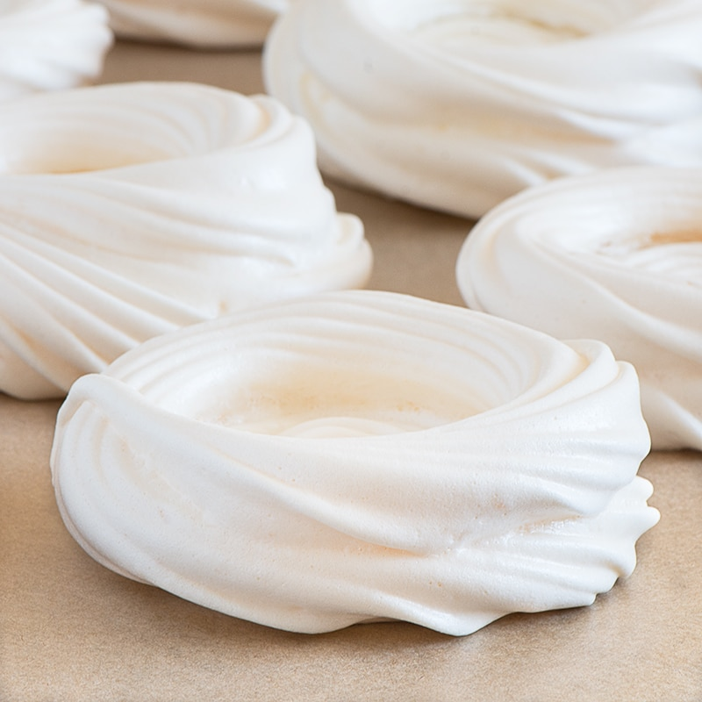
MERINGUE-UTAN
LARGE RED APE FROM SOUTH-EAST ASIA

Slide 26
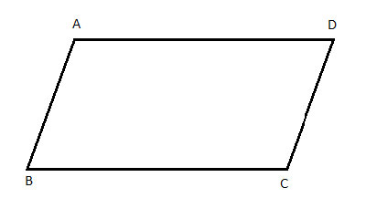
PARALLELOGRAMMAR
RULES ABOUT HOW YOU USE WORDS

Slide 27
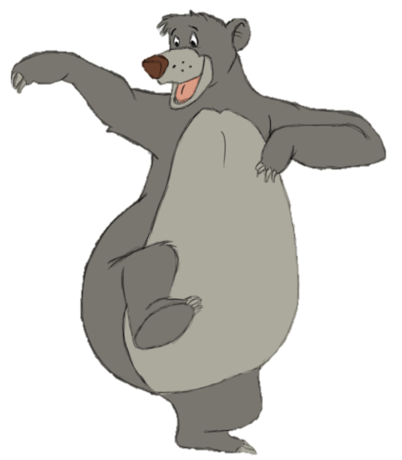
BALOONEY TUNES
Animated comedy company known for introducing Bugs Bunny, Daffy Duck, Tweety Pie, Porky Pig and Road Runner?

Slide 28
UNION JACK IN THE BOX
Children’s toy with a person inside that jumps out to surprise?

Slide 29
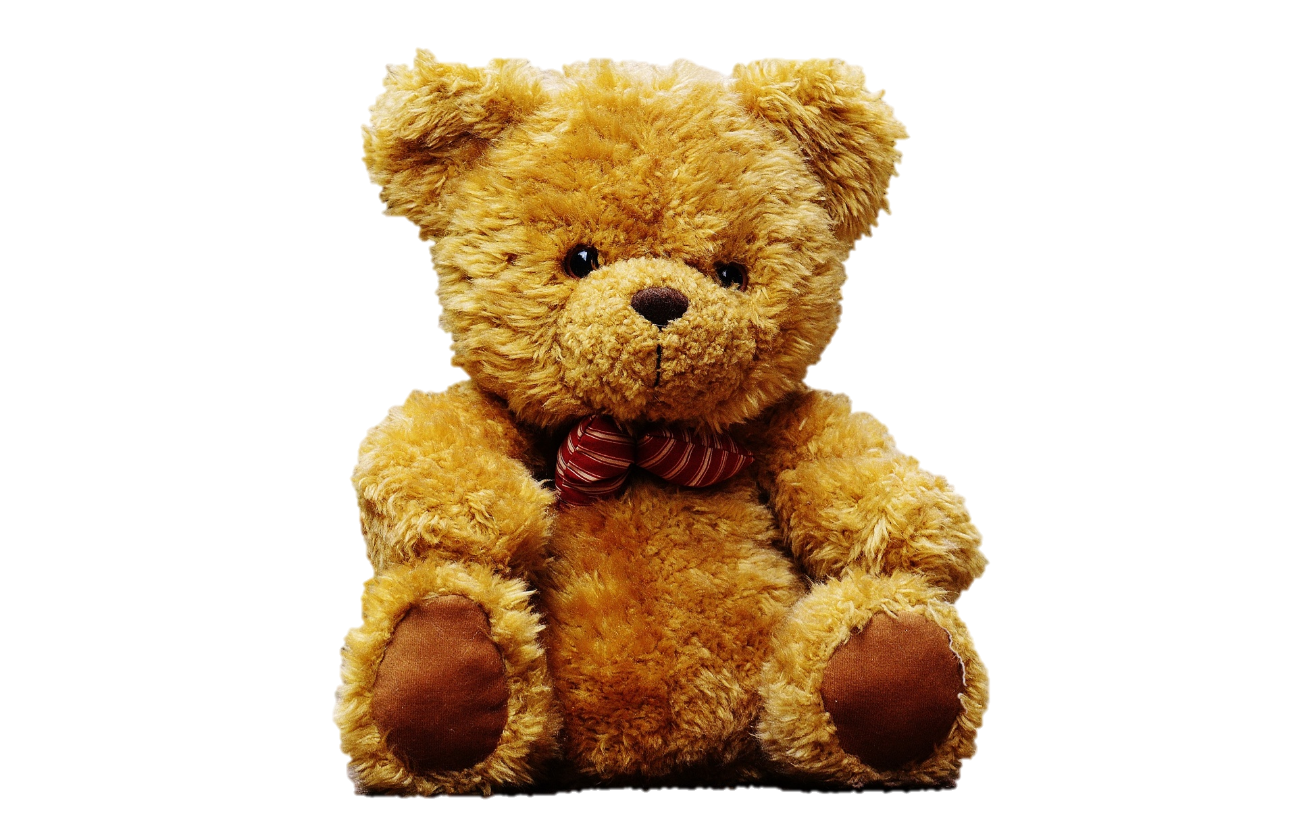
TEDDY BEAR GRYLLS
Our current Chief Scout

Slide 30
RONALD McDONALD DUCK
Partner of Daisy Duck

Slide 31
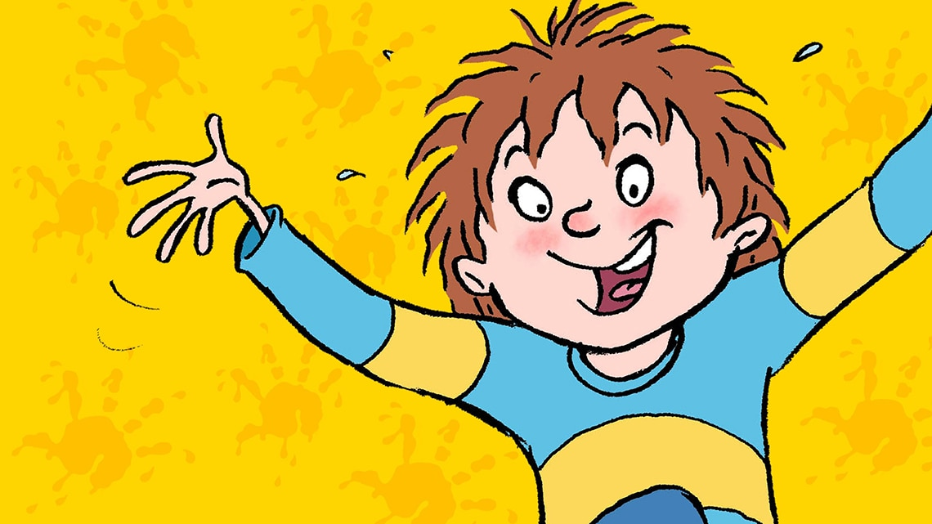
HORRID HENRY VIII
Which King of England had six wives?

Slide 32
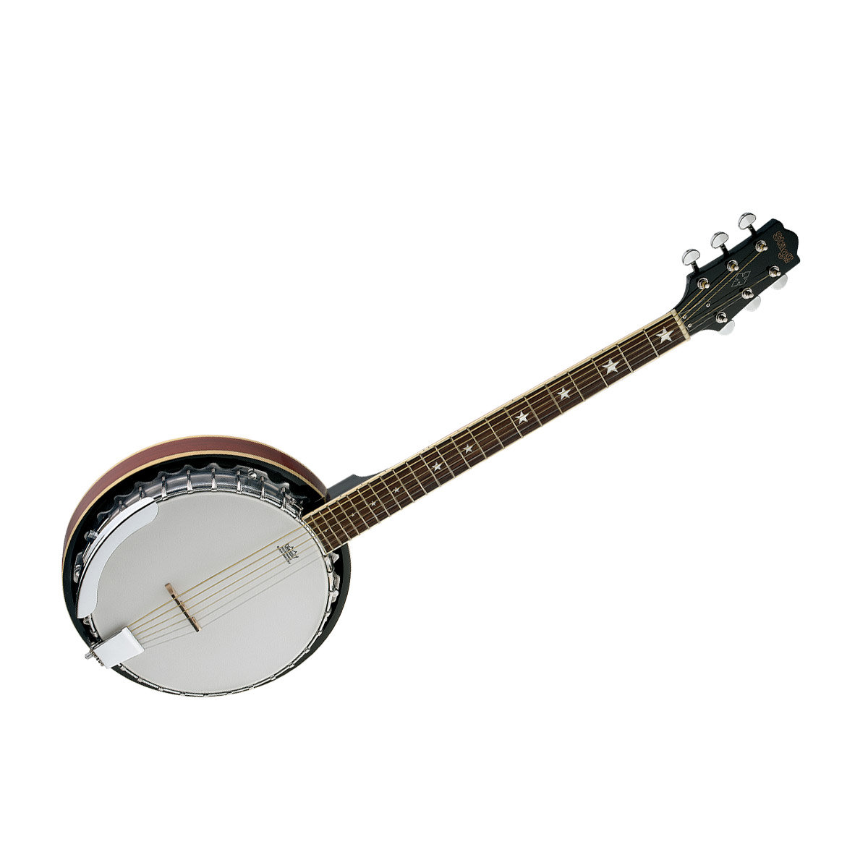
BANJOEBIDEN
The US Democratic Party’s presidential candidate for 2020

Slide 33
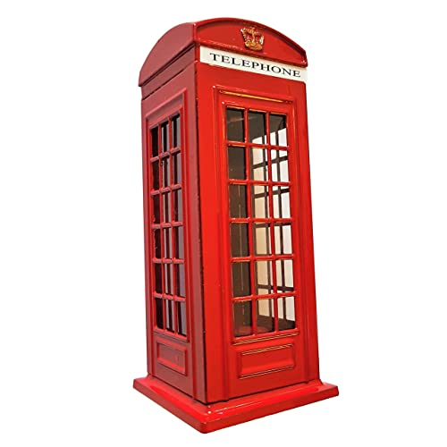
TELEPHONEBOXFORD
A UNIVERSITY TOWN IN ENGLAND

Slide 34
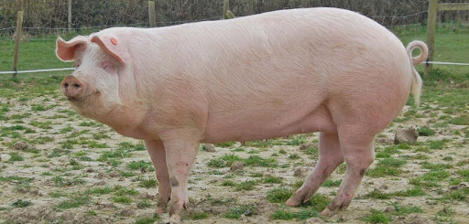
PIGLOO
A STRUCTURE MADE BY INUITS, OUT OF ICE

Slide 35
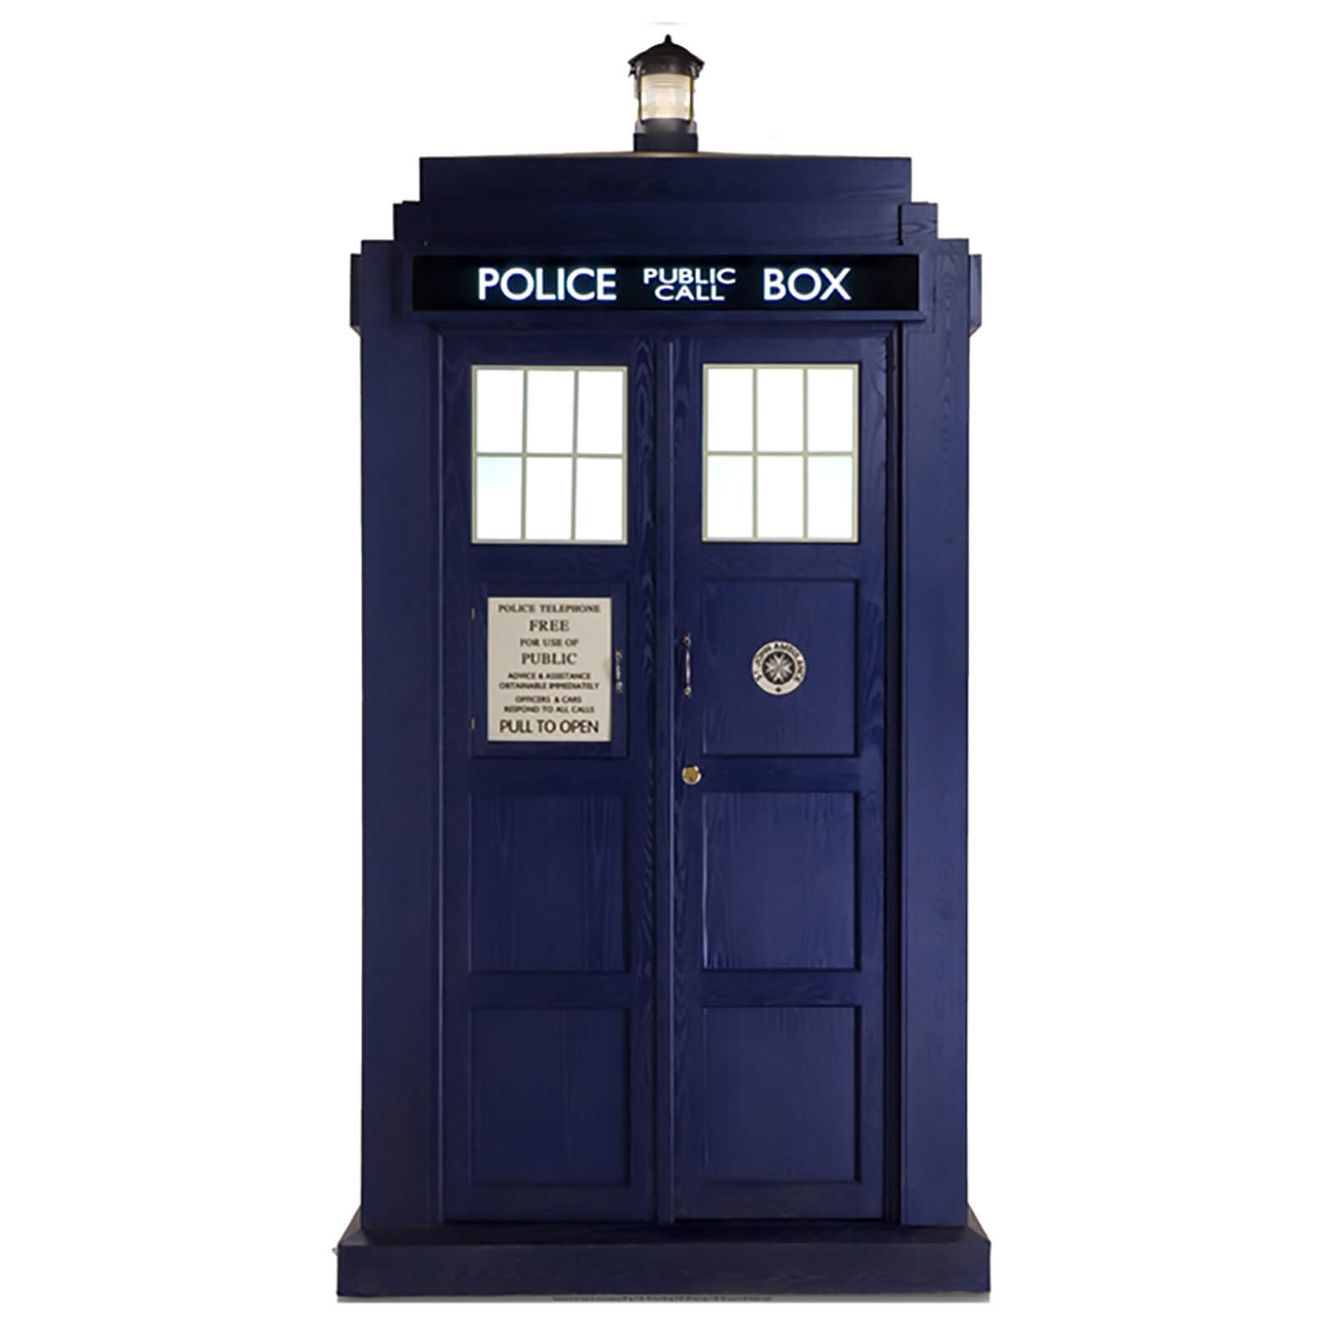
TARDISASTER
ANOTHER WORD FOR A CATASTROPHE

Slide 36
ANSWER SMASH
Railway terminus edition

Slide 37
Water-loom
SOMETHING YOU SPIN CLOTH ON

Slide 38
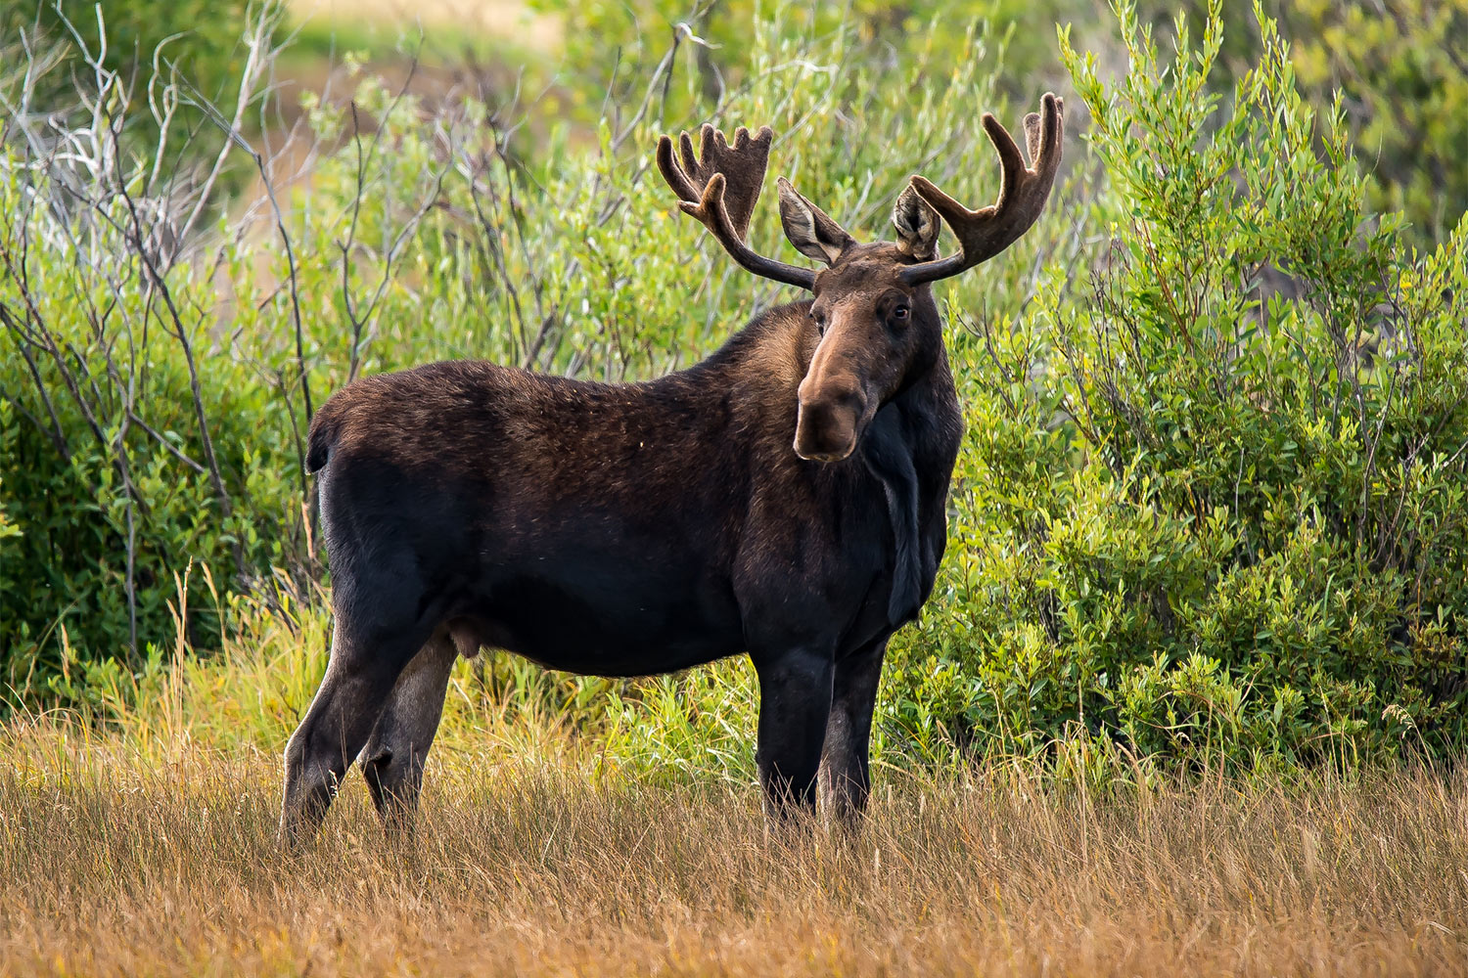
Moose-ton
SOMETHING REALLY HEAVY WEIGHS A …

Slide 39
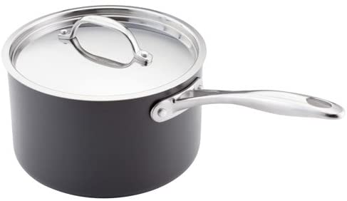
Saucepan-Cress (sorry)
TINY THIN VEGETABLE YOU MIGHT GROW ON WINDOWSILLS

