Slide 1
Name the item……

Slide 2
Horse Chestnut (Conker)

Slide 3
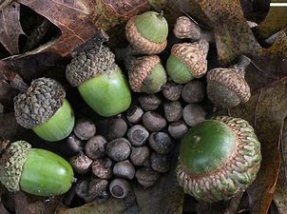
Oak Leaf

Slide 4
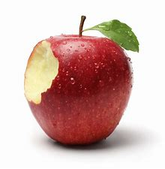
Apple

Slide 5
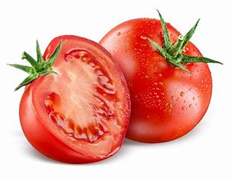
Tomatoes

Slide 6
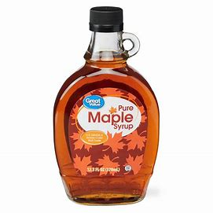
Maple Leaf

Slide 7
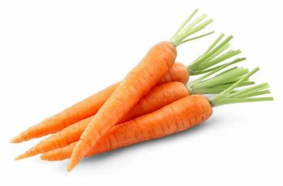
Carrots

Slide 8
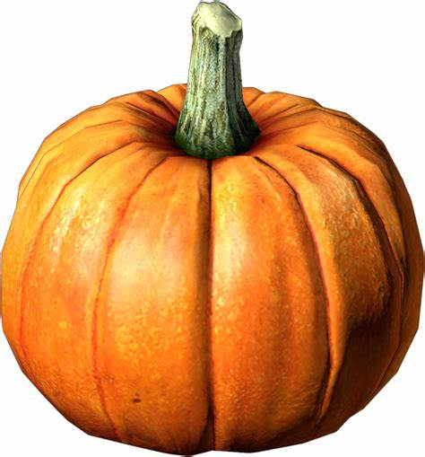
Pumpkin

Slide 9
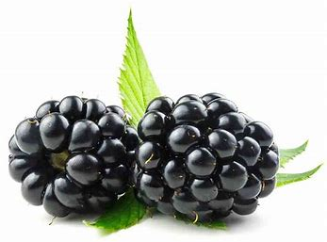
Blackberries

Slide 10
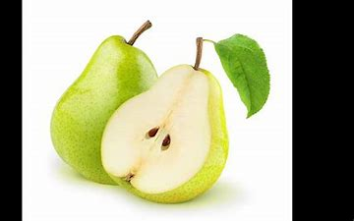
Pears

Slide 11
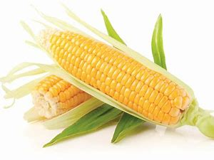
Sweetcorn

Slide 12
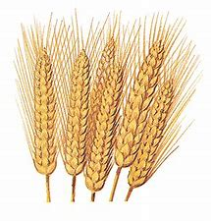
Wheat

Slide 13
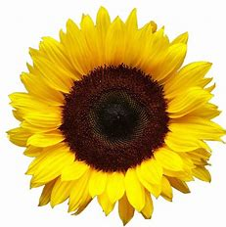
Sunflower

Slide 14
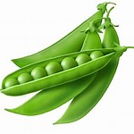
Peas

Slide 15
Potato

Slide 16
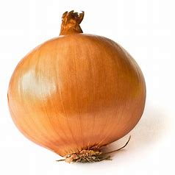
Onion

Slide 17
Dobble

Slide 18
Notes:
pumpkin

Slide 19
Notes:
sunflower

Slide 20
Notes:
carrots

Slide 21
Notes:
Maple leaf

Slide 22
Notes:
tomatoes

Slide 23
Notes:
onion

Slide 24
Notes:
Oak leaf

Slide 25
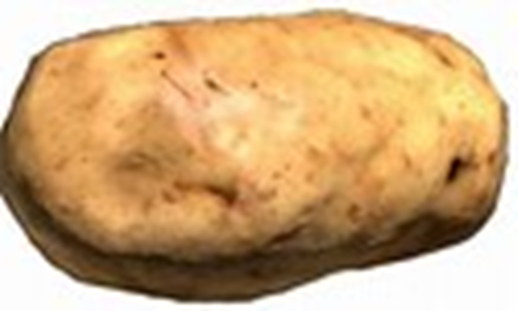
Notes:
Potato

Slide 26
Notes:
Apple

Slide 27
Notes:
Peas

