Slide 2
Beaver Scouts –
Part 5
Outdoor Challenge Badge

Slide 3
Requirements of the badge
Point out and name five different types of animal, insect, bird or fish that you might find near where you live. Find out about the food they eat and the places they might live.

Slide 4
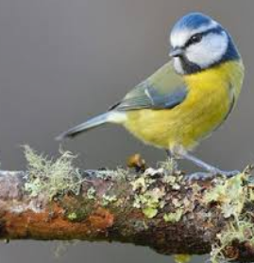
Number 1
What Bird is this?
BLUE TIT
Notes:
CPU (Central Processing Unit)

Slide 5
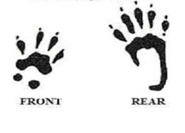
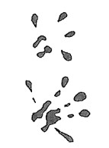
Number 1 - Footprints
A
B
C
D
E
Notes:
CPU (Central Processing Unit)

Slide 6
Number 1 – What do I eat?
A - Food:
Preferred foods include insects (especially flies), snails, slugs and worms. They catch their prey on their long sticky tongues
B – Food: These animals are opportunistic omnivores and will eat both plant and animal based food. Wild versions will eat a wide variety of seeds, grains, and other plant material as well as invertebrates, small vertebrates
C - Food
Varied diet of; fruits, berries and grasses. It also eats birds and small mammals like squirrels, rabbits and mice. Also invertebrates like crickets, caterpillars, grasshoppers, beetles and crayfish
D - Food:
Insects, caterpillars, seeds and nuts.
E - Food: Hazelnuts, acorns, beech mast, tree bark, fungi, buds, leaves, shoots, flowers; will also raid birds' nests for eggs and young.
Notes:
CPU (Central Processing Unit)

Slide 7
Number 1 – Where do I live?
A - Habitat:
Like areas with scattered trees such as; woodlands, hedgerows, parks and gardens, lives in a nest
B – Habitat:
Can be found in meadows, gardens and woodland. They hibernate and breed in puddles, ponds, lakes and canals, muddy burrows or at the bottom of ponds.
E – Habitat They have a summer home and a winter home. The summer drey is flatter, lighter and more open as protection from the weather is less important. In autumn, this might be adapted or abandoned altogether in favour of a freshly built drey suitable for winter. In the colder, wetter weather, they need somewhere safe, warm and dry to raise the first litter of the year, born around February.
C - Habitat
These animals live around the world in many diverse habitats including; forests, grasslands, mountains, and deserts. They also adapt well to human environments such as farms, suburban areas
D – Habitat They sleep in burrows when it's light and venture out to forage during the evenings.
Notes:
CPU (Central Processing Unit)

Slide 8
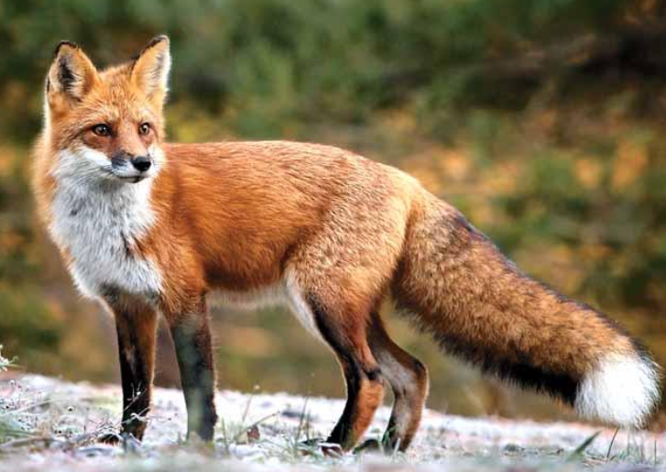
Number 2
What Animal is this?
FOX
Notes:
CPU (Central Processing Unit)

Slide 9
Number 2 - Footprints
A
B
C
D
E
Notes:
CPU (Central Processing Unit)

Slide 10
Number 2 – What do I eat?
A - Food:
Preferred foods include insects (especially flies), snails, slugs and worms. They catch their prey on their long sticky tongues
B – Food: These animals are opportunistic omnivores and will eat both plant and animal based food. Wild versions will eat a wide variety of seeds, grains, and other plant material as well as invertebrates, small vertebrates
C - Food
Varied diet of; fruits, berries and grasses. It also eats birds and small mammals like squirrels, rabbits and mice. Also invertebrates like crickets, caterpillars, grasshoppers, beetles and crayfish
D - Food:
Insects, caterpillars, seeds and nuts.
E - Food: Hazelnuts, acorns, beech mast, tree bark, fungi, buds, leaves, shoots, flowers; will also raid birds' nests for eggs and young.
Notes:
CPU (Central Processing Unit)

Slide 11
Number 2 – Where do I live?
A - Habitat:
Like areas with scattered trees such as; woodlands, hedgerows, parks and gardens, lives in a nest
B – Habitat:
Can be found in meadows, gardens and woodland. They hibernate and breed in puddles, ponds, lakes and canals, muddy burrows or at the bottom of ponds.
E – Habitat They have a summer home and a winter home. The summer drey is flatter, lighter and more open as protection from the weather is less important. In autumn, this might be adapted or abandoned altogether in favour of a freshly built drey suitable for winter. In the colder, wetter weather, they need somewhere safe, warm and dry to raise the first litter of the year, born around February.
C - Habitat
These animals live around the world in many diverse habitats including; forests, grasslands, mountains, and deserts. They also adapt well to human environments such as farms, suburban areas
D – Habitat They sleep in burrows when it's light and venture out to forage during the evenings.
Notes:
CPU (Central Processing Unit)

Slide 12
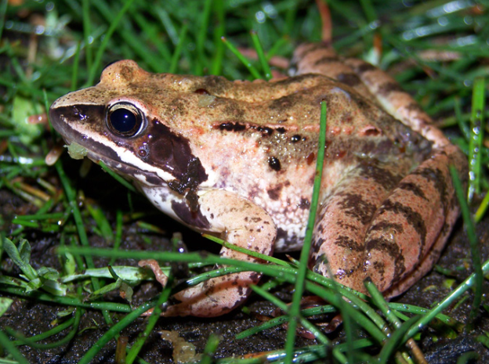
Number 3
What Animal is this?
FROG
Notes:
CPU (Central Processing Unit)

Slide 13
Number 3 - Footprints
A
B
C
D
E
Notes:
CPU (Central Processing Unit)

Slide 14
Number 3 – What do I eat?
A - Food:
Preferred foods include insects (especially flies), snails, slugs and worms. They catch their prey on their long sticky tongues
B – Food: These animals are opportunistic omnivores and will eat both plant and animal based food. Wild versions will eat a wide variety of seeds, grains, and other plant material as well as invertebrates, small vertebrates
C - Food
Varied diet of; fruits, berries and grasses. It also eats birds and small mammals like squirrels, rabbits and mice. Also invertebrates like crickets, caterpillars, grasshoppers, beetles and crayfish
D - Food:
Insects, caterpillars, seeds and nuts.
E - Food: Hazelnuts, acorns, beech mast, tree bark, fungi, buds, leaves, shoots, flowers; will also raid birds' nests for eggs and young.
Notes:
CPU (Central Processing Unit)

Slide 15
Number 3 – Where do I live?
A - Habitat:
Likes areas with scattered trees such as; woodlands, hedgerows, parks and gardens, lives in a nest
B – Habitat:
Can be found in meadows, gardens and woodland. They hibernate and breed in puddles, ponds, lakes and canals, muddy burrows or at the bottom of ponds.
E – Habitat They have a summer home and a winter home. The summer drey is flatter, lighter and more open as protection from the weather is less important. In autumn, this might be adapted or abandoned altogether in favour of a freshly built drey suitable for winter. In the colder, wetter weather, they need somewhere safe, warm and dry to raise the first litter of the year, born around February.
C - Habitat
These animals live around the world in many diverse habitats including; forests, grasslands, mountains, and deserts. They also adapt well to human environments such as farms, suburban areas
D – Habitat They sleep in burrows when it's light and venture out to forage during the evenings.
Notes:
CPU (Central Processing Unit)

Slide 16
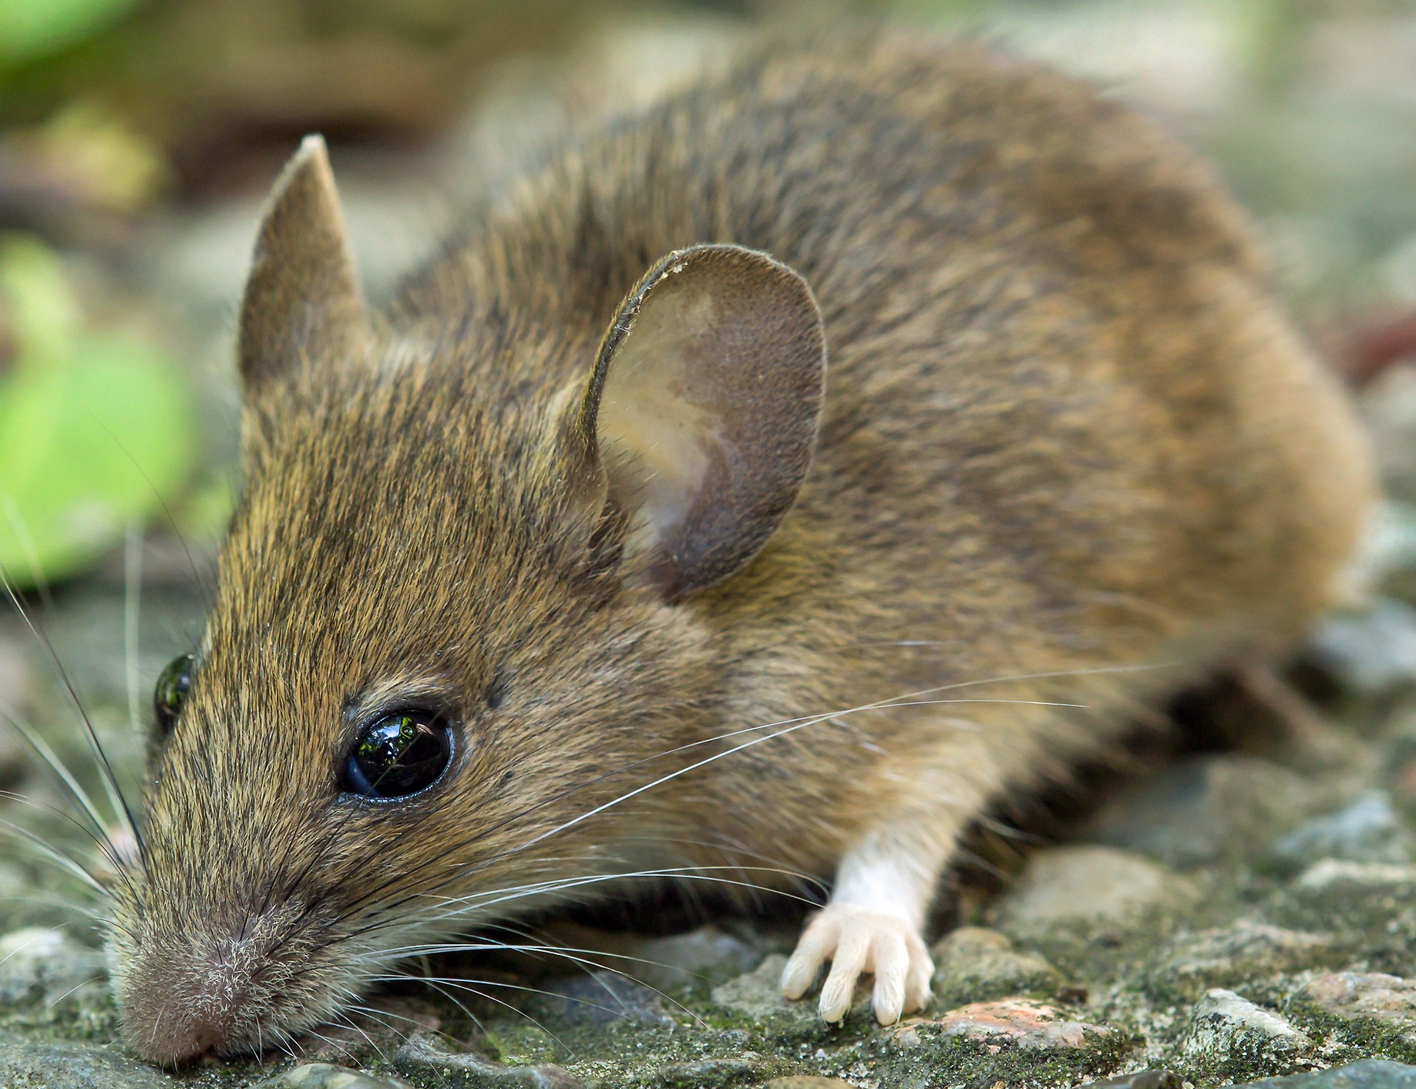
Number 4
What Animal is this?
WOOD MOUSE
Notes:
CPU (Central Processing Unit)

Slide 17
Number 4
Notes:
CPU (Central Processing Unit)

Slide 18
Number 4 - Footprints
A
B
C
D
E
Notes:
CPU (Central Processing Unit)

Slide 19
Number 4 – What do I eat?
A - Food:
Preferred foods include insects (especially flies), snails, slugs and worms. They catch their prey on their long sticky tongues
B – Food: These animals are opportunistic omnivores and will eat both plant and animal based food. Wild versions will eat a wide variety of seeds, hazelnuts, grains, and other plant material as well as invertebrates, small vertebrates
C - Food
Varied diet of; fruits, berries and grasses. It also eats birds and small mammals like squirrels, rabbits and mice. Also invertebrates like crickets, caterpillars, grasshoppers, beetles and crayfish
D - Food:
Insects, caterpillars, seeds and nuts.
E - Food: Hazelnuts, acorns, beech mast, tree bark, fungi, buds, leaves, shoots, flowers; will also raid birds' nests for eggs and young.
Notes:
CPU (Central Processing Unit)

Slide 20
Number 4 – Where do I live?
A - Habitat:
Likes areas with scattered trees such as; woodlands, hedgerows, parks and gardens, lives in a nest
B – Habitat:
Can be found in meadows, gardens and woodland. They hibernate and breed in puddles, ponds, lakes and canals, muddy burrows or at the bottom of ponds.
E – Habitat They have a summer home and a winter home. The summer drey is flatter, lighter and more open as protection from the weather is less important. In autumn, this might be adapted or abandoned altogether in favour of a freshly built drey suitable for winter. In the colder, wetter weather, they need somewhere safe, warm and dry to raise the first litter of the year, born around February.
C - Habitat
These animals live around the world in many diverse habitats including; forests, grasslands, mountains, and deserts. They also adapt well to human environments such as farms, suburban areas
D – Habitat They sleep in burrows when it's light and venture out to forage during the evenings.
Notes:
CPU (Central Processing Unit)

Slide 21
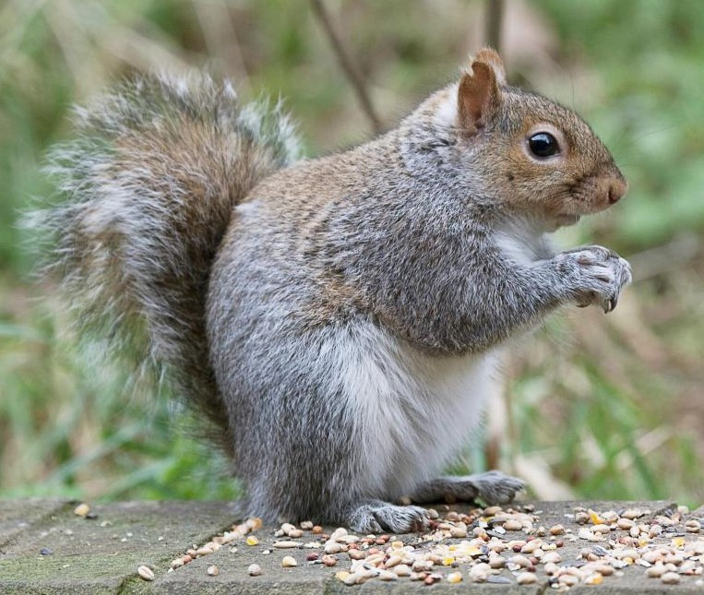
Number 5
What Animal is this?
GREY SQUIRREL
Notes:
CPU (Central Processing Unit)

Slide 22
Number 5 - Footprints
A
B
C
D
E
Notes:
CPU (Central Processing Unit)

Slide 23
Number 5 – What do I eat?
A - Food:
Preferred foods include insects (especially flies), snails, slugs and worms. They catch their prey on their long sticky tongues
B – Food: These animals are opportunistic omnivores and will eat both plant and animal based food. Wild versions will eat a wide variety of seeds, grains, and other plant material as well as invertebrates, small vertebrates
C - Food
Varied diet of; fruits, berries and grasses. It also eats birds and small mammals like squirrels, rabbits and mice. Also invertebrates like crickets, caterpillars, grasshoppers, beetles and crayfish
D - Food:
Insects, caterpillars, seeds and nuts.
E - Food: Hazelnuts, acorns, beech mast, tree bark, fungi, buds, leaves, shoots, flowers; will also raid birds' nests for eggs and young.
Notes:
CPU (Central Processing Unit)

Slide 24
Number 5 – Where do I live?
A - Habitat:
Likes areas with scattered trees such as; woodlands, hedgerows, parks and gardens, lives in a nest
B – Habitat:
Can be found in meadows, gardens and woodland. They hibernate and breed in puddles, ponds, lakes and canals, muddy burrows or at the bottom of ponds.
E – Habitat They have a summer home and a winter home. The summer drey is flatter, lighter and more open as protection from the weather is less important. In autumn, this might be adapted or abandoned altogether in favour of a freshly built drey suitable for winter. In the colder, wetter weather, they need somewhere safe, warm and dry to raise the first litter of the year, born around February.
C - Habitat
These animals live around the world in many diverse habitats including; forests, grasslands, mountains, and deserts. They also adapt well to human environments such as farms, suburban areas
D – Habitat They sleep in burrows when it's light and venture out to forage during the evenings.
Notes:
CPU (Central Processing Unit)

Slide 25
ANSWERS
A - Habitat:
Likes areas with scattered trees such as; woodlands, hedgerows, parks and gardens, lives in a nest
D - Food:
Insects, caterpillars, seeds and nuts.
B
Notes:
CPU (Central Processing Unit)

Slide 26
ANSWERS
A
C - Habitat
These animals live around the world in many diverse habitats including; forests, grasslands, mountains, and deserts. They also adapt well to human environments such as farms, suburban areas
C - Food
Varied diet of; fruits, berries and grasses. It also eats birds and small mammals like squirrels, rabbits and mice. Also invertebrates like crickets, caterpillars, grasshoppers, beetles and crayfish
Notes:
CPU (Central Processing Unit)

Slide 27
ANSWERS
C
B – Habitat:
Can be found in meadows, gardens and woodland. They hibernate and breed in puddles, ponds, lakes and canals, muddy burrows or at the bottom of ponds.
A - Food:
Preferred foods include insects (especially flies), snails, slugs and worms. They catch their prey on their long sticky tongues
Notes:
CPU (Central Processing Unit)

Slide 28
ANSWERS
B – Food: These animals are opportunistic omnivores and will eat both plant and animal based food. Wild versions will eat a wide variety of seeds, grains, and other plant material as well as invertebrates, small vertebrates
E
D – Habitat They sleep in burrows when it's light and venture out to forage during the evenings.
Notes:
CPU (Central Processing Unit)

Slide 29
ANSWERS
D
E – Habitat They have a summer home and a winter home. The summer drey is flatter, lighter and more open as protection from the weather is less important. In autumn, this might be adapted or abandoned altogether in favour of a freshly built drey suitable for winter. In the colder, wetter weather, they need somewhere safe, warm and dry to raise the first litter of the year, born around February.
E - Food: Hazelnuts, acorns, beech mast, tree bark, fungi, buds, leaves, shoots, flowers; will also raid birds' nests for eggs and young.
Notes:
CPU (Central Processing Unit)

