Slide 1
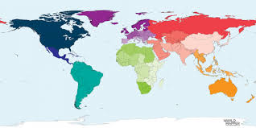
Beaver Scouts around the World
International badge
Find out about Beaver Scouts, or younger Scouts if they don’t have Beaver Scouts, in another country.

Slide 2
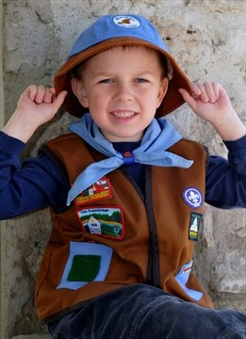
Canadian Beaver Scouts
Canadian Beaver promise
I promise to love God and help take care of the world.

Slide 3
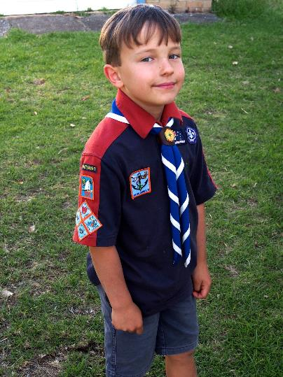
Australian Beaver Scouts are called Joeys
Their promise is
I promise to do my best.
To love God and be helpful

Slide 4
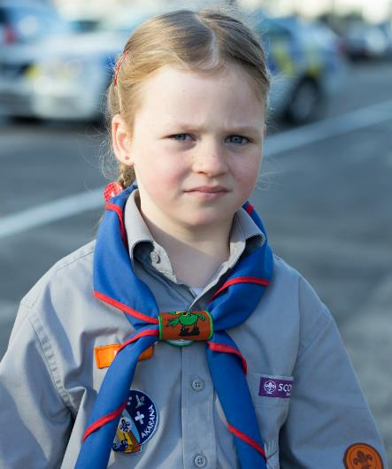
In New Zealand Beaver Scouts are called Kea Scouts
Their promise is
I will try to share my fun and help others

Slide 5
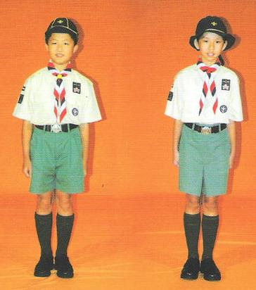
In Hong Kong Beavers are called Grasshopper Scouts
Their promise is
I promise to be a Grasshopper Scout, to love God, to love people and to love my country

Slide 6
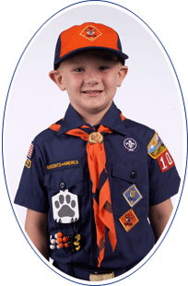
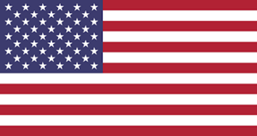
In the United States of America, Beavers are called Tiger Cubs
Their promise is
I promise to love God, my family and my country and to learn about the world

Slide 7
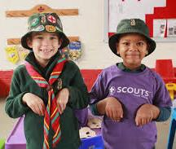
In South Africa Beavers are called Meercats
Their promise
I promise to do my best. To obey my Leaders and parents, and to be a good Beaver

