Slide 1
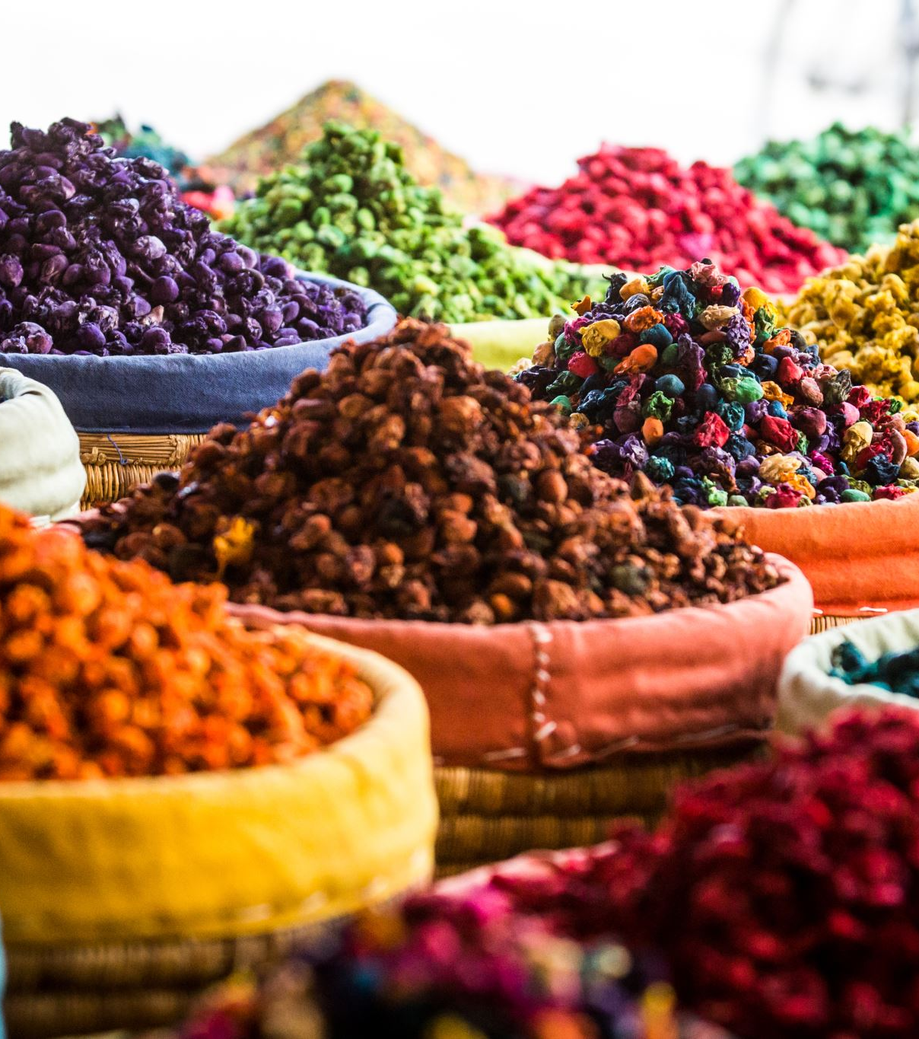
Food Around the World!
International Badge Quiz

Slide 2
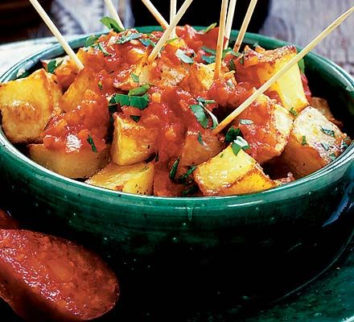
Which country gave us patatas bravas?
Italy
Spain
New Zealand

Slide 3
Which country gave us patatas bravas?
b) Spain
It’s fried potatoes, with a spicy tomato sauce. Yum!

Slide 4
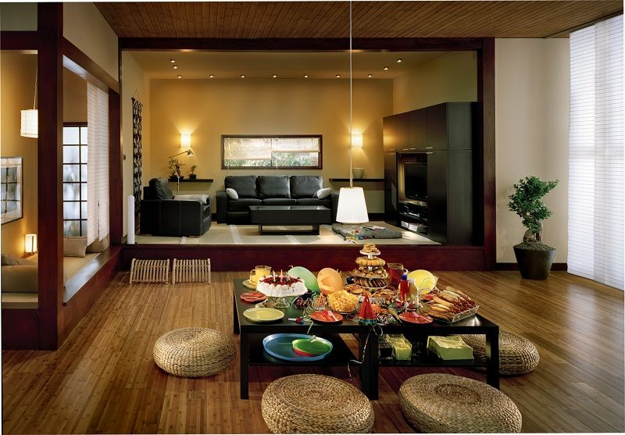
Where in the world is this a traditional dining table?
Brazil
Norway
Japan

Slide 5
Where in the world is this a traditional dining table?
c) Japan
It’s traditional to eat kneeling on the floor. Another thing to consider is that traditional Japanese flooring (tatami mats) are soft and don’t do well with heavy furniture on them!

Slide 6
What time do many Greeks eat their dinner?
a) 9pm to 10pm
b) 5.30pm to 6.30pm
c) 1pm to 2pm

Slide 7
What time do many Greeks eat their dinner?
9pm to 10pm
This is because the high temperatures during the day make eating a hot meal less appealing.
The picture here is of stuffed grape leaves – tasty!

Slide 8
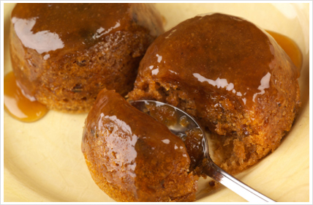
This is a Malva Pudding. It’s a traditional Christmas dessert in…
Portugal
South Africa
Norway

Slide 9
This is a Malva Pudding. It’s a traditional Christmas dessert in…
b) South Africa
It has sponge, apricot jam and syrup. What’s not to like?!

Slide 10
Roald Dahl wrote about eating krokan ice cream while on holiday in Norway. But what is special about it?
It is made with goat’s milk
It is actually hot ice cream
You have to crunch it up before you swallow it

Slide 11
Roald Dahl wrote about eating krokan ice cream while on holiday in Norway. But what is special about it?
c) You have to crunch it up before you swallow it
This is because it has pieces of crunchy almond brittle mixed into it.

Slide 12
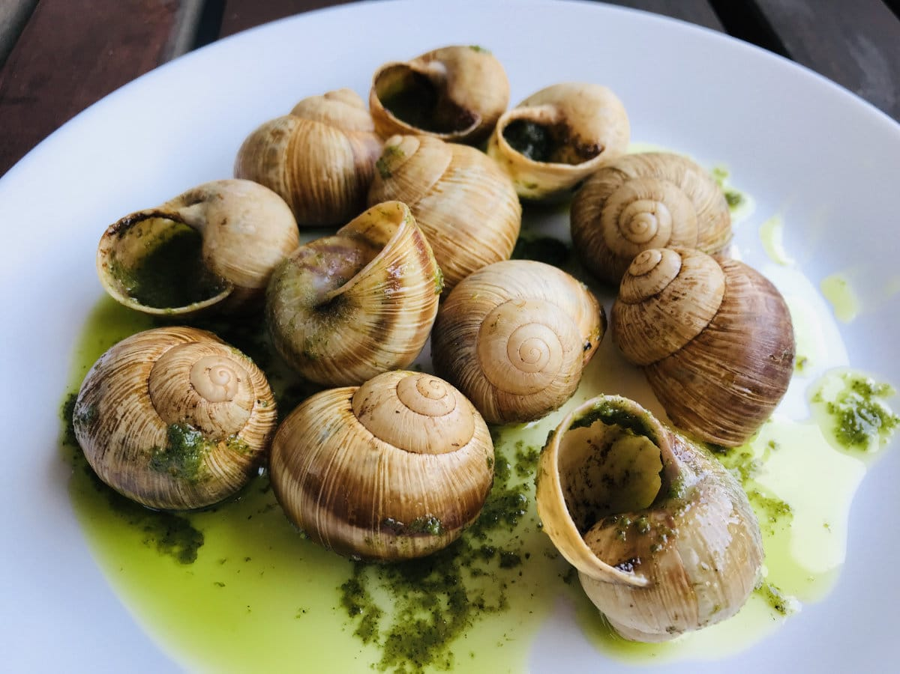
Which country consumes the largest weight of snails per year?
a) France
b) Morocco
c) Spain

Slide 13
Which country consumes the largest weight of snails per year?
c) Spain
According to Google, the Spanish eat 16,500 tonnes of snails per year!
French people only each 5300 tonnes, while Moroccans consume 6000 tonnes.
Yum…?

Slide 14
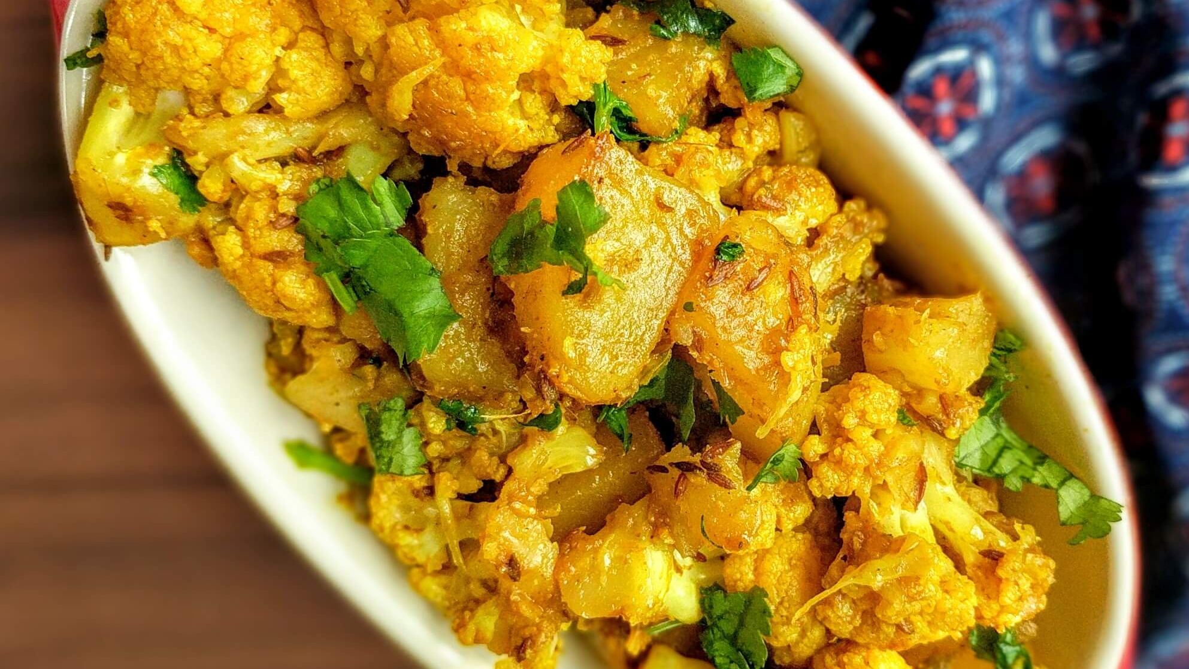
Aloo Gobi is a popular dish in India and Pakistan. What are the two main ingredients?

Slide 15
Aloo Gobi is a popular dish in India and Pakistan. What are the two main ingredients? Potato and cauliflower – it also contains turmeric which causes the yellow colour.

Slide 16
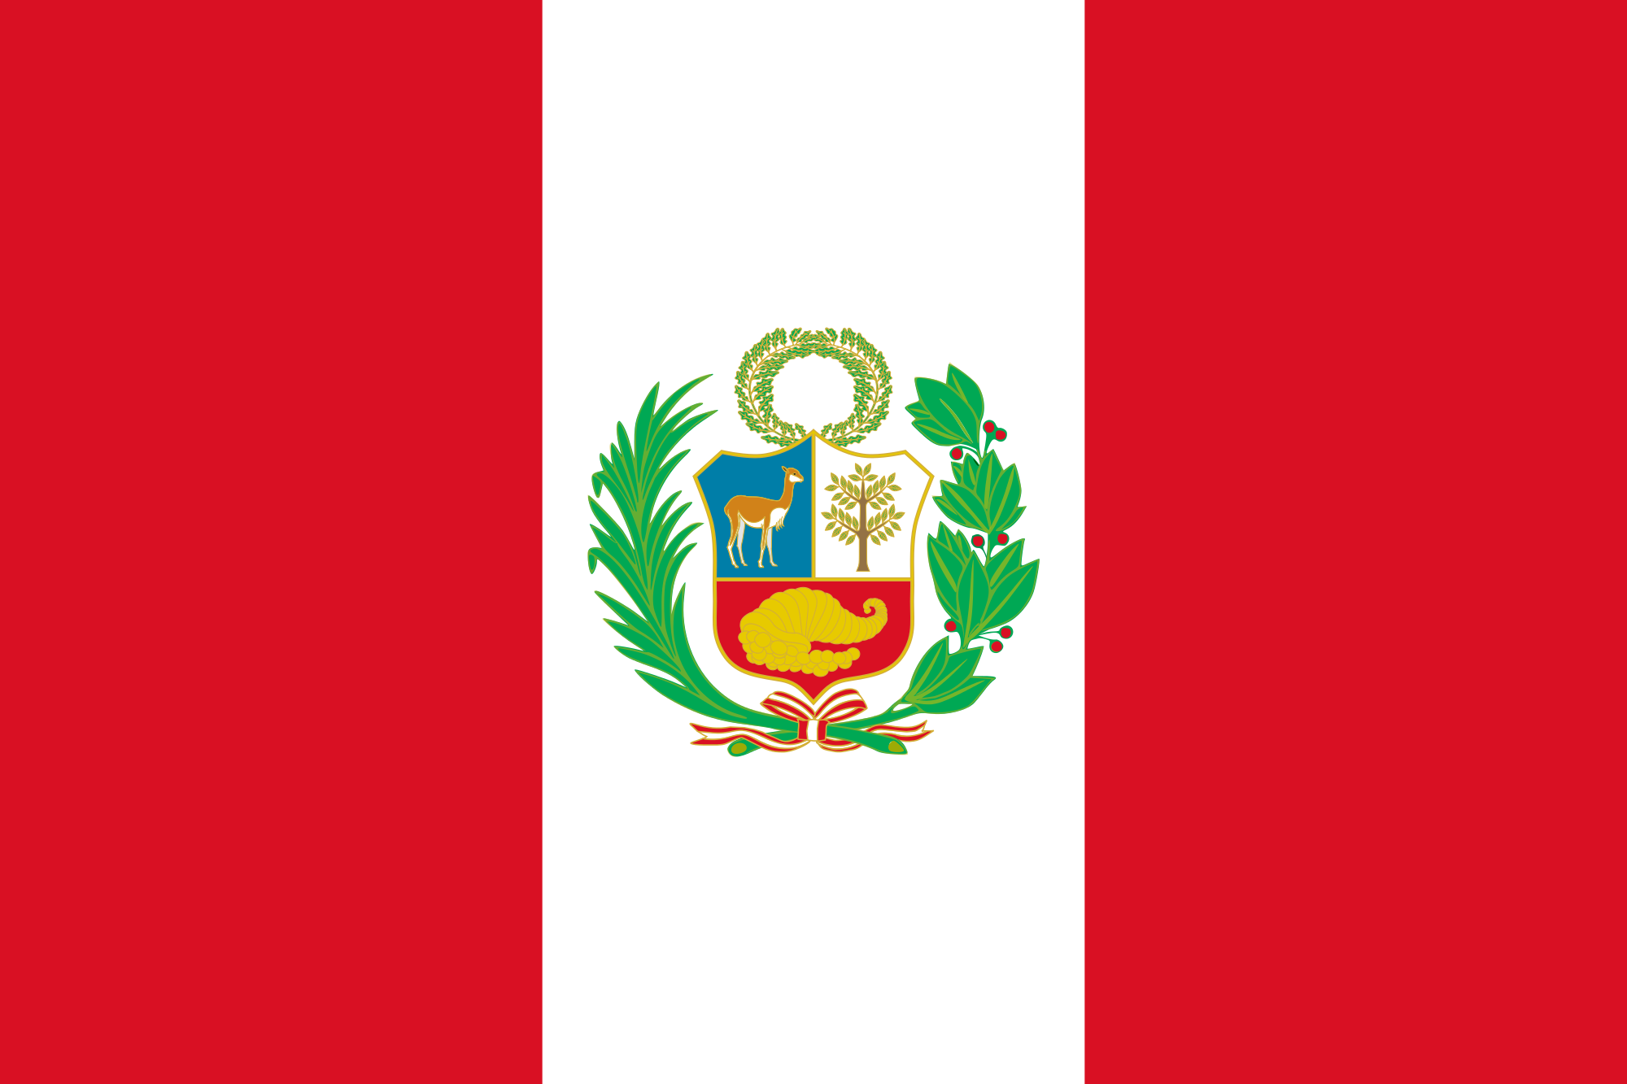
Ceviche is a popular dish in Peru. What is it?
Roasted guinea pig
Raw fish
Frogs’ legs

Slide 17
Ceviche is a popular dish in Peru. What is it?
b) Raw fish
The fish is marinated in lime juice, onions and chillies.
However, they do also eat guinea pig in Peru!

Slide 18
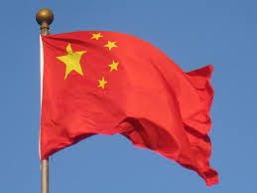
How might you compliment the chef in China?
Do a “thank you” dance
Smash the plates after you’ve finished eating
Burp

Slide 19
How might you compliment the chef in China?
c) Burp!
Burping is considered a compliment to the chef in many countries, including in China and Taiwan.
However, in many Western cultures it is considered rude.
That’s confusing.

Slide 20
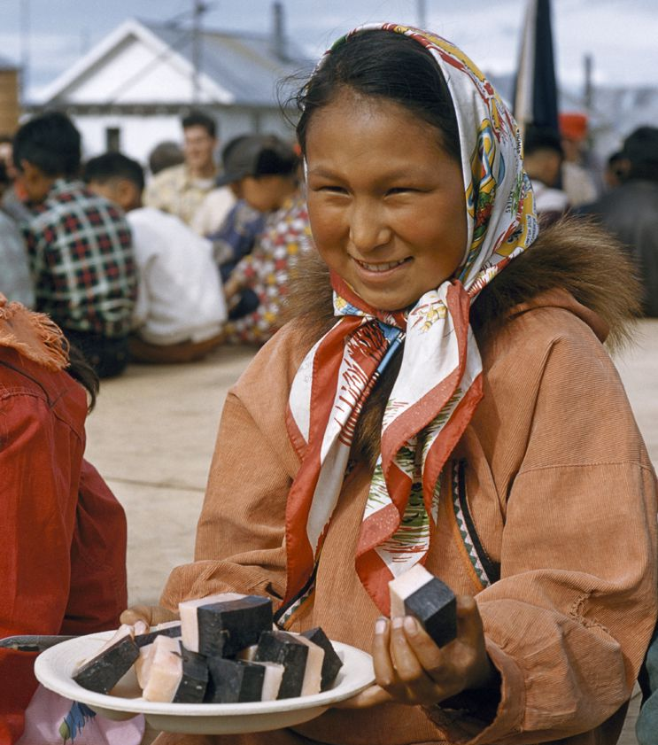
Muktuk is a traditional Inuit food. What is it?
A double-layer of sponge cake
Fish, potato and seaweed
Whale blubber

Slide 21
Muktuk is a traditional Inuit food. What is it?
c) Whale blubber
Not just any whale blubber though – it’s raw!
It usually comes from the bowhead whale.

