Slide 1
Beavers Quiz
HEALTHY QUIZ

Slide 2
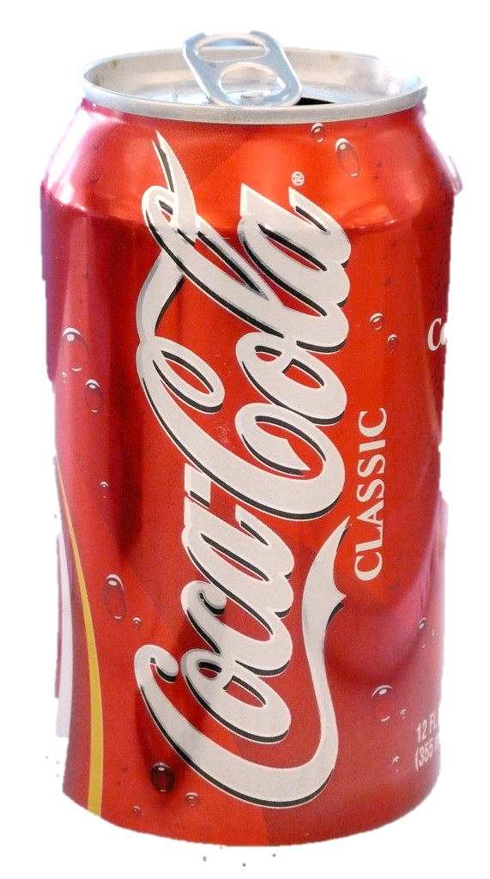
Question 1
How many cubes of sugar are in a normal can of coca cola?
4, 9 or 15?
Answer: 9

Slide 3
Question 2
How many salt sachets are in a standard box of Coco Pops?
3, 7 or 10?
Answer: 10

Slide 4
Question 3
What has more sugar?
Cucumber or Apple
Answer: Apple

Slide 5
Question 4
What is the most sugary fruit?
Banana, Date or Mango
Answer: Date

Slide 6
Question 5
What is the least sugary fruit?
Cranberry, Lime, or Avocado
Answer: Avocado

Slide 7
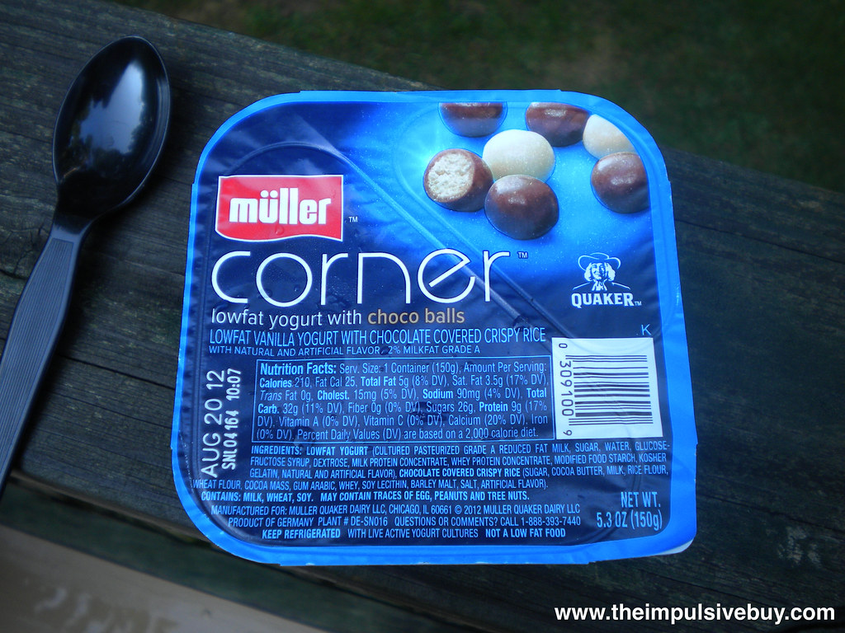
Question 6
How many cubes of sugar in a sugary corner yoghurt?
1, 5 or 8?
Answer: 5

Slide 8
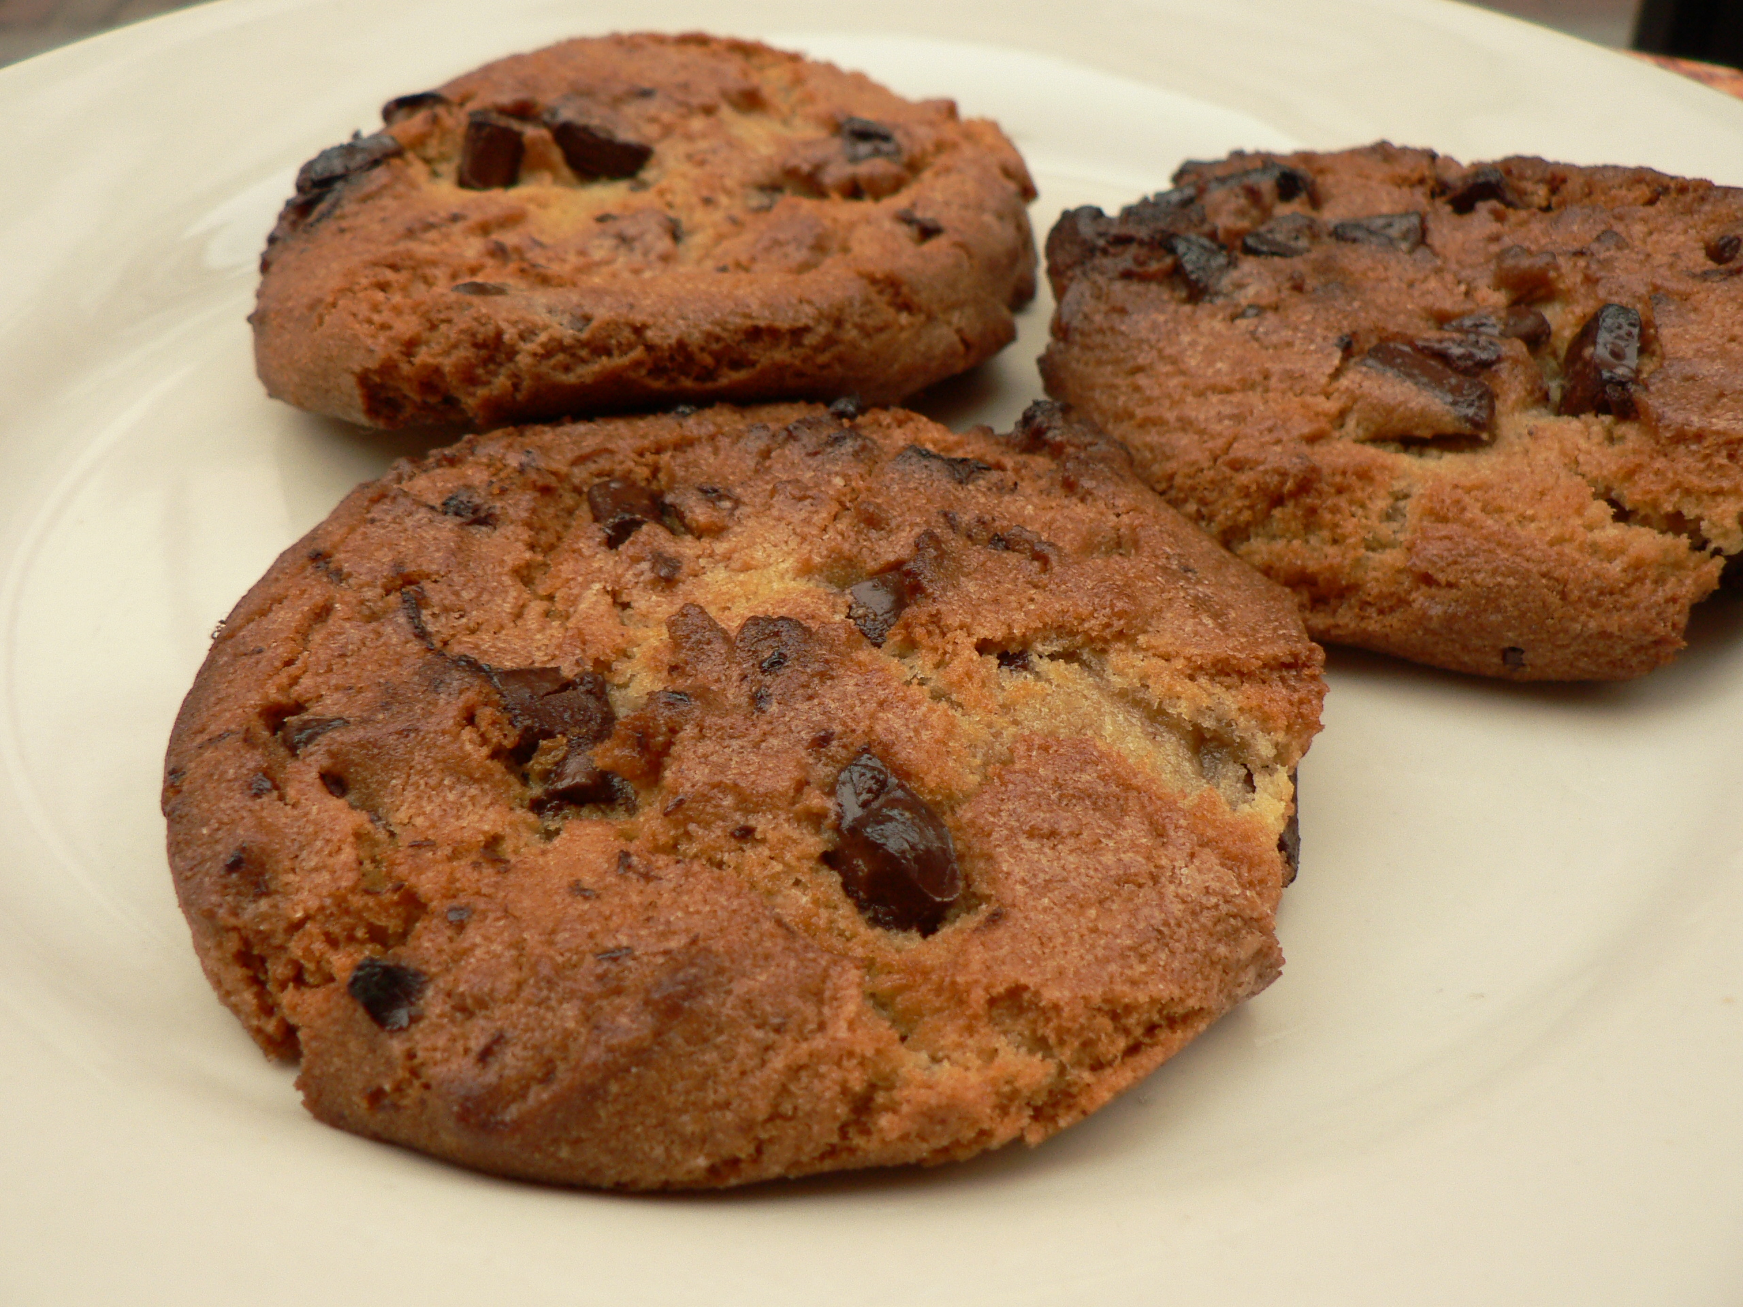
Question 7
How much saturated fat is in 3 chocolate biscuits?
4g, 10g or13g
Answer - 4g

Slide 9
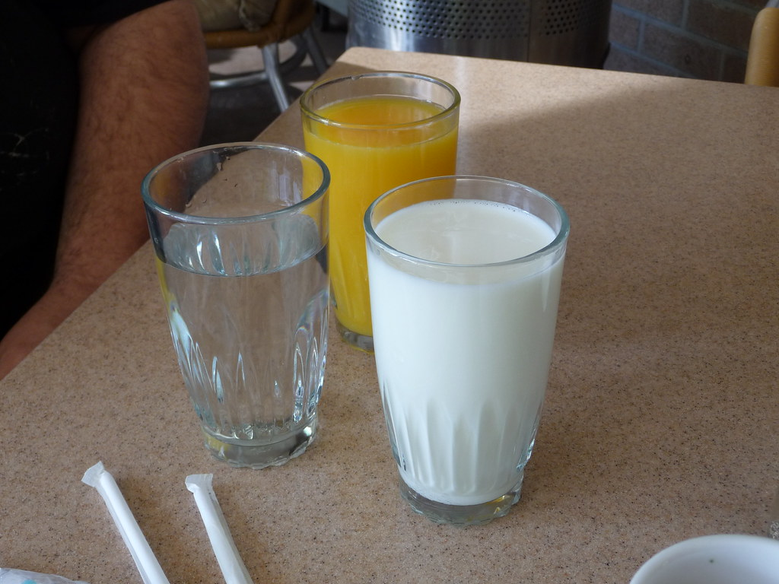
Question 8
What is better to hydrate you?
Milk, Water or Fruit Juice
Answer: Milk
milk is better at hydrating you than water
because it is retained in the body for longer. In addition,
milk provides essential nutrients including calcium, protein,
and B vitamins. But it is higher in calories

Slide 10
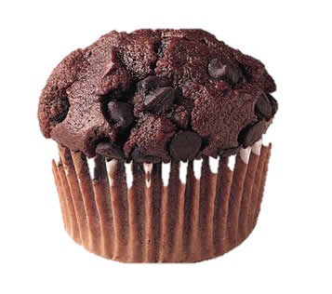
Question 9
How many sugar cubes are in a chocolate muffin?
2, 4 or 6
Answer: 6

Slide 11
Question 10
How long a period of physical activity does a child of 6+ need?
30, 60 or 90 minutes
Answer: 60

