Slide 2
My World Challenge
Take part in an activity that reflects England, Northern Ireland, Scotland, Wales or your part of the UK. This could include dance, music, craft, festivals, sport etc.

Slide 3
The United Kingdom (UK)
The UK is made up of 4 separate countries:-
England
Scotland
Northern Ireland
Wales

Slide 4
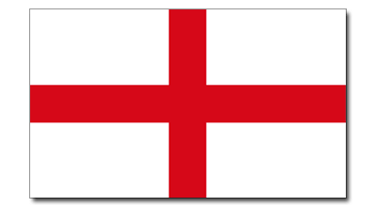
England
The Rose
What is the National Flower?
Flag of St George
What is the name of the flag?

Slide 5
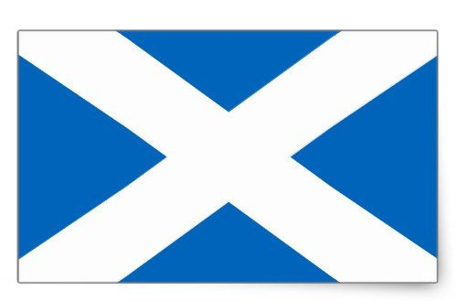
Scotland
The Thistle
What is the National Flower?
Flag of St Andrew
What is the name of the flag?

Slide 6
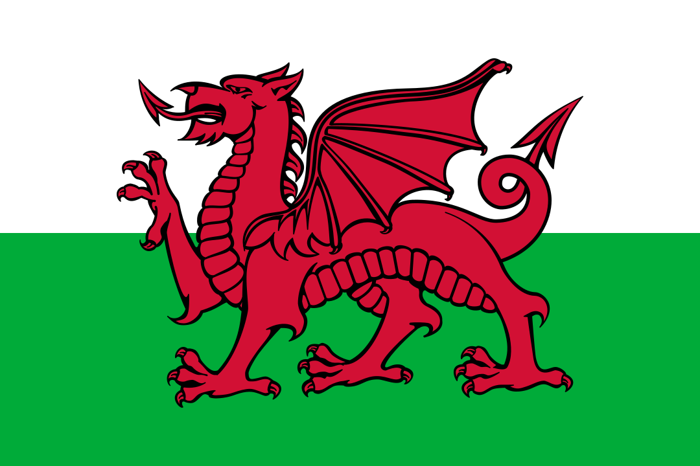
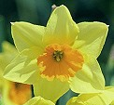
Wales
The Daffodil and the Leek
What is the National Flower or emblem?
The Red Dragon
What is the name of the flag?
Saint David
Who is the Patron Saint?

Slide 7
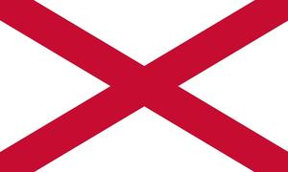
Northern Ireland
The Shamrock
What is the National Flower?
Flag of St Patrick
What is the name of the flag?

Slide 8
Union Flag
England
Scotland
Northern
Ireland

Slide 9
Union Flag
Which Countries Flag does not appear on the Union Flag?
Wales

Slide 10
Lots of Festivals and events take place in the United Kingdom. Many you will have heard of…
FESTIVALS OF THE UK
Christmas
Halloween
Pancake Day

Slide 11
But there are some strange ones around the country that you probably will not have seen or heard about!
On the next pages are some Festivals that take place in our country.
Or do they?
Write down “YES” if you think they are a real festival or “NO” if not

Slide 12
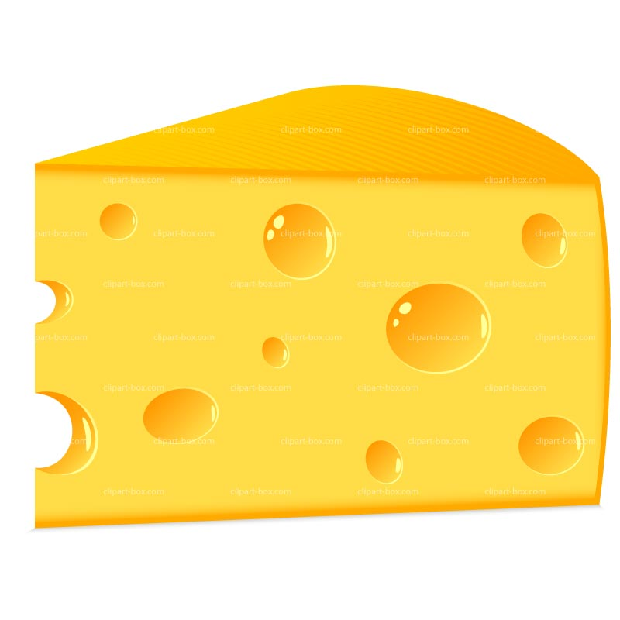
1
Cheese Rolling
Date:
May Spring Bank Holiday
Place
Cooper’s Hill, Brookworth, Gloucester
What happens?
A large round lump of Double Gloucester cheese is thrown down a steep slope. Lots of competitors run (and roll) after it. The one who catches the cheese wins it!

Slide 13
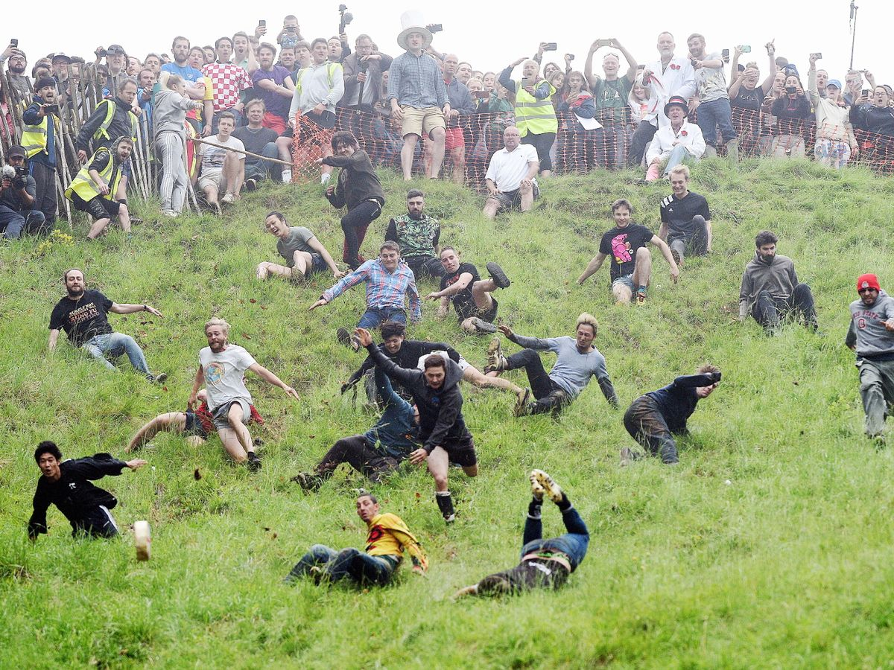
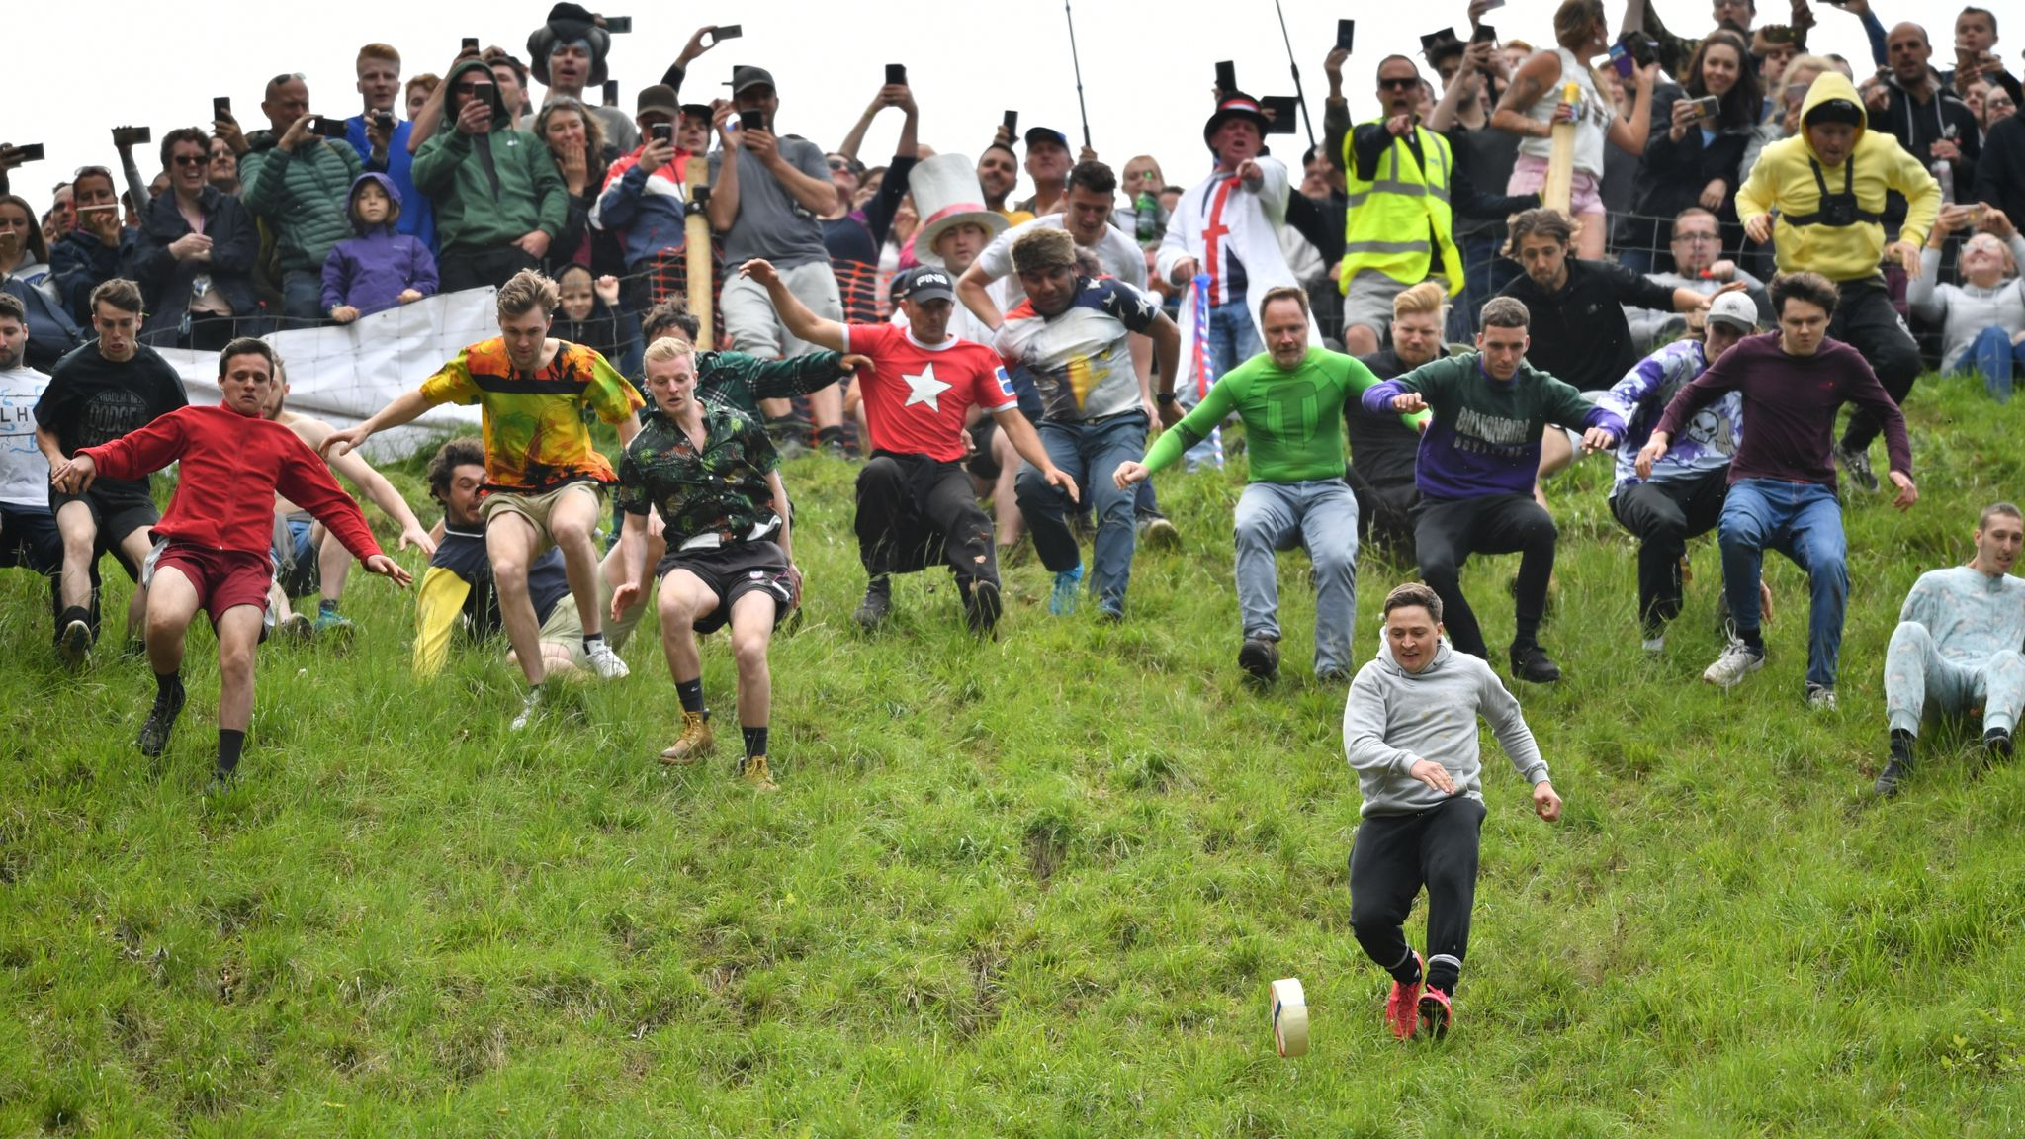
1
Cheese Rolling
TRUE!

Slide 14
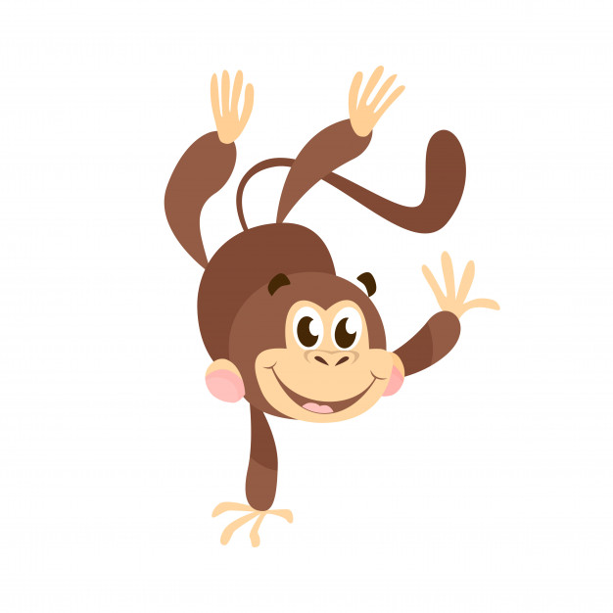
2
Handstand Racing
Date:
3rd Saturday in June
Place
Alexandra Palace, London
What happens?
Competitor’s from all around the World meet up and race in the hand-stand position over 50m, 100m, 200m and 500m.

Slide 15
2
Handstand Racing
FALSE

Slide 16
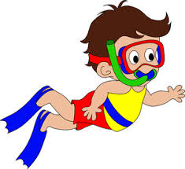
3
Bog Snorkelling Championships
Date:
Last Monday in August
Place
Llanwrtyd Wells in mid Wales
What happens?
The aim is to swim two lengths of the 60-yard Waen Rhydd peat bog with flippers and snorkel in the fastest time

Slide 17
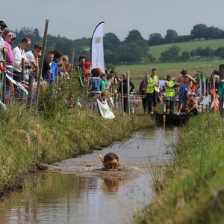
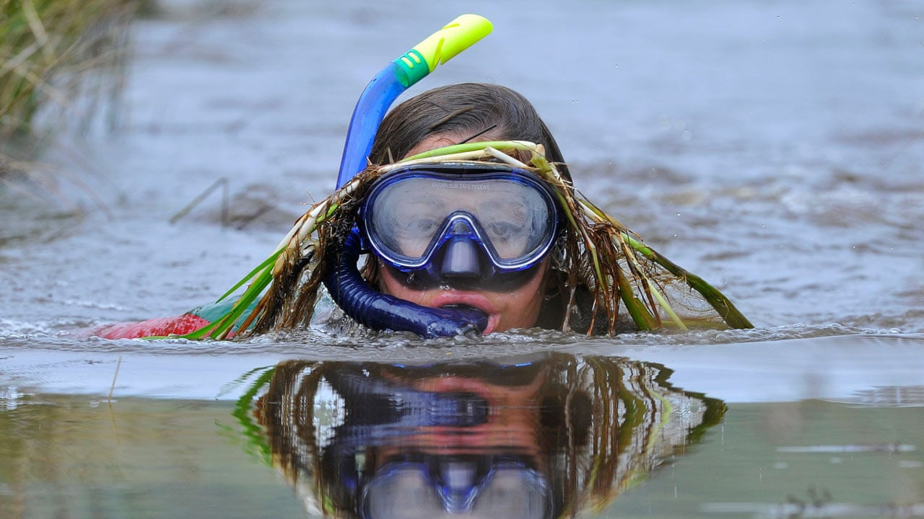
3
Bog Snorkelling Championships
TRUE!

Slide 18
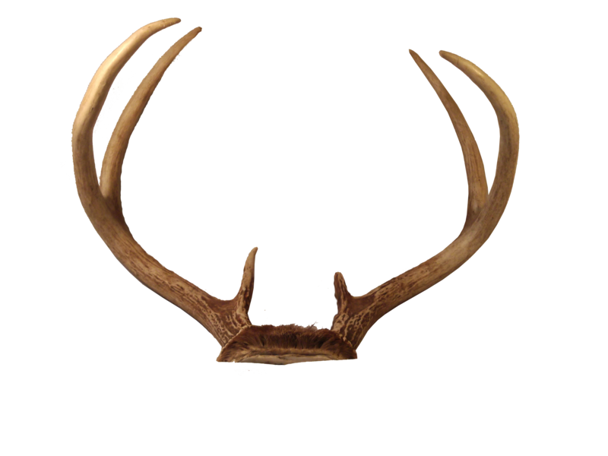
4
The Horn Dance
Date:
1st Monday after the first Sunday after September 4th
Place
Abbots Bromley in Staffordshire
What happens?
The famous Horn Dance is performed by six Deer-men who wear reindeer horns. The dancers follow a 10 mile course and perform the ritual in 12 different locations in and around the village

Slide 19
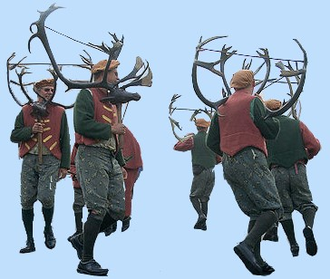
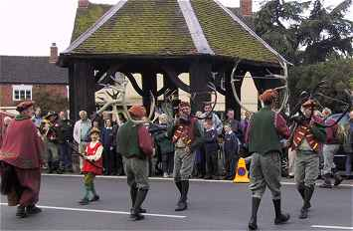
4
The Horn Dance
TRUE!

Slide 20
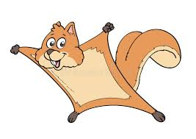
5
Squirrel Throwing Contest
Date:
2nd Saturday in August
Place:
Edinburgh Castle, Scotland
What happens?
Contestants attempt to throw a squirrel the furthest distance. Squirrels are a regarded as pests in the Castle as they destroy the wooden foundations trying to store their nuts! The contest frightens them away for a few months!

Slide 21
5
Squirrel Throwing Contest
FALSE

Slide 22
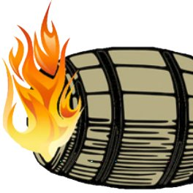
6
Tar-Barrel Racing
Date:
5th November (Bonfire Night)
Place:
Ottery St Mary, Devon
What happens?
People race through the streets of the town, carrying flaming wooden barrels of burning tar on their backs.

Slide 23
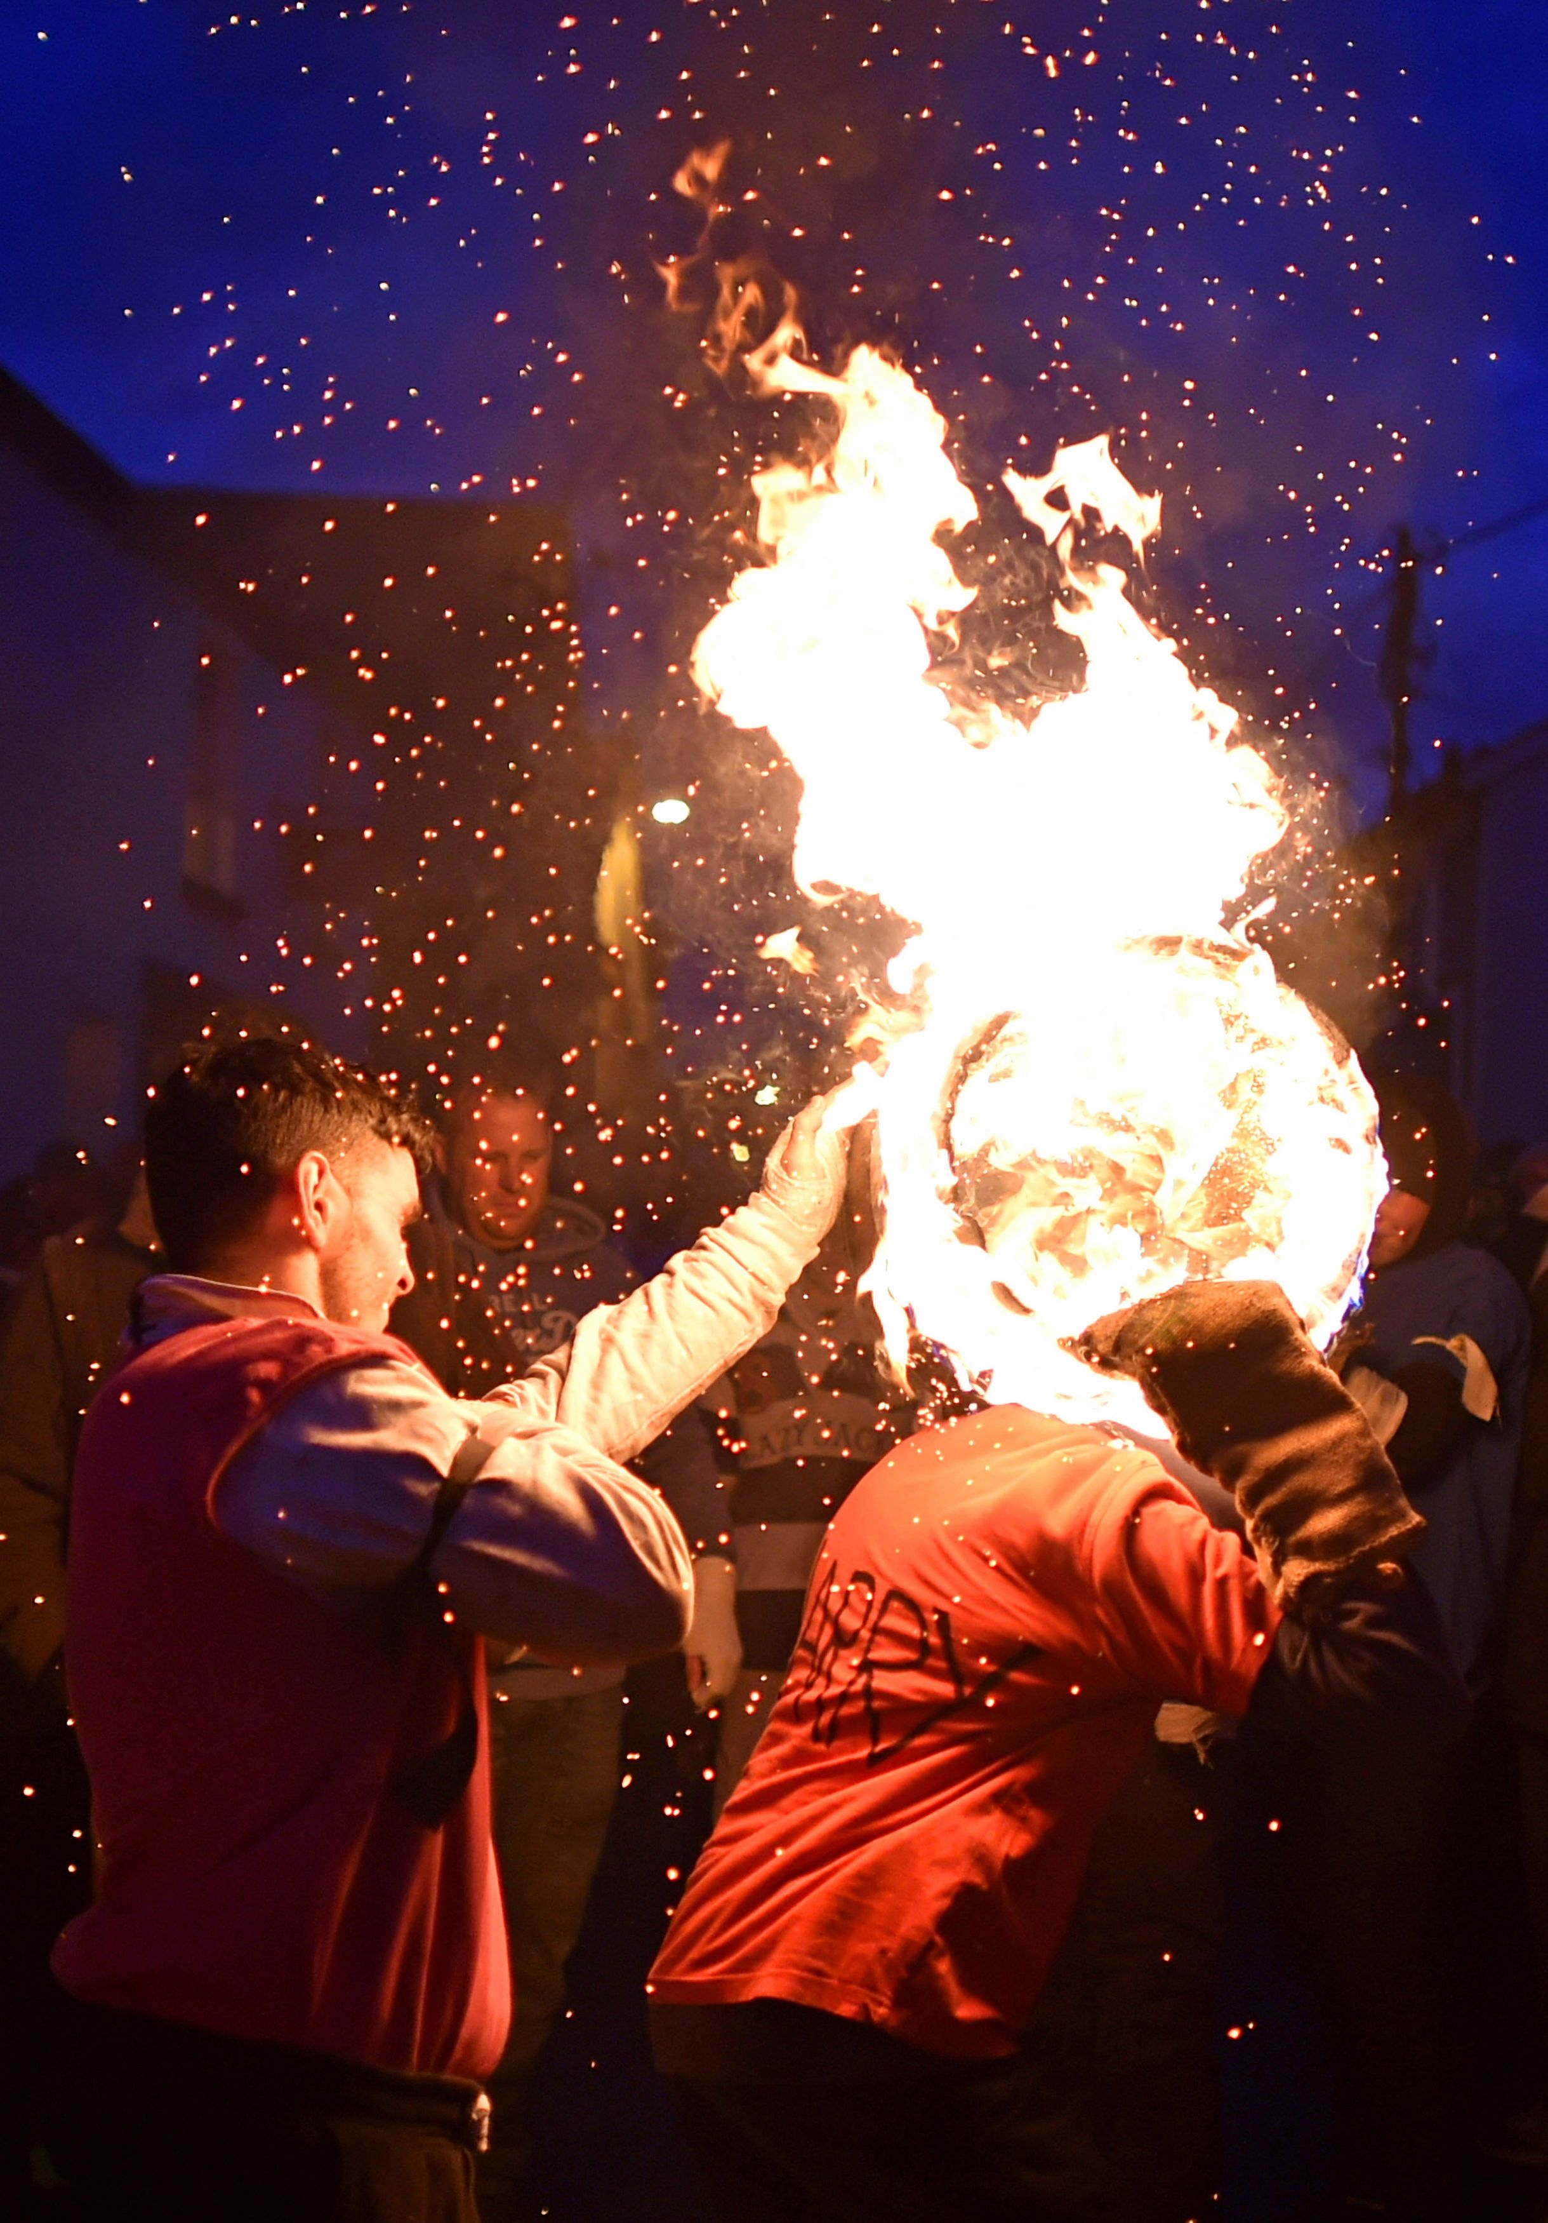
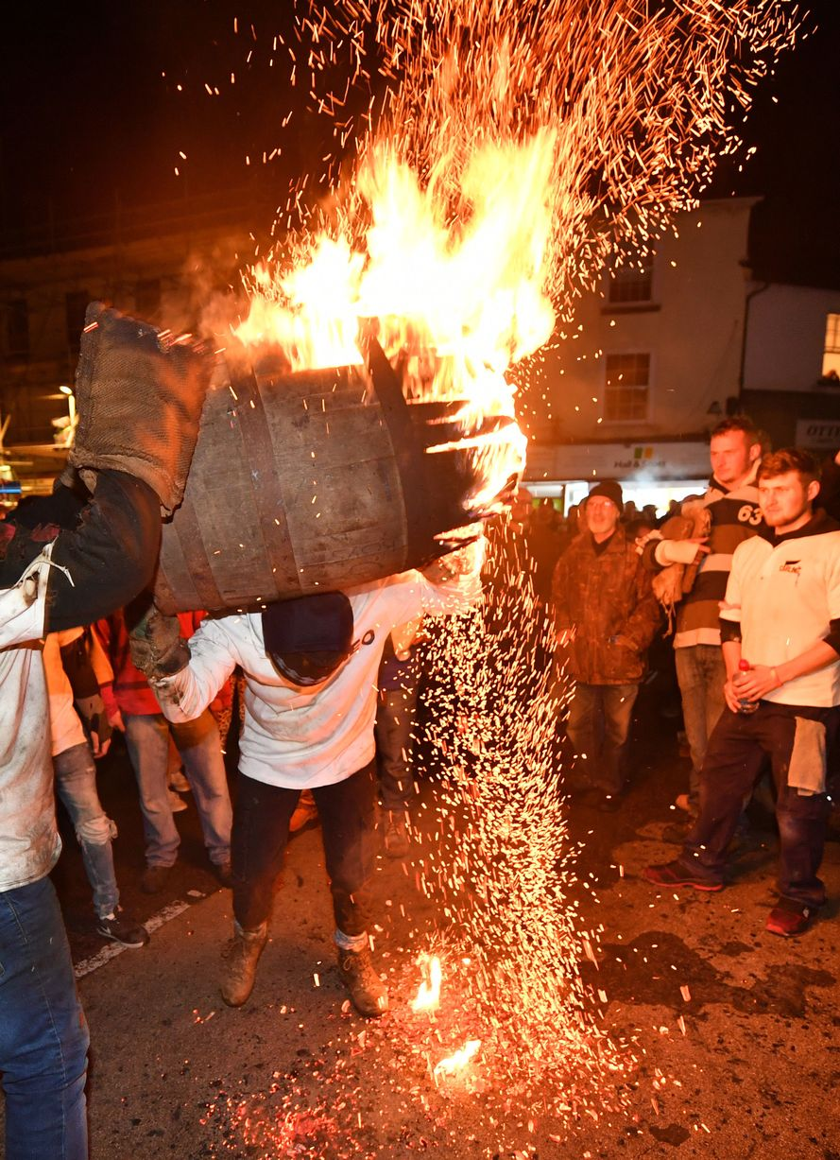
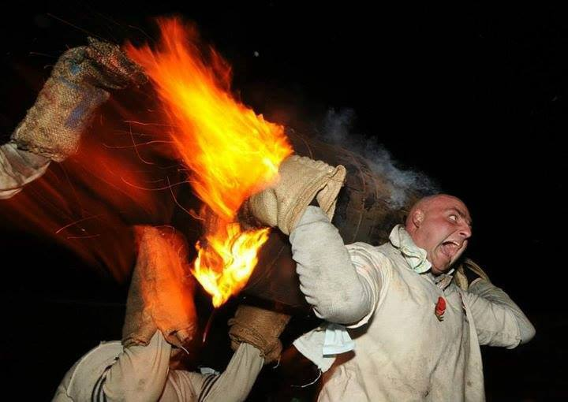
6
Tar-Barrel Racing
TRUE!

Slide 24
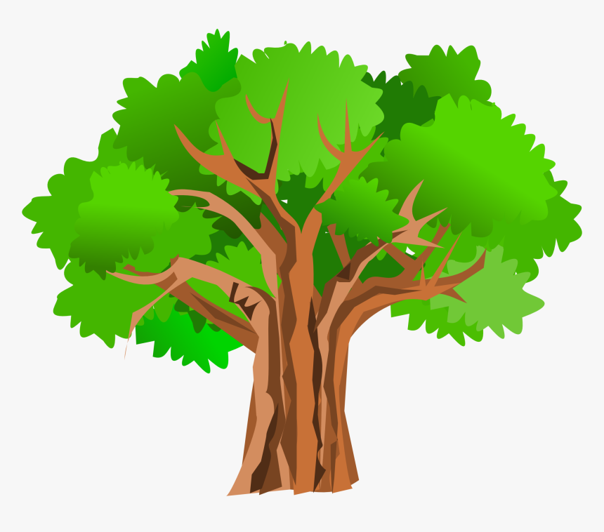
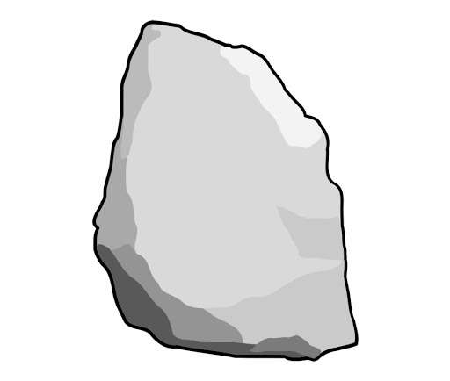
7
Turning the Devil's Stone
Date:
5th November (Bonfire Night)
Place:
Shebbear, Devon
What happens?
The villagers of Shebbear in Devon, turn over a six feet long stone under an ancient oak tree! It is believed to be a stone that the Devil threw to earth when he was cast out of Heaven

Slide 25
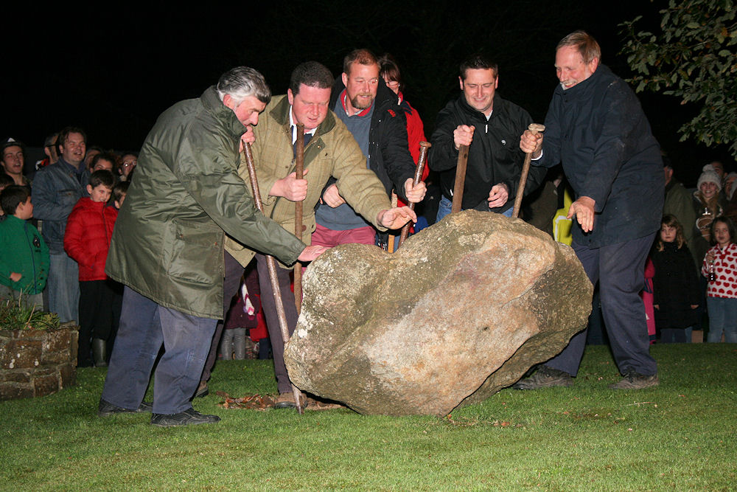
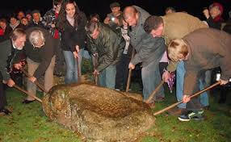
7
Turning the Devil's Stone
TRUE!

Slide 26
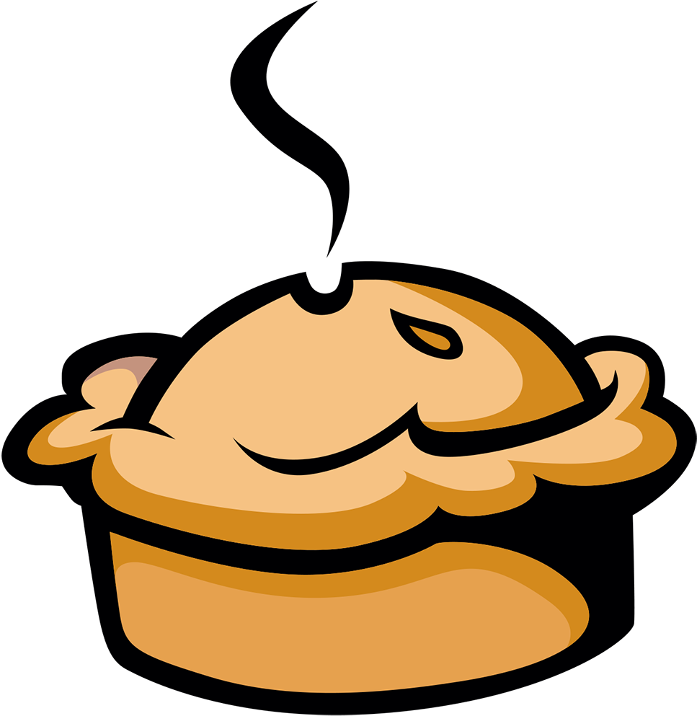
8
Piehead Racing
Date:
2nd Saturday in April
Place:
Pickering, Yorkshire
What happens?
The villagers of Pickering rename their town Pie-kering for a weekend. They race through the town with large pork pies on their heads.

Slide 27
8
Piehead Racing
FALSE

Slide 28
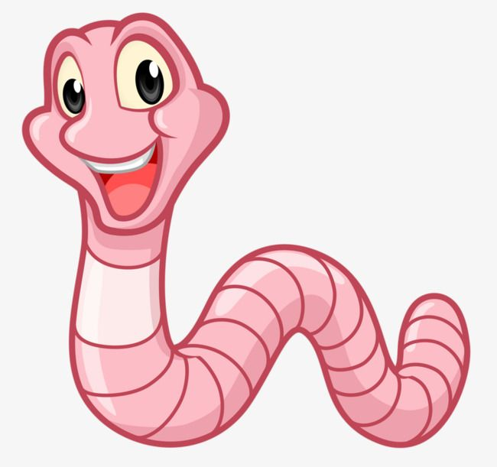
9
Worm Charming
Date:
2nd Saturday in May
Place:
Blackawton, Devon
What happens?
Teams of 3 people each have a 1mx1m square. They have 5 minutes to Worm-up and then 15 minutes to “charm” as many earthworms from the ground as possible without digging, forking or using harmful liquids. The team with the most worms is the winner

Slide 29
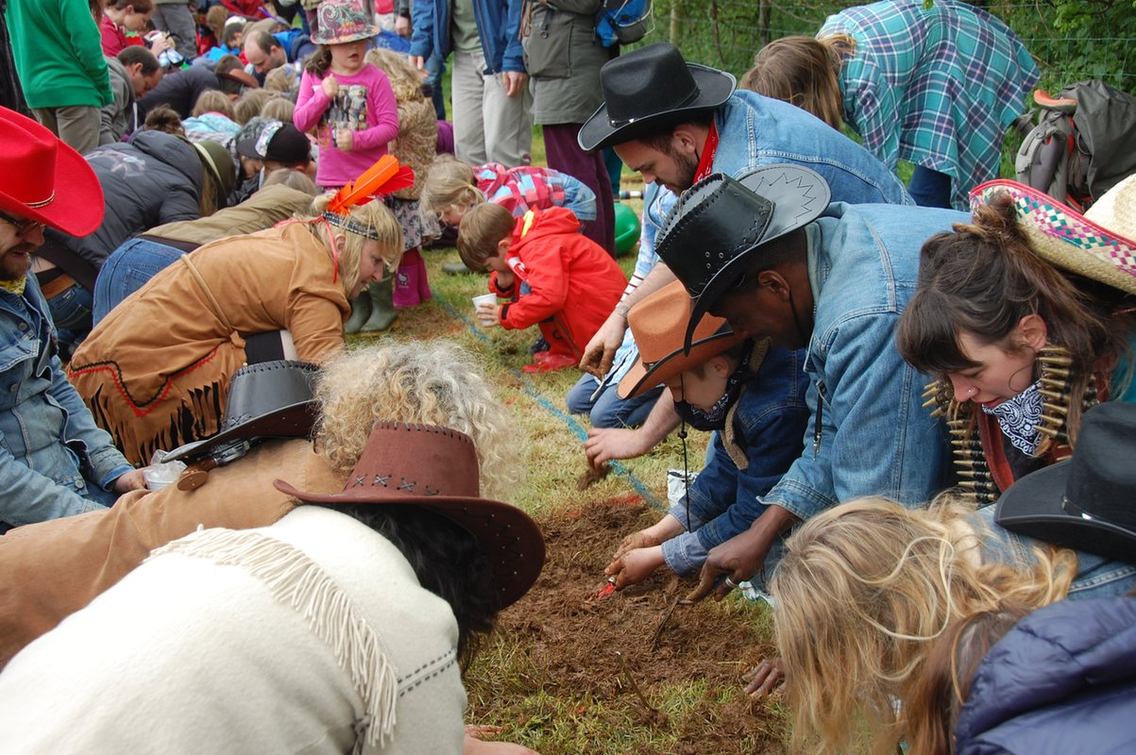
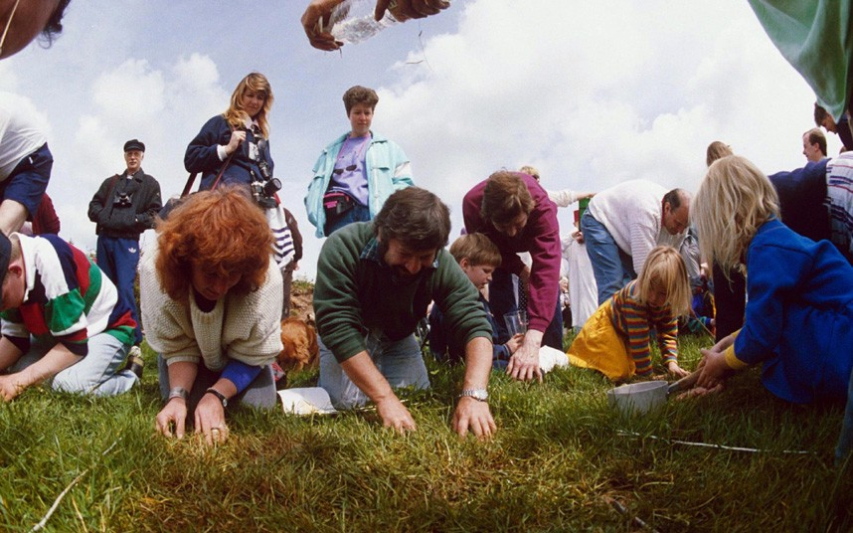
9
Worm Charming
TRUE!

Slide 30
10
UK Wife Carrying Race
Date:
A Saturday in February
Place:
'The Nower,' Dorking, Surrey
What happens?
“Husbands” carry their “Wives” over a 380m long, up and downhill course including hay-bale hurdles and water obstacles. First ones over the line get to enter into the World Wife Carrying Championships in Finland.

Slide 31
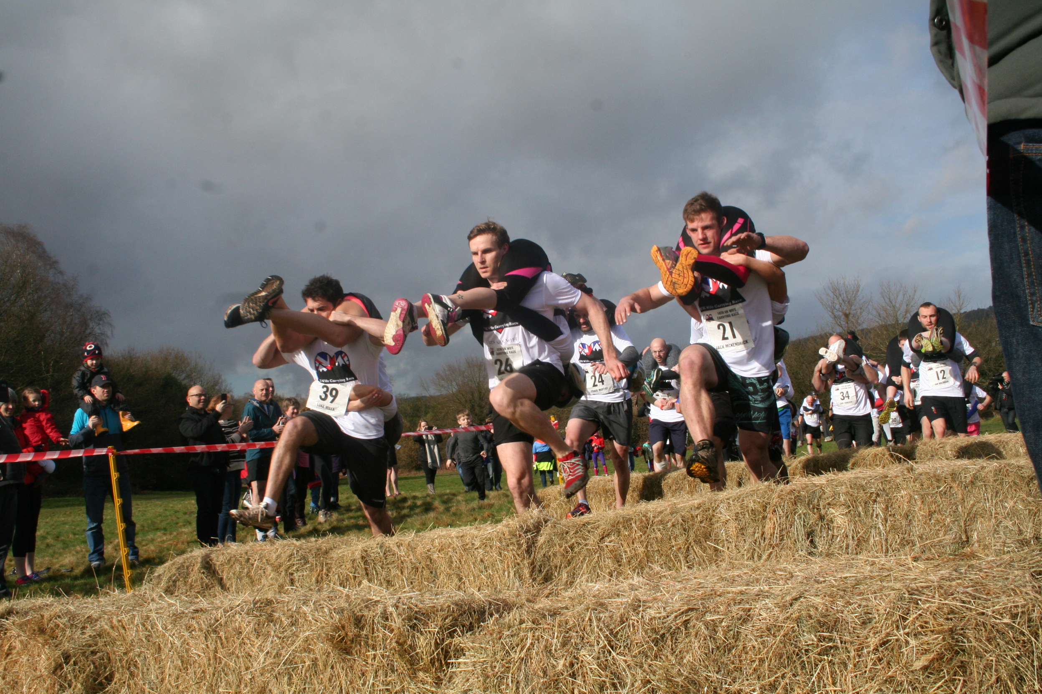
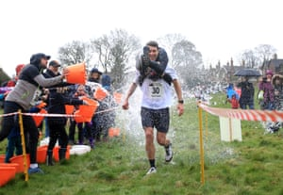
10
UK Wife Carrying Race
TRUE!

Slide 32
Do you know of any other unusual festivals?

