Slide 1
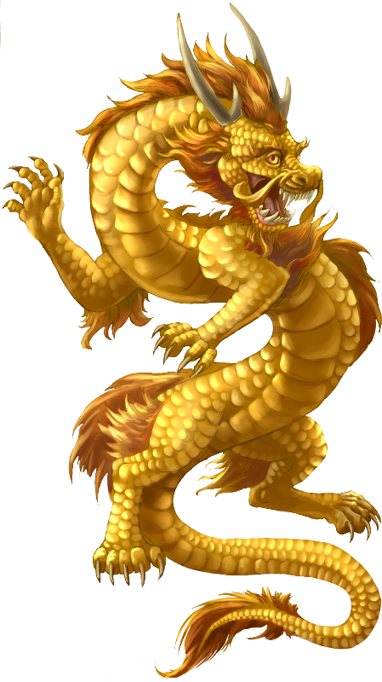
CHINESE NEW YEAR
QUIZ

Slide 2
Question 1 | The date of Chinese New Year is set by the position of?
Is it
1 | Jupiter
2 | The Sun
3 | The Moon

Slide 3
Question 2 | Chinese New Year is also called?
Is it
1 | The Spring Festival
2 | The Start of Summer
3 | The Red Event

Slide 4
Question 3 | The Chinese lunar cycle is 60 years long but it is made up of several smaller cycles. How many?
Is it
1 | Twelve (12)
2 | Ten (10)
3 | Six (6)

Slide 5
Question 4 | Each small cycle is know by an animal but which of these animals is not included?
Is it
1 | Dragon
2 | Cat
3 | Rabbit

Slide 6
Question 5 | The celebrations last for more than one day but how many?
Is it
1 | 28
2 | 7
3 | 15

Slide 7
Question 6 | The last day of Chinese New Year is know as?
Is it
1 | Hurray it’s all over
2 | The festival of light
3 | The lantern festival

Slide 8
Question 7 | Where is Chinese New Year celebrated?
Is it
1 | In China Towns all over the world
2 | Only in mainland China
3 | In China, Tiawan and Hong Kong

Slide 9
Question 8 | Chinese people give red envelopes as presents but what to they usually contain?
Is it
1 | Little friendly notes, like our cards
2 | Money
3 | Sweets

Slide 10
Question 9 | Chinese people hold big parades for Chinese New Year but what animal is used for a very spectacular dance?
Is it
1 | Lion
2 | Dragon
3 | Tiger

Slide 11
Question 10 | What well known decoration do Chinese people use for New Year?
Is it
1 | Coloured lights
2 | Lanterns
3 | Firecrackers

Slide 12
CHINESE NEW YEAR
QUIZ
ANSWERS

Slide 13
Question 1 | The date of Chinese New Year is set by the position of?
3 | The Moon

Slide 14
Question 2 | Chinese New Year is also called?
1 | The Spring Festival

Slide 15
Question 3 | The Chinese lunar cycle is 60 years long but it is made up of several smaller cycles. How many?
1 | Twelve (12)

Slide 16
Question 4 | Each small cycle is know by an animal but which of these animals is not included?
2 | Cat

Slide 17
Question 5 | The celebrations last for more than one day but how many?
3 | 15

Slide 18
Question 6 | The last day of Chinese New Year is know as?
3 | The lantern festival

Slide 19
Question 7 | Where is Chinese New Year celebrated?
1 | In China Towns all over the world

Slide 20
Question 8 | Chinese people give red envelopes as presents but what to they usually contain?
2 | Money

Slide 21
Question 9 | Chinese people hold big parades for Chinese New Year but what animal is used for a very spectacular dance?
1 | Lion

Slide 22
Question 10 | What well known decoration do Chinese people use for New Year?
2 | Lanterns

Slide 23
Gong hei fat choy?

