Slide 1
CUBS Grid References

Slide 2
Draw a grid 5 squares by 5:

Slide 3
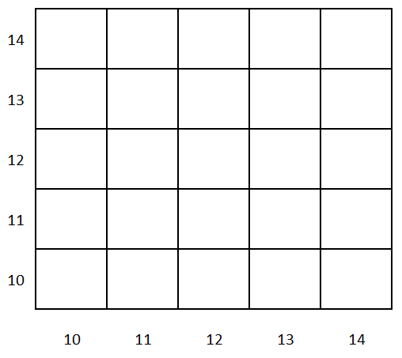
Add the following numbers along the sides:

Slide 4
Grid references – always go along the bottom before you go up the side.
I remember by going along the hall before I can go up the stairs.

Slide 5
Fill in square 1213:

Slide 6
Fill in square 1013:

Slide 7
Fill in square 1312:

Slide 8
Fill in square 1210:

Slide 9
Fill in square 1412:

Slide 10
Fill in square 1311:

Slide 11
Fill in square 1112:

Slide 12
Fill in square 1111:

Slide 13
Fill in square 1314:

Slide 14
Fill in square 1310:

Slide 15
Fill in square 1012:

Slide 16
Fill in square 1212:

Slide 17
Fill in square 1110:

Slide 18
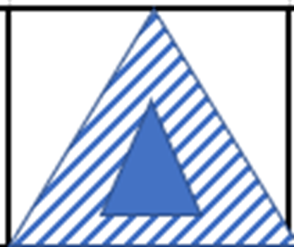
Fill in square 1114:

Slide 19
Fill in square 1413:

Slide 20
Fill in square 1113:

Slide 21
Fill in square 1211:

Slide 22
Fill in square 1313:

Slide 23
What have you got?

Slide 24
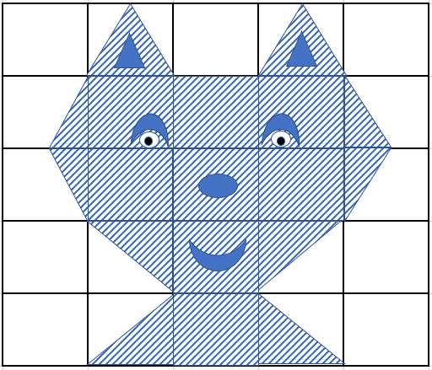

Slide 25
THE END

