Slide 1
Fitness and Sports evening

Slide 2
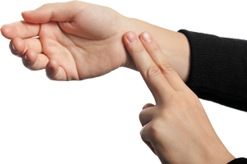
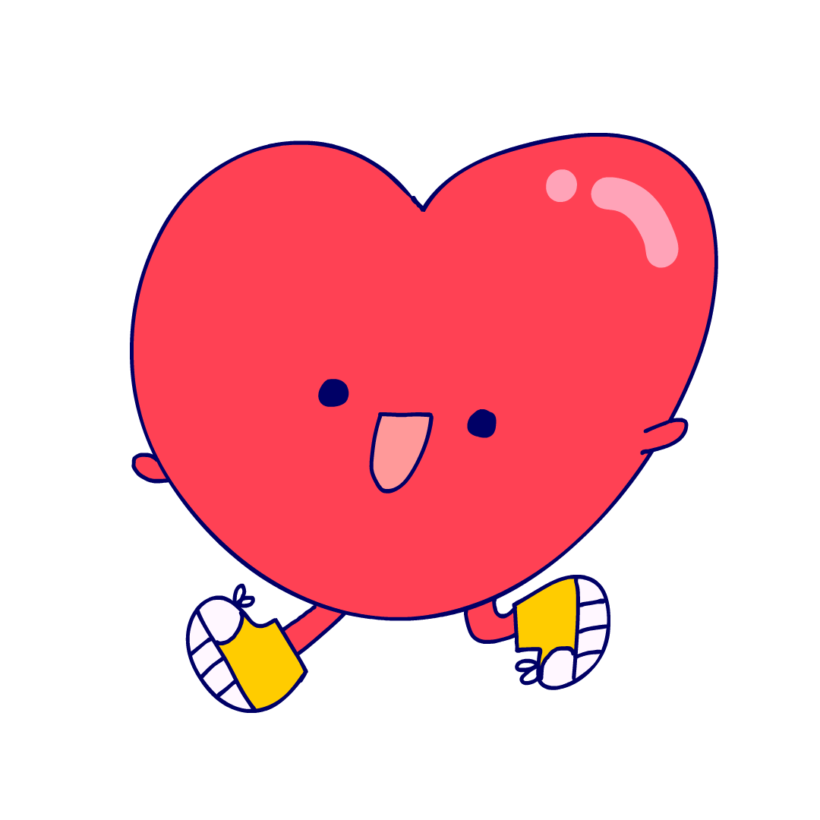
How to take a pulse Count your pulse for 15 seconds and multiply by 4
STOP!

Slide 3
Warm up Time!

Slide 4
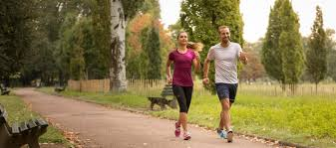
Walk on the spot for 30 seconds

Slide 5
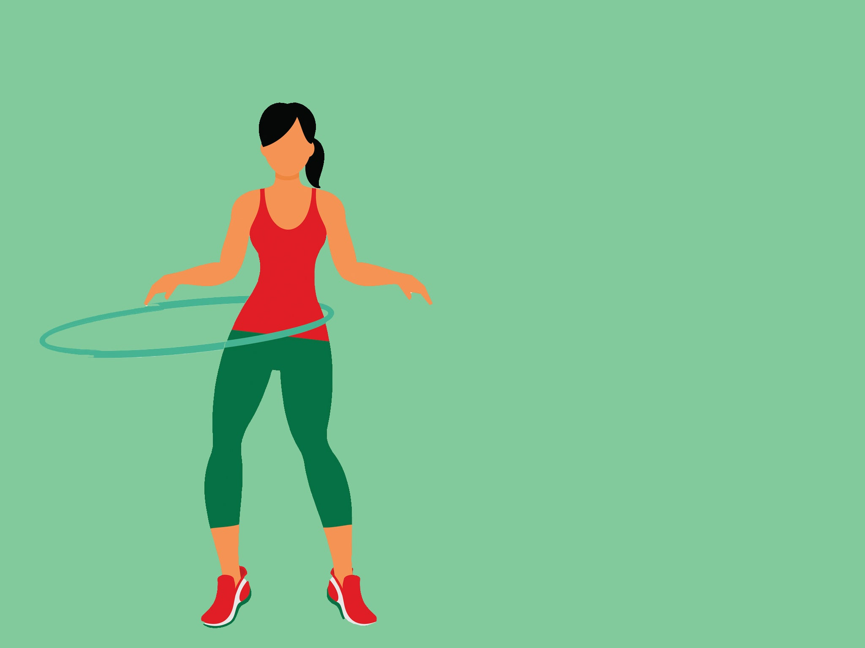
Pretend you have a hula-hoop

Slide 6
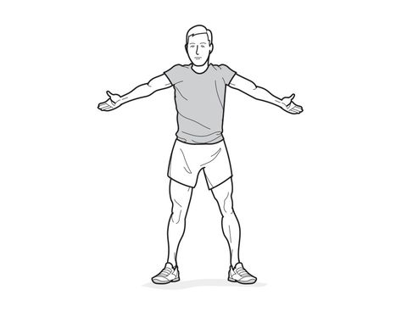
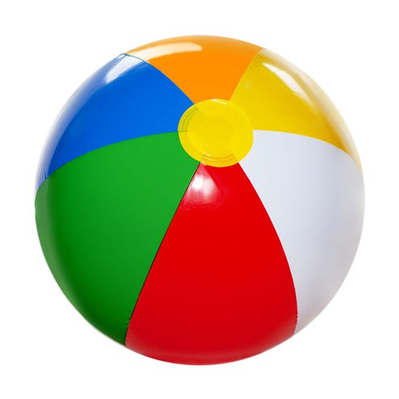
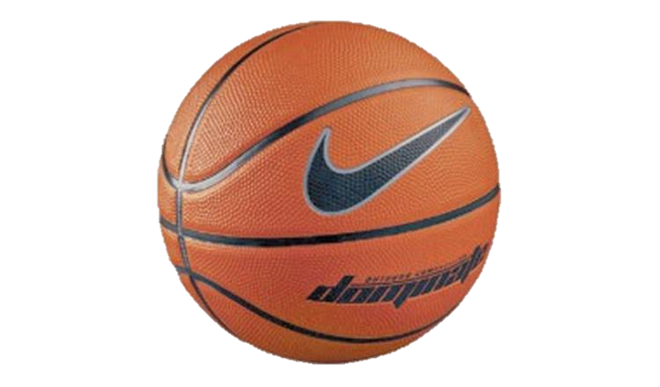
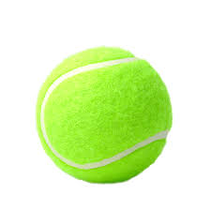
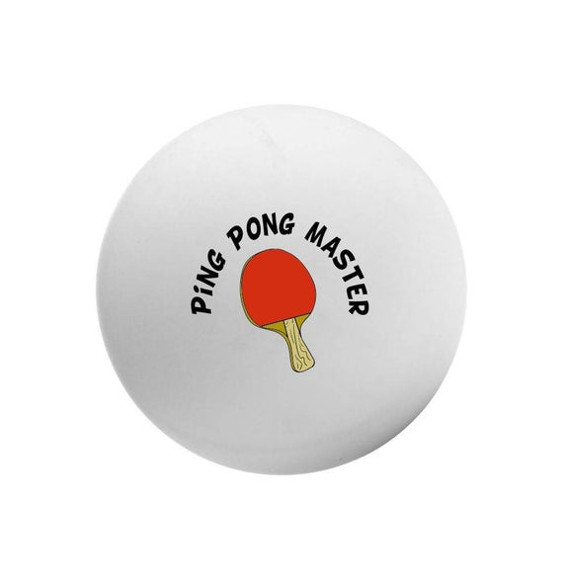
Rotate your arms at the size of a:
Beach ball
Basket ball
Tennis ball
Ping pong ball

Slide 7
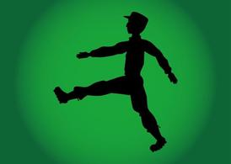
March for 30 seconds

Slide 8
Exercise time

Slide 9
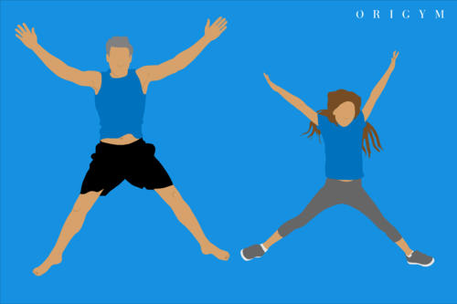
10 Star Jumps

Slide 10
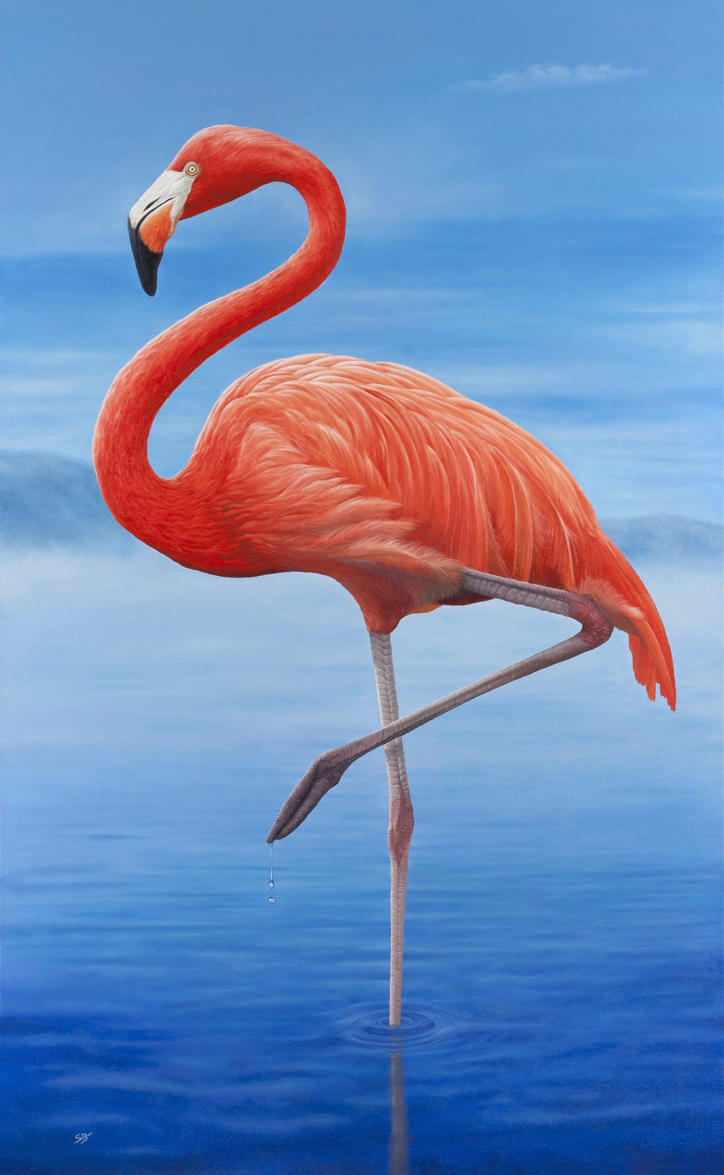
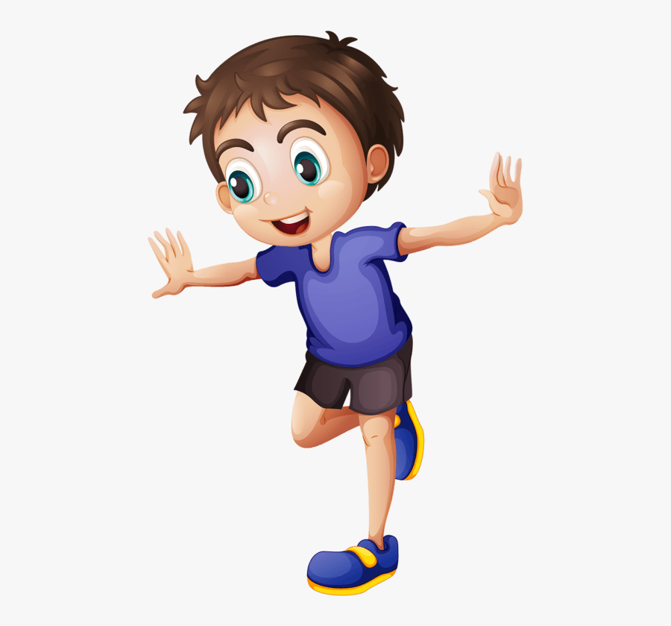
Balance on one leg
Can you do it with your eyes shut??

Slide 11
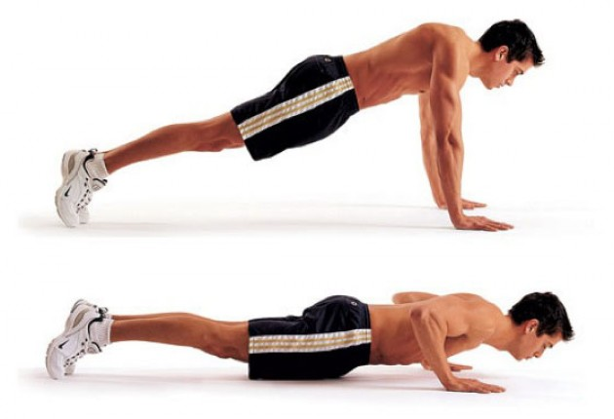
4 Push Ups

Slide 12
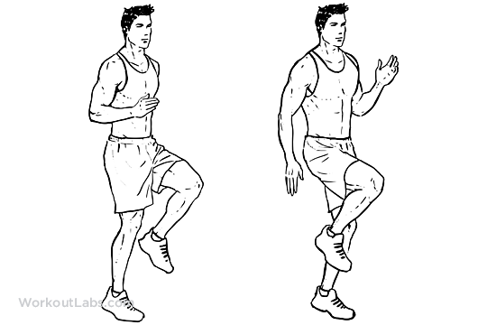
Jog on the spot for a 30 seconds

Slide 13
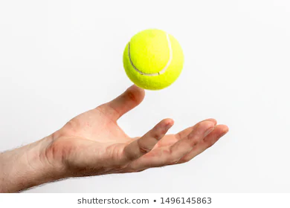
Throw and catch something
Can you throw it and spin round before catching it?

Slide 14
Time to take your pulse again.
STOP!

Slide 15
Cool down and stretch

Slide 16
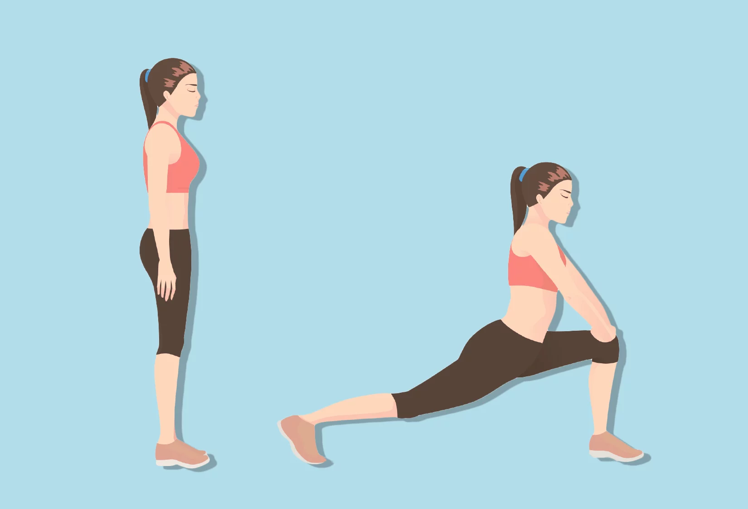
Hold these stretch's for 10 seconds on each side

Slide 18
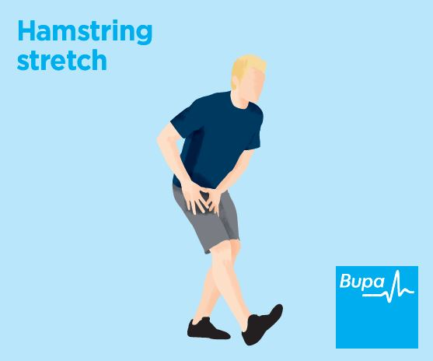

Slide 19
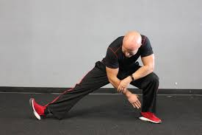

Slide 20
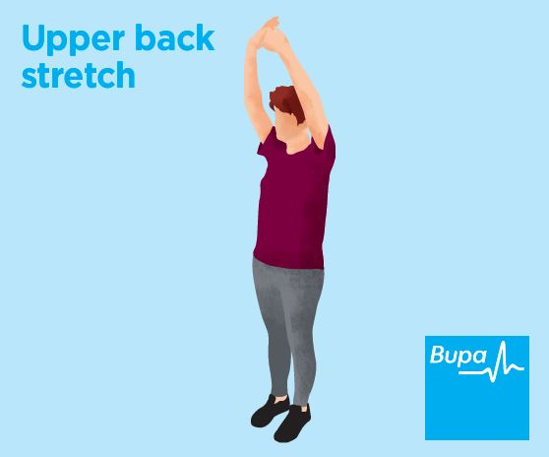

Slide 21
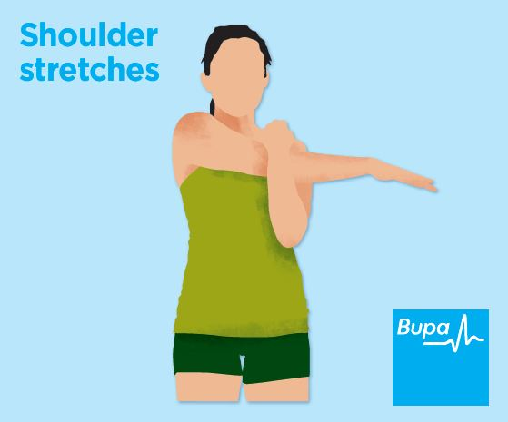

Slide 22
What stretch's do you know?

Slide 23
Time to take your pulse for the last time.
STOP!

