Slide 1
Big Garden Bird Watch

Slide 2
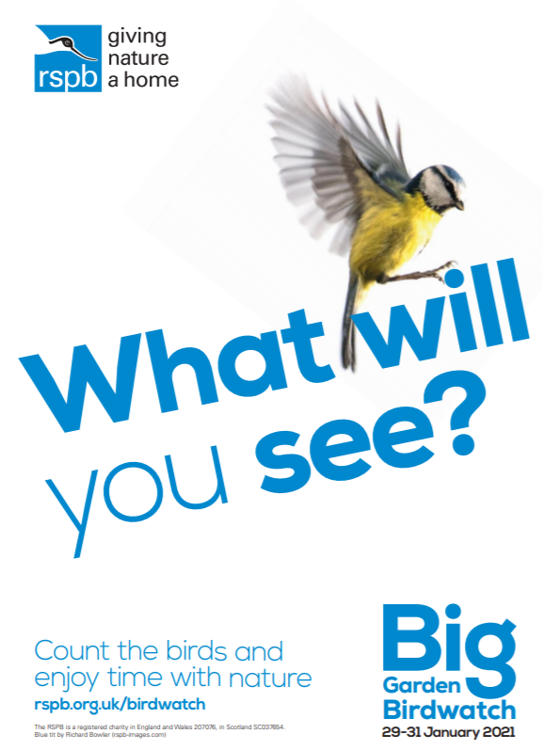
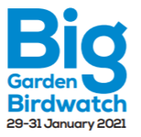
RSPB

Slide 3
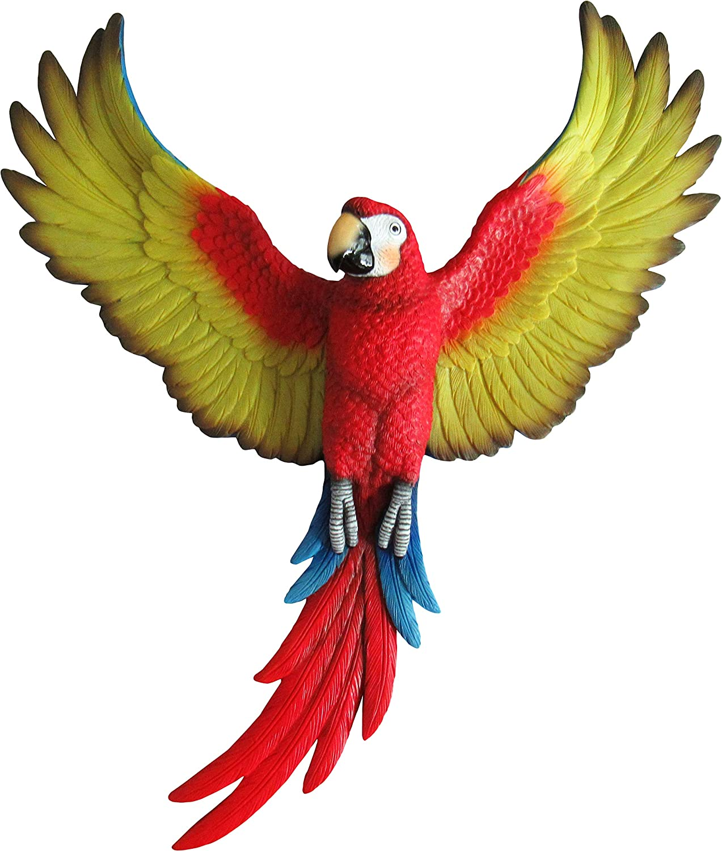
What am I?
You will be show pictures of some birds. Choose what you think is the correct answer and do the relevant action.
A – If you think the answer is A use you hand as a beak and cheep like a bird.
B – If you think the answer is B stand on one leg like a flamingo.
C – If you think the answer is C flap your arms like a birds wings.

Slide 4
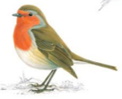
What am I?
A - Robin
B – Blue tit
C – Collared Dove

Slide 5
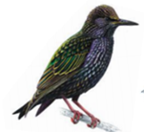
What am I?
A - Chaffinch
B – Magpie
C – Starling

Slide 6
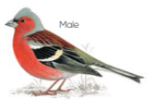
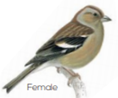
What am I?
A - Greenfinch
B – Chaffinch
C – Woodpigeon

Slide 7
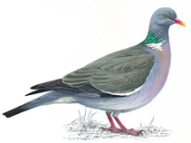
What am I?
A – Wood Pigeon
B – Long-tailed tit
C – Collared Dove

Slide 8
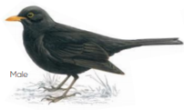
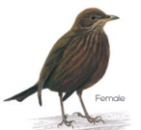
What am I?
A - Magpie
B – Blackbird
C – House sparrow

Slide 9
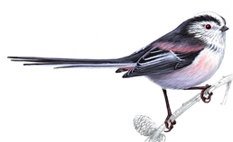
What am I?
A - Robin
B – Blue tit
C – Long-tailed tit

Slide 10
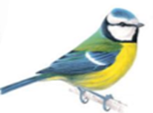
What am I?
A – House sparrow
B – Magpie
C – Blue tit

Slide 11
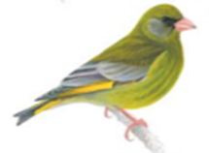
What am I?
A - Greenfinch
B – Coal tit
C – Collared Dove

Slide 12
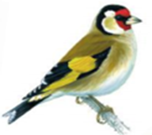
What am I?
A - Robin
B – Goldfinch
C – Greenfinch

Slide 13
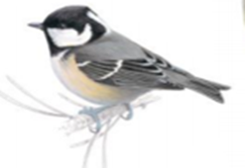
What am I?
A – Coal tit
B – Magpie
C – House sparrow

Slide 14
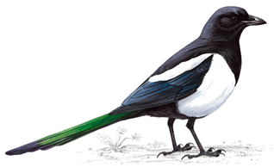
What am I?
A - Blackbird
B – House sparrow
C – Magpie

Slide 15
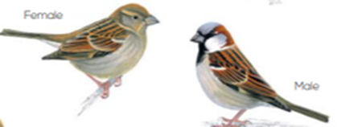
What am I?
A – House sparrow
B – Coal tit
C – Collared Dove

Slide 16
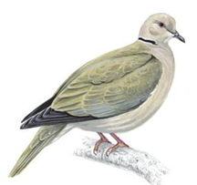
What am I?
A - Greenfinch
B – Long-tailed tit
C – Collared Dove

Slide 17
Find the pairs
Cubs take it in turns to pick two numbers to try and find 2 matching birds.
If they match, leave them showing.
If they do not match, click on them again to cover them up.

Slide 18
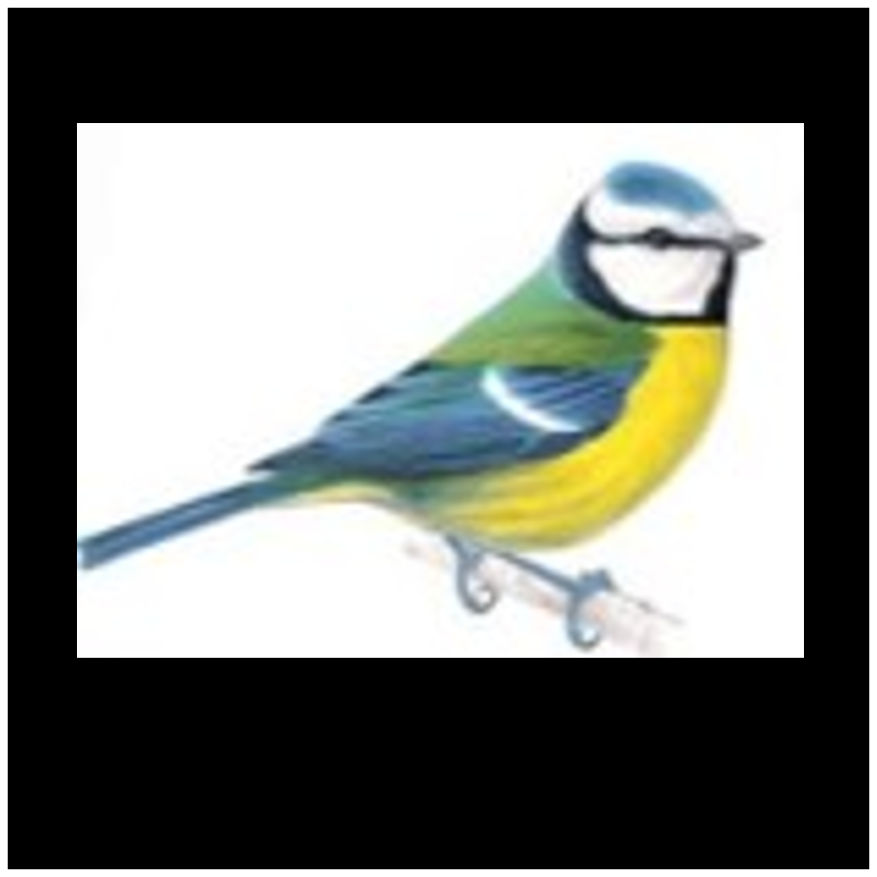
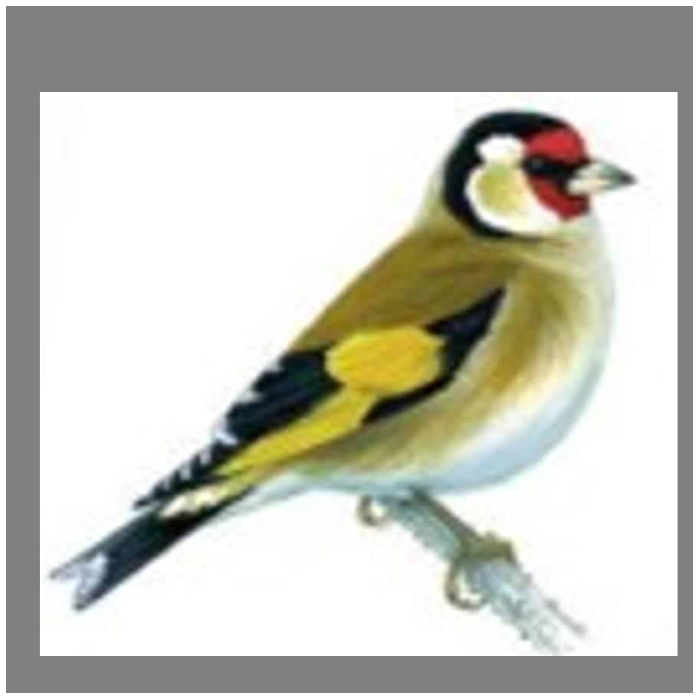
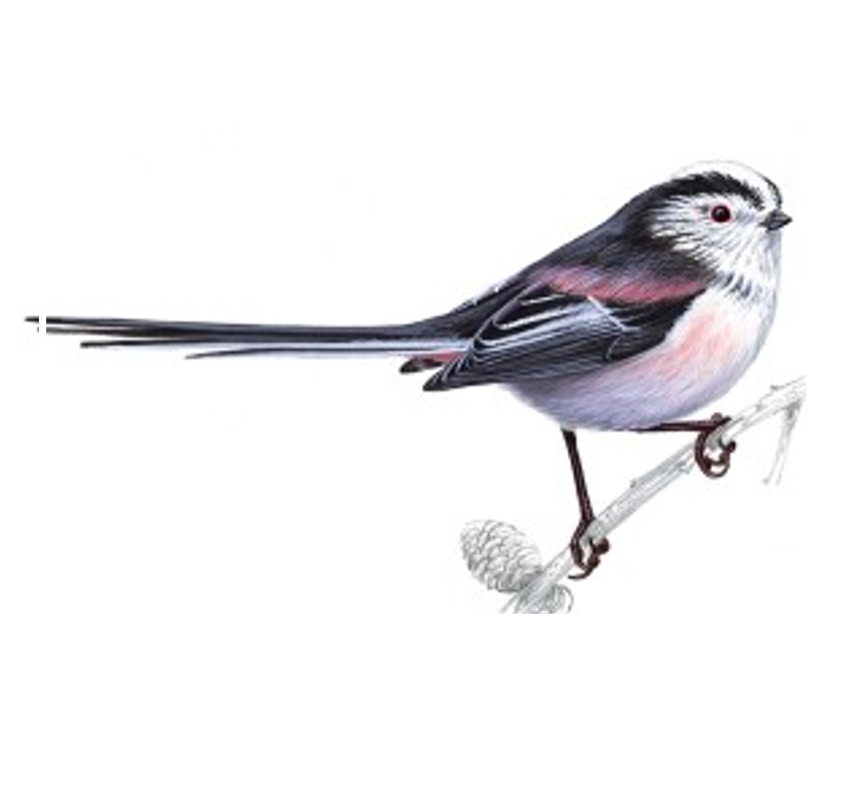
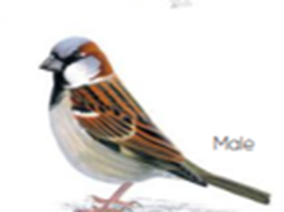
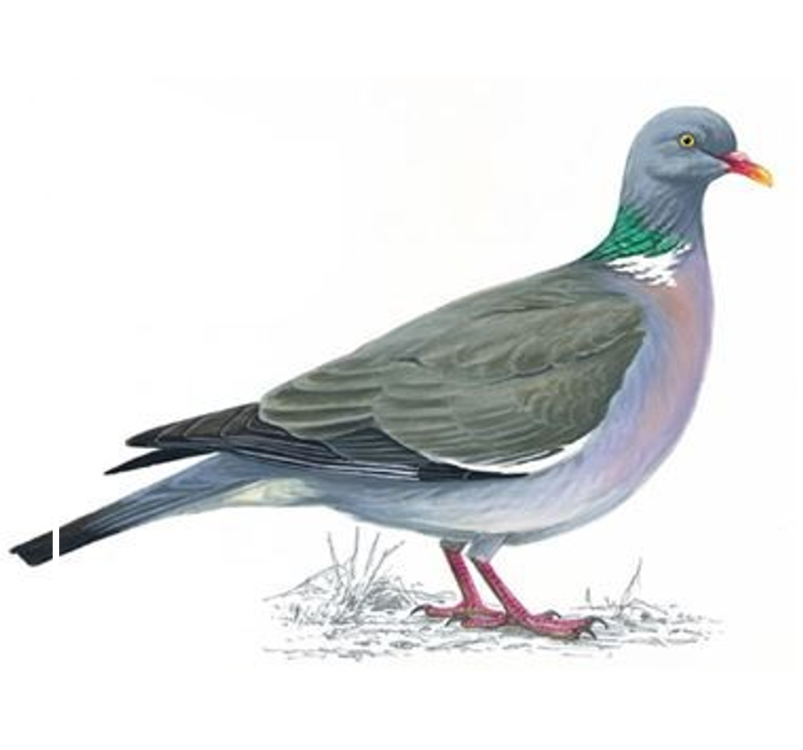
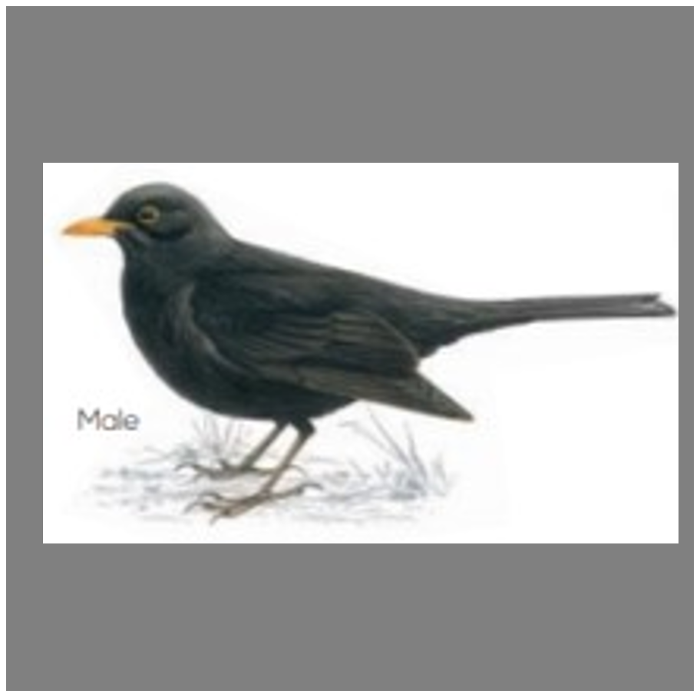
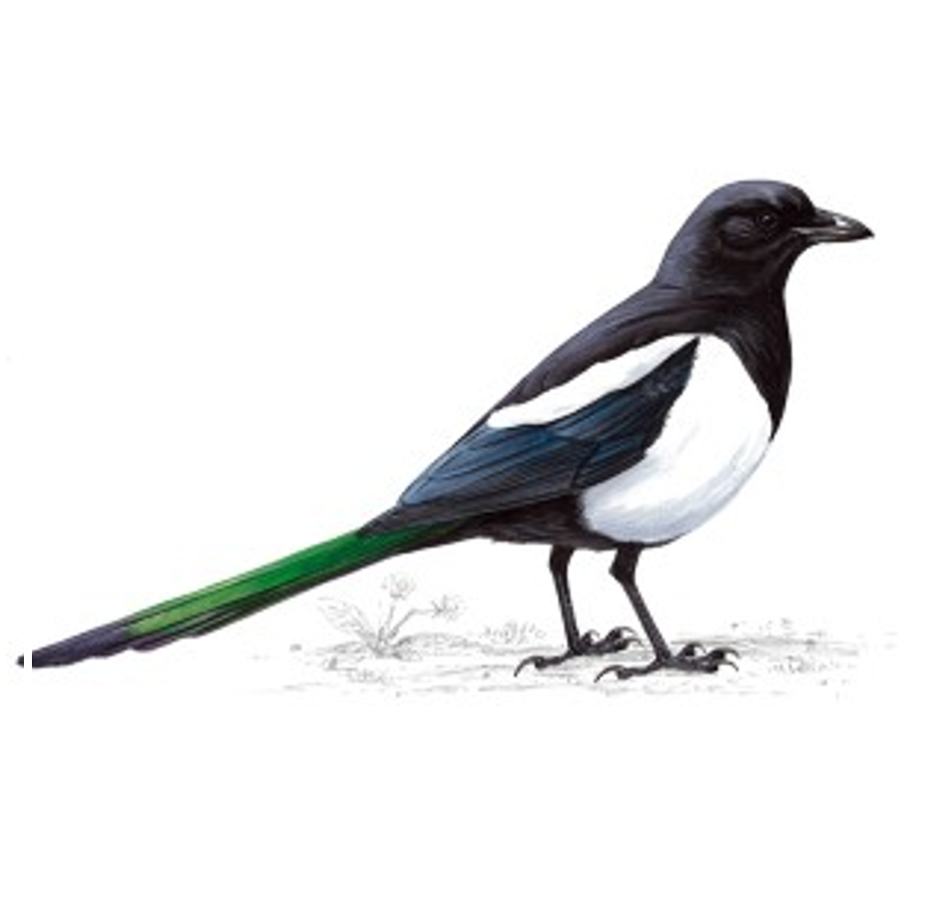
1
2
3
4
5
6
7
8
9
10
11
12
13
14
15
16
17
18

Slide 19
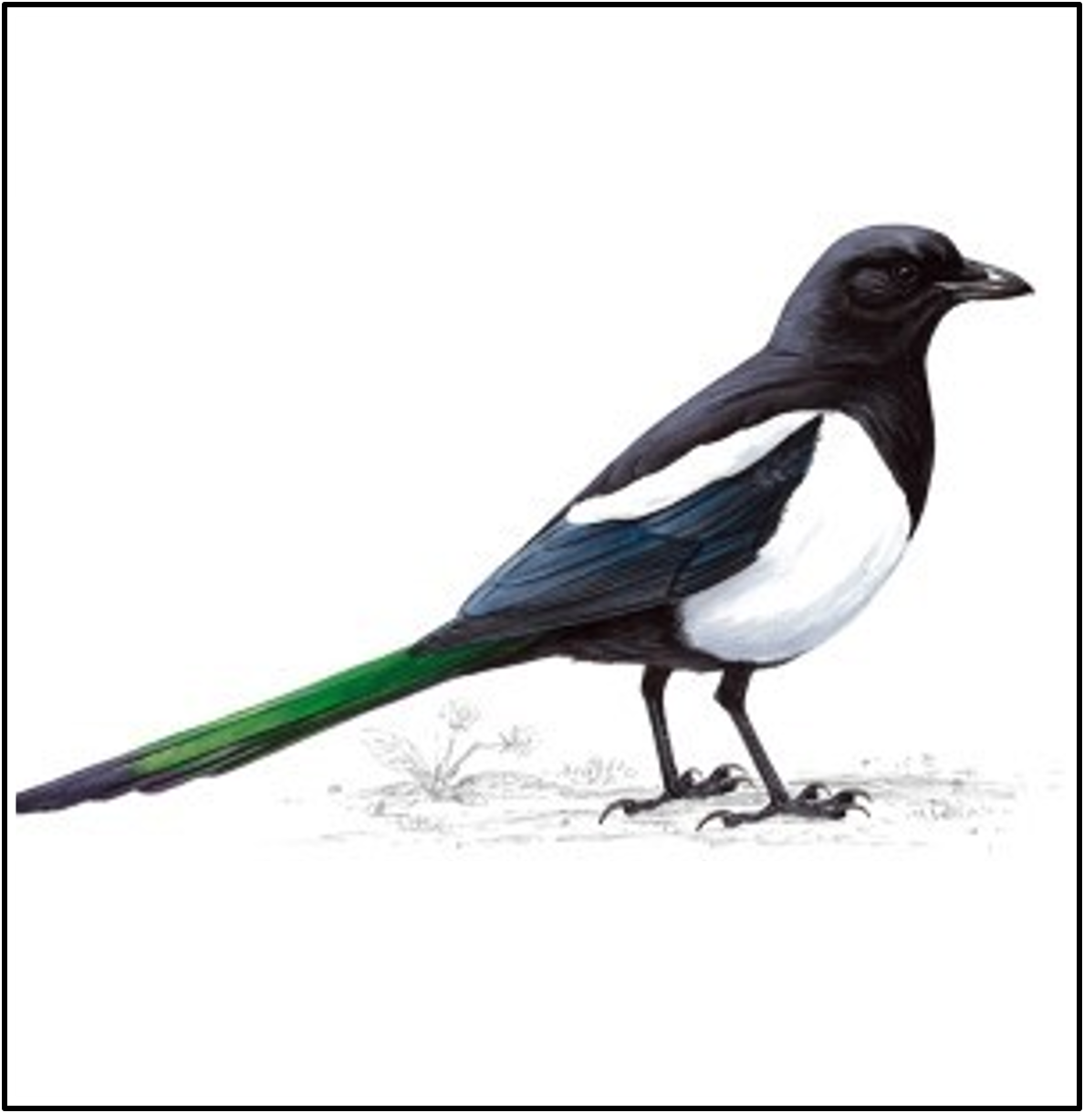
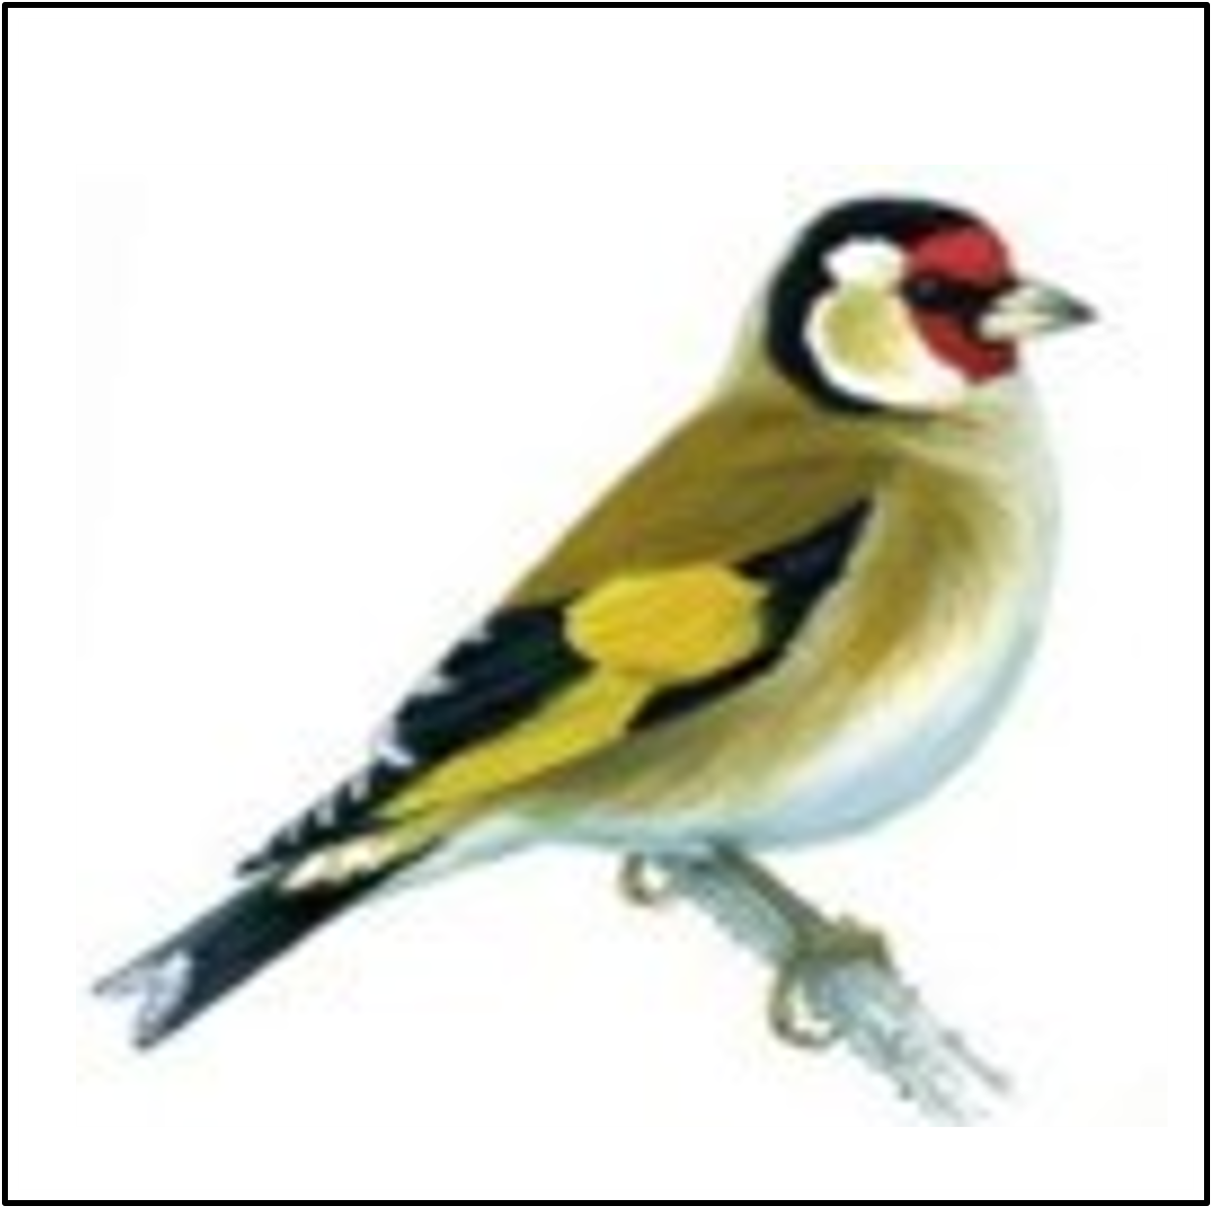
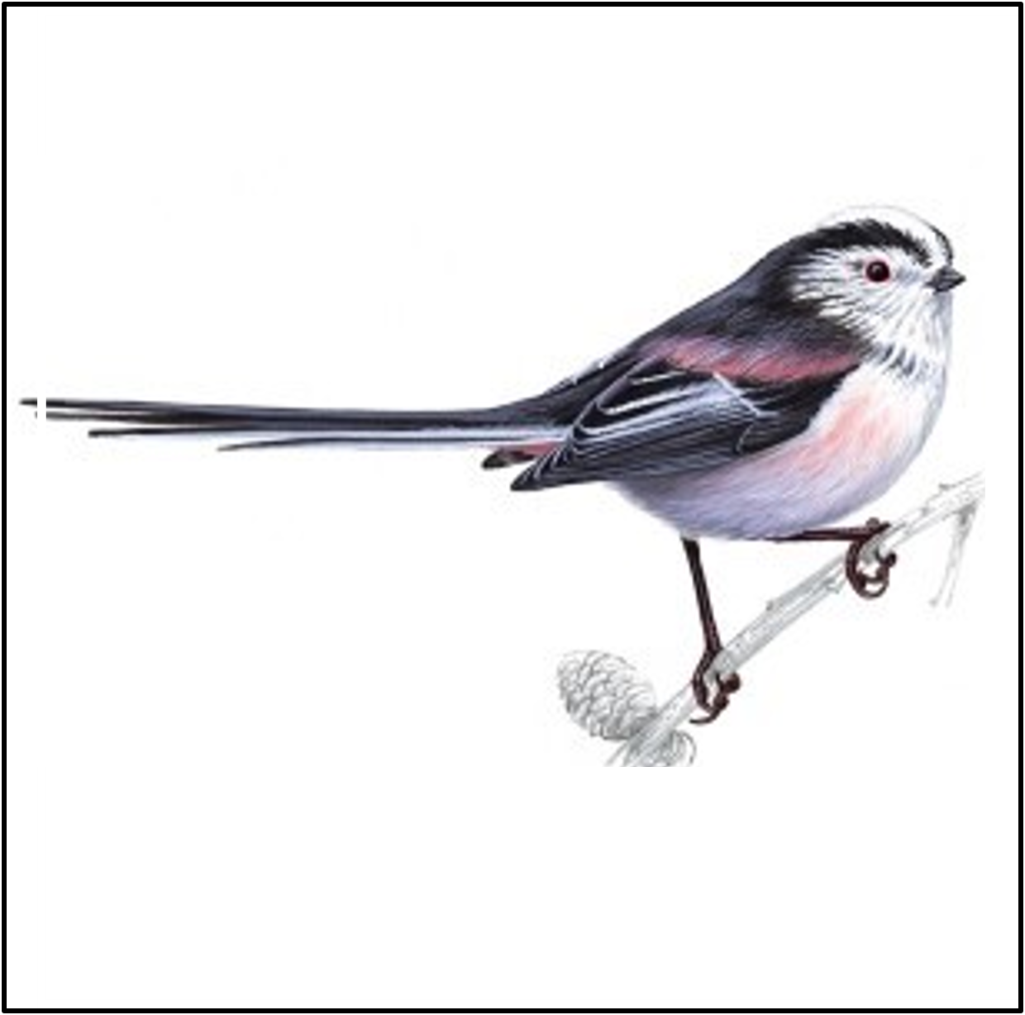
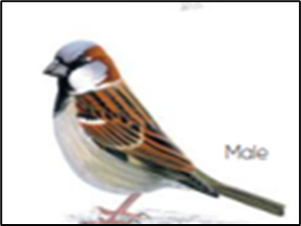
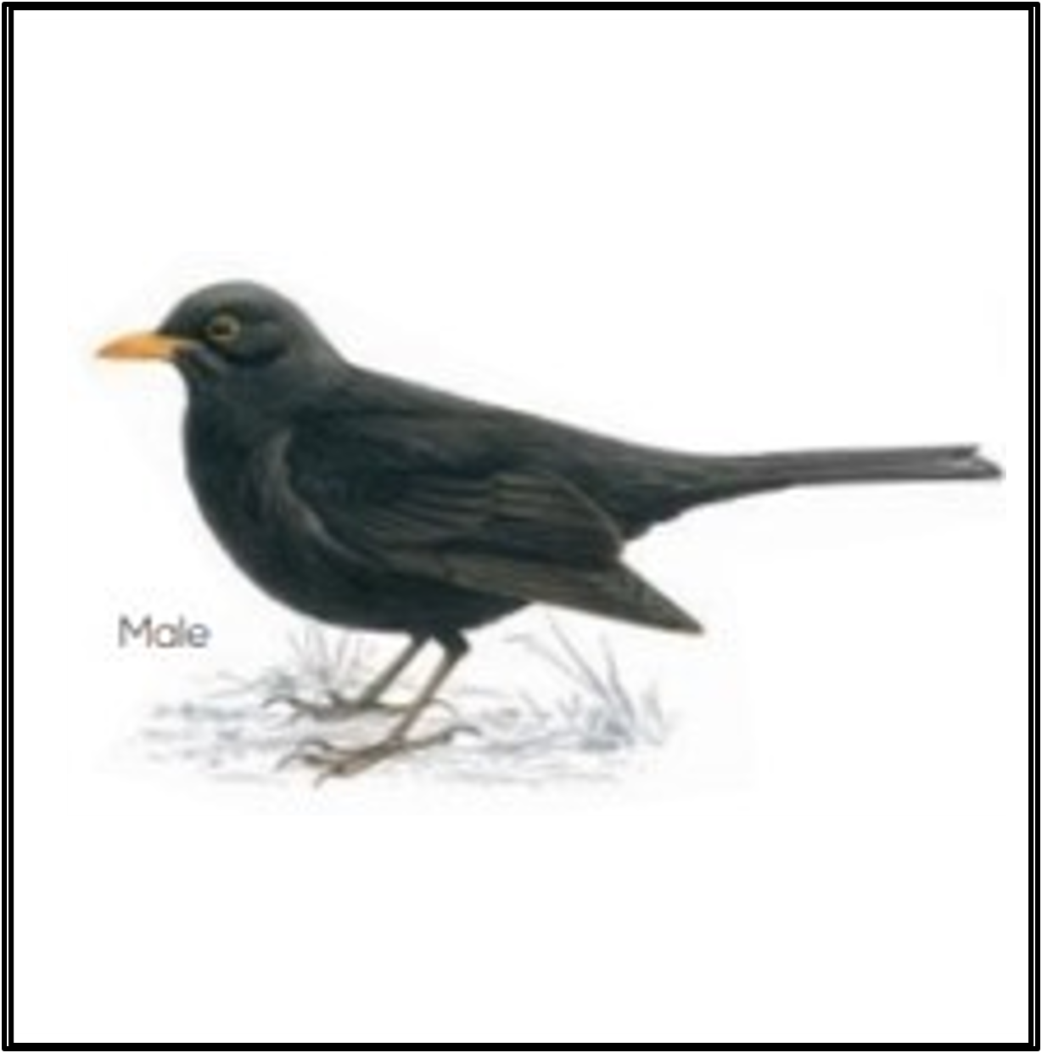
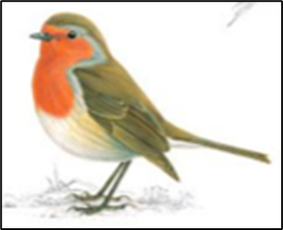
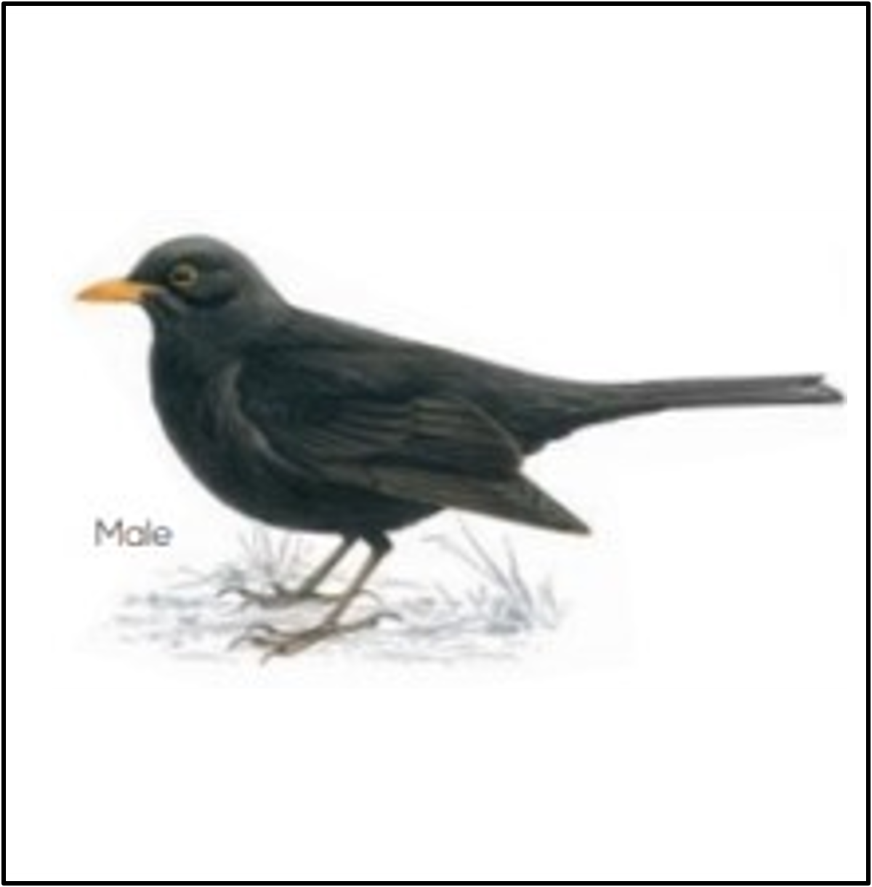
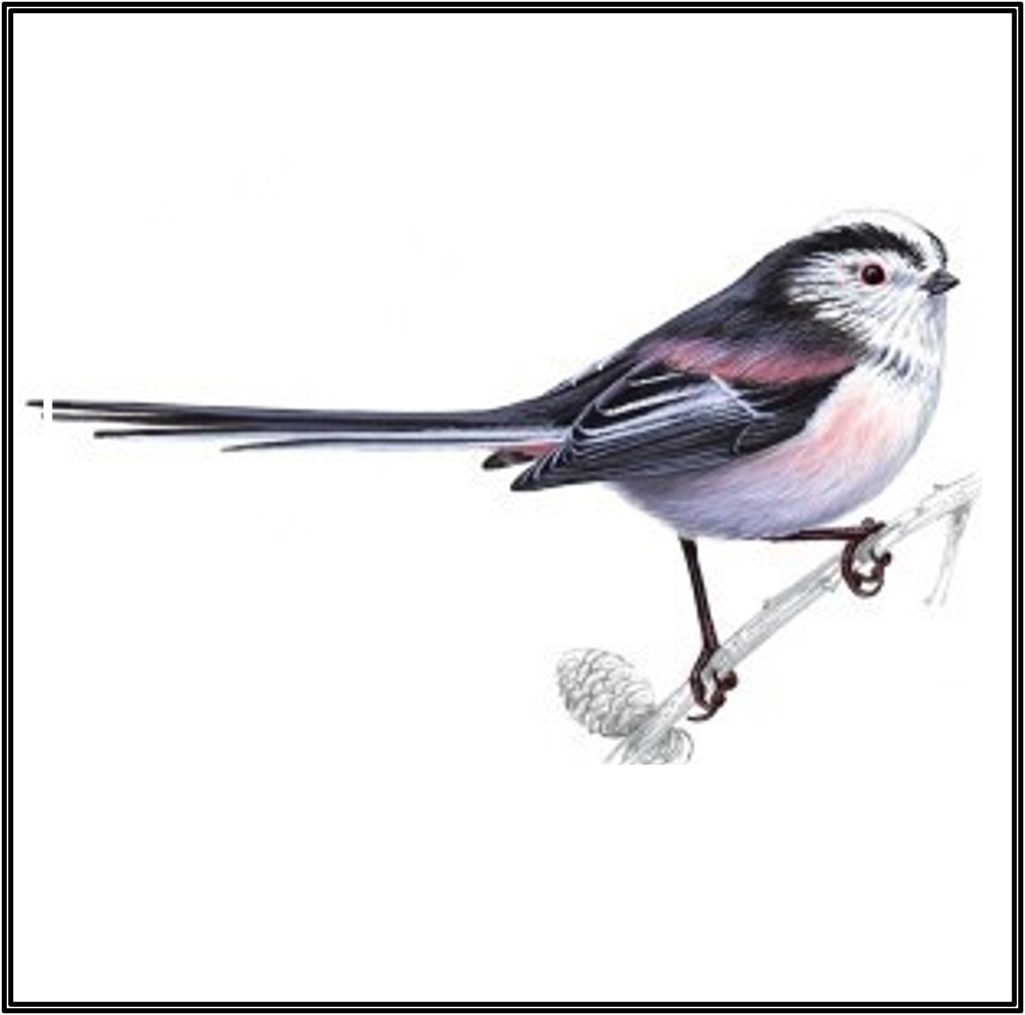
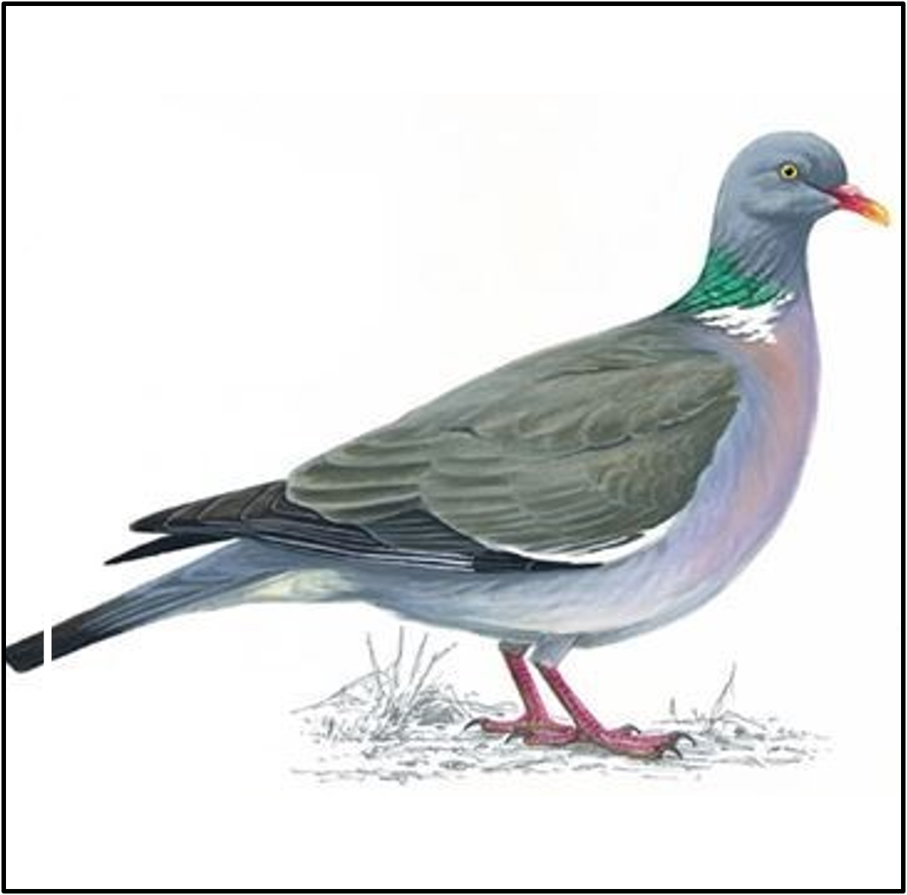
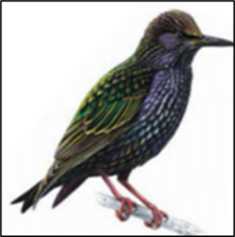
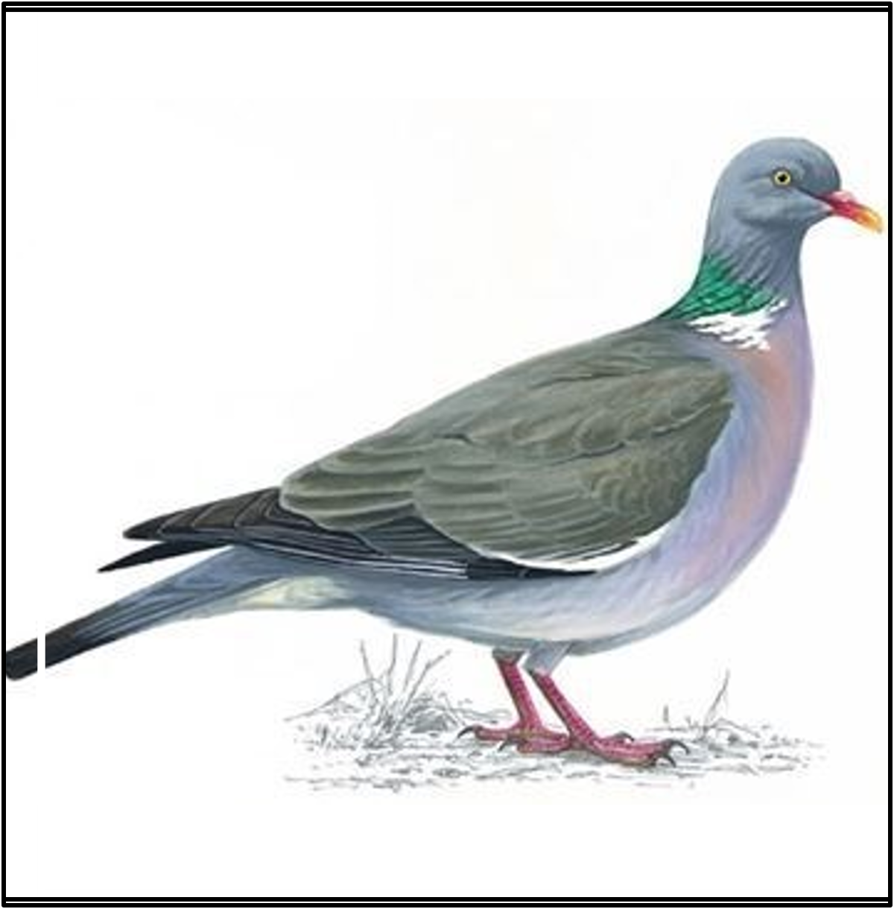
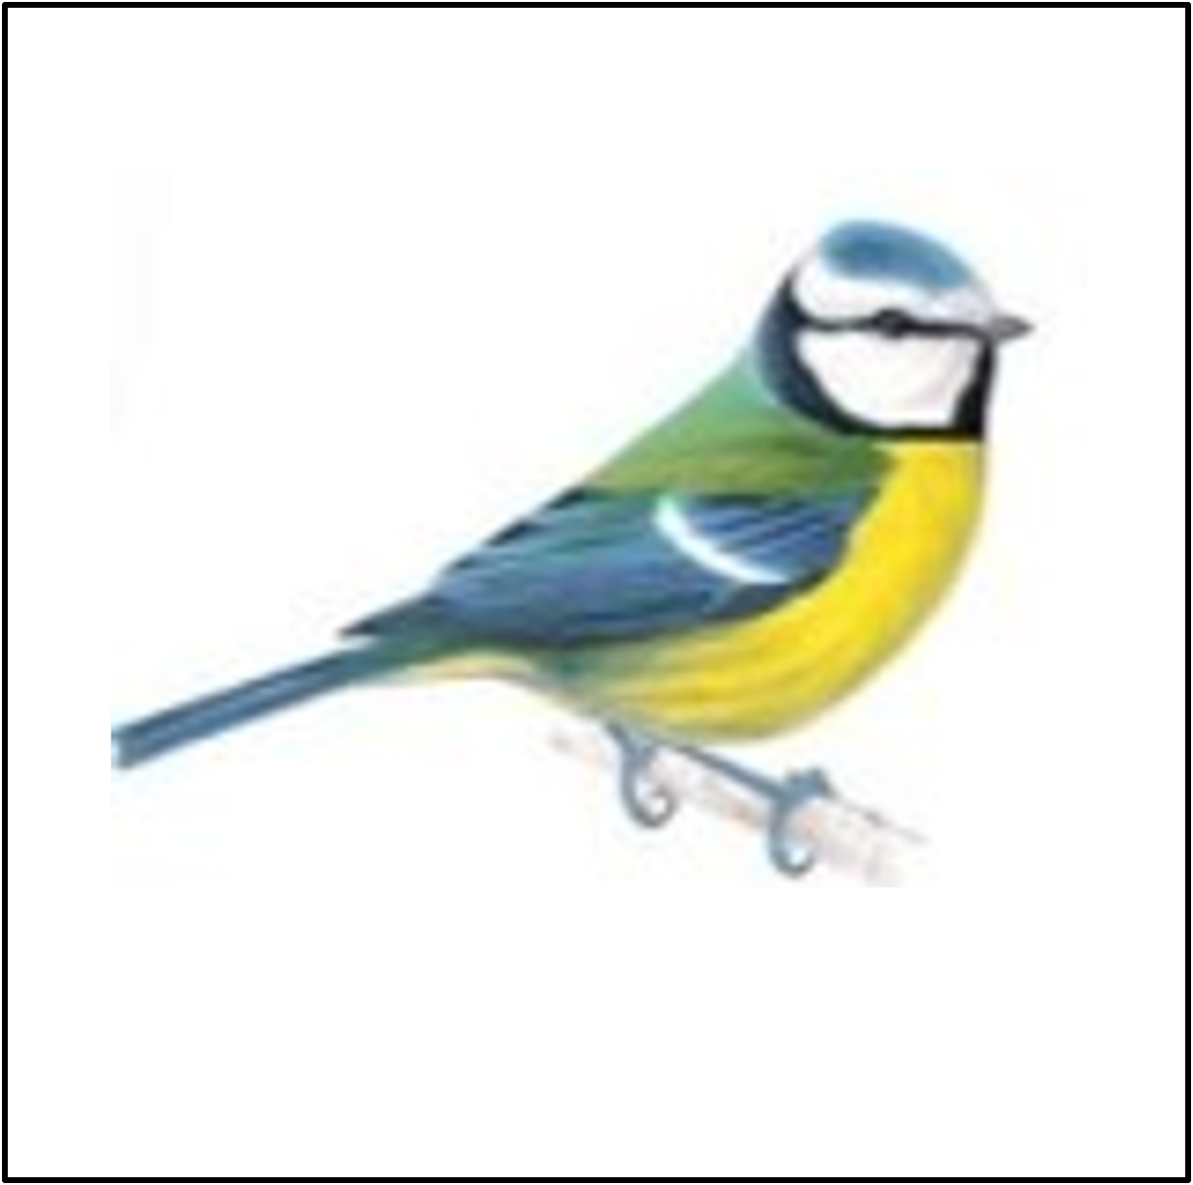
1
2
3
4
5
6
7
8
9
10
11
12
13
14
15
16
17
18

Slide 20
Wordsearch
Cubs can use the annotation feature to write on the screen when they find each of the words.

Slide 21
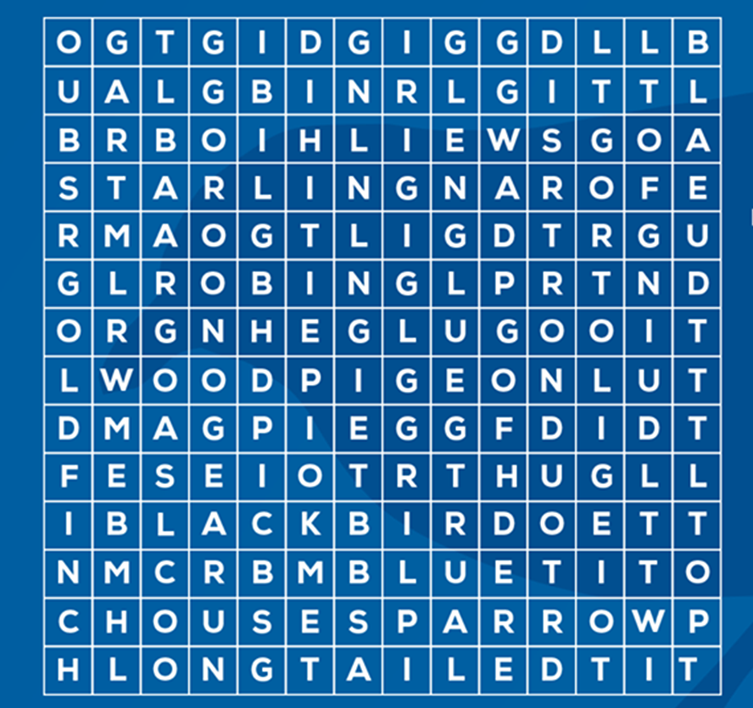
House sparrow
Starling
Blue tit
Woodpigeon
Blackbird
Goldfinch
Great tit
Robin
Long tailed tit
Magpie

Slide 22
Make a bird feeder

Slide 23
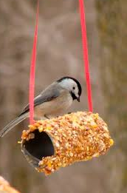
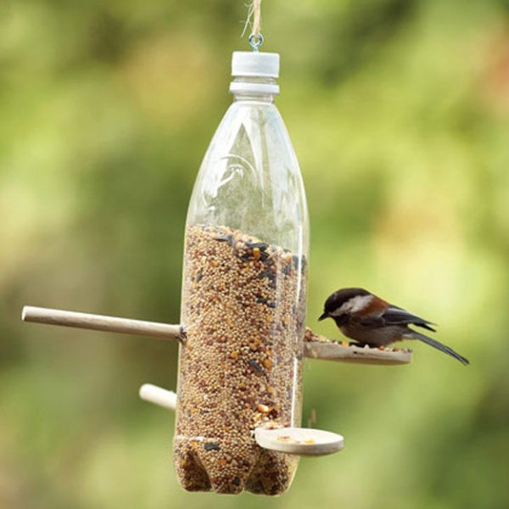
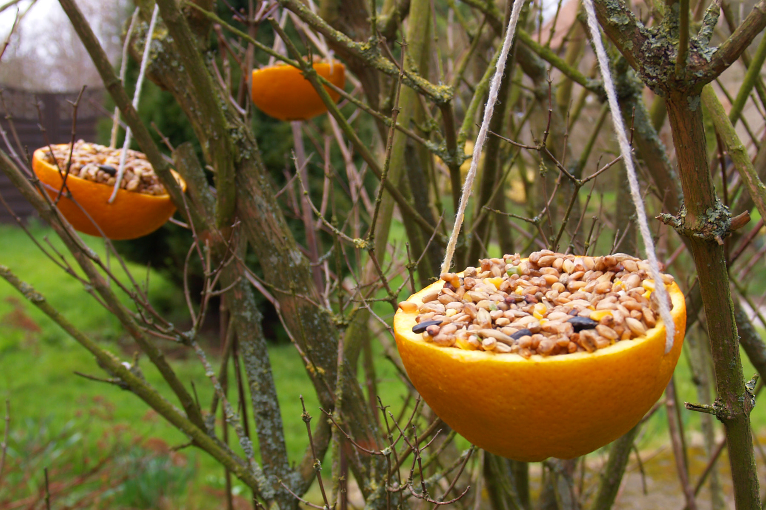
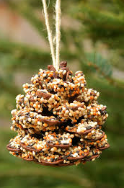
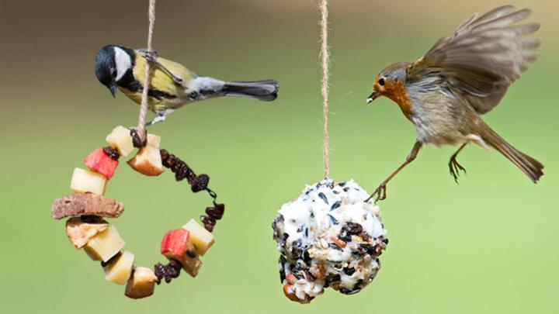
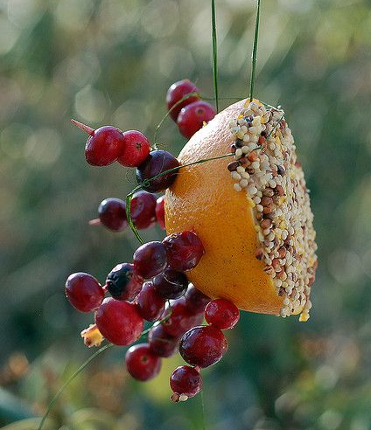

Slide 24
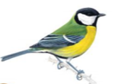
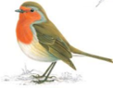
Join in with the RSPB Bird Watch
Pick a time
One hour between 29 and 31 January
Report what you see
Count the birds you see in your garden
Only count the birds that land in the garden
Only count the highest number of each bird species you see at any one time – not a running total.
Submit your results
Log on to rspb.org.uk/birdwatch
Tell them what you’ve seen

