Slide 1


Keeping our city tidy
Disposing of waste correctly

Slide 2
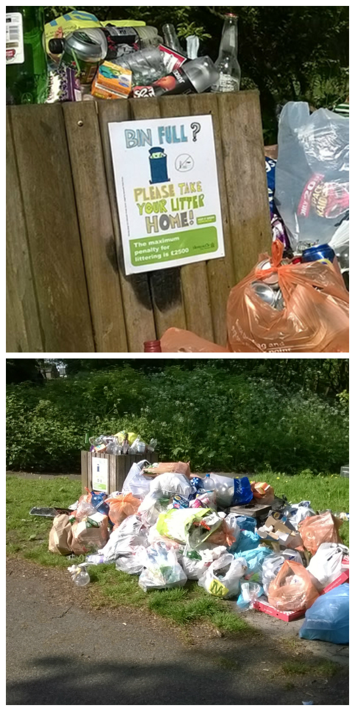
What is waste?
Anything we think we can longer use
so we throw it away!
Notes:
As it says just mention what is on the slide.

Slide 3

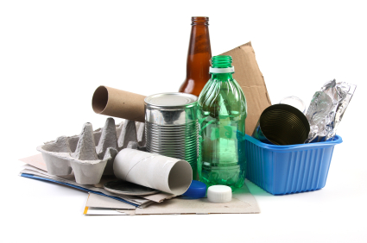

Recycling
Is it just a load of rubbish?
Notes:
I ask them if they think the likes of recycling is rubbish or not?

Slide 4
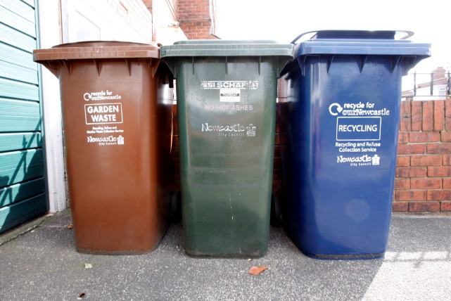
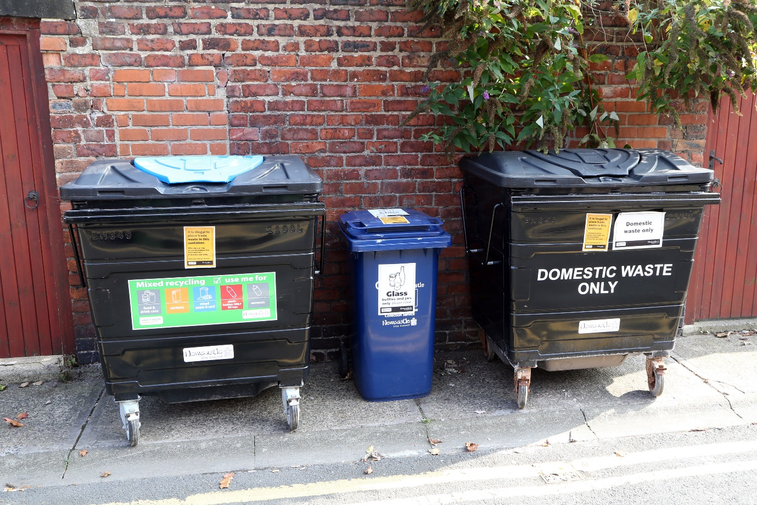
Waste & Recycling in Newcastle
Its very important to use the correct bin
Some homes use shared or communal bins
Brown = garden waste
Green = domestic waste
Blue = recycling

Slide 5
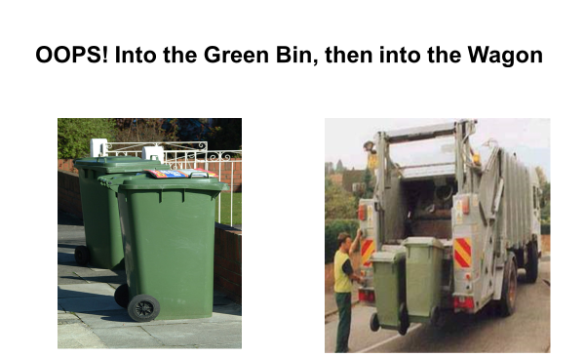
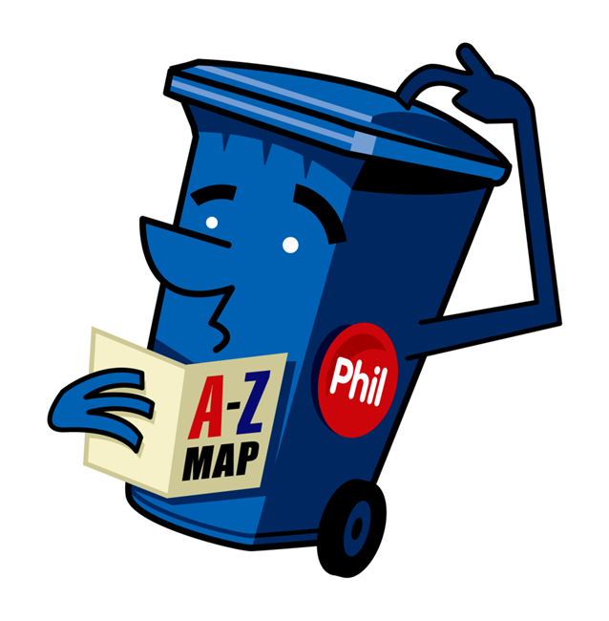
What happens if we get it wrong?

Slide 6
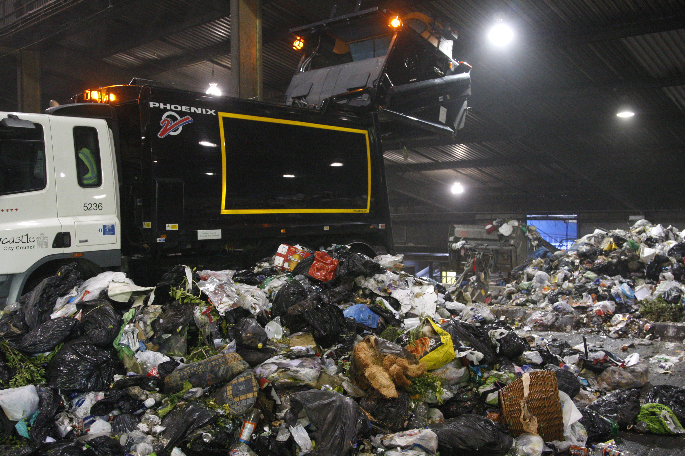
Green bin rubbish goes to SUEZ plant in Byker

Slide 7
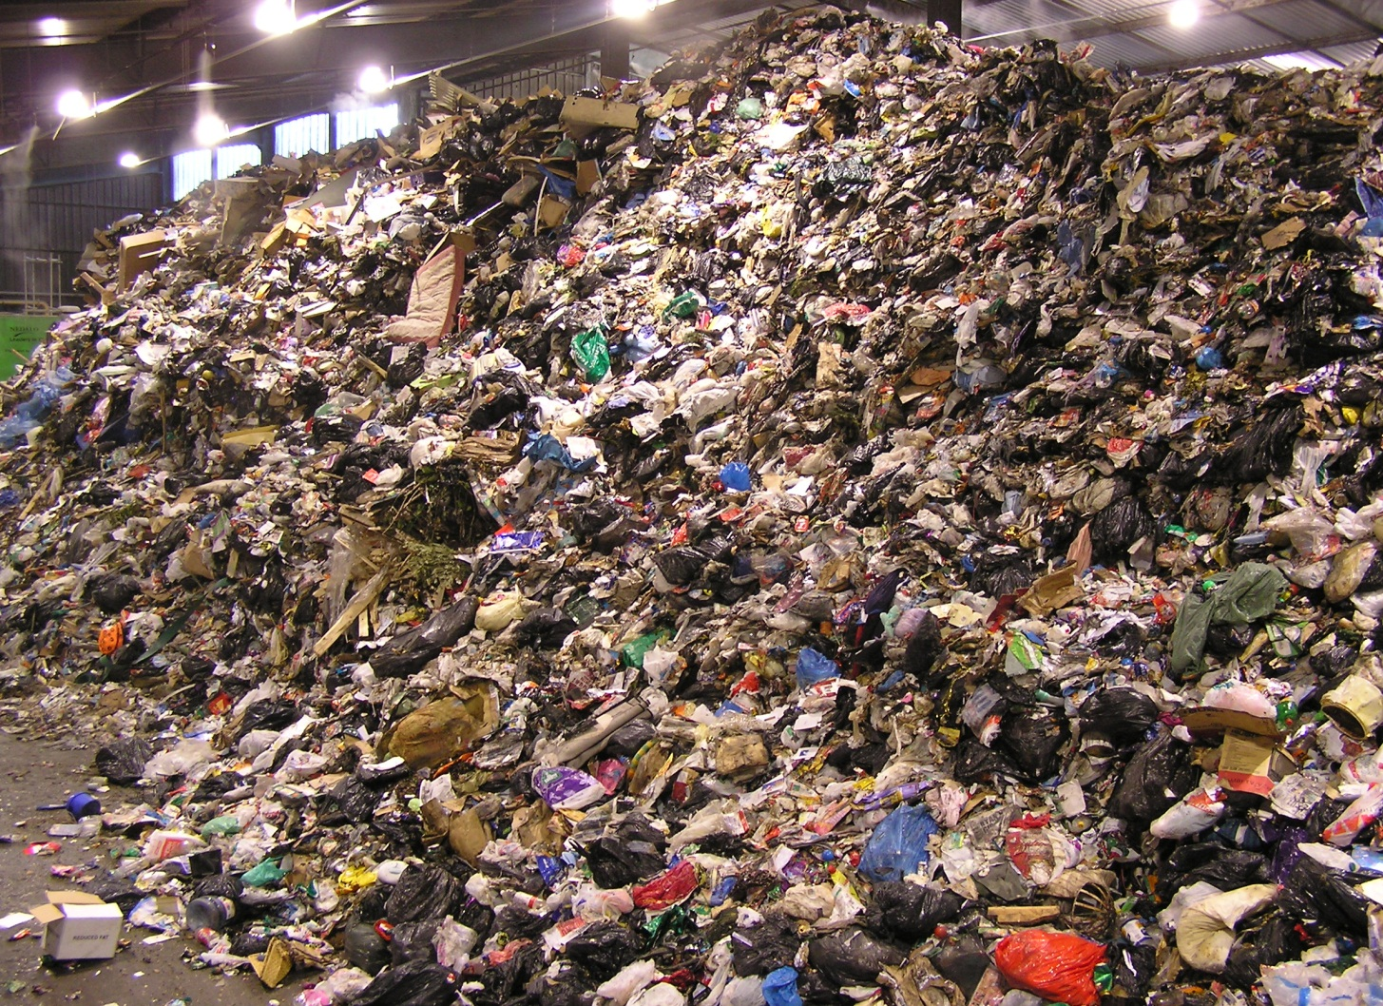
This amount of rubbish is collected in just a few days
All this rubbish will be sent to Landfill.
Can you spot the double mattress?
Notes:
How much rubbish there is and can they spot the double mattress.

Slide 8
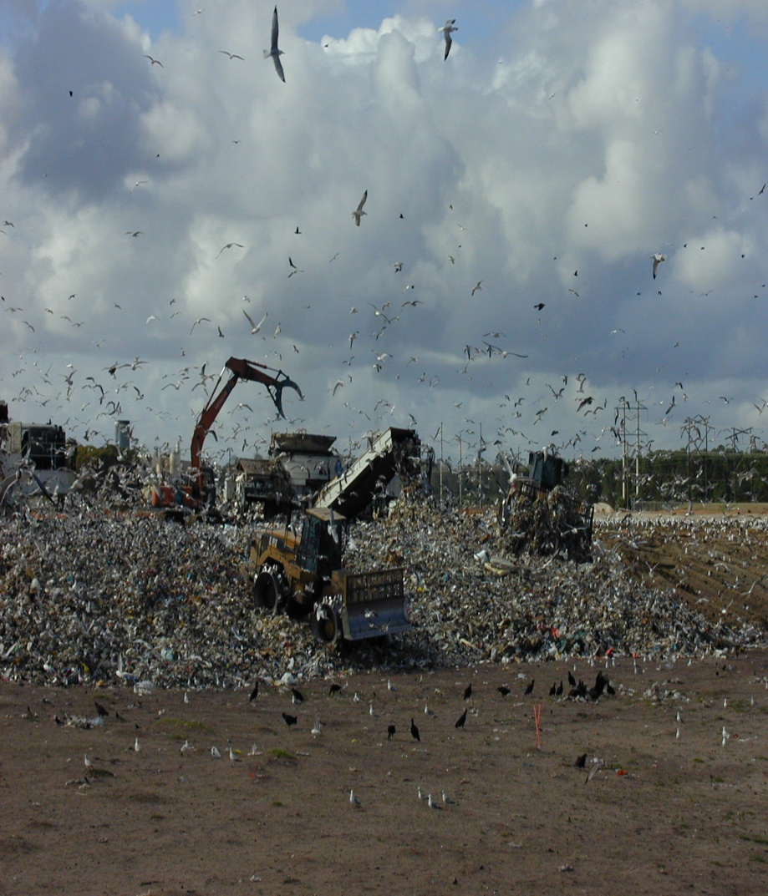
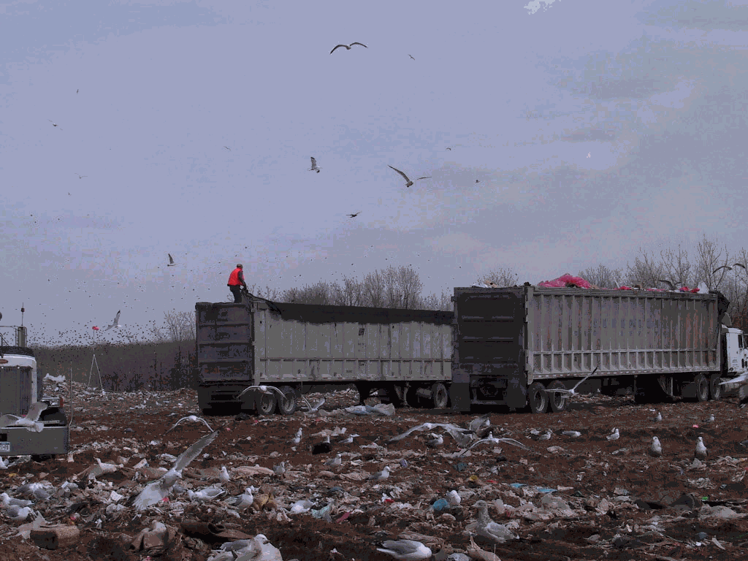
What is a Landfill Site?
A big hole in the ground
Notes:
Then into a big hole in the ground and why its sad for materials to be in there as not all can bio degrade over the years and the land cannot be used for years either.

Slide 9
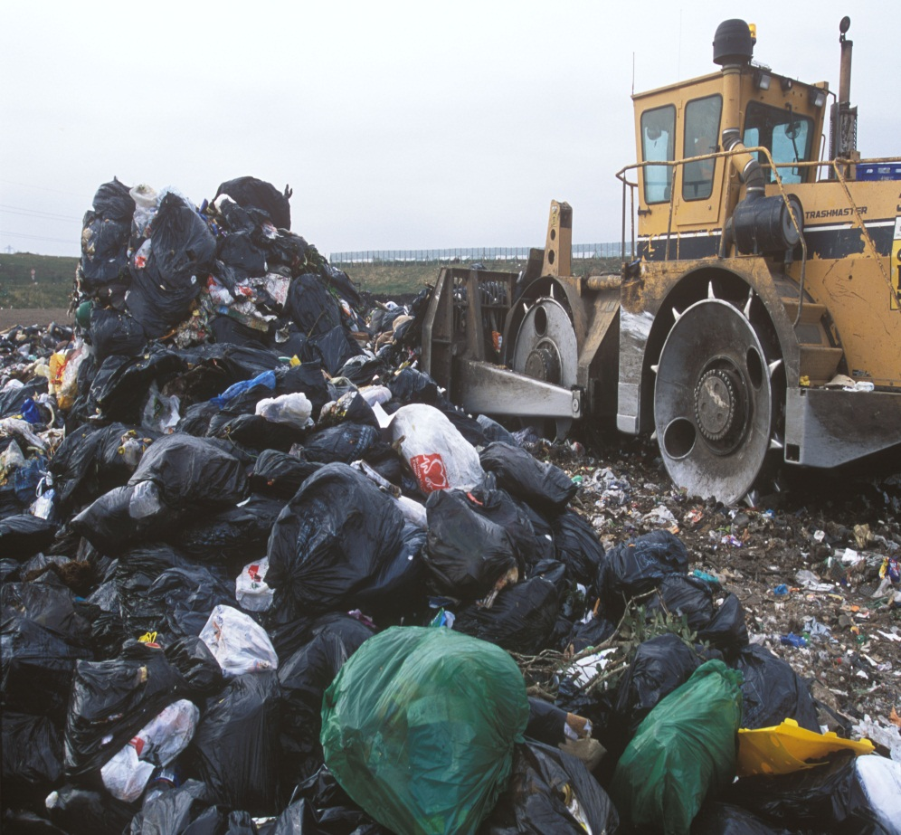
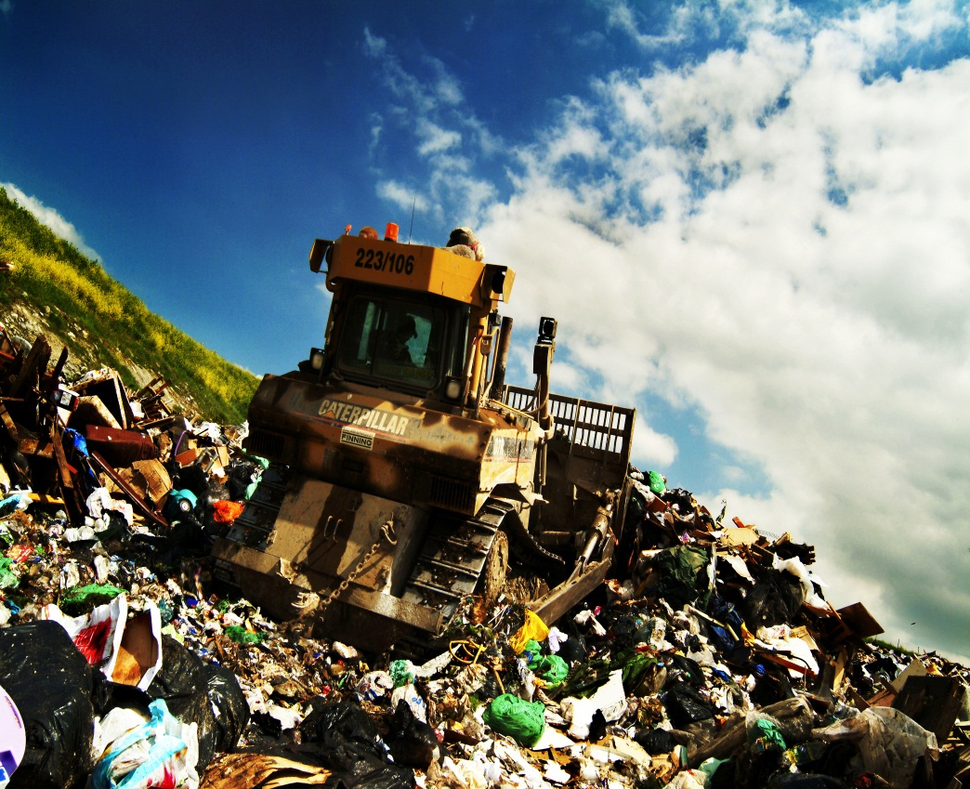
Look at all the rubbish!
Imagine the smell and noise!
Notes:
More about the rubbish to landfill.

Slide 10
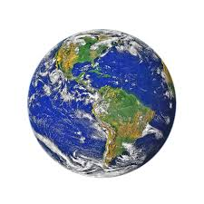

Why should we recycle?
Natural materials from the earth are used to make Paper, Glass, Steel, Aluminium and Plastics.
Recycling helps to
Save energy.
Reduce pollution.
Protect the planet and slows down using natural materials we may run out of them

Slide 11
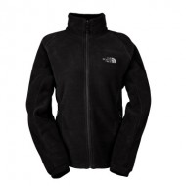
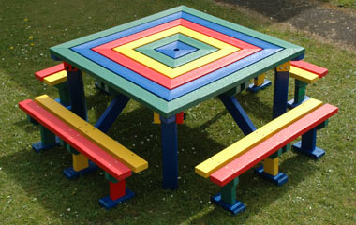
What can be made from recycled items ?
What do you think these are made from?
Notes:
Items that can be used from plastic bottles to make the bench and part of the coat.

Slide 12
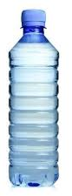
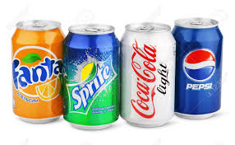
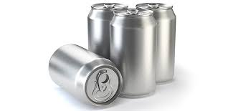
It takes around 400 years for a plastic bottle to biodegrade
Using bottles more than once is good but when they’re recycled they can be made into park benches, sleeping bags and football kits
An aluminium drink can will take 200 years to decompose but could be recycled into another drink can in 2 months
Recycling one can saves enough energy is saved to power a TV for over 3 hours

Slide 13

So that’s what happens when we get it wrong
What happens when we get it right?

Slide 14
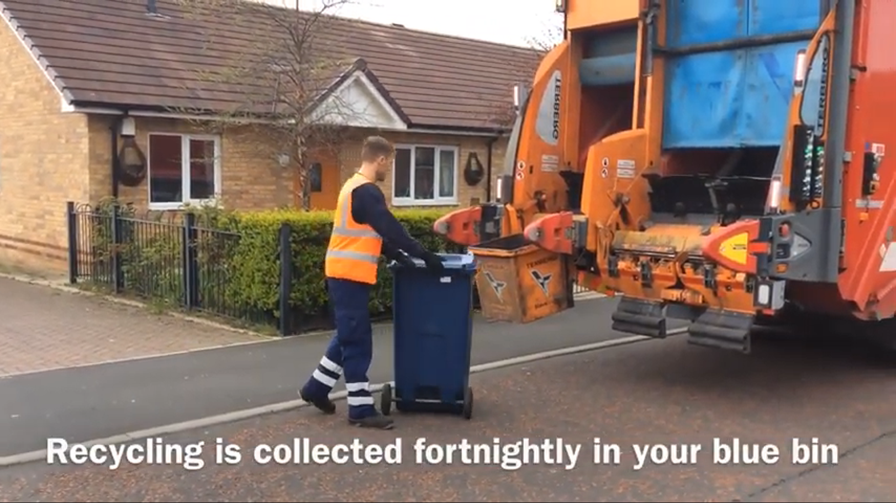

Slide 15

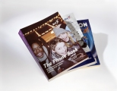
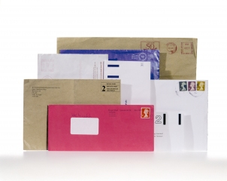
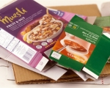
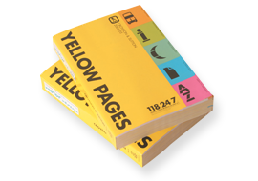
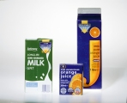
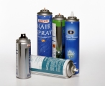
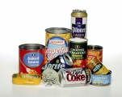
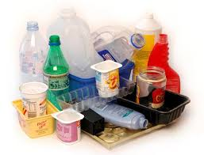
What can be put in your blue recycling bin?
Newspaper, paper, magazines, envelopes, card, cardboard, yogurt pots, food & drink cartons
Aerosols, foil, food and drink tins & cans
Plastic bottles, pots, punnets, tubs & trays

Slide 16
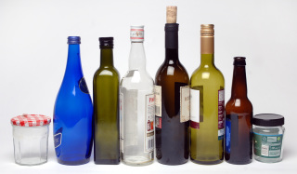
What can be put in your black box (caddy)
Mixed glass bottles & jars
Glass is 100% recyclable but if sent to landfill it would remain unchanged for thousands of years
Batteries should now be taken to shops with collection boxes.

Slide 17
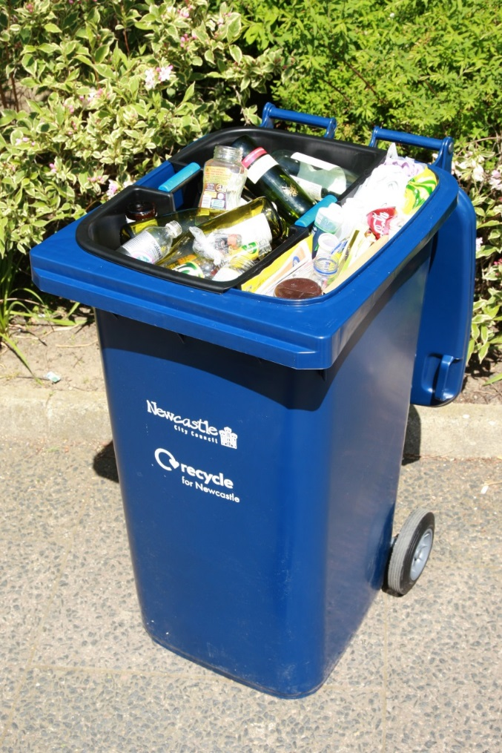
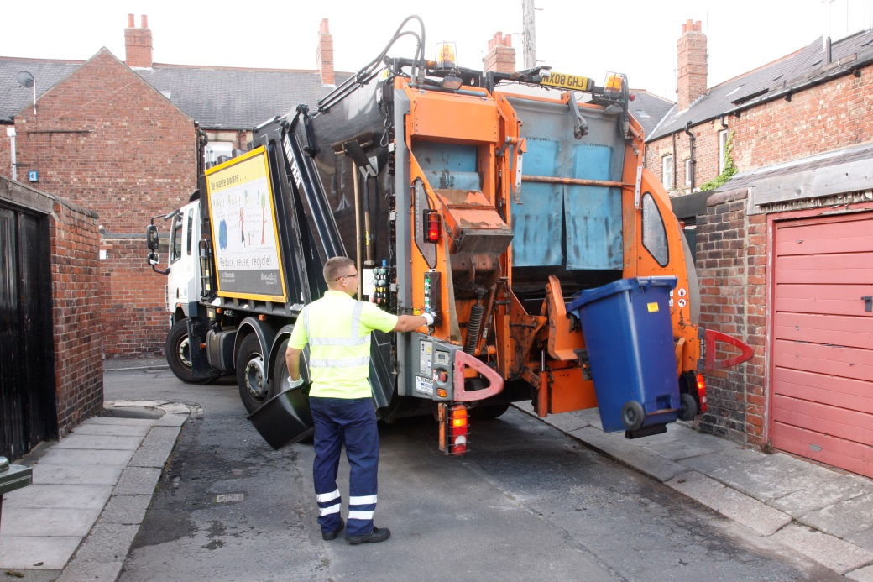
Blue mixed recycling bin goes to J&J
Stanley in Blaydon

Slide 18
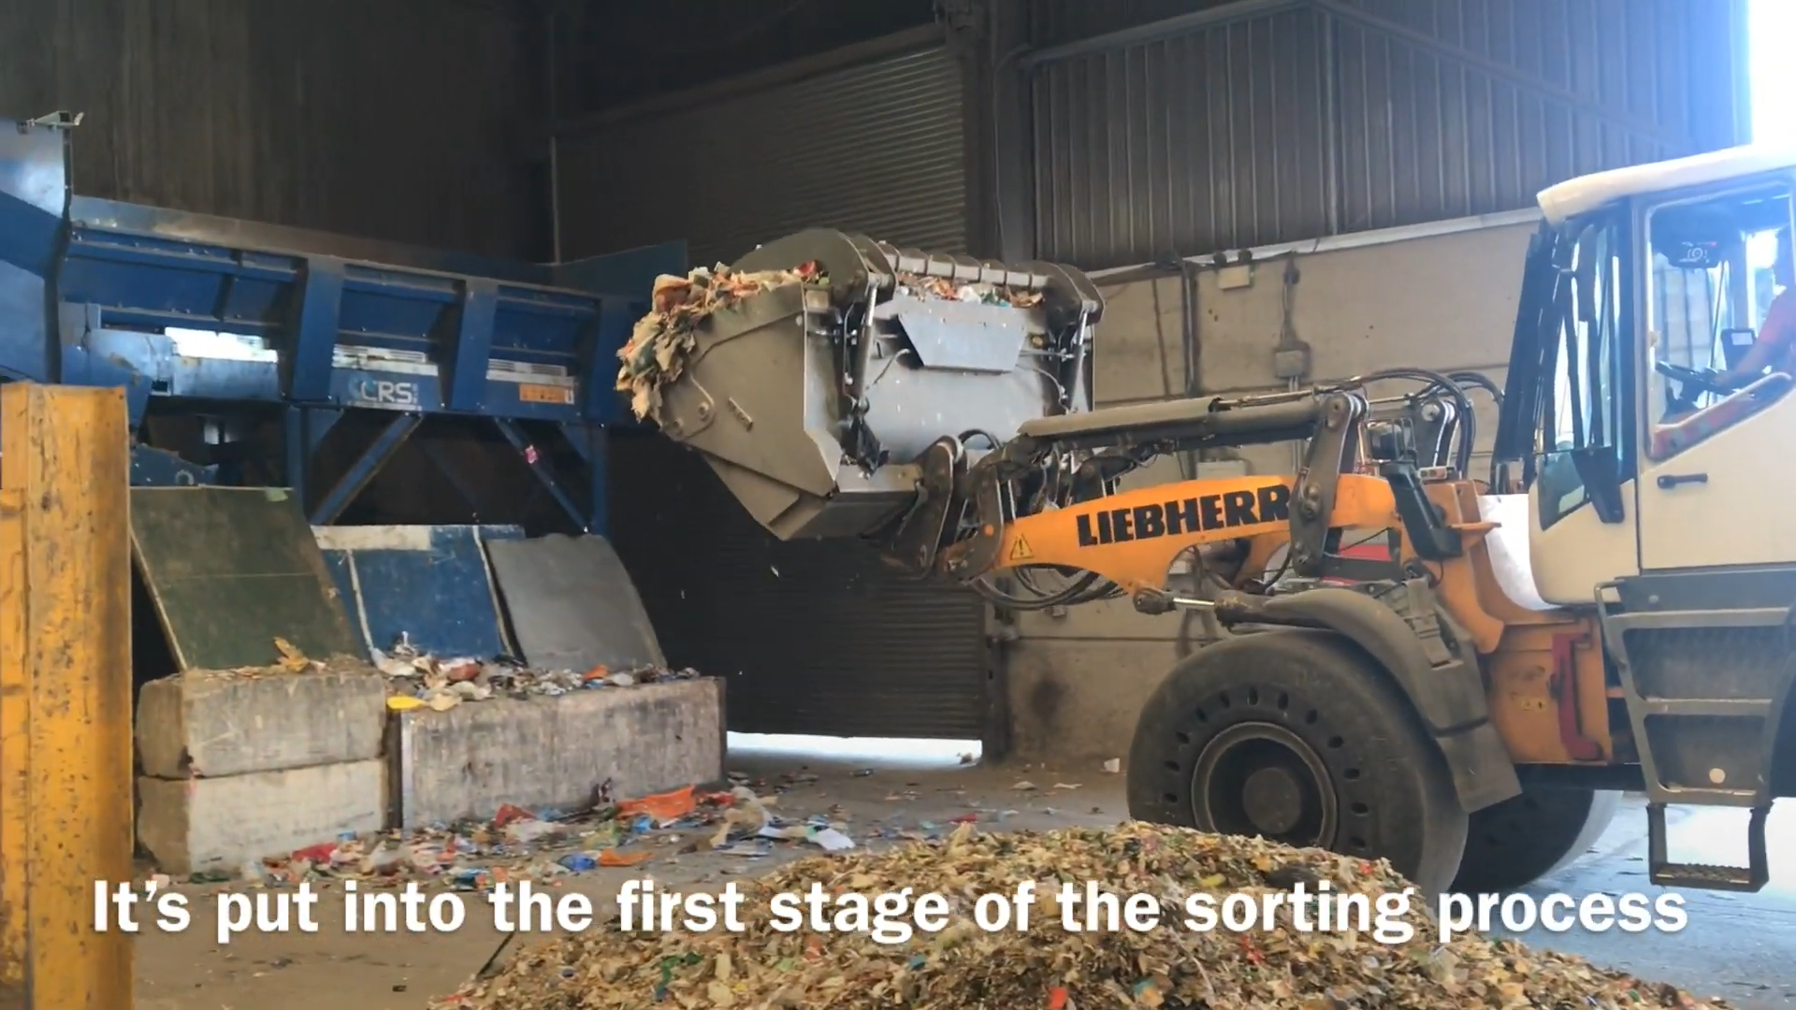

Slide 19
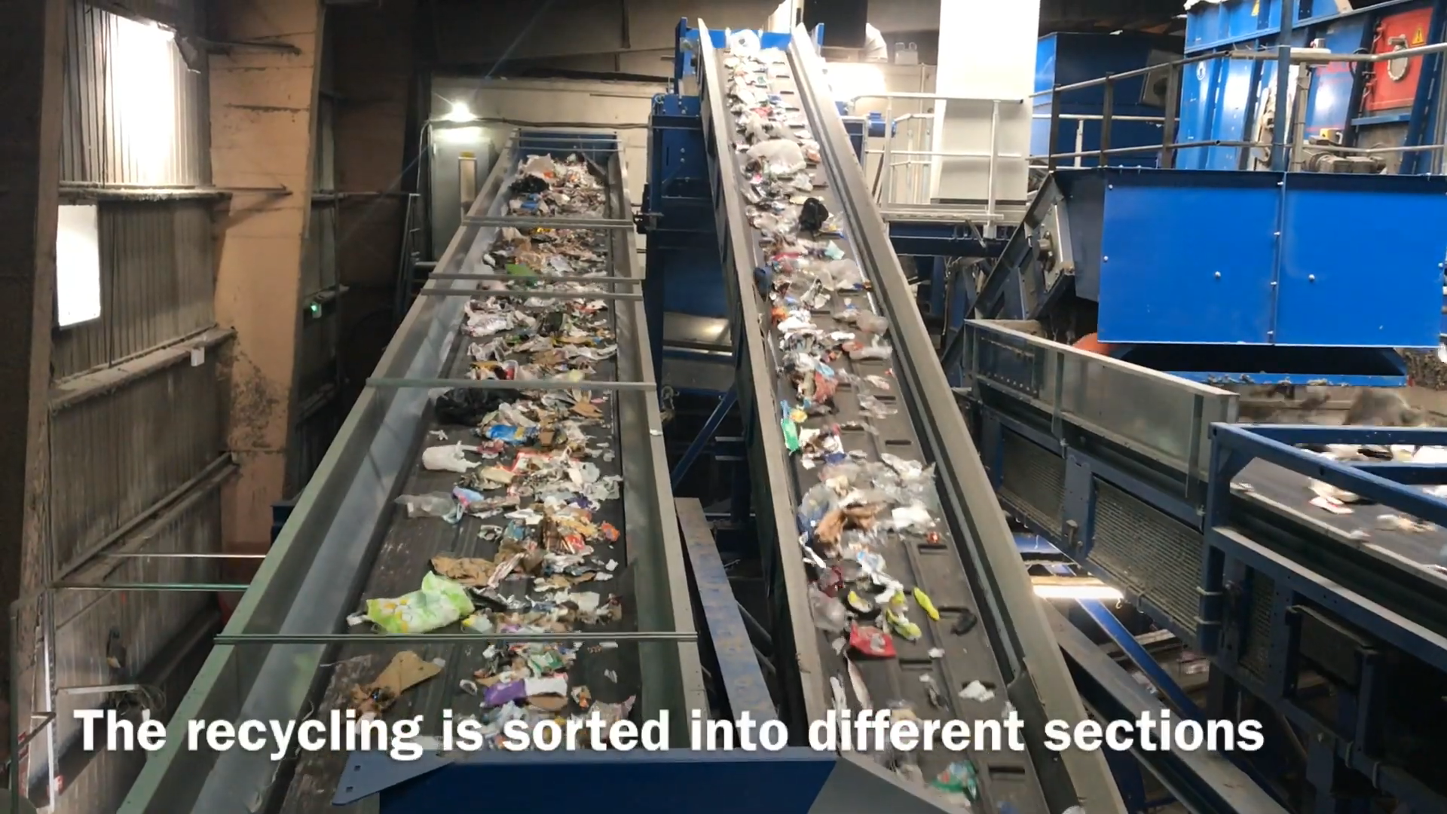

Slide 20
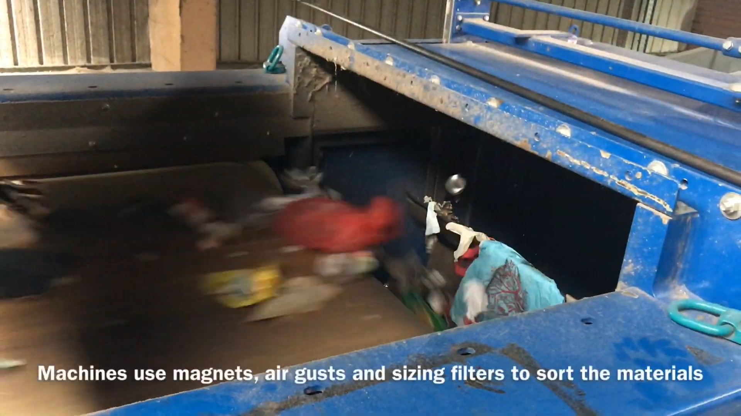

Slide 21
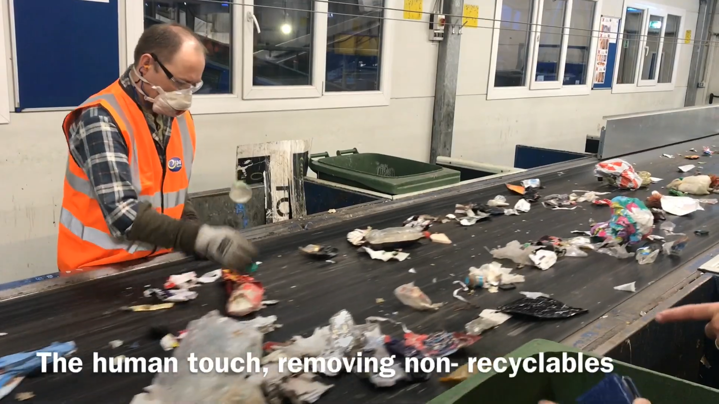

Slide 22
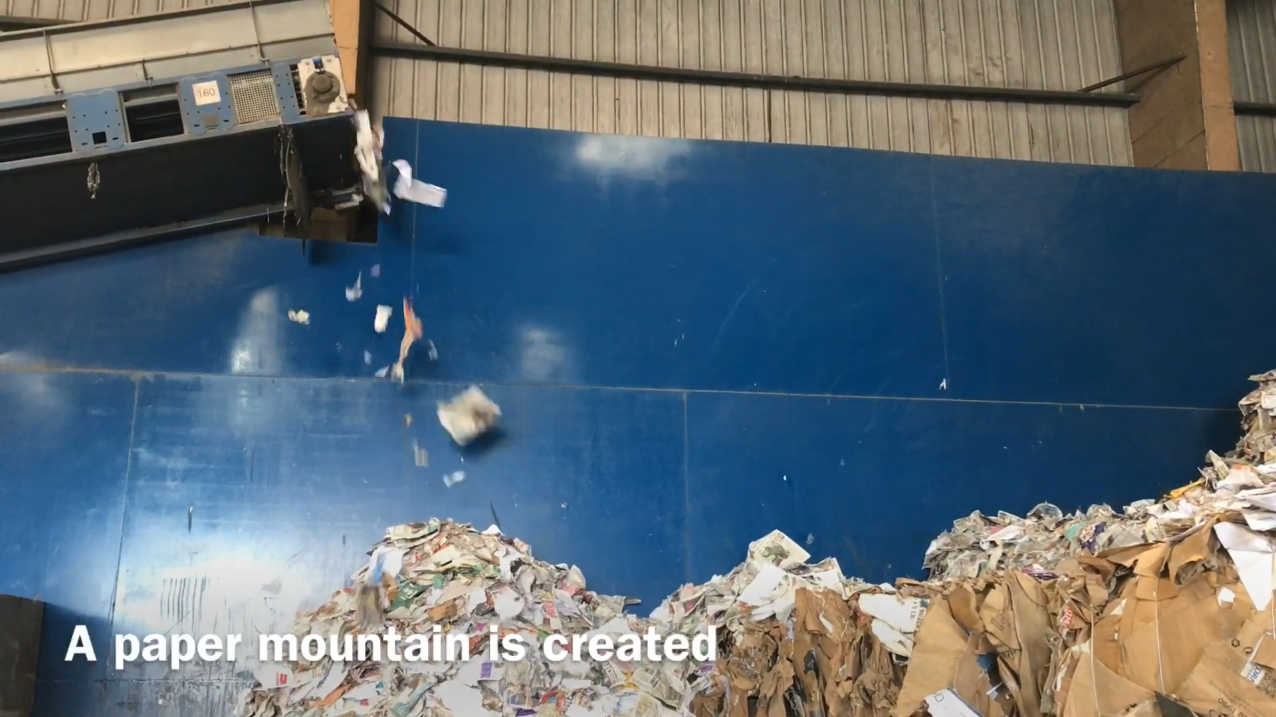

Slide 23
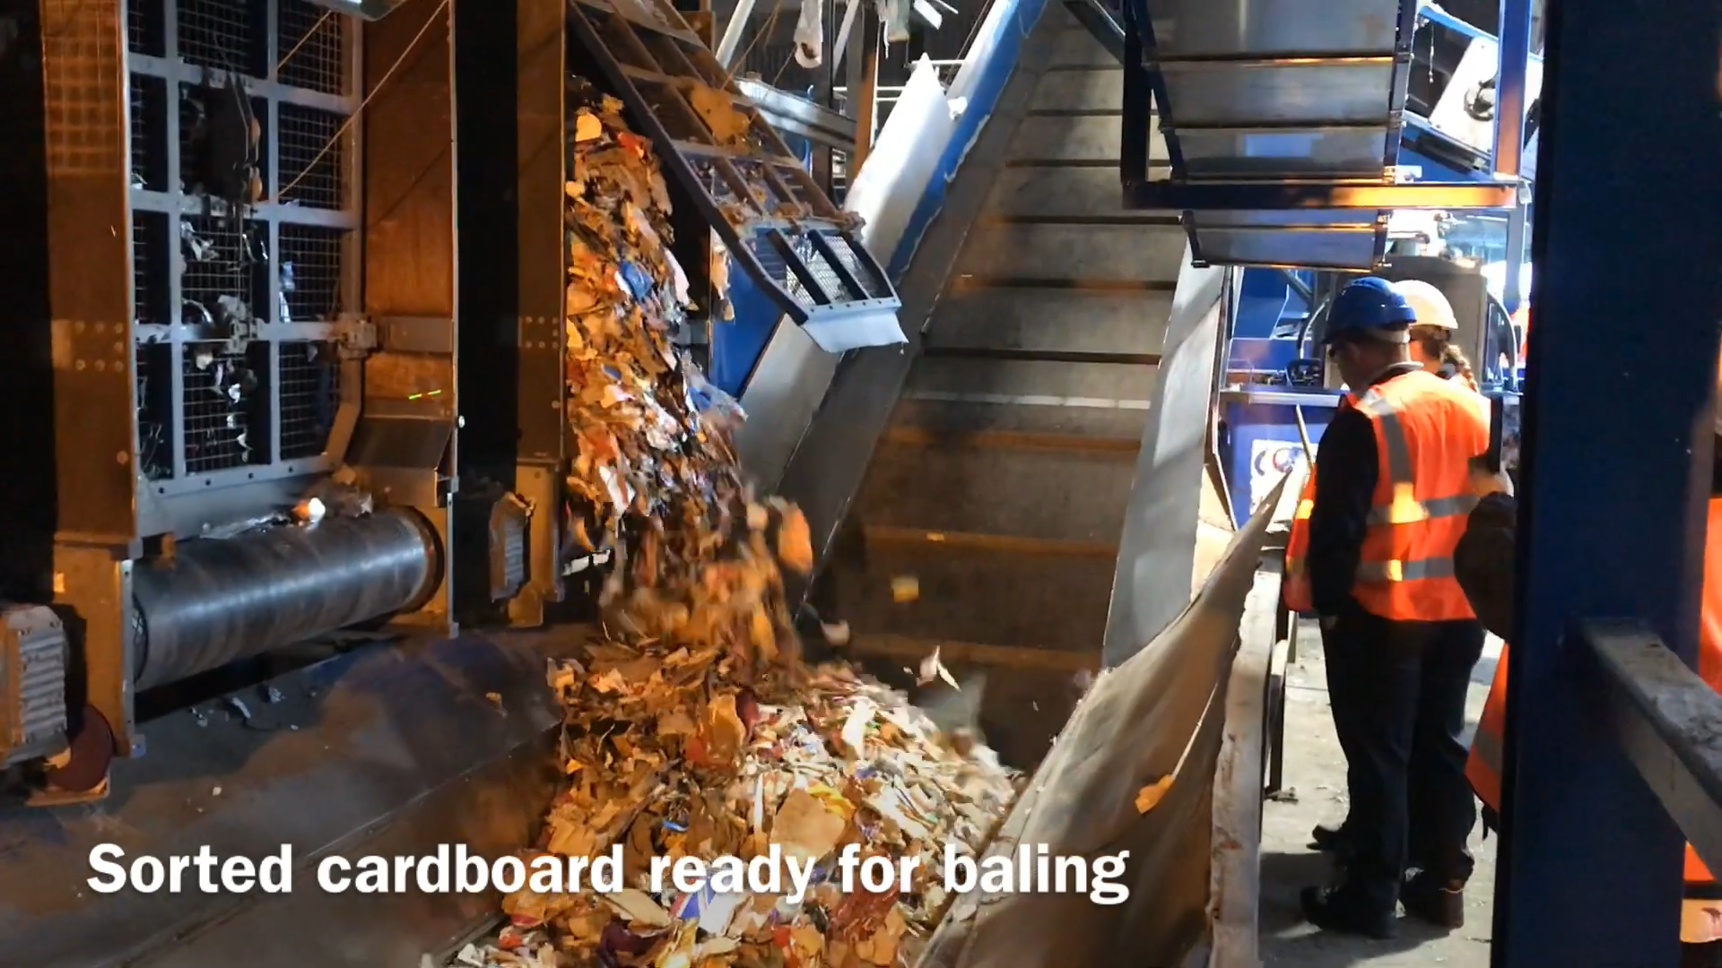

Slide 24
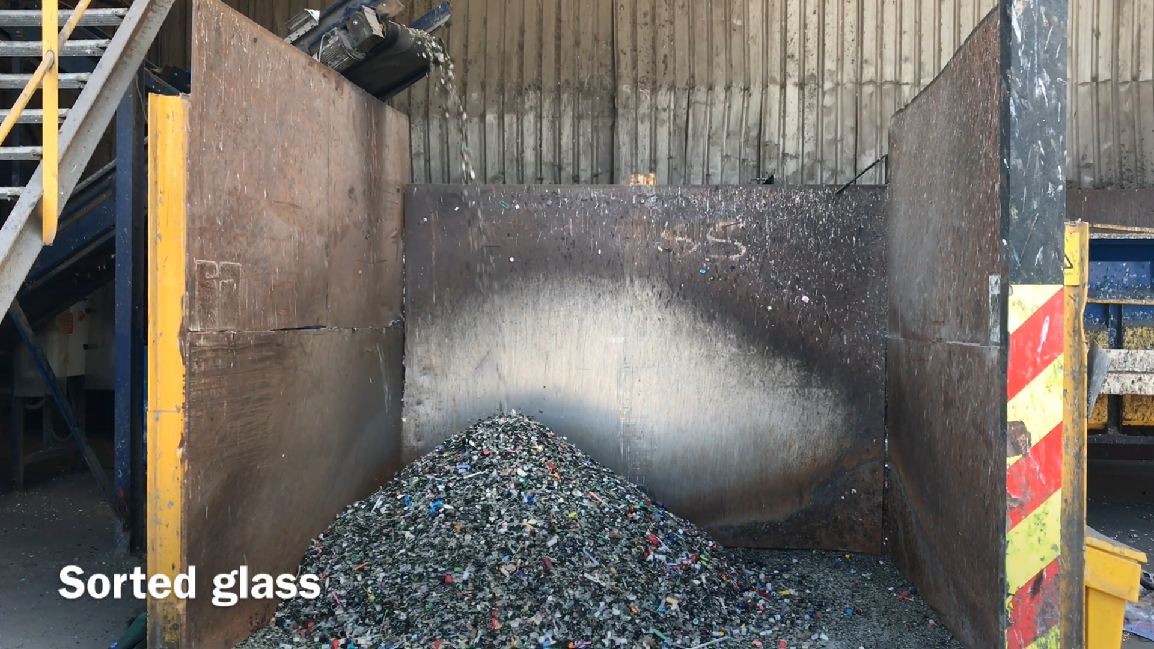

Slide 25
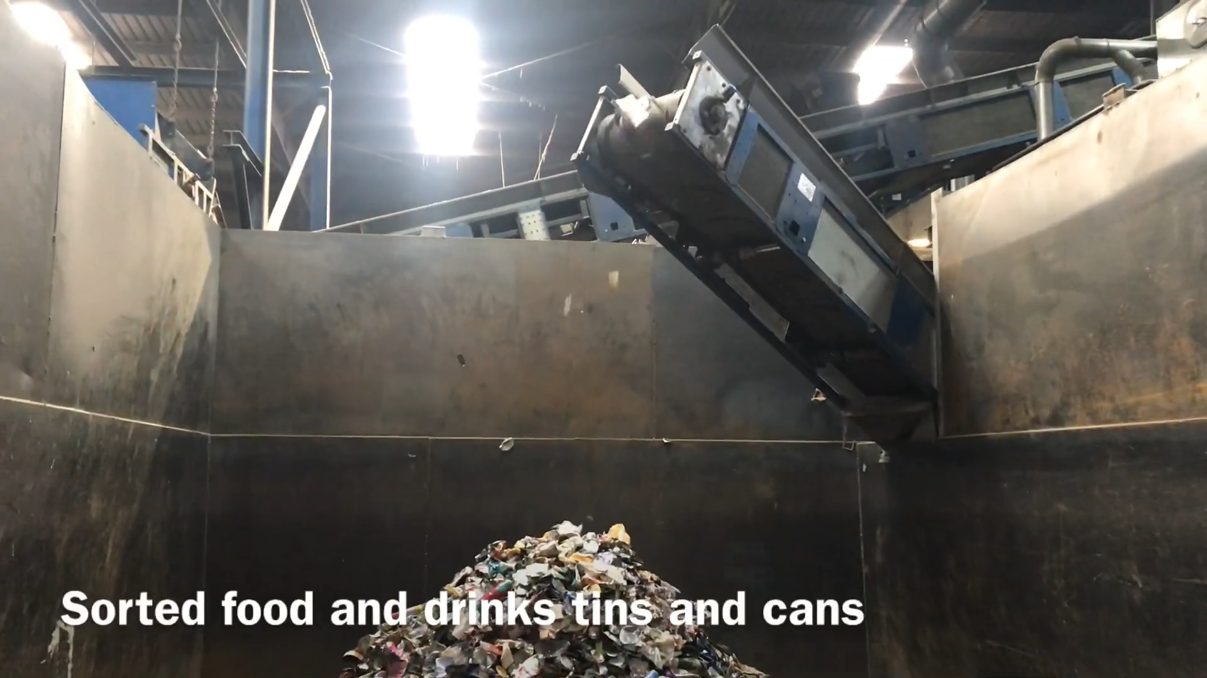

Slide 26
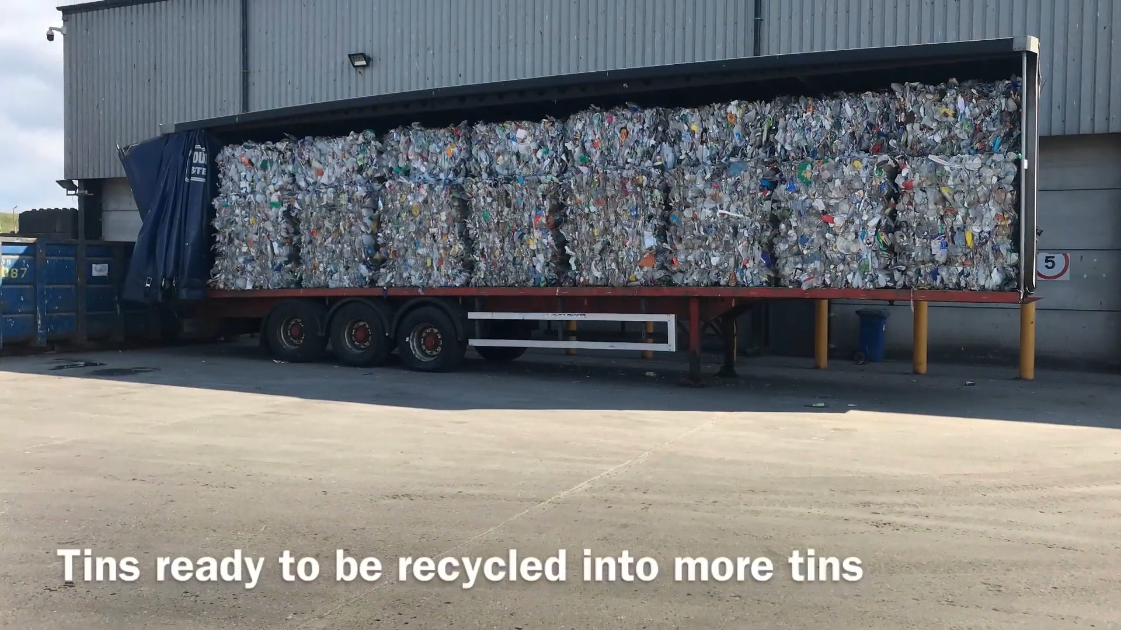

Slide 27
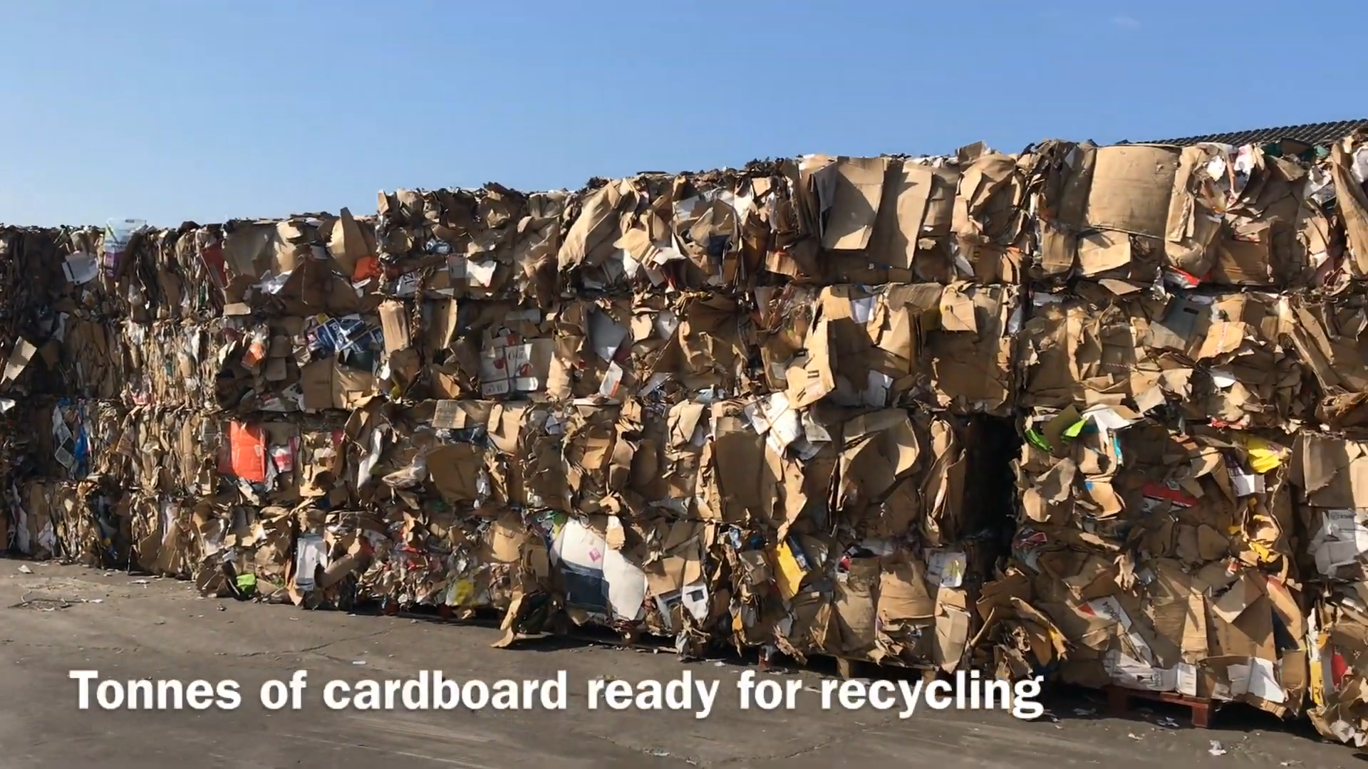

Slide 28
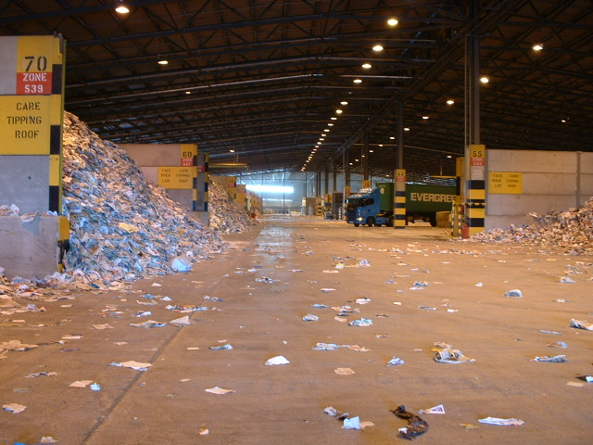
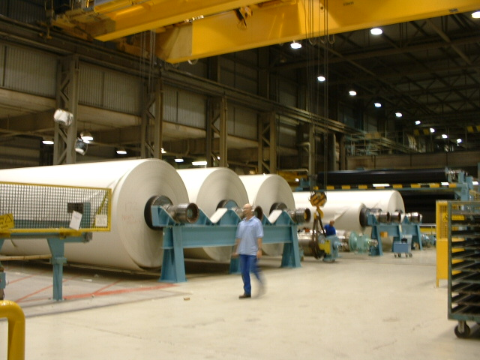
The paper is transported to the re-processors…
IN AS WASTE……… OUT AS NEW PAPER
What can we make from our recycled paper ?
Notes:
Explain how paper is reused and what it then turns out to be like.

Slide 29
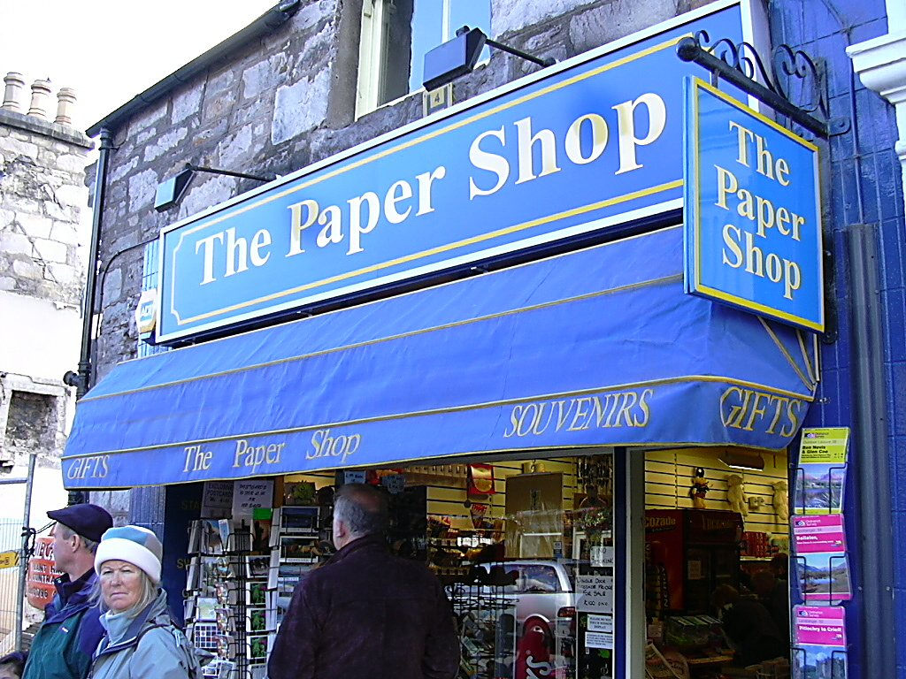
…and then back to the shop as news papers and magazines
Notes:
How within a matter of weeks it can be back at the beginning again.

Slide 30
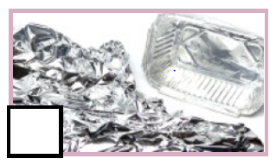
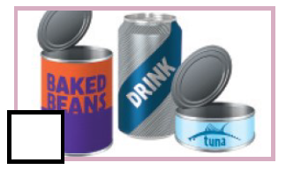

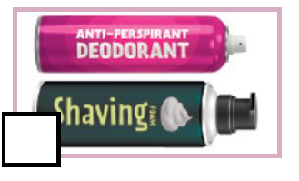
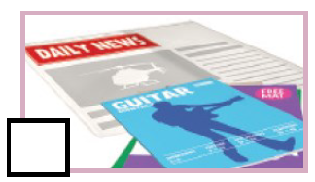
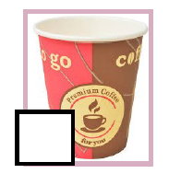
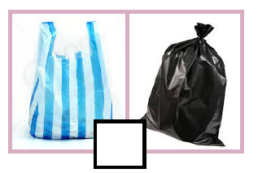


Slide 31
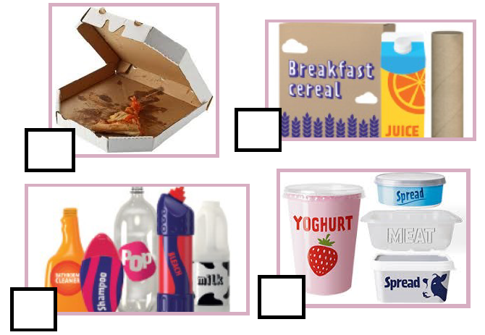



Slide 32





