Slide 1
Disability Awareness
Part 2

Slide 2
What is a disability?

Slide 3
Disability is a physical or mental condition that limits a person's movements, senses, or activities.

Slide 4
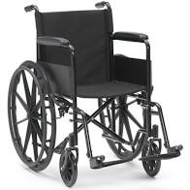
What is this called?
This enhances someones mobility.
Don’t ask why someone is in a wheelchair. It’s none of our business.
Don’t touch or hold on to the chair unless you are invited to. Some people who use a chair feel that this is an extension of their body.
Make sure you give people in wheelchairs plenty of space so they can move to where they need to go.

Slide 5
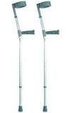
What are these called?
Walking aid
It transfers weight from the legs to the upper body and is iften used by people who cannot use their legs to support their weight
Don’t move people’s crutches to somewhere they can’t reach

Slide 6
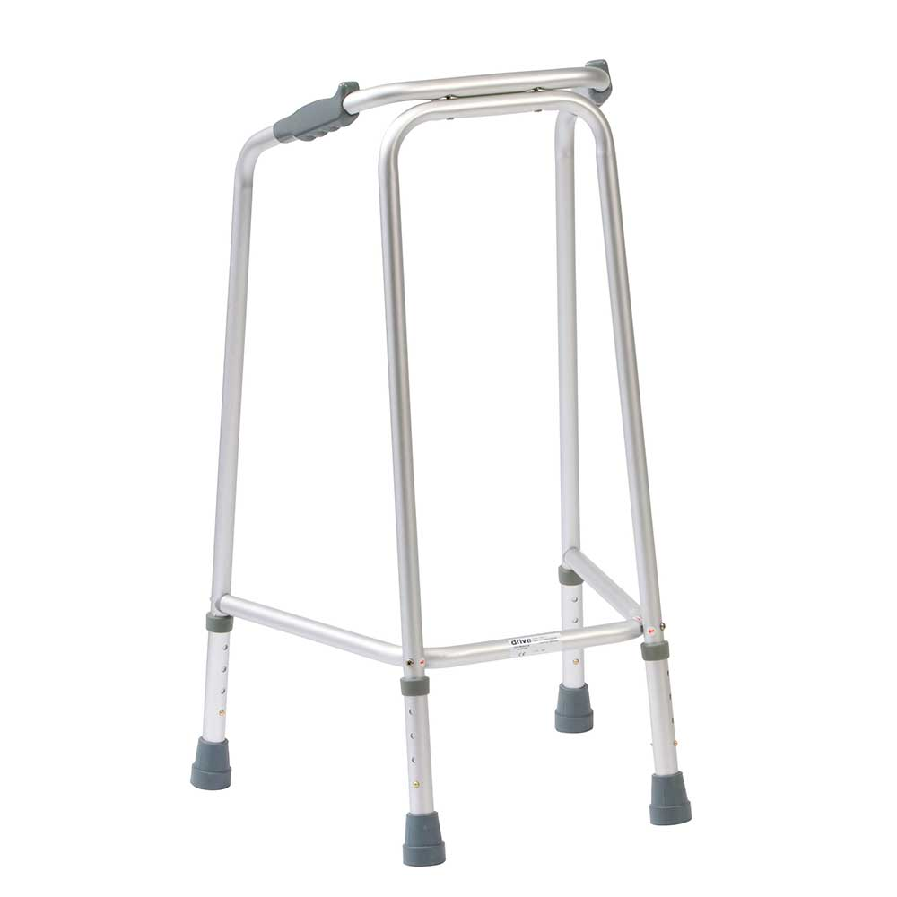
What is this called?
Walking aid
Helps people keep their balance whilst walking
They put their weight on the frame
Don’t move this item out of reach form the person who uses it,

Slide 7
Are these buildings suitable for somebody in a wheelchair?

Slide 9
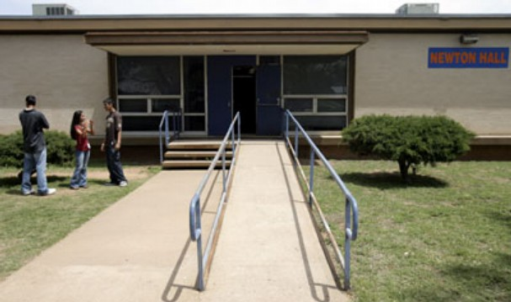

Slide 10
Think about when you go shopping
Now think about those shops if you were in a wheelchair
What kind of things would you need to consider?

Slide 11
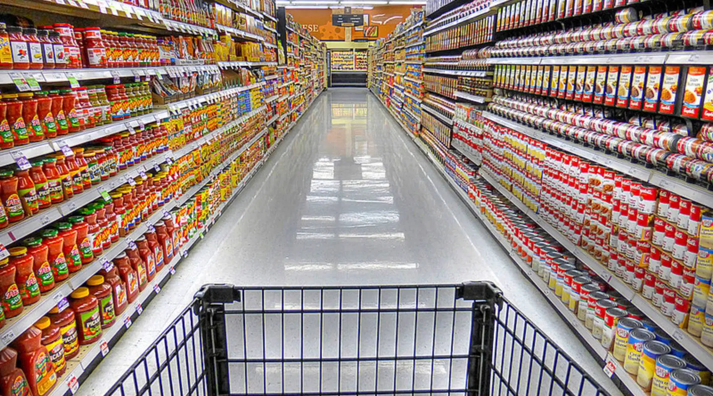

Slide 12
Can I access the building?
Are the aisles wide enough to fit the wheelchair?
Can I reach the top shelf?
Are there shop assistants available to help if I need help?
Are their lots of customers in aisle that I’ll need to move around?
If the building has two floors, how do I get upstairs?
Some disabled toilets require a key, is it signposted where the key is?
Can I reach my shopping when its been scanned through?
When paying can I reach the card machine?

Slide 13
The law for buildings for wheelchair users
A step-free entrance to a building
A lift or suitable ramp between different levels of a building
Wheelchair-accessible toilets
All doors to be easily opened and wide enough with good handles that are low enough for wheelchair users.

Slide 14
Did anyone do the homework I set last week to research a disabled famous person?

