Slide 1
Disability Awareness

Slide 2
What is a disability?

Slide 3
Disability is a physical or mental condition that limits a person's movements, senses, or activities.

Slide 4
What different types of disability are there?

Slide 5
Vision
Hearing
Thinking
Learning
Movement
Mental health
Remembering
Communicating

Slide 6
Vision
Some people who have visual disabilities have assistance from a Guide dog. A guide dog enables people who have visual impairments to be independent.
If you see a guide dog with in public, please do not stroke them. The guide dogs knows that when their harness is on, they are working and stroking them causing distraction and is confusing to them.
https://youtu.be/AHXMePThvgw

Slide 7
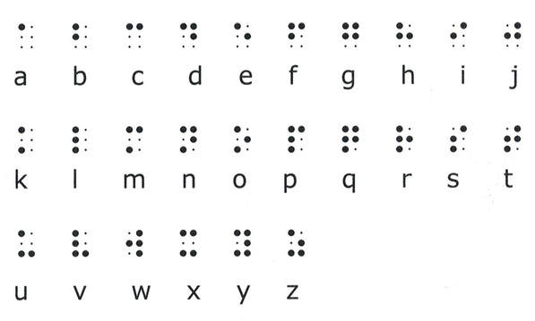
Vision
People who are blind use something called braille.
Braille is a series of dots which represent letters and numbers. You might have seen braille on classroom doors. They use they’re fingers to trace the bumps to enable them to read

Slide 8
How do people who are deaf or having learning needs communicate?
They use sign language or makaton. Both BSL (British sign language) and Makaton allow people use their hands to communicate.
Makaton is a simplified version of sign language.
Sometimes, people who have an hearing impairment can wear a hearing aid or have grommet implants which will enable them to hear better.

Slide 9
Tips for communicating people who are hard of hearing
https://www.youtube.com/watch?v=d-MHRa0LKG0&t=187s

Slide 10
Let’s have a go at learning Makaton
We’re going to watch a song performed in makaton and
then we’ll have a go.
https://www.youtube.com/watch?v=cYx-bs8yTwE

Slide 11
Homework
Research a famous person with a disability.
Make a poster or write about their life and achievements.

