Slide 1
Journey through Wonderland

Slide 2
Our adventure begins in the park, where you’re sat reading (Harry Potter of course).

Slide 3
Harry has just boarded the Hogwarts express and is off on his way to Hogwarts.

Slide 4
You think thats a very curious thing indeed, and decide to follow him!
Suddenly a white rabbit comes running past looking at his pocket watch and talking to himself.

Slide 5
You follow the white rabbit down a rabbit hole, and fall and fall and fall.. until

Slide 6
You land with a thump, just as the white rabbit disappears through a tiny door. Much too small for you!

Slide 7
You look around and notice a puzzle waiting for you on the table, maybe this is how we get through the door!

Slide 8
A+1= G+2= T-1= E-2= T+1= G+2= S+1=
B
+1 :
L=
H=
K=
J=
I
s
M
C
I
U
L
I
K
T

Slide 9
You decide to drink the milk first...

Slide 10
But you suddenly start growing at an alarming rate!
How are you possibly going to fit through the tiny door now?!

Slide 11
You decide to nibble on a biscuit whilst you come up with a plan....

Slide 12
The biscuit makes you shrink again! Perfect, now we can finally run after the White Rabbit!

Slide 13
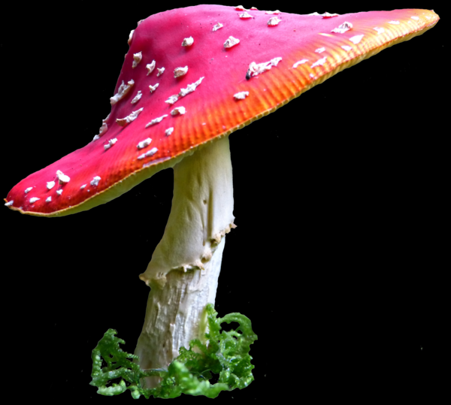
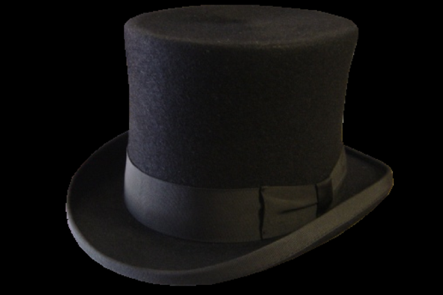
Once outside the door you find yourself in a strange place and decide to look for clues.

Slide 14
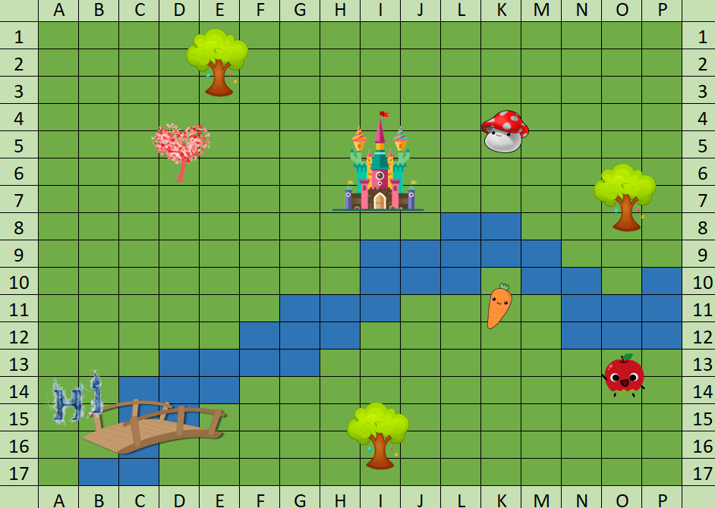

Slide 15
Start at B2
Head East 2 squares
Then South 4 squares
BACK

Slide 16
Afatca Terpillar
Engraved in the back of the pocket watch is a very odd name. You place it back on the floor incase it’s owner comes looking for it.
BACK

Slide 17
BACK

Slide 18
So you think you can just run right through my game of croquet?
Following the directions has lead us to the grounds of the Queen of Hearts! You have a feeling she won’t let us pass easily...

Slide 19
You’re lucky I’m in a good mood today. If you can bring me just what I need for my picnic, I will let you leave... with your head!

Slide 20
Here are your clues!
What do R+Y make?
What is 16+22-34=
Finish the sequence FGHIJ...

Slide 21
R+Y =
16+22-34=
FGHIJ...
R+Y =
16+22-34=
FGHIJ...
Orange
four
K
You rush off to the Queens Castle to find what she needs,
the clues written down hastily.
You can hear shouts of “OFF WITH THEIR HEADS!” in the distance.

Slide 22
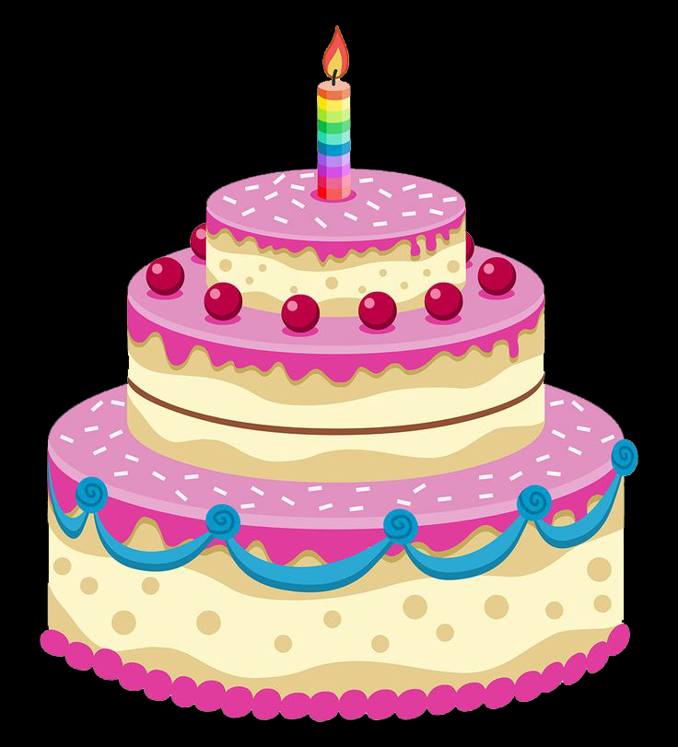
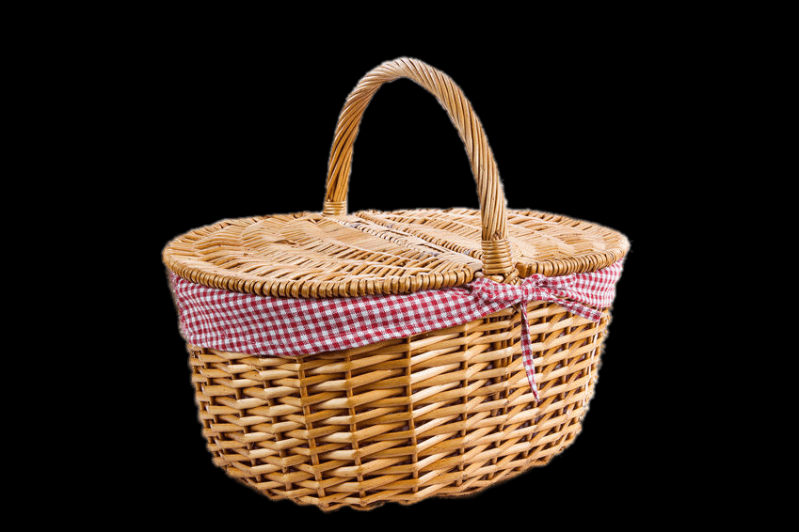
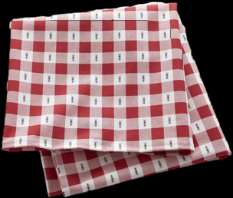
Find White Rabbit
croquet @ 5pm
Chop heads off

Slide 23
Oh you found it, brilliant!
Now leave me, I must concentrate...
Clutching the Queens fork, you rush back to find her playing croquet...
You don’t hesitate and find a quiet corner to consult your map and directions

Slide 24
From D6
6 south
3 south west

Slide 25
You come to a bridge, but blocking your path across is a rather large caterpillar.

Slide 26
Normally I would let you cross after 6 o’clock without a fee
But unfortunately I cannot tell the time as I left my watch by a tree

Slide 27
So if you’d like to cross the bridge you’re going to have to play a game
I want you to give me 10 words that include the initials of my name!

Slide 28
Now I don’t mean words that simply have the letters in
They must sit next to each other nicely, to seperate them would be a sin...

Slide 29
1
Back

Slide 30
1
2
Back

Slide 31
2
3
Back

Slide 32
3
4
Back

Slide 33
4
5
Back

Slide 34
5
6
Back

Slide 35
7
6
Back

Slide 36
7
8
Back

Slide 37
9
8
Back

Slide 38
9
10
Back

Slide 39
Very well, you gave me the 10 words I asked of you
Continue across the bridge and do what you must do.

Slide 40
From E16
7 East
5 North
You hurry across the bridge, and pause to check which way to go.

Slide 41
You arrive at a little house that looks like the perfect size for a rabbit to live in.

Slide 42
You can hear laughter coming from behind the house so go and investigate.

Slide 43
Unfortunately all the tea has gone and the cake has been eaten. You realise that you’re quite hungry and should be getting home.
You find a delightful tea party hosted by the White Rabbit!

Slide 44
Well it’s nice to finally meet you. I hope you enjoyed your trip through wonderland!
I can of course help you to get home.

Slide 45
There’s a speical tea I can brew, but the recipe is locked inside a box, and unfortunately I have lost the key...

Slide 46
Yes that is the key I need!

Slide 47
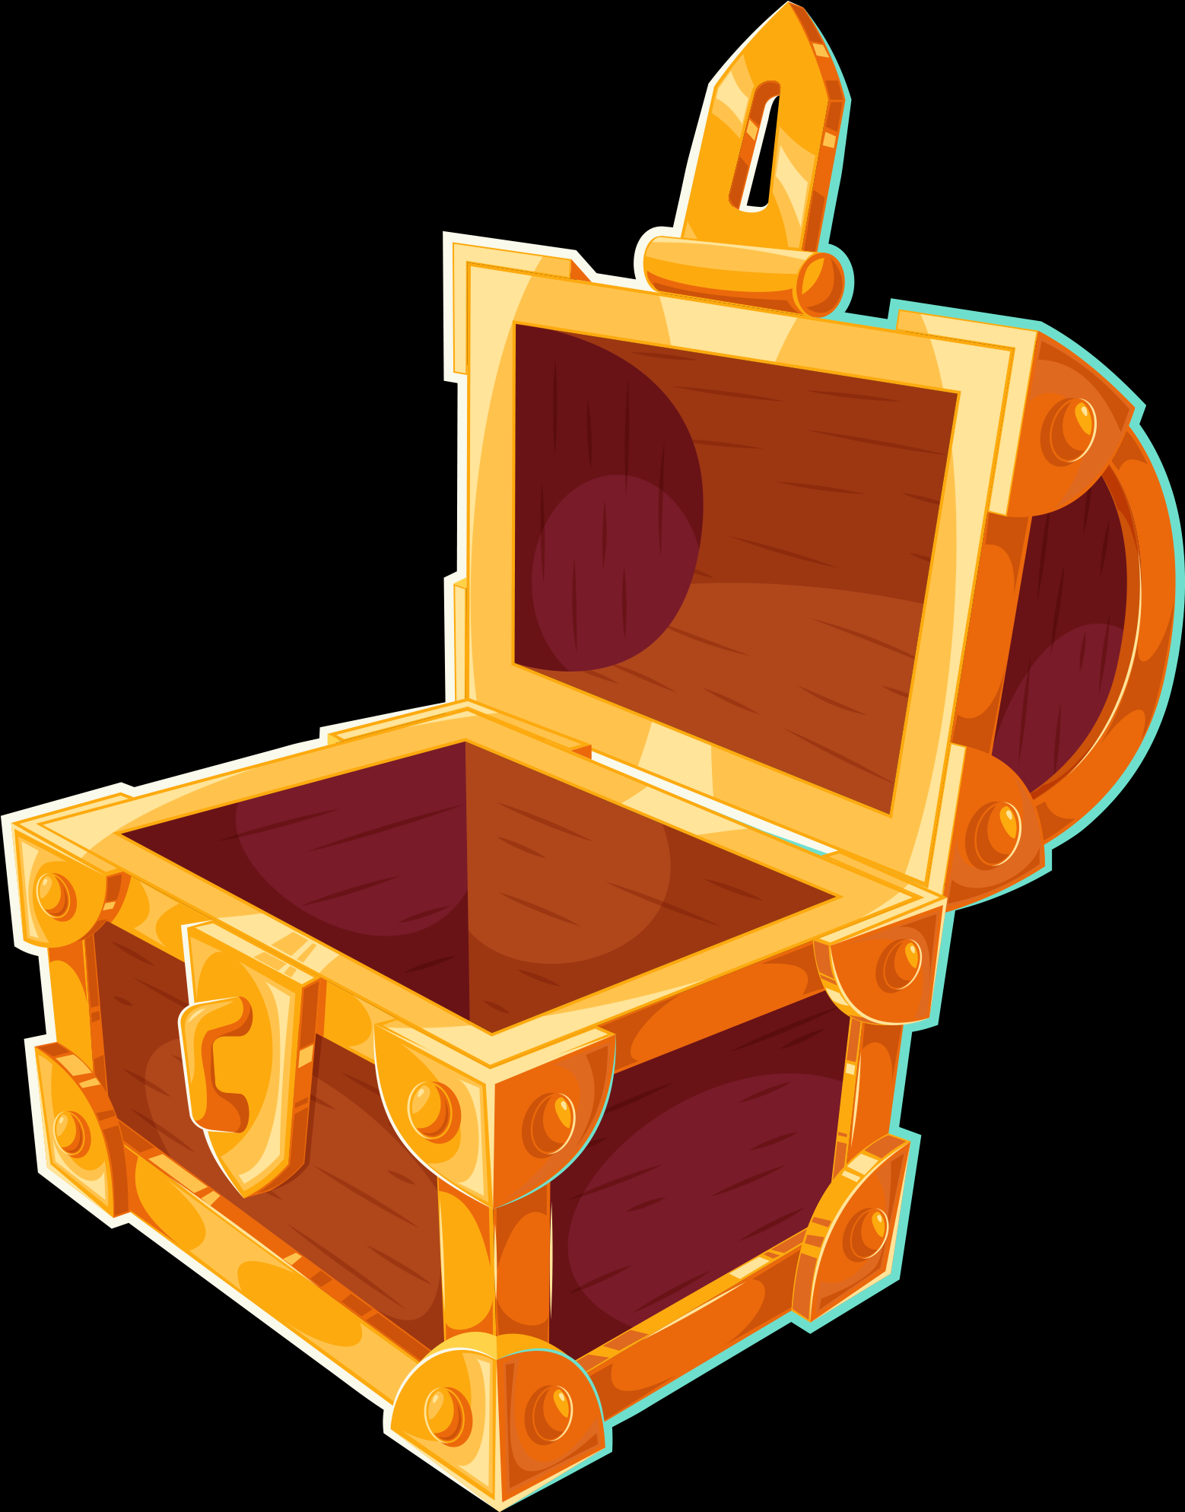

Slide 48
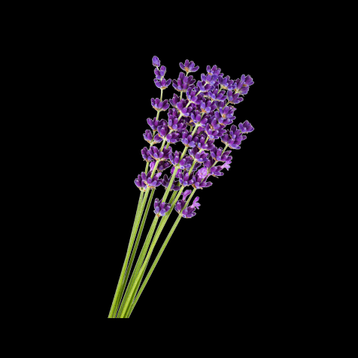
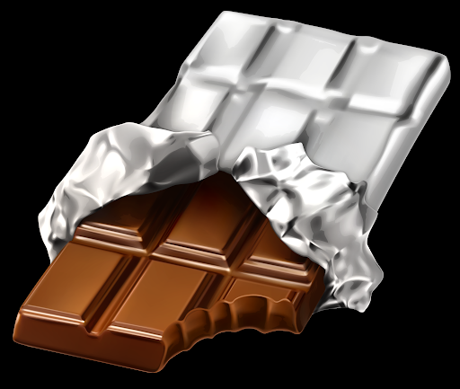
First into the pot a chunk of something sweet and brown
Next in- this is made with the help of a Queen Bee in her crown
Third ingredient is purple in colour and can help you go to sleep
Lastly, pour in some liquid that farmers sell too cheap.

Slide 49
The White Rabbit brews the tea for you. One sip is all it takes. Suddenly you wake up and find yourself...

Slide 50
back where it all began! You must have been daydreaming all along...

Slide 51
You carry on reading your book, and Harry arrives safely at Hogwarts.

