Slide 1
Family Fortunes

Slide 3
A Fruit that begins with the letter “P”
Question 1
Pear 41
Peach 39
Pineapple 15
Plum 4
Pomegranate 1

Slide 4
Something that has numbers on it?
Question 2
Clock / Watch 31
Telephone 30
Car number plate 23
House 9
Calculator 7

Slide 5
Something that a car has more than one of…….
Question 3
Headlights 38
Doors 30
Wipers 25
Wing mirrors 5
Bumpers 2

Slide 6
Something a dog does to tell you how he feels
Question 4
Wag his tail 47
Barks 35
Licks you 9
Whines 7
Growls 2

Slide 7
Something you see in the sky
Question 5
Clouds 48
Stars 25
Sun 14
Moon 8
Birds 5

Slide 8
Household appliance you wouldn’t want to do without
Question 6
Fridge 30
Washing machine 28
Cooker 26
Microwave 9
Dishwasher 7

Slide 9
An animal with paws
Question 7
Dog 37
Cat 35
Lion 14
Tiger 12
Bear 2

Slide 10
Something that moves very slowly
Question 8
Snail 38
Worm 35
Turtle/Tortoise 23
Traffic 3
Time 1

Slide 11
Something that has a screen
Question 9
TV 60
Computer/tablet 30
Car windscreen 5
Cinema 4
Shower 1

Slide 12
Something people do during a bad film
Question 10
Leave 37
Yawn 26
Sleep 20
Kiss 12
Talk 5

Slide 13
CONGRATULATIONS

Slide 14
Instructions ☺
Print out answer sheet on slide 15
There is an into sound clip on the slide 2
On the question slide click on the yellow Question bar to reveal the question
If correct click on the appropriate blue box to reveal their answer/score
If incorrect click on the buzzer sound (just below the red circle). Then click on the red circle to add a cross to the screen.
Continue until all answers revealed or 3 crosses.
Repeat
We played just like the game and picked a person from each team to start and first to shout an answer. If not the top answer the other person gets to guess. Then tam decide to play or pass. Rotate round the team asking for an answer, if they don’t guess them all the other team get a chance to steal by guessing one of the remaining answers
There is a ‘blank’ template on slide 16. Click and drag the colour boxes out the way to input question/answer, then move back to cover them up.
Feel free to add, modify and improve ☺

Slide 15
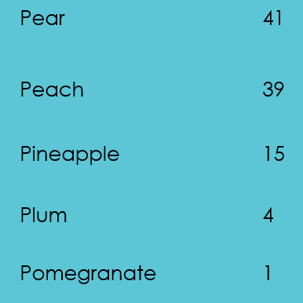
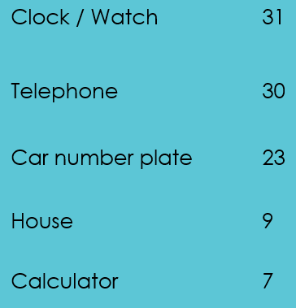
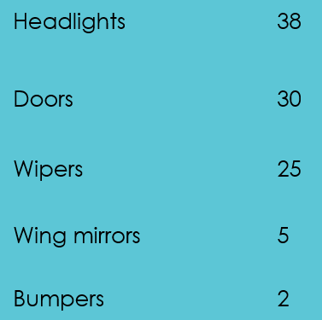
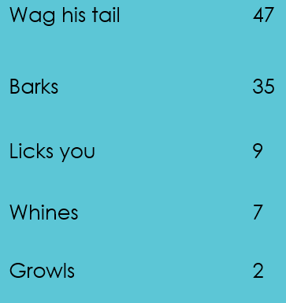
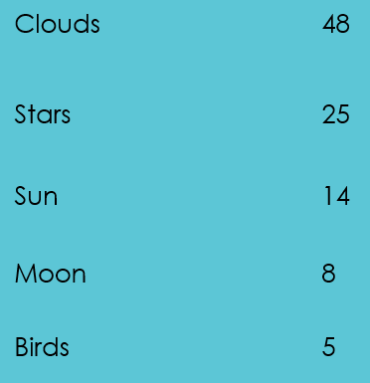
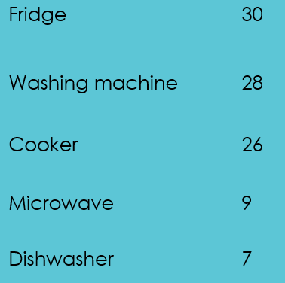
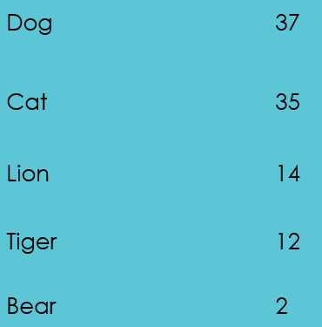
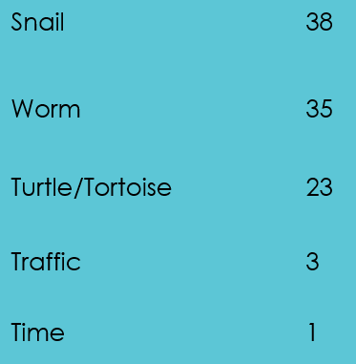
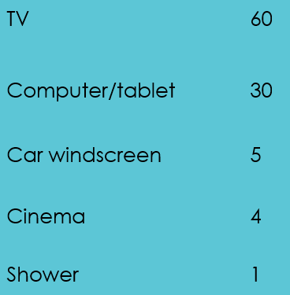
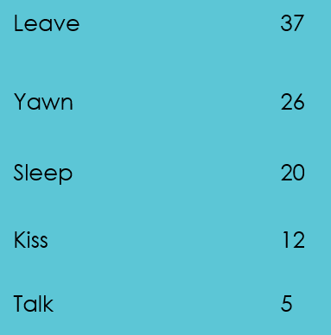

Slide 16
Add question here
Question ?
Blank 0
Blank 0
Blank 0
Blank 0
Blank 0

