Slide 1
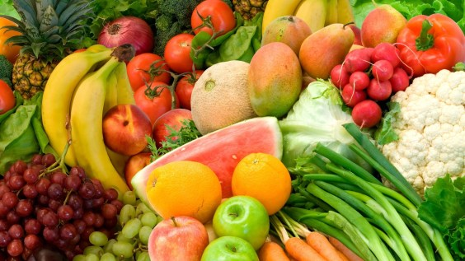
Fruit & vegetables

Slide 2
Why should we eat fruit and vegetables?
They provide vitamins, minerals and fibre.
Help to keep us healthy.
Helps our body fight against diseases.
Helps to boost our brain power.

Slide 3
Guess the fruit or vegetable
T_M_T_

Slide 4
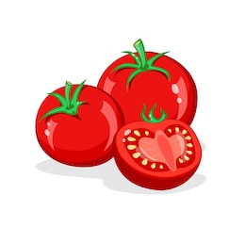
Guess the fruit or vegetable
TOMATO

Slide 5
Guess the fruit or vegetable
P_T_T_

Slide 6
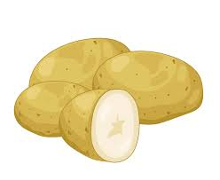
Guess the fruit or vegetable
POTATO

Slide 7
Guess the fruit or vegetable
P_N_ _PPL_

Slide 8
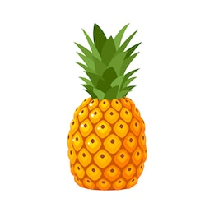
Guess the fruit or vegetable
PINEAPPLE

Slide 9
Guess the fruit or vegetable
C_ _L_FL_W_R

Slide 10
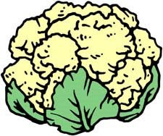
Guess the fruit or vegetable
CAULIFLOWER

Slide 11
Guess the fruit or vegetable
N_CT_R_N_

Slide 12
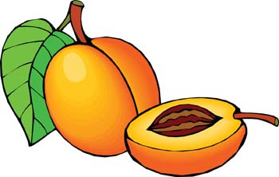
Guess the fruit or vegetable
NECTARINE

Slide 13
Guess the fruit or vegetable
B_ _TR_ _T

Slide 14
Guess the fruit or vegetable
BEETROOT

Slide 15
Guess the fruit or vegetable
S_TS_M_

Slide 16
Guess the fruit or vegetable
SATSUMA

Slide 17
Guess the fruit or vegetable
C_C_MB_R

Slide 18
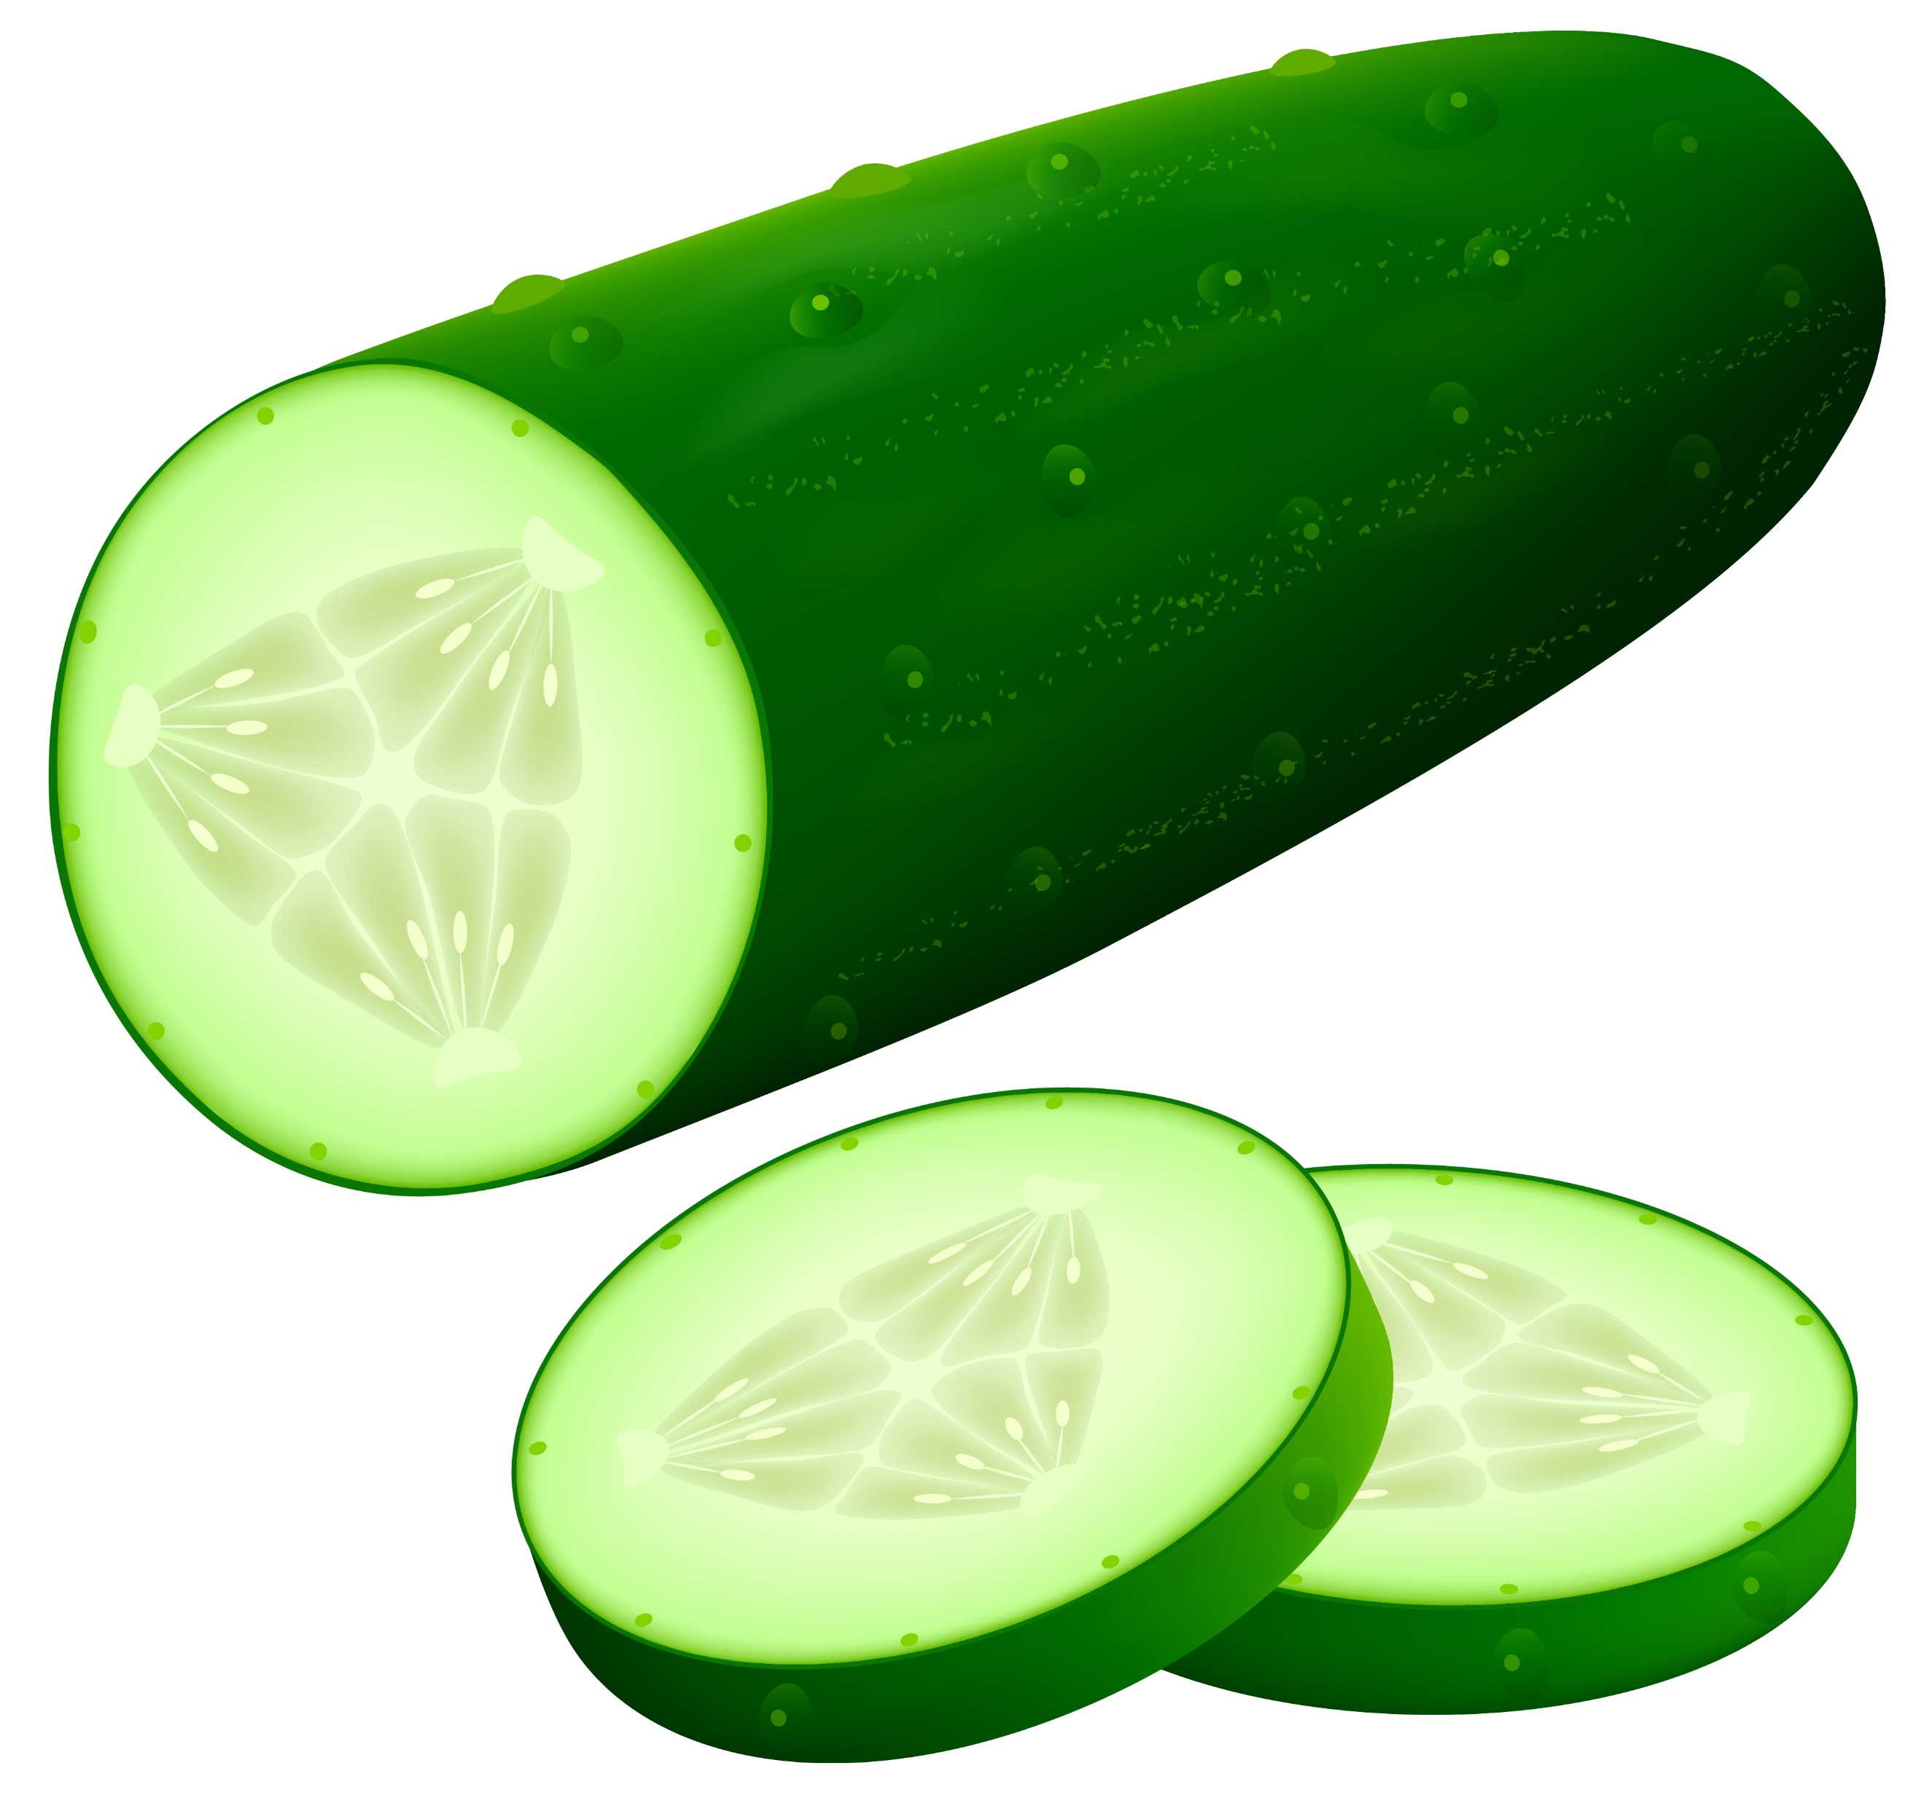
Guess the fruit or vegetable
CUCUMBER

Slide 19
Guess the fruit or vegetable

Slide 20
Guess the fruit or vegetable

Slide 21
Guess the fruit or vegetable

Slide 22
Guess the fruit or vegetable

Slide 23
Guess the fruit or vegetable

Slide 24
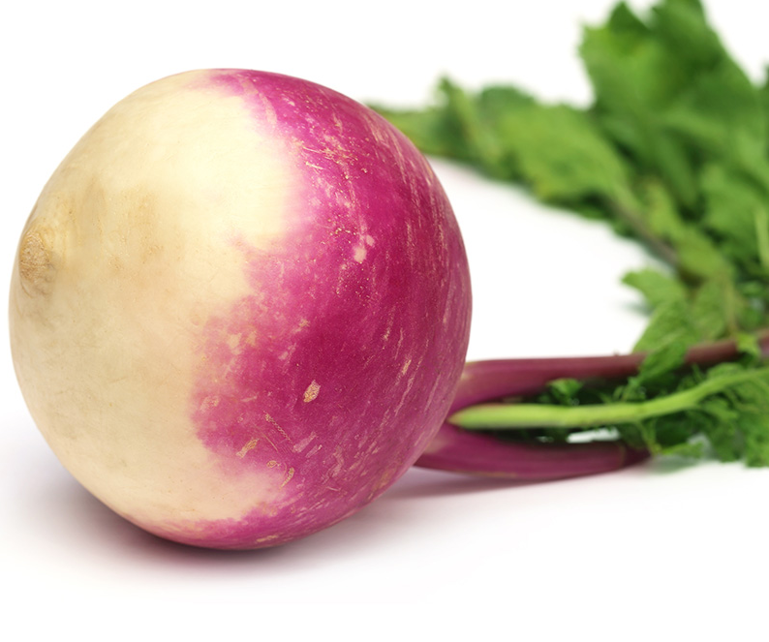
Guess the fruit or vegetable

Slide 25
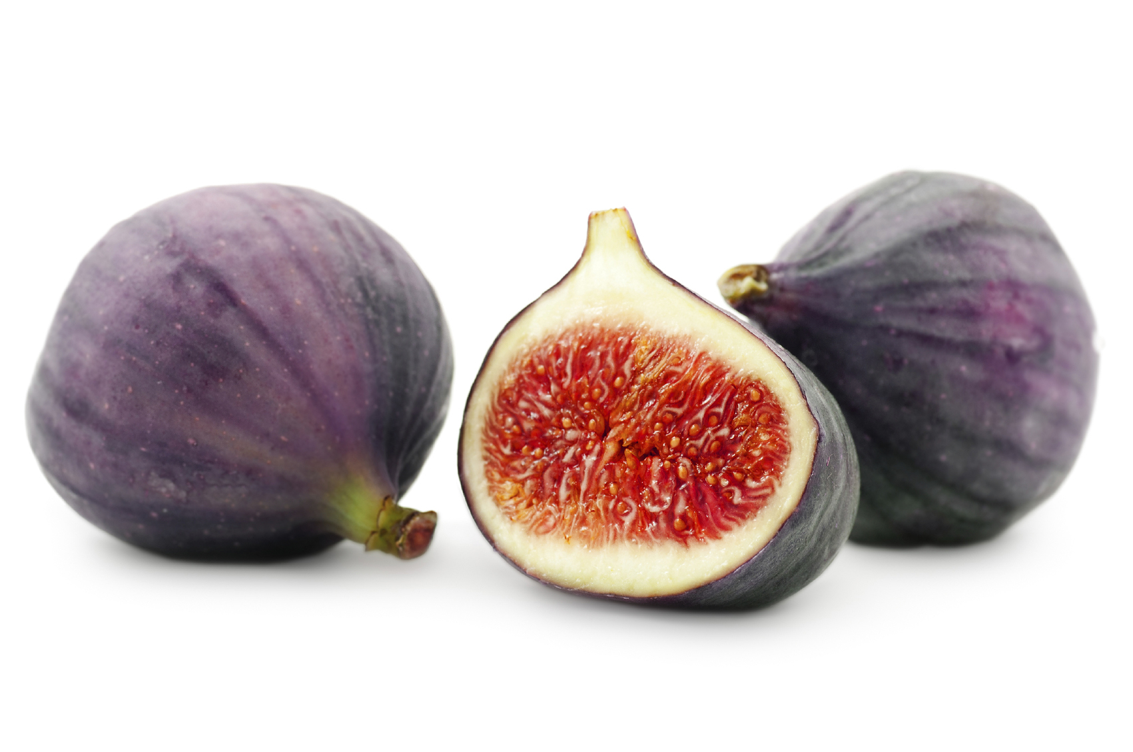
Guess the fruit or vegetable

Slide 26
Guess the fruit or vegetable

Slide 27
Fruit & vegetable jokes
What is the fastest vegetable?

Slide 28
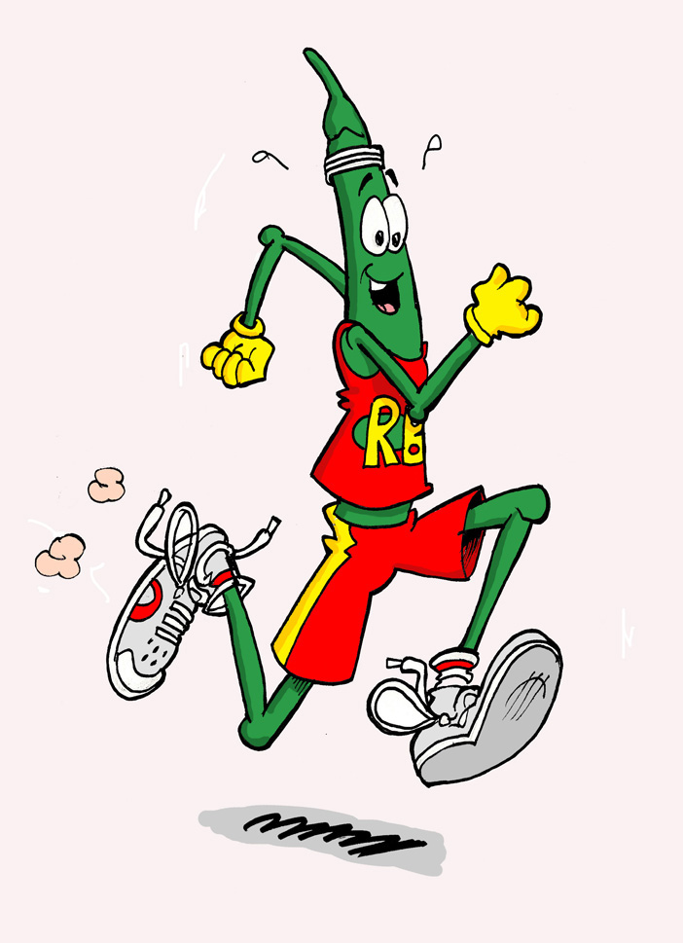
Fruit & vegetable jokes
What is the fastest vegetable?
A runner bean!

Slide 29
Fruit & vegetable jokes
What is a plumber’s favourite vegetable?

Slide 30
Fruit & vegetable jokes
What is a plumber’s favourite vegetable?
A leek!

Slide 31
Fruit & vegetable jokes
What kind of shoes can you make from banana peels?

Slide 32
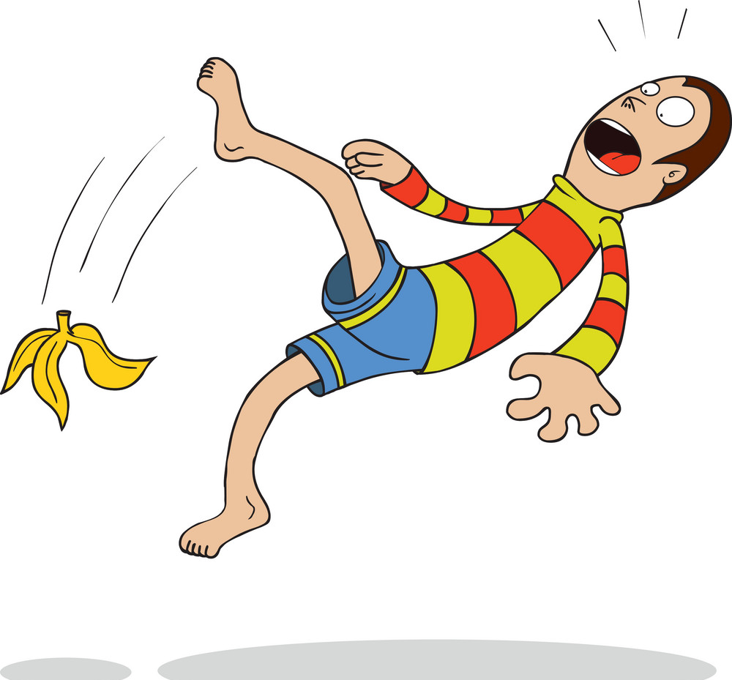
Fruit & vegetable jokes
What kind of shoes can you make from banana peels?
Slippers!

Slide 33
Fruit & vegetable jokes
What is green and goes camping?

Slide 34
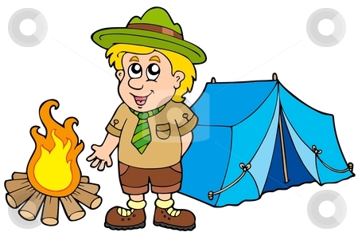
Fruit & vegetable jokes
What is green and goes camping?
A brussels scout!

