Slide 1
Healthy Food and Exercise
Notes:
Game = exercise. Star jumps etc – how many in 30 secs. Write number in chat.
Email parents – pictures of healthy & unhealthy foods, including a drink. Also fruit.

Slide 2
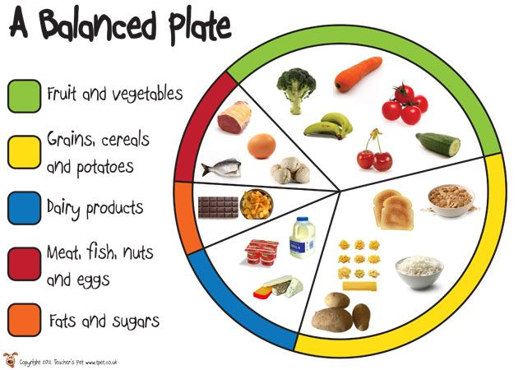
Why eat a Balanced Diet?
A balanced diet is important because it will help you to grow up to be healthy. It will give you strong bones and teeth. Without the right food, you are more likely to get ill and be tired. It will also help you concentrate at school.
33%
10%
5%
37%
15%

Slide 3
Food Groups Game
Beavers need 5 pieces of paper/card in 5 colours – Green, Yellow, Blue, Red, Orange – can be coloured in with crayon or just a word. (Keep coloured cards for future games)
Green = Fruit, Vegetables,
Yellow = Grains, Cereals, Potatoes (carbohydrates)
Blue = Dairy
Red = Meat, Fish, Nuts, Eggs (protein)
Orange = Fats and Sugars
Notes:
List foods, Beavers hold up correct colour –
Chicken, chips, apples, cake, pasta, chocolate, cheese, yogurt, rice, carrots, egg, peas, ice cream, potatoes, coke, milk, sweets, sausage, tomatoes, biscuits, weetabix, butter, broccoli, banana, frosties, strawberries.

Slide 4
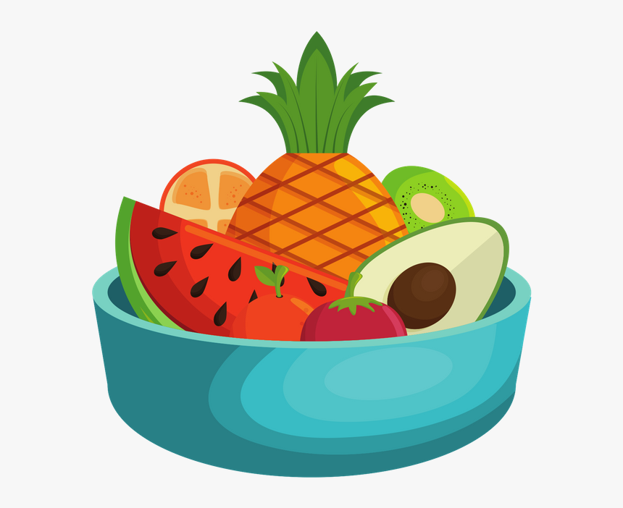
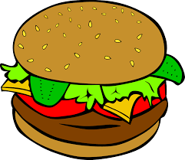
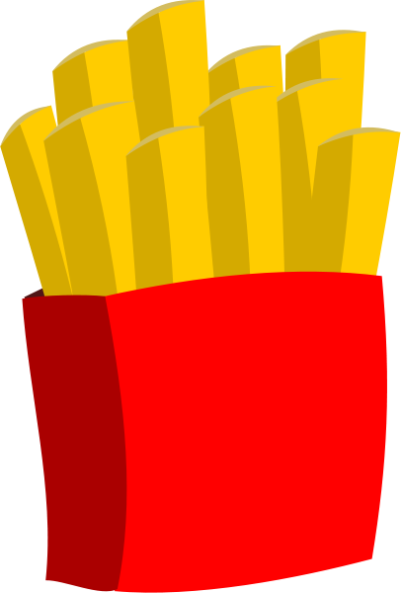
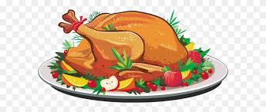
Healthy (good)and Unhealthy (bad) Foods
video
Create 2 plates/pictures to show a healthy and an unhealthy meal. You can do this by sticking pictures on paper/paper plates. Or you can draw & label your pictures.
Have 6 foods on each plate including a drink.
Notes:
Video links to a 4min clip showing Max the puppet talking about healthy food (or not!). Unfortunately on Zoom the sound was poor so you need to put the subtitles on.
Ask parents to collect pictures from magazines or off internet of healthy and unhealthy foods so that they can stick them down to make picture of 2 meals. Include a drink.

Slide 5
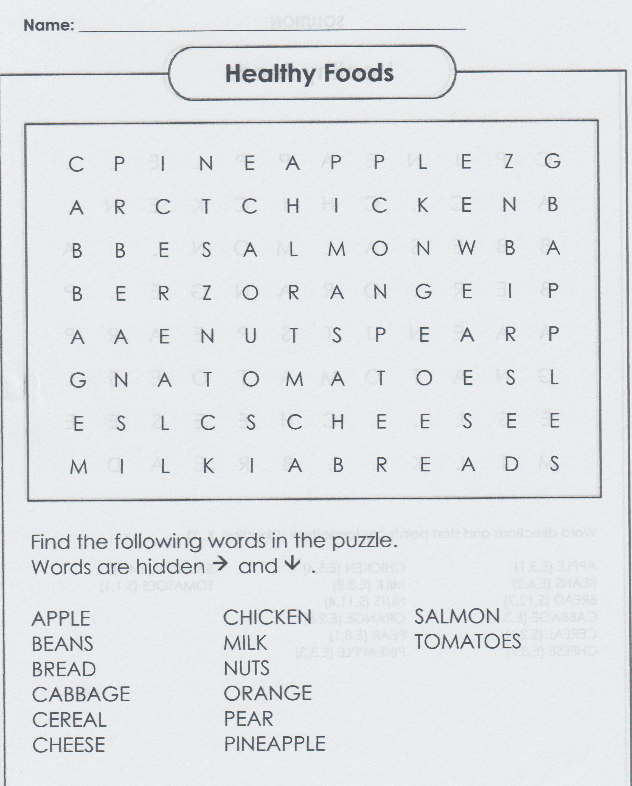
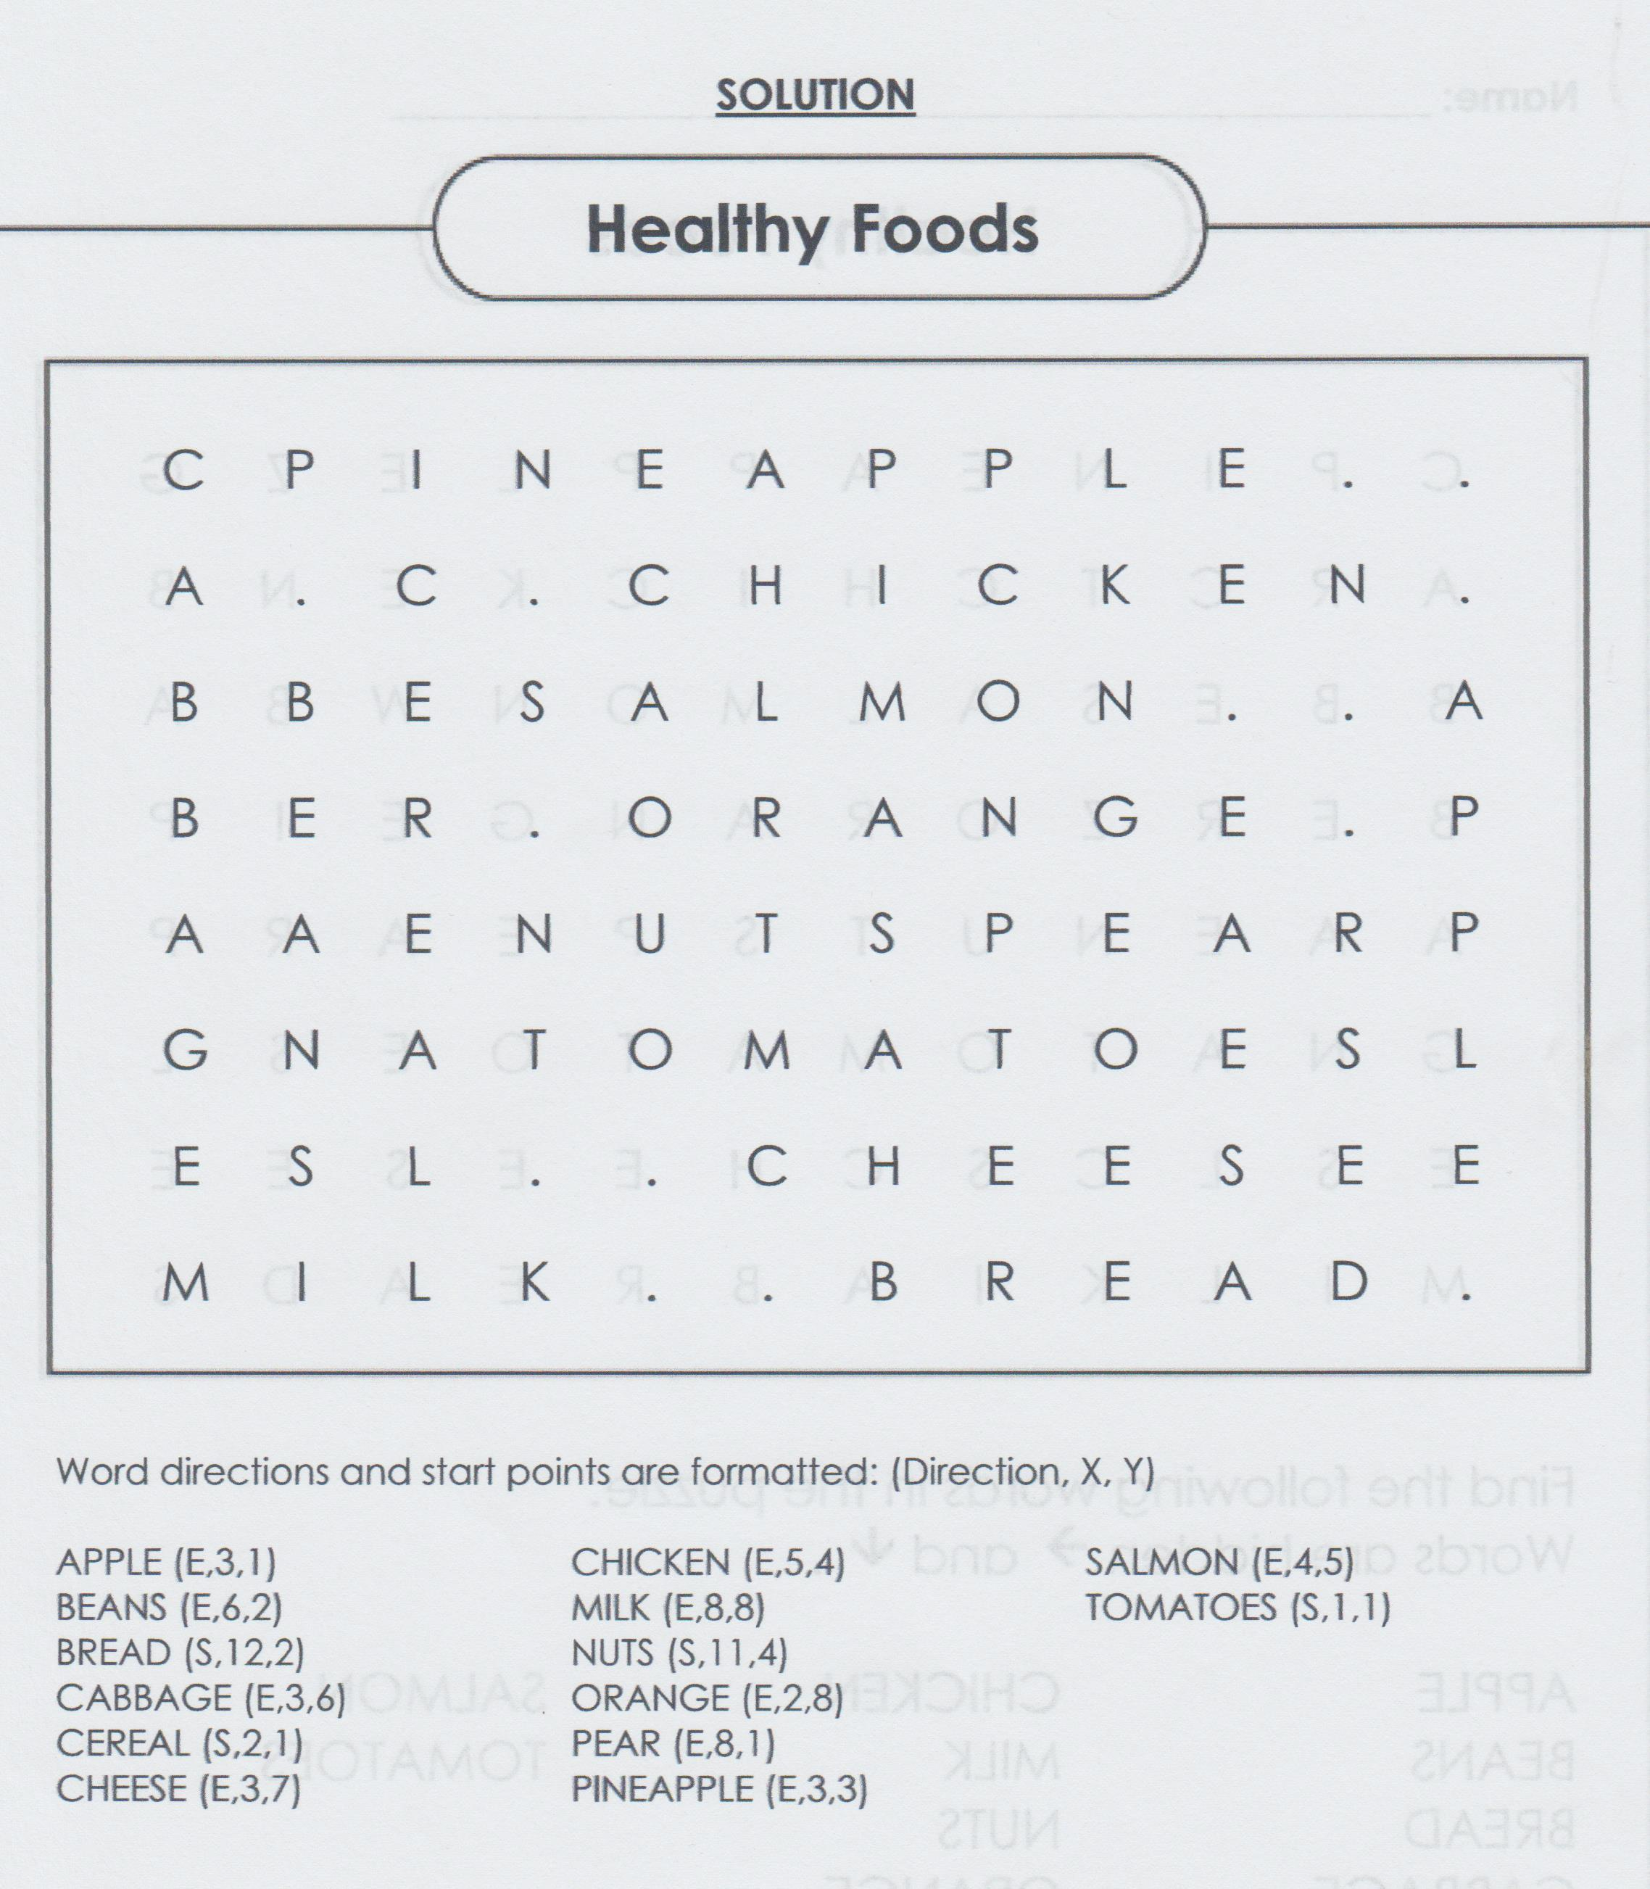
1

Slide 6
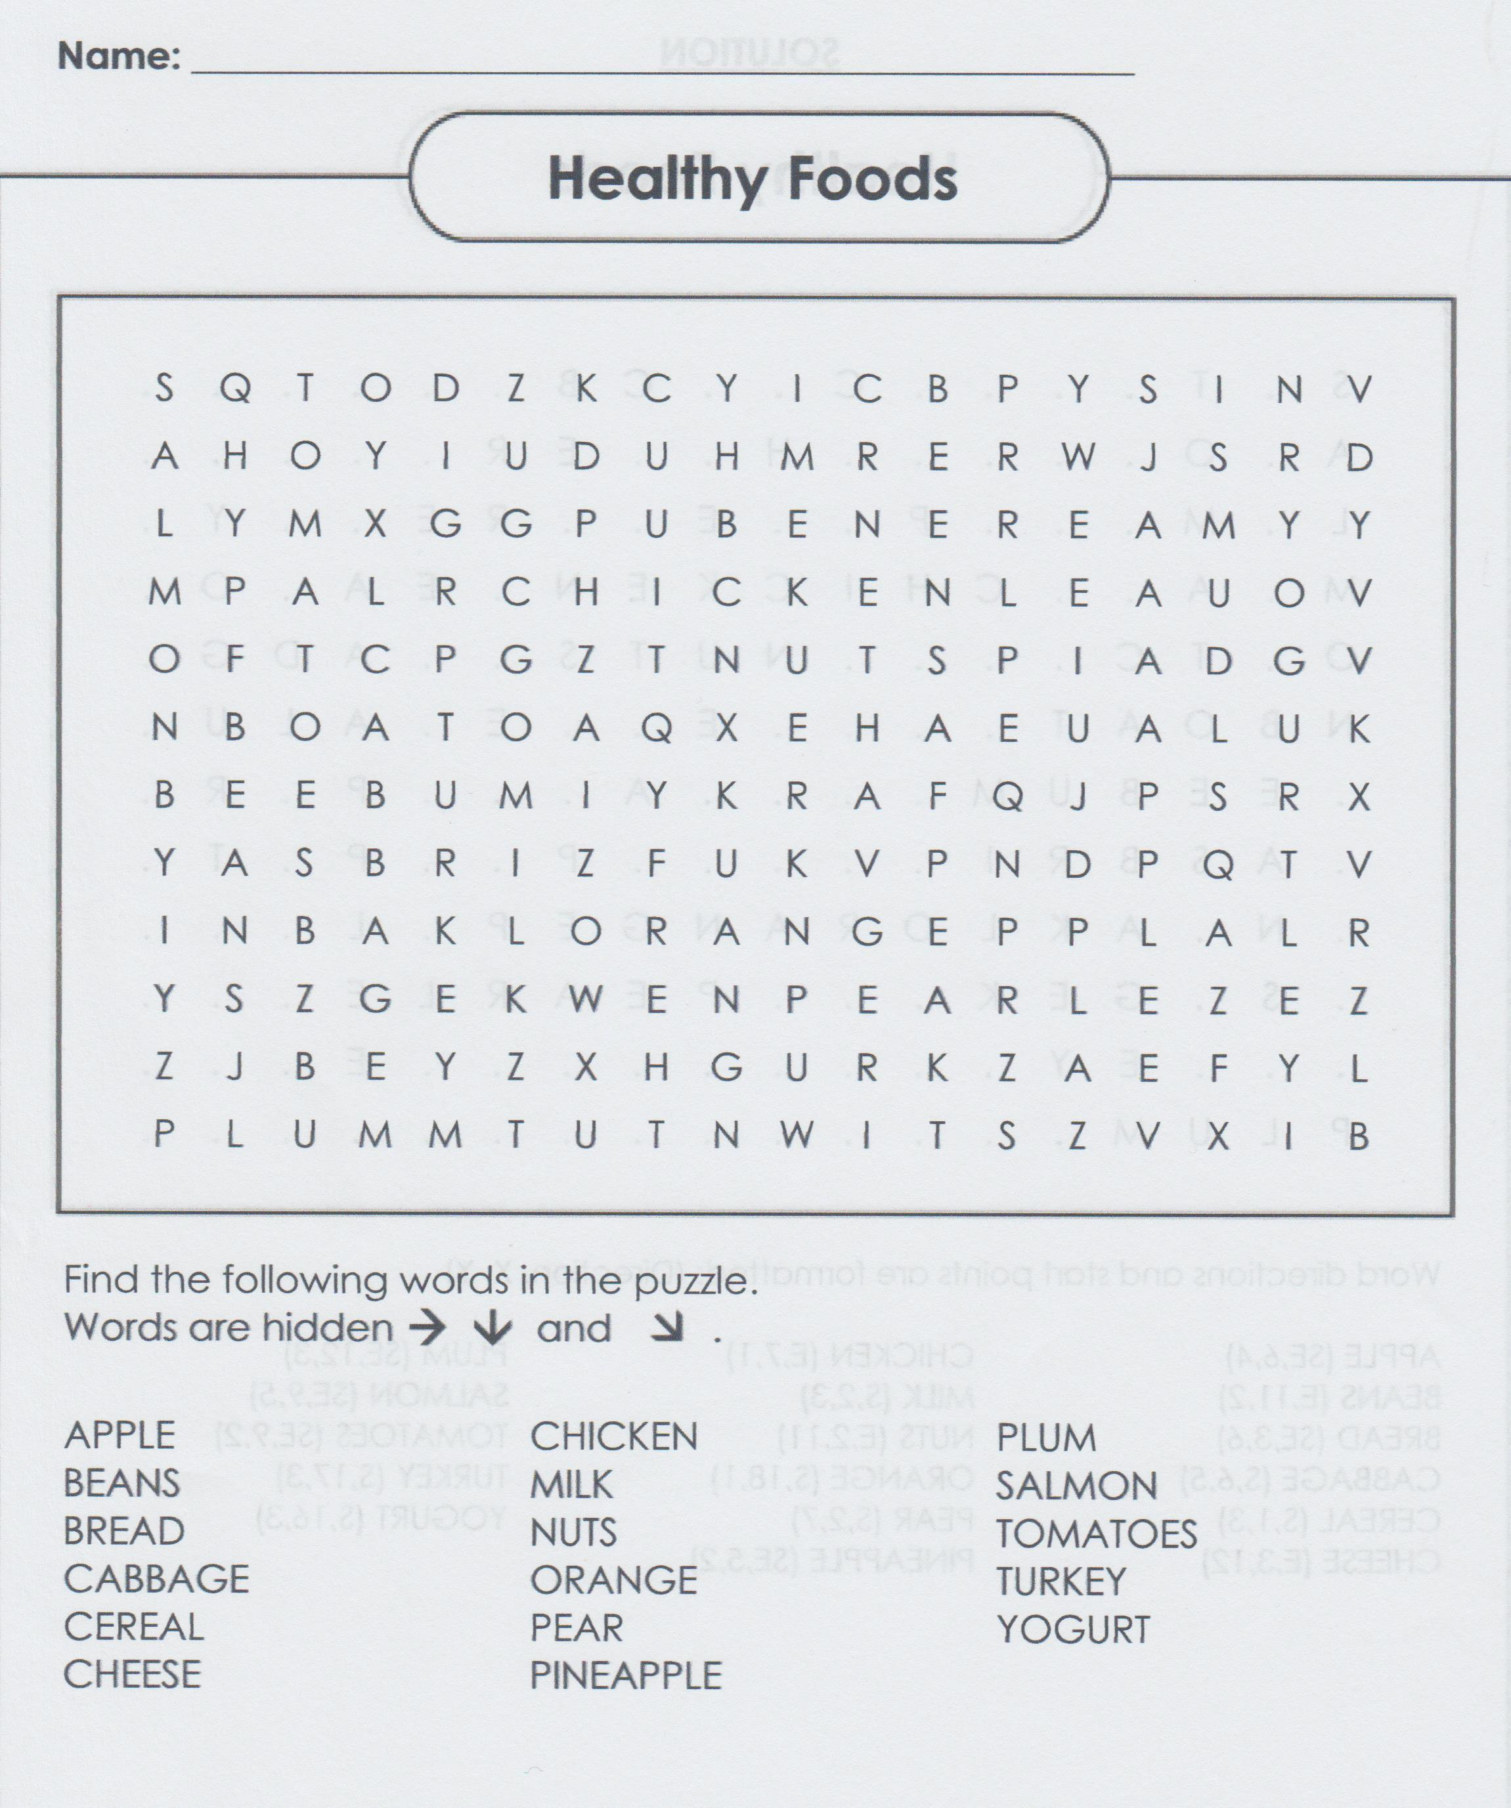
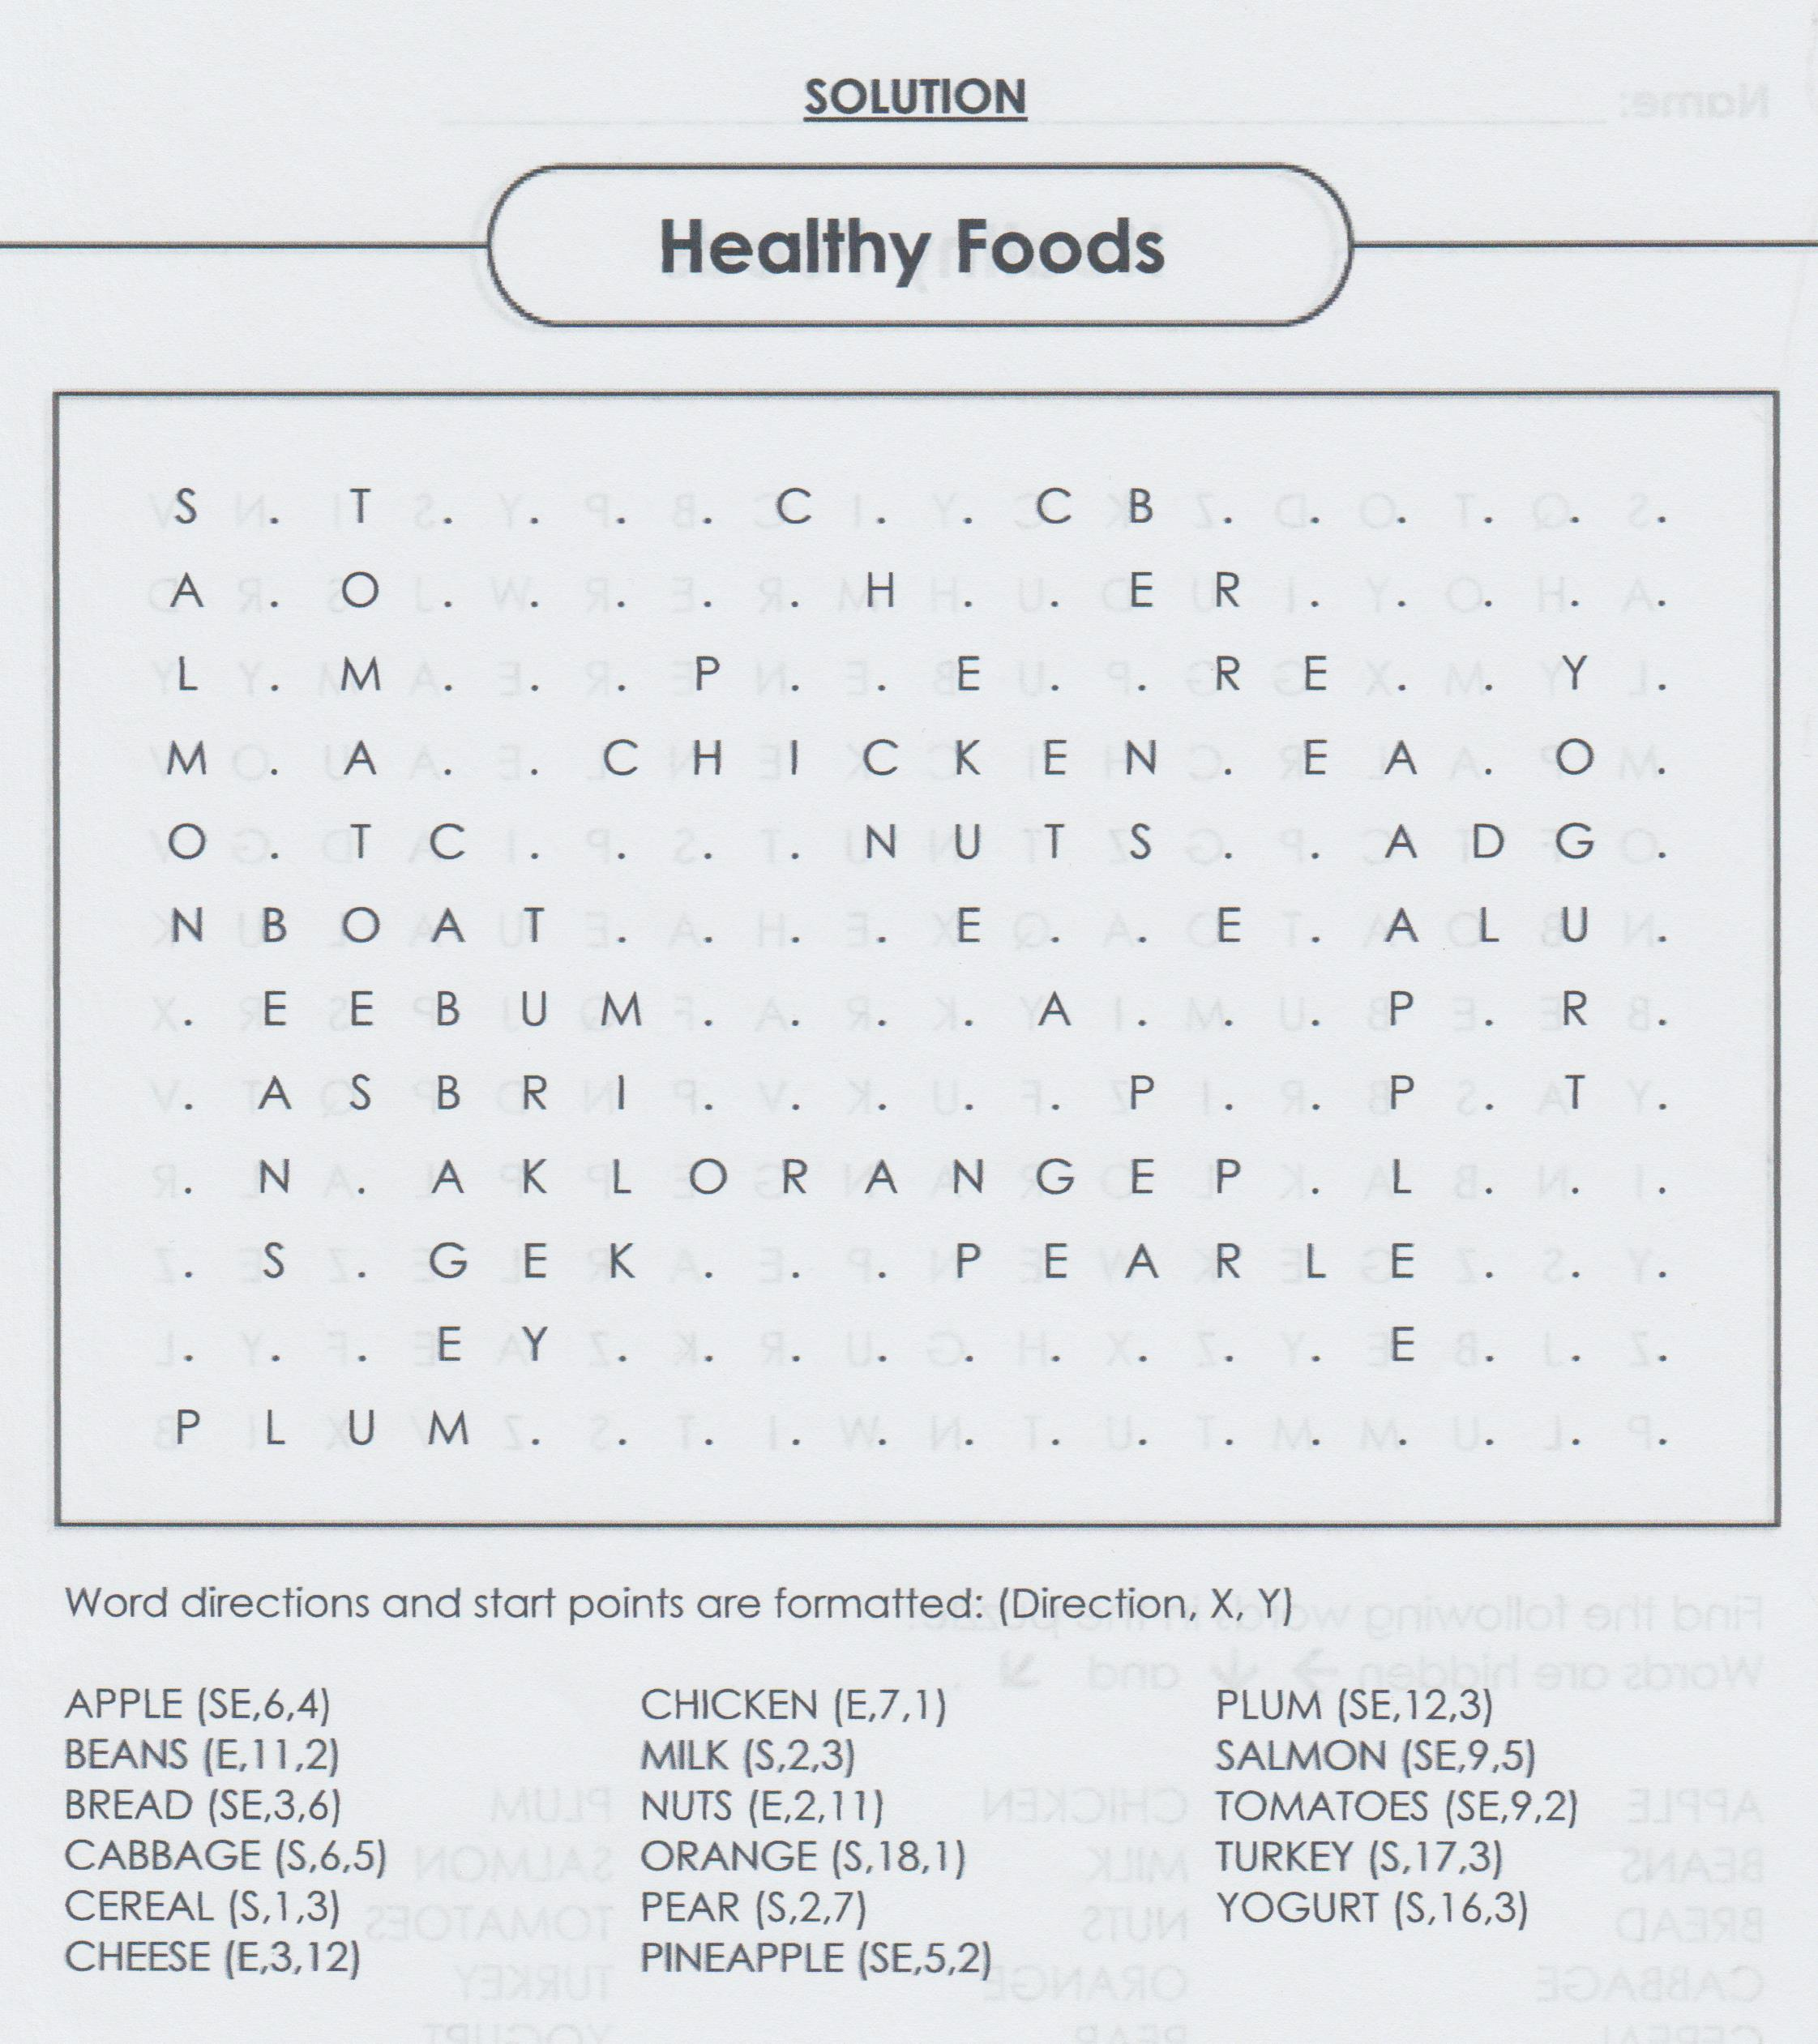
2

Slide 7
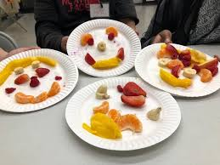
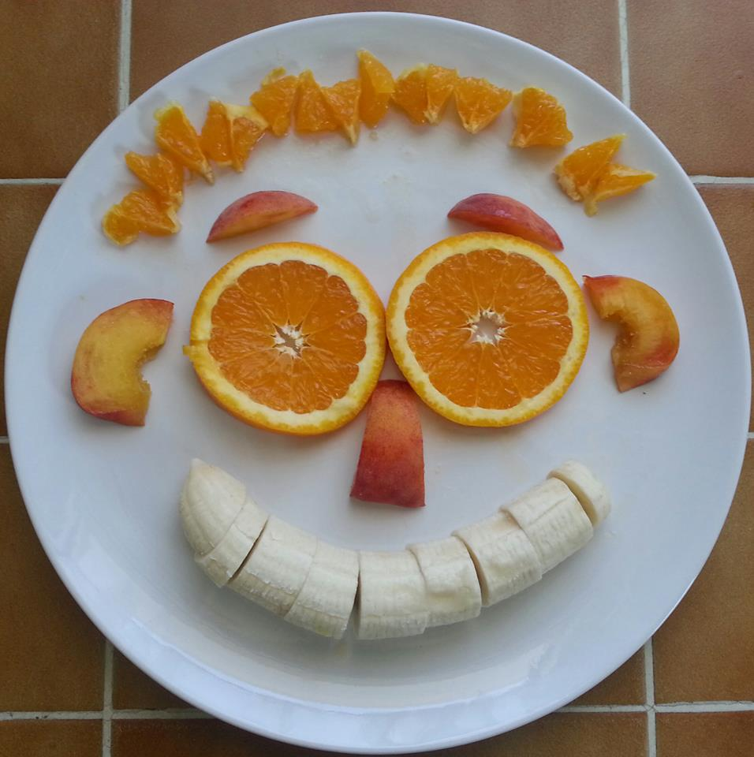
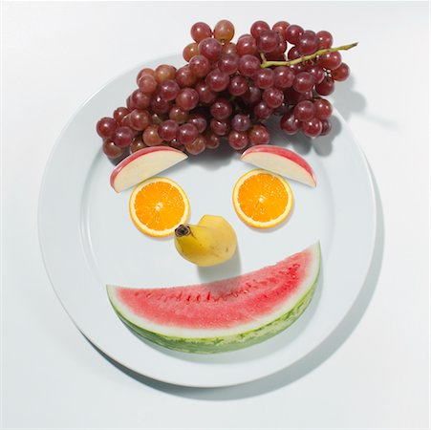
At Home: Fruit Kebabs/Fruit Face
1. Use a variety of fruits to make fruit kebabs or
2. Make a face from fruit.
3. Take a photo and get your parents to email it to me. Please put your name on your photo. I’ll make a collage of all the pictures for next week.

