Slide 1
Kim’s Game
Kim’s Game is an old Scout game, coming from a 1901 book called Kim and was in the first ever Scout book!
You’ll see a picture of a tray with items on it. You have 30 seconds to remember everything.
Each person will see a picture of the tray with an item taken away. You have to remember which one.
Only answer on your turn.

Slide 2
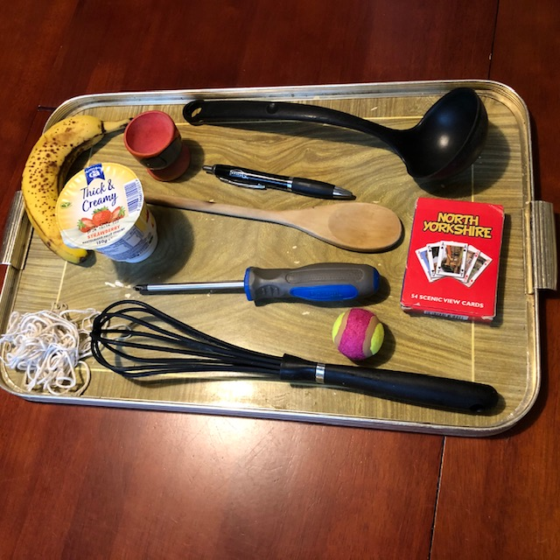

Slide 3
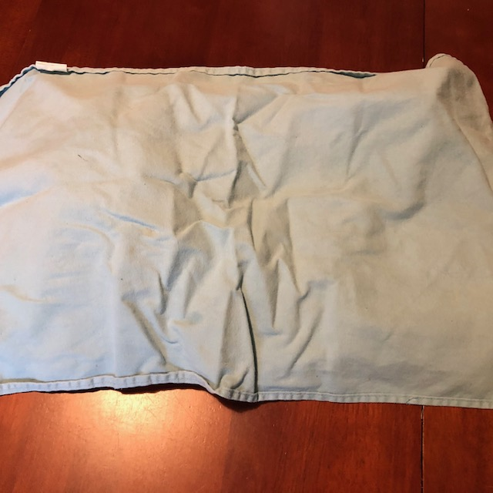

Slide 4
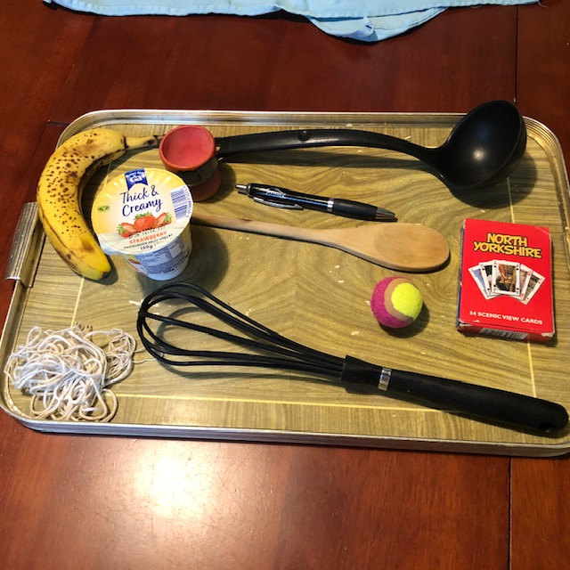

Slide 5
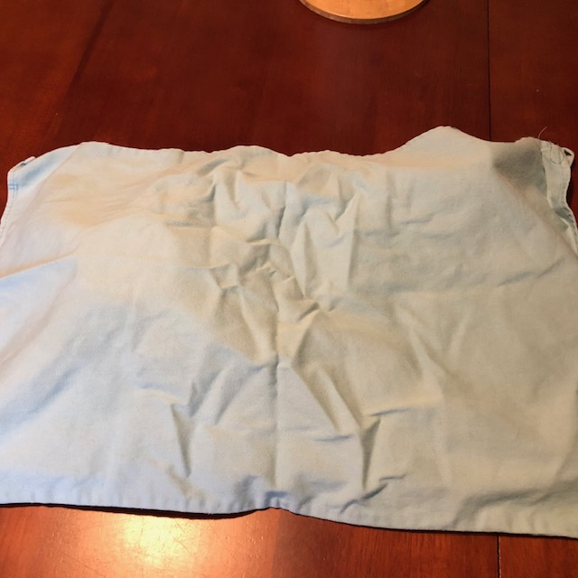

Slide 6
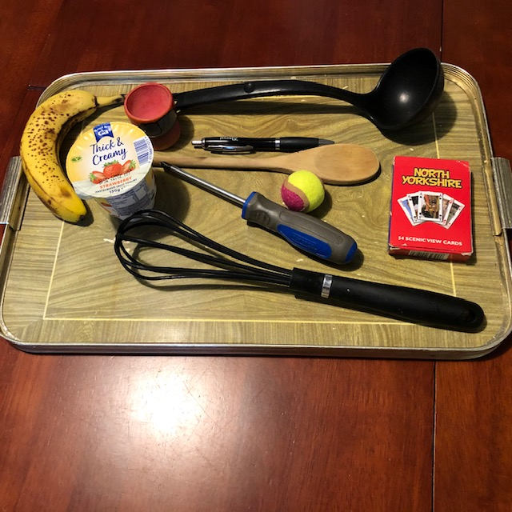

Slide 9
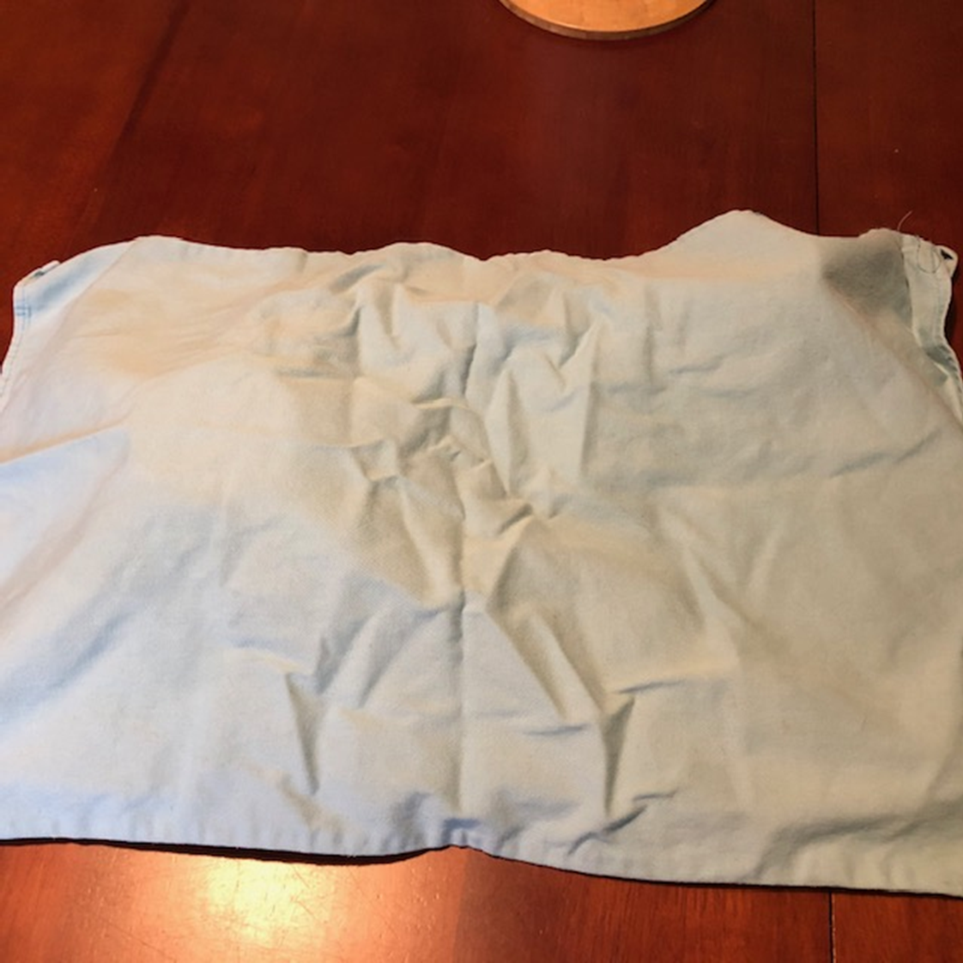

Slide 10
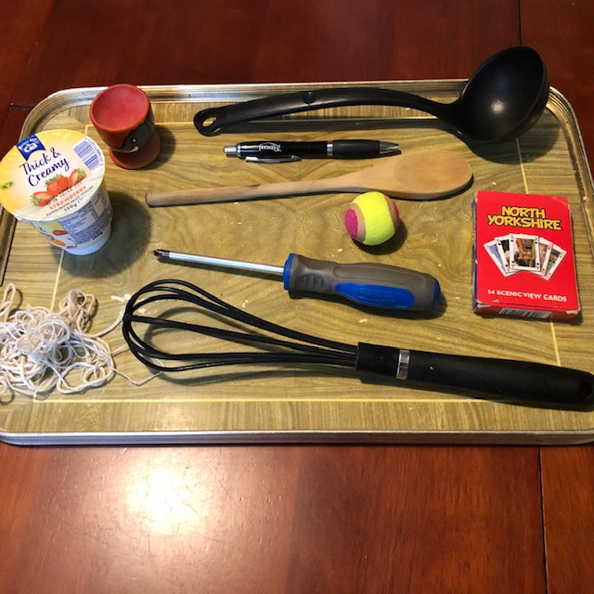

Slide 11
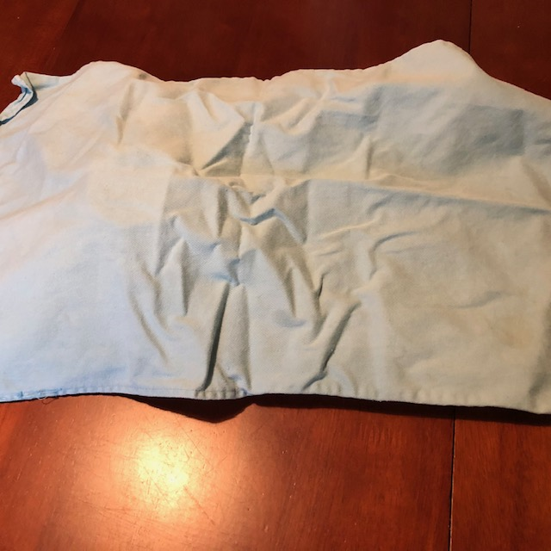

Slide 12
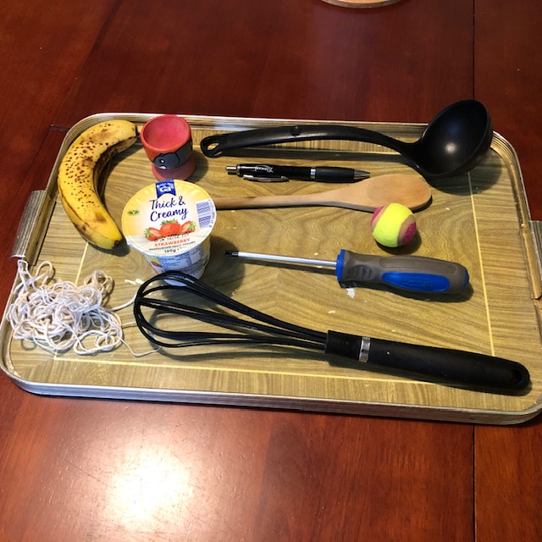

Slide 16
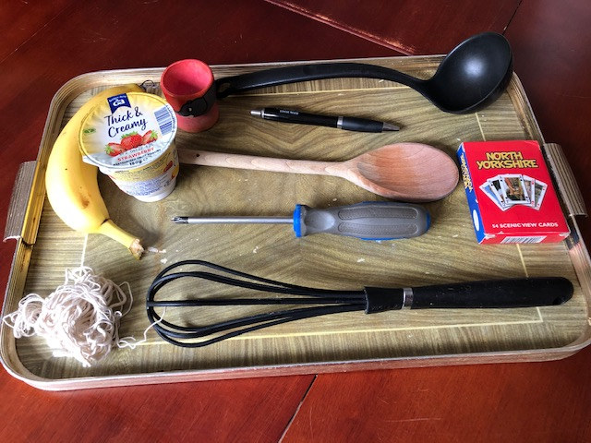

Slide 18
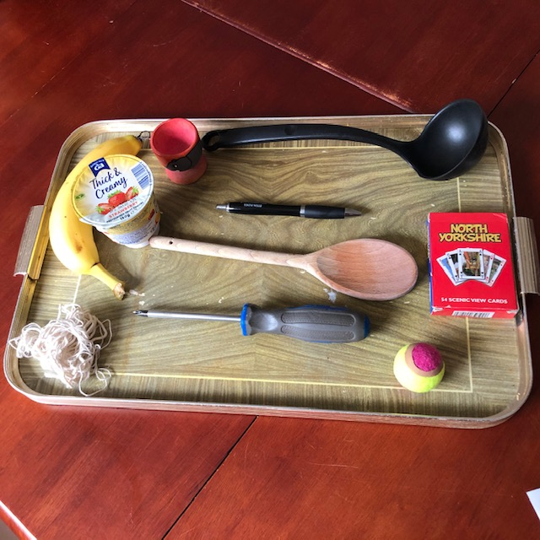

Slide 20
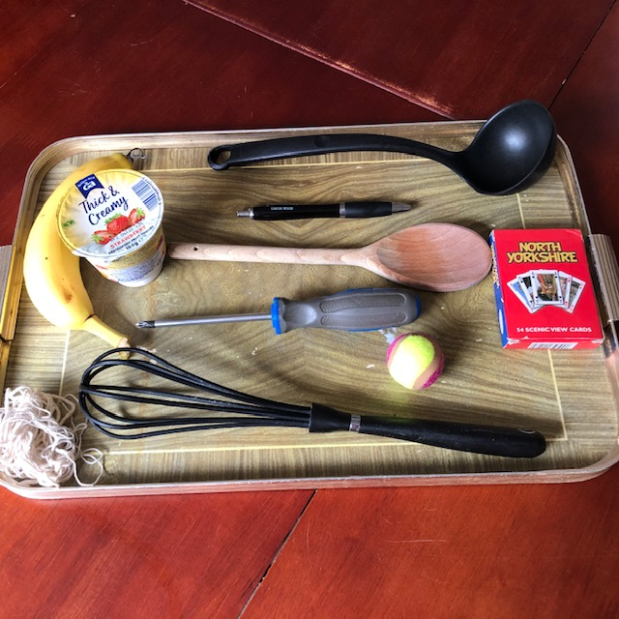

Slide 24
