Slide 1
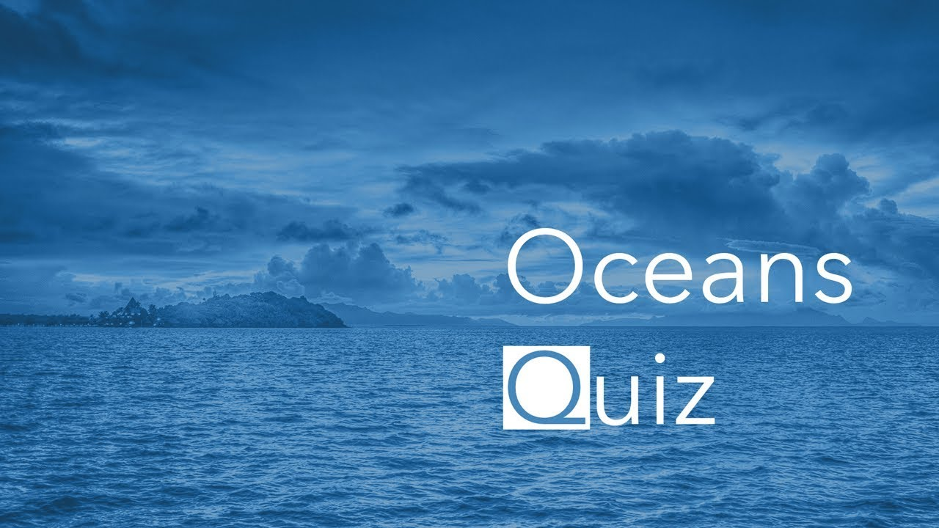

Slide 2
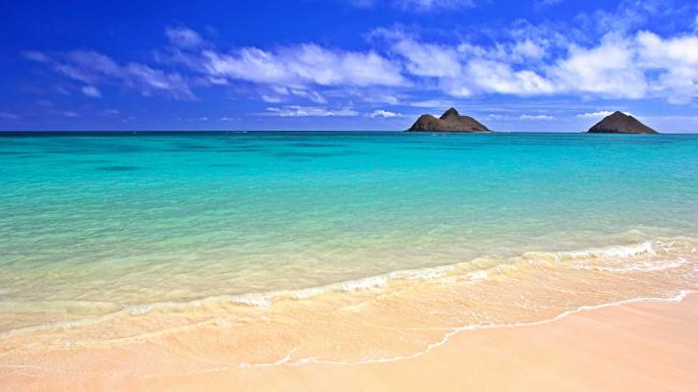

Slide 3
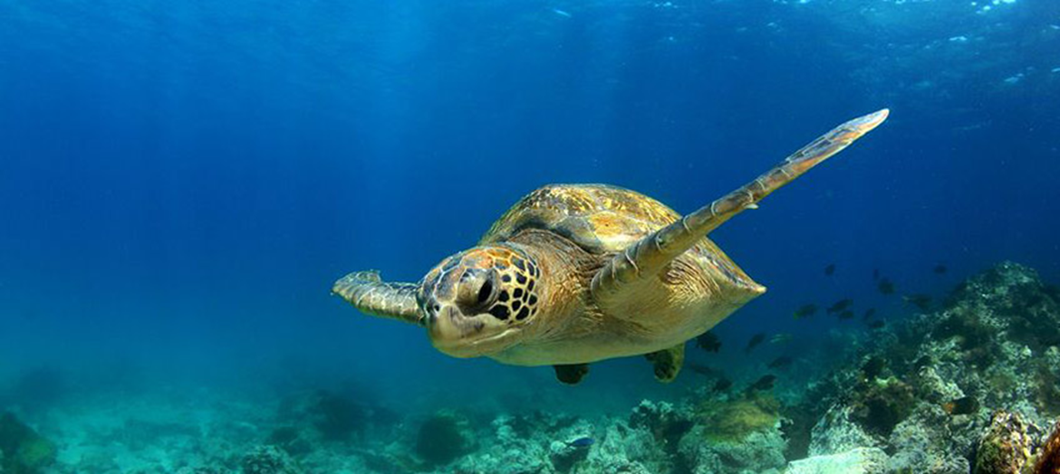

Slide 4
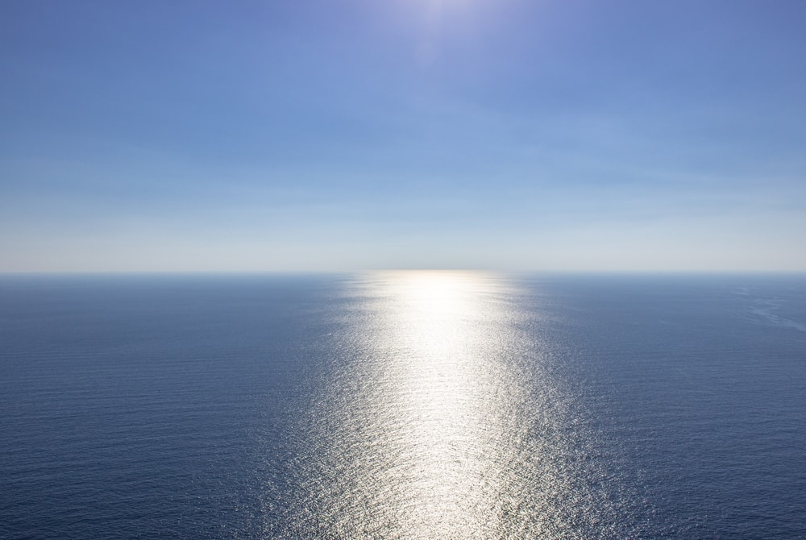
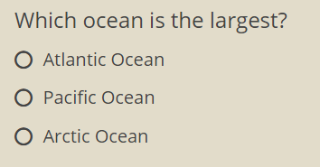
About 155 million square kilometres. That's larger than the total land area of the world.

Slide 5
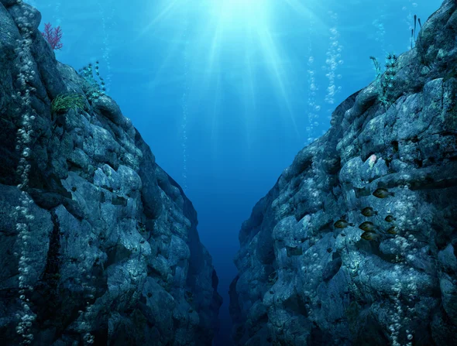
Lies approximately 10.91 kilometres below sea level and runs for 2,542 kilometres. It's the deepest part of the ocean.

Slide 6
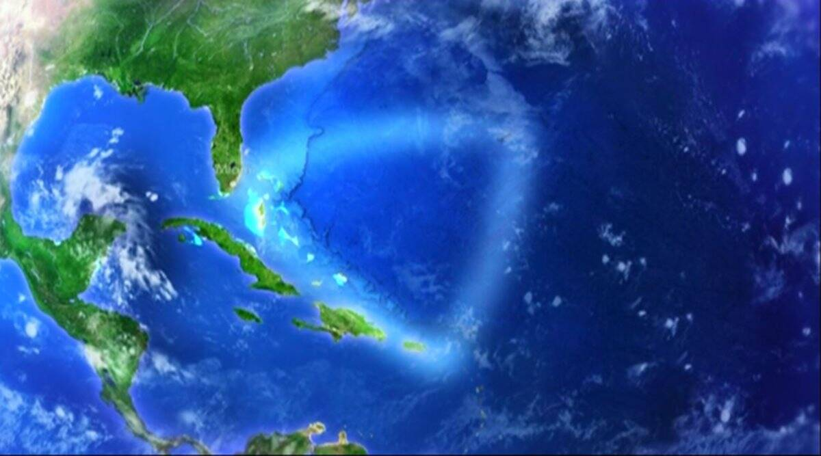
The Bermuda Triangle is an area in the western part of the Atlantic Ocean. It's a triangle shape because its outermost points include Puerto Rico, Bermuda and the tip of Florida.

Slide 7
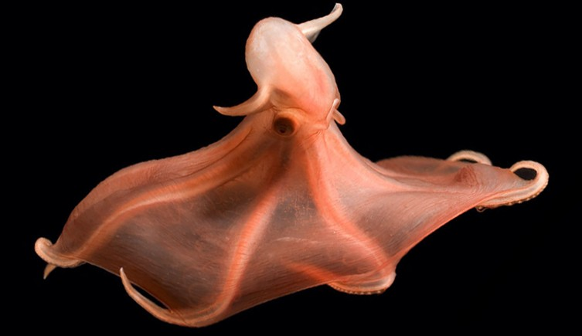
A whopping 50-80 per cent of all life are found in the ocean! Not surprising that so much life is in the ocean since it covers 70 per cent of the Earth.

Slide 8
It's amazing to think that with so much ocean, only 5 per cent of it has been explored!

Slide 9
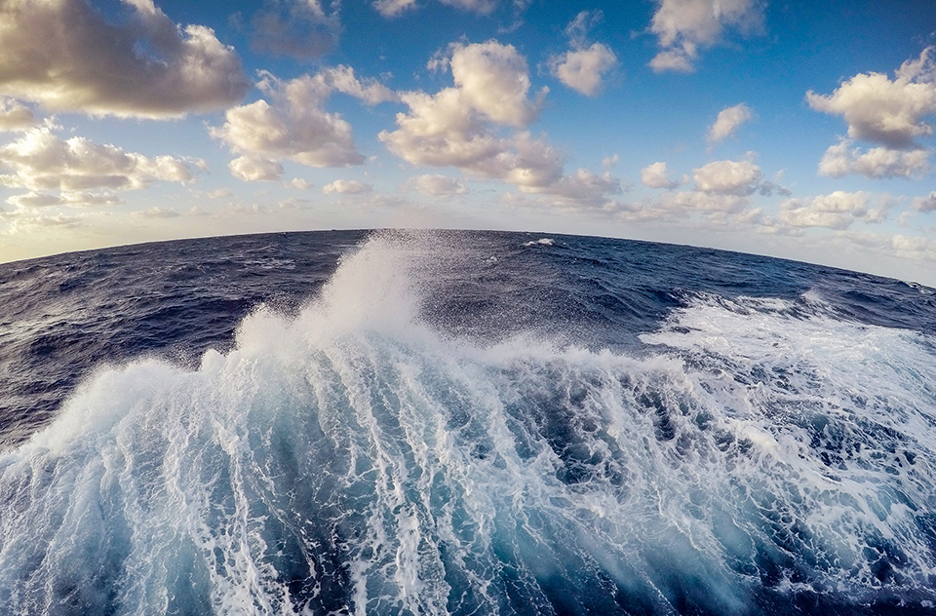
The oceans produce 70 per cent of our oxygen. Amazing, isn't it?

Slide 10
Can you imagine all those ships sinking over hundreds of years? That's three million treasures just waiting to be found.

Slide 11
It seems impossible that we could dump six billion kilograms of trash into the ocean every year, but it happens.

