Slide 1
CAN YOU SOLVE THE RHYME IN TIME?
The rhyming charades game

Slide 2
All you have to do is work out the rhyme in time.
Some are pretty surreal, like Jessica Biel wrestling an eel. Some are very dumb, like Heidi Klum has a big bum!
Each round has a 1 minute time limit
(look we just can’t stop rhyming!)
If it’s too hard, you might be allowed a little bit of google to work out the celebrity name

Slide 3
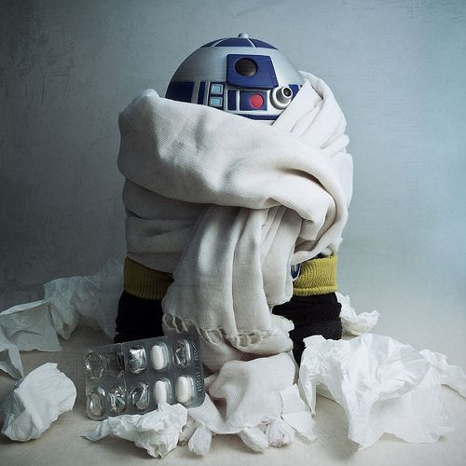
R2-D2
HAS GOT FLU
C-3P0’s pal has got a very bad cold

Slide 4
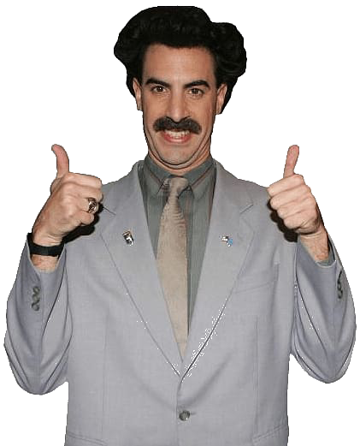
The Lion from C.S. Lewis’ books is on holiday in Borat’s country
Aslan in Kazakhstan

Slide 5
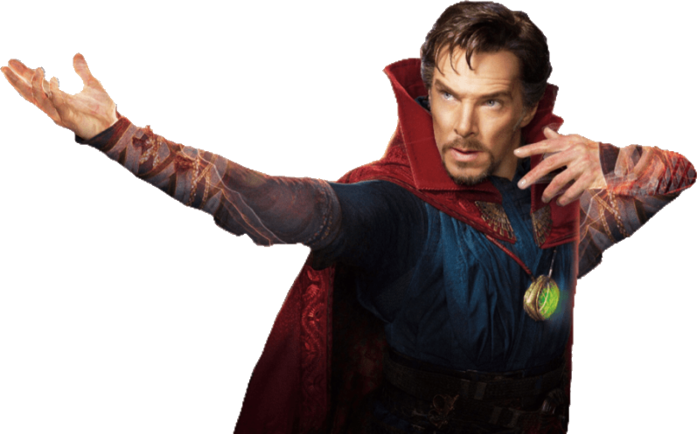
Benedict Cumberbatch having a scratch
Sherlock and Dr Strange star dealing with an itch

Slide 6
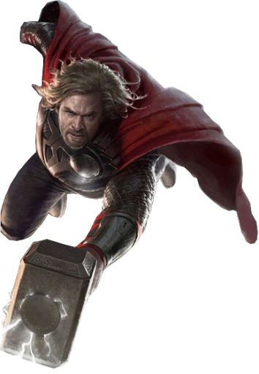
Thor is saddle sore
Norse god with a big hammer has been riding a horse for too long

Slide 7
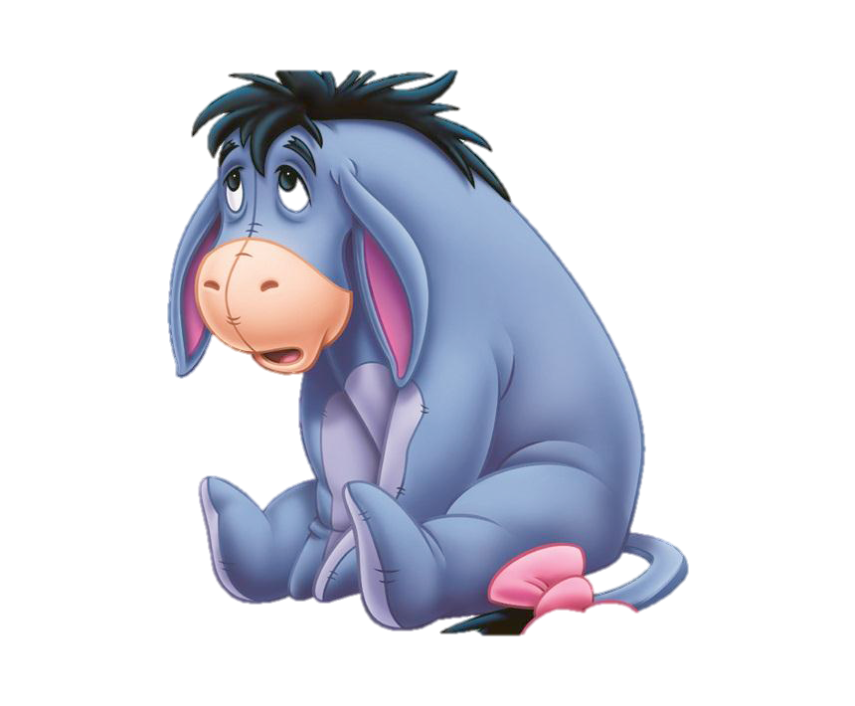
Eeyore swore
Winnie-the-Pooh’s grumpy donkey friend said a rude word

Slide 8
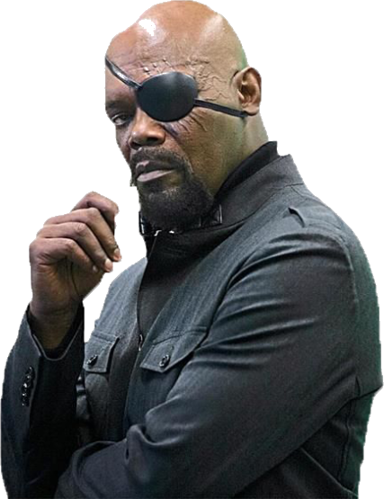
Samuel L Jackson using a klaxon
Star of ‘Snakes On A Plane’ sounding a loud warning hooter

Slide 9
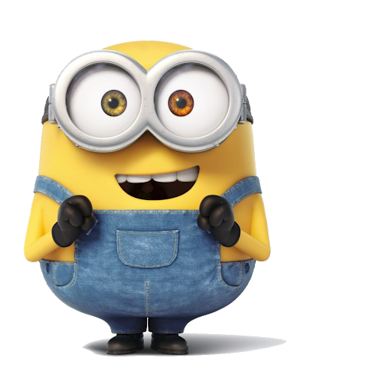
Yellow henchmen from ‘Despicable Me’ aren’t afraid to voice their thoughts on any subject
Minions have strong opinions

Slide 10
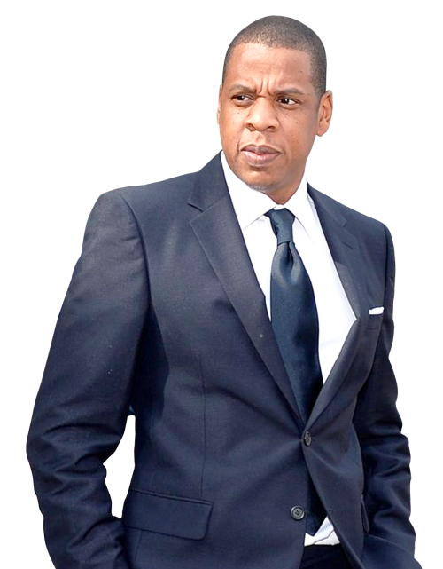
Jay Z feeling lazy
Beyonce’s husband having a duvet day

Slide 11
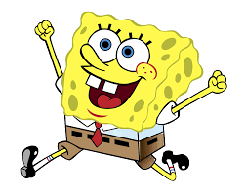
Yellow cartoon sponge consuming small insects
SpongeBob SquarePants eating ants

Slide 12
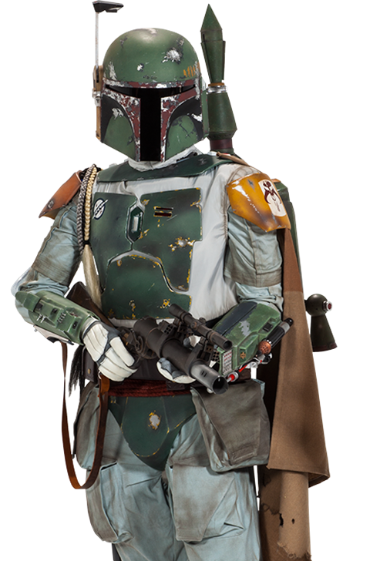
Cool bounty hunter from ‘Star Wars’ enjoys making music with one other person
Boba Fett playing a duet

Slide 13
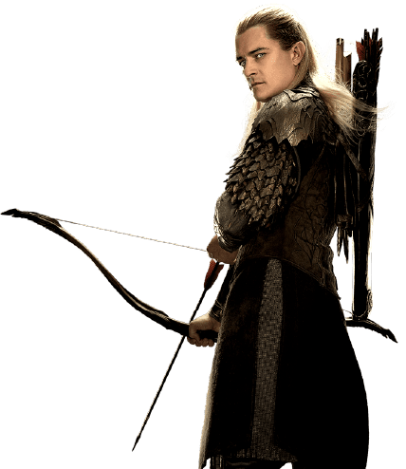
Orlando Bloom goes boom
Legolas actor explodes

Slide 14
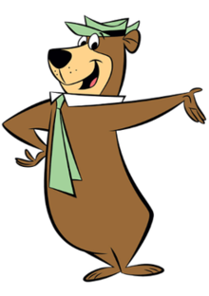
Yogi Bear full of hot air
Smarter-than-the-average-bear is inflating with warm oxygen

Slide 15
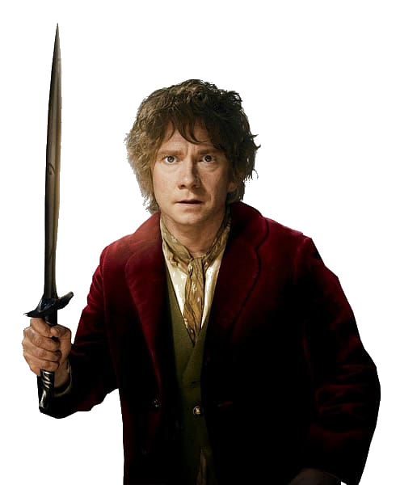
Martin Freeman surrounded by seamen
‘Sherlock’ and Bilbo Baggins actor on a boat with loads of sailors

Slide 16
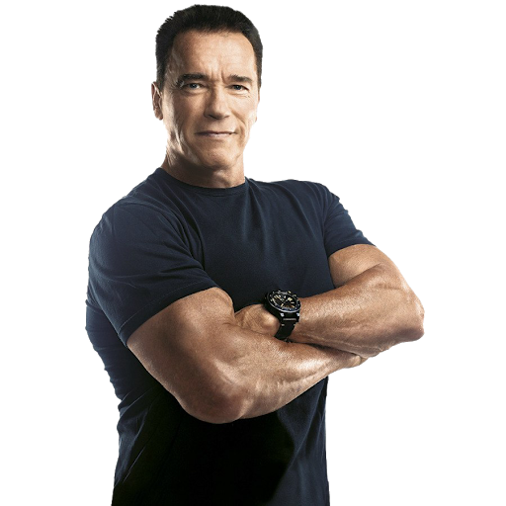
Arnold Schwarzenegger is a beggar
The Terminator is pleading for money

Slide 17
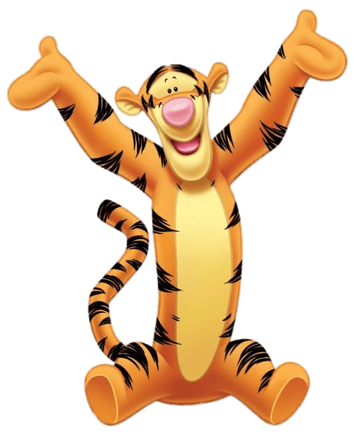
Tigger is a gold digger
Bouncy tiger from ‘Winnie-the-Pooh’ is only after his girlfriend’s money

Slide 18
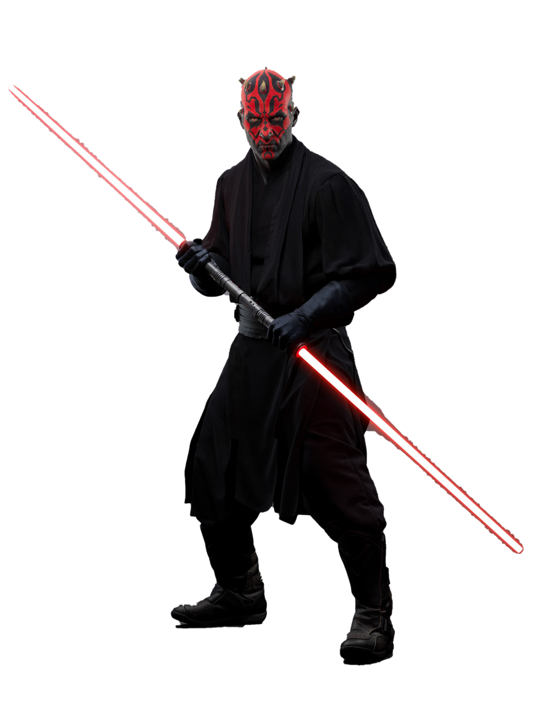
Darth Maul on a pub crawl
Tattoo-faced baddie from ‘Star Wars’ is visiting one bar after another

Slide 19
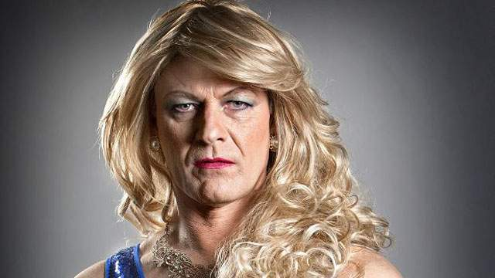
The actor who played Ned Stark and Boromir impersonating her majesty
Sean Bean playing the Queen

Slide 20
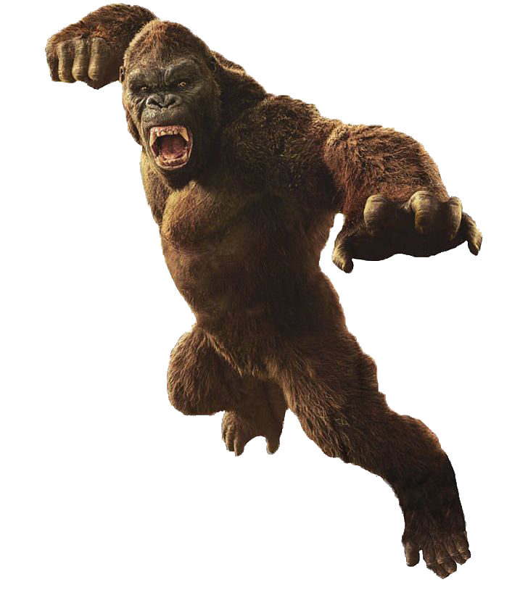
Giant gorilla is wearing small underwear
King Kong is wearing a thong

Slide 21
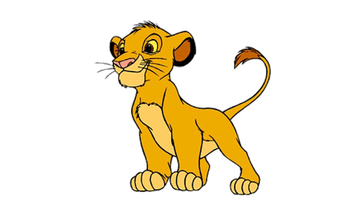
Musafa’s son in the ‘Lion King’ is yelling a certain word after chopping down a tree
Simba shouting timber

Slide 22
Musafa’s son in the ‘Lion King’ is yelling a certain word after chopping down a tree
Simba shouting timber

Slide 23
007 star has the black death!
Daniel Craig has the plague

Slide 24
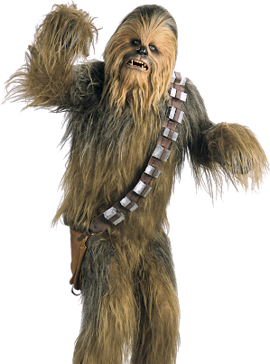
Fury Star War character having a romantic meal with a fury four legged animal
Chewbacca dating an alpaca

Slide 25
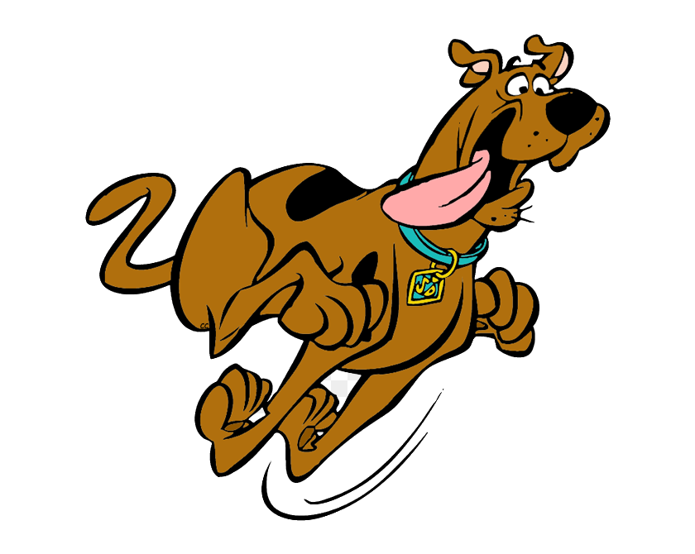
Cartoon dog enjoying hot cheese dip!
Scooby-Doo eating fondue

Slide 26
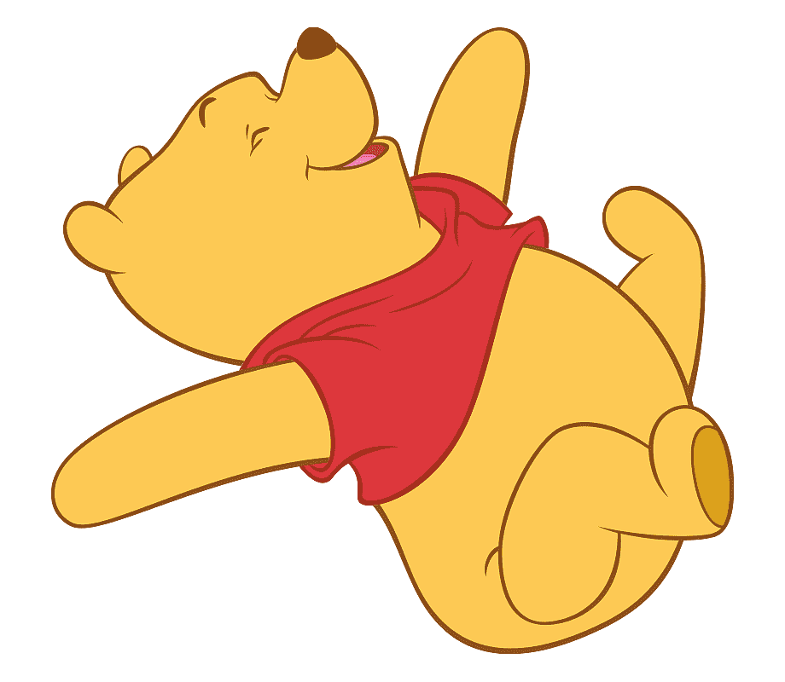
A.A.Milnes most famous bear has picked up a martial art!
Winnie-the-Pooh doing kung fu

Slide 27
X-Factor judge making strange bird noises
Simon Cowell hooting like an owl

Slide 28
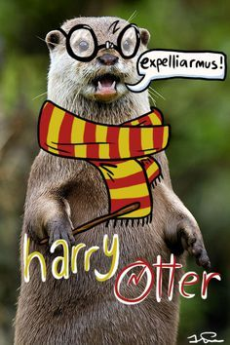
J.K Rowling main character embracing a water based mammal
Harry Potter cuddling an otter

Slide 29
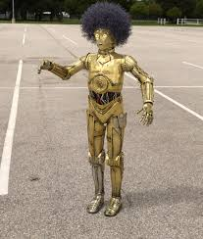
Golden Star Wars robot grows a hairdo
C-3P0 growing an afro

Slide 30
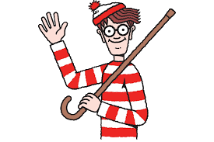
Popular hidden character in a book eating a summer treat
Where’s Wally eating an ice lolly

Slide 31
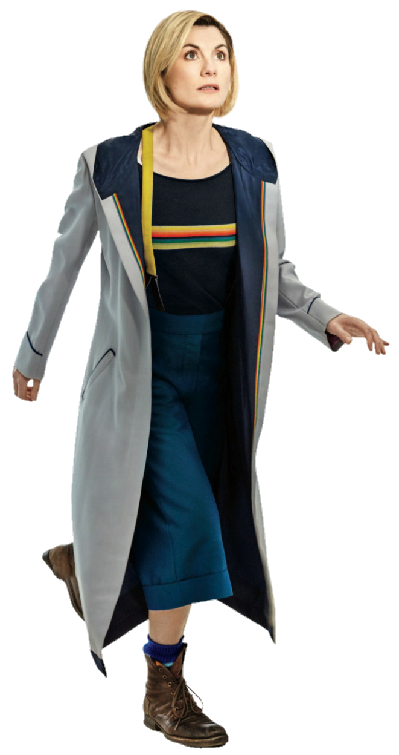
Space and Time traveller visiting a south American country
Dr Who is in Peru

Slide 32
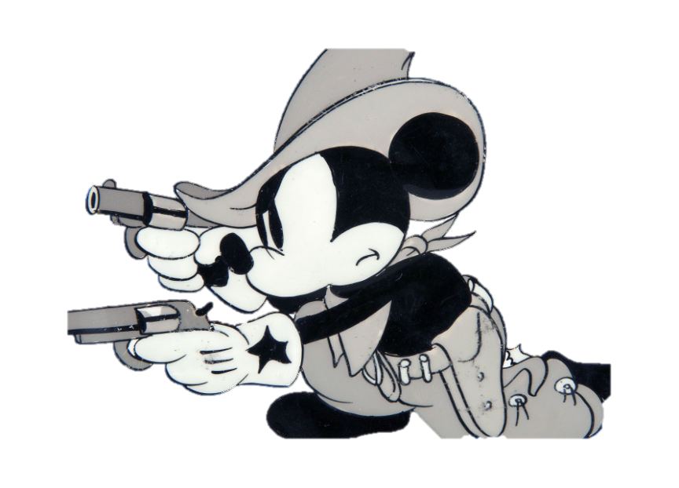
Disney icon has taking up shooting seasonal birds
Mickey Mouse hunting grouse

Slide 33
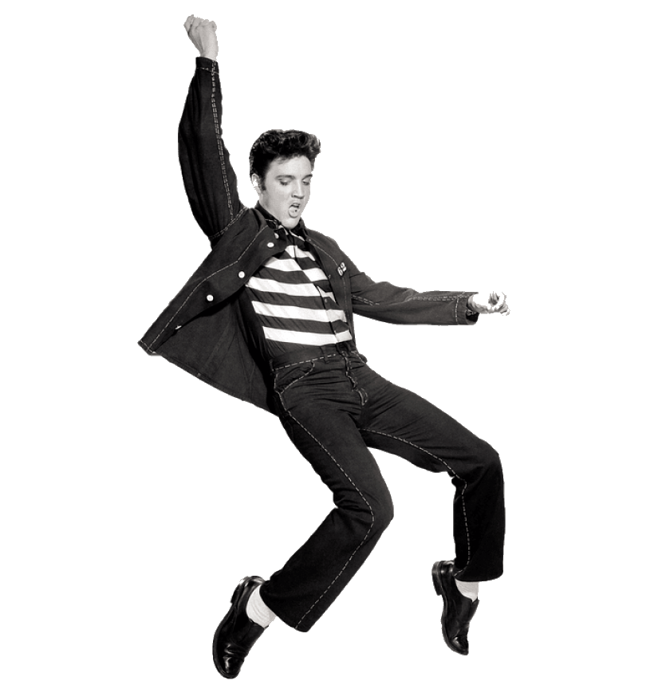
50’s & 60’s singer with big hair likes shaking a bodypart
Elvis wiggling his pelvis

Slide 34
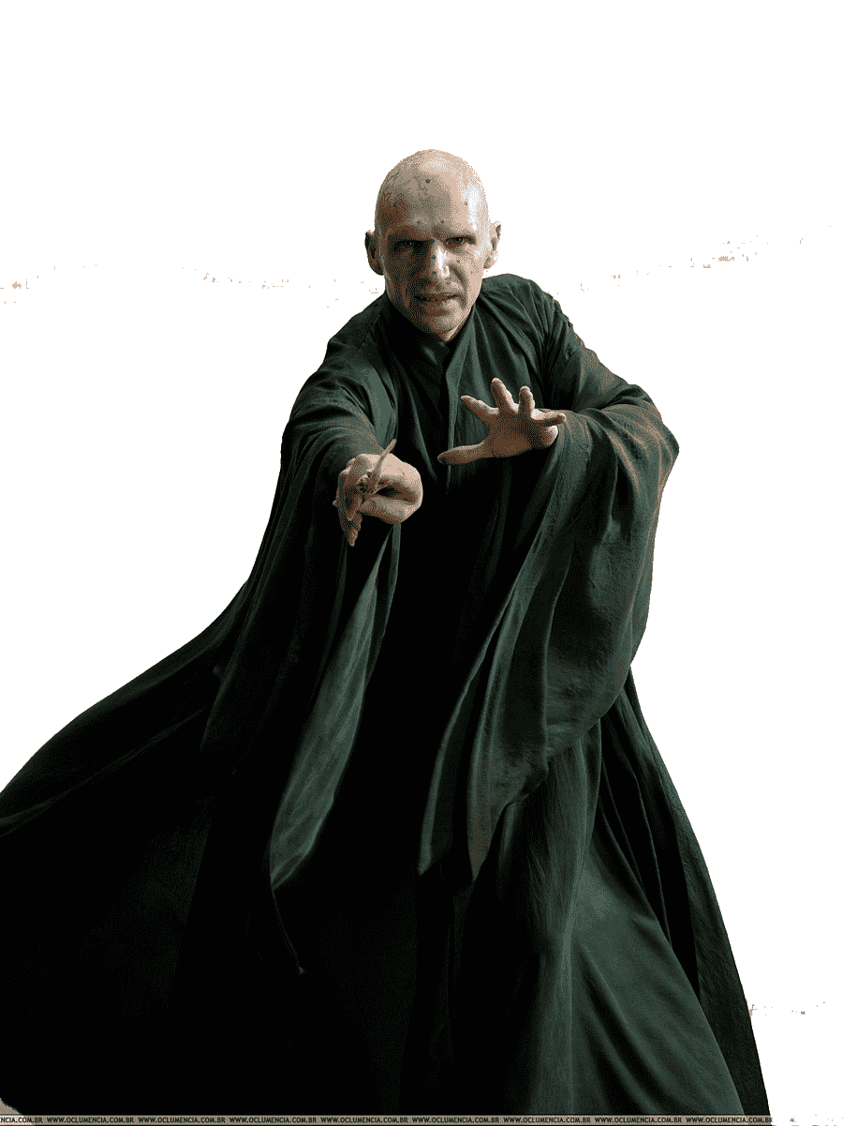
Harry Potter Villain going for a hearing
Voldemort going to court

Slide 35
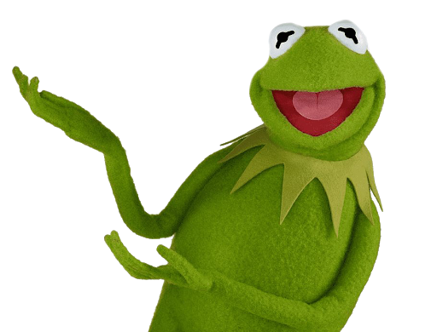
Popular green frog trying a new kind of shoe
Kermit the Frog wearing a clog

Slide 36
Disney water fowl using his HGV license
Donald Duck driving a truck

Slide 37
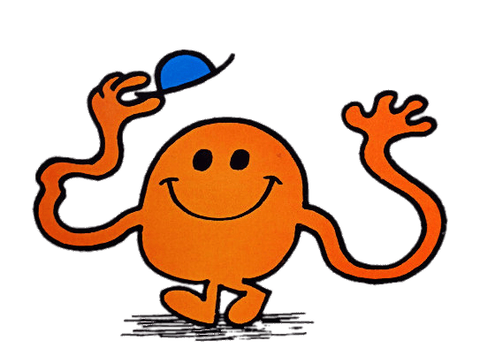
Mr Men Character with long arms eating a vegetable soaked in vinegar
Mr Tickle eating a pickle

Slide 38
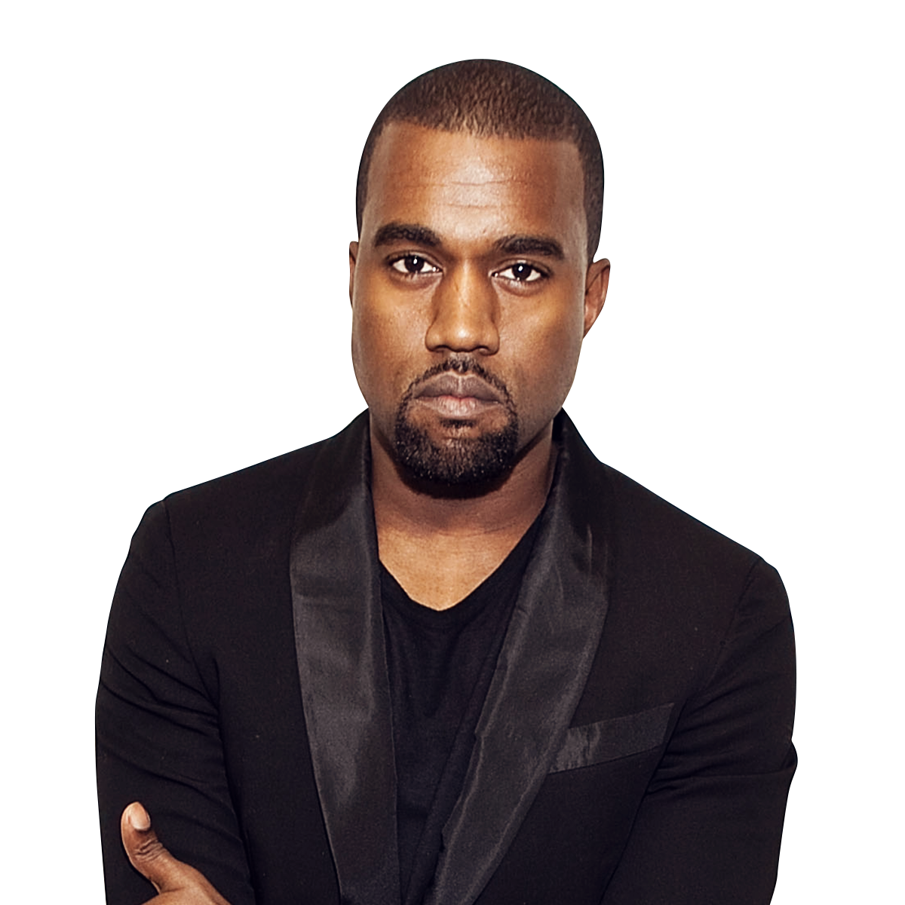
Kim Kardashian’s husband has just revealed secrets to a priest
Kanye West has confessed

Slide 39
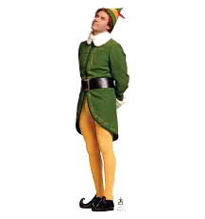
Elf actor in mortal danger
Will Ferrell in peril

Slide 40
Elf actor in mortal danger
Will Ferrell in peril

