Slide 1
STAR WARS QUIZ
ROUND 1
GUESS THE CHARACTER

Slide 2
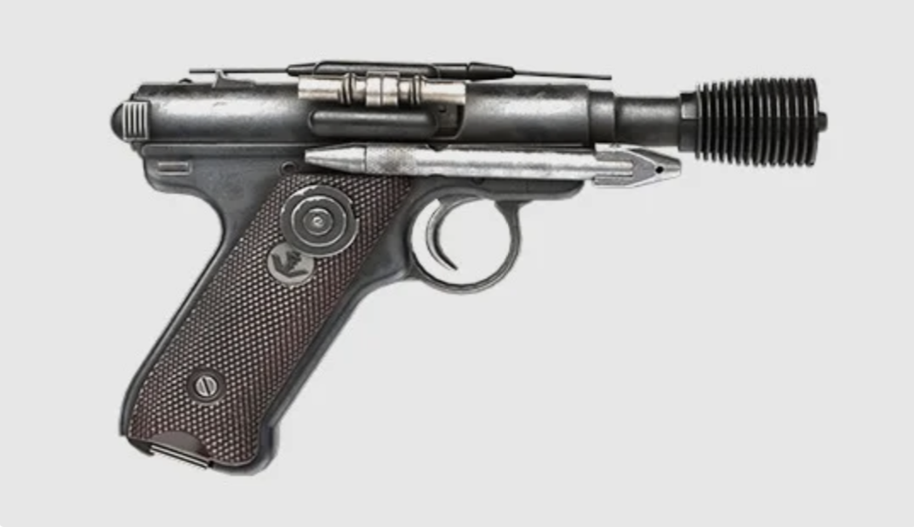
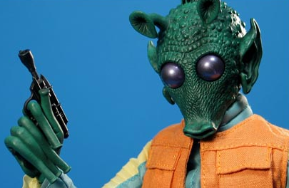
GUESS THE CHARACTER
GREDO

Slide 3
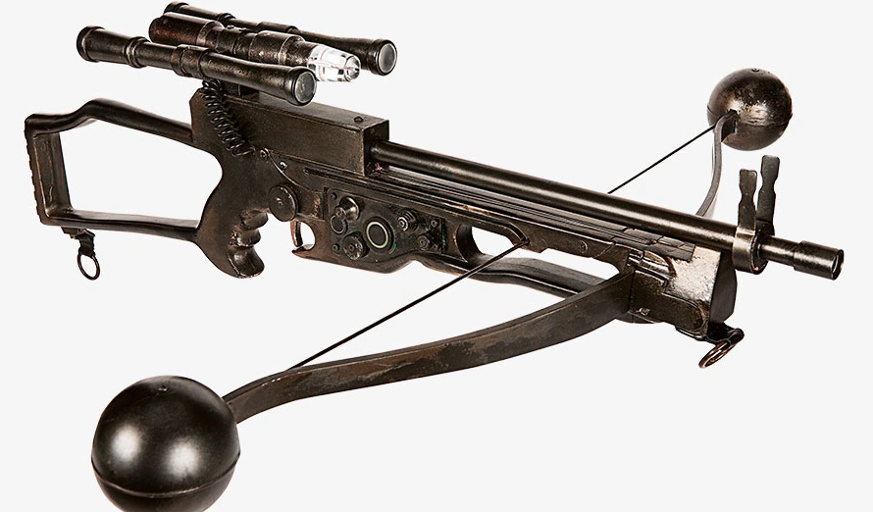
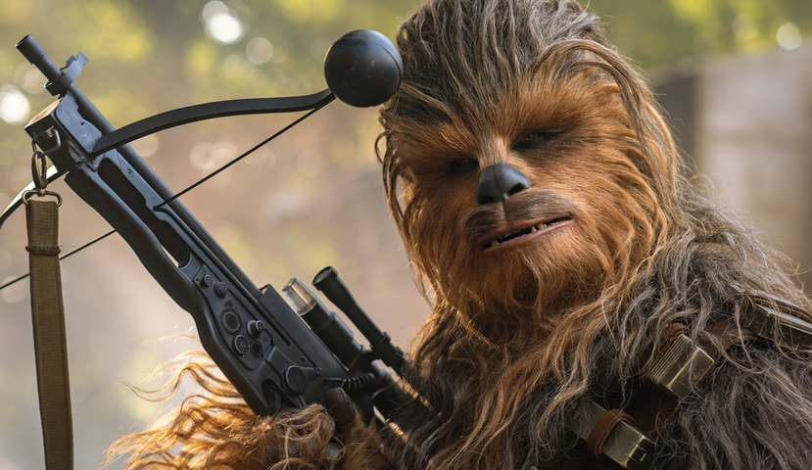
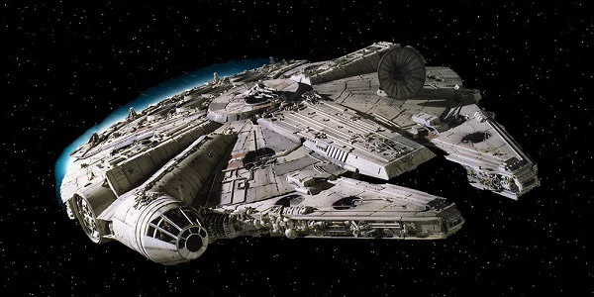
GUESS THE CHARACTER
CHEWEY

Slide 4
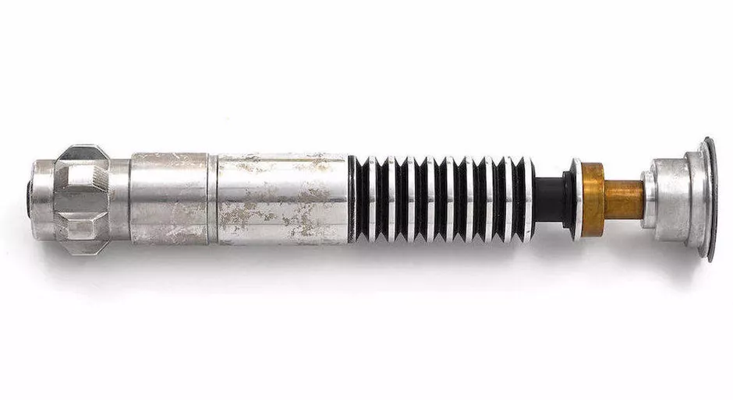
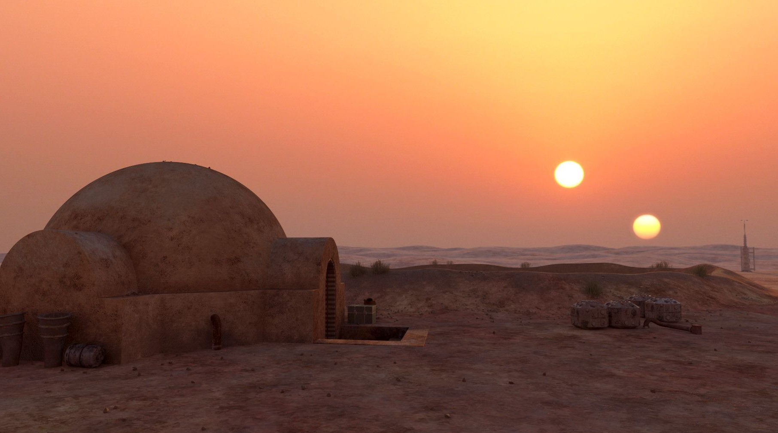
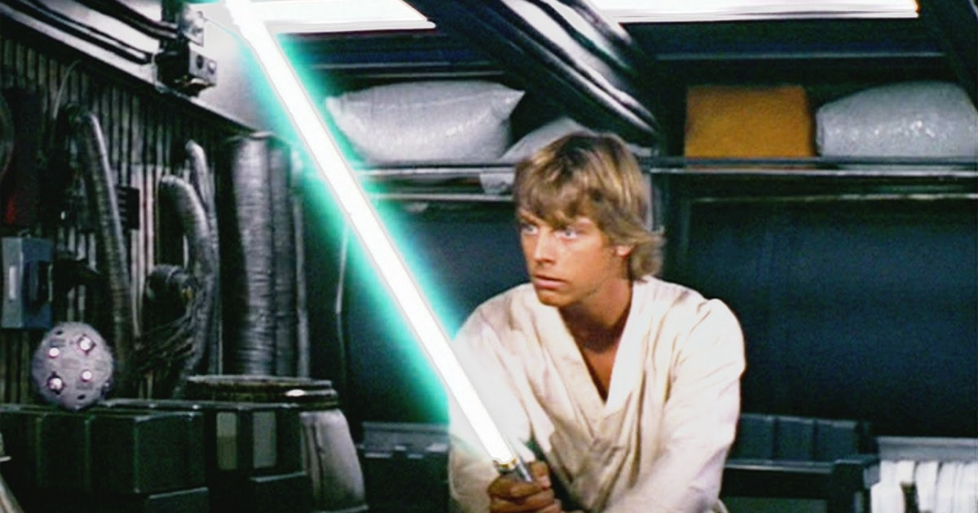
GUESS THE CHARACTER
LUKE

Slide 5
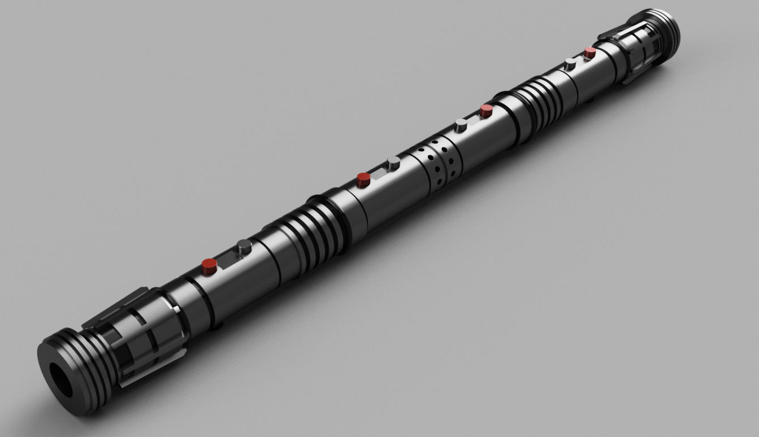
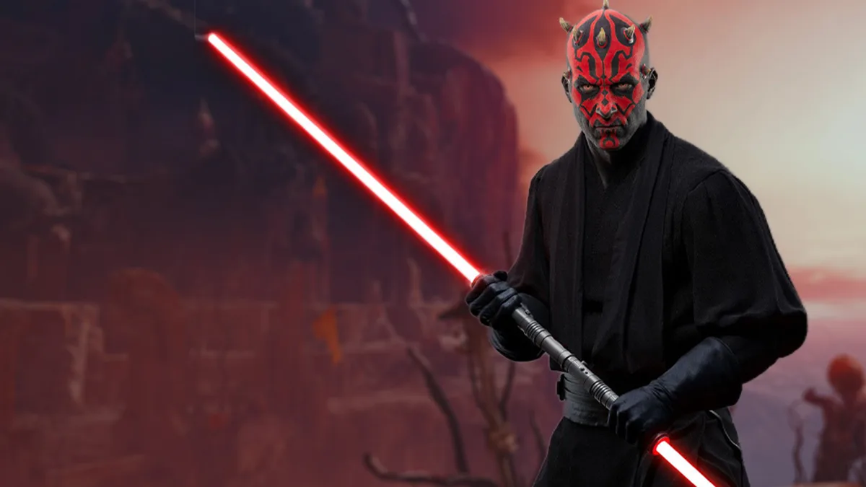
GUESS THE CHARACTER
MAUL

Slide 6
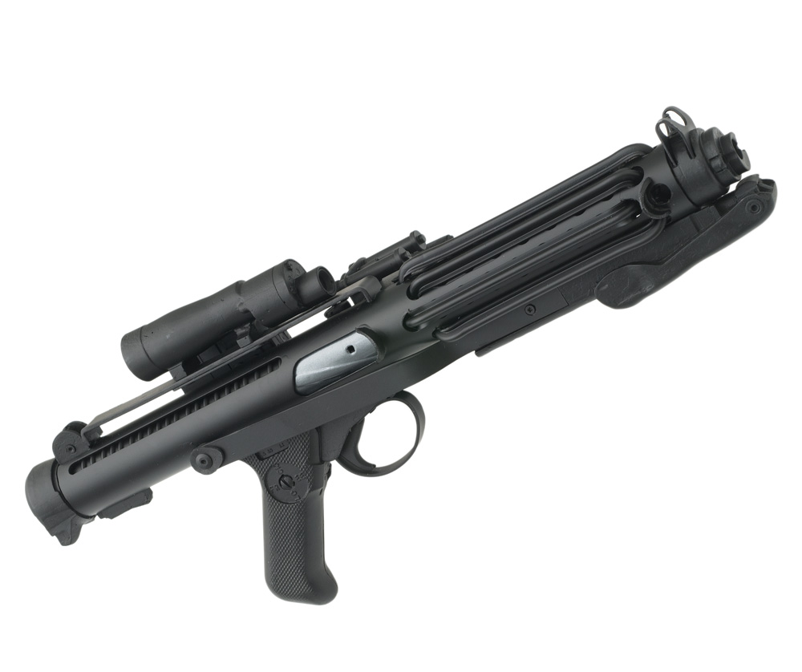
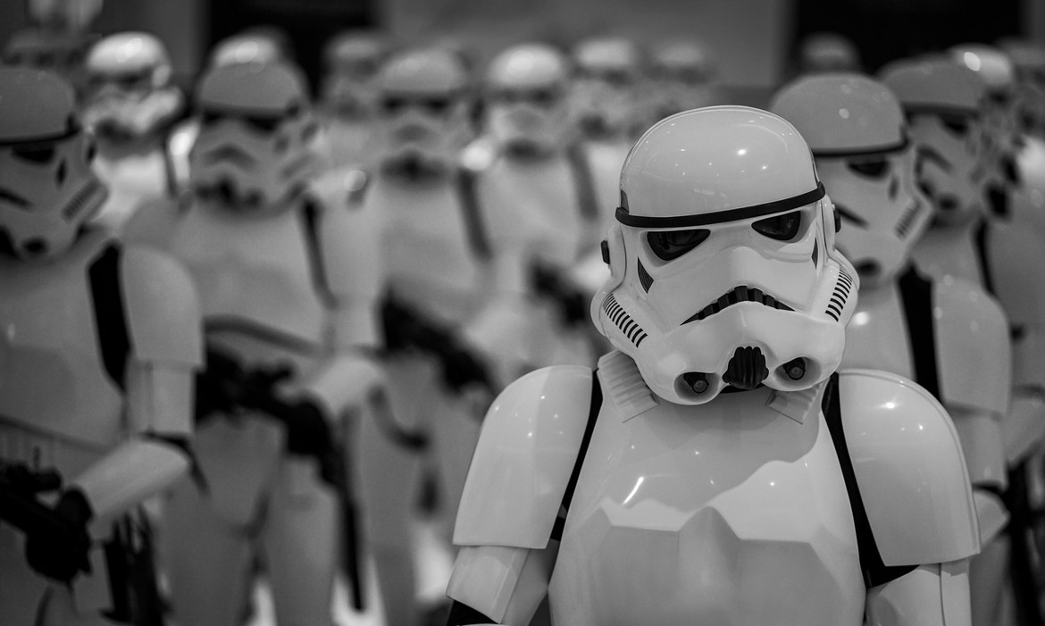
GUESS THE CHARACTER
STORM
TROOPER

Slide 7
ROUND 2
Who am I?

Slide 8
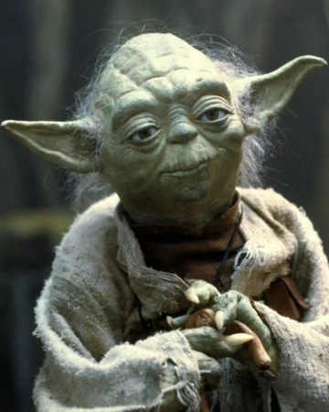
WHO AM I?
YODA

Slide 9
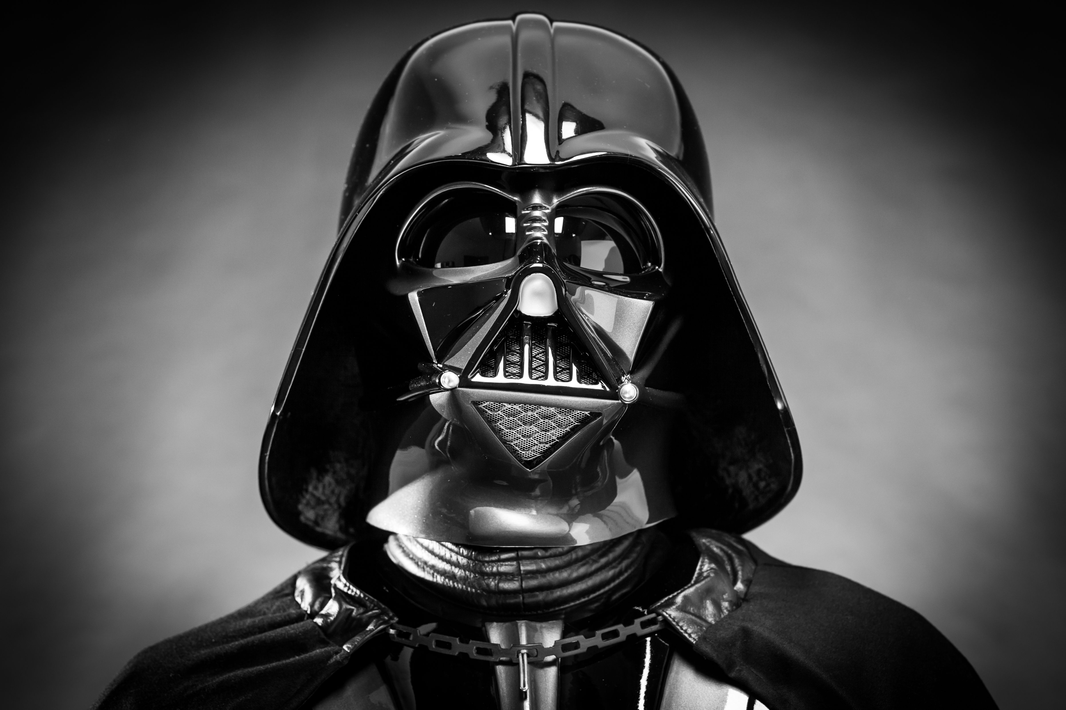
WHO AM I?
DARTH VADER

Slide 10
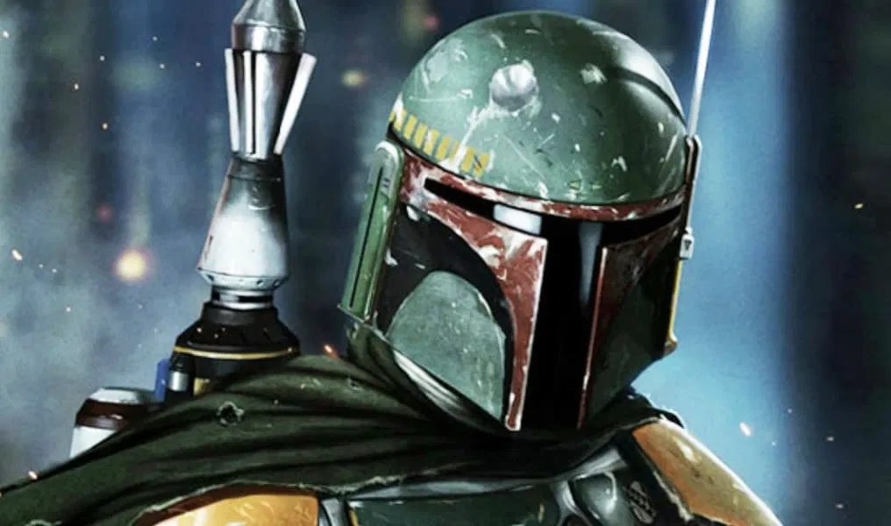
WHO AM I?
BOBA FETT

Slide 11
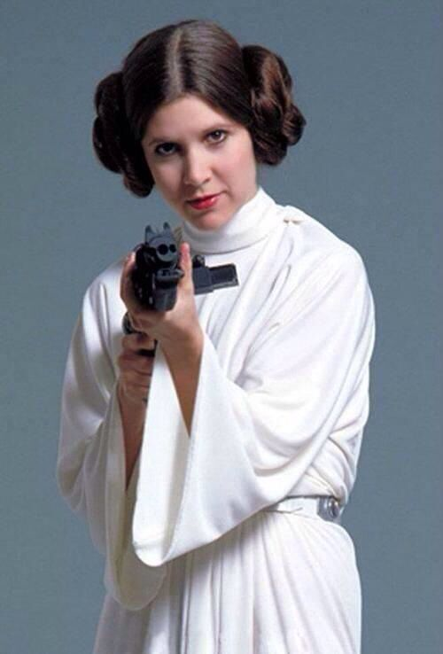
WHO AM I?
PRINCESS LEIA

Slide 12
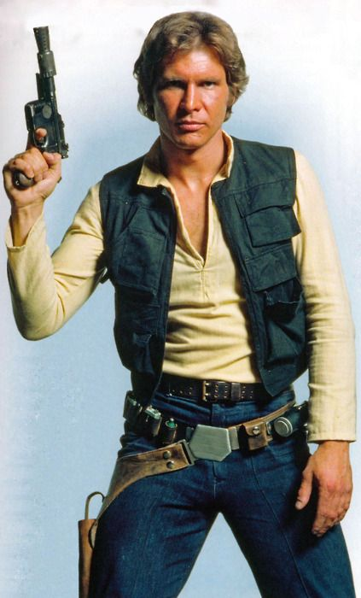
WHO AM I?
HAN SOLO

Slide 13
ROUND 3
NAME THE CRAFT?

Slide 14
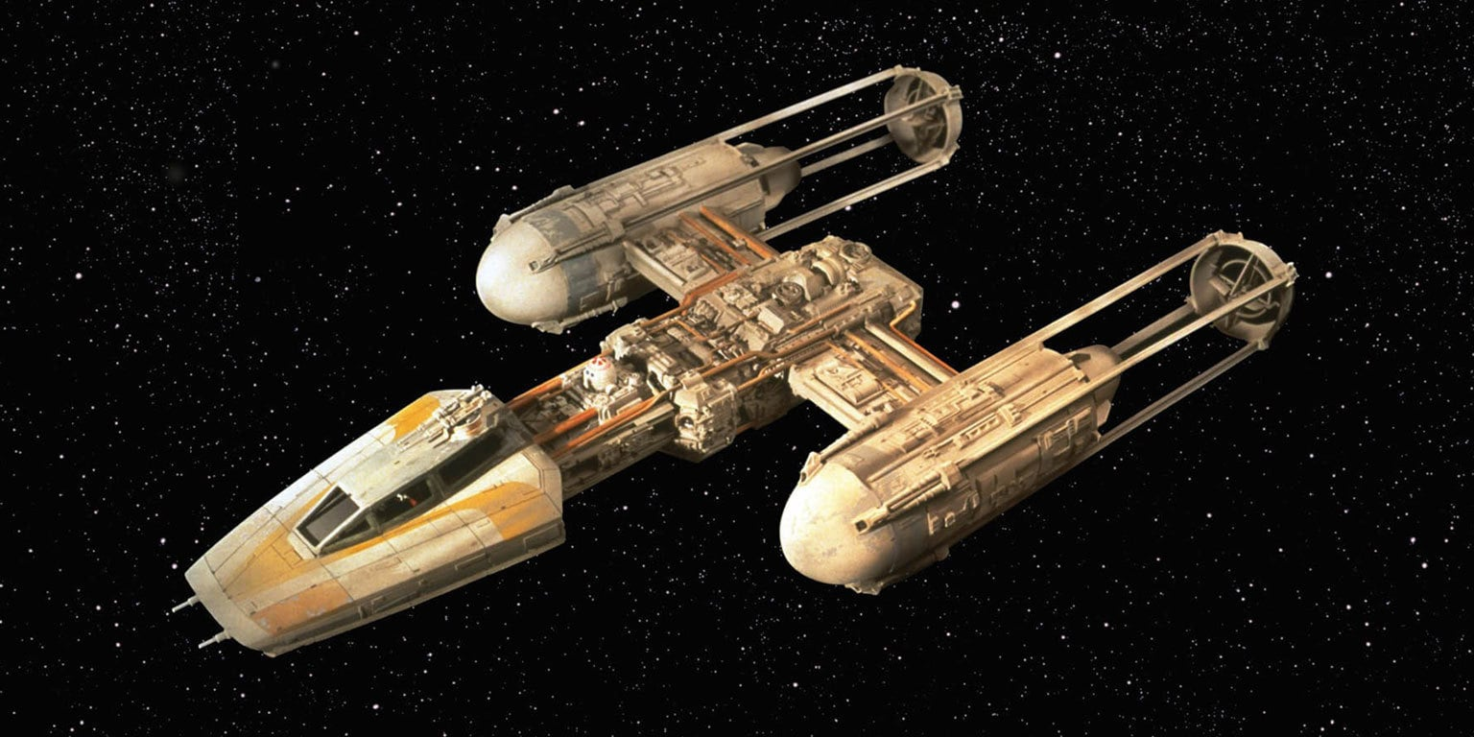
NAME THE CRAFT?
Y WING

Slide 15
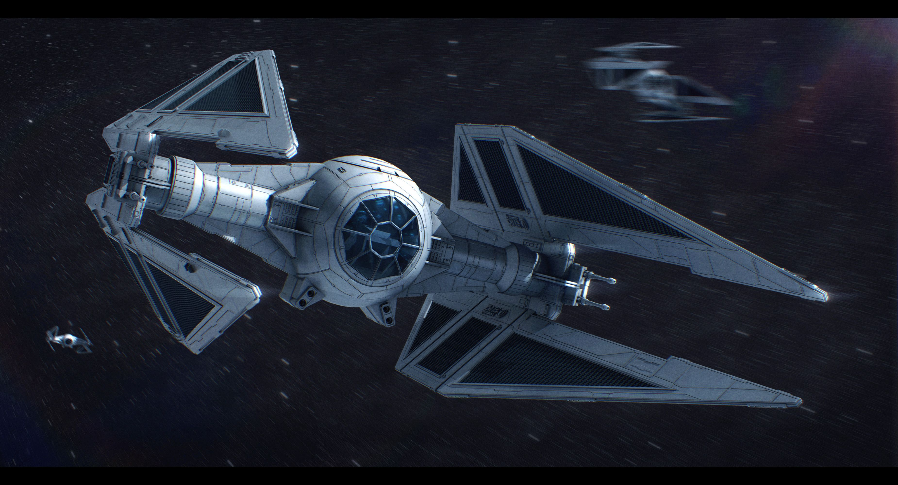
NAME THE CRAFT?
TIE INTERCEPTOR

Slide 16
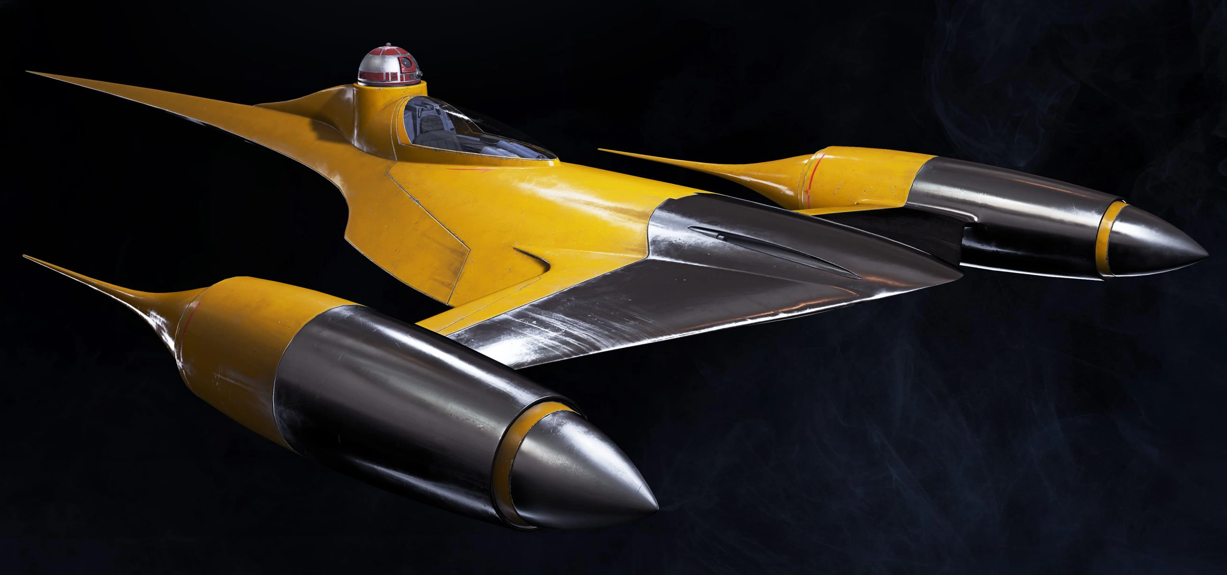
NAME THE CRAFT?
NABOO STARFIGHTER

Slide 17
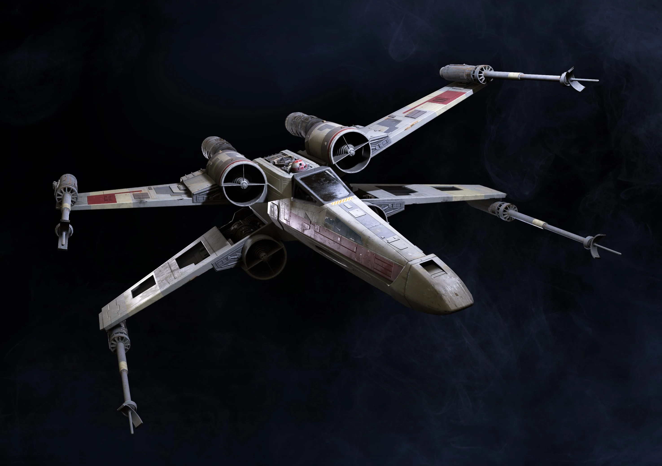
NAME THE CRAFT?
X WING

Slide 18
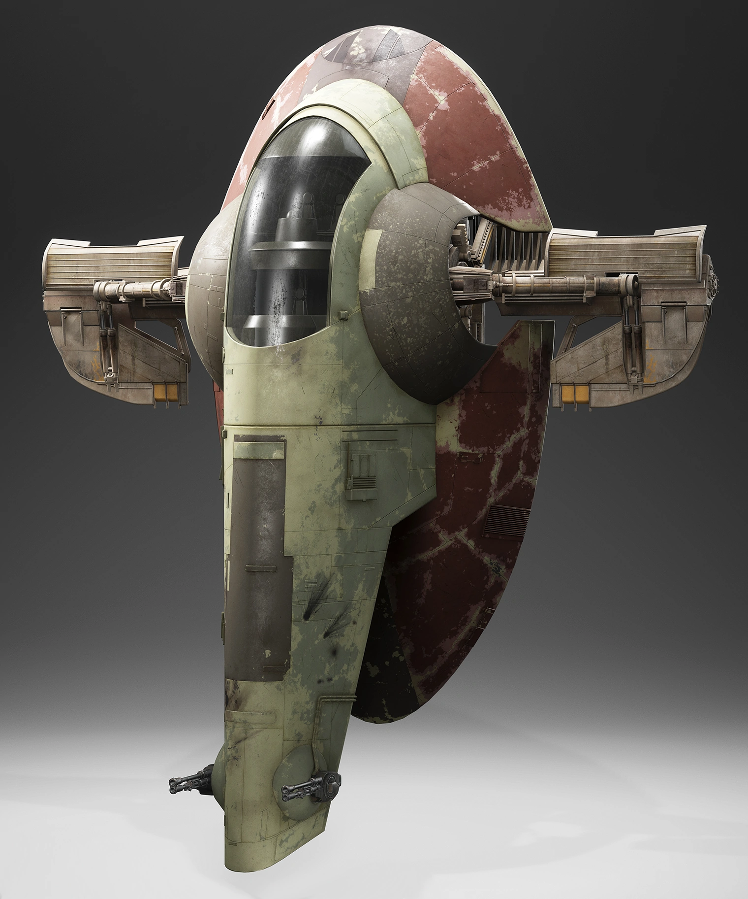
NAME THE CRAFT?
SLAVE 1

Slide 19
ROUND 4
WHO’S MY MATE?

Slide 20
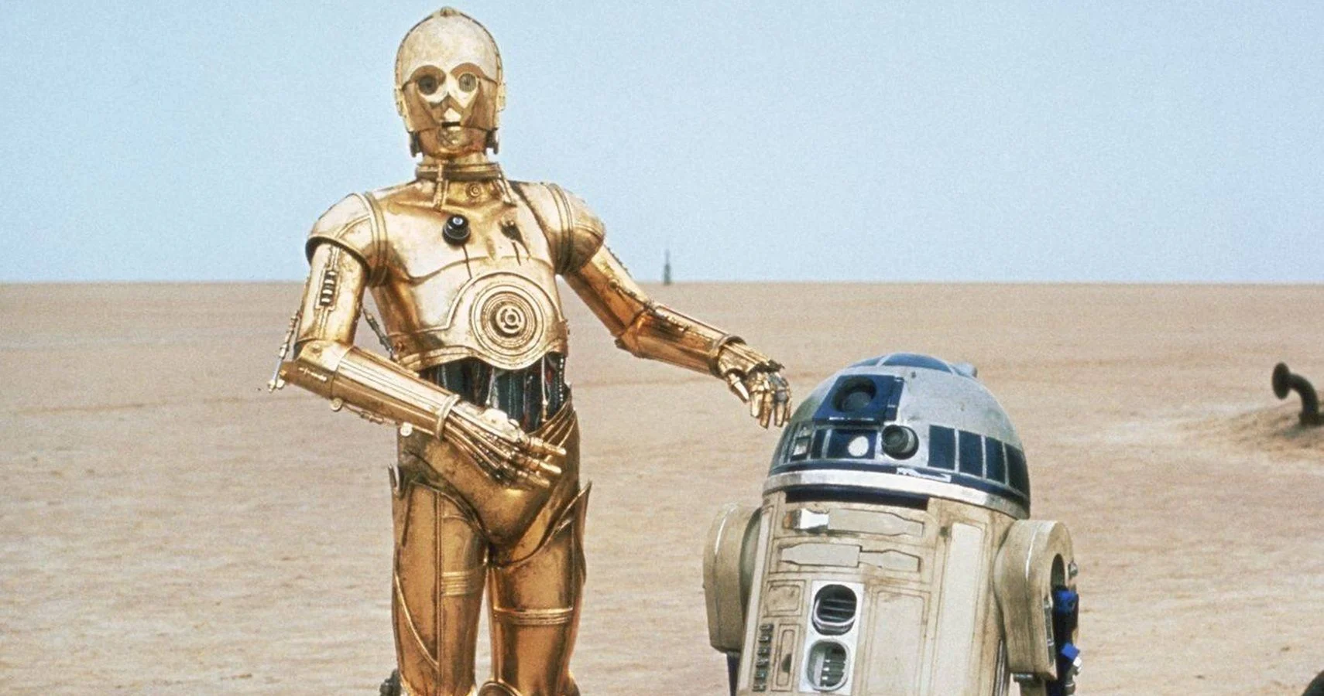
WHO’S MY MATE?
R2D2

Slide 21
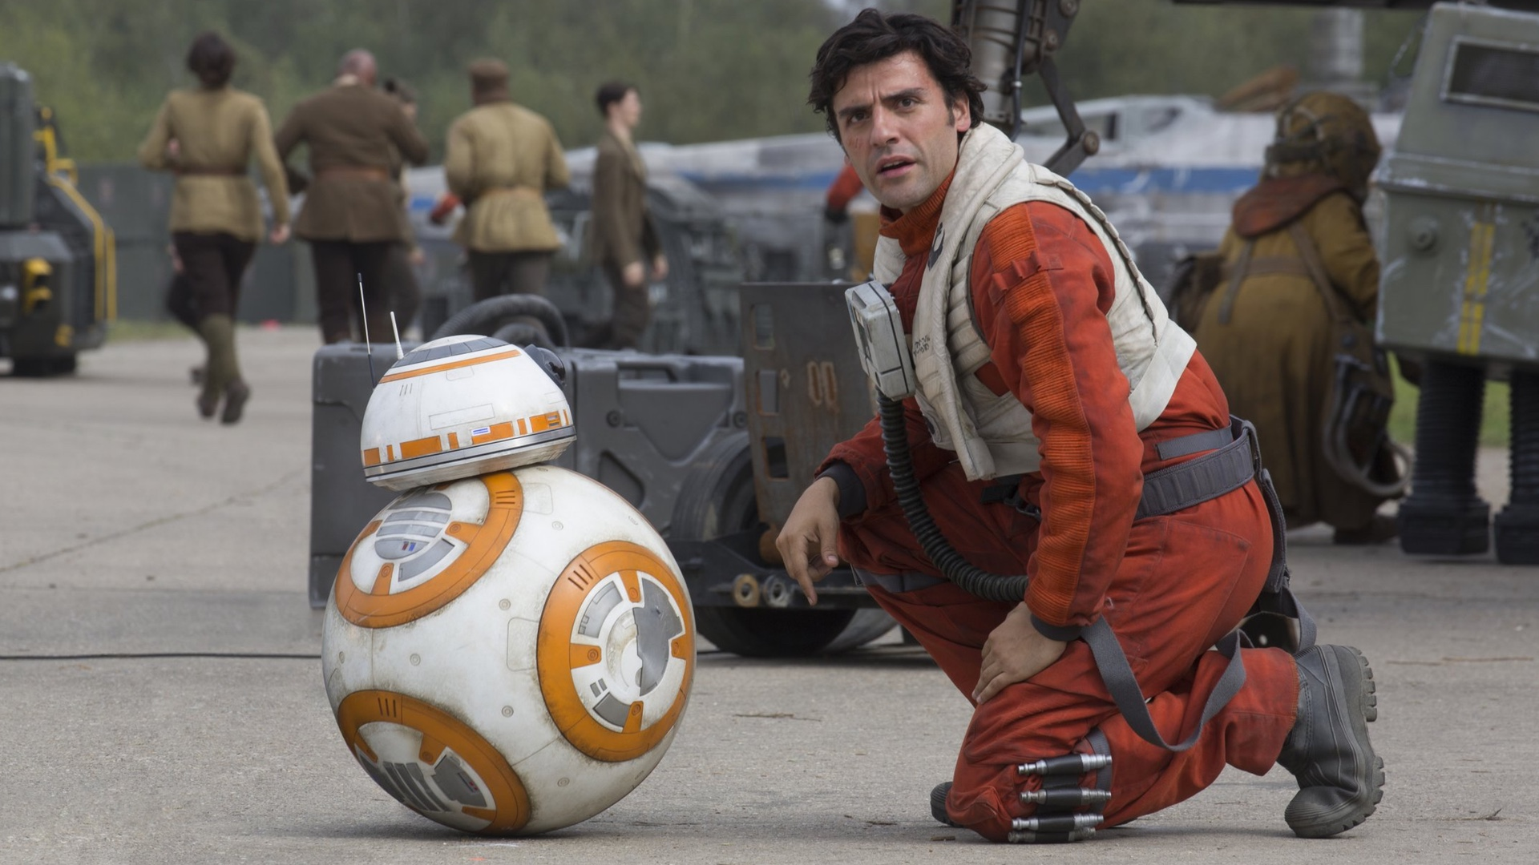
WHO’S MY MATE?
BB8

Slide 22
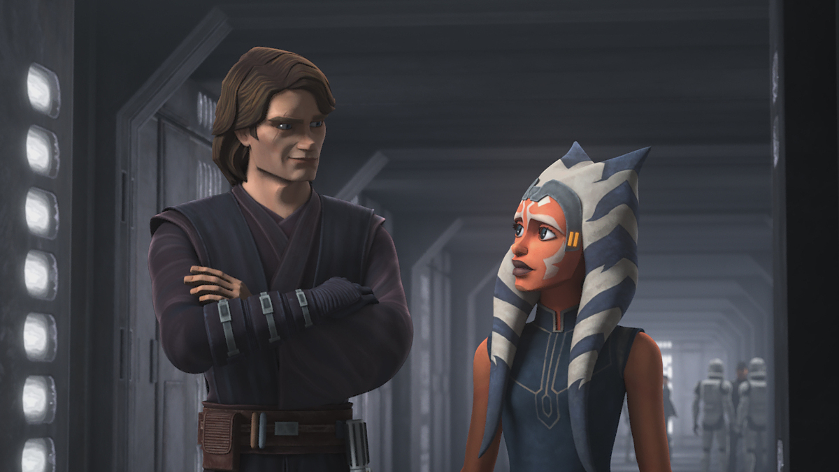
WHO’S MY MATE?
AHSOKA TANO

Slide 23
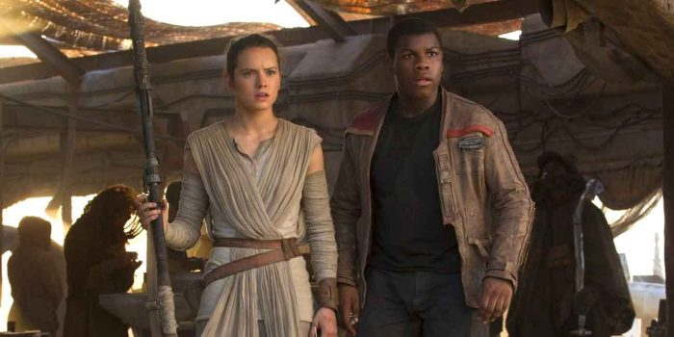
WHO’S MY MATE?
FINN

Slide 24
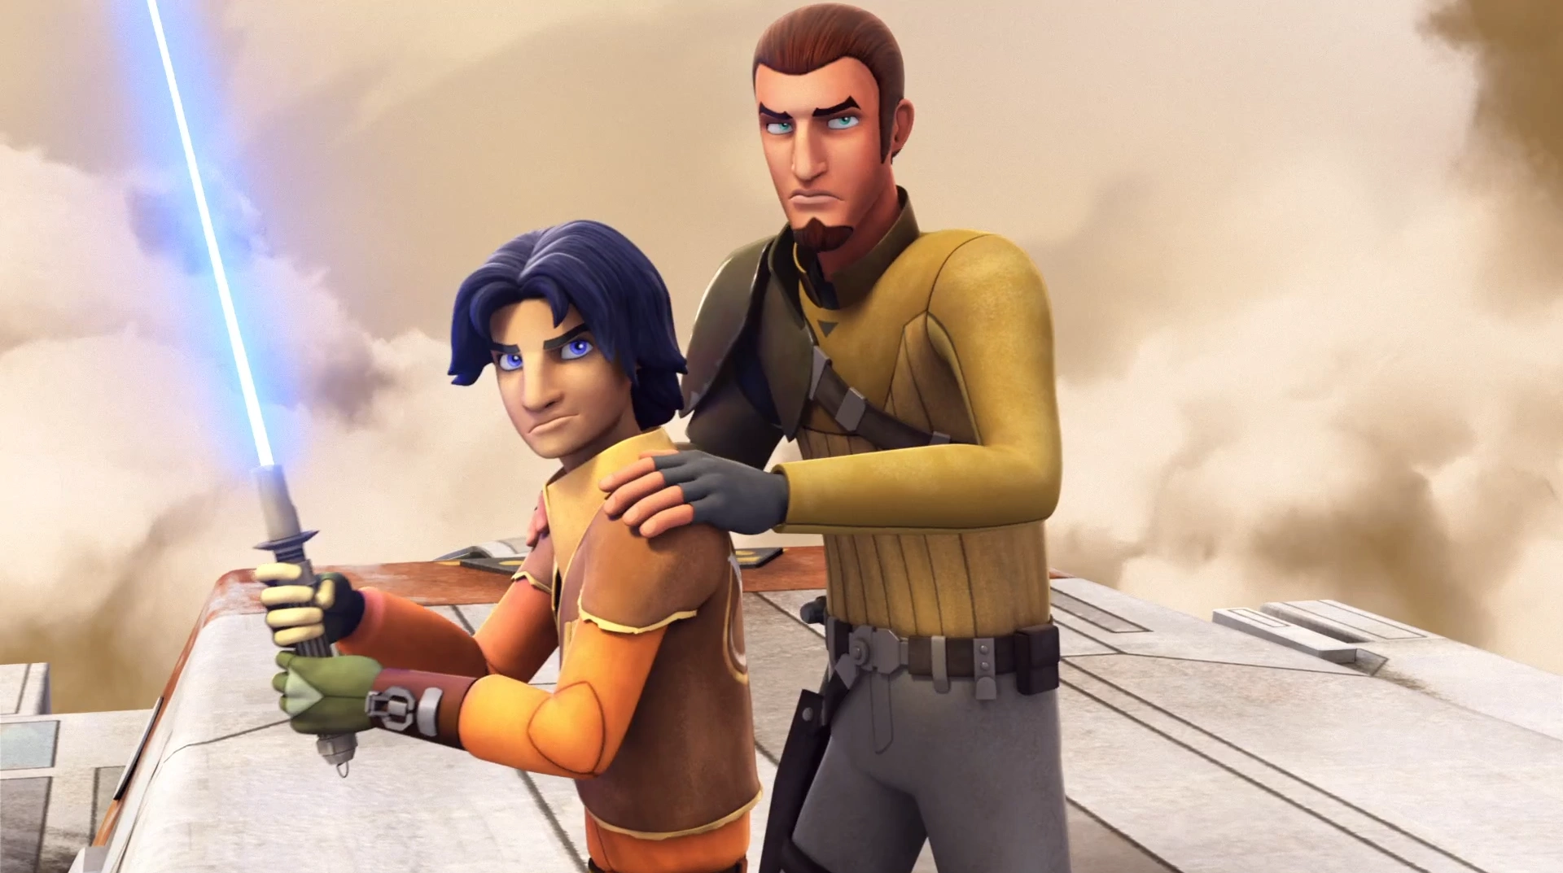
WHO’S MY MATE?
KANAN JARRUS

