Slide 1
LEADER NOTES
Z-A : To pause letters appearing press ‘f’, to unpause press ‘f’ again
TNUH REGNEVACS : Find the opposites of the things listed. Click the timer to start (10 minutes)

Slide 2
SCOUT GAMES
OF

Slide 3
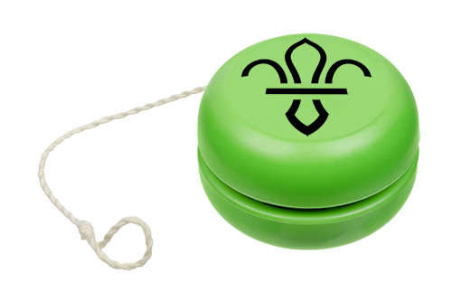
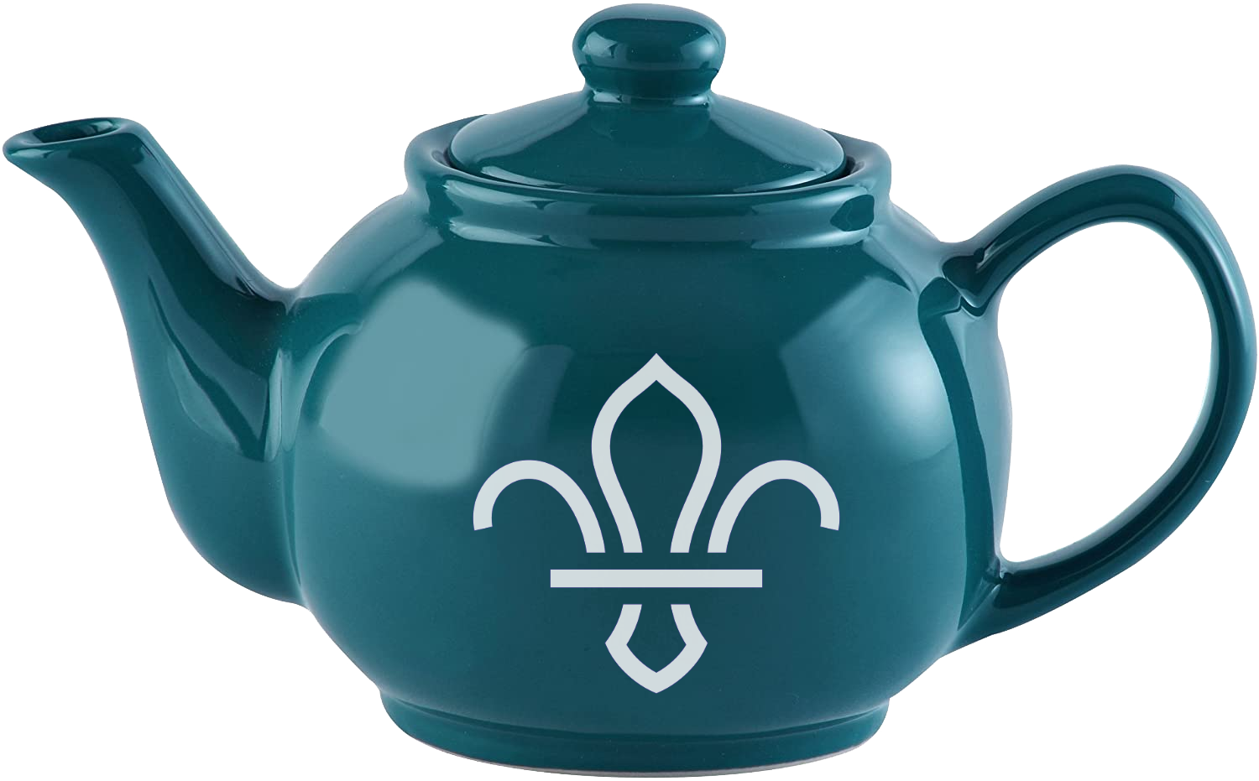
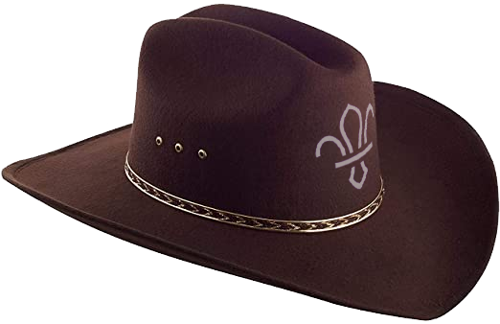
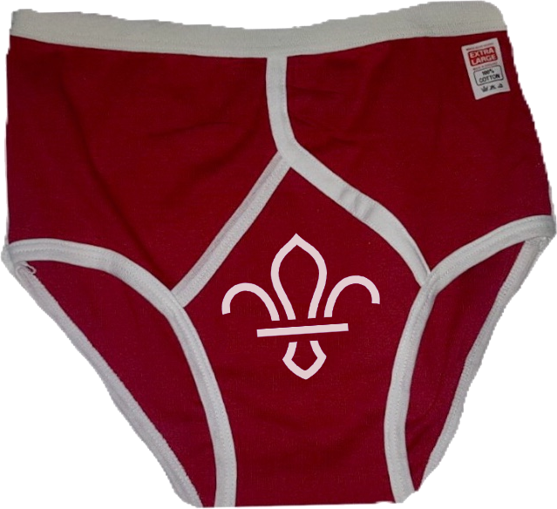
SCOUT OF GAMES
Hello, and welcome to everyone’s favourite Game Show,
Scout of Games.
Let’s take a look at the prizes on offer today, what would you like to win?

Slide 4
Z - A
Notes:
https://www.classtools.net/blog/z-a-word-association-quiz-for-startersplenaries/
Press ‘F’ to pause and resume letters appearing

Slide 5
Z - A
I’ve written 3 words that are linked in some way
The letters will be filled in from Z to A
Give me the link to win the point
For Example:
L
E
M
O
N
A
D
E
F
A
N
T
A
C
O
K
E
Fizzy Drinks

Slide 6
Z
Y
X
W
V
U
T
S
R
Q
P
O
N
M
L
K
J
I
H
G
F
E
D
C
B
A
T
E
N
N
I
S
F
O
O
T
B
A
L
L
P
I
N
G
-
P
O
N
G
BALL GAMES

Slide 7
Z
Y
X
W
V
U
T
S
R
Q
P
O
N
M
L
K
J
I
H
G
F
E
D
C
B
A
B
U
Z
Z
R
E
X
W
O
O
D
Y
TOY STORY CHARACTERS

Slide 8
Z
Y
X
W
V
U
T
S
R
Q
P
O
N
M
L
K
J
I
H
G
F
E
D
C
B
A
G
L
O
V
E
S
H
A
T
S
C
A
R
F
WINTER CLOTHES

Slide 9
Z
Y
X
W
V
U
T
S
R
Q
P
O
N
M
L
K
J
I
H
G
F
E
D
C
B
A
Y
E
L
L
O
W
R
E
D
G
R
E
E
N
COLOURS

Slide 10
Z
Y
X
W
V
U
T
S
R
Q
P
O
N
M
L
K
J
I
H
G
F
E
D
C
B
A
T
E
S
C
O
A
S
D
A
M
O
R
R
I
S
O
N
S
SUPERMARKETS

Slide 11
Z
Y
X
W
V
U
T
S
R
Q
P
O
N
M
L
K
J
I
H
G
F
E
D
C
B
A
D
R
U
M
G
U
I
T
A
R
T
R
U
M
P
E
T
INSTRUMENTS

Slide 12
Z
Y
X
W
V
U
T
S
R
Q
P
O
N
M
L
K
J
I
H
G
F
E
D
C
B
A
O
X
Y
G
E
N
Z
I
N
C
I
R
O
N
CHEMICAL ELEMENTS

Slide 13
Z
Y
X
W
V
U
T
S
R
Q
P
O
N
M
L
K
J
I
H
G
F
E
D
C
B
A
T
E
N
T
T
O
R
C
H
B
L
A
N
K
E
T
THINGS TO TAKE CAMPING

Slide 14
Z
Y
X
W
V
U
T
S
R
Q
P
O
N
M
L
K
J
I
H
G
F
E
D
C
B
A
P
O
T
A
T
O
C
A
R
R
O
T
S
W
E
D
E
VEGETABLES

Slide 15
Z
Y
X
W
V
U
T
S
R
Q
P
O
N
M
L
K
J
I
H
G
F
E
D
C
B
A
S
W
E
D
E
N
F
R
A
N
C
E
S
W
I
T
Z
E
R
L
A
N
D
EUROPEAN COUNTRIES

Slide 16
Z
Y
X
W
V
U
T
S
R
Q
P
O
N
M
L
K
J
I
H
G
F
E
D
C
B
A
D
O
G
F
I
S
H
H
A
M
S
T
E
R
HOUSEHOLD PETS

Slide 17
Z
Y
X
W
V
U
T
S
R
Q
P
O
N
M
L
K
J
I
H
G
F
E
D
C
B
A
B
M
W
F
O
R
D
R
E
N
A
U
L
T
CAR MANUFACTURERS

Slide 18
Z
Y
X
W
V
U
T
S
R
Q
P
O
N
M
L
K
J
I
H
G
F
E
D
C
B
A
M
O
U
S
E
K
E
Y
B
O
A
R
D
M
O
N
I
T
O
R
PARTS OF A COMPUTER

Slide 19
Z
Y
X
W
V
U
T
S
R
Q
P
O
N
M
L
K
J
I
H
G
F
E
D
C
B
A
C
A
R
D
C
H
E
Q
U
E
C
A
S
H
WAYS TO PAY FOR THINGS

Slide 20
Z
Y
X
W
V
U
T
S
R
Q
P
O
N
M
L
K
J
I
H
G
F
E
D
C
B
A
A
P
P
L
E
B
A
N
A
N
A
K
I
W
I
FRUIT

Slide 21
THE BACKWARDS ROUND
Notes:
https://www.youtube.com/watch?v=GZebJs0VrFs

Slide 22
THE BACKWARDS ROUND
Everything in this round is backwards
I will ask the question backwards and you need to give me the answer backwards
For Example:
What does USA stand for?
For stand ASU does what?
America of States United
United States of America

Slide 23
What is The Main River in London?
London in River Main The is What?
Thames River
River Thames

Slide 24
What is The Main Vitamin in An Orange?
Orange An in Vitamin Main The is What?
C Vitamin
Vitamin C

Slide 25
Who is The Chief Scout?
Scout Chief The is Who?
Grylls Bear
Bear Grylls

Slide 26
What Spiky Mammal lives in Britain?
Britain in lives Mammal Spiky What?
Hog Hedge
Hedgehog

Slide 27
In What Nursery Rhyme does the “Cow jump over the moon”?
“Moon the over jump Cow” the does Rhyme Nursery What In?
Diddle Diddle Hey
Hey Diddle Diddle

Slide 28
What Ocean is Between the UK and USA?
USA and UK the Between is Ocean What?
Ocean Atlantic North
North Atlantic Ocean

Slide 29
What award do you get for completing all of the Challenge Badges?
Badges Challenge the of all completing for get you do award What?
Award Gold Scouts Chief
Chief Scouts Gold Award

Slide 30
What is the Name of the big clock in London?
London in clock big the of Name the is What?
Ben Big
Big Ben

Slide 31
You Are Part of Which Scout Group?
Group Scout Which of Part Are You?
Scouts Heath Squirrels 8th
8th Squirrels Heath Scouts

Slide 32
Who is The UK Prime Minister?
Minister Prime UK The is Who?
Johnson Boris
Boris Johnson

Slide 33
What Film Is This Character From?
From Character This Is Film What?
Ralph It Wreck
Wreck It Ralph

Slide 34
Which Country is This?
This is Country Which?
Ireland of Republic
Republic of Ireland

Slide 35
What Is This Symbol Called?
Called Symbol This Is What?
Yang Ying
Ying Yang

Slide 36
Who Is This Telly Tubby?
Tubby Telly This Is Who?
Winky Tinky
Tinky Winky

Slide 37
Who Is This Famous Character?
Character Famous This Is Who?
Bond James
James Bond

Slide 38
OPPOSITES ATTRACT
Notes:
https://www.youtube.com/watch?v=kEmCDbHeK-A

Slide 39
OPPOSITES ATTRACT
I’m going to give you some categories and some hints to things from those categories
The hints will be the exact opposite of the answer
For Example: Bands
Give This
Take That

Slide 40
Bands
Hot Pause
Coldplay

Slide 41
Bands
King
Queen

Slide 42
Bands
Frontstreet Girl
Backstreet Boys

Slide 43
Bands
Red Night
Green Day

Slide 44
Bands
Knives and Celebrations
Guns and Roses

Slide 45
Birds
Spit
Swallow

Slide 46
Birds
Slow
Swift

Slide 47
Birds
Queen Sushi
Kingfisher

Slide 48
Birds
Donating
Robin

Slide 49
Birds
Extinguished Stop
Flamingo

Slide 50
Films
Melted
Frozen

Slide 51
Films
Slow and Calm
Fast and Furious

Slide 52
Films
Outside In
Inside Out

Slide 53
Films
Nurse Do-a-Lot
Dr Dolittle

Slide 54
Films
The Bad, The Good, and The Handsome
The Good, The Bad, and The Ugly

Slide 55
TNUH REGNEVACS

Slide 56
TNUH REGNEVACS
Lose as few of these as you can’t
- Something Heavy
- Something Opaque
- Something Red
- Something You Wear On Your Hands
- Something Dull
- Something Hard
- Something Quiet
- Something You Wear When It’s Hot

Slide 57
THANKS FOR PLAYING
How did you score?
I hope you had fun, stay safe, and keep washing your hands!
SCOUT OF GAMES Is a rip off of the popular television programme House of Games, from whom I did not get permission to make this. Let’s hope Richard Osman doesn’t sue me!

