Slide 3
As the blocks disappear Say what you see….

Slide 5
Chip off the old block

Slide 7
The grass is always greener on the other side

Slide 9
Every cloud has a silver lining

Slide 10
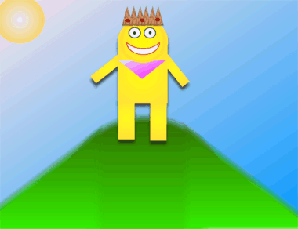

Slide 11
King of the hill

Slide 13
Falling on Deaf ears

Slide 15
Blast from the past

Slide 17
Bad hair day

Slide 19
Catch 22

Slide 21
Cat out of the bag

Slide 23
Falling from grace

Slide 25
Hand in hand

Slide 27
Keep an eye on things

Slide 29
Put your money where your mouth is

Slide 31
Split Second

Slide 33
Two timer

Slide 35
Digging a hole for yourself

Slide 37
Keep it under your hat

Slide 39
Cost an arm and a leg

Slide 41
Going round in circles

Slide 43
Surf the web

Slide 44
That’s all for now. Thanks for playing.

