Slide 1
SKILLS CHALLENGE
Show you understand why eating a sensible diet and getting enough sleep is important.

Slide 2
DIET & HEALTHY EATING
NUTRIENTS
FOOD GROUPS & BALANCED DIET
HIDDEN SUGAR
WHY IS HEALTHY EATING IMPORTANT?

Slide 3
Nutrients
CARBOHYDRATES
PROTEINS
FATS
CALCIUM
IRON
WHY DO I NEED THIS?
Starchy carbohydrates are the best source of energy
For growth, maintenance and repair of the body
Some fat is needed but it needs to be the right type of fat and the right amount
For healthy teeth and bones
For healthy blood and for transporting oxygen around the body
WHAT SORT OF FOOD IS GOOD FOR THIS?
SATURATED FAT
Fatty meats, butter, lard, & products made from these (like cakes, biscuits)
UNSATURATED FAT
Olive/rapeseed/sunflower oils, oily fish, nuts & seeds
Milk, yogurt, cheese, soya beans, tofu, green leafy vegetables, bread made with fortified flour and fish that have edible bones
Lean meat, liver, wholegrain cereals, pulses, beans, nuts, sesame seeds, dried fruit and fortified breakfast cereals
Potatoes, breads, rice, pasta, oats, breakfast cereals, cous cous and other grains
Lean meat, fish, dairy products, eggs, pulses, beans and soya products

Slide 4
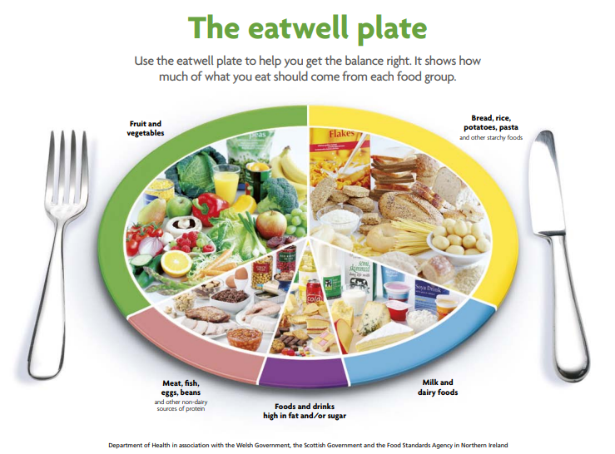
Food Groups
Don’t forget to drink plenty of water to keep hydrated!

Slide 5
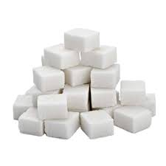
Hidden Sugar
What is a hidden sugar?
It’s the sugar that is ‘hidden’ (either naturally or added) in foods which you might consider healthy or good for you but could be bad for you if you eat too much.
Examples include:
Pasta sauces
Fruit juices (and fruit!)
Breakfast cereals
Yogurts
Ketchups & sauces
How many sugar cubes should you have a day maximum?
4-6 year olds 5
7-10 year olds 6
11 and above 7
(1 sugar cube = 1 teaspoon of sugar)

Slide 6
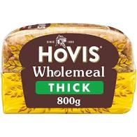
Hidden Sugar
Can you organise these pictures into order from LEAST sugar to the MOST sugar content?
2 slices
THE ANSWERS!
2 slices
1 cube
3.8g
4.2 cubes
16.8g
4.5 cubes
16.8g
4.9 cubes
19.6g
6 cubes
24g
8.6 cubes
34.4g
11.5 cubes
46g
14.25 cubes
57g

Slide 7
Why is Healthy Eating important?
Eating a nutritious, balanced diet is important for a number of reasons:
Ensuring you get the right vitamins and minerals in your diet helps you grow and develop optimally
Proper diet will keep you energised and motivated
It can help support your ability to learn and concentrate
Helps maintain a healthy weight
Can prevent many chronic diseases such as heart disease or Type 2 diabetes
Eating healthily as a child will help you make healthier choices as adults.
Calorie Quiz

Slide 8
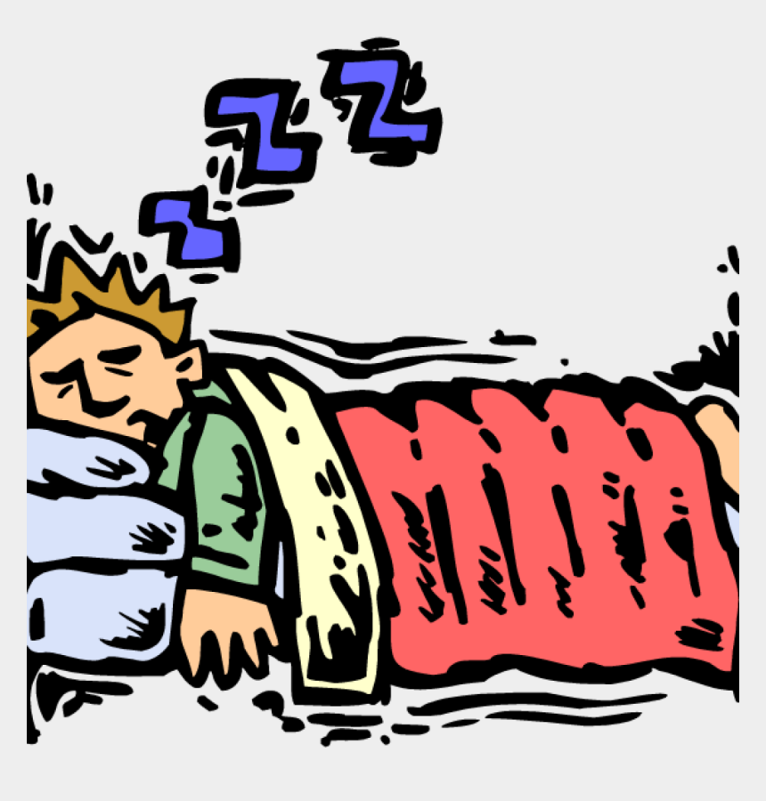
SLEEP
HOW MUCH SLEEP SHOULD YOU BE GETTING?
WHAT CAN HAPPEN IF YOU DON’T GET ENOUGH SLEEP?
WHAT CAN HELP YOU SLEEP?

Slide 9
How much sleep should you be getting?
Imagine you have to get up at 7am.
What time would you normally go to sleep (not go to bed)? Write your answer in the chat box.
Is there a difference between the time you go to bed and the time you go to sleep?
How much sleep do you think you need?
For the example above….
So in an ideal world, the younger scouts should be asleep by 9.15pm and the oldest should be asleep by 10.00pm.
Is that the case?
Age | Sleep Needed
10 | 9.75hrs
11 | 9.5hrs
12 | 9.25hrs
13 | 9.25hrs
14 | 9hs
(Millpond Children’s Sleep Clinic – NHS)

Slide 10
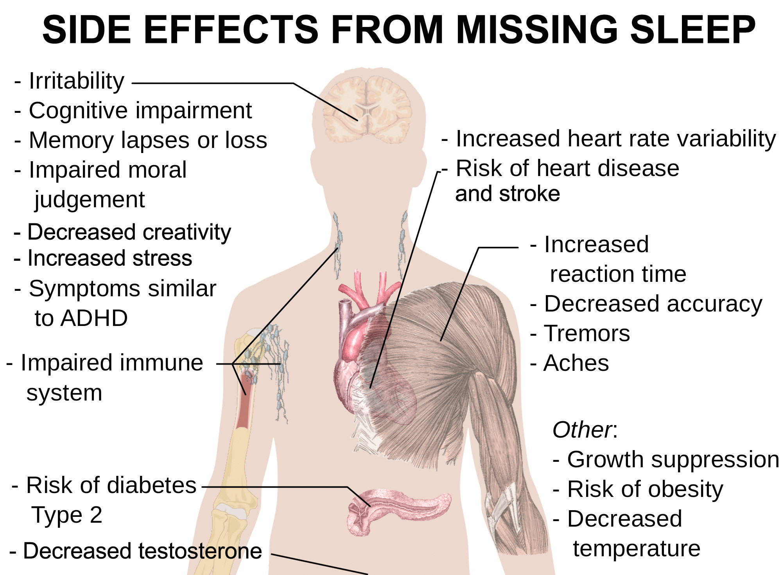
What if you don’t get enough sleep?
Some of the main effects for children who don’t get enough sleep include:
Physical health and development: Sleep contributes to the effective function of virtually every system of the body. It empowers the immune system, helps regulate hormones, and enables muscle and tissue recovery.
Weight gain: Lack of sleep can make you feel hungrier, so you are drawn to eat more. Plus, lack of sleep also affects your metabolism. Not getting enough sleep raises the risk of diabetes and unhealthy weight gain in kids and adults.
Bad moods: Lack of sleep can make it difficult for you to regulate your emotions. Overtime, not getting enough sleep can increase risk of depression, anxiety and substance abuse in teens.
Trouble in school: Sleep is essential for building memory and allows you to concentrate better.
Bad judgment: If you are overtired you are more likely to make poor decisions or take part in riskier activities.
Anything here that surprises you?

Slide 11
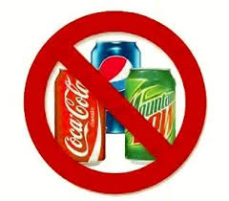
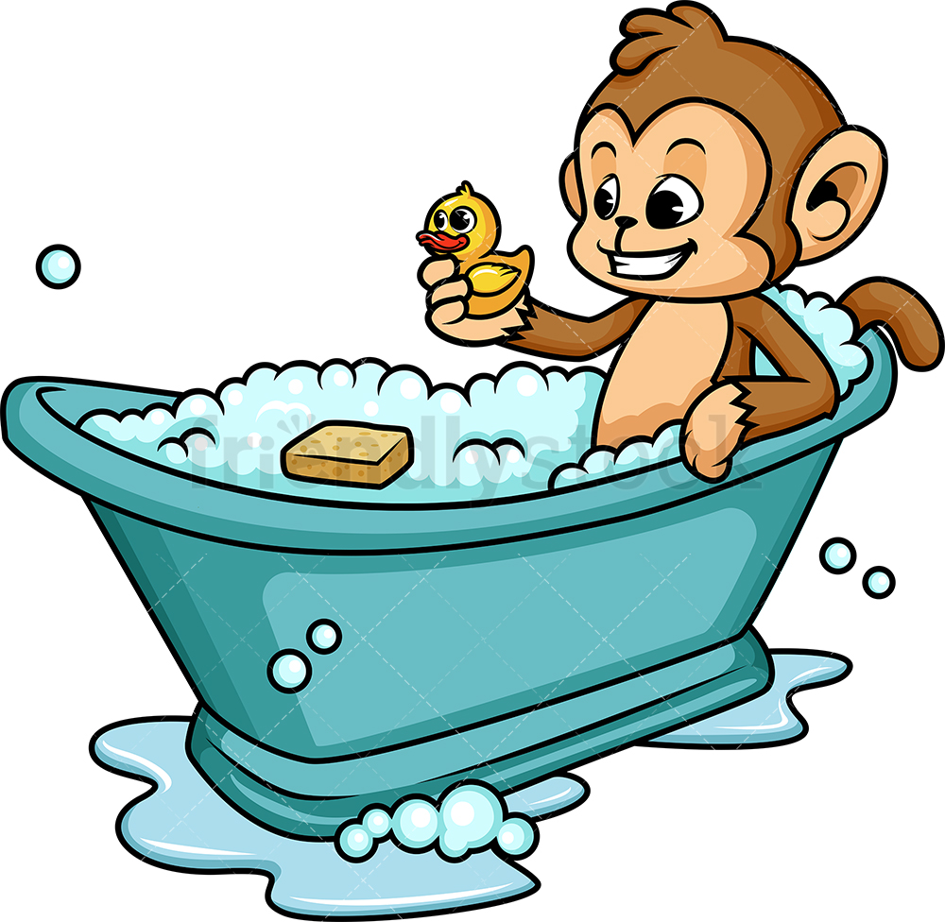
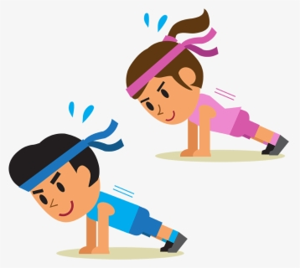
What can help you sleep?
Can you think of anything which might help you sleep better?
A relaxing bedtime routine:
Avoid heavy meals before sleep and reduce intake of caffeine and other stimulants (sugar, coke etc.) several hours before bedtime. A hot milky drink is good.
A warm (not hot) bath will help you relax and get ready for sleep.
Keeping lights dim encourages your body to produce the sleep hormone, melatonin.
Fix your bedroom:
Your bedroom should ideally be dark, quiet and tidy. It should be well ventilated and kept at a temperature of about 16 to 20C.
Avoid screens in the bedroom:
Tablets, smartphones, TVs and other electronic gadgets can affect how easily you get to sleep.
Try to keep your bedroom a screen-free zone.
Stop using screens an hour before bedtime – read a book instead
Exercise:
Daily physical activity improves sleep, helps with stress management and promotes general health, but don’t do heavy exercise within 3 hours of bedtime.

