Slide 1
Stop Motion Animation
What Do You Need?

Slide 2
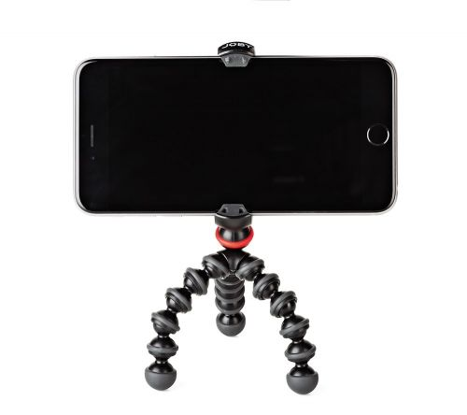
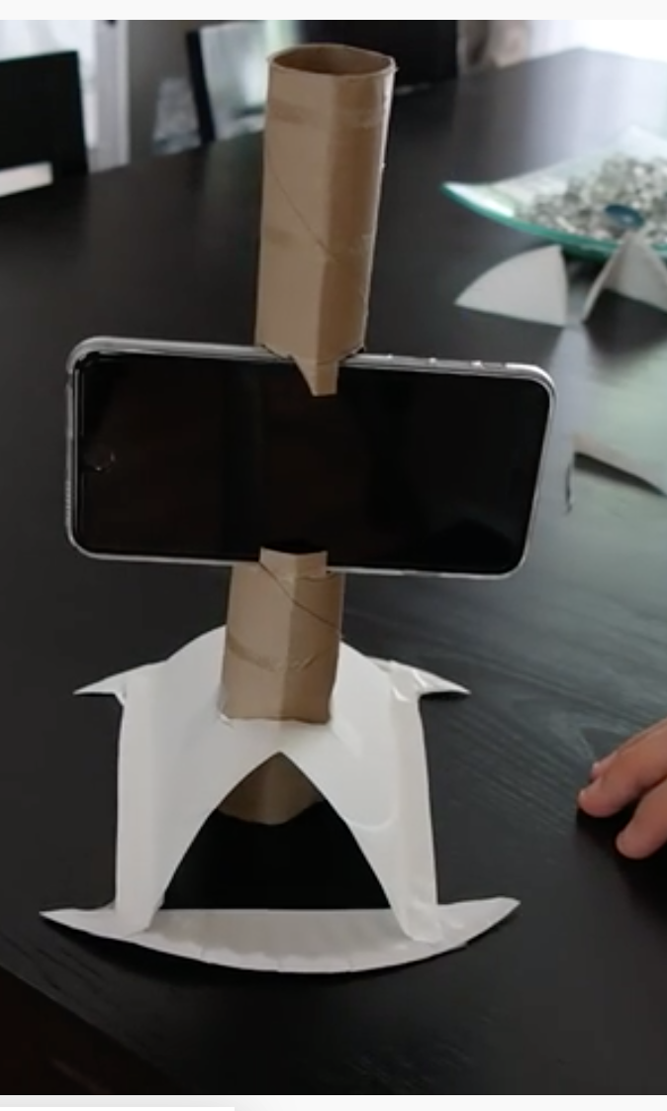
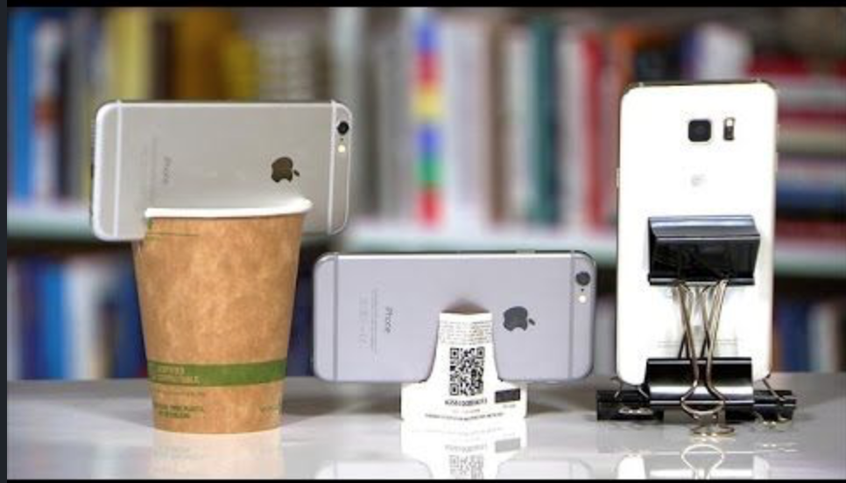
Phone or tablet
+
Stand (optional)

Slide 3
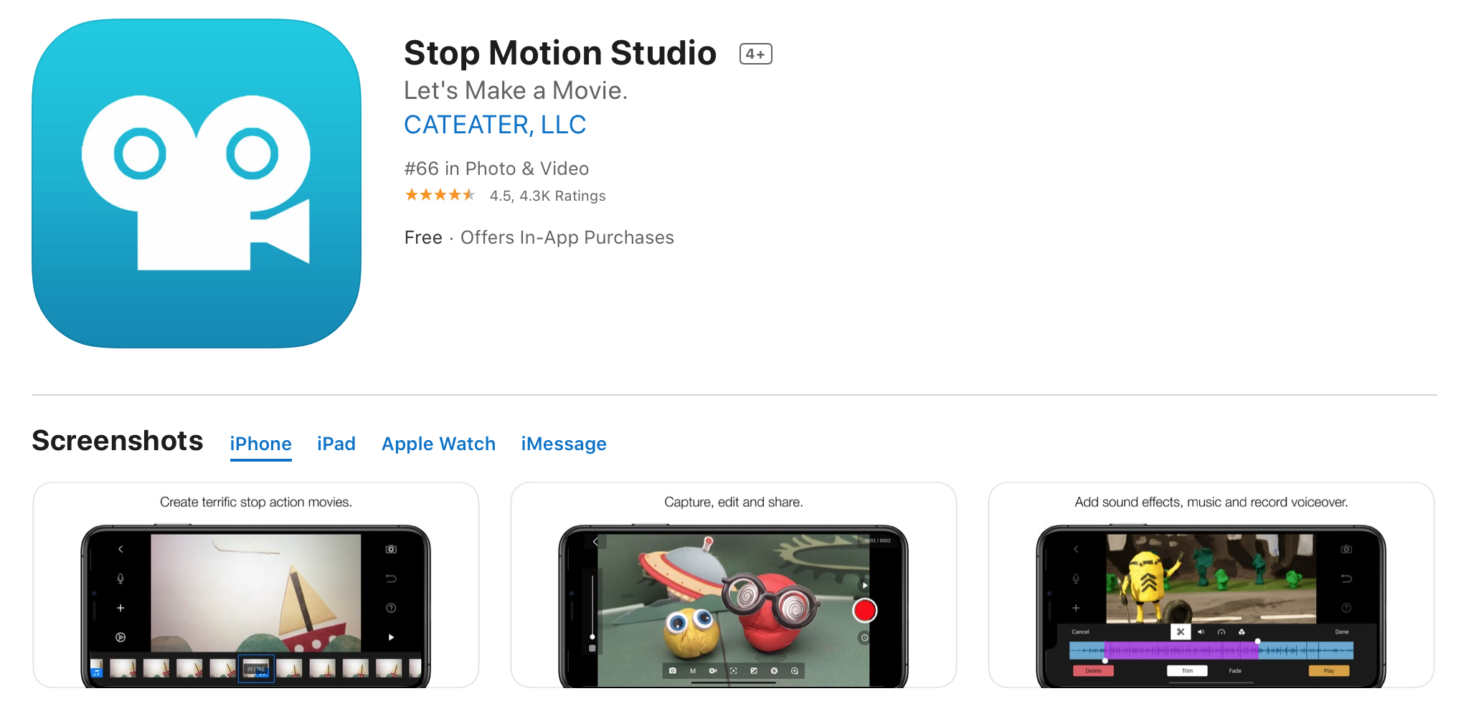
Stop Motion App

Slide 4
Patience

Slide 5
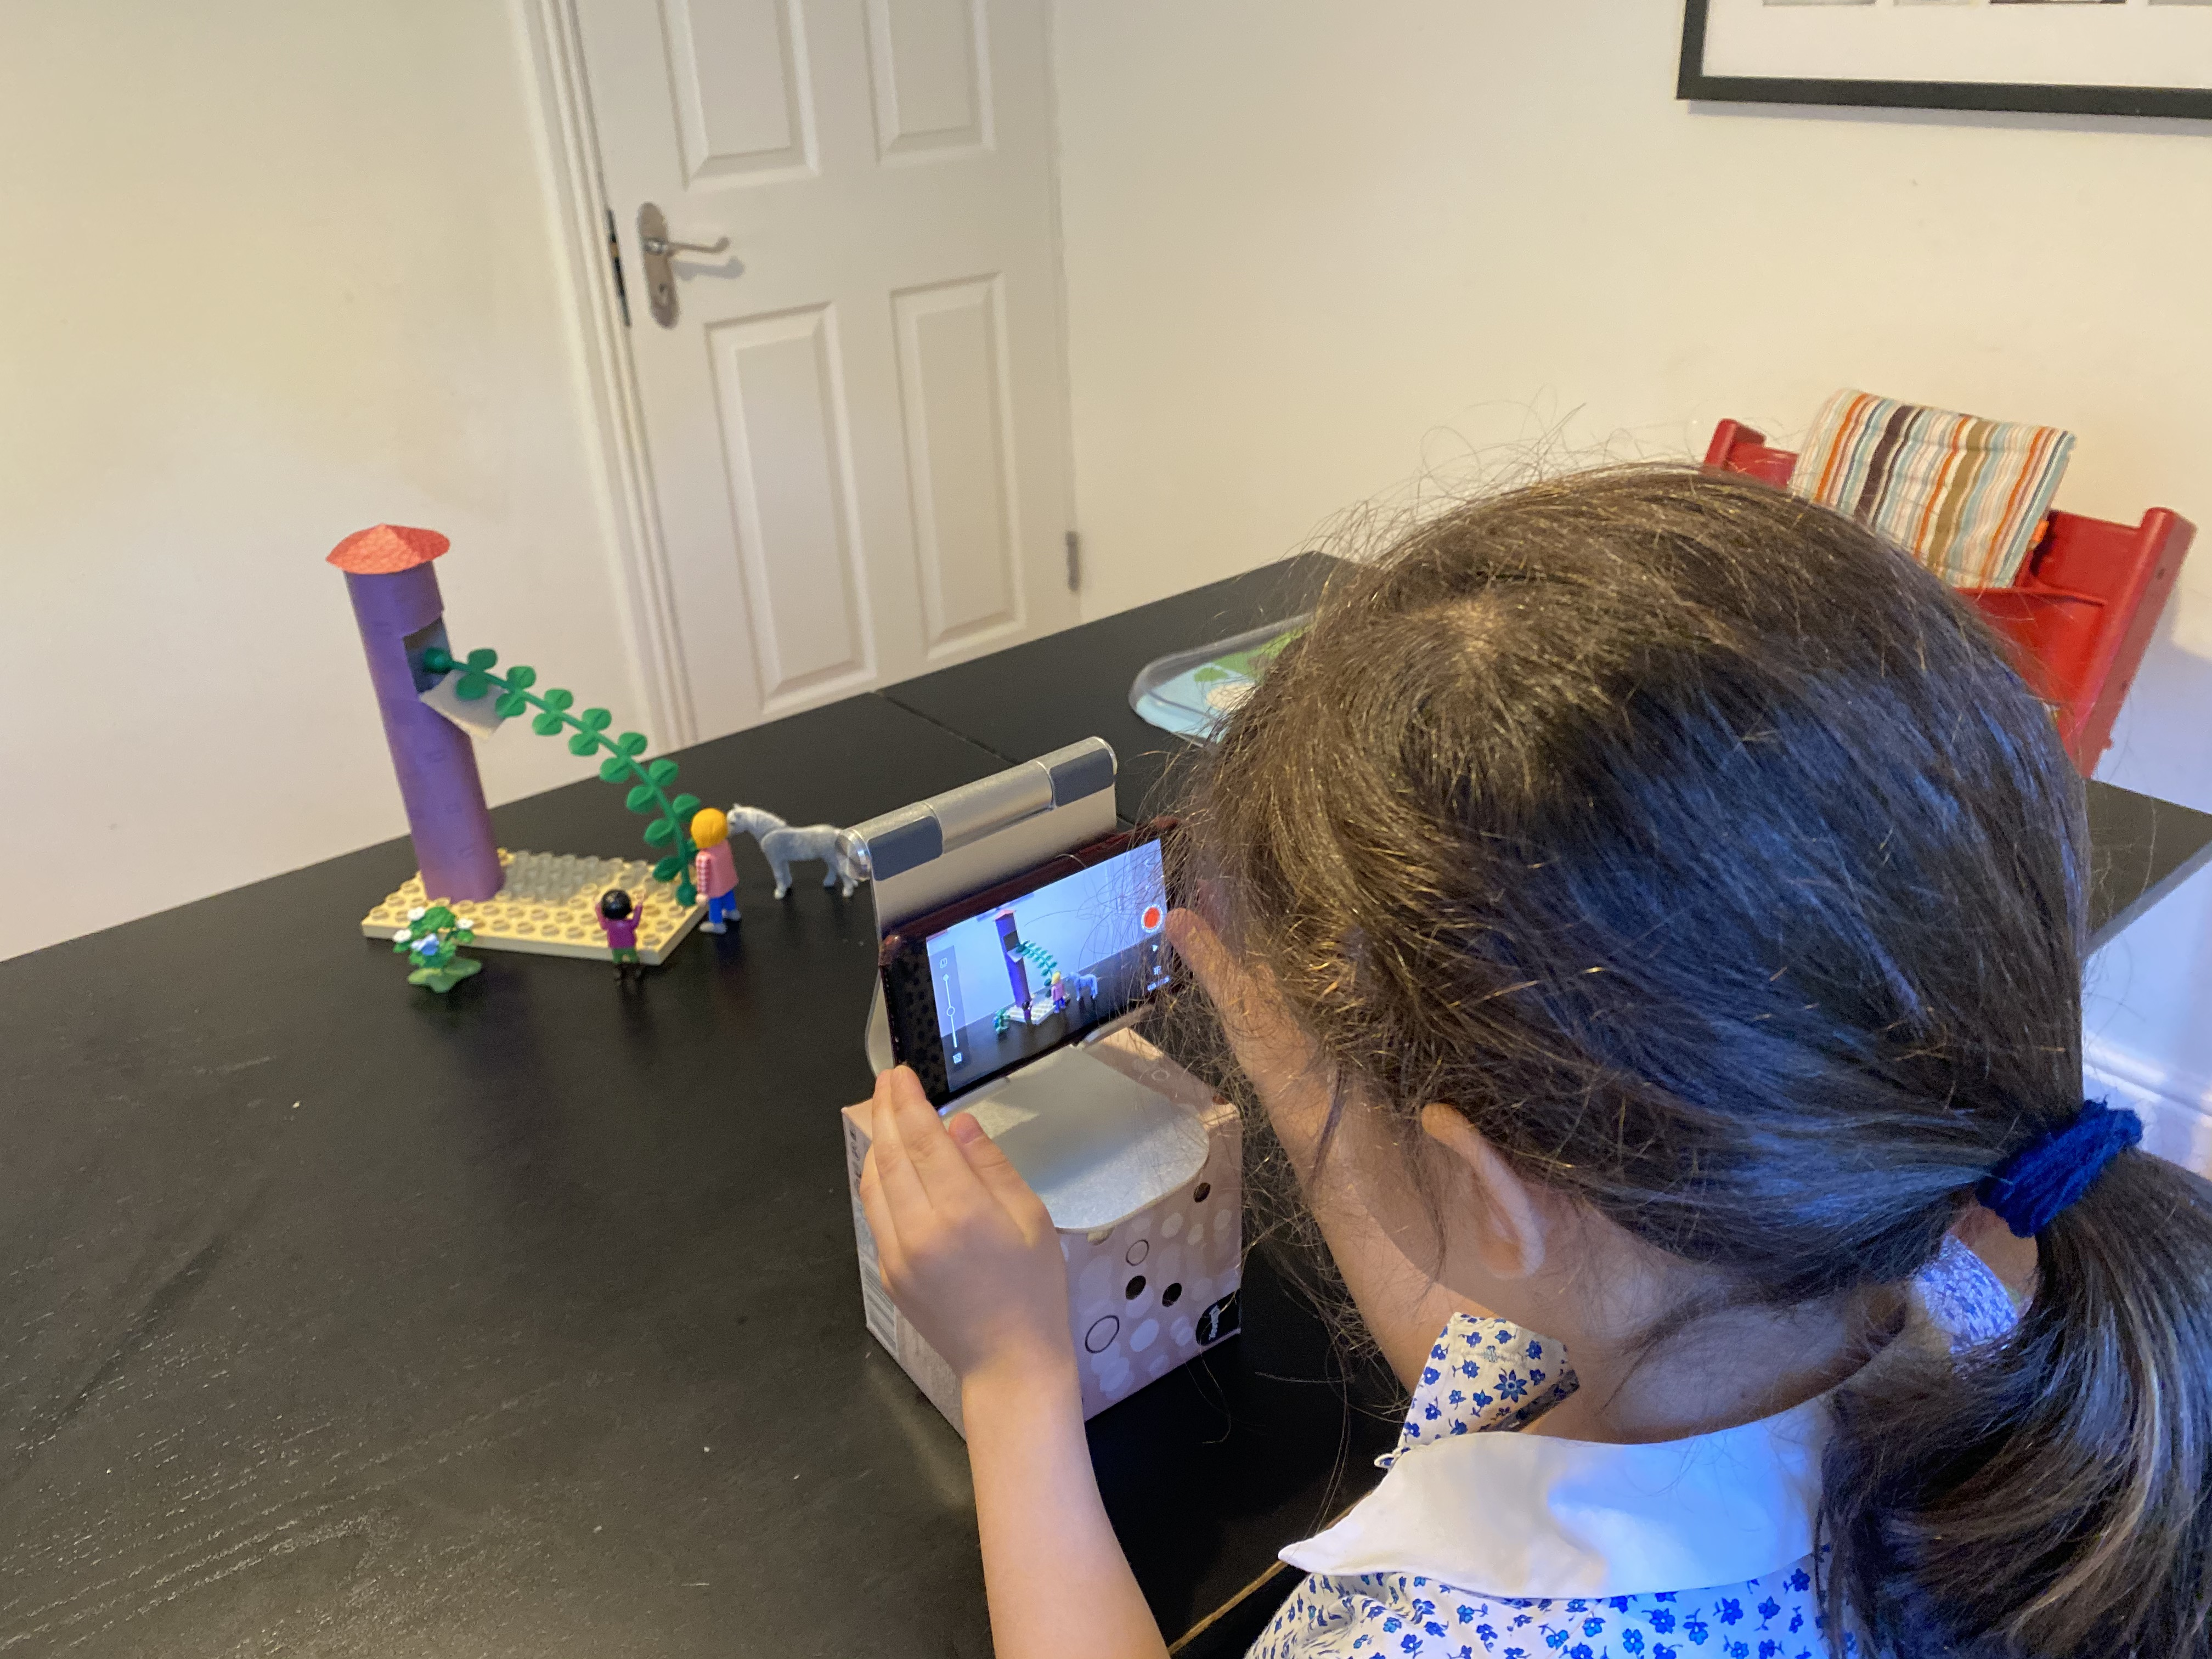

Slide 6
Steps
Select New Movie
Give access to camera if needed
Select camera
Take a photo
Move object
Repeat steps 4,5
Play to watch the movie so far
Advanced Features
Timer - takes photo every 5 seconds so you just need to move the object
Voice over - record voice/sounds

Slide 8
Have Fun!

