Slide 1
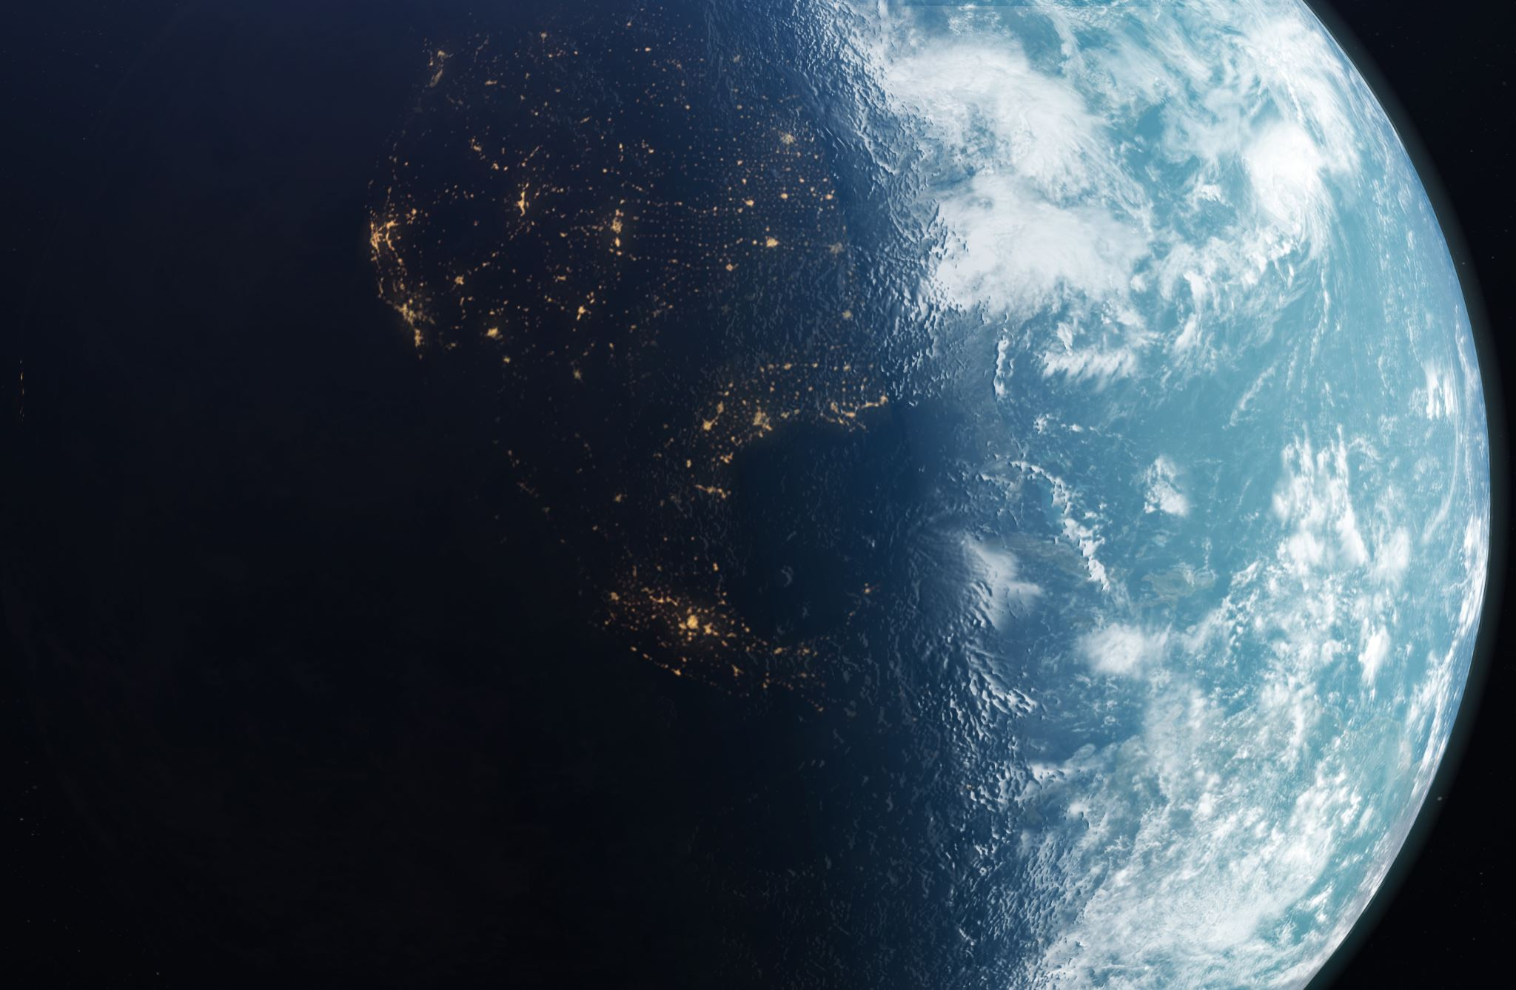
The World Scout Membership badge
Scouts from around the World wear the membership badge; but do we know what it means?
31 million people in 216 countries are members

Slide 2
The World Scout Badge

Slide 3
Why the purple background?
Because it’s a nice colour
Because it was Lord Baden Powell’s favorite colour
Purple denotes leadership and service
It makes the badges cheaper

Slide 4
The Encircling rope, what does this mean?
It shows that Scouts like to tie knots
Its to show that Scouts do a lot of camping
It looks nice
It symbolises the Unity and the family of the World Scout Movement

Slide 5
Why the reef knot?
It can’t be undone no matter how hard it is pulled is a symbolic of the strength of the World Scouting’s unity and family
Its an easy knot to learn
Looks nice
Easy to print on a badge

Slide 6
The parts of the Arrowhead design, what do these mean?
Its for Beavers
Its for the Cubs
Its for the Scouts
Its for the Explorers
Its part of our promise, Duty (or Service) to others

Slide 7
The parts of the Arrowhead design, what do these mean?
Its for Beavers
Its for the Cubs
Its for the Scouts
Its for the Explorers
Its part of our promise, Duty to self (following the Scout laws)

Slide 8
The parts of the Arrowhead design, what do these mean?
Its for Beavers
Its for the Cubs
Its for the Scouts
Its for the Explorers
Its part of our promise, Duty to God

Slide 9
The two five pointed stars, what do these mean?
These stand for truth and knowledge.
The ten points represent the ten points of the original Scout law
Its because all the leaders are stars
Decoration

Slide 10
The band around the arrowhead, what does this mean?
It goes around the arrowhead to show that The Scouts are a Worldwide organisation
It means that we all act like Angels all the time
It indicates the bond of the family of Scouting
Because a triangle would look rubbish

Slide 11
So, can you remember?

