Slide 1
Pancake And Noodle Detective Agency

Slide 2
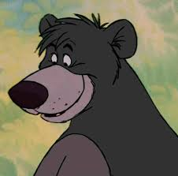
The Case
Baloo has been kidnapped!
However, he has managed to leave
some messages to
help us identify
who has taken him.
KIDNAPPED

Slide 3
P.A.N.D.A
These messages have been passed to the Pancake And Noodle Detective Agency (P.A.N.D.A)
It seems that some of these
messages have been written in code to stop the kidnapper reading them.
The Agency has asked for our
help to decode some of messages

Slide 4
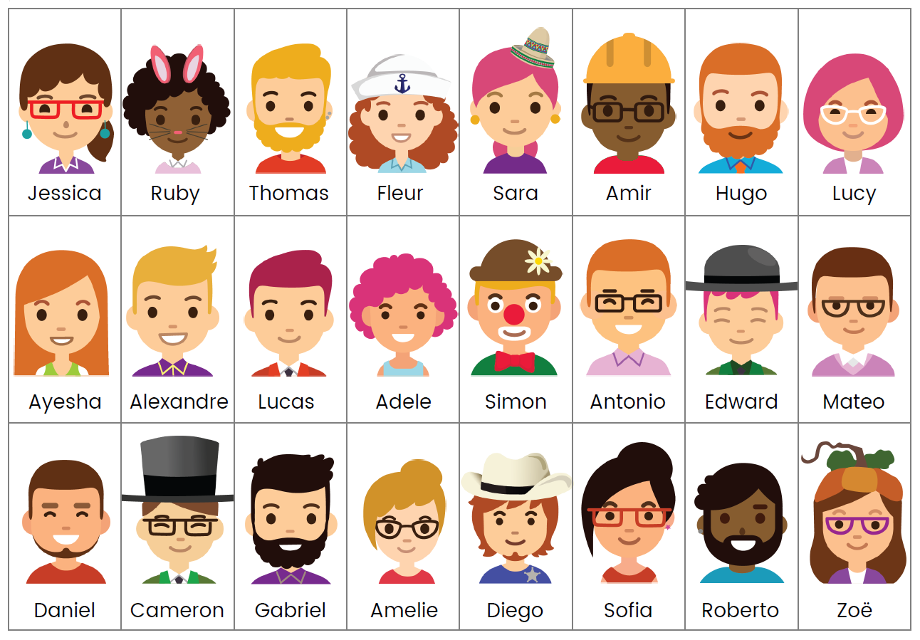
Suspects
Using the information so far, P.A.N.D.A have managed to create this
list of suspects. Can you help to crack
the remaining codes and rescue Baloo?!

Slide 5
Code 1
Letter-Number Cypher

Slide 6
Code 1
Letter-Number Cypher
13 . 25 11 . 9 . 4 . 14 . 1 . 16 . 16 . 5 . 18
9 . 19 13 . 1 . 12 . 5
A | B | C | D | E | F | G | H | I | J | K | L | M | N | O | P | Q | R
S | T | U | V | W | X | Y | Z

Slide 7
Code 1
Letter-Number Cypher
13 . 25 11 . 9 . 4 . 14 . 1 . 16 . 16 . 5 . 18
9 . 19 13 . 1 . 12 . 5
8 . 5 . 12 . 16
H . E . L . P
A | B | C | D | E | F | G | H | I | J | K | L | M | N | O | P | Q | R
S | T | U | V | W | X | Y | Z

Slide 8
Code 1
Letter-Number Cypher
13 . 25 11 . 9 . 4 . 14 . 1 . 16 . 16 . 5 . 18
9 . 19 13 . 1 . 12 . 5
8 . 5 . 12 . 16
H . E . L . P
A | B | C | D | E | F | G | H | I | J | K | L | M | N | O | P | Q | R
 |  |  |  | 5 |  |  | 8 |  |  |  | 12 |  |  |  | 16
S | T | U | V | W | X | Y | Z

Slide 9
Code 1
Letter-Number Cypher
13 . 25 11 . 9 . 4 . 14 . 1 . 16 . 16 . 5 . 18
9 . 19 13 . 1 . 12 . 5
8 . 5 . 12 . 16
H . E . L . P
A | B | C | D | E | F | G | H | I | J | K | L | M | N | O | P | Q | R
1 | 2 | 3 | 4 | 5 | 6 | 7 | 8 | 9 | 10 | 11 | 12 | 13 | 14 | 15 | 16 | 17 | 18
S | T | U | V | W | X | Y | Z
19 | 20 | 21 | 22 | 23 | 24 | 25 | 26

Slide 10
Code 1
Letter-Number Cypher
13 . 25 11 . 9 . 4 . 14 . 1 . 16 . 16 . 5 . 18
M . Y K . I . D . N . A . P . P . E . R
9 . 19 13 . 1 . 12 . 5
8 . 5 . 12 . 16
H . E . L . P
I . S M . A . L . E
A | B | C | D | E | F | G | H | I | J | K | L | M | N | O | P | Q | R
1 | 2 | 3 | 4 | 5 | 6 | 7 | 8 | 9 | 10 | 11 | 12 | 13 | 14 | 15 | 16 | 17 | 18
S | T | U | V | W | X | Y | Z
19 | 20 | 21 | 22 | 23 | 24 | 25 | 26

Slide 11
Suspects

Slide 12
Suspects

Slide 13
Code 2
Dots and Dashes

Slide 14
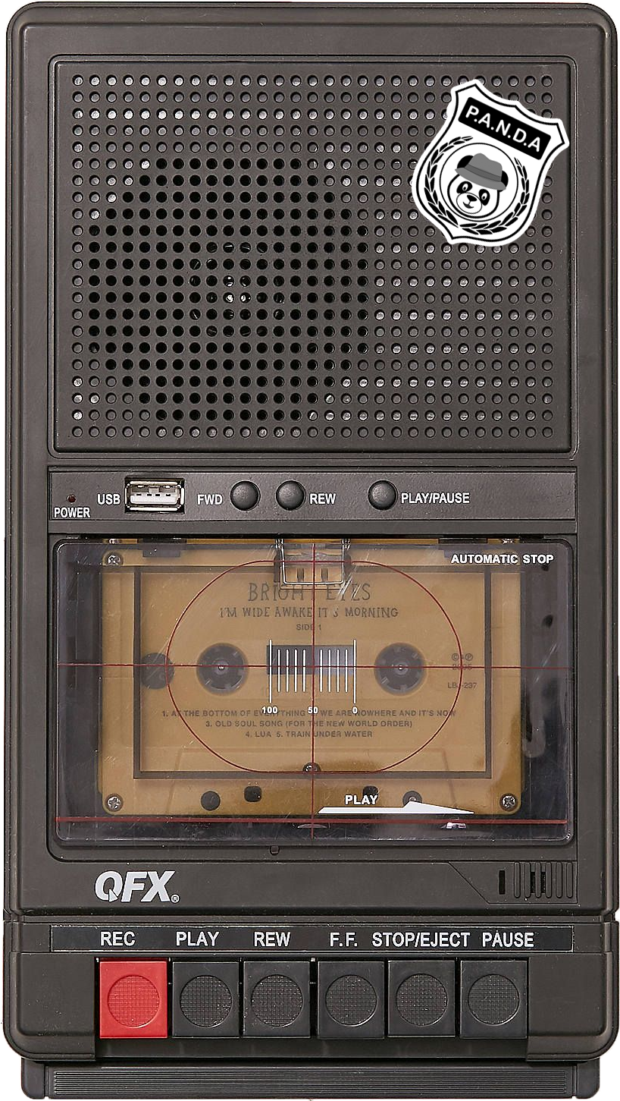
Code 2
Dots and Dashes
We have found a tape featuring a weird message
Listen carefully
We think it might contain some sort of code

Slide 15
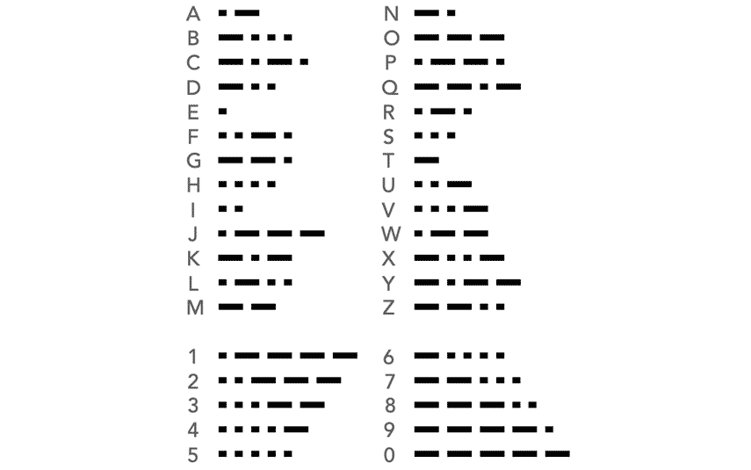
Code 2
Morse Code
.... .
-.. --- . ...
-. --- -
.... .- ...- .
.-
-... . .- .-. -..

Slide 16
Code 2
Morse Code
.... .
H E
-.. --- . ...
D O E S
-. --- -
N O T
.... .- ...- .
H A V E
.-
A
-... . .- .-. -..
B E A R D

Slide 17
Suspects

Slide 18
Suspects

Slide 19
Code 3
Code Wheels

Slide 20
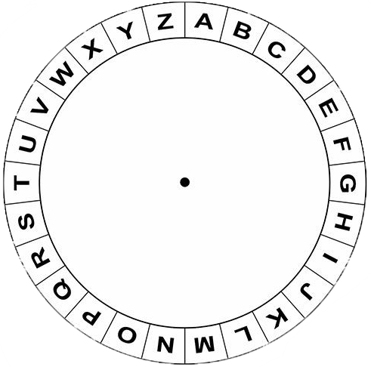
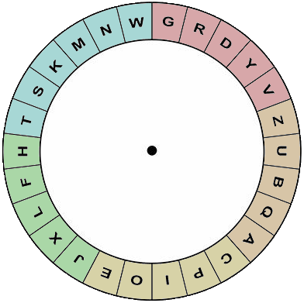
Code 3
Code Wheels
We found 2 code wheels and these notes from Baloo
I D B K
O D Y Q B N P
Y I Y J
A = P

Slide 21
Code 3
Code Wheels
The two wheels can be placed on top of each other
I D B K
O D Y Q B N P
Y I Y J
A = P

Slide 22
Code 3
Code Wheels
Rotate the middle circle
until the A on the outside
lines up with P on the inside
I D B K
O D Y Q B N P
Y I Y J
A = P

Slide 23
Code 3
Code Wheels
Now the wheels are aligned,
can you decode the message?
I D B K
O D Y Q B N P
Y I Y J
A = P

Slide 24
Code 3
Code Wheels
Look up the letter from the message on the outside wheel, and write down the letter on the inside wheel
I D B K
H
O D Y Q B N P
Y I Y J
A = P

Slide 25
Code 3
Code Wheels
I D B K
H E I S
O D Y Q B N P
W E A R I N G
Y I Y J
A = P
A H A T

Slide 26
Suspects

Slide 27
Suspects

Slide 28
Code 4
Alpha, Bravo, Charlie

Slide 29
Code 4
Alpha, Bravo, Charlie
We have received a
another message
from Baloo
Listen carefully
Hotel. Echo.
Whiskey. Echo. Alpha. Romeo. Sierra.
Golf. Romeo. Echo. Echo. November

Slide 30
Code 4
Alpha, Bravo, Charlie
Hotel. Echo.
Whiskey. Echo. Alpha. Romeo. Sierra.
Golf. Romeo. Echo. Echo. November
Hotel. Echo.
Whiskey. Echo. Alpha. Romeo. Sierra.
Golf. Romeo. Echo. Echo. November

Slide 31
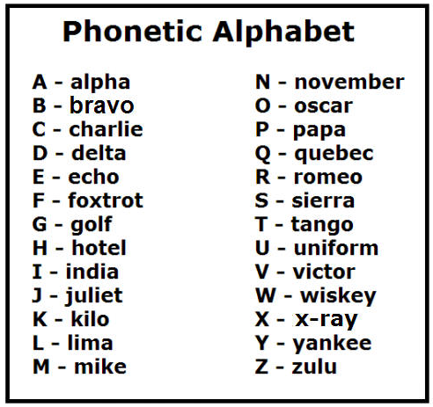
Code 4
Alpha, Bravo, Charlie
Hotel. Echo.
Whiskey. Echo. Alpha. Romeo. Sierra.
Golf. Romeo. Echo. Echo. November
Hotel. Echo.
Whiskey. Echo. Alpha. Romeo. Sierra.
Golf. Romeo. Echo. Echo. November

Slide 32
Code 4
Alpha, Bravo, Charlie
Hotel. Echo.
H . E
Whiskey. Echo. Alpha. Romeo. Sierra.
W . E . A . R . S
Golf. Romeo. Echo. Echo. November
G . R . E . E . N

Slide 33
Suspects

Slide 34
Suspects

Slide 35
Code 5
Pig Pens

Slide 36
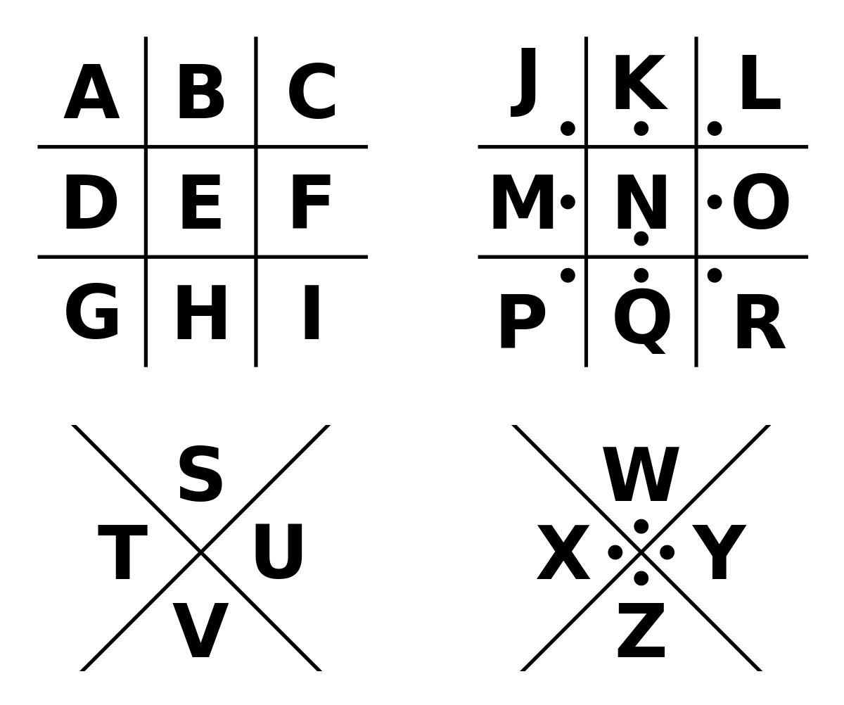
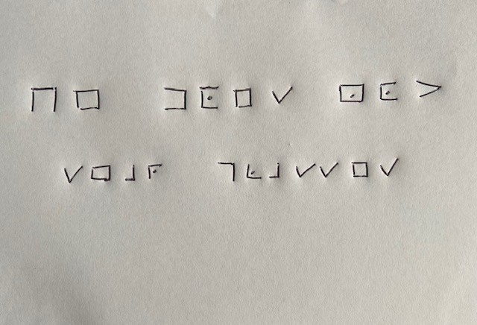
Code 5
Pig Pens

Slide 37
Code 5
Pig Pens
= B
= P
= V
= W

Slide 38
Code 5
Pig Pens
HE DOES NOT
H E D O E S N O T
WEAR GLASSES
W E A R G L A S S E S
= B
= P
= V
= W

Slide 39
Suspects

Slide 40
Suspects

Slide 41
Code 6
Grid References

Slide 42
Code 6
Grid References
63
R | J | K | C | U
E | A | QX | N | P
W | I | H | B | Y
D | S | L | T | G
Z | M | F | V | O
3360 3260 3259
62
3461 3261 3258 3161
61
3259 3459 3261 3162 3459 3259
60
3160 3260 3459 3360 …
59
58
31
32
33
34
35
36

Slide 43
Code 6
Grid References
63
R | J | K | C | U
E | A | QX | N | P
W | I | H | B | Y
D | S | L | T | G
Z | M | F | V | O
3360 3260 3259
62
3461 3261 3258 3161
61
3259 3459 3261 3162 3459 3259
60
3160 3260 3459 3360 …
59
58
31
32
33
34
35
36

Slide 44
Code 6
Grid References
63
R | J | K | C | U
E | A | QX | N | P
W | I | H | B | Y
D | S | L | T | G
Z | M | F | V | O
3360 3260 3259
62
3461 3261 3258 3161
61
3259 3459 3261 3162 3459 3259
60
3160 3260 3459 3360 …
59
58
3561 = P 3362 = K 3159 = D
31
32
33
34
35
36

Slide 45
Code 6
Grid References
63
R | J | K | C | U
E | A | QX | N | P
W | I | H | B | Y
D | S | L | T | G
Z | M | F | V | O
3360 3260 3259
H I S
62
3461 3261 3258 3161
N A M E
61
3259 3459 3261 3162 3459 3259
60
S T A R T S
3160 3260 3459 3360 …
59
W I T H ?
58
3561 = P 3362 = K 3159 = D
31
32
33
34
35
36

Slide 46
Code 6
Grid References
Hmm…
What does this mean?
Have we seen this before?
3360 3260 3259
H I S
3461 3261 3258 3161
N A M E
3259 3459 3261 3162 3459 3259
…
S T A R T S
3160 3260 3459 3360 …
W I T H ?

Slide 47
Code 6
Grid References
3360 3260 3259
H I S
3461 3261 3258 3161
N A M E
3259 3459 3261 3162 3459 3259
…
S T A R T S
3160 3260 3459 3360 …
W I T H ?

Slide 48
Code 6
Grid References
3360 3260 3259
H I S
3461 3261 3258 3161
N A M E
3259 3459 3261 3162 3459 3259
…
S
S T A R T S
3160 3260 3459 3360 …
W I T H ?

Slide 49
Code 6
Grid References
3360 3260 3259
H I S
3461 3261 3258 3161
N A M E
3259 3459 3261 3162 3459 3259
S T A R T S
3160 3260 3459 3360 …
W I T H S

Slide 50
Suspects

Slide 51
Suspects

Slide 52
Congratulations!
You have solved the case and managed to rescue Baloo!
KIDNAPPED

Slide 53
Pancake And Noodle Detective Agency

Slide 54
Extra Codes
We hope you enjoyed cracking each of the codes
Here are some extra ones, which show how
codes can be made harder so they take longer to crack

Slide 55
Extra Code 1
Letter-Number Cypher (with maths)
It can be quite easy for people to work out the
Letter-Number Cypher because all of the numbers will
be between 1 and 26
However, if you change each number into a maths question,
this becomes less obvious and takes people longer to decode

Slide 56
Extra Code 1
Letter- Number Cypher (with maths)
In order to decode this message
you will need to calculate the numbers
(3 x 6) . (8 + 7) . (4 ÷ 2) . (3 + 2) . (22 – 4) . (4 x 5)
(8 ÷ 4) . (16 – 15) . (2 x 2) . (15 ÷ 3) . (9 + 5)
(4 x 4) . (3 x 5) . (10 + 12 + 1) . (7 – 2) . (3 x 4) . (9 + 3)

Slide 57
Extra Code 1
Letter- Number Cypher (with maths)
Now you can decode the message
(18) . (15) . (2) . (5) . (18) . (20)
(2) . (1) . (4) . (5) . (14)
(16) . (15) . (23) . (5) . (12) . (12)

Slide 58
Extra Code 1
Letter- Number Cypher (with maths)
This could be made even more difficult by making the maths questions harder. But remember that not everyone will have a calculator!
(18) . (15) . (2) . (5) . (18) . (20)
R . O . B . E . R . T
(2) . (1) . (4) . (5) . (14)
B . A . D . E . N
(16) . (15) . (23) . (5) . (12) . (12)
P . O . W . E . L . L

Slide 59
Extra Code 2
Code Wheel (Double Encoded)
Once you have used the discs to decode a message, you can rotate the discs a second time and decode the message again.
This means that the answer from the first stage still looks like a coded message

Slide 60
Extra Code 2
Code Wheel (Double Encoded)
Line up the discs so that A = Z
MQ
GNQGTNV
1. A = Z 2. F = R

Slide 61
Extra Code 2
Code Wheel (Double Encoded)
Decode the message
MQ
GNQGTNV
1. A = Z 2. F = R

Slide 62
Extra Code 2
Code Wheel (Double Encoded)
The answer is still in code
You will need to decode it a second time to read it
MQ
LS
GNQGTNV
PFSPNFSG
1. A = Z 2. F = R

Slide 63
Extra Code 2
Code Wheel (Double Encoded)
Now change the discs so
F = R and decode it a second time
LS
PFSPNFSG
1. A = Z 2. F = R

Slide 64
Extra Code 2
Code Wheel (Double Encoded)
This could be repeated again and again.
Or you can use different wheels each time
LS
BE
PFSPNFSG
PREPARED
1. A = Z 2. F = R

Slide 65
Extra Code 3
Multiple Cyphers
You don’t just have to use one sort of code when creating the message. For example, you could use a combination of the Pig Pen and Grid Reference codes.
In this case you can actually choose whether to decode the whole grid and then find the references, or choose the reference square and just translate the ones you need. Either order works!

Slide 66
Extra Code 3
Multiple Cyphers
32
A | S | L | O | C | R | X
M | Y | M | A | F | L | Q
A | I | G | K | V | E | W
N | Z | L | B | I | B | O
Y | L | T | T | Z | K | J
K | H | B | N | D | H | E
L | W | C | U | R | G | I
X | J | S | I | S | C | F
G | P | F | H | F | R | E
O | F | Q | E | I | D | S
4924 5227 4829 5230 4725 5322
31
30
4822 5031 5125
29
28
4827 5128 5123 5326
27
26
25
24
23
22
47
48
49
50
51
52
53
54

Slide 67
Extra Code 3
Multiple Cyphers
32
A | S | L | O | C | R | X
M | Y | M | A | F | L | Q
A | I | G | K | V | E | W
N | Z | L | B | I | B | O
Y | L | T | T | Z | K | J
K | H | B | N | D | H | E
L | W | C | U | R | G | I
X | J | S | I | S | C | F
G | P | F | H | F | R | E
O | F | Q | E | I | D | S
4924 5227 4829 5230 4725 5322
31
30
4822 5031 5125
29
28
4827 5128 5123 5326
27
26
25
24
23
22
47
48
49
50
51
52
53
54

Slide 68
Extra Code 3
Multiple Cyphers
32
A | S | L | O | C | R | X
M | Y | M | A | F | L | Q
A | I | G | K | V | E | W
N | Z | L | B | I | B | O
Y | L | T | T | Z | K | J
K | H | B | N | D | H | E
L | W | C | U | R | G | I
X | J | S | I | S | C | F
G | P | F | H | F | R | E
O | F | Q | E | I | D | S
4924 5227 4829 5230 4725 5322
31
S K I L L S
30
4822 5031 5125
29
F O R
28
4827 5128 5123 5326
27
L I F E
26
25
24
23
22
47
48
49
50
51
52
53
54

Slide 69
Extra Code 3
Multiple Cyphers
32
A | S | L | O | C | R | X
M | Y | M | A | F | L | Q
A | I | G | K | V | E | W
N | Z | L | B | I | B | O
Y | L | T | T | Z | K | J
K | H | B | N | D | H | E
L | W | C | U | R | G | I
X | J | S | I | S | C | F
G | P | F | H | F | R | E
O | F | Q | E | I | D | S
4924 5227 4829 5230 4725 5322
31
S K I L L S
30
4822 5031 5125
29
F O R
28
4827 5128 5123 5326
27
L I F E
26
25
24
23
22
47
48
49
50
51
52
53
54

Slide 70
Pancake And Noodle Detective Agency

