Slide 1
You arrive first at the scene of an accident…

Slide 2
What is the ‘scene of an accident…’? Where could it be?

Slide 3
What should you do?

Slide 4
Check for Dangers
2. Check for Pokemon

Slide 5
No! Go back

Slide 6
Yes! You must be safe. It is the most important thing.

Slide 7
Things which might make it unsafe.....
Something might fall on you
Traffic
Electrical things
Strange liquids/chemicals
Smoke or Fire
A strange smell – open the door, get help
Broken glass

Slide 8
If it is not safe, get help! (I’ll tell you how to do that, in a moment)

Slide 9
If it is safe…….

Slide 10
Check the casualty
Someone who is hurt
Are their eyes open?
Are they awake?
Are they talking?
Do they make sense?
Are they breathing?

Slide 11
You are worried. Something isn’t right. What should you do?

Slide 12
1. Shout ‘help’ very loudly
2. Call 999

Slide 13
Yes! Try and get help from someone older than you.

Slide 14
Well done! Someone comes to help you but they are worried too. They ask you to call an ambulance. What number will you ring?

Slide 15
Try shouting for an adult first, so that they can decide what to do.
BUT if no one comes, you need to ring for an ambulance. What number will your ring?

Slide 16
You need to call 999 But how?

Slide 17
Find a phone

Slide 18
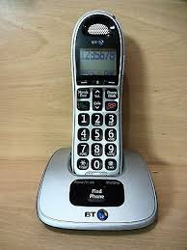
Pick the phone up
Press 999

Slide 19
On a mobile, press the home button

Slide 20
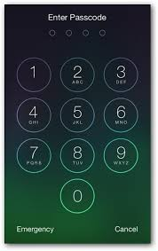
You should get to this screen
Press

Slide 21
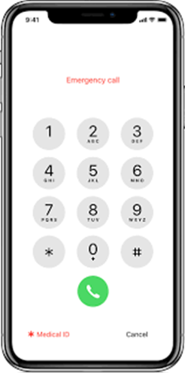
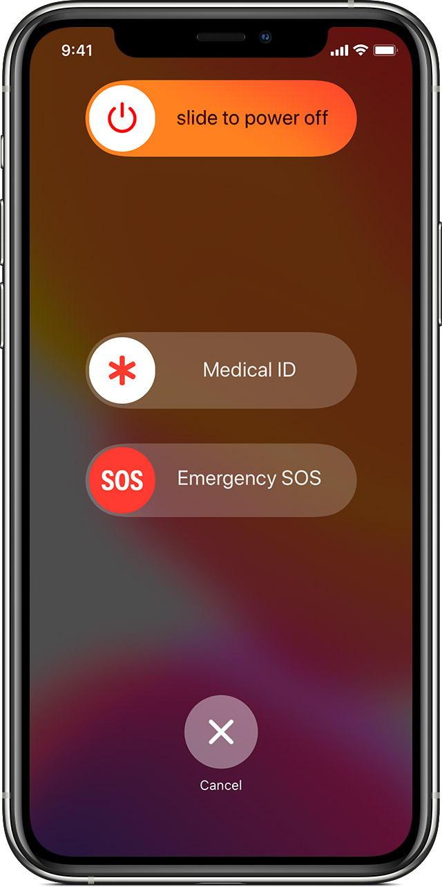
999

Slide 22
No one will EVER be cross with you for calling 999, if you are worried

Slide 23
When you ring 999, they will say, What do they mean?
“Which service please?”

Slide 24
Ambulance Fire brigade Police Coast Guard

Slide 25
Start talking! They will realise you are young and help you.

Slide 26
They might ask…
“What happened?”

Slide 27
“Is the casualty breathing?”
Is their chest going up and down
Can you feel breath coming from their nose or mouth

Slide 28
They may ask where you are…… don’t worry! They can find you if you aren’t sure.

Slide 29
Answer their questions

Slide 30
Don’t put the phone down.

Slide 31
If the casualty can hear you but needs help, you may need to talk to them to keep them calm. What could you do or say?

Slide 32
The ambulance is on its way
Help is coming
Everything is alright
Tell me where it hurts
They’ll be here soon

Slide 33
Homework 1. Get whoever is at home to show you how to use your phones to make a 999 call 2. Learn your address

