Slide 1
FaceMashes
9th Barnsley (Wombwell)

Slide 2
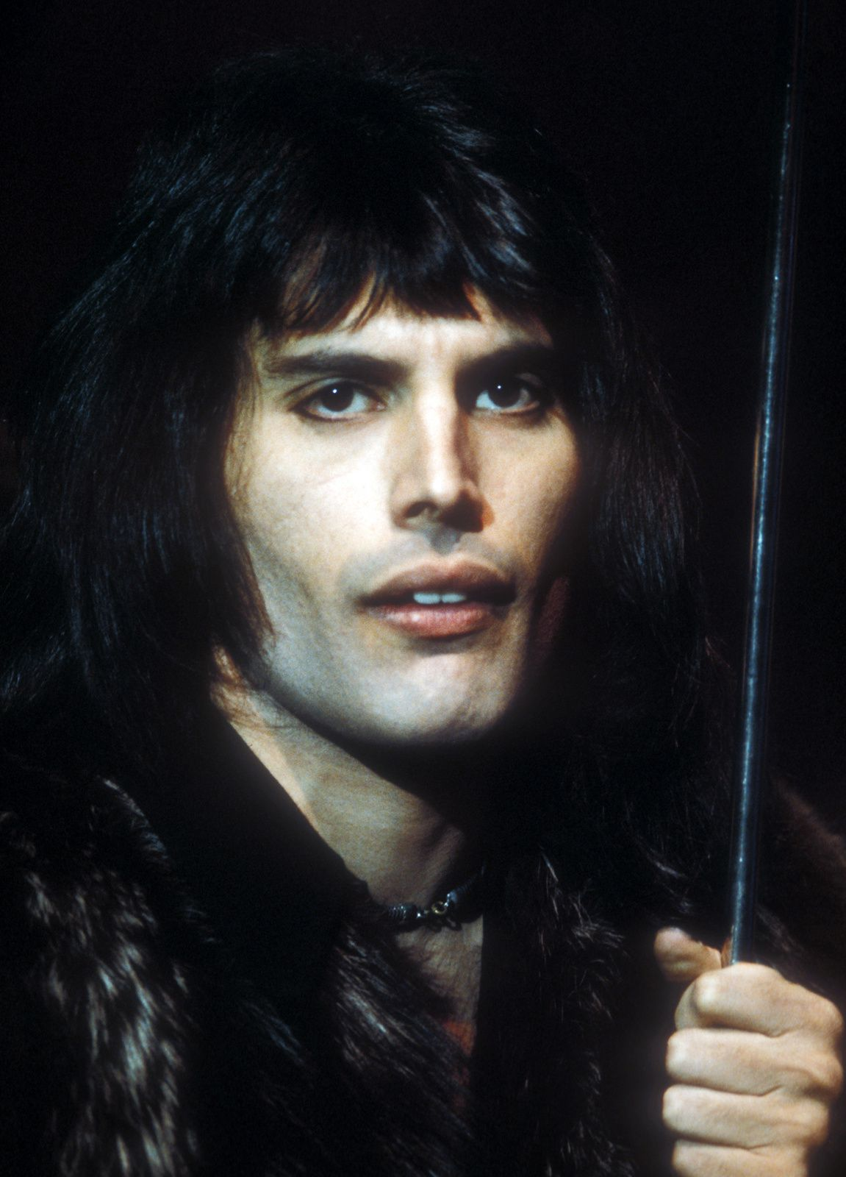
How it works: Freddie

Slide 3
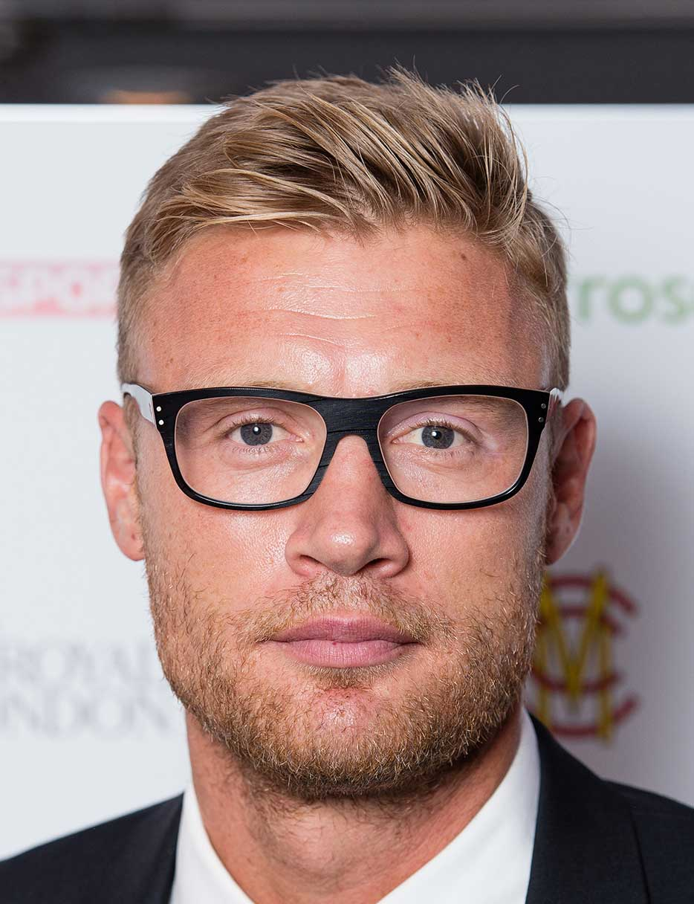
Freddie…
Flintoff
Mercury

Slide 4
1) Bob…

Slide 5
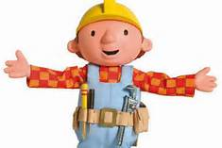
Bob…
The minion
the builder

Slide 6
2) Ash…

Slide 7
Ash…
Ketchum
Banjo

Slide 8
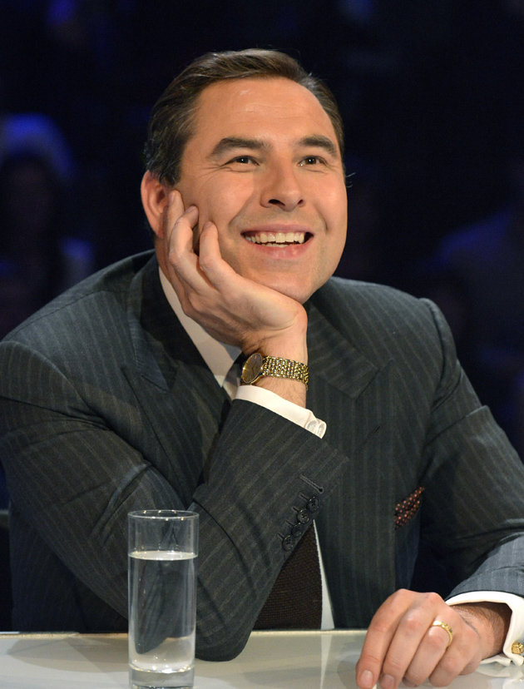
3) David…

Slide 9
David…
Walliams
Beckham

Slide 10
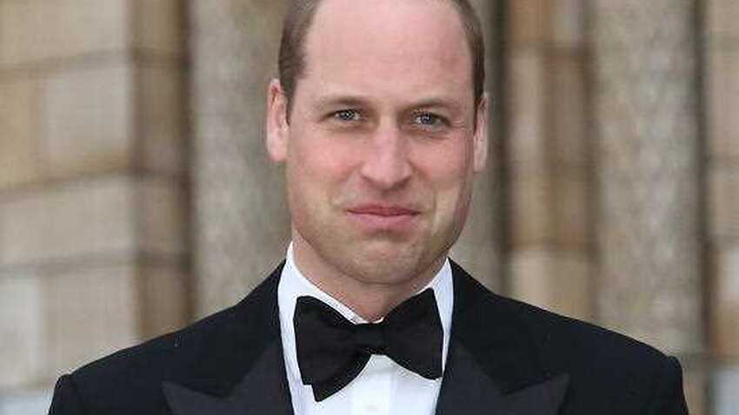
4) Will…

Slide 11
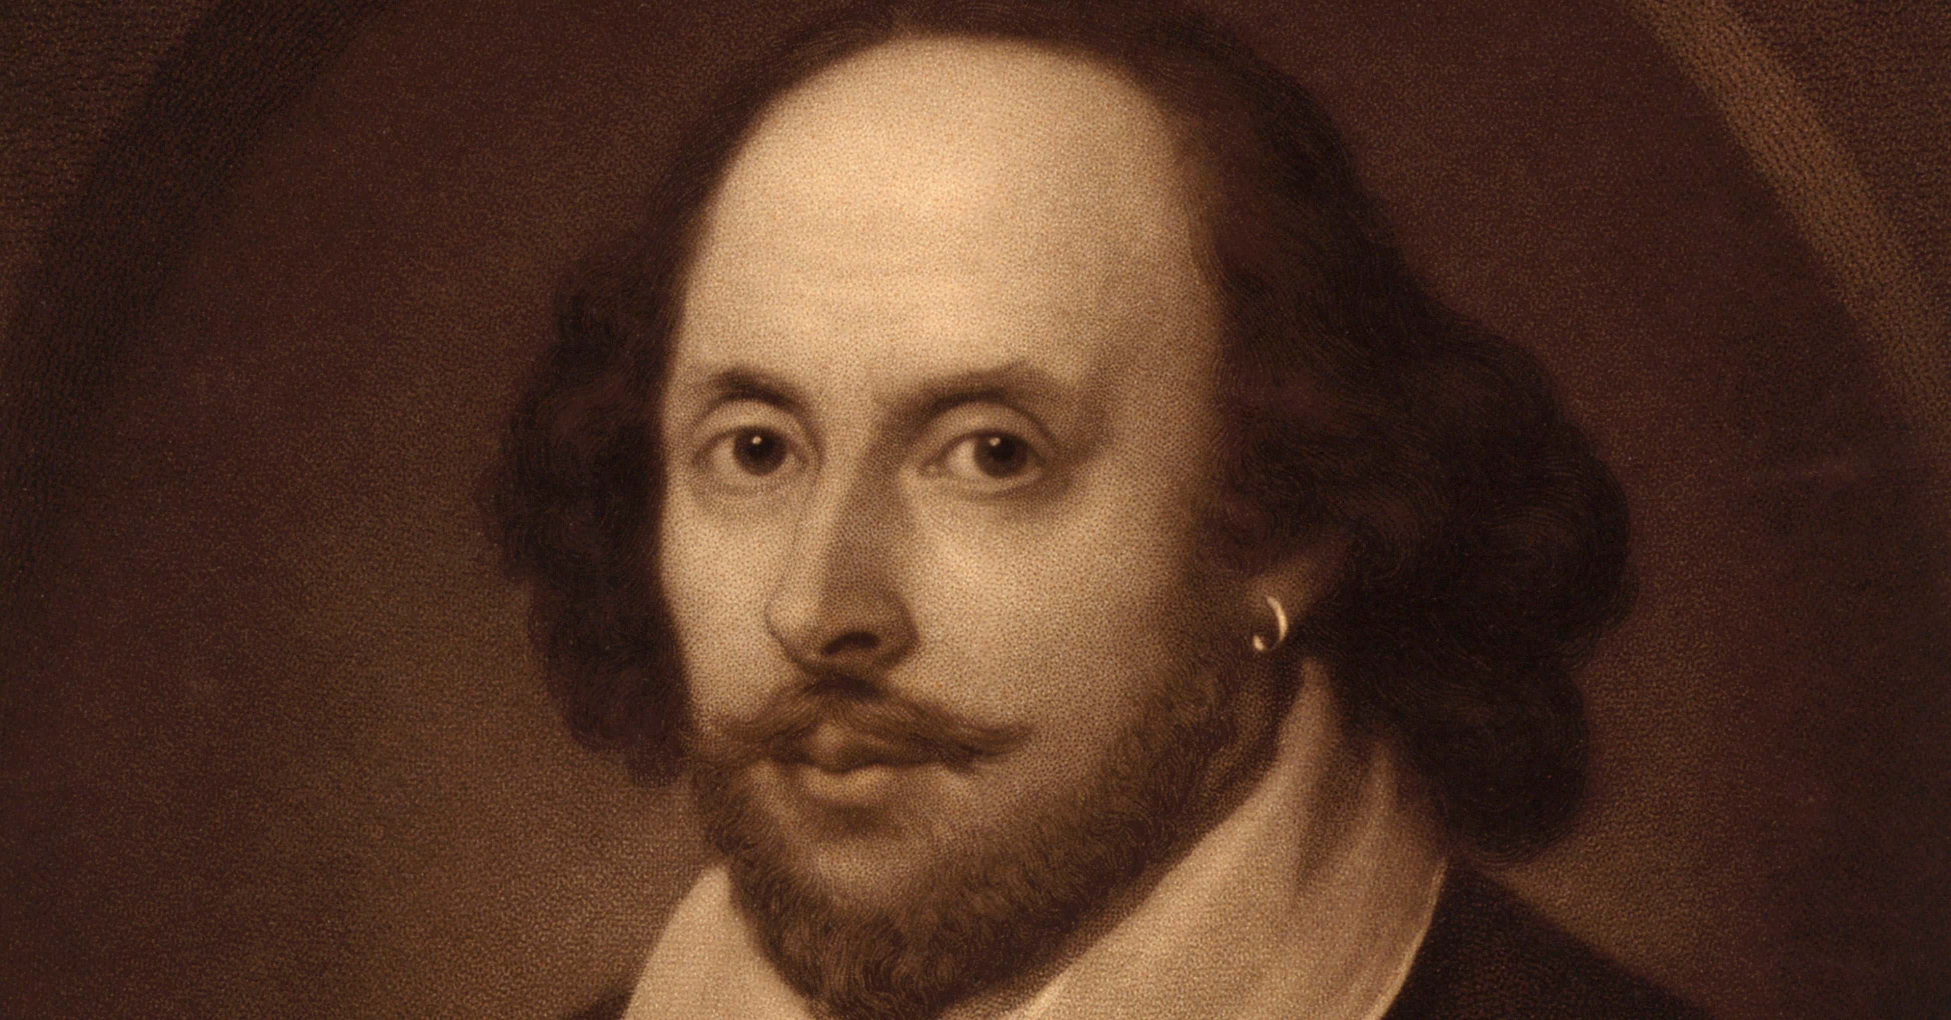
Will…
Windsor
Shakespeare

Slide 12
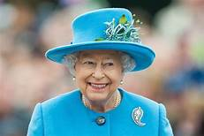
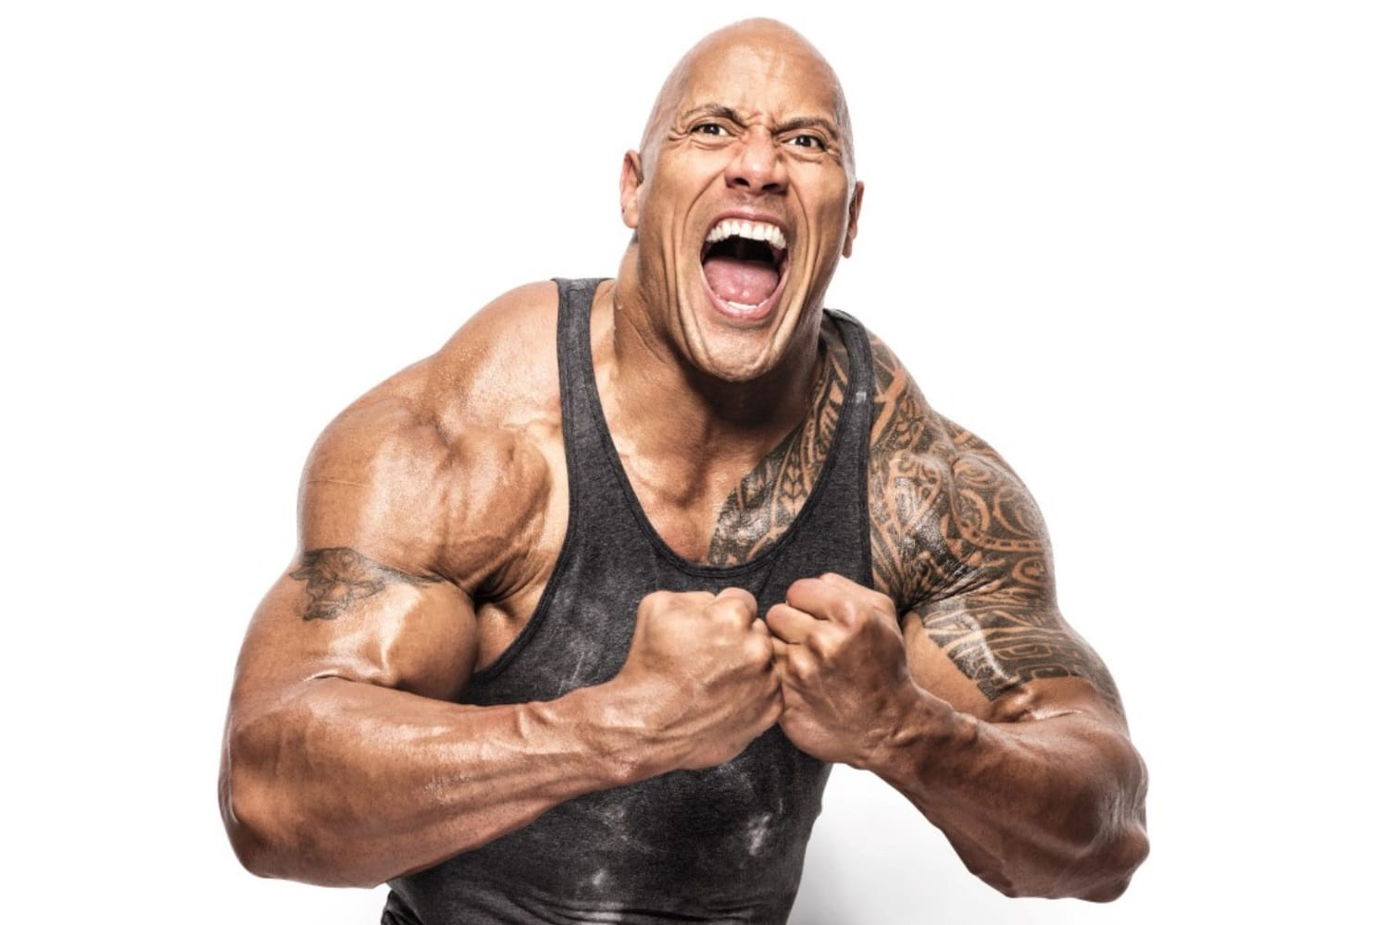
5) The…

Slide 13
The…
Queen
Rock

Slide 14
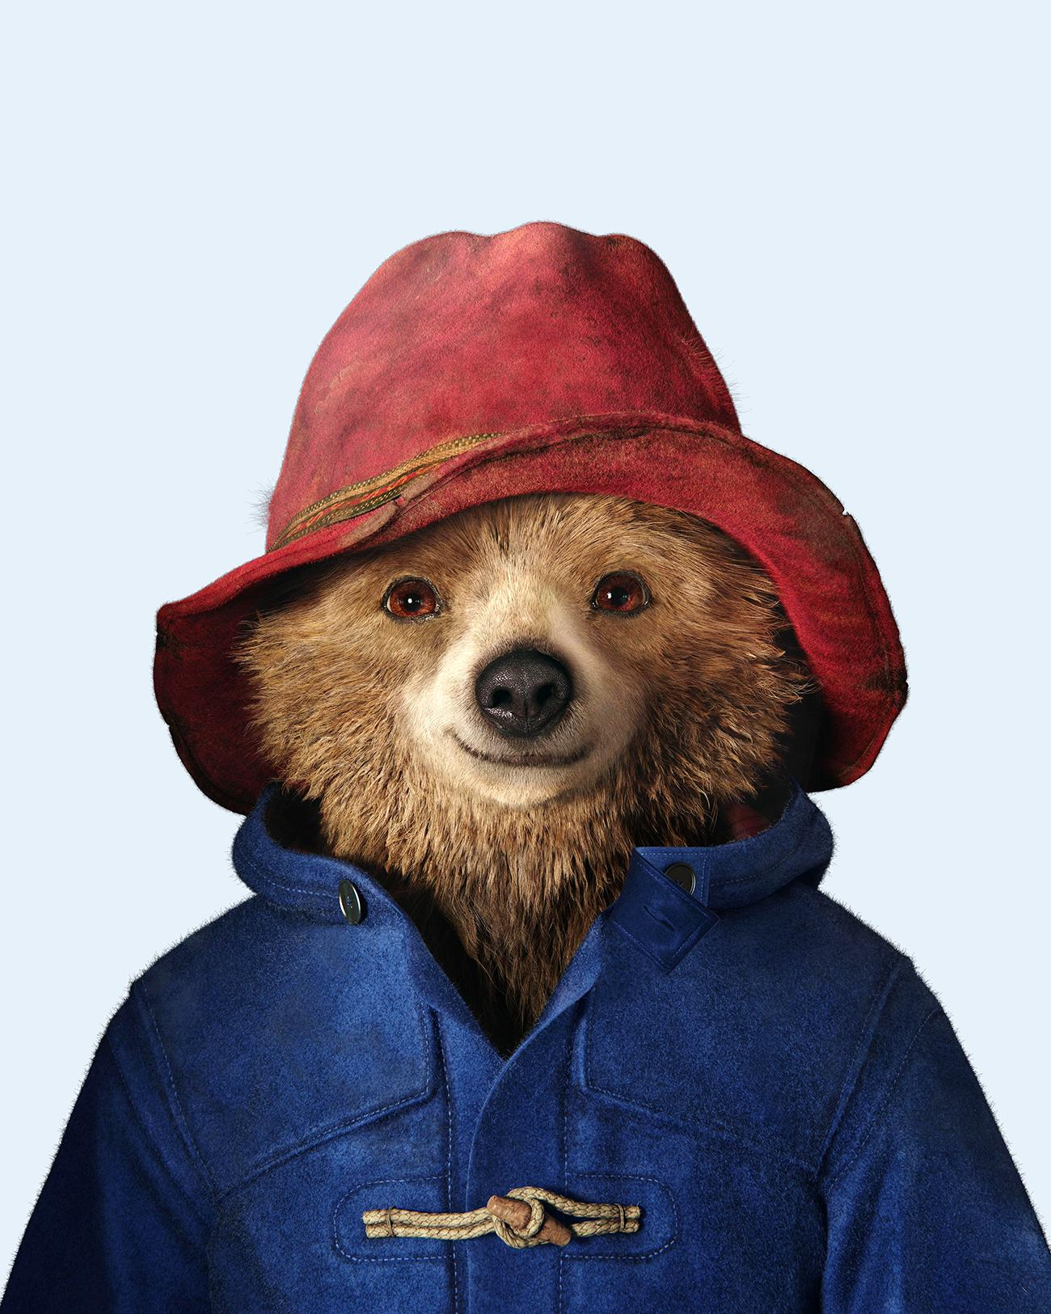
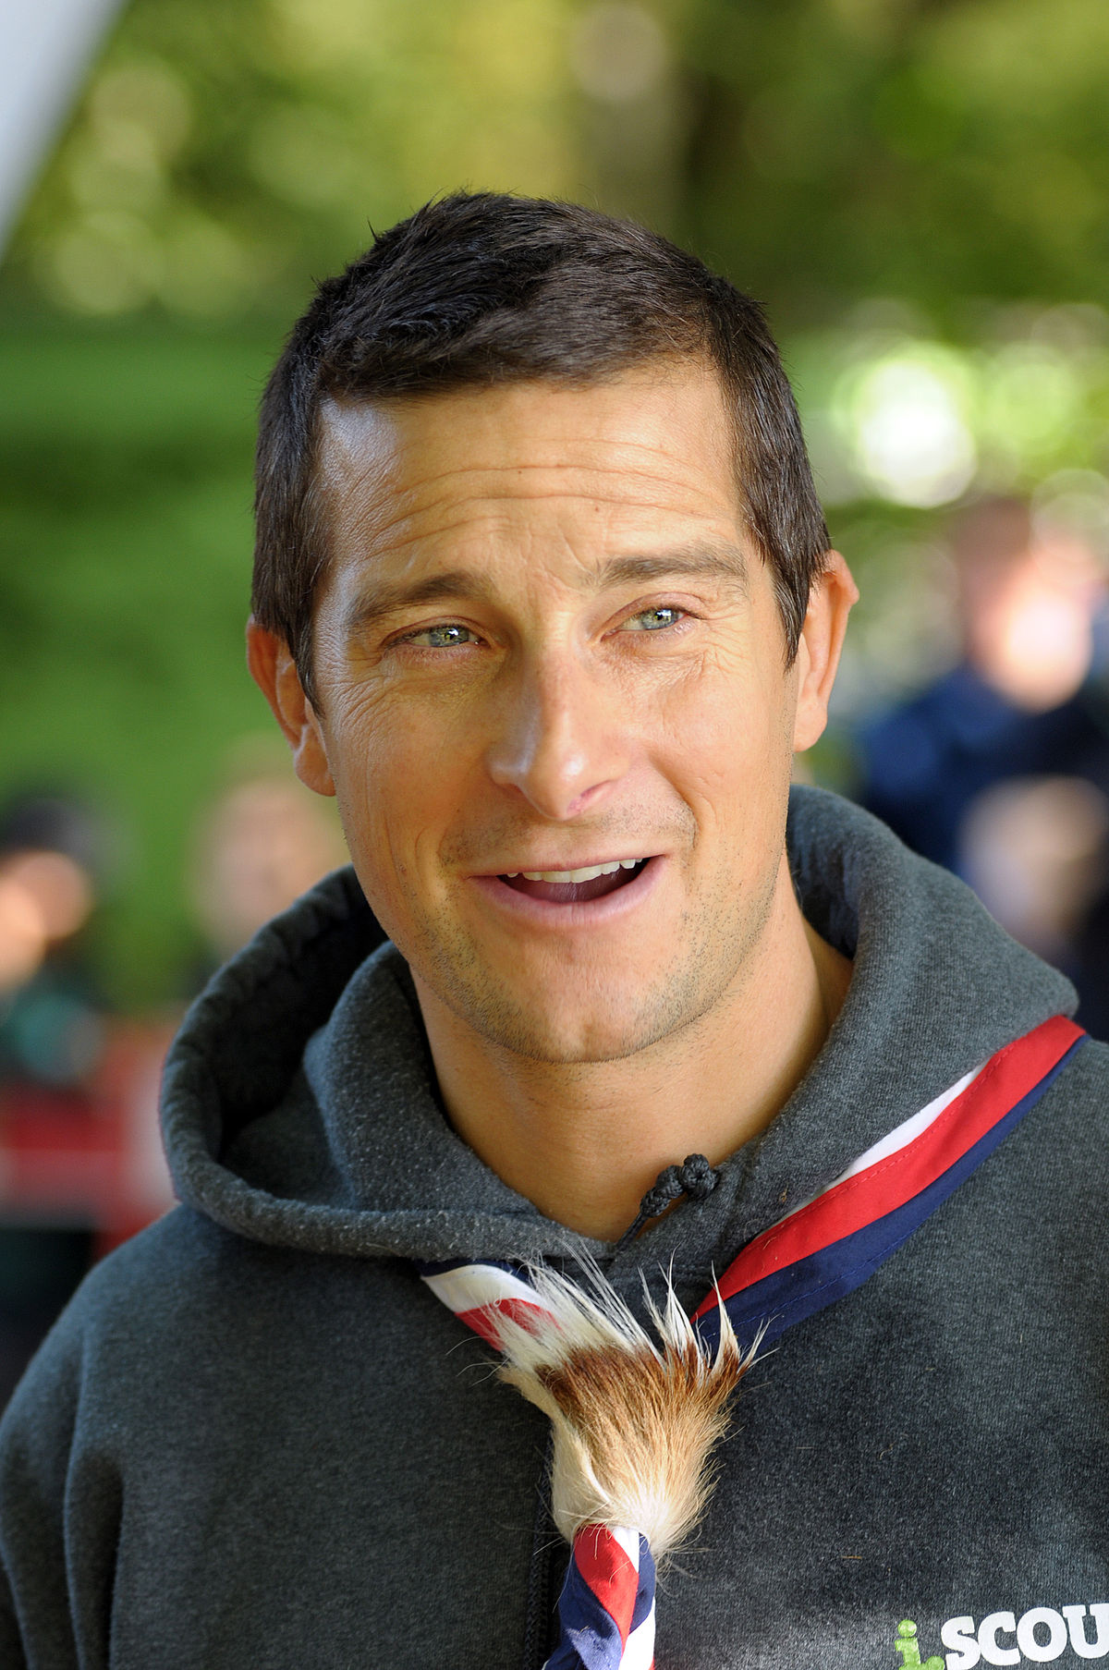
6) bear…

Slide 15
bear…
Grills
Paddington

Slide 16
No clues now!!!
It could be anyone!

Slide 17
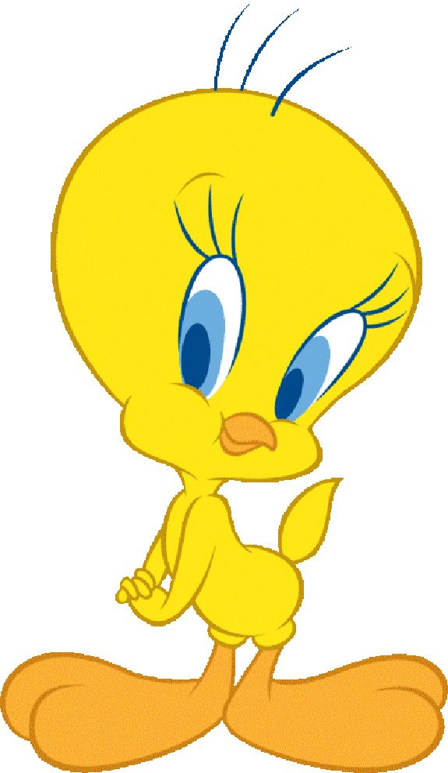
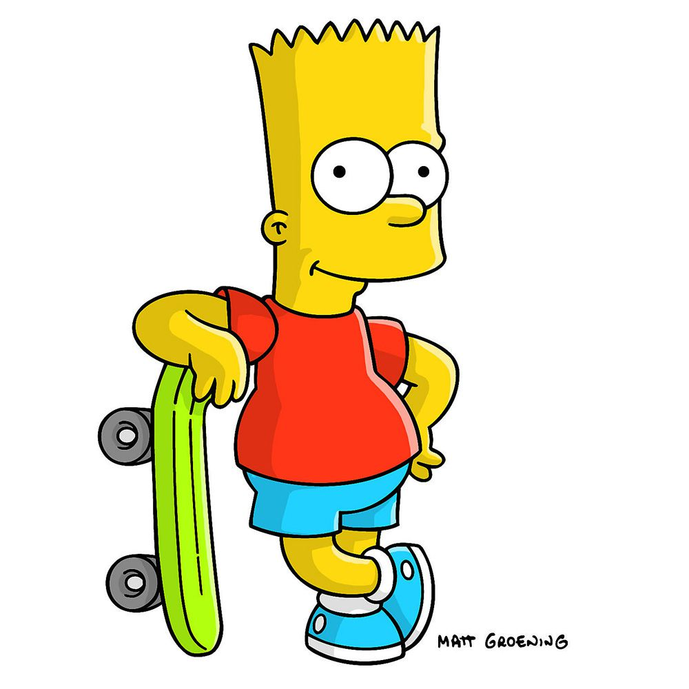
7)

Slide 18
Tweety-pie and bart simpson

Slide 19
8)

Slide 20
Pooh and sonic the hedgehog

Slide 21
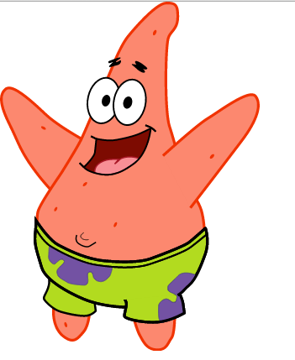
9)

Slide 22
Pikachu and Patrick

Slide 23
10) Have a go at this one!!! 4 to get

Slide 24
Tinky winky, Garfield, buttercup and mickey

