Slide 2
Gardener Activities Badge How to earn your badge
Find out what happens to trees in each of the four seasons.
Learn what tools you need to garden and how to use some of the tools safely.
Find out what plants need to grow.
Help to look after a garden or allotment for two months. Alternatively grow at least three different plants in pots and look after them for two months.
Keep a record of what you have done and the changes you see. You could draw pictures, write short sentences and take photographs.

Slide 3
TREES DURING THE SEASONS

Slide 4
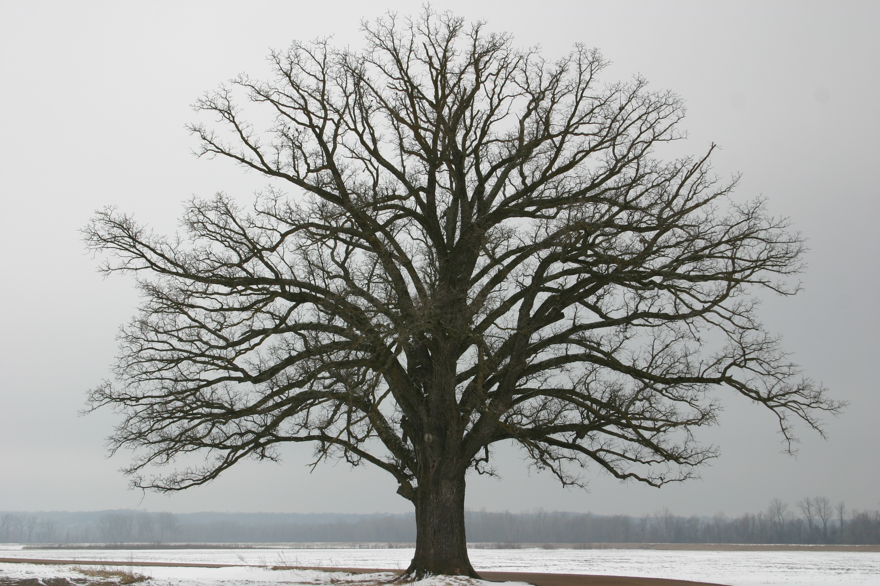
TREES IN WINTER
Notes:
Trees in spring - flowering

Slide 5
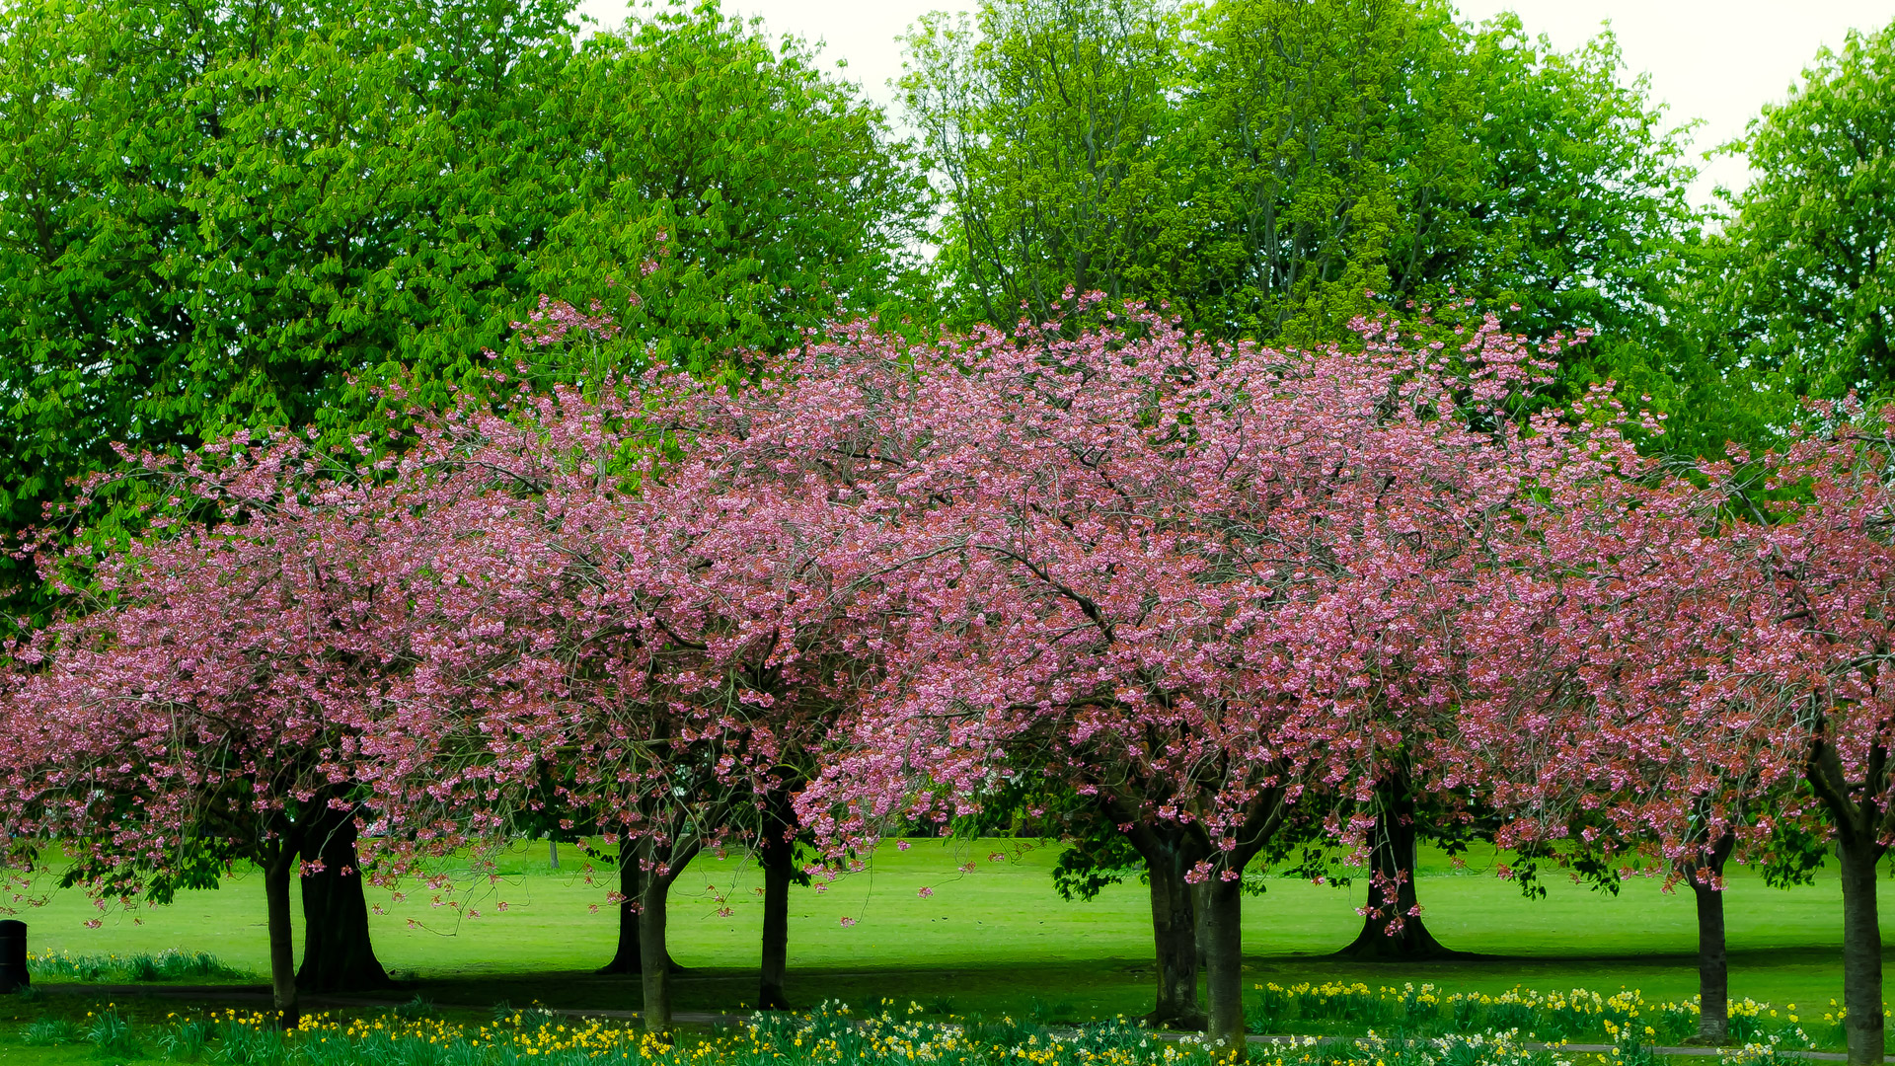
TREES IN SPRING
Notes:
Trees in winter (bare branches)

Slide 6
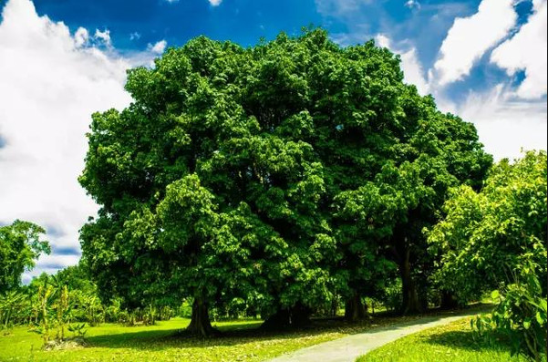
TREES IN SUMMER
Notes:
Trees in summer (full of green leaves)

Slide 7
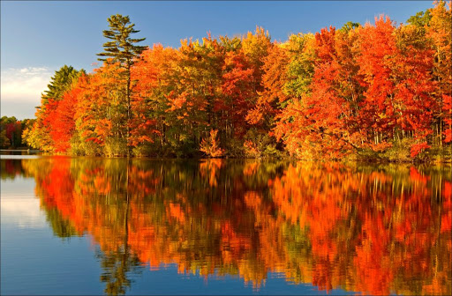
TREES IN AUTUMN
Notes:
Trees in autumn - fall

Slide 8
Gardening equipment
What do I need?

Slide 9
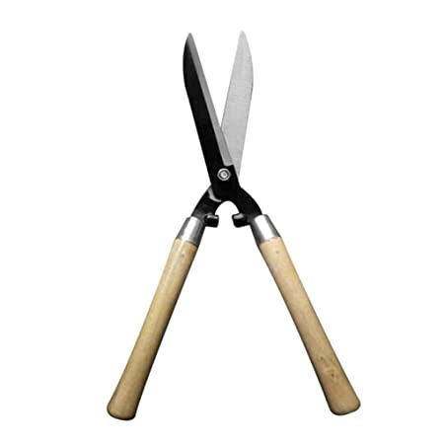
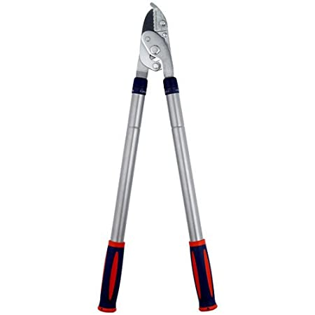
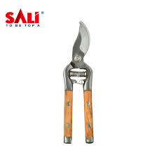
What tools might a gardener use?
Can you name this equipment?
Is it safe for you to use this equipment?

Slide 10
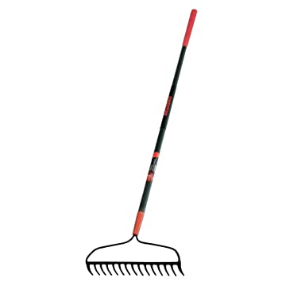
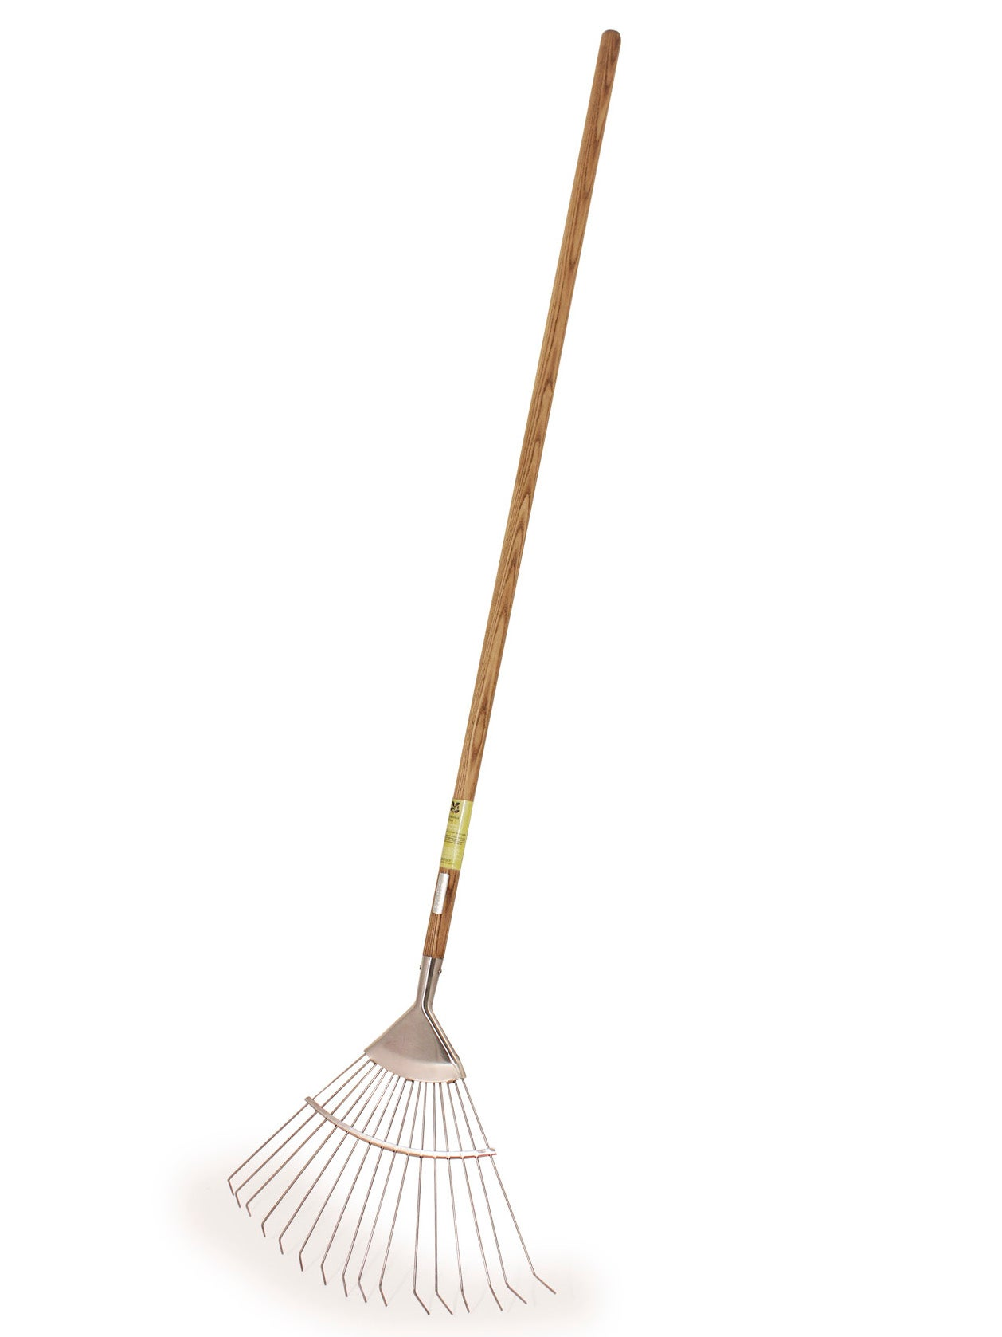
What tools might a gardener use?
Can you name this equipment?
Is it safe for you to use this equipment?

Slide 11
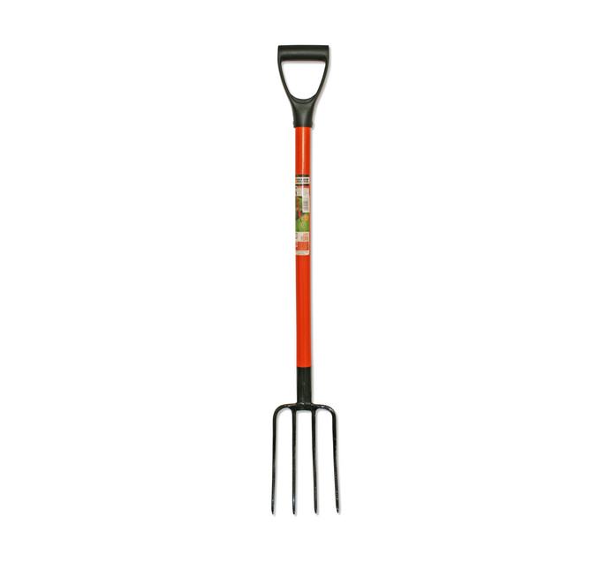
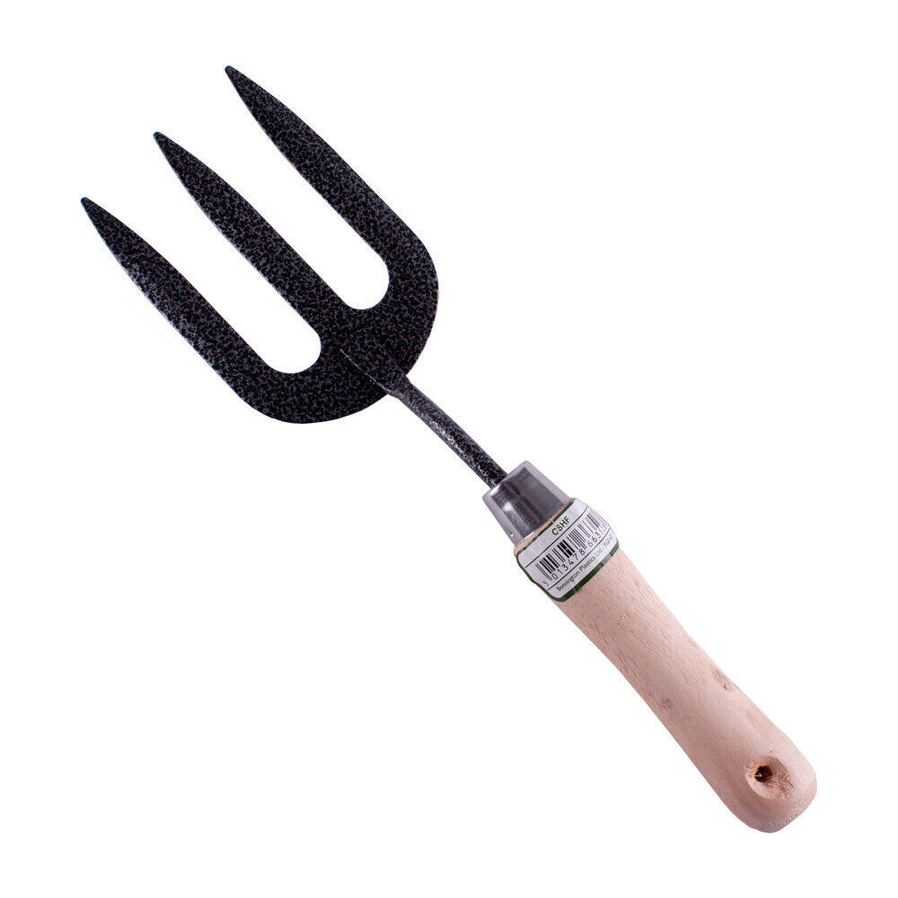
What tools might a gardener use?
Can you name this equipment?
Is it safe for you to use this equipment?

Slide 12
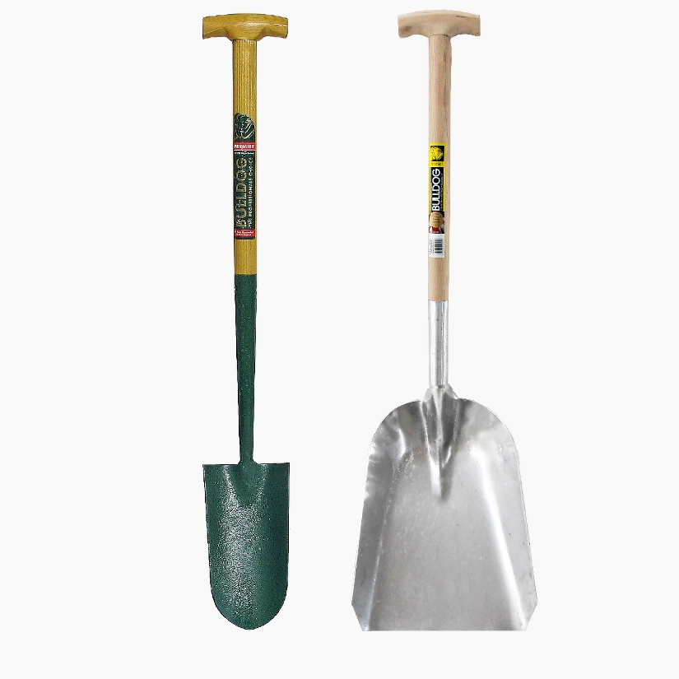
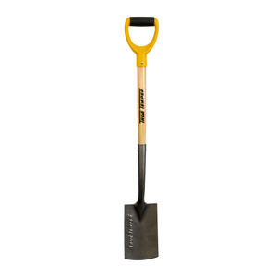
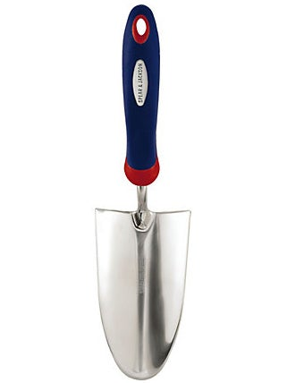
What tools might a gardener use?
Can you name this equipment?
Is it safe for you to use this equipment?

Slide 13
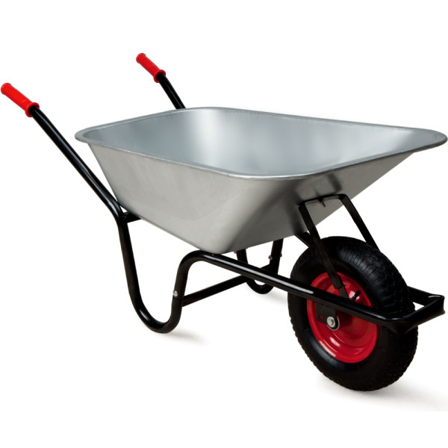
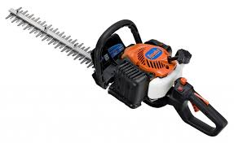
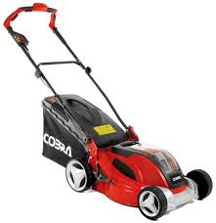
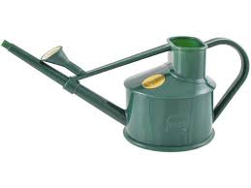
What tools might a gardener use?
Can you name this equipment?
Is it safe for you to use this equipment?

Slide 14
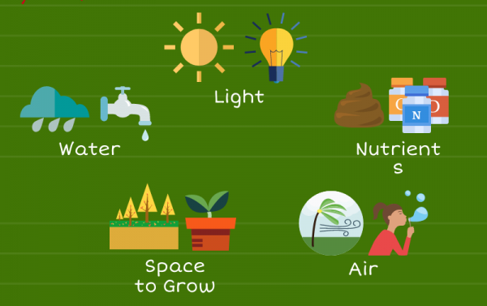
5 THINGS PLANTS NEED TO GROW

Slide 15
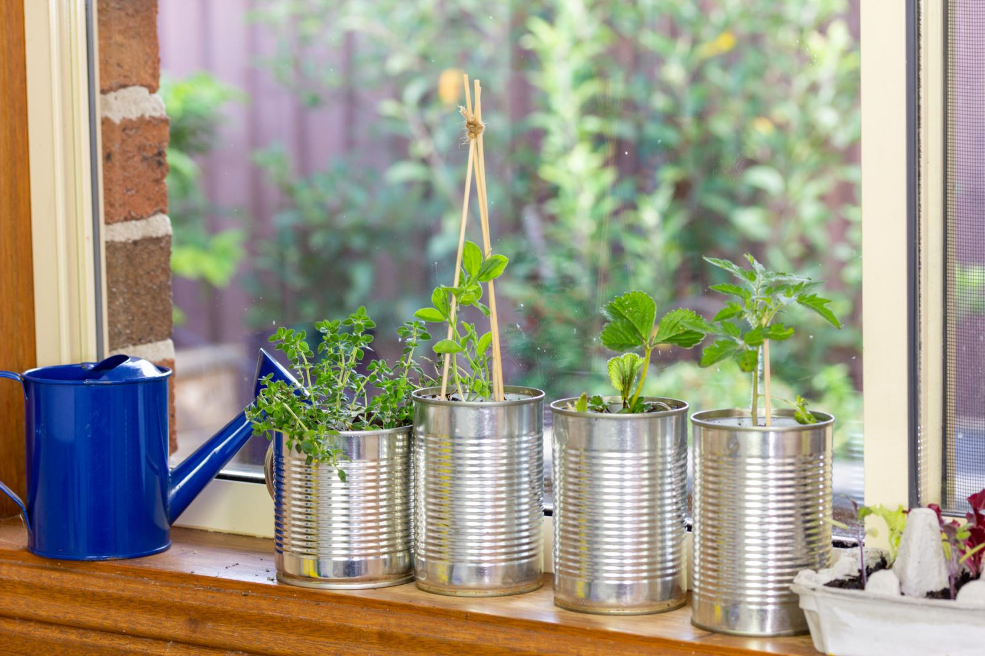
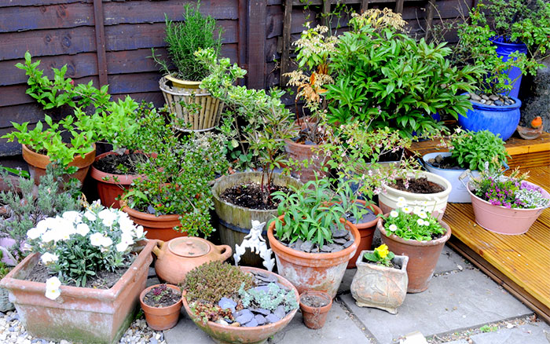
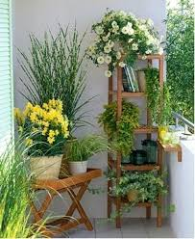
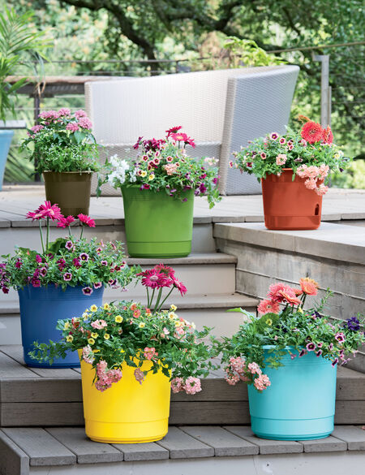
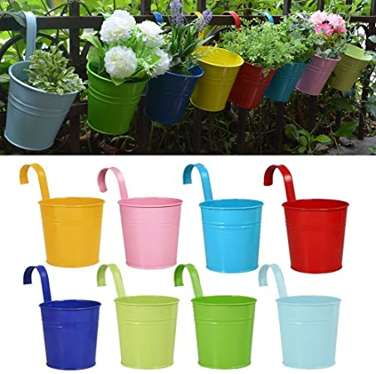
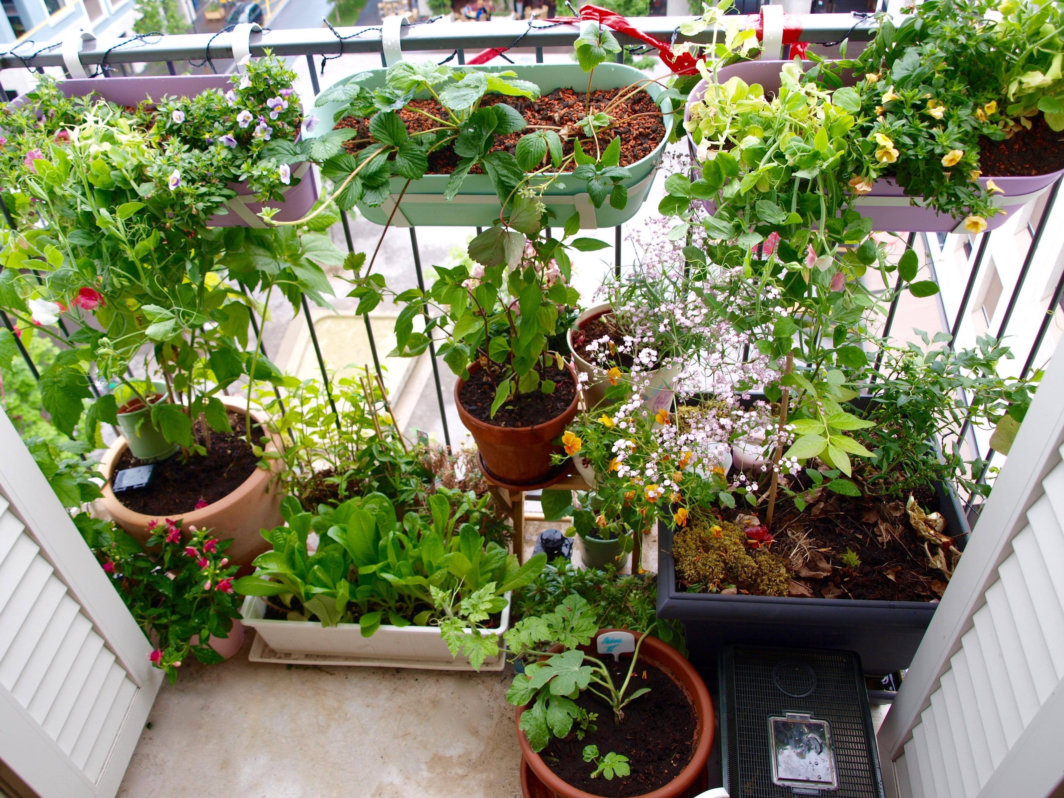
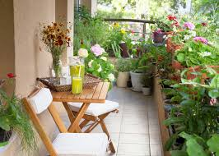
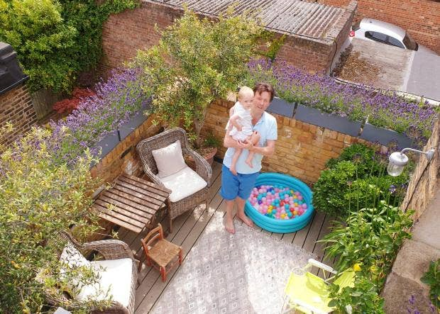
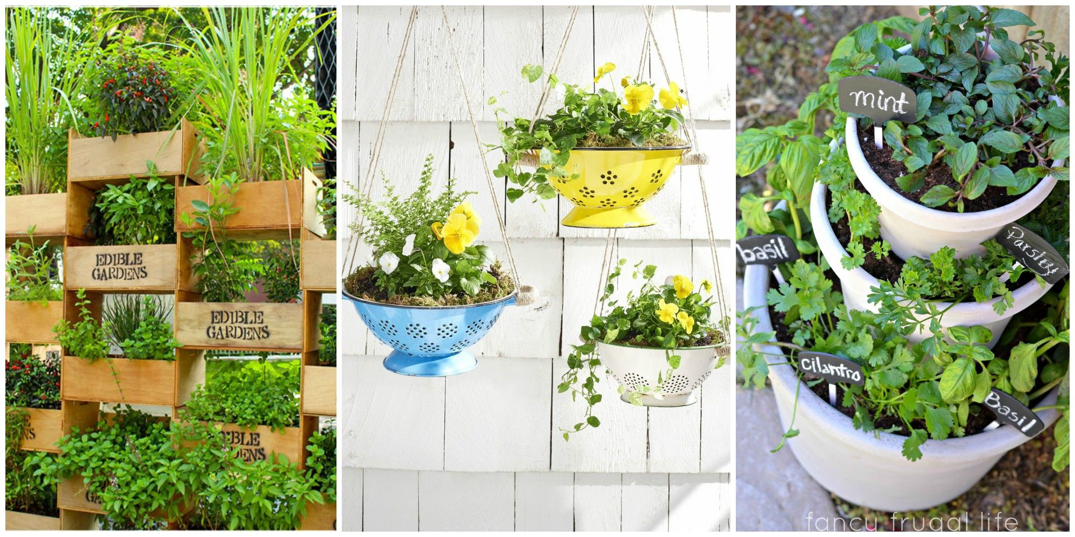
Where can you grow things at home?

Slide 16
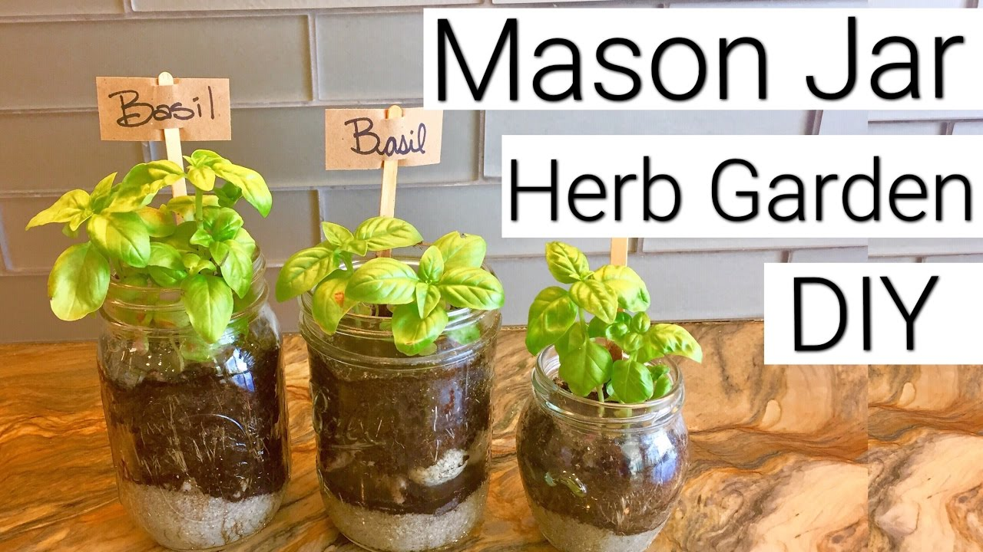
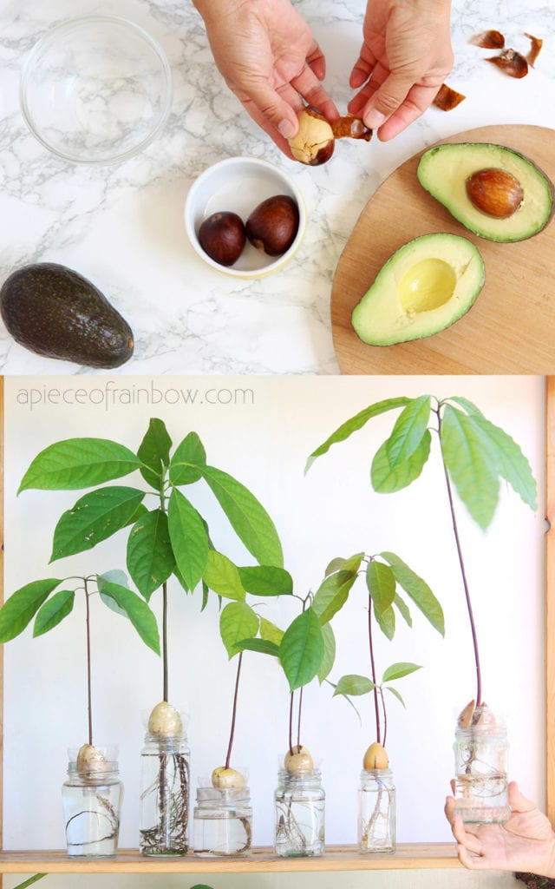
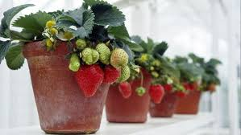
What could you try to grow?

Slide 17
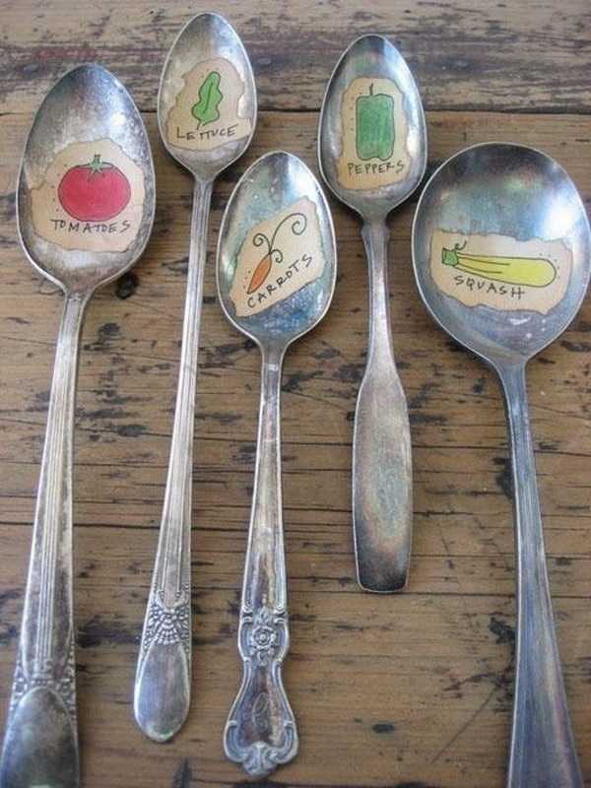
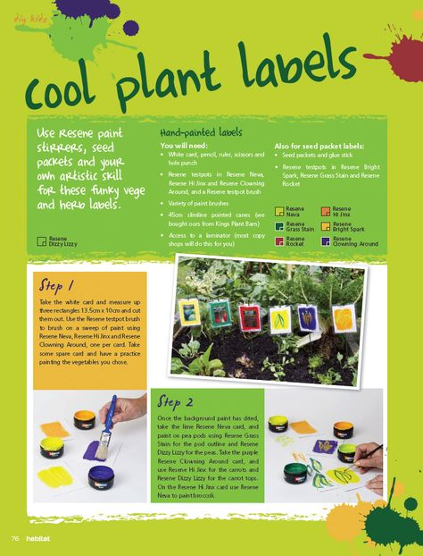
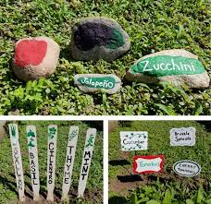
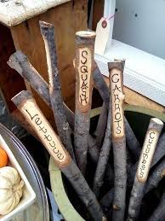
Once planted you need labels so you know what things are – It can be fun to make these too.

Slide 18
Gardener Activities Badge How to earn your badge
Find out what happens to trees in each of the four seasons.
Learn what tools you need to garden and how to use some of the tools safely.
Find out what plants need to grow.
Help to look after a garden or allotment for two months. Alternatively grow at least three different plants in pots and look after them for two months.
Keep a record of what you have done and the changes you see. You could draw pictures, write short sentences and take photographs.
Notes:
Think about what you’d like to grow and you need to record what you grow some plants for 2 months.

