Slide 1
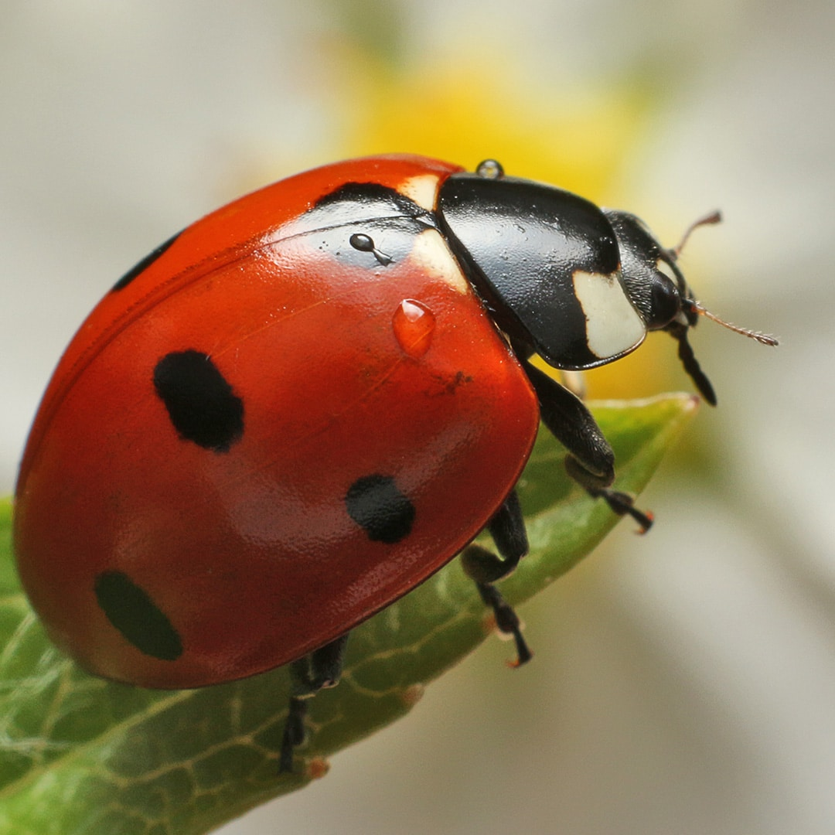
Bugs
Cubs and Beavers
All available at www.wildlifetrusts.org
#actionforinsects

Slide 2
A 2
B 6
C 8
Answer: B

Slide 3
A 9,000,000
B 20,000
C 5,000
Answer: A

Slide 4
A 500
B 20,000
C 1,400,000
Answer: C

Slide 5
A 10
B 101
C 38
Answer: C

Slide 6
A 65%
B 90%
C 10%
Answer: B

Slide 7
A 380,000
B 6,000
C 890
Answer: A

Slide 8
A 2
B 12
C 0
Answer: A
2 - a wingless midge and a louse that lives on the bodies of Weddel seals

Slide 9
A 2cm
B 26cm
C 57cm
Answer: C (Chans Megastick)

Slide 10
Chan's megastick is the longest insect in the world. One specimen in the London Natural History Museum measures 567 mm (22.3 in). This is with the front legs fully extended!

Slide 11
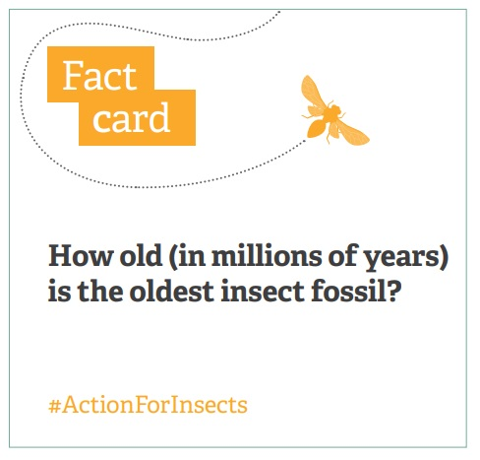
A 400
B 6
C 50
Answer: A

Slide 12
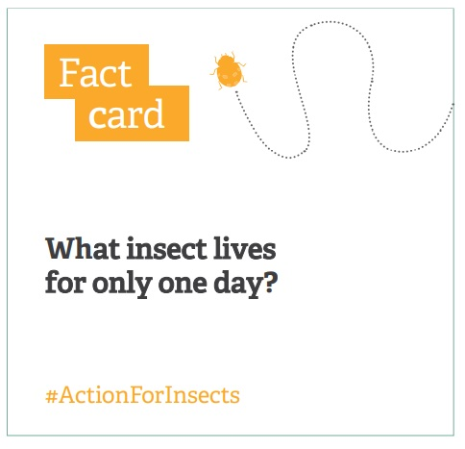
A Pill Millipede
B Grasshopper
C Mayfly
Answer: C

Slide 13
Mayfly Also known as the 'Green drake mayfly', the Common mayfly can be found around unpolluted wetlands, such as lakes and rivers. It has transparent, lacy wings and three long 'tails'.

Slide 14
Name these minibeasts:

Slide 15
Answers How many did you get?

Slide 16
Name these Minibeasts:

Slide 17
Answers How many did you get?

Slide 18
Bug Hotel Materials:

Slide 20
