Slide 1
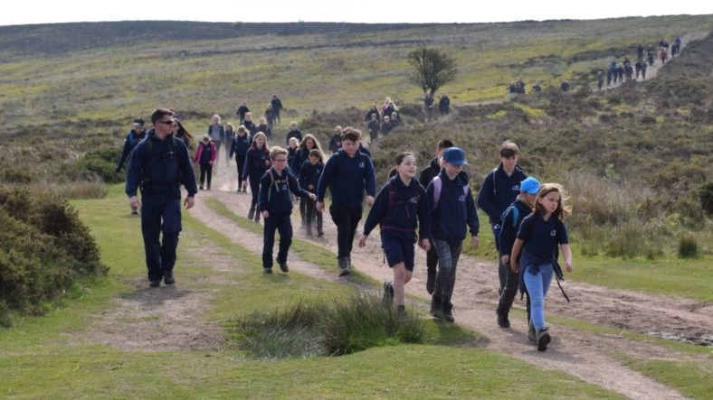
Hike Preparation
What to bring & what to do

Slide 2
HIKE PREPERATION
We are planning on going on a hike, but before we can go, we have a lot of planning we need to do.
Can you think of the preparations steps we have to take?

Slide 3
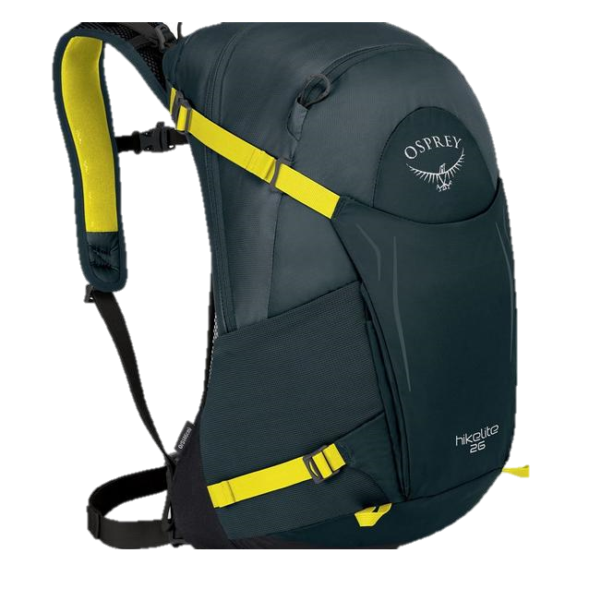
WHAT DO YOU NEED TO TAKE
On the next slide you are going to have a go at packing a Day Rucksack ready for your Hike, but be careful there are some items you don’t need to take
You need to click on each picture to try and put it in your Pack

Slide 4
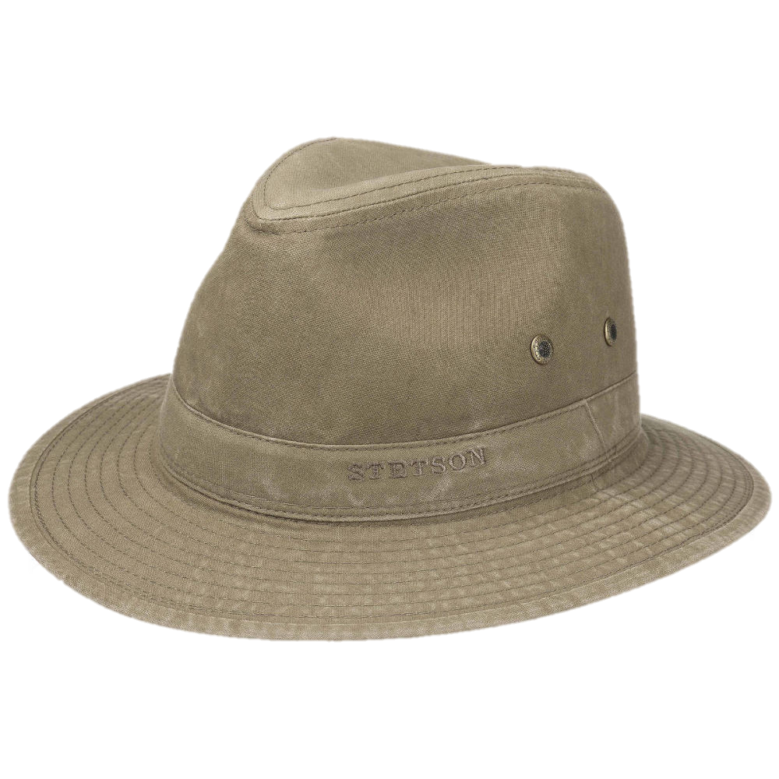
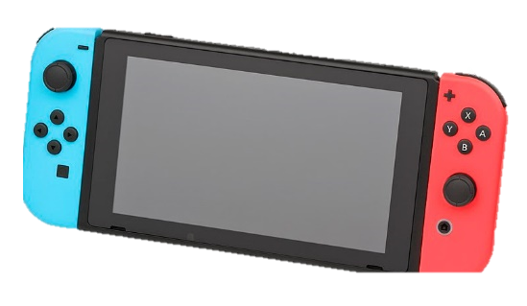
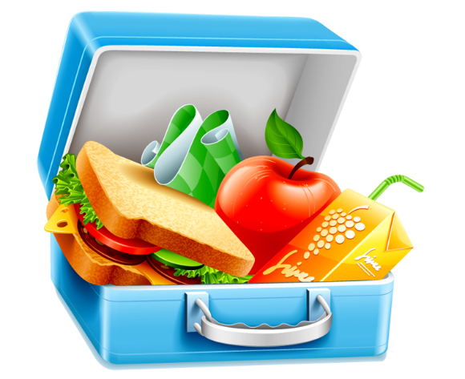
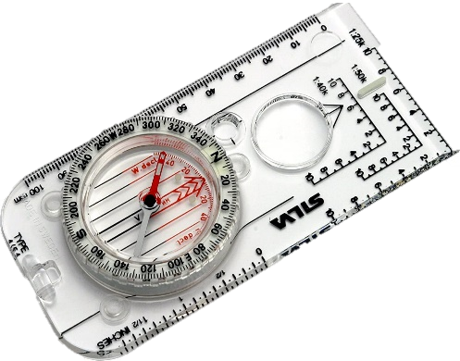
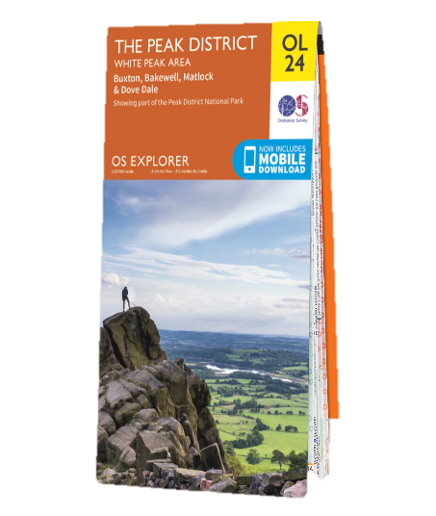
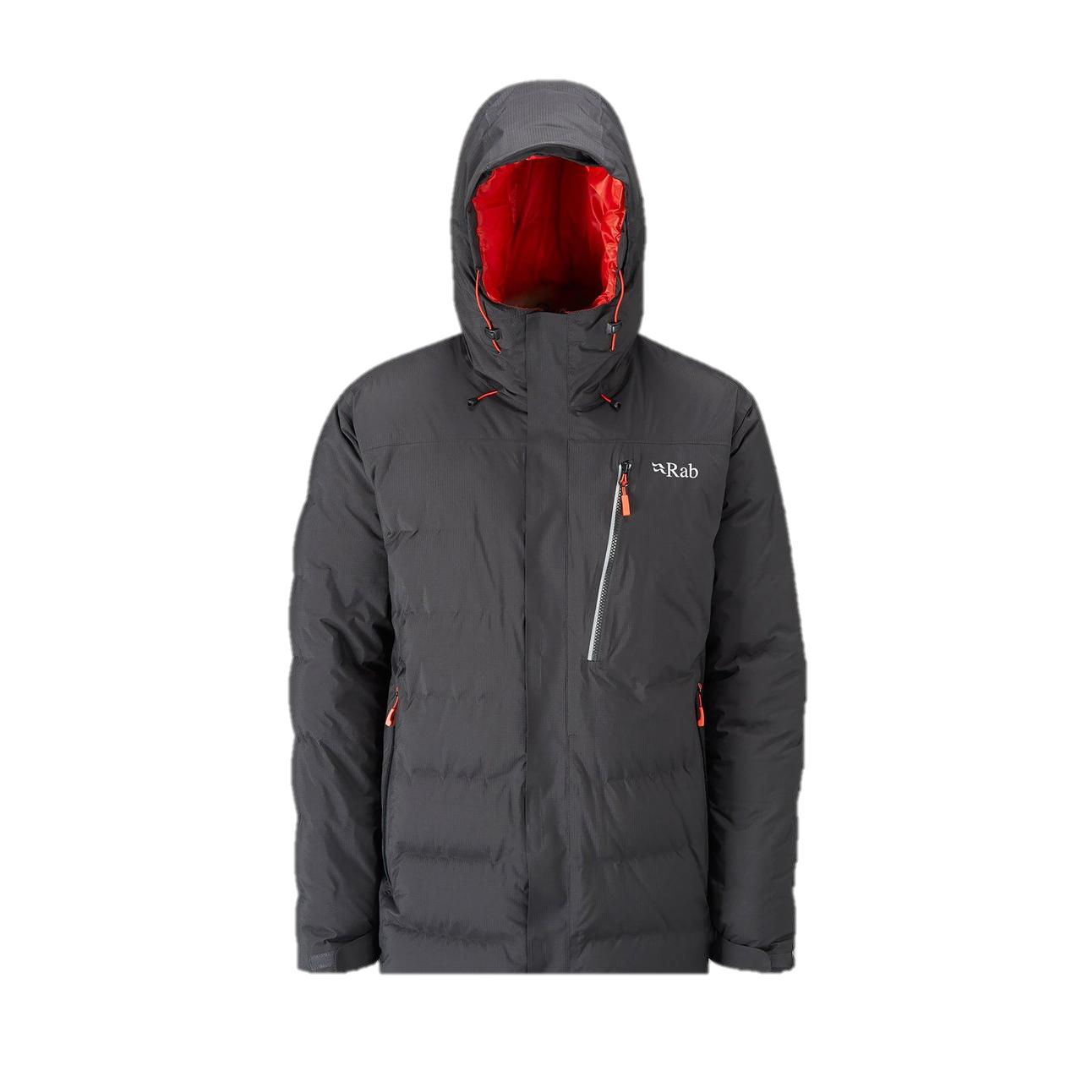
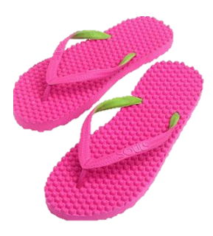
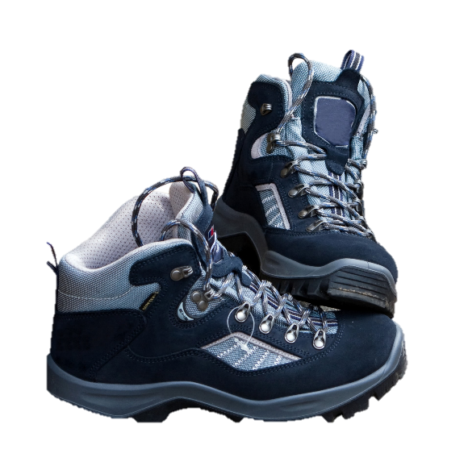
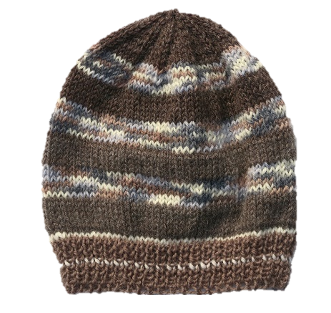
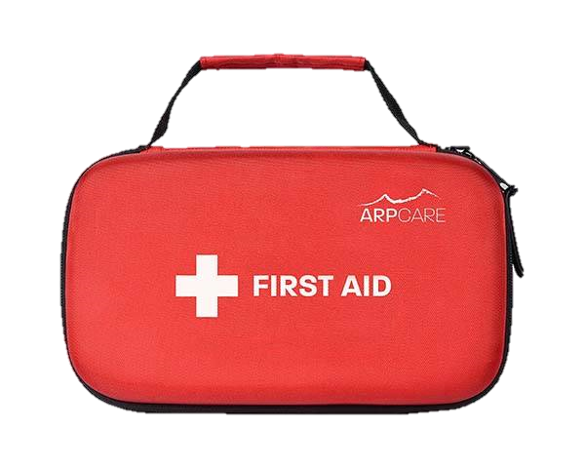
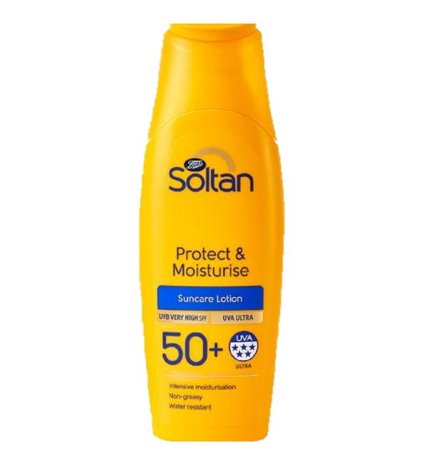

Slide 5
What else do you need?
What else shouldn’t you take?

Slide 6
Can you remember what you have Packed?
When you go on a hike, you have to remember what’s in you Rucksack in case you need it.
So, we are know going to play a game to test your observation skills
On the next slides you will see an image of items you have packed for your hike, you will have 10 seconds to look at the image before it changes to the next slide you have to work out what item has been removed.
Can you guess what item is missing?
GOOD LUCK

Slide 7
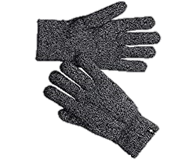
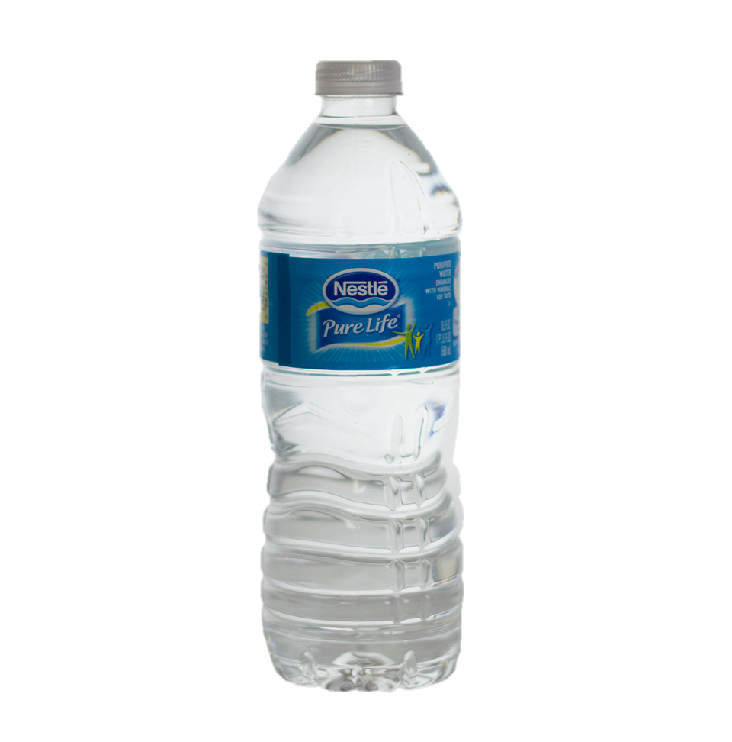
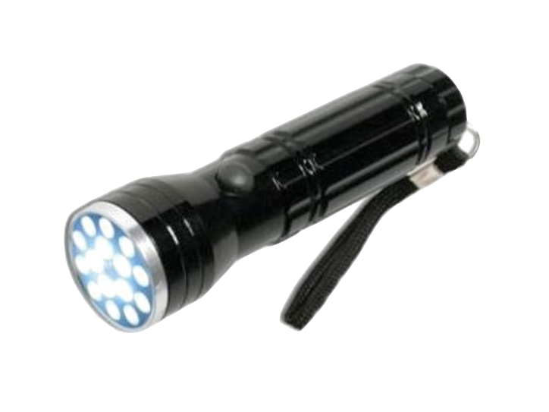

Slide 8
REVEAL
NEXT

Slide 10
REVEAL
NEXT

Slide 12
REVEAL
NEXT

Slide 13
HOW WELL DID YOU DO?
We will now look at the type of food to take
On the next slide you are going to have a go at selecting the type of food to take on your hike in addition to your lunch
We will click on each picture to see if it is suitable for taking on a hike

Slide 14
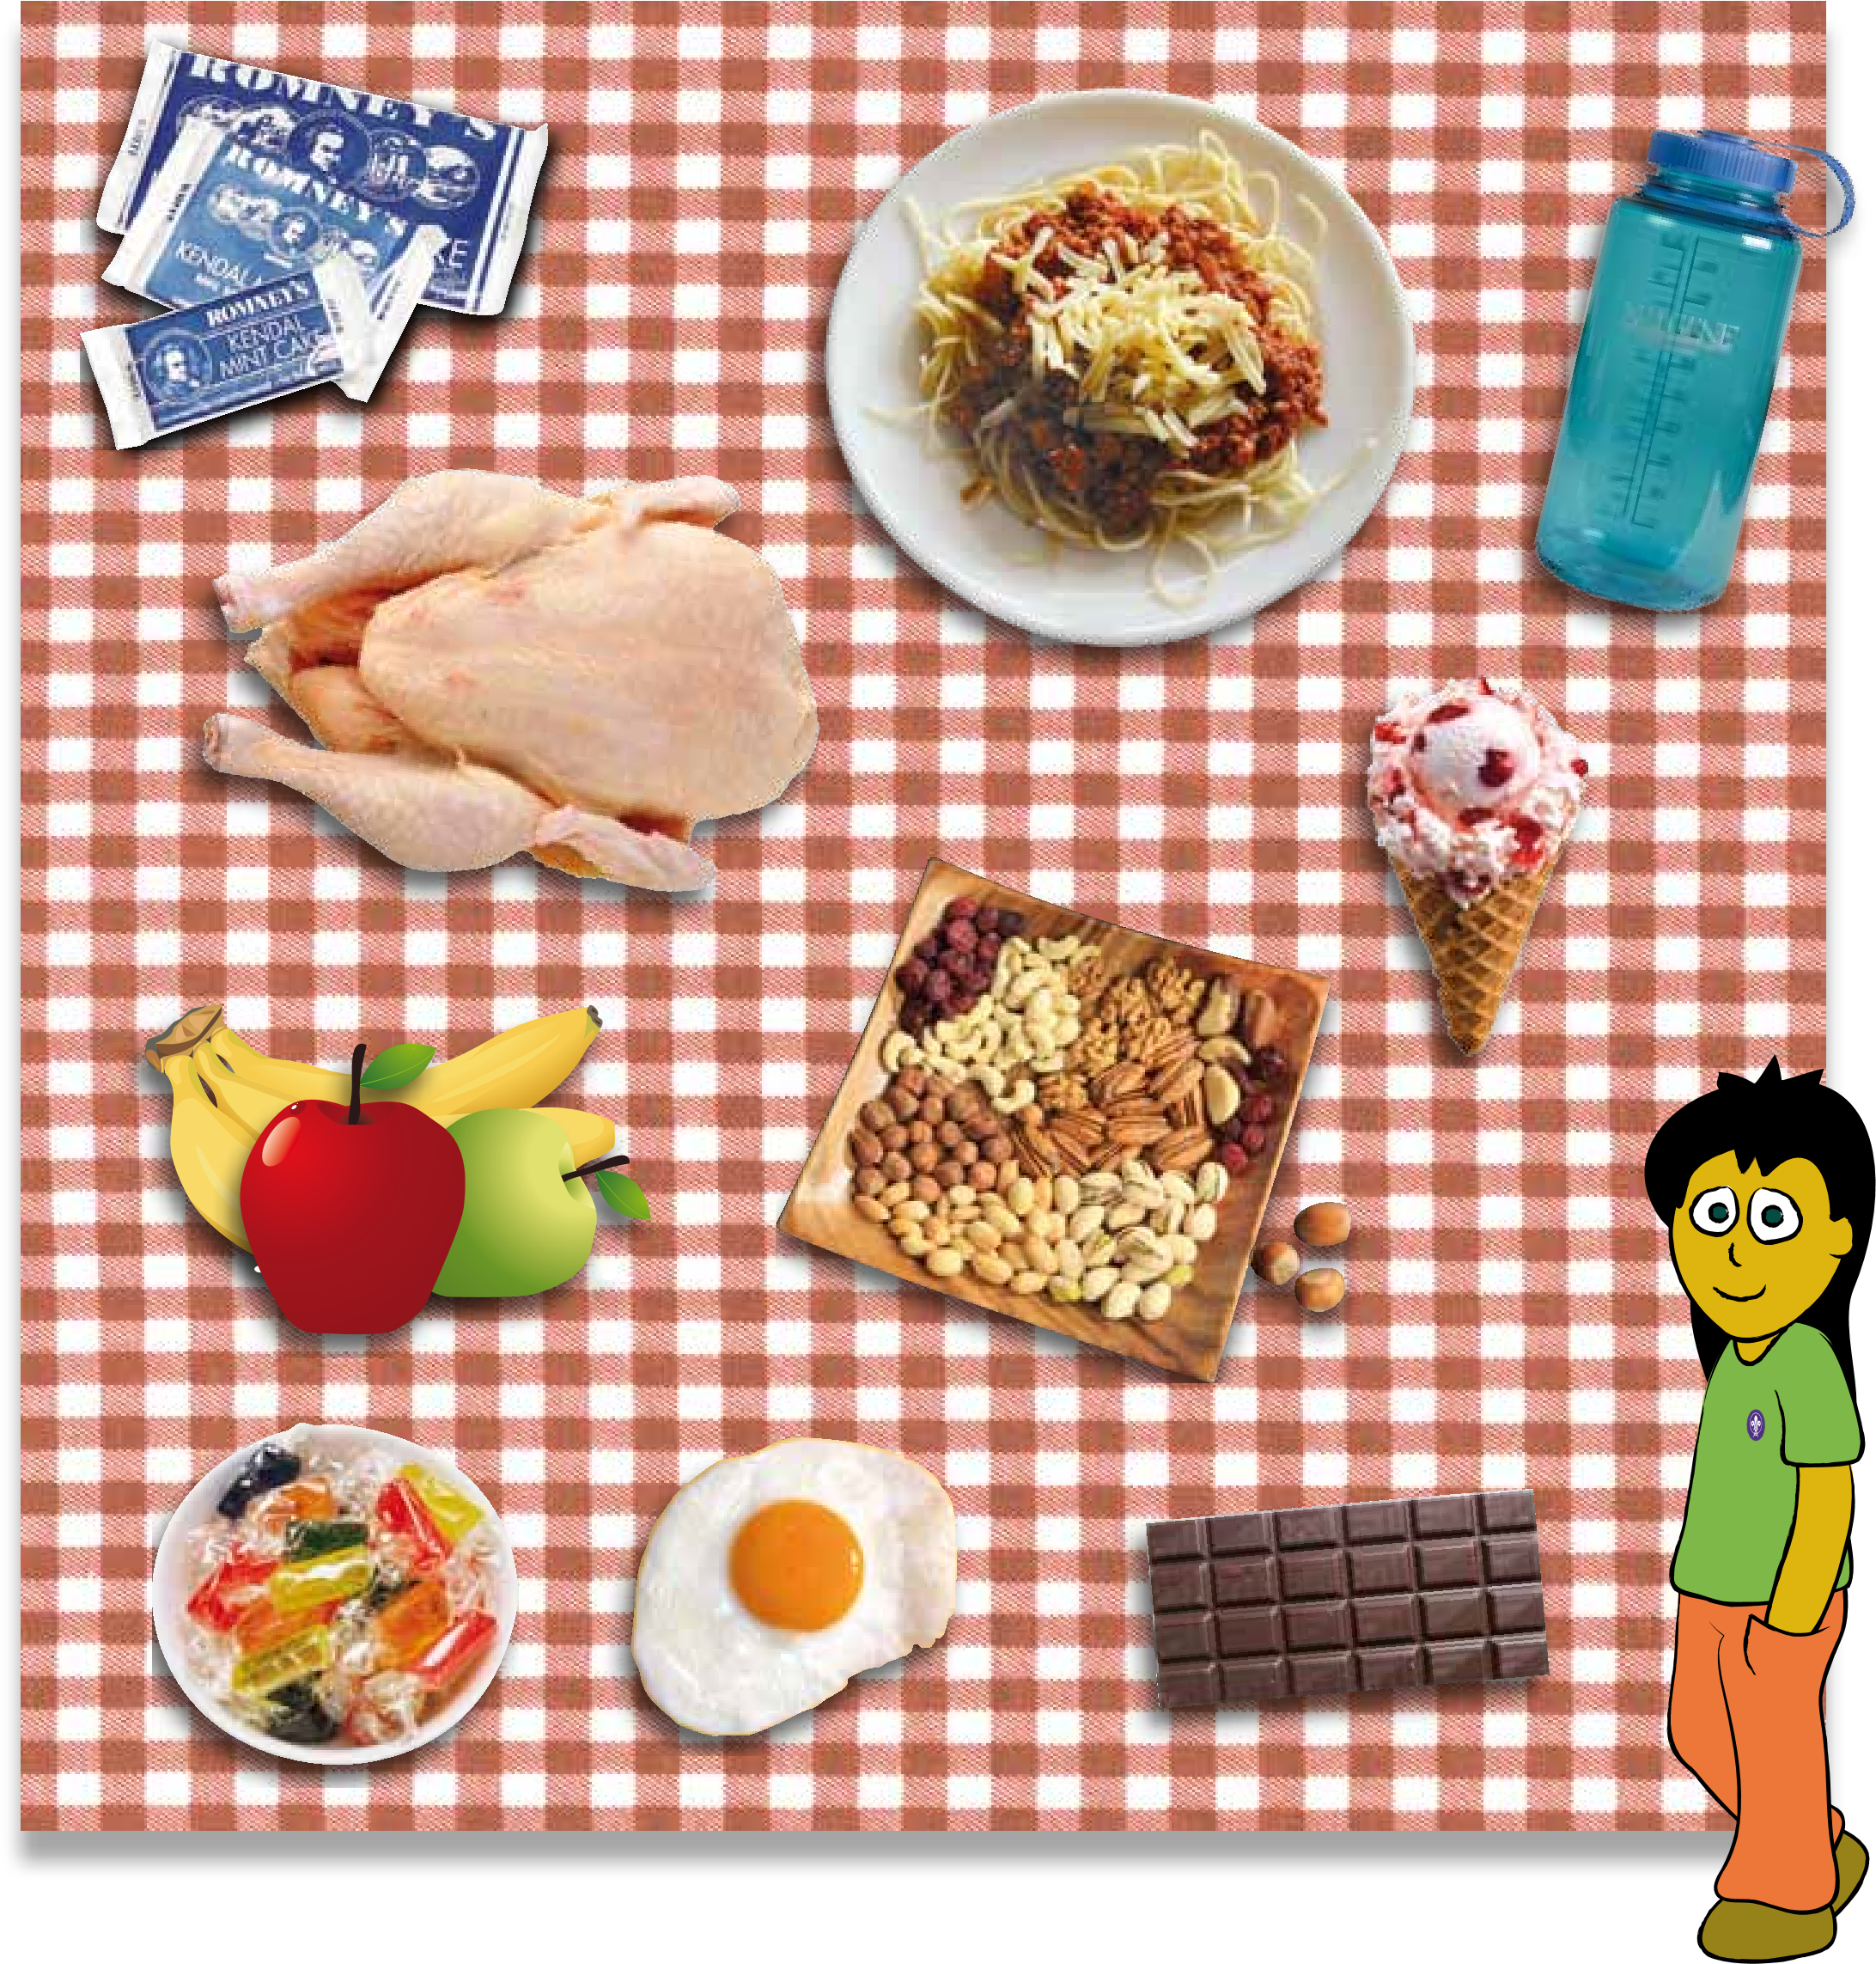

Slide 15
THE REASONS
All High Energy Foods
Easy to Carry
Water needed to keep you Hydrated
Difficult to Carry
No means of cooking
Ice Cream Melts !!!!!

Slide 16
Any other foods you could take?

Slide 17
HOW WELL DID YOU DO?
ARE YOU READY, TO HEAD OFF TO THE GREAT OUTDOORS?

