Slide 1
Making Your Own Country
- By Baloo

Slide 2
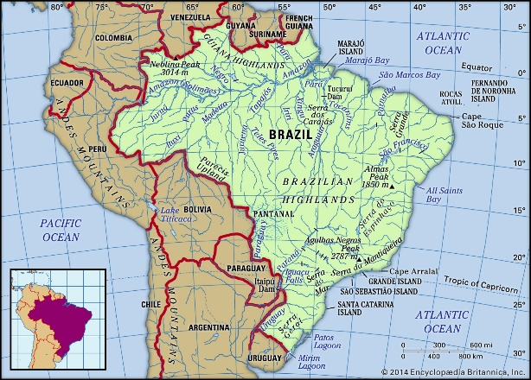
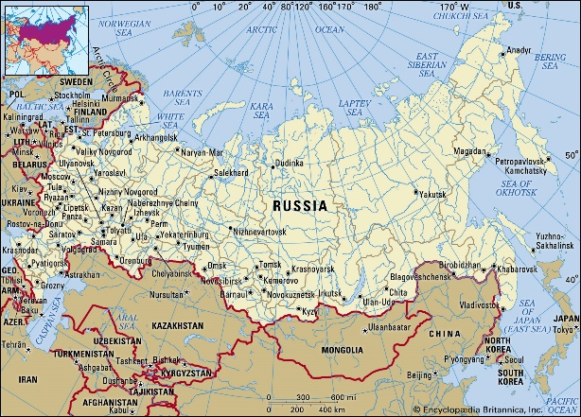
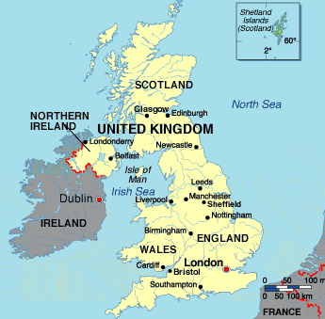
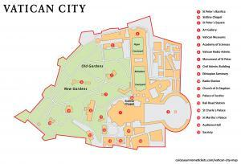
What is a Country/Nation?
As defined by the dictionary a country is “a nation with its own government, which occupies a particular territory.”
A few examples of countries are:
Brazil
Russia
The Vatican
The United Kingdom

Slide 3
How are Countries made/formed?
Most countries which we know today come from a group of people, often by geography and language, who come together and create a society to help one another.
Sometimes a new country can be made from the remnants of an older one where the citizens of the old nation seek independence. A good example of this is when South Sudan gained independence from Sudan.
Every country will have places where people will come together and live with each other to create society. These places, depending on size, can be villages, towns, and cities.

Slide 4
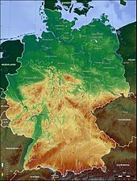
What makes Countries different?
Every country is different from one another in one way or another and this makes them separate from each other.
Things that make countries different from one another include:
Geography
Currency
Language
Flag
Capital City
Example : Germany
Geography
Language
Flag
Capital City
German
Berlin

Slide 5
Coming up with your own country
Hopefully you should now know some basic information on how countries are made and what they are.
Now it’s your turn to come up with ideas for your own country. We shall do everything bit by bit in the creation of your own nation!
To give you some inspiration for ideas Baloo has made an example country he came up with. Afterwards you can have a go at making your own countries.
You’ll need your pencils and paper for this!

Slide 6
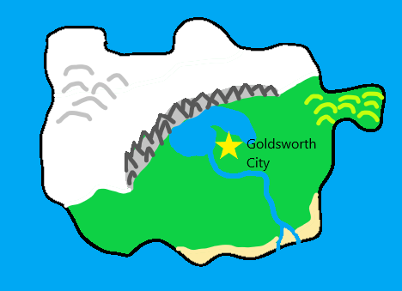
Baloo’s Country
Country Name: Cubton
Capital City: Goldsworth City
Currency: Cub Pound
Flag:
Geography:

Slide 7
Your Turn!
You now have around 10-15 minutes to come up with your own country. Use your pencils and paper to write down and draw your ideas!
If you are stuck for ideas then think of something that you can relate to/know about really well. This could be your favourite food or movie.
Here’s what you’ll need to create:
Country Name
Capital City
Currency
Flag
Geography (what it looks like on a map)

