Slide 1
CUBS SCIENCE BADGE – PART 1

Slide 2
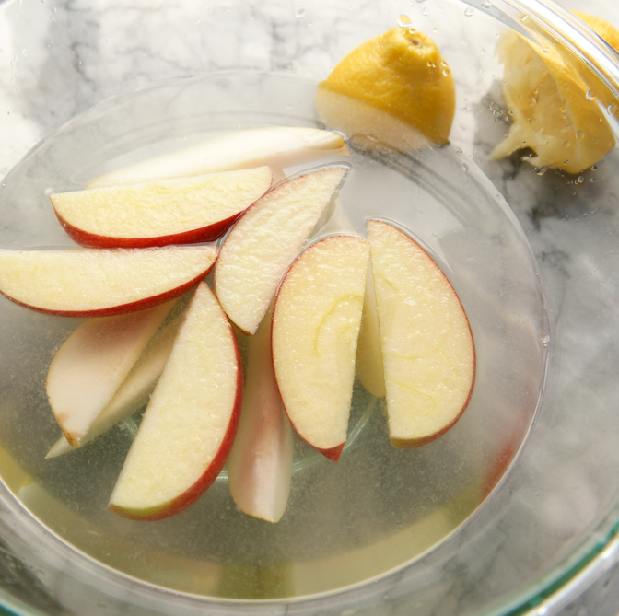
Method
Get 4 cups and half fill each with the different liquids.
a) Water
b) Water + a large spoon of salt – stir
c) Lemonade
d) Fruit juice

Slide 3
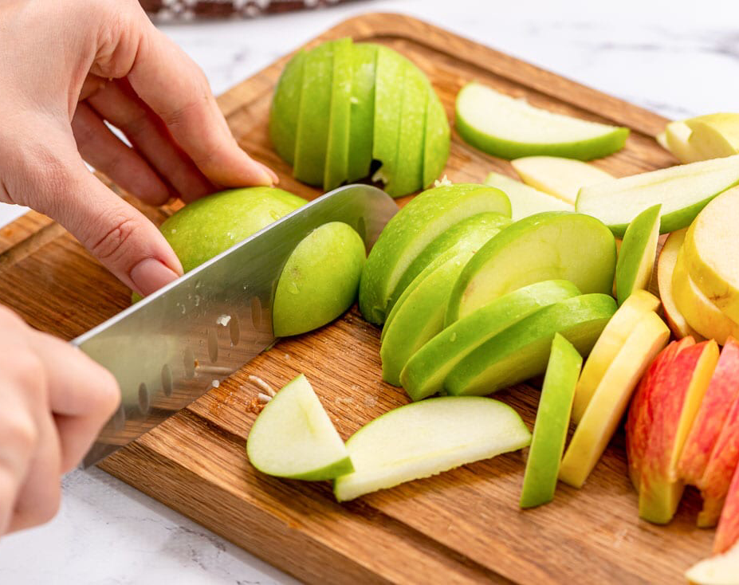
Method
Get 4 cups and half fill with each of your liquids
Chop your apple into 5 slices – keep them as equal as possible in size BE CAREFUL! (get an adult to help)
Put one apple slice into each of the 4 cups with different liquids in and keep 1 out
Leave it while we are doing another experiment

Slide 4
Which one do you think is the most effective at stopping the apples browning?
Water
Water + a large spoon of salt
Lemonade
Fruit juice
Leaving it out of the liquid
Remember your prediction – you will see at the end if you were correct.

Slide 5
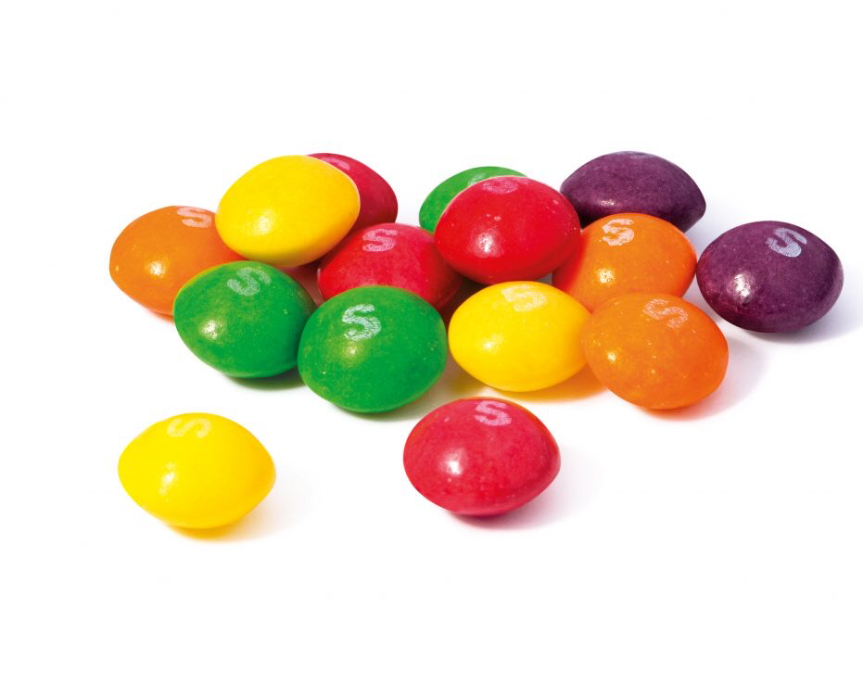
Rainbow skittles
You will need:
Water
A plate (preferably white)
Skittles

Slide 6
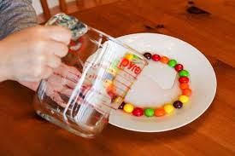
1) Place the plate on a flat surface. Space the skittles evenly around the edge of your plate.
2) Use a cup or jug to gently pour in some water. The water level should sit about half-way up the skittles.
3) Wait patiently for your skittle rainbow to form.
Do not touch it while you wait as the results may not be as good!

Slide 7
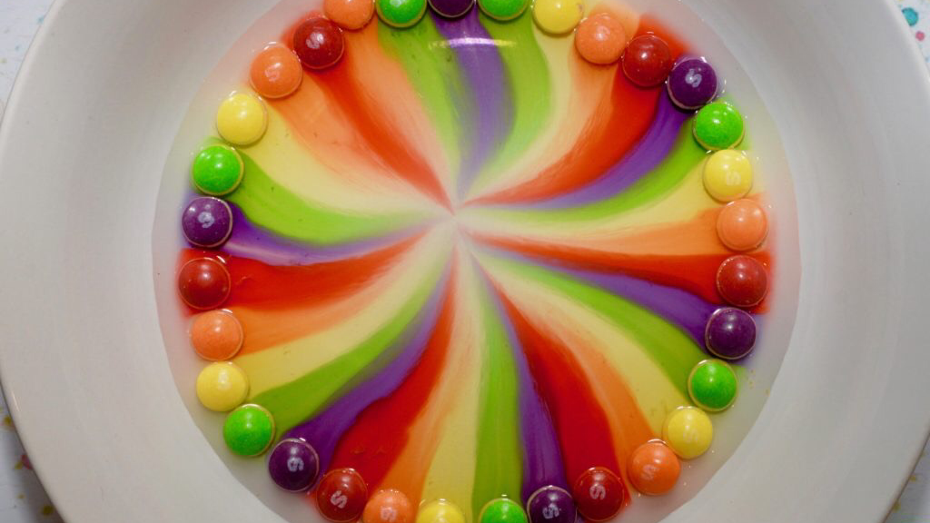
https://www.youtube.com/watch?v=h7o6WLtC5dY

Slide 8
What happened? Why do you think this happened?

Slide 9
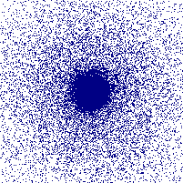
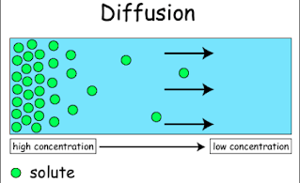
The dye on the skittles DISSOLVES into the water
It then DIFFUSES
( diffusion – when particles move from a high to low concentration )
This happens because the particles in a liquid are always moving randomly , making the colourings spread out across the plate.

Slide 10
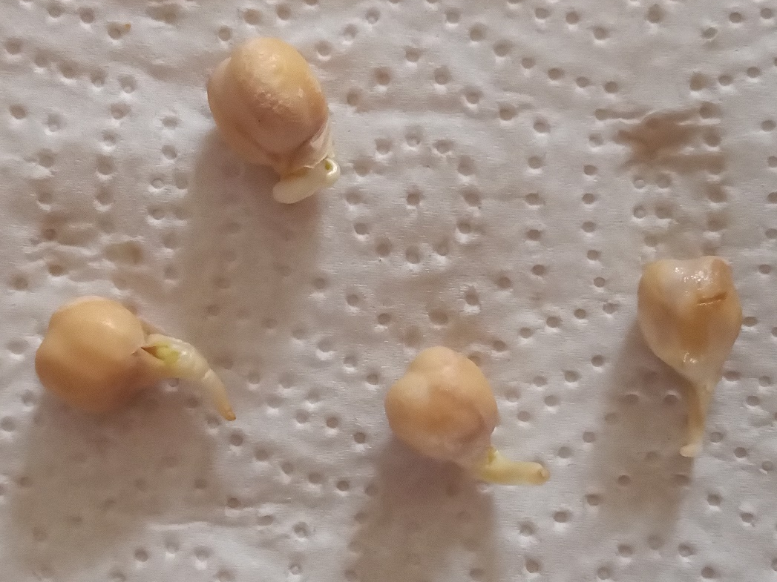
Soak your chick peas of beans for next week
Put chickpeas into a glass of water and leave to soak for a day
Tomorrow
Stuff a jar with kitchen towel and pour
water in until the towel is soaked through
Drain the beans and push them down
the side of the jar
Put the jar in a warm dark cupboard
check it each day & add water if needed to keep them wet
Once they’ve sprouted (after a few days), move the jar to a light place (such as a windowsill), and keep them wet

Slide 11
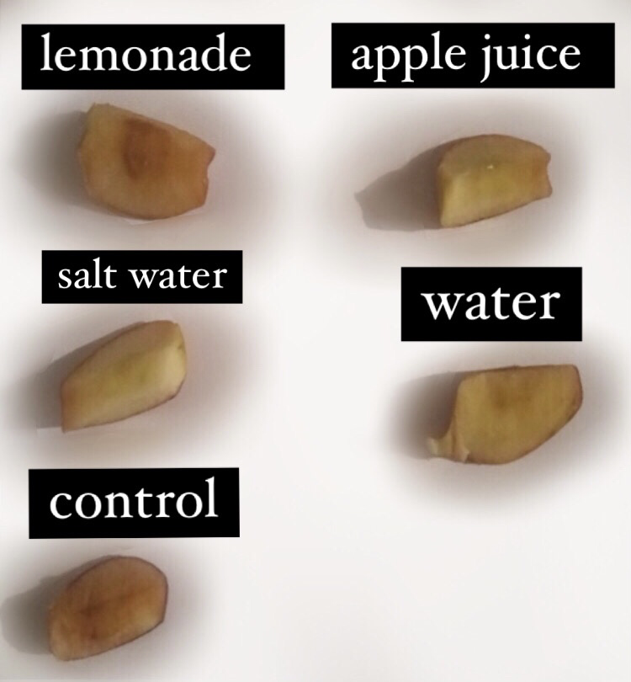
Results
Look in your cups to see if any of the apple slices have started to brown
You can leave it longer if you want and tell us next week what happens.

Slide 12
Why did this happen?
What do you think?

Slide 13
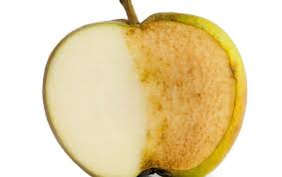
Why do apples turn brown?
Once the apple is cut or bruised the plant has been injured and oxygen in the air combines with chemicals in the apple.
Enzymes in the fruit make this process go faster.
(enzyme – a biological catalyst that speeds up reactions)
You can delay this process and stop the apple slices browning by either:
reducing the exposure to oxygen – you can reduce oxygen exposure by coating something with sugar, adding salt or a liquid.
or
Reducing the pH of the fruit – you can do the by adding an acid which slow enzyme activity

Slide 14
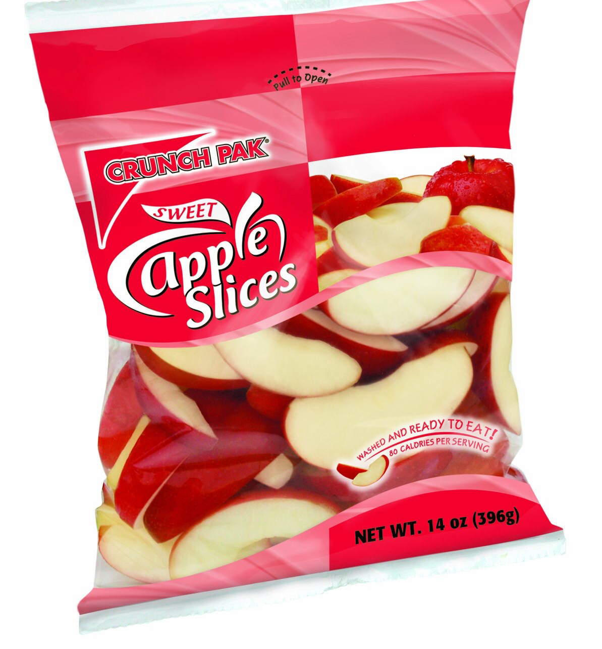
Bags of apple slices don’t brown because acids are added in the factory and the bags are filled with nitrogen instead of oxygen

Slide 15
CUBS SCIENCE BADGE – PART 2

Slide 16
Physics

Slide 17
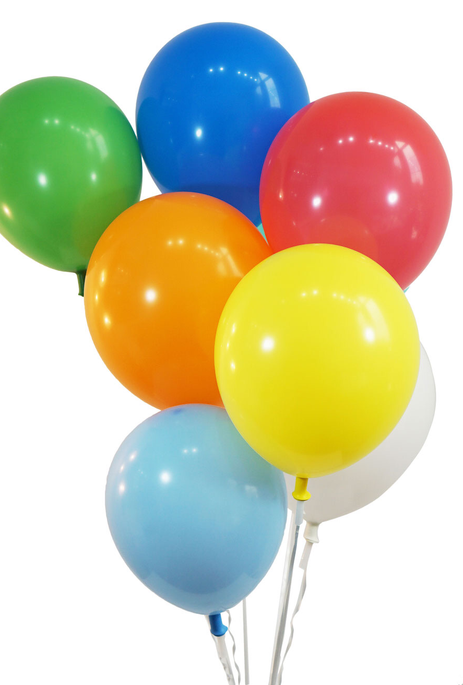
Get a balloon
Blow it up and tie a knot in the end

Slide 18
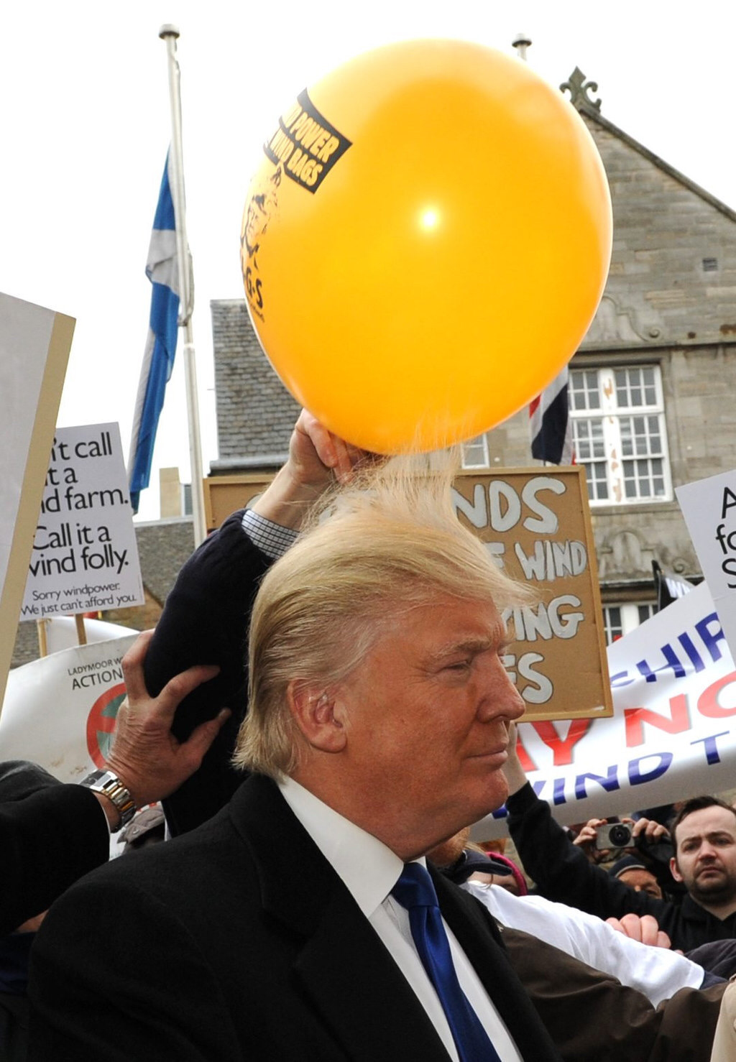
3) Rub it on your jumper or t-shirt for a minute.
4) See if it will stick to a wall, or hold it near your head to see the effect of the static charge.

Slide 19
What happened? Why do you think this happened?

Slide 20
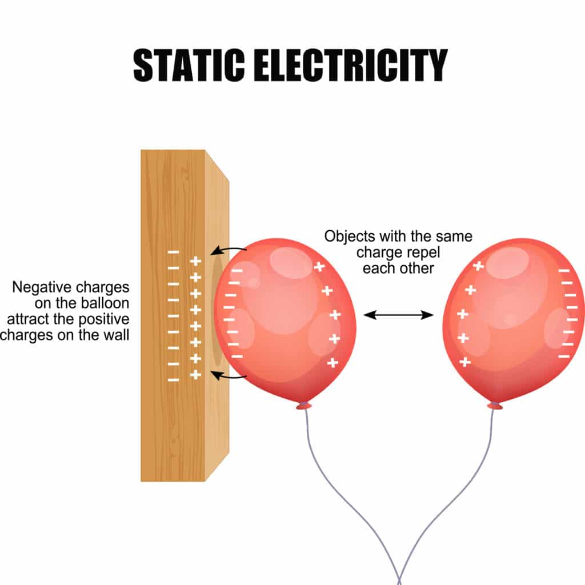
Rubbing the balloon on clothing gives it a negative charge.
This makes it attracted to things with a positive charge, such as your hair, or the wall.
(opposite charges attract)

Slide 21
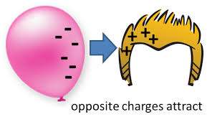
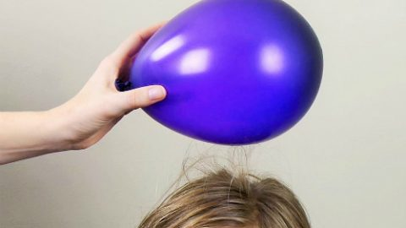
Why?
When a balloon is rubbed on hair, fur or wool, electrons are transferred from the hair to the balloon, giving the balloon a negative charge.

Slide 22
Hair
Balloon

Slide 23
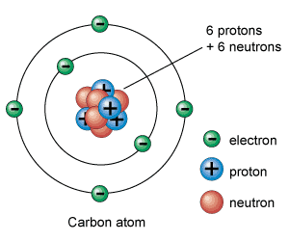
Fun fact
Lots of space between the nucleus and electrons
If we lost all the dead space inside our atoms, we would each be able to fit into a particle of dust, the entire human species would fit into the volume of a sugar cube and the earth would be the size of a basketball.

Slide 24
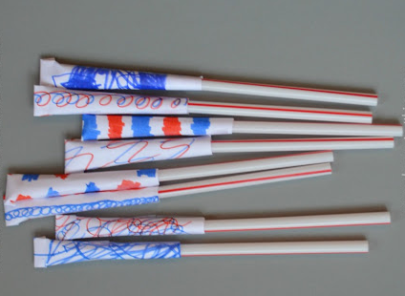
Straw rockets
Wrap a piece of paper around your straw. Seal the side and one end with Sellotape.
This should fit loosely over the top of your straw.
Seal at the side with Sellotape
Seal at the end with Sellotape
Make sure it fits over the straw loosely

Slide 25
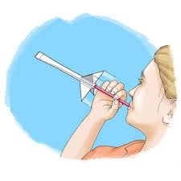
Place the paper tube over the straw and blow, it should shoot into the air!
You could also try blowing the straw with more/less force or at different angles and see how the flight of the rocket changes.

Slide 26
What happened? Why do you think this happened?

Slide 27
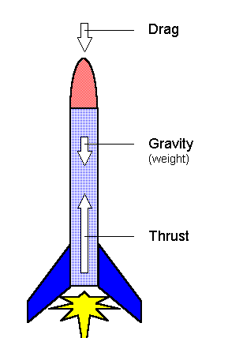
Air resistance
The harder you blow into the straw the more energy the air has and the further your rocket will fly!
There are three forces acting on the straw rocket:
Gravity pulling the rocket down
Air resistance slowing the rocket
Thrust (the force from you blowing the straw)

Slide 28
How can you make it travel further?
Air resistance
In order to increase the distance that the rocket flies you could:
make the rocket lighter so there is less gravity acting on it and pulling it down
make the aeroplane more aerodynamic in order to reduce air resistance
blow harder on the straw to increase the amount of thrust

Slide 30
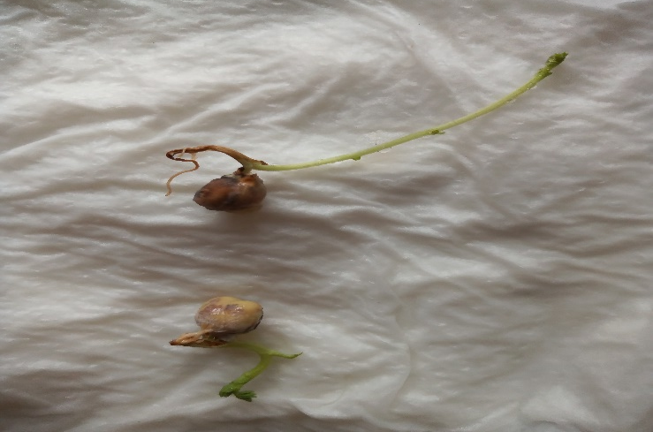
Soak your chick peas of beans
Once they’ve sprouted (after a few days) move the jar to a light place (such as a windowsill), and keep them damp

Slide 31
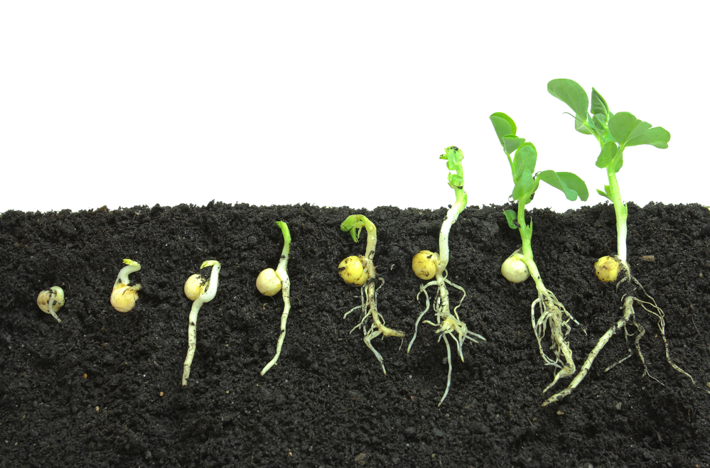
They will begin to grow roots
After 1 or 2 weeks, plant them in a small pot and water regularly.

Slide 32
Why did this happen?
What do you think?

Slide 33
Most plants grow from seeds.
A seed that hasn’t grown any leaves yet can survive with the food (starch) already stored inside the seed.

Slide 34
Once the seed bursts open, the root from the seed continues to provide food to the baby plant until the leaves emerge and are capable of making their own food.

Slide 35
The roots begin to grow downwards to make the plant stable.
Next, the shoot breaks above ground and straightens up towards the light.
Finally, the plant grows it’s stem and leaves.

Slide 36
pulse rate

Slide 37
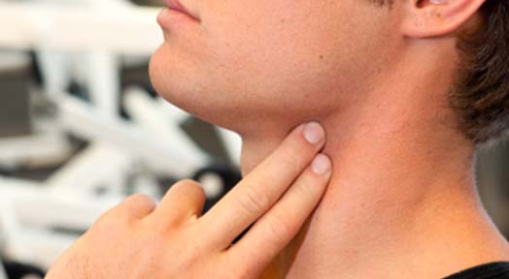
What happens to your pulse rate before, during and after exercise?
Find your pulse: put three fingers of your left hand onto your Adam's apple in your throat.
Push gently down on one side of it, and you will find your pulse beating (you can feel it going up and down).
It can be a bit tricky to find this pulse, so you may not be able to feel it.

Slide 38
What happens to your pulse rate before, during and after exercise?
When you have found a steady beat, count the amount of beats in 30 seconds.
I will tell you when to start and stop
Times your score by 2, and that will tell you your pulse rate per minute.
Write it down

Slide 39
What happens to your pulse rate before, during and after exercise?
When I say do 20 star jumps

Slide 40
What happens to your pulse rate before, during and after exercise?
Take pulse again for 30 seconds
I will tell you when to start and stop
Times your score by 2, and that will tell you your pulse rate per minute
Write it down
How different is this result to your resting heart rate from before?

Slide 41
Why did this happen?
What do you think?

Slide 42
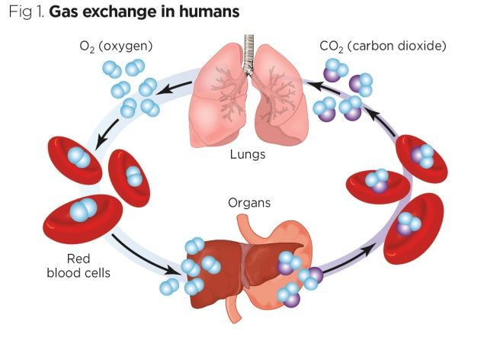
Why did your pulse rate go up?
During exercise the cells demand more oxygen, because of this the heart needs to beat faster to provide the fresh oxygenated blood that the cells need.

Slide 43
You have now finished your Science badge

