Slide 1
Notes:
Click to start quiz

Slide 2
1.
Notes:
Click for next question

Slide 3
2.
Notes:
Click for next question

Slide 4
3.
Notes:
Click for next question

Slide 5
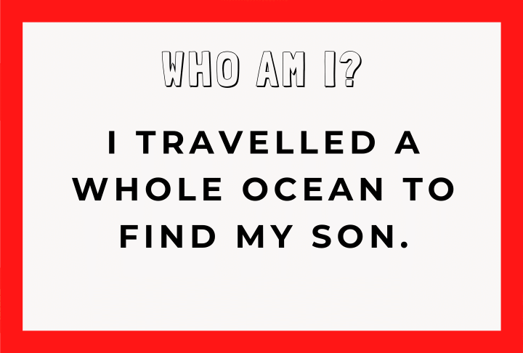
4.
Notes:
Click for next question

Slide 6
5.
Notes:
Click for next question

Slide 7
6.
Notes:
Click for next question

Slide 8
7.
Notes:
Click for next question

Slide 9
8.
Notes:
Click for next question

Slide 10
9.
Notes:
Click for next question

Slide 11
10.
Notes:
Click for next question

Slide 12
11.
Notes:
Click for next question

Slide 13
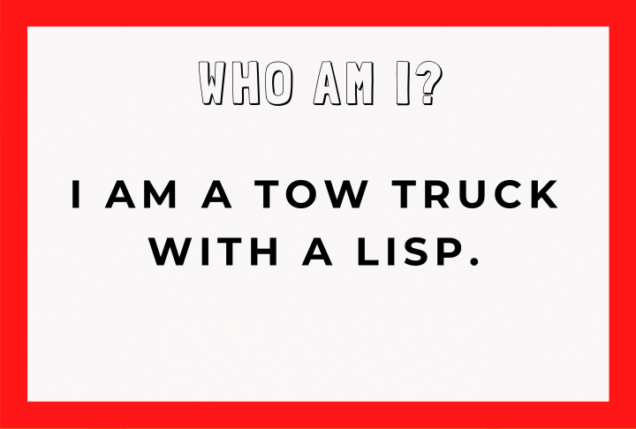
12.
Notes:
Click for next question

Slide 14
13.
Notes:
Click for next question

Slide 15
14.
Notes:
Click for next question

Slide 16
15.
Notes:
Click for next question

Slide 17
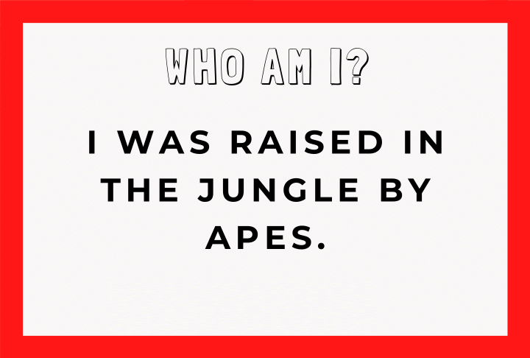
16.
Notes:
Click for next question

Slide 18
17.
Notes:
Click for next question

Slide 19
18.
Notes:
Click for next question

Slide 20
19.
Notes:
Click for next question

Slide 21
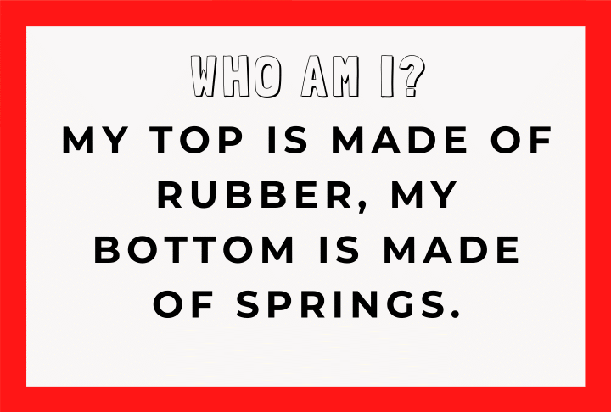
20.
Notes:
Click for next slide

Slide 22
21.
Notes:
Click for next slide

Slide 23
22.
Notes:
Click for next slide

Slide 24
23.
Notes:
Click for next slide

Slide 25
24.
Notes:
Click for next slide

Slide 26
25.
Notes:
Click for next slide

Slide 27
26.
Notes:
Click for next slide

Slide 28
27.
Notes:
Click for next slide

Slide 29
28.
Notes:
Click for next slide

Slide 30
29.
Notes:
Click for next slide

Slide 31
30.
Notes:
Click for next slide

Slide 32
31.
Notes:
Click for next slide

Slide 33
32.
Notes:
Click for next slide

Slide 34
33.
Notes:
Click for next slide

Slide 35
34.
Notes:
Click for next slide

Slide 36
35.
Notes:
Click for next slide

Slide 37
36.
Notes:
Click for next slide

Slide 38
37.
Notes:
Click for next slide

Slide 39
38.
Notes:
Click for next slide

Slide 40
39.
Notes:
Click for next slide

Slide 41
40.
Notes:
Click for next slide

Slide 42
Notes:
Click for the answers

Slide 43
1.
Notes:
Click to reveal answer
Click for next question

Slide 44
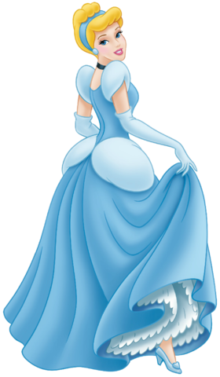
2.
Notes:
Click to reveal answer
Click for next question

Slide 45
3.
Notes:
Click to reveal answer
Click for next question

Slide 46
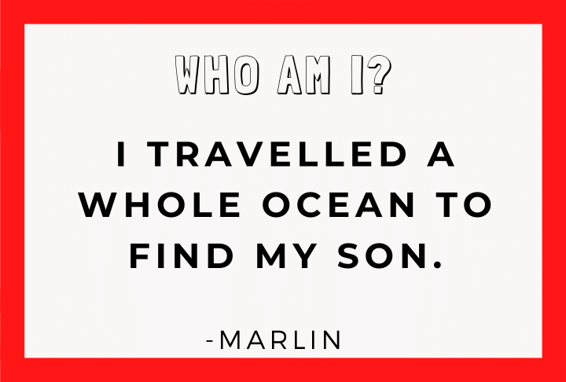
4.
Notes:
Click to reveal answer
Click for next question

Slide 47
5.
Notes:
Click to reveal answer
Click for next question

Slide 48
6.
Notes:
Click to reveal answer
Click for next question

Slide 49
7.
Notes:
Click to reveal answer
Click for next question

Slide 50
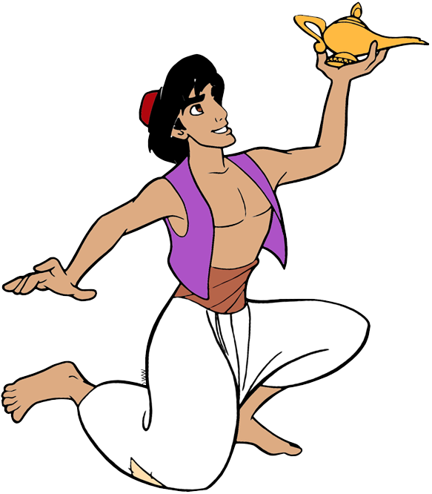
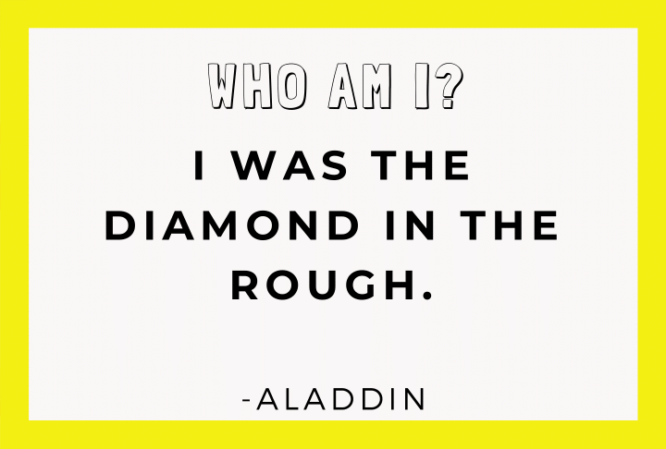
8.
Notes:
Click to reveal answer
Click for next question

Slide 51
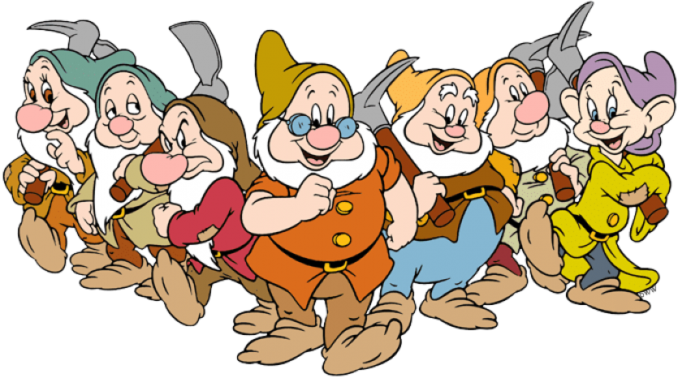
9.
Notes:
Click to reveal answer
Click for next question

Slide 52
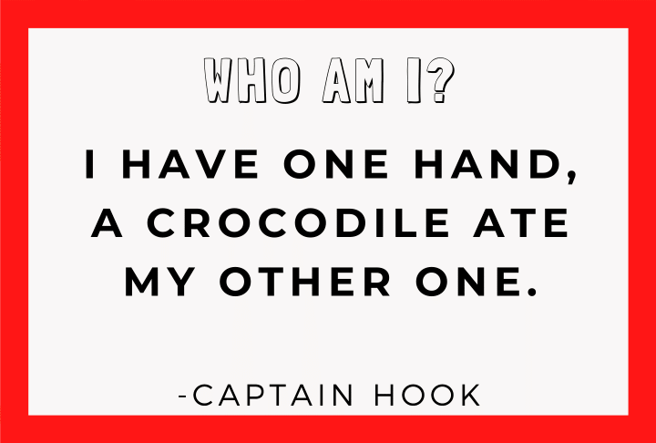
10.
Notes:
Click to reveal answer
Click for next question

Slide 53
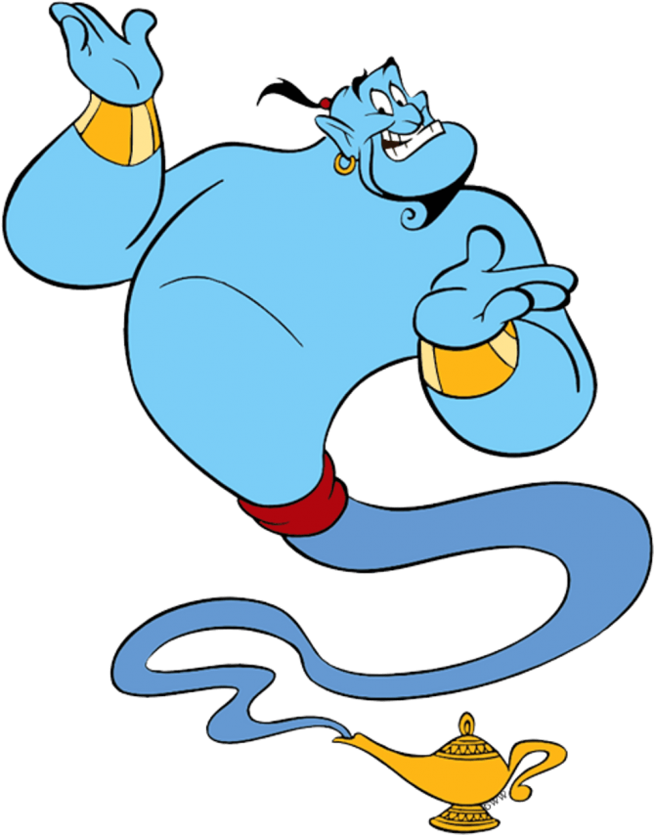
11.
Notes:
Click to reveal answer
Click for next question

Slide 54
12.
Notes:
Click to reveal answer
Click for next question

Slide 55
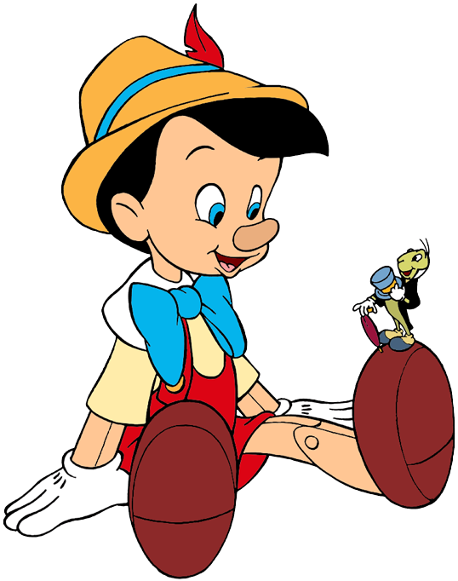
13.
Notes:
Click to reveal answer
Click for next question

Slide 56
14.
Notes:
Click to reveal answer
Click for next question

Slide 57
15.
Notes:
Click to reveal answer
Click for next question

Slide 58
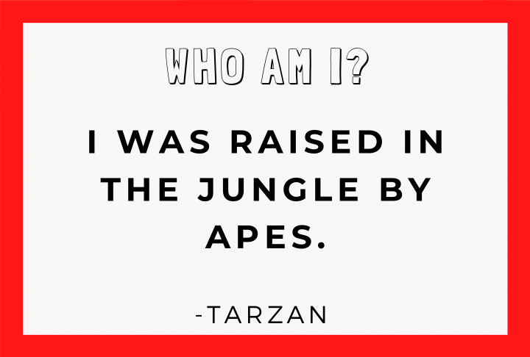
16.
Notes:
Click to reveal answer
Click for next question

Slide 59
17.
Notes:
Click to reveal answer
Click for next question

Slide 60
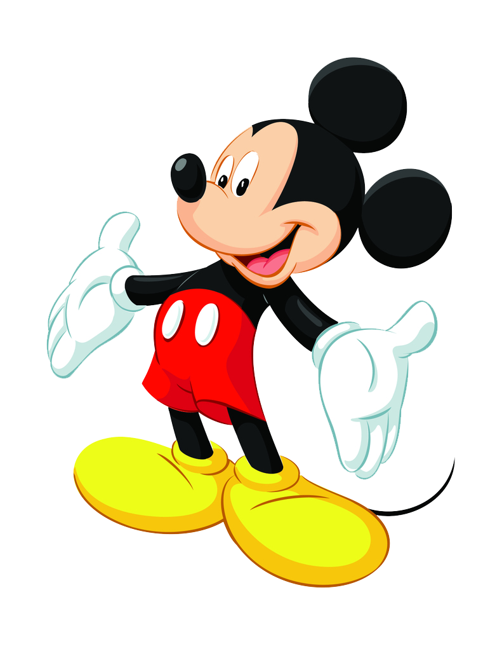
18.
Notes:
Click to reveal answer
Click for next question

Slide 61
19.
Notes:
Click to reveal answer
Click for next question

Slide 62
20.
Notes:
Click to reveal answer
Click for next slide

Slide 63
21.
Notes:
Click for next slide

Slide 64
22.
Notes:
Click for next slide

Slide 65
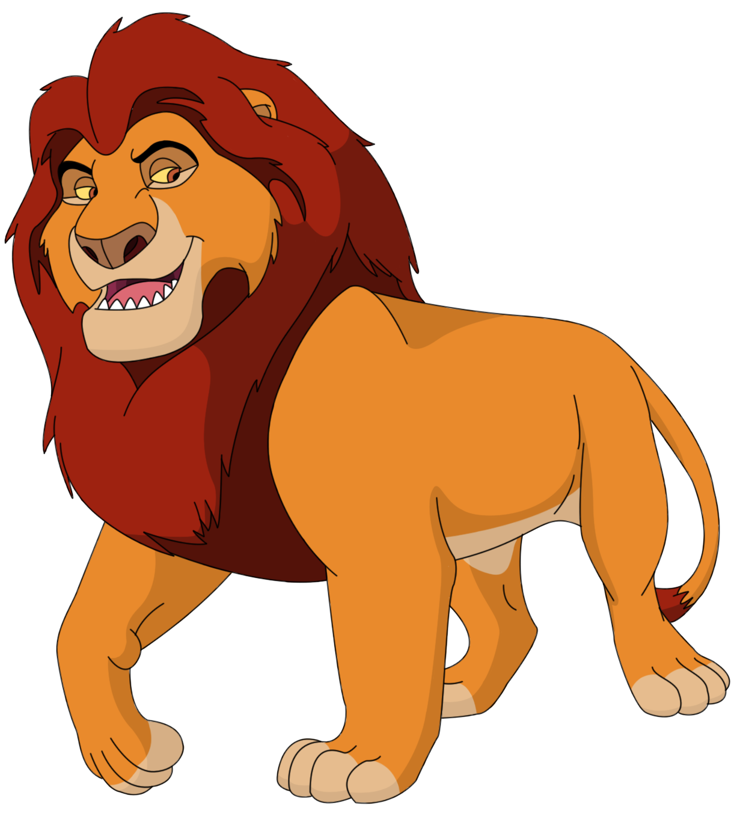
23.
Notes:
Click for next slide

Slide 66
24.
Notes:
Click for next slide

Slide 67
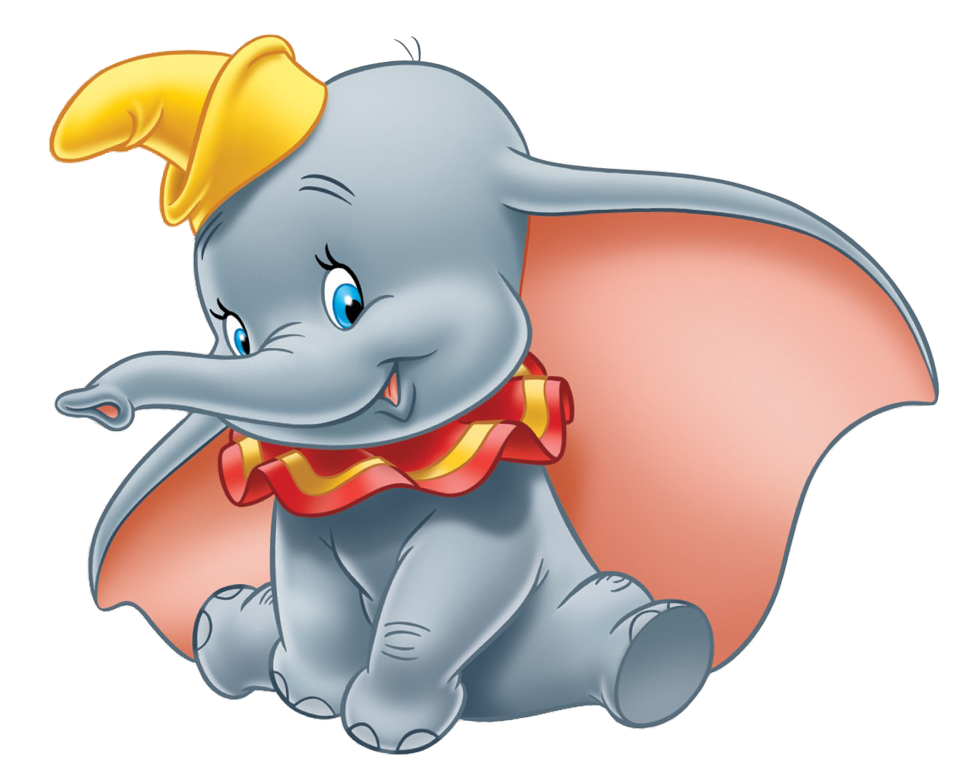
25.
Notes:
Click for next slide

Slide 68
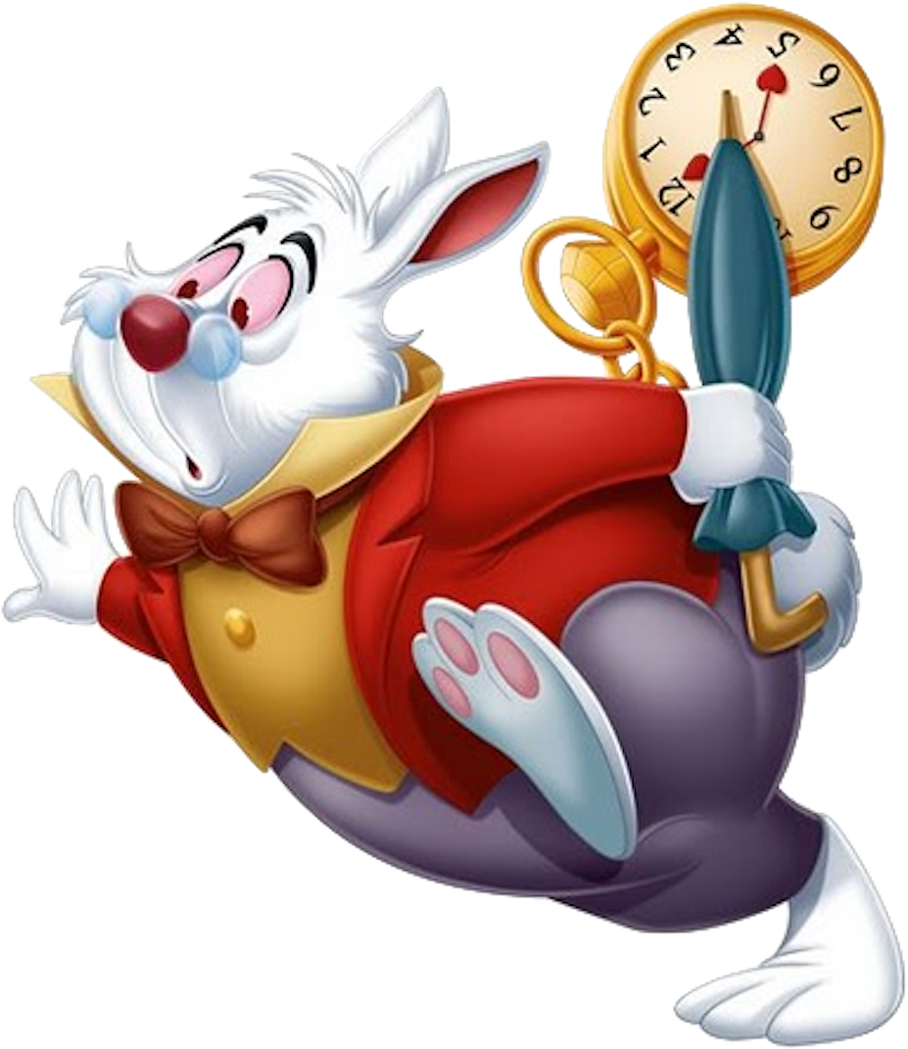
26.
Notes:
Click for next slide

Slide 69
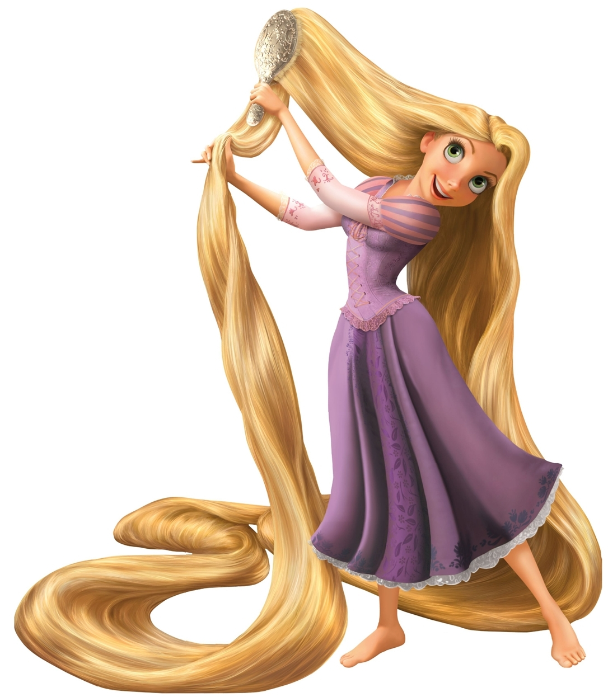
27.
Notes:
Click for next slide

Slide 70
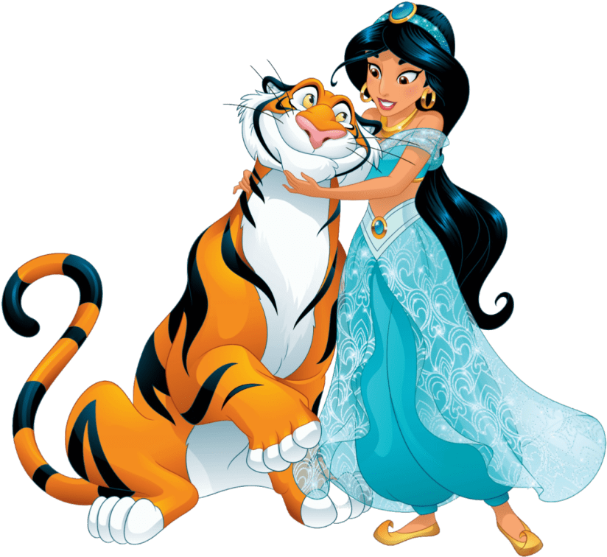
28.
Notes:
Click for next slide

Slide 71
29.
Notes:
Click for next slide

Slide 72
30.
Notes:
Click for next slide

Slide 73
31.
Notes:
Click for next slide

Slide 74
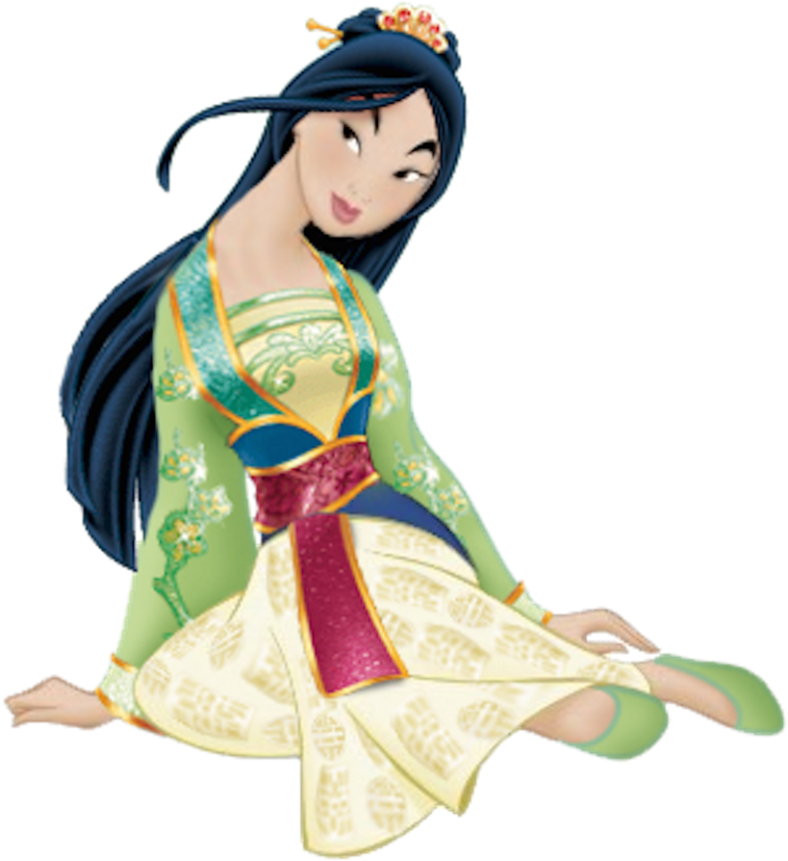
32.
Notes:
Click for next slide

Slide 75
33.
Notes:
Click for next slide

Slide 76
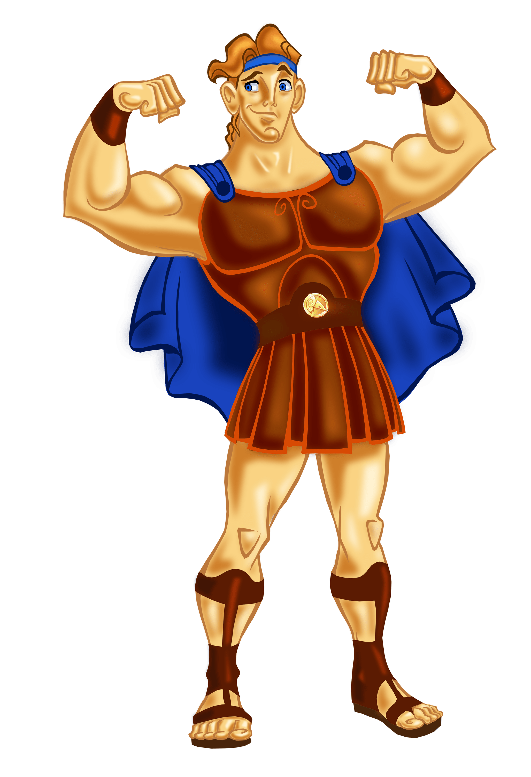
34.
Notes:
Click for next slide

Slide 77
35.
Notes:
Click for next slide

Slide 78
36.
Notes:
Click for next slide

Slide 79
37.
Notes:
Click for next slide

Slide 80
38.
Notes:
Click for next slide

Slide 81
39.
Notes:
Click for next slide

Slide 82
40.
Notes:
Click for next slide

Slide 83
Notes:
Questions extracted from the Disney Who Am I? game from marcieandthemouse.com

