Slide 1
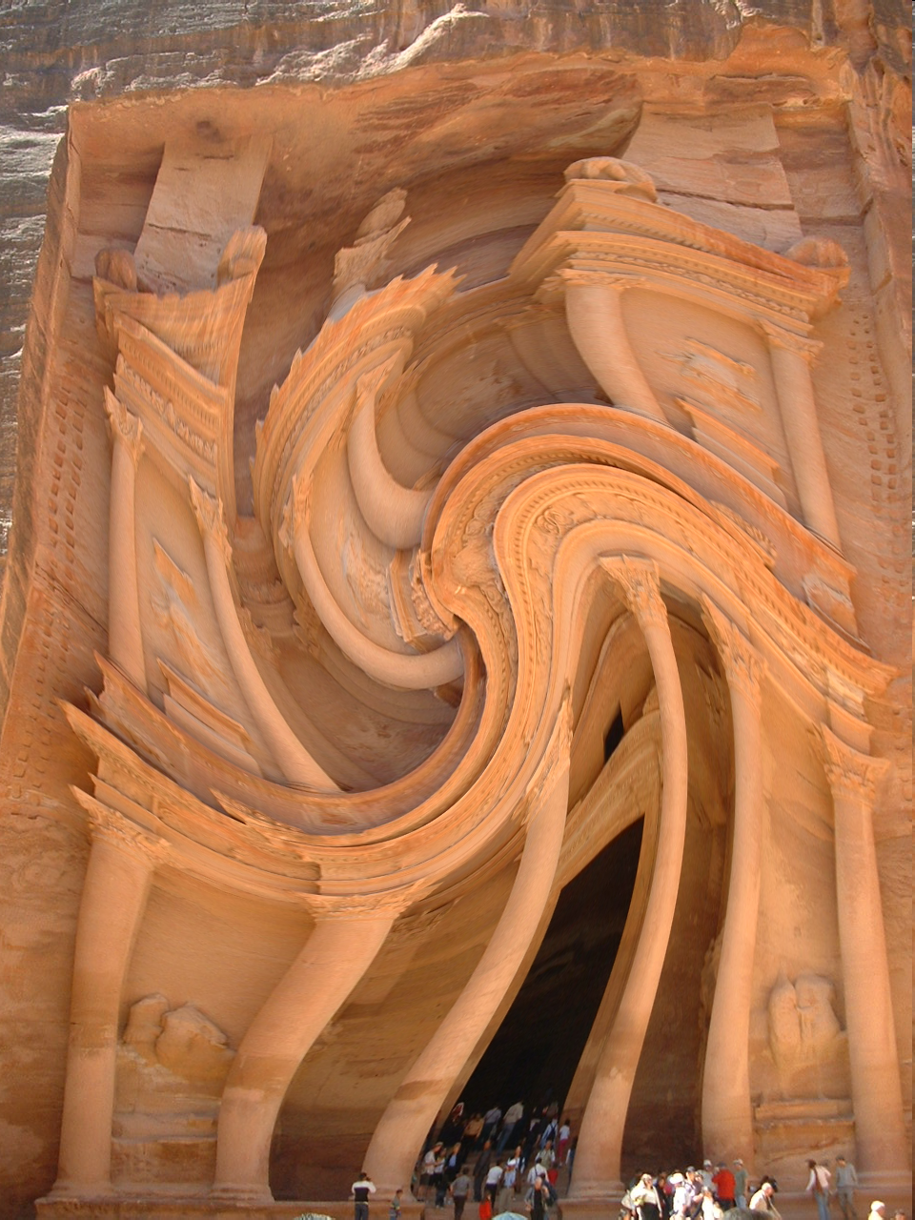
Distorted Geography!
Write down the numbers 1-12
1 point for the landmark
1 point for the country
E.g.
Petra, Jordan

Slide 2
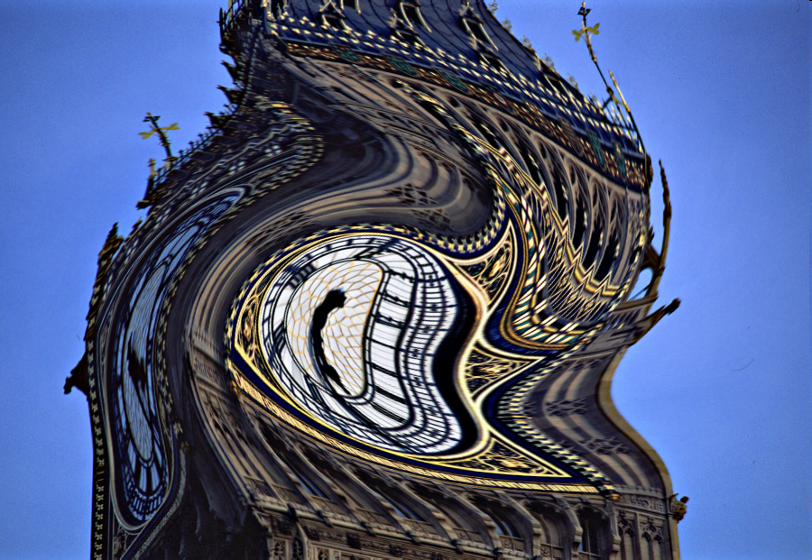

Slide 3
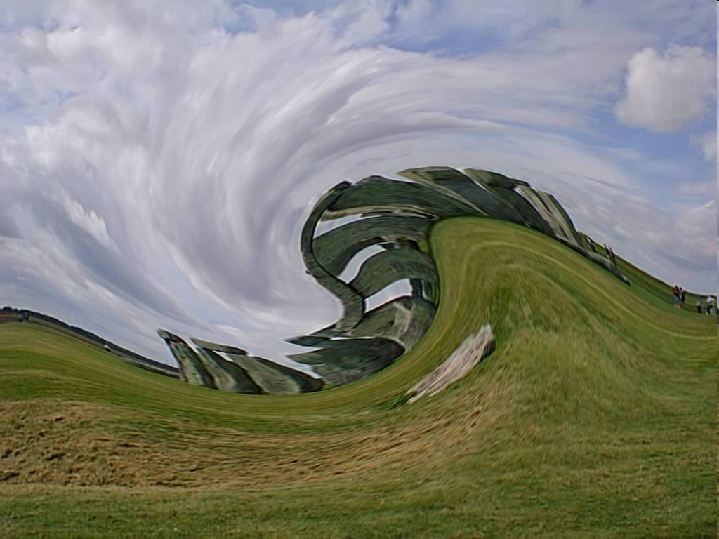

Slide 5
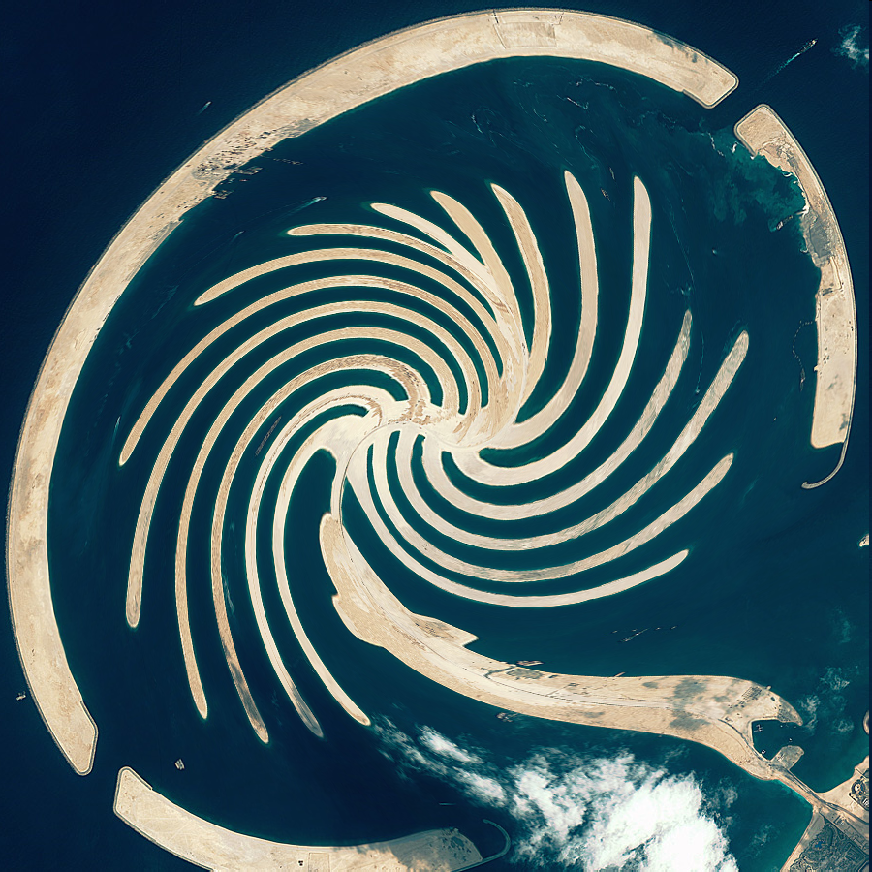

Slide 6
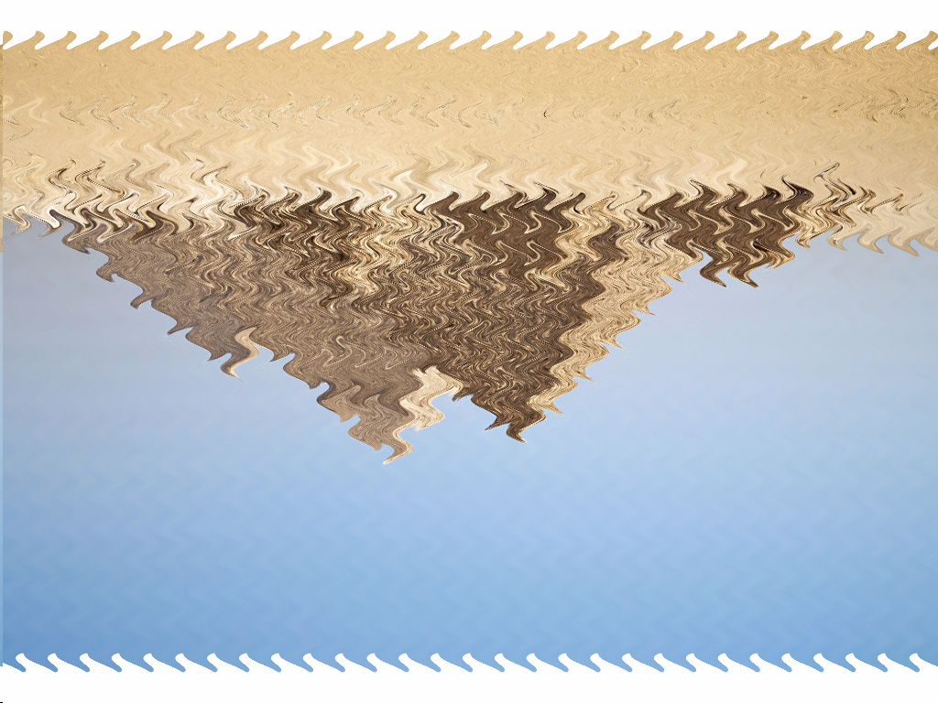

Slide 7
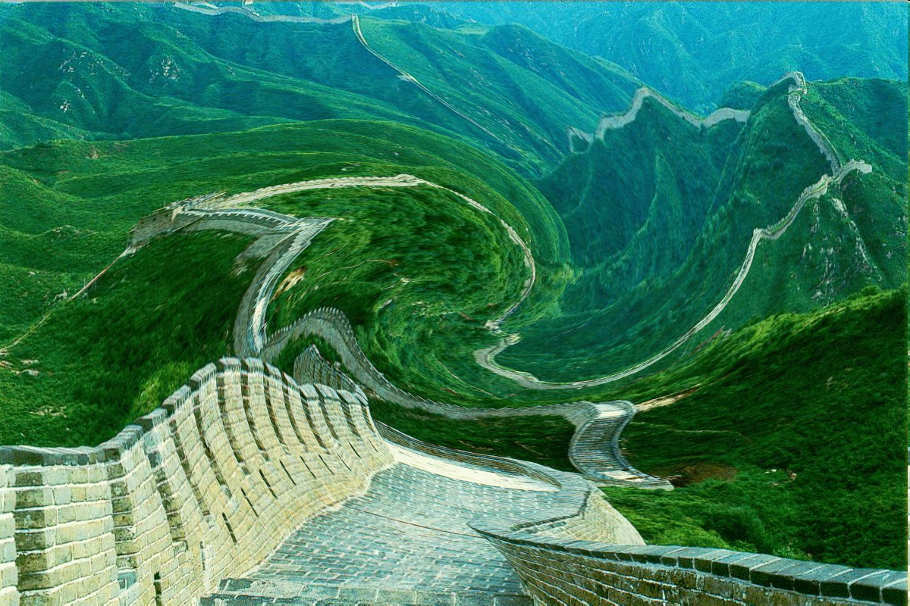

Slide 8
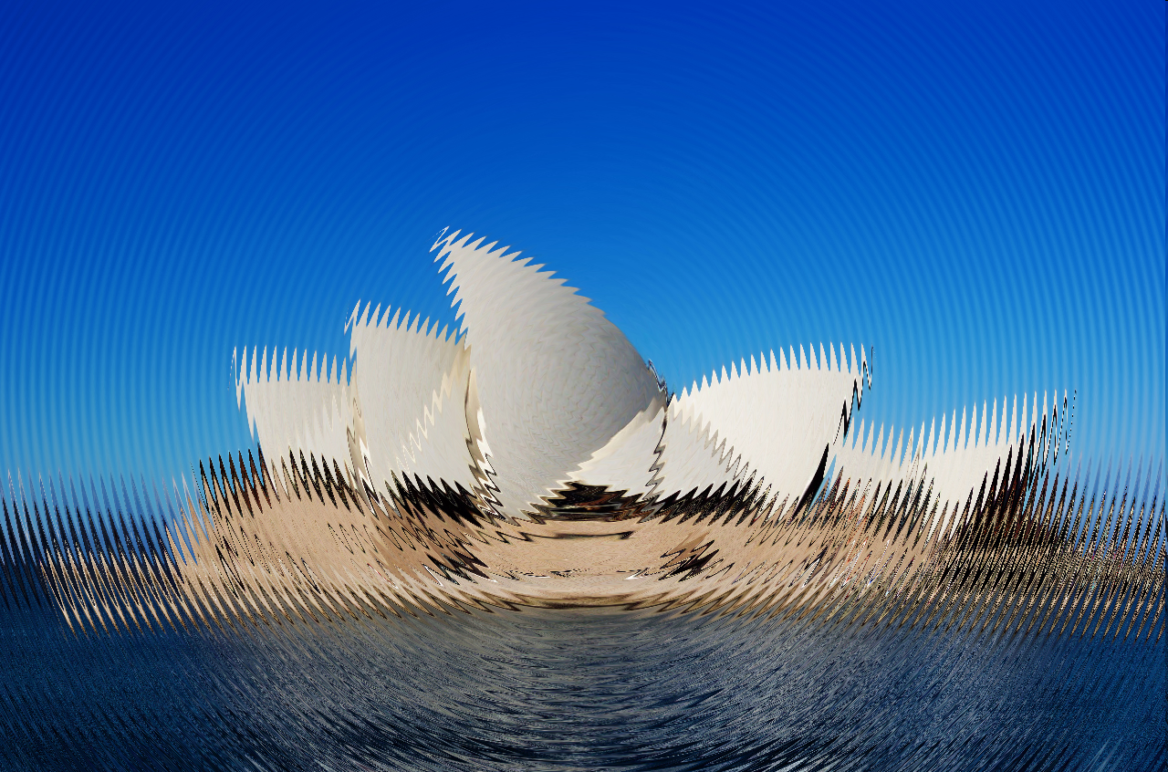

Slide 9
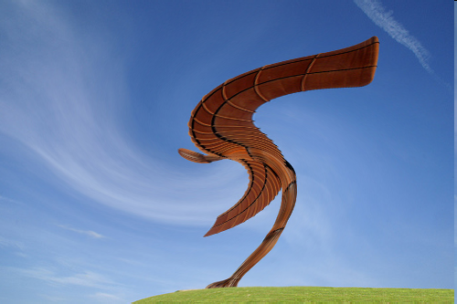

Slide 10
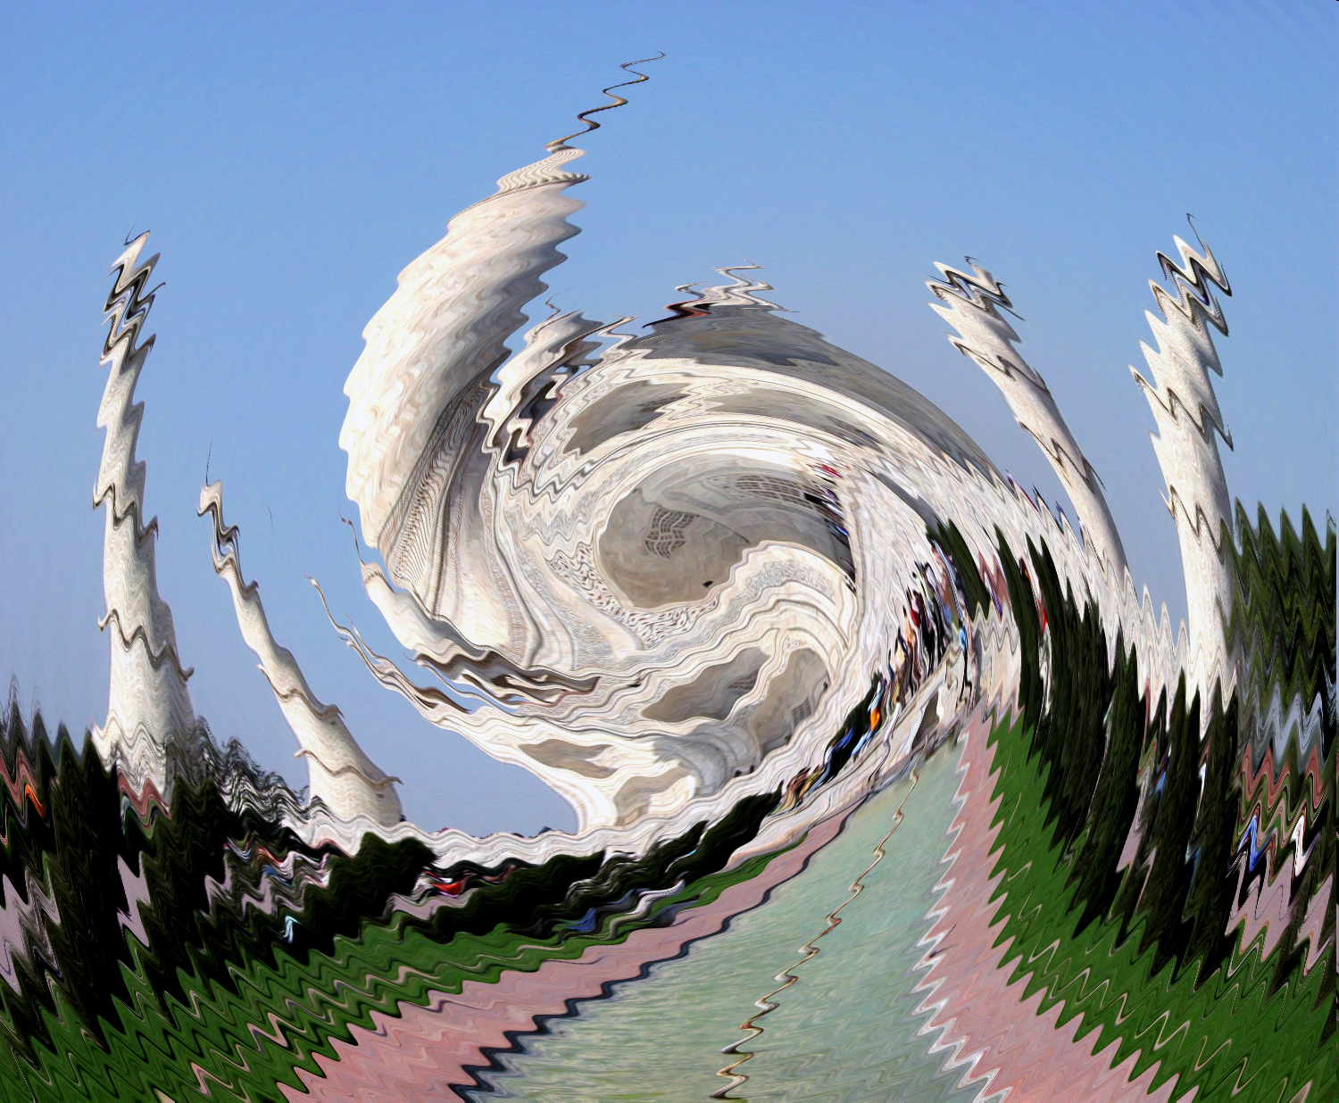

Slide 11
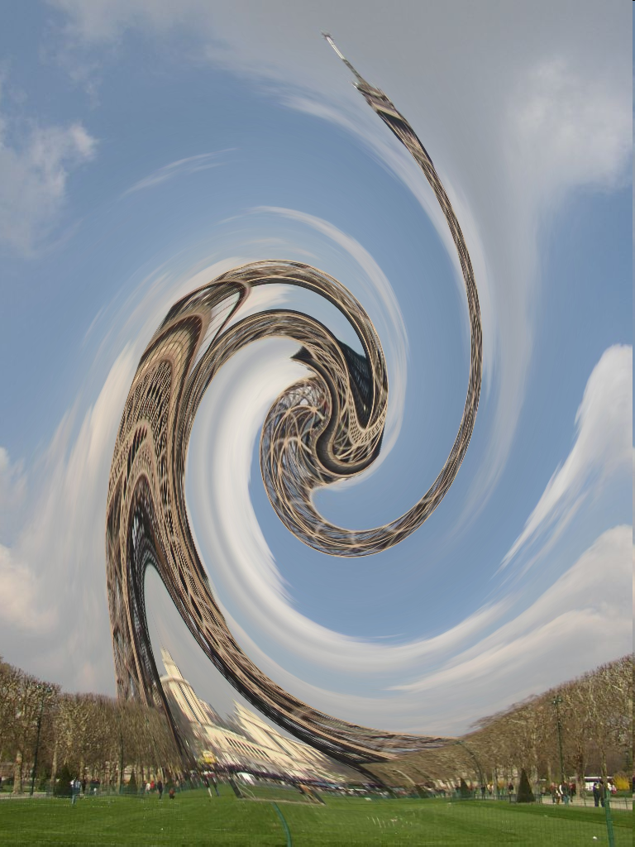

Slide 12
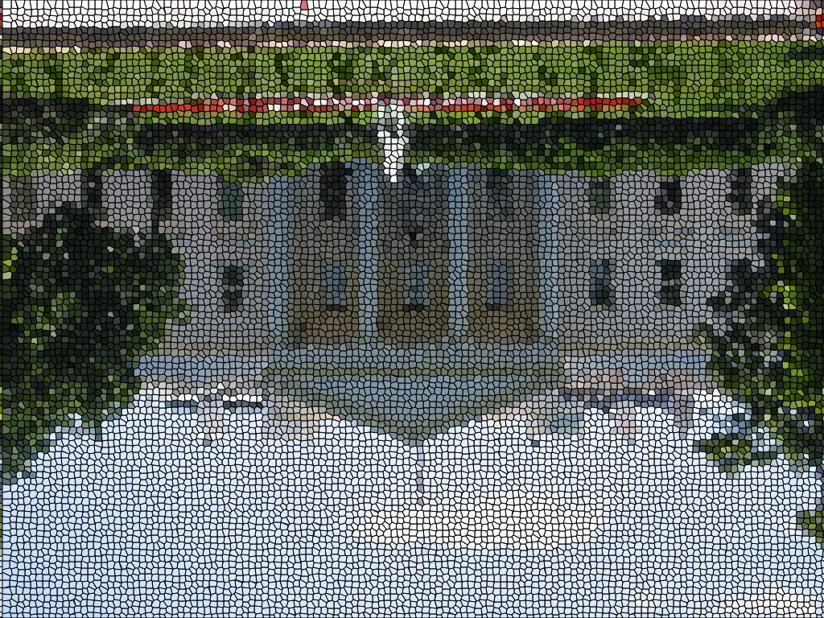

Slide 13
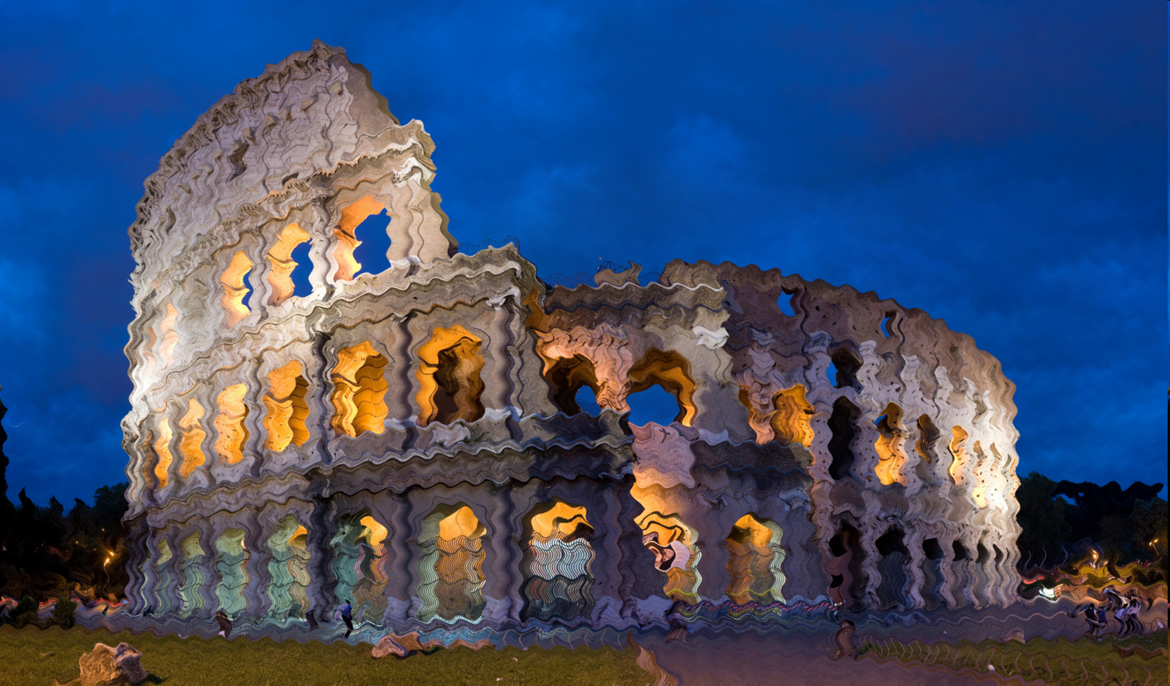

Slide 14
Big Ben, UK
Stonehenge, UK
Statue of Liberty, America
Palm Island, Dubai
Pyramids, Egypt
Great Wall of China, China
Sydney Opera House, Australia
Angel of the North, UK
Taj Mahal, India
Eiffel Tower, Paris
The White House, America
The Coliseum, Rome

