Slide 1
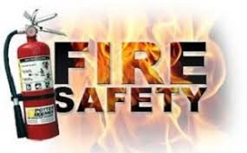
A virtual tour of Cambridge Fire Station and some Home Fire Safety
HUGE THANKS to Cambridge Fire Department for posting their videos up on YOUTUBE

Slide 2
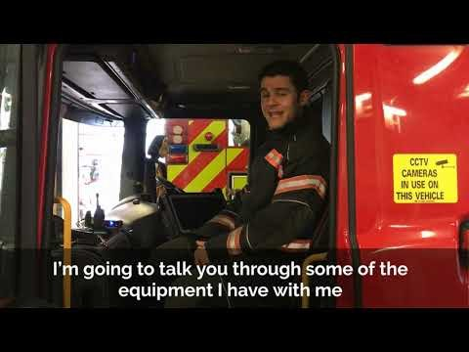

Slide 3
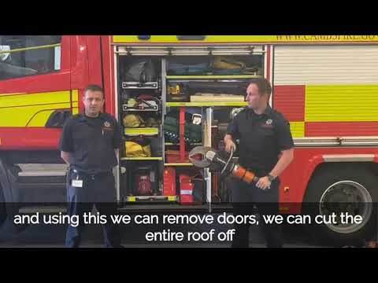

Slide 4
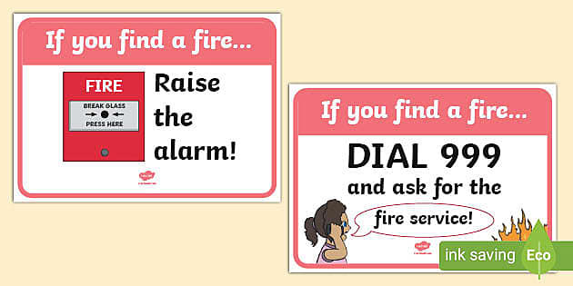
MAIN THINGS TO KNOW IF THERE IS A FIRE - GET OUT

Slide 6
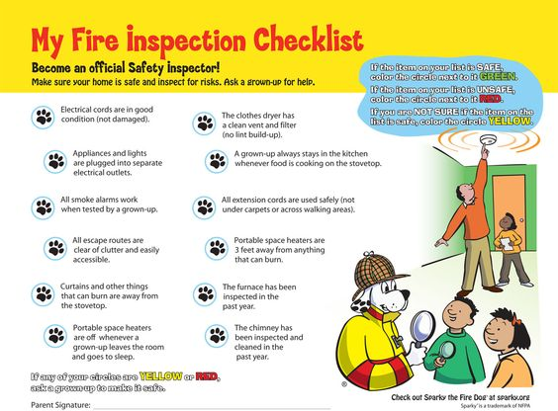

Slide 7
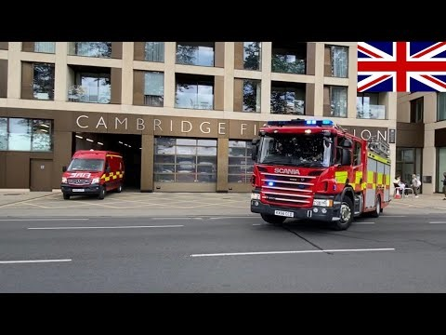

Slide 8
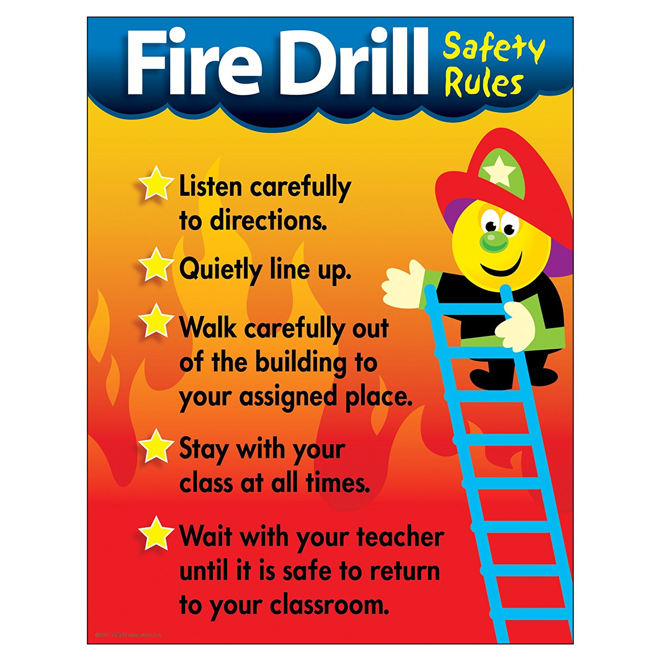

Slide 9
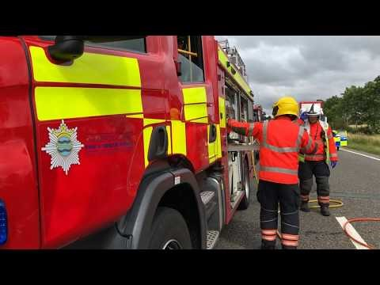

Slide 10
YOUR HOME CHECKLIST
Does your home have smoke alarms on every level, inside each bedroom, and outside each sleeping area?
Do you know the sound that a smoke alarm makes? Do you know what to do if you smoke alarm sounds?
Are all the exits in your home clear of furniture, toys, and clutter?
Can you see the number on your house from the street (have a grown-up go with you to check)?
Has your family picked a safe place to meet outside if a fire occurs?

Slide 11
BE SAFE AT HOME
KNOW WHAT TO DO
LEARN HOW TO GET HELP and HOW TO MAKE
A 999 (112) EMERGENCY CALL

