Slide 1
REN District Scouts

Slide 2
Pitching (putting up) and Striking (taking down)
your tent at camp

Slide 3
First make sure you have all the correct parts of the tent:
Outer sheet (flysheet)
Inner compartment
Poles
Pegs
Groundsheet

Slide 4
Next lay out the outer sheet (the flysheet) with the inside facing down

Slide 5
Insert the poles into the sleeves on the flysheet.
If the poles are different colours, check the coloured tag on the end of each sleeve to make sure the correct pole goes into each one

Slide 6
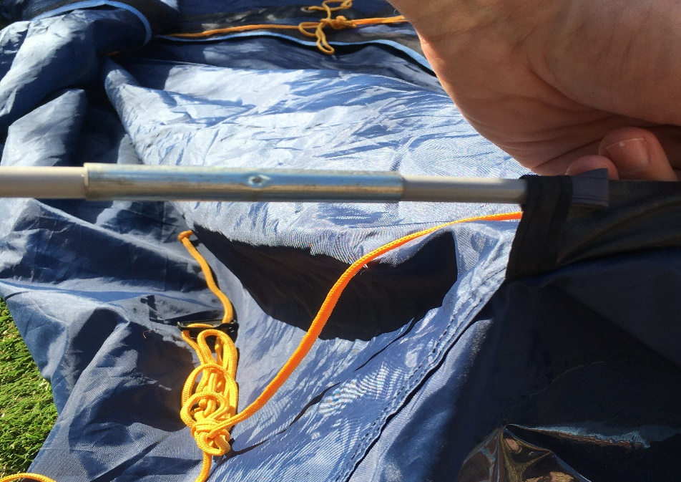
NEVER pull pole sections as they could come apart inside the sleeve, or you could snap the elastic cord that joins them together.
ALWAYS push the pole into the sleeve and pull the tent canvass towards you

Slide 7
When all the poles have been inserted, find each metal pin on the edge of the tent canvass and insert a pin into one end of each pole
Then carefully bend each pole and insert a pin in the other end of the pole

Slide 8
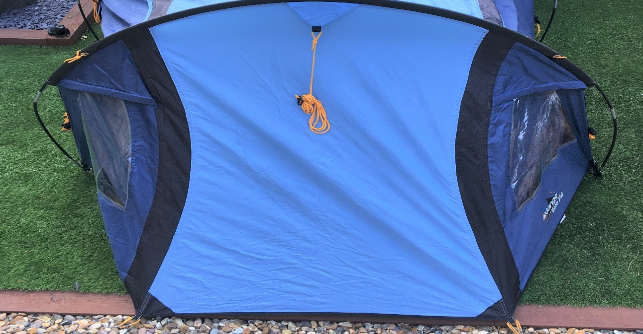
Next peg out the tent
Make sure the sides of the tent are pulled tight as you peg them out
Then peg out the guy ropes
You may need to peg out the guys at each end of the tent before pegging the canvass

Slide 9
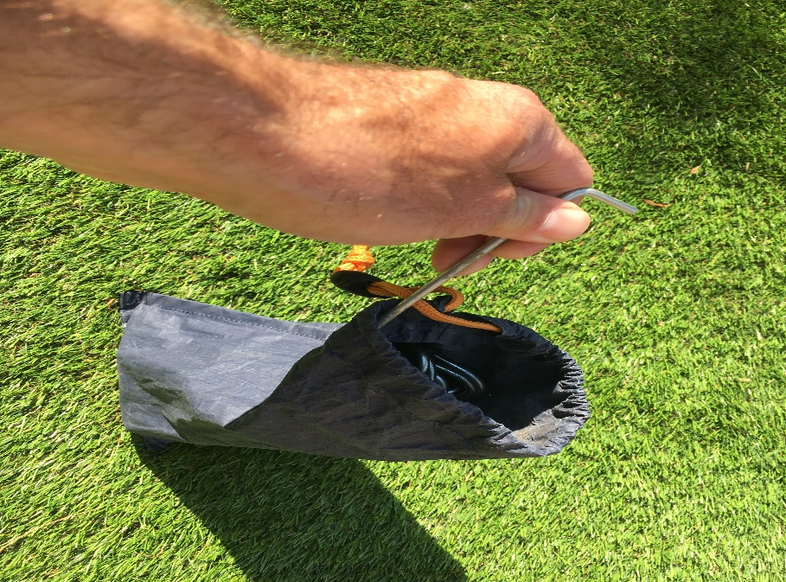
NEVER tip all of the pegs out onto the ground as you could lose some of them
ALWAYS take pegs out of the peg bag one at a time as you need them

Slide 10
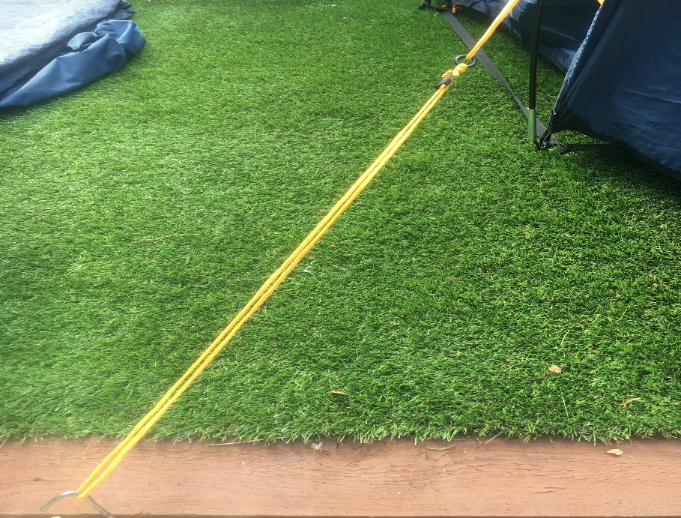
NEVER leave the guy ropes slack as they won’t support the tent properly
ALWAYS tighten each guy rope after pegging it out

Slide 11
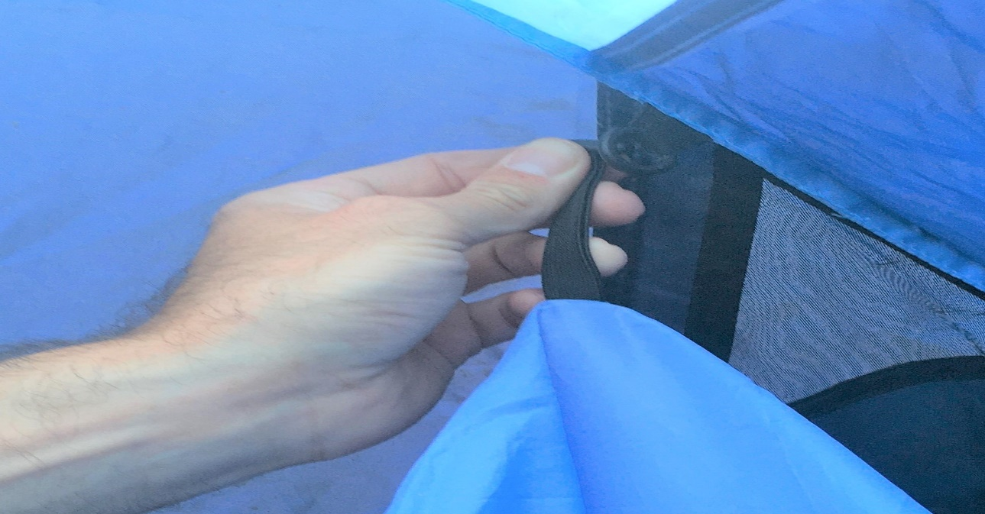
Next lay out the inner compartment
Hook the corners onto the bottom of the flysheet
Then fasten the sides of the compartment to the loops on the inside of the flysheet

Slide 12
Finally, peg out the groundsheet in the front porch area

Slide 13
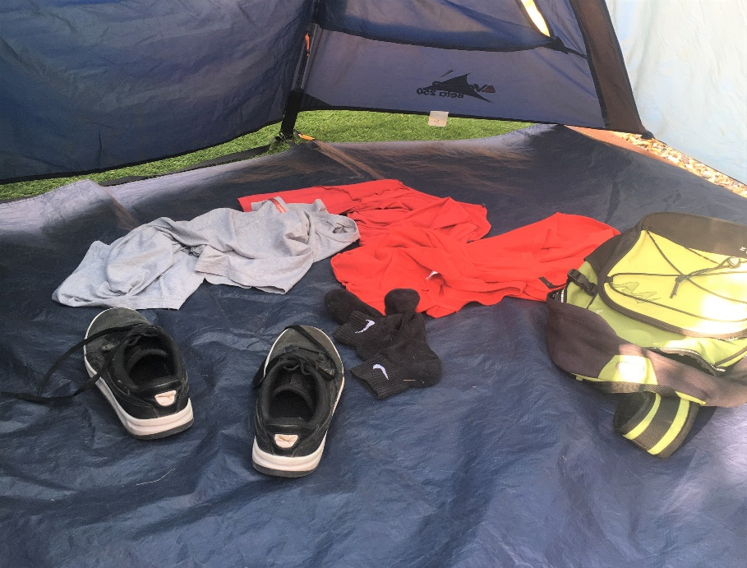
Look after your tent:
NEVER leave your bag touching the sides of the tent as it will get wet if it rains
NEVER leave your clothes and belongings lying around the floor of the tent

Slide 14
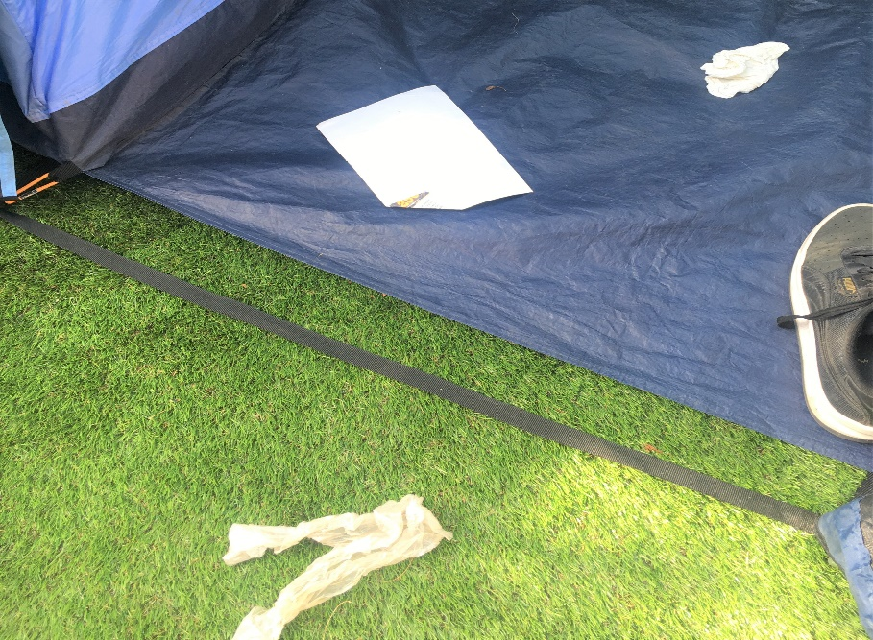
Look after your tent
NEVER enter the inner compartment wearing boots or trainers, always take them off first
NEVER leave litter inside your tent or around the campsite

Slide 15
ALWAYS keep your tent tidy.
There will always be a tent inspection at camp!

Slide 16
Take down the tent in the reverse order to putting up:
Pack & remove belongings
Remove, dry out and fold up groundsheet
Take down, dry out & fold up the inner compartment
Unpeg and tie up the guys
Unpeg the flysheet
Remove pins & slide out poles
Fold up flysheet

Slide 17
Happy Camping!

