Slide 2
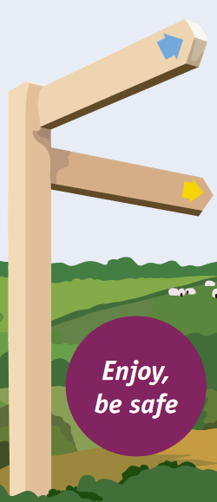
The Countryside Code
Respect other people
Consider the local community and other people enjoying the outdoors
Park carefully so access to gateways and driveways is clear
Leave gates and property as you find them
Follow paths but give way to others where it’s narrow
Stay on the path unless it’s an "Open Access Area"
Protect the natural environment
Leave no trace of your visit, take all your litter home
Don’t have BBQs or fires
Keep dogs under effective control
Dog poo - bag it and bin it
Enjoy the outdoors
Plan ahead, check what facilities are open, be prepared
Follow advice and local signs and obey social distancing measures
Tell someone where you are going and check the weather forecast

Slide 3
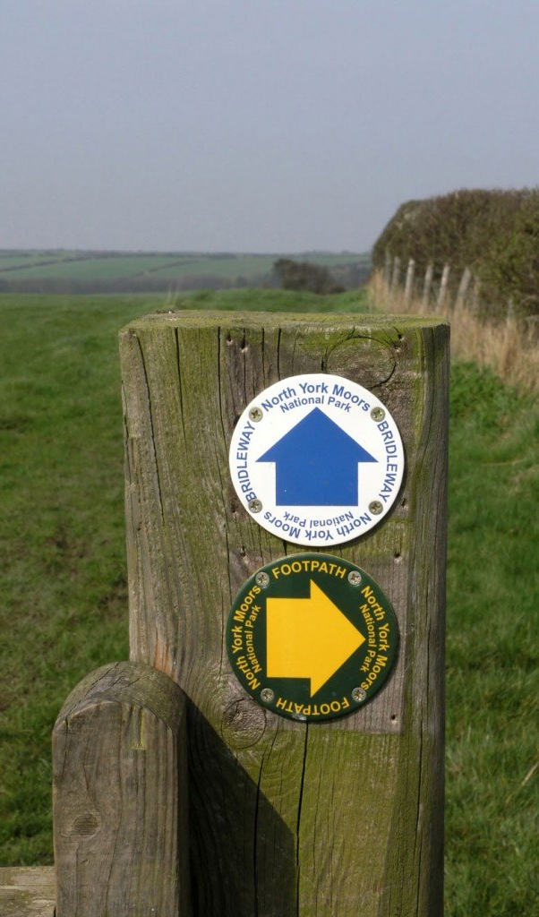
Footpath Signs in England & Wales
Footpath Sign (Yellow Arrow)
The most common sign you will come across and it means the footpath is open to walkers only.
Bridleway (Blue Arrow)
Horse-riders and cyclists are welcome as well as walkers.

Slide 4
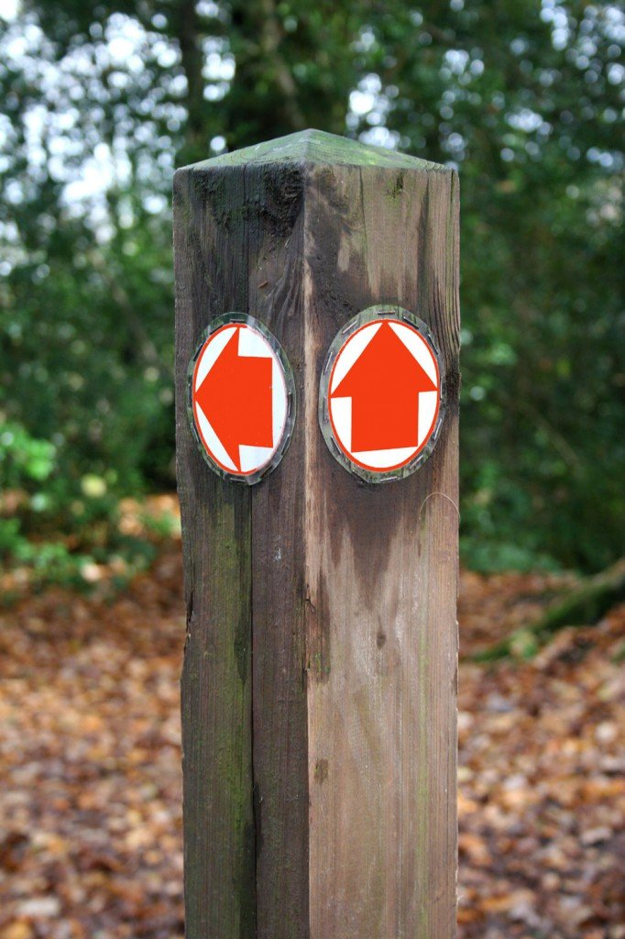
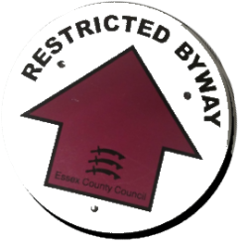
Footpath Signs in Cont...
Byway Open To All Traffic (Red Arrow)
As the title suggests, these are open to walkers, horse-riders, cyclists, horse drawn and motorised vehicles.
Restricted Byway (Plum Coloured Arrow)
Walkers, horse-riders, cyclists and horse drawn carriages but NOT motorised vehicles.

Slide 5
Footpath Signs in Cont...
National Trail (Black Acorn)
Mainly for walkers but some can also be for cyclists and horse-riders. They are often well sign posted, run and funded by Natural England and pass through some of the most breathtaking landscapes England and Wales have to offer.

Slide 6
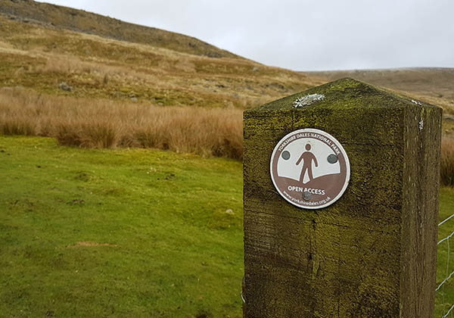
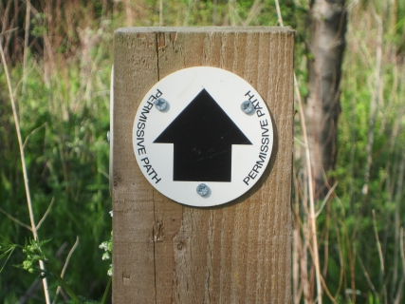
Footpath Signs in Cont...
Open Access Land (Brown Man Stood on Land)
Roam at will, just consult your map or check with the local council as to where these areas finish. They are made for you to walk, watch wildlife, climb, run and have fun amongst the great outdoors
Permitted/Permissive Paths (White Arrow)
Paths the landowner has agreed with the local authority to allow public access to. These routes can be closed for several days every year by the landowner for maintenance and to avoid claims of continuous public right of way.

