Slide 1
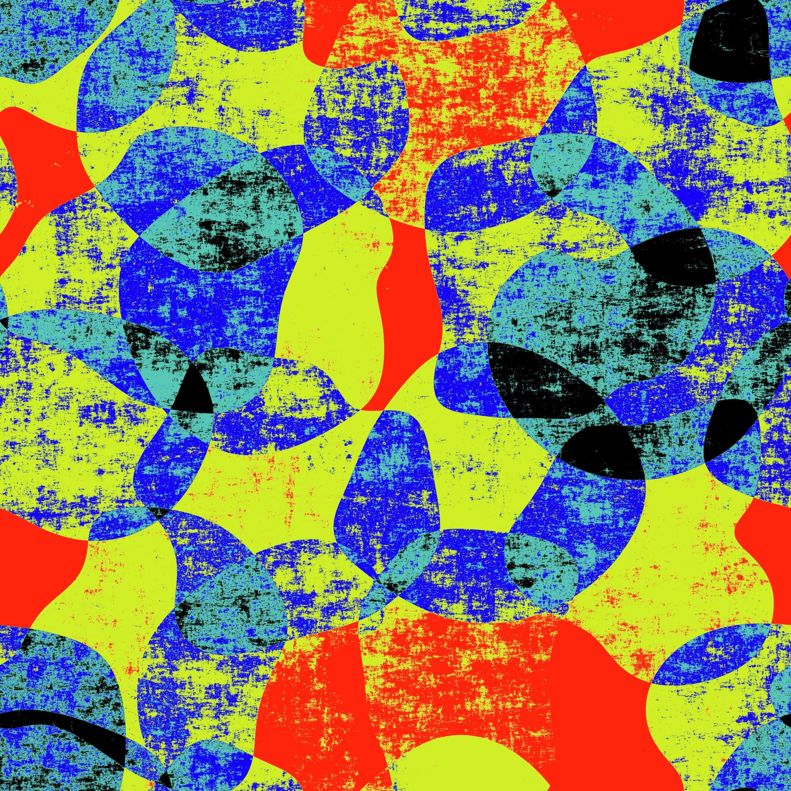
What’s in a name?

Slide 2
Get yourself a pen and paper and write down the numbers 1 to 21

Slide 3
1 2 3 4 5 6 7
8 9 10 11 12 13 14
15 16 17 18 19 20 21
Notes:
Mark your answers down. When done, go through one at a time

Slide 4
Why Marketing works…
Ok so those were pretty easy…
Actually, scarily easy!
That’s because our brains are incredibly good at making associations
It’s those brain associations that make marketing so powerful

Slide 5
BREAK OUTS!
Do you think you’ve ever been influenced by marketing?
When? How did it influence you?

Slide 6
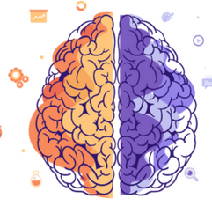
Surely it’s not that easy?…
Urmmm…
…unfortunately, it is actually really easy to influence humans.
One of the well known concepts of neuroscience is that the human brain has two systems of thinking,
System 1, which is intuitive, emotional, and quick
System 2, which is logical, rational, slow and hard work for our brains!
The human brain usually prefers System 1 thinking because it’s energy efficient, and avoids System 2 where it can.

Slide 7
So how do marketeers tap into our quick, emotional system 1 thinking?
Notes:
Thoughts?

Slide 8
They tap into feelings. What does this picture make you think of?
Studies suggest that people judge facial expressions in milliseconds and associate the same emotion to your brand.
What do you think that this advertising?

Slide 9
So POLIGRIP (a type of glue that you use to keep your false teeth in place)
= Happiness, smiling, confident, and a little bit in love!
Sounds crazy? It is, but here’s the thing…
Your brain makes an association, whether you want it to or not!

Slide 10
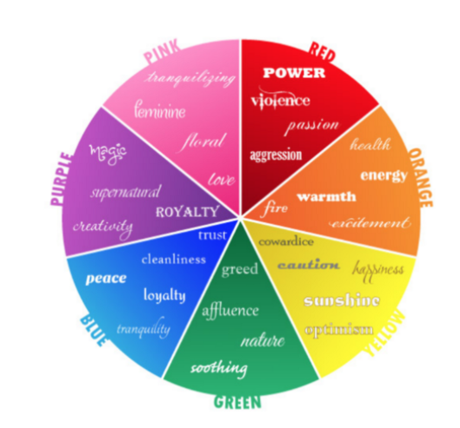
They create an association with a feeling. Music and colour all play their part.
What colours might you use to create the impression that something was organic or natural?

Slide 11
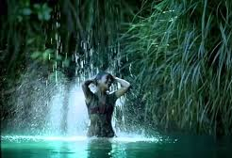
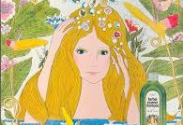
A SHAMPOO STORY…
Full of natural associations: ‘organic experience’ ‘inspired by nature’
BUT the brand was still using damaging sulphates and preservatives
Only changed recently when market-share dropped and it became clear their target audience had worked it out!

Slide 12
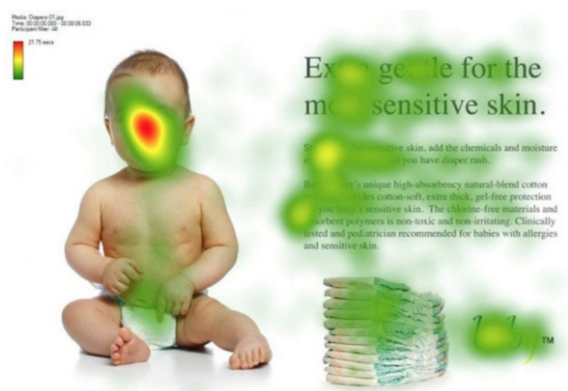
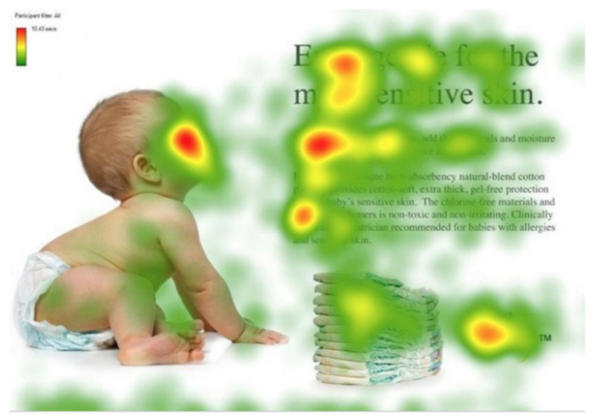
They focus our attention. Where in each picture is your attention directed?
We are programmed to follow someone’s gaze. It’s actually a pretty powerful instinct.

Slide 13
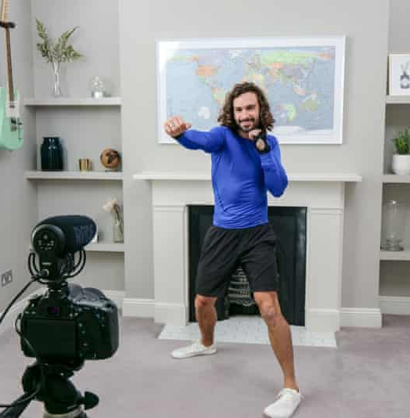
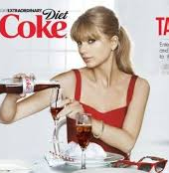
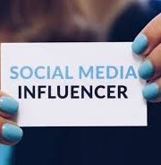
They draw on people we already trust
Social Media Influencers. People we associate with trust.
People we aspire to be.

Slide 14
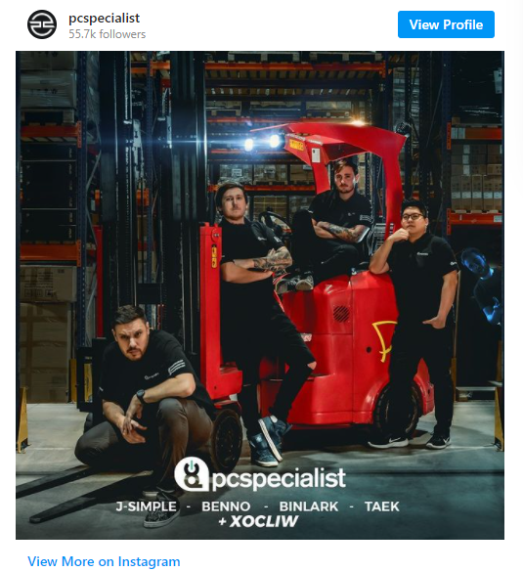
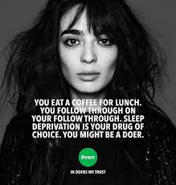
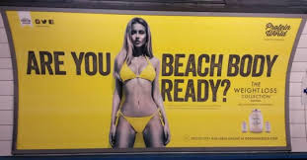
When marketing hurts…

Slide 15
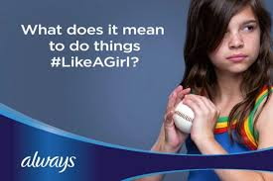
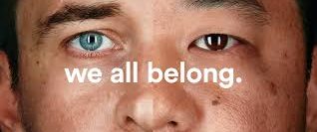
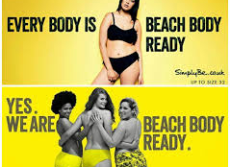
And when it helps…

Slide 16
So how do I protect myself from marketing?
You can’t stop the associations in your brain, but there are some things you can remember:
Realise that everyone is faking it!
Remember that brands don’t really care about you
Channel jealousy into Inspiration
Be grateful for everything you have
Remind yourself what you love about your friends and family – I bet it’s not what they have or how they look. And neither is what the people who love you, love the most about you!

Slide 17
Your Digital Citizen Challenge…
We would like you to produce your own advert
They can be serious or silly, it’s up to you!
You can use the techniques we’ve talked about or come up with you own ☺
This will complete the final part of your Digital Citizen badge
You have the next two and a half weeks. We’d love your videos sent to us or uploaded to facebook by the end of Half Term

