Slide 1
Cyclist Badge
Find out why it’s important to wear safety equipment like a helmet, reflective clothing and lights

Slide 2
How to earn your badge
Find out why it’s important to wear safety equipment like a helmet, reflective clothing and lights
Show how to put on and wear a cycle helmet correctly
Show how to pump up a tyre
Go for a short ride in a safe place

Slide 3
Clothes, helmet fit general to 2min 10
https://www.youtube.com/watch?v=l5BeBmNcV4k
Choose which videos you want to show
Helmet noggin : https://www.youtube.com/watch?v=NF8CiNXEmcU
Helmet fitting rules quick https://www.youtube.com/watch?time_continue=5&v=iZ4wWoChSe8
Safety checks:
https://www.youtube.com/watch?v=6RJ0VyFmeuw
https://www.youtube.com/watch?v=dkoVxBnnGko
http://www.helmetsonkids.ca/index.php/SafetyInformation/Index

Slide 4
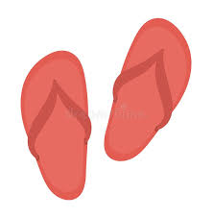
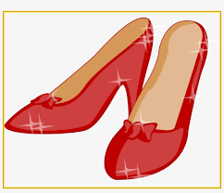
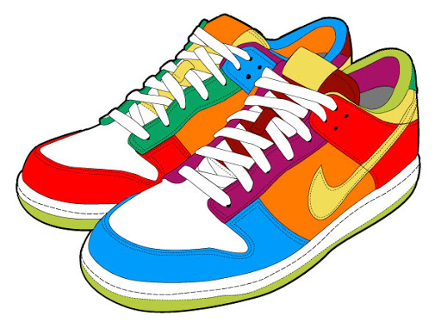
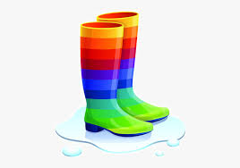
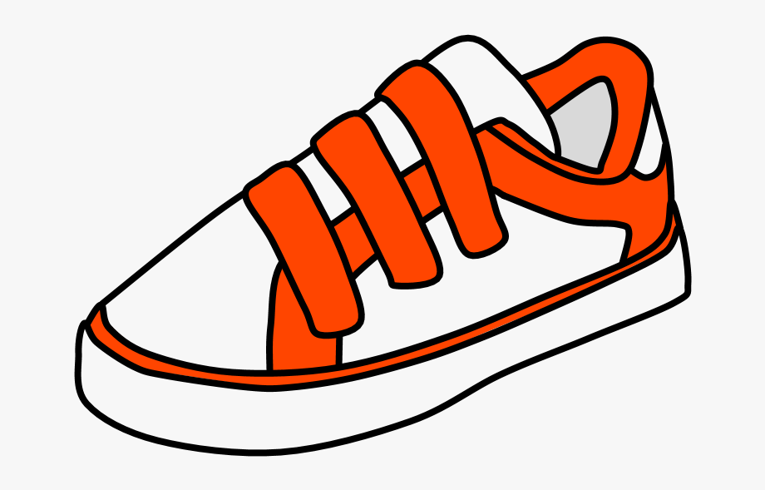
Which shoes would be safest to wear whilst riding your bike?
Notes:
Be careful of laces being loose, tuck them in, Velcro even safer

Slide 5
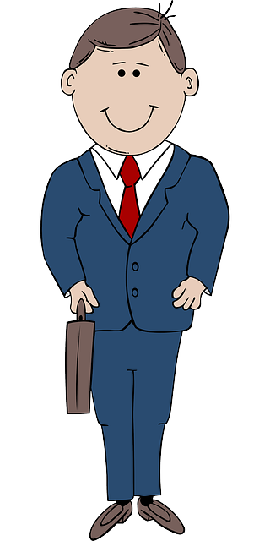
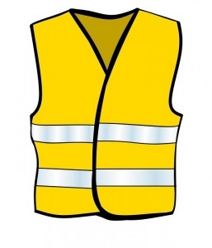
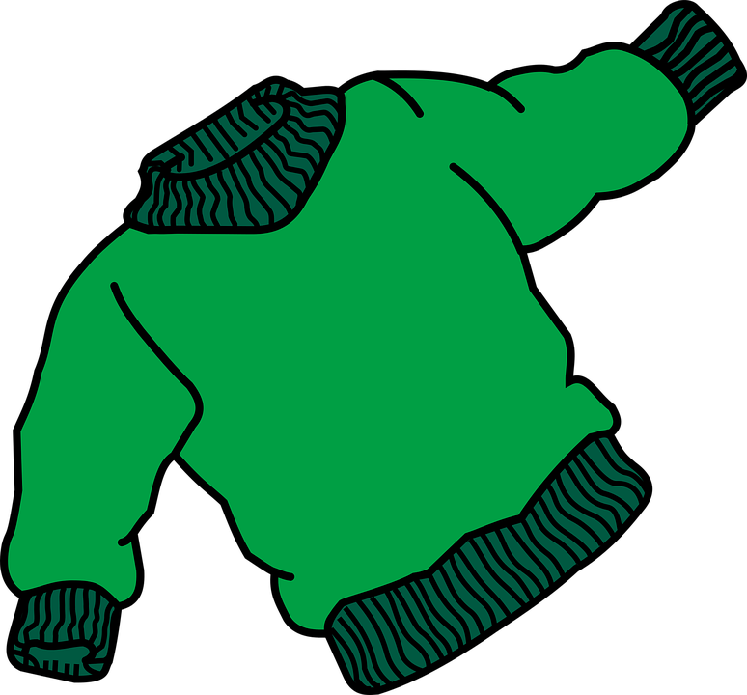
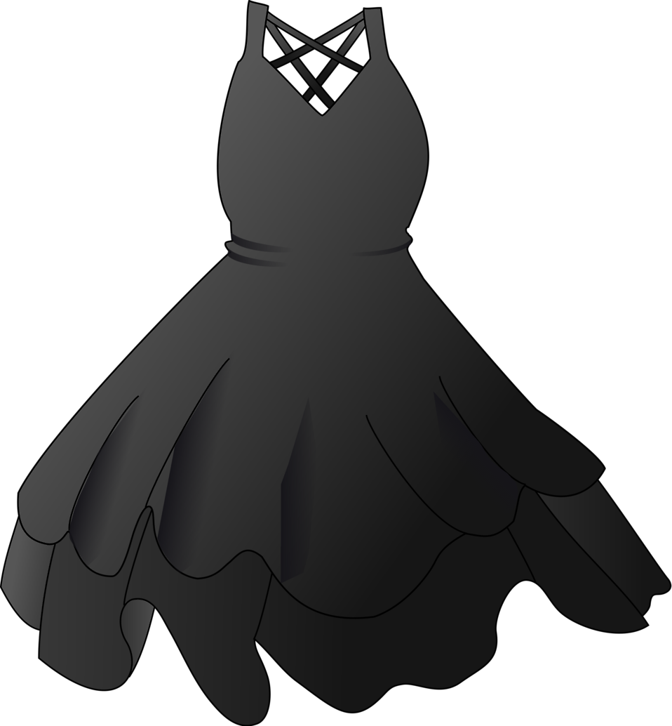
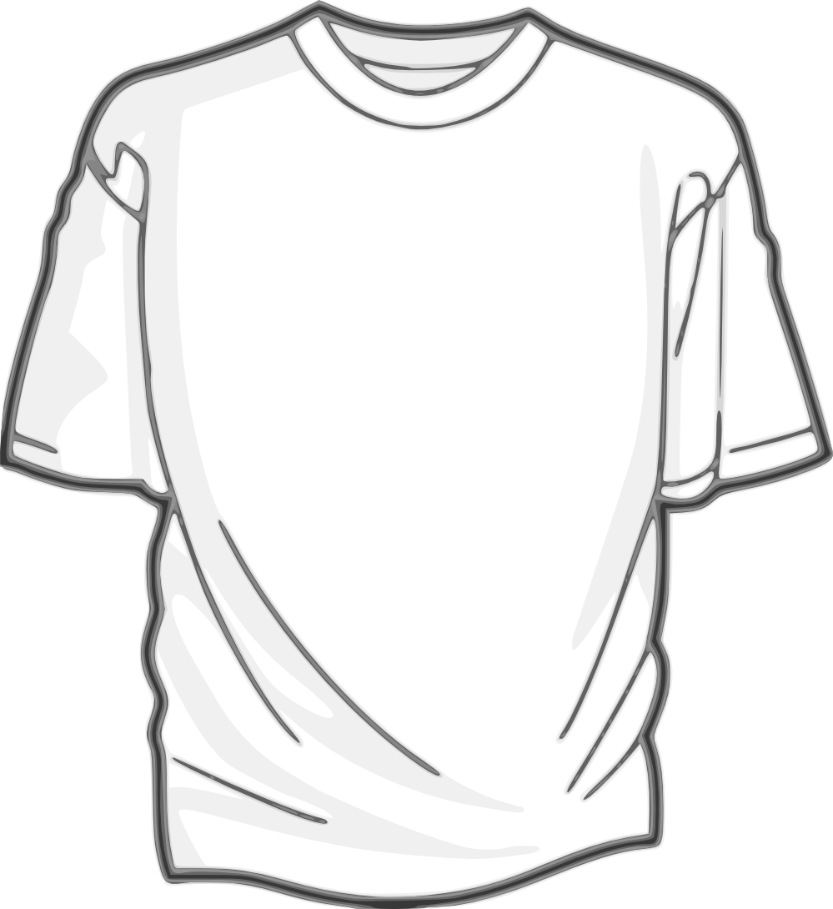
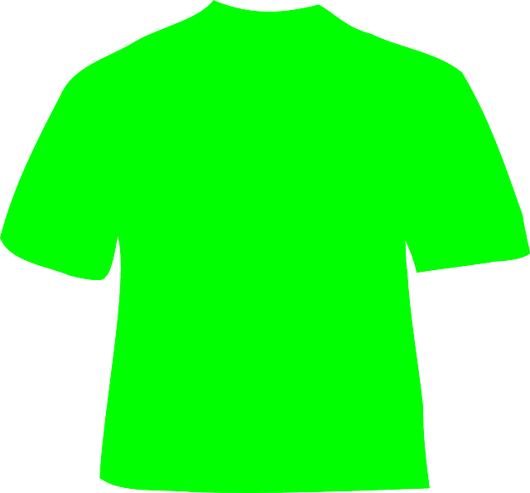
What kind of clothing is safest?
A B C D
This Photo by Unknown Author is licensed under CC BY-NC

Slide 6
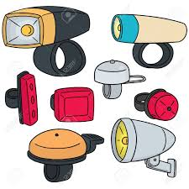
Why are these
important to have on
our bikes?
They make our They make the bike They make it easy I don’t
bikes look cool heavier so it doesn’t for other vehicles to know!
wobble see us on the roads
when the light isn’t good
A B C D

Slide 7
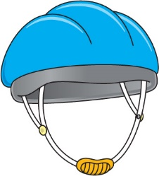
When wearing my helmet which of these is NOT important?
The straps making a V around my ears and allowing 1 finger between the strap and my chin.
The correct size so it is 2 fingers above my eyes.
Sitting level on my head – not too far back or forward
The colour and style
A B C D

Slide 8
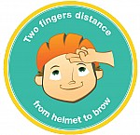
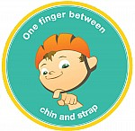

Slide 9
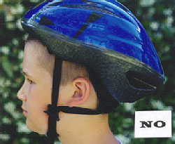
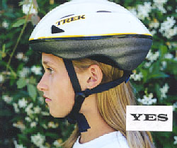
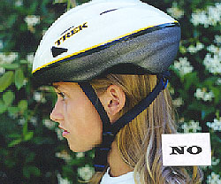
Which of these people is wearing their helmet correctly?
A B C D

Slide 10
Congratulations
on completing
skill 1 of the
Cyclist Badge

