Slide 1
Beavers vs Science

Slide 2
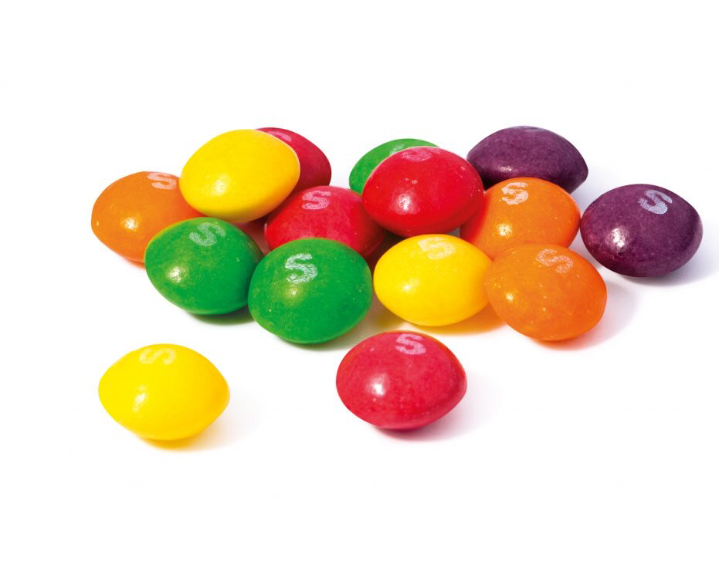
Rainbow skittles
You will need:
Water
A plate (preferably white)
Skittles

Slide 3
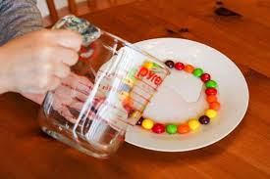
1) Place the plate on a flat surface. Space the skittles evenly around the edge of your plate.
2) Use a cup or jug to gently pour in some water. The water level should sit about half-way up the skittles.
3) Wait patiently for your skittle rainbow to form.
Do not touch it while you wait as the results may not be as good!

Slide 4
What happened? Why do you think this happened?

Slide 5
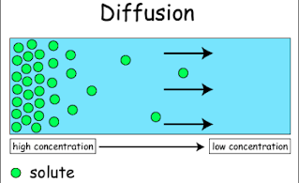
The dye on the skittles DISSOLVES into the water
It then DIFFUSES
( diffusion – when particles move from a high to low concentration )
This happens because the particles in a liquid are always moving randomly , making the colourings spread out across the plate.

Slide 6
Get a balloon
Blow it up and tie a knot in the end

Slide 7
Physics

Slide 8
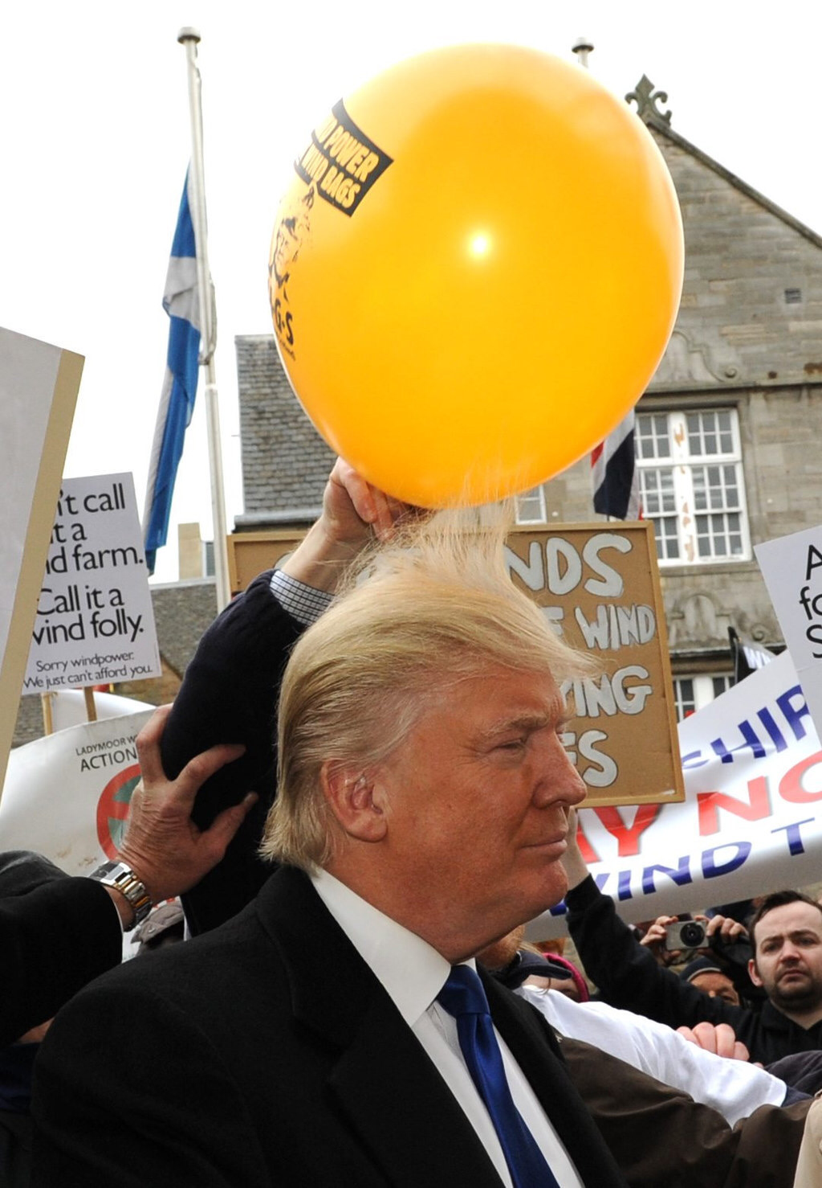
3) Rub it on your jumper or t-shirt for a minute.
4) See if it will stick to a wall, or hold it near your head to see the effect of the static charge.

Slide 9
What happened? Why do you think this happened?

Slide 10
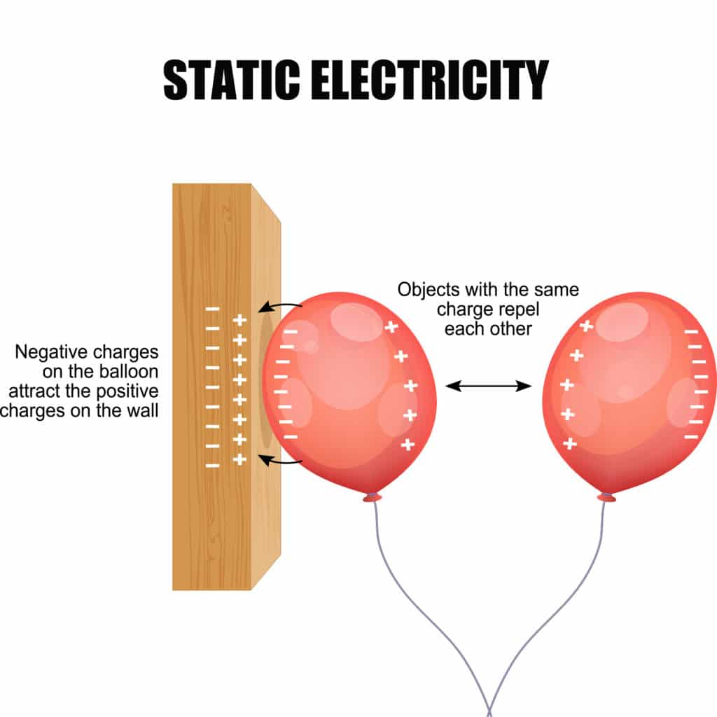
Rubbing the balloon on clothing gives it a negative charge.
This makes it attracted to things with a positive charge, such as your hair, or the wall.
(opposite charges attract)

Slide 11
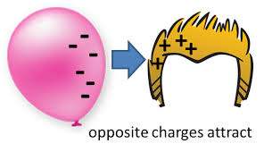
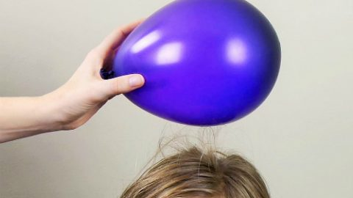
Why?
When a balloon is rubbed on hair, fur or wool, electrons are transferred from the hair to the balloon, giving the balloon a negative charge.

Slide 12
Hair
Balloon

Slide 13
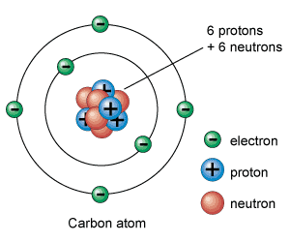
Fun fact
Lots of space between the nucleus and electrons
If we lost all the dead space inside our atoms, we would each be able to fit into a particle of dust, the entire human species would fit into the volume of a sugar cube and the earth would be the size of a basketball.

Slide 14
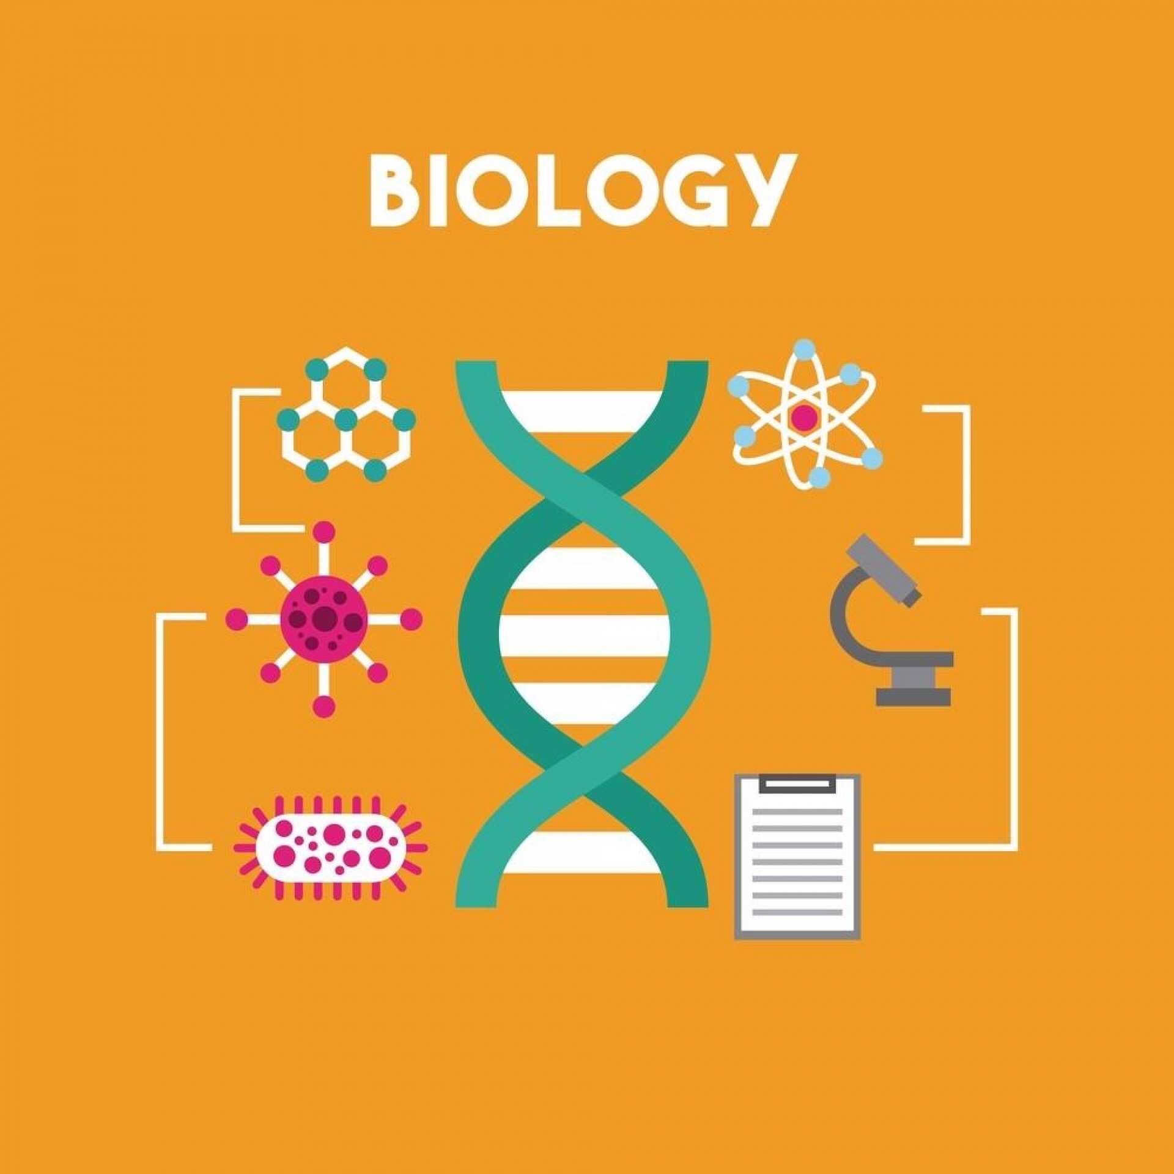

Slide 15
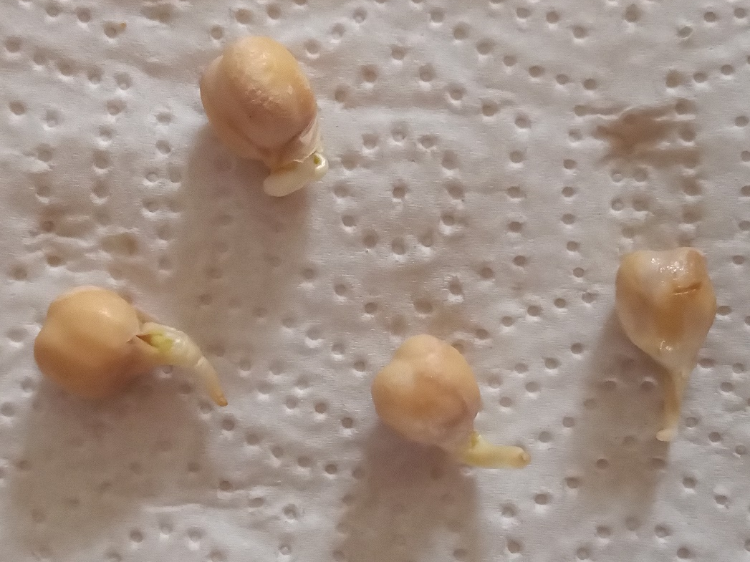
Soak your chick peas of beans for next week
Put chickpeas into a glass of water and leave to soak for a day
Tomorrow
Stuff a jar with kitchen towel and pour
water in until the towel is soaked through
Drain the beans and push them down
the side of the jar
Put the jar in a warm dark cupboard
check it each day & add water if needed to keep them wet
Once they’ve sprouted (after a few days), move the jar to a light place (such as a windowsill), and keep them wet

Slide 16
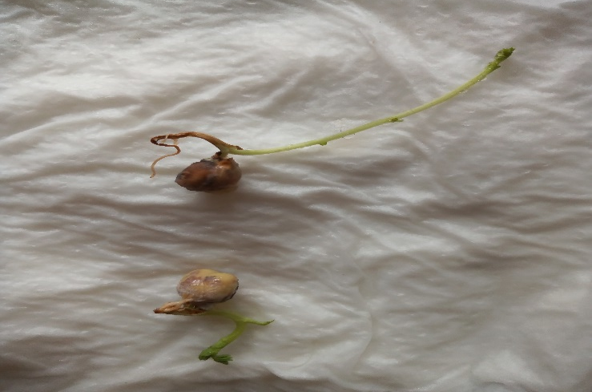
Soak your chick peas of beans
Once they’ve sprGET A BALLOONouted (after a few days) move the jar to a light place (such as a windowsill), and keep them damp

Slide 17
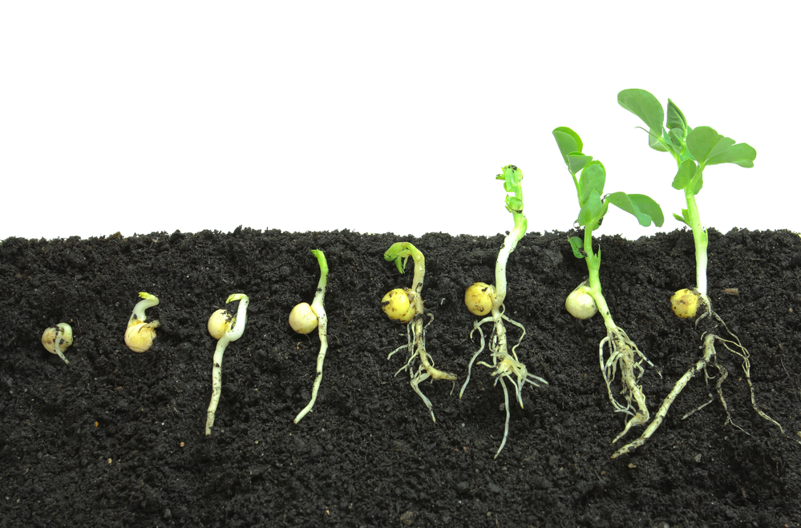
They will begin to grow roots
After 1 or 2 weeks, plant them in a small pot and water regularly.

Slide 18
Why did this happen?
What do you think?

Slide 19
Most plants grow from seeds.
A seed that hasn’t grown any leaves yet can survive with the food (starch) already stored inside the seed.

Slide 20
Once the seed bursts open, the root from the seed continues to provide food to the baby plant until the leaves emerge and are capable of making their own food.

Slide 21
The roots begin to grow downwards to make the plant stable.
Next, the shoot breaks above ground and straightens up towards the light.
Finally, the plant grows it’s stem and leaves.

Slide 22
When your seeds have grown you have finished your Experiment Badge

