Slide 1
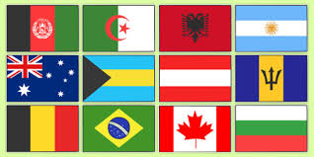
FOREIGN NIGHT

Slide 2
FRERE JACQUES
The song is about a friar who has overslept and is urged to wake up and sound the bell for the matins, the midnight or very early morning prayers for which a monk would be expected to wake.

Slide 3
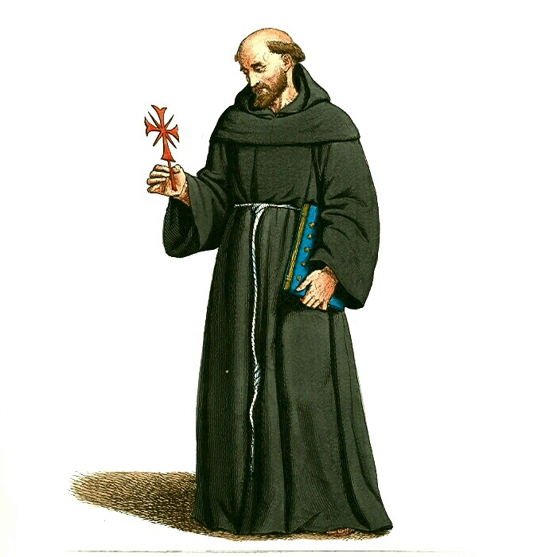

Slide 4
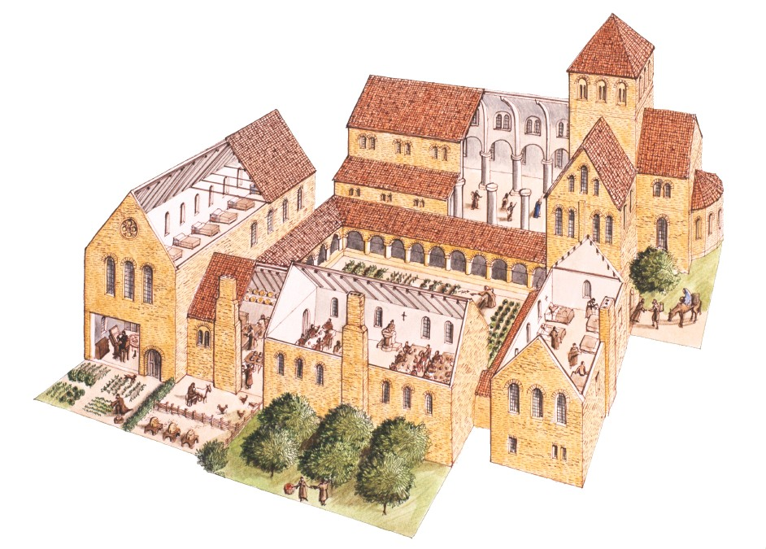

Slide 5
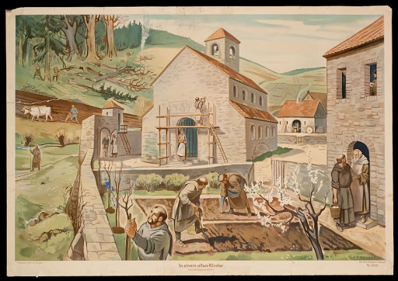

Slide 6
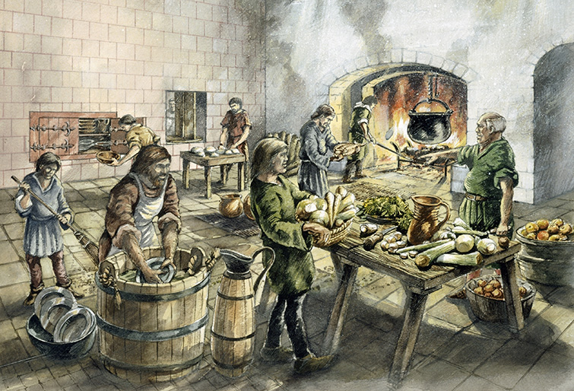

Slide 8
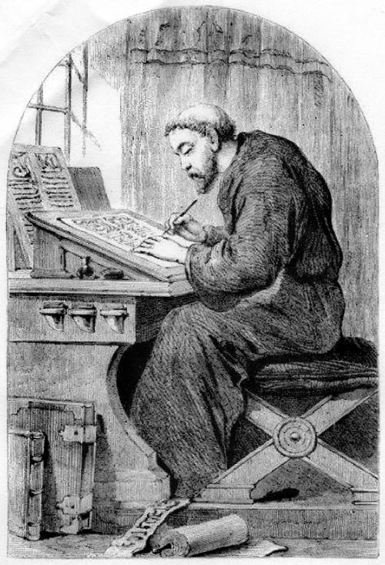

Slide 10
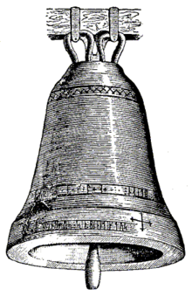

Slide 11
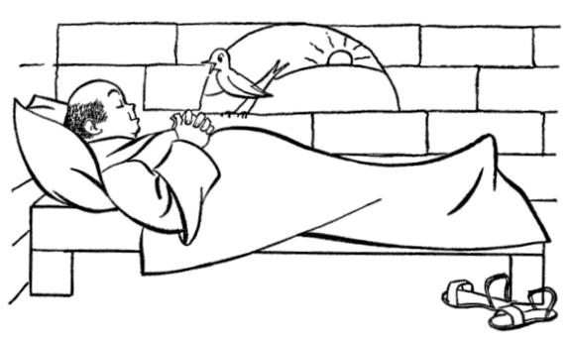

Slide 12
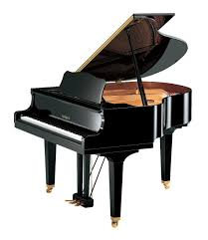
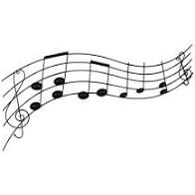
Frère Jacques, Frère Jacques, Dormez-vous? Dormez-vous? Sonnez les matines!
Sonnez les matines! Ding, dang, dong. Ding, dang, dong.

Slide 13
Traditional English lyrics
Are you sleeping?
Are you sleeping? Brother John,
Brother John, Morning bells are ringing!
Morning bells are ringing! Ding, dang, dong.
Ding, dang, dong.

Slide 14
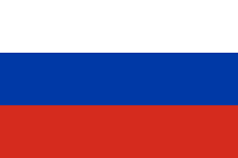
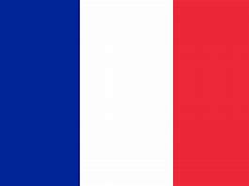
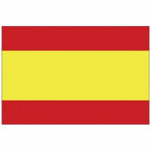
GREETINGS
ROMANIAN
HAWAIIAN
RUSSIAN
BULGARIAN
CHINESE
ITALIAN
FRENCH
JAPANESE
SPANISH
WELSH

Slide 15
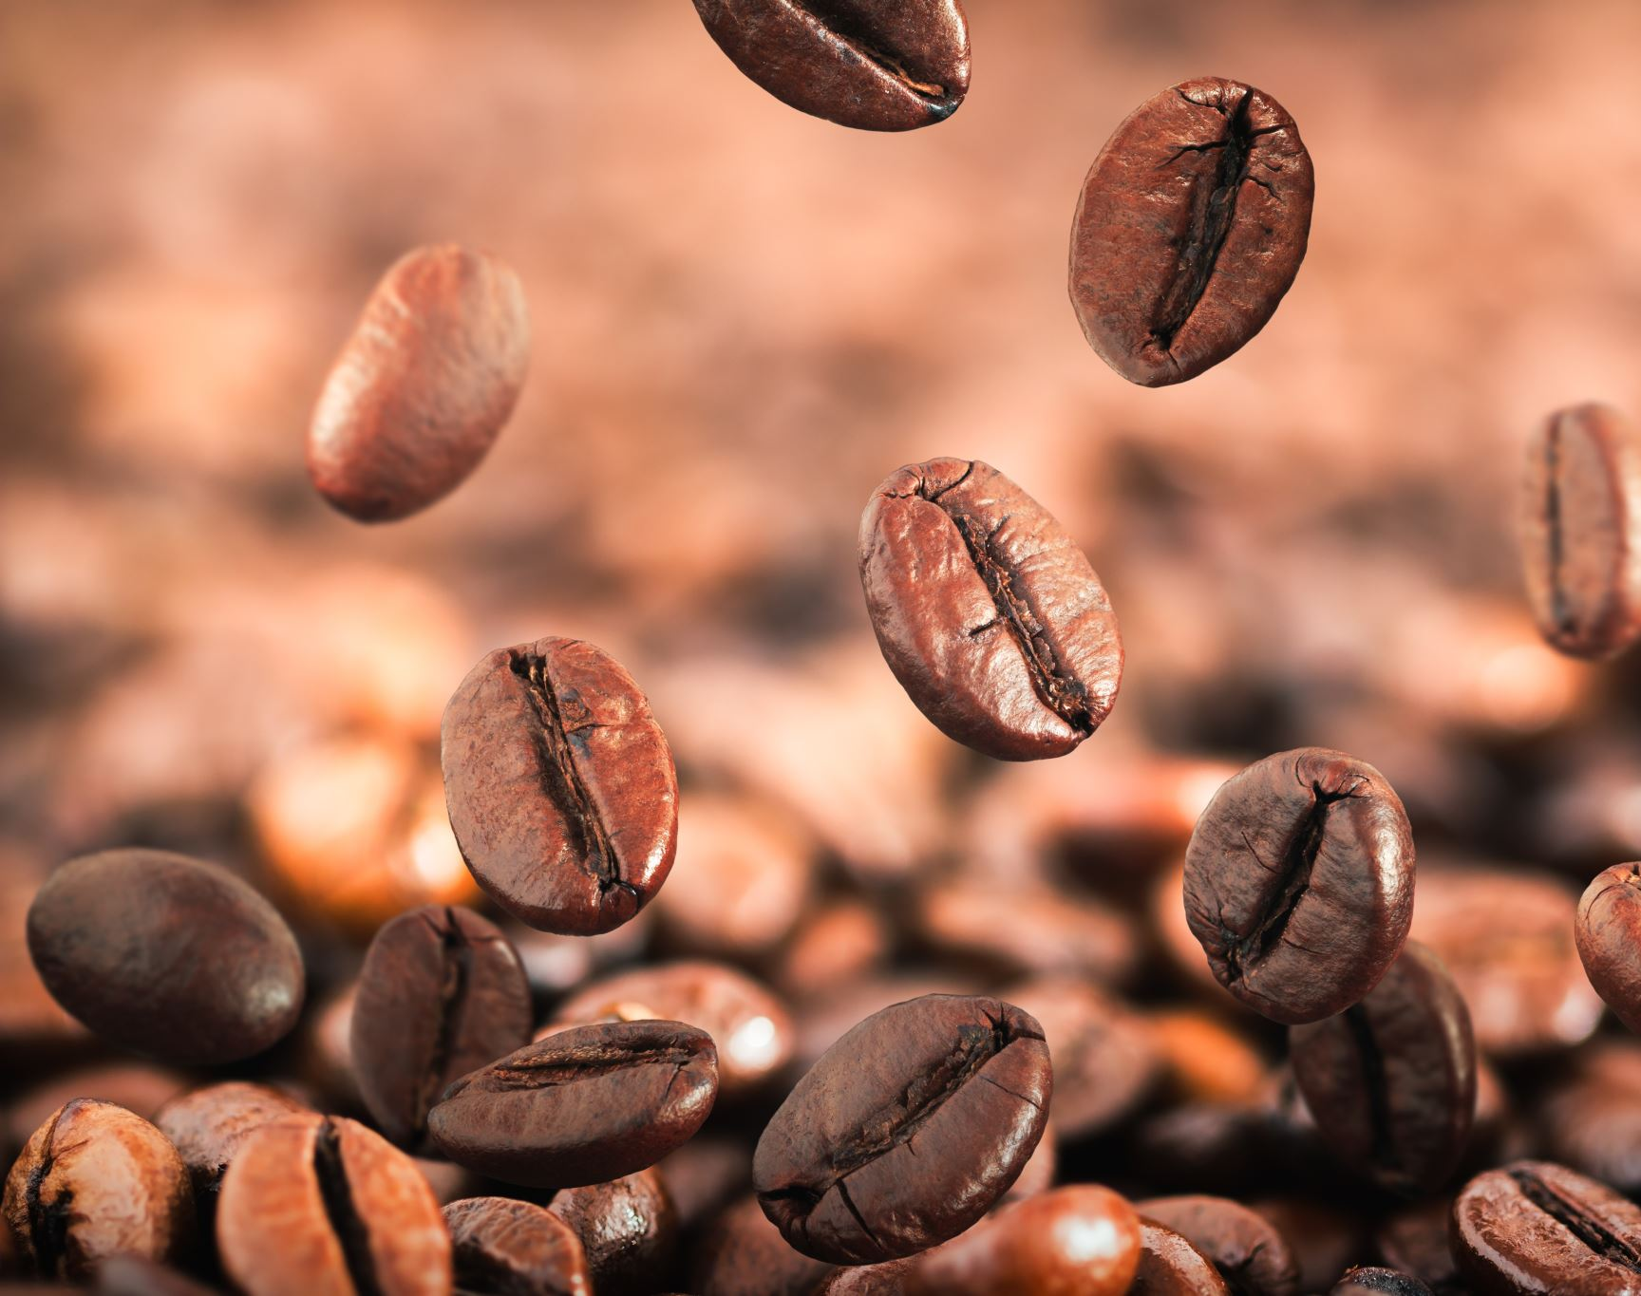
WEIRD FOOD FROM AROUND THE WORLD QUIZ

Slide 16
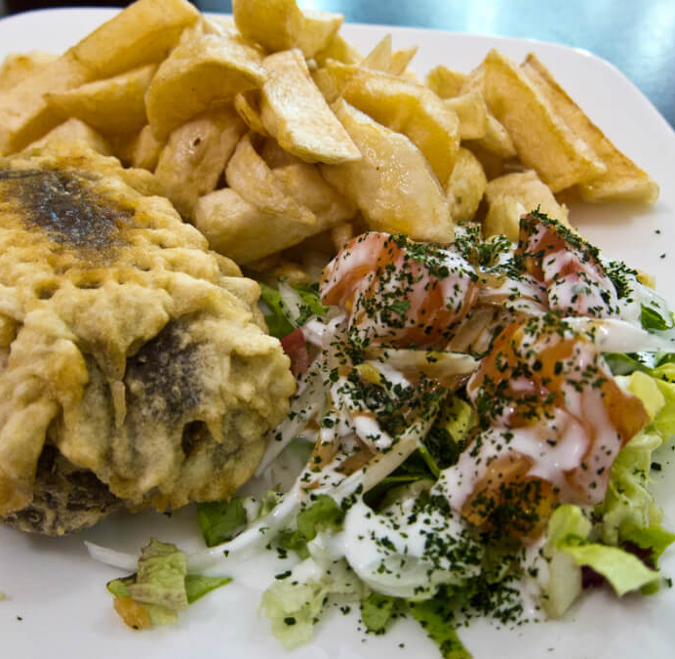
Haggis
A sheep’s heart, liver and lungs minced and mixed with onions, oatmeal, suet and seasoned with salt and spices cooked inside the animal’s stomach. Is it from?
Iran - Spin around
Scotland -Wave your arms in the air
Belgium -Jump on the spot
Notes:
Scotland

Slide 17
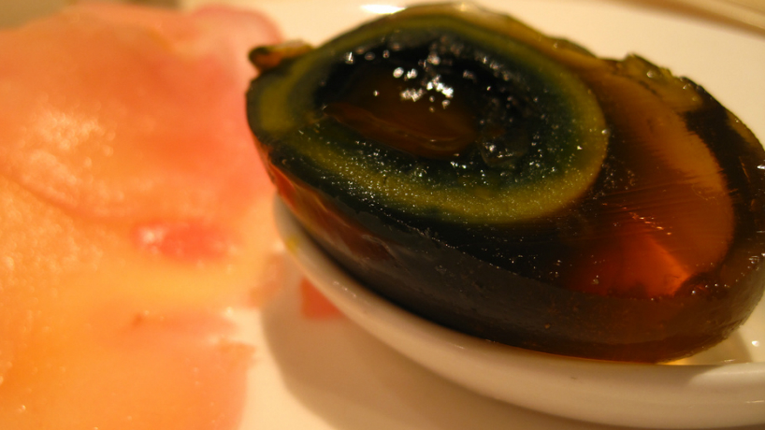
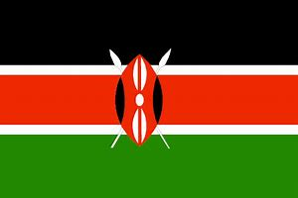
Century Egg
After being preserved in a mixture of clay, ash and quicklime for a few months, the yolk turns a dark green or even black and slimy while the white turns to a dark brown translucent jelly. Apparently it smells strongly of sulphur and ammonia,(smells pretty rotten) but tastes like a hardboiled egg. Is it from?
China – Get your smelly feet out
Germany- Hold your nose
Kenya- Wave your hands
Notes:
China

Slide 18
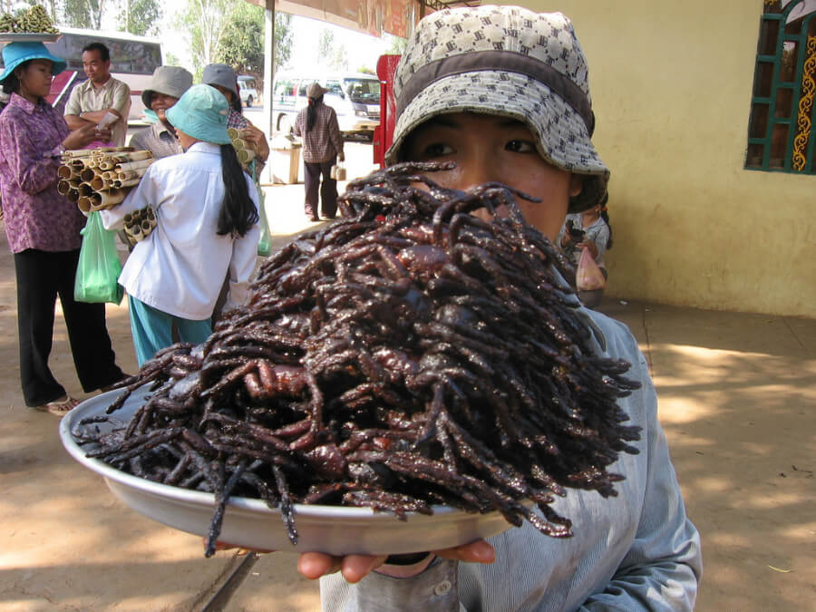
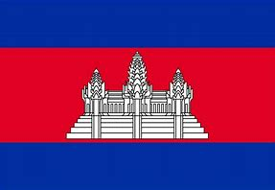
Fried Spider
Marinated in MSG, sugar and salt and then fried in garlic. Is it from?
Vietnam-Thumbs up
North Korea- Thumbs down
Cambodia- Thumbs together
Notes:
Cambodia

Slide 19
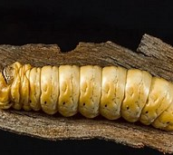
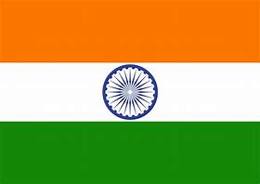
Witchetty Grub
These can either be eaten raw, where it tastes like almonds or lightly cooked, where its skin crisps like roast chicken and its insides take on the look and consistency of scrambled egg. Is it from?
Australia- Fingers in your ears
Indonesia- Fingers on your nose
India-Fingers in the air
Notes:
Austrailia

Slide 20
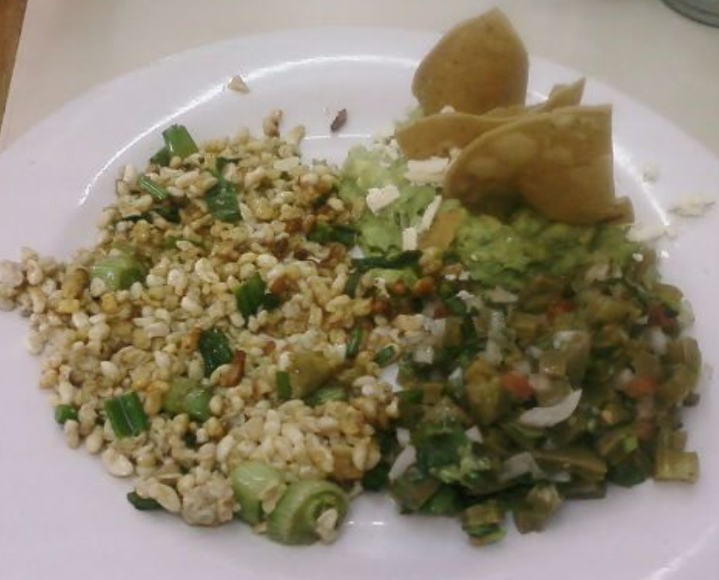
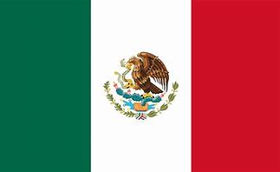
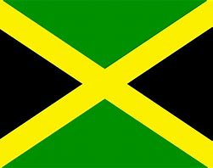
Escamol
Also known as ‘insect caviar’ This dish is made of the edible larvae and pupae of ants and harvested from the tequila or mescal plant.
Is it from?
Sudan- Talk to the hand
Mexico-Cup your ear
Jamaica – Shake a finger
Notes:
Mexico

Slide 21
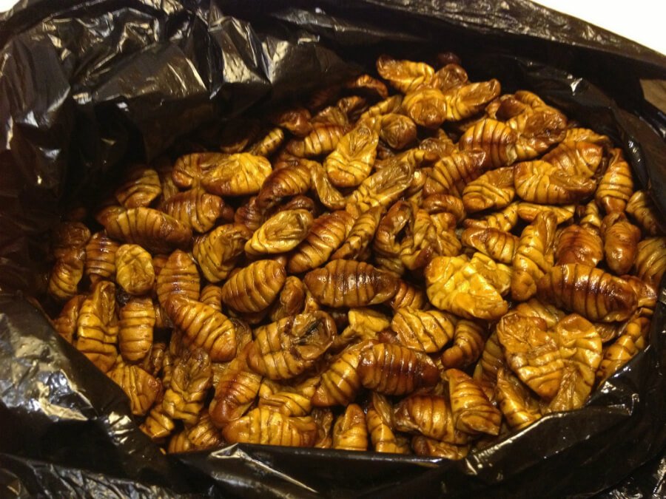
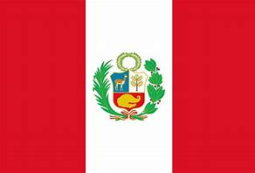
Beondegi
Mmm, lovely, lovely silkworm. Simply boiled or steamed and lightly seasoned
Apparently they taste like wood, if you’ve ever tried wood…? Are they from?
Egypt-
Thumbs down
South Korea- Thumbs up
Peru –
Thumbs together
Notes:
South Korea

Slide 22
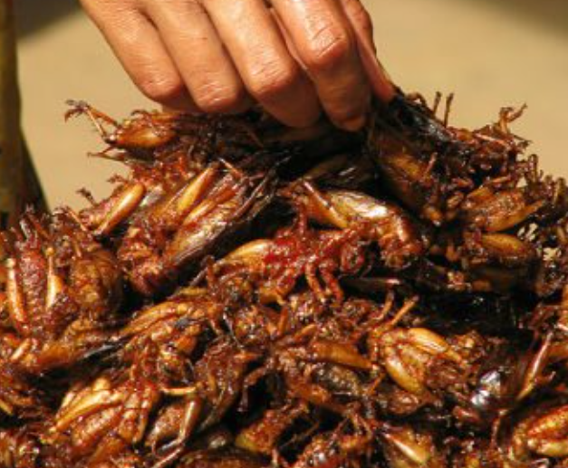
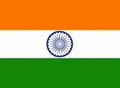
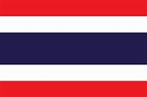
Jing Leed (Grasshoppers)
Big old grasshopper seasoned with salt, pepper and chilli and fried in a big wok. Tastes a little like hollow popcorn skin… except a little juice squirts out when you bite into it… nice.
China
Thumbs up
India
Thumbs down
Thailand
Jump on the spot
Notes:
Thailand

Slide 23
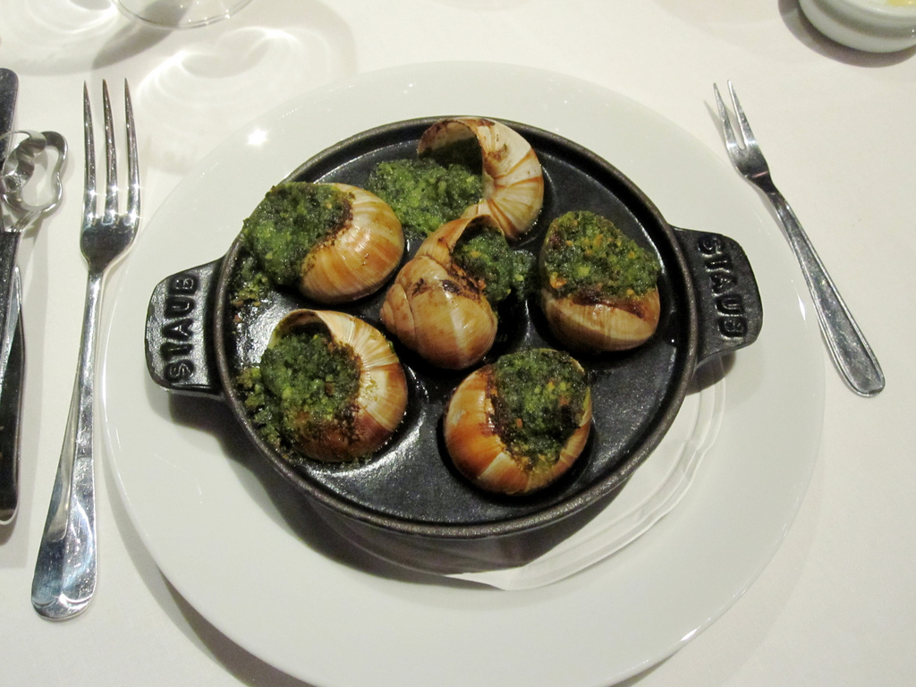
Escargots à la Bourguignonne
Snails cooked in a sauce of white wine, garlic, butter and parsley served in their shells.Rather rubbery! Are they from?
IRAQ-Hands on head
FRANCE- Hands on shoulders
BELGIUM-Cross arms
Notes:
France

Slide 24
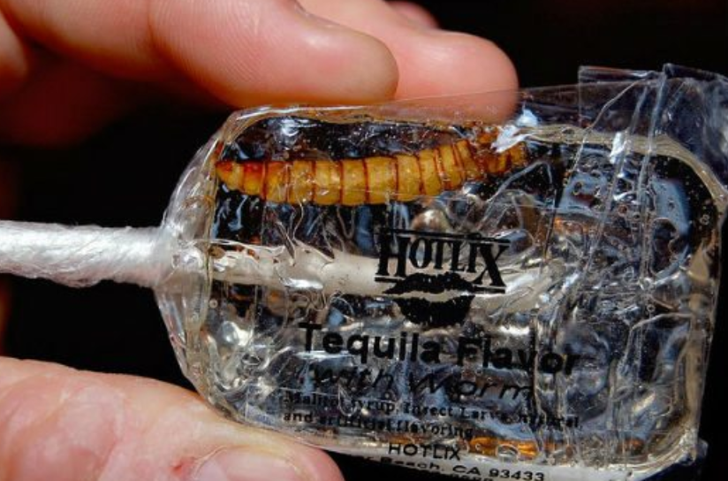
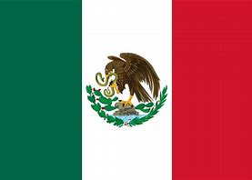
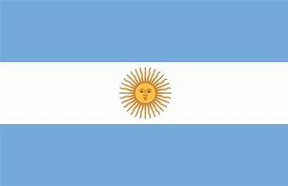
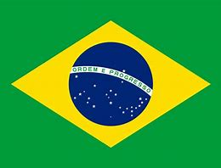
Tequila Worm
A big fat, juicy worm that’s said to be full of meat. Although traditionally dried or smoked to preserve, they are usually re-hydrated and cooked with tomato or chilli sauce to flavour. Are they from?
MEXICO –Thumbs up
ARGENTINA-Thumbs down
BRAZIL-Thumbs together
Notes:
Mexico

Slide 25
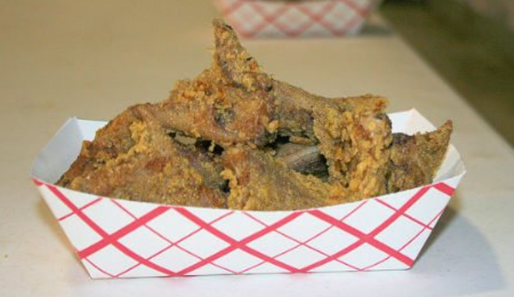
Southern Fried Rattlesnake
Tastes a little like frogs legs from France - Texture of chicken with a faint taste of fish. Is it from?
CANADA-Peddle your feet in the air
USA- Do star jumps
ALASKA – Do a dance
Notes:
Unites States

Slide 26
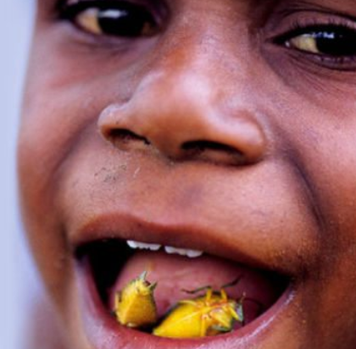
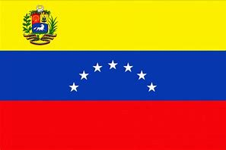
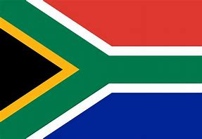
Stink Bugs
Used to flavour stews or eaten on their own, stinkbugs are said to have a crunch to them and taste a little like apple. Are they from?
VENEZUELA -Cup your ear
ISRAEL- Talk to the hand
SOUTH AFRICA- Do the ‘floss’ dance
Notes:
South Africa

Slide 27
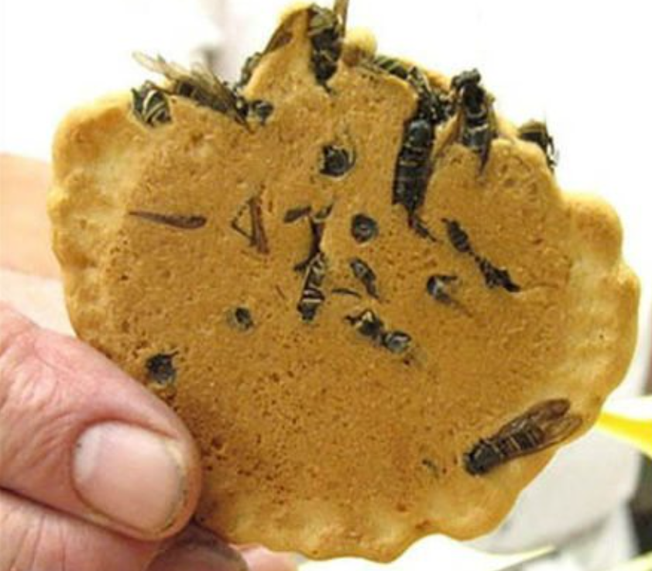
Wasp Crackers
Yep, you guessed it, it’s a biscuit filled with wasps. Think chocolate chip cookies, only the insects replace the choccy chips. Apparently the digger wasp, which the biscuit contains, has a pretty mean sting. I wish your tongue good luck.
Japan
Hands on head
Tunisia
Finger on nose
Ethiopia
Fold your arms
Notes:
Japan

Slide 28
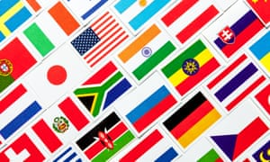
DO YOU KNOW YOUR FLAGS?

Slide 29
BELGIUM
HANDS ON HEAD
FINGER ON YOUR NOSE
FRANCE

Slide 30
SCOTLAND
HANDS ON HEAD
FINGER ON YOUR NOSE
BRAZIL

Slide 31
CHINA
HANDS ON HEAD
FINGER ON YOUR NOSE
SOUTH KOREA

Slide 32
FRANCE
HANDS ON HEAD
FINGER ON YOUR NOSE
INDIA

Slide 33
GERMANY
HANDS ON HEAD
FINGER ON YOUR NOSE
ISRAEL

Slide 34
USA
HANDS ON HEAD
FINGER ON YOUR NOSE
JAMAICA

Slide 35
BEAVERS - SCOUTS CANADA

