Slide 1
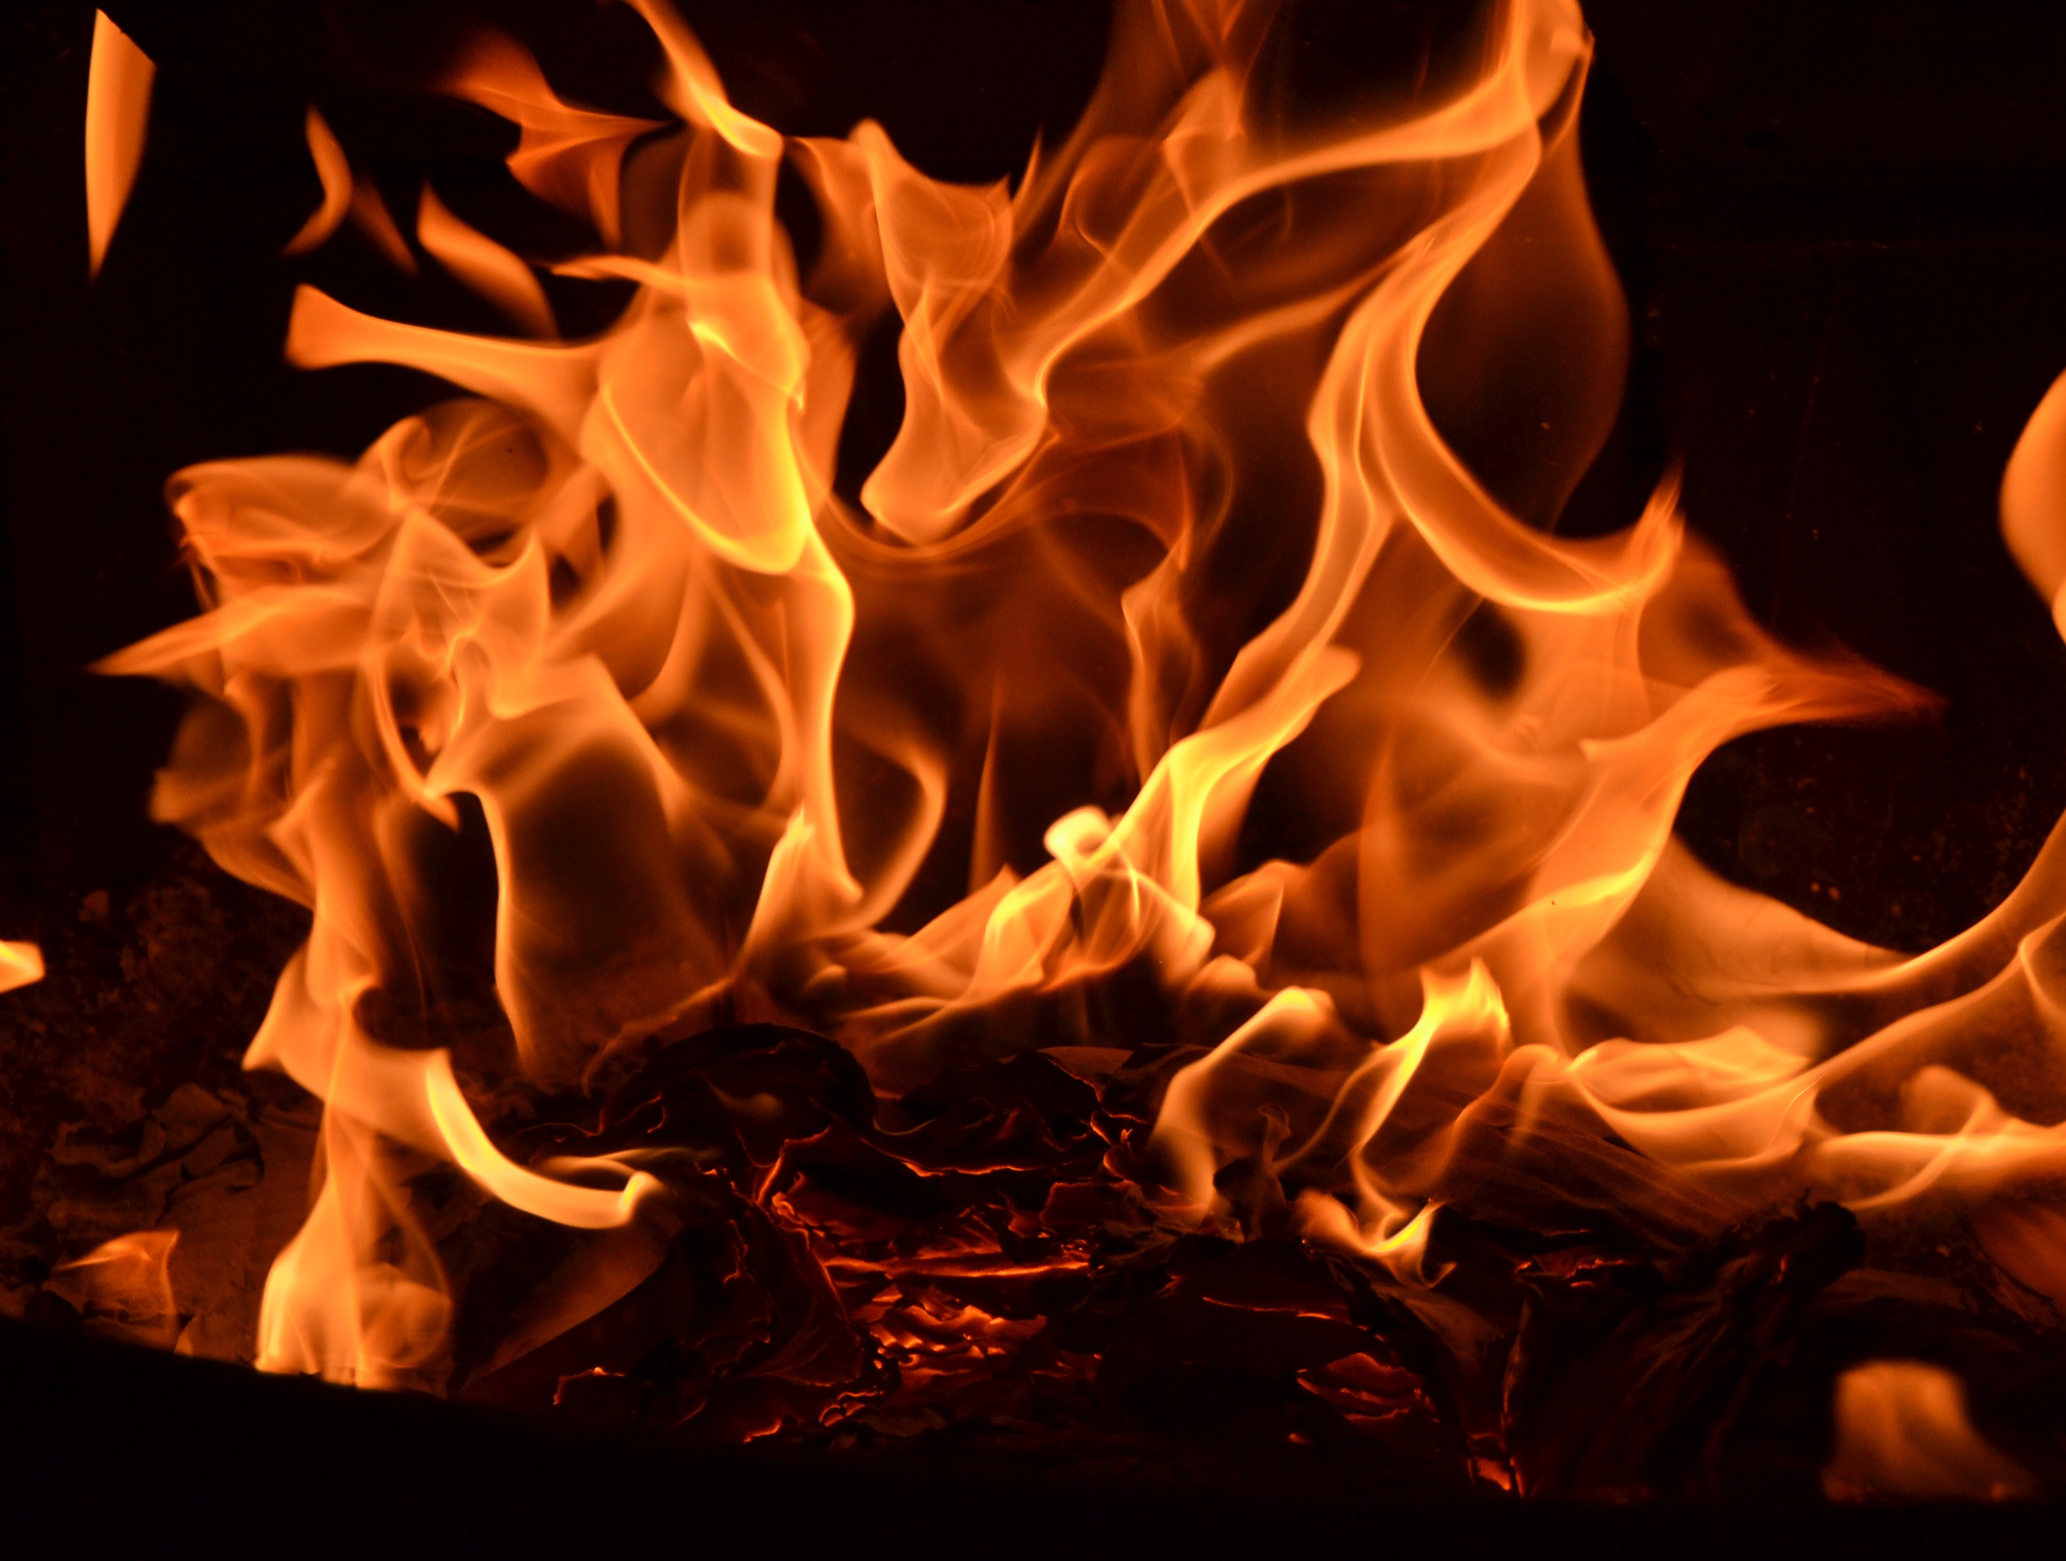
Fire safety
Safety activity badge

Slide 2
What is fire?
A reaction between oxygen and fuel
Notes:
A bit of science to start with! What is fire, exactly? A “reaction” is just a scientific name for what happens when two (or more) things change when they’re put together. If you’ve done the volcano experiment with vinegar and bicarbonate of soda, where it goes all bubbly, you’ve seen a chemical reaction. Fire is just another kind of chemical reaction.

Slide 3
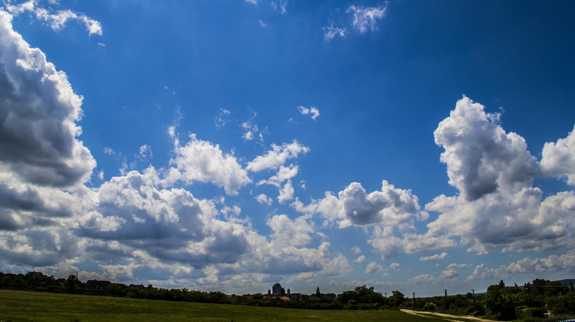
Oxygen is all around us
Notes:
So where does the oxygen come from? It’s all around us, in the air that we breathe – and it’s important for life. Most animals on Earth breathe oxygen to live.

Slide 4
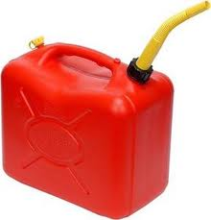
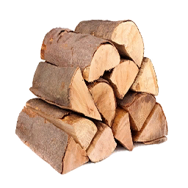
Fuel is anything that burns
Notes:
Fuel, at its simplest, is anything that burns. For example, petrol (like you put in your car), paper, furniture, wood and even crisps. (Pringles in particular make brilliant firelighters!) But most things will burn if they get hot enough…

Slide 5
Fire also needs heat to start
Notes:
A fire needs heat to start. You can see that this is the case, because right now you’re sitting in a room full of fuel, and you’re breathing in air containing oxygen. But you’re not sitting in a fire! Watch the video next for an explanation of the fire triangle.

Slide 6
The fire triangle

Slide 7
Fire triangle scavenger hunt
Find 3 things that are fuel
Find at least 1 thing that can make heat, and start a fire burning
Go!!
Notes:
So now you know about the three things that are necessary for a fire to start. In your house, can you find three things that are fuel (i.e. would burn in a fire), and at least one thing that might get hot and cause a fire? Think of things that you could use to start a fire deliberately, but also that might cause a fire accidentally. Try to find things that aren’t obvious, that you might not think of as being fuel or a source of heat.
(Note for leader - special mention if any participant identifies these as a source of heat: magnifying glass, hair straighteners or hairdryer, frying pan, multisocket)

Slide 8
Fire is useful!
Notes:
Humans learned to make and control fire thousands of years ago. It’s helped us to survive and stay healthy (eat a wider range of foods, live in colder climates and still keep warm, clear land for farming, do things during the hours of darkness, make tools and building materials etc).

Slide 9
Fire is also dangerous
Notes:
This is what a burned house looks like.
The next video is from a fire brigade and explains what might happen in a house fire. It’s aimed at children so we hope it isn’t too scary!

Slide 10
The dangers of fire

Slide 11
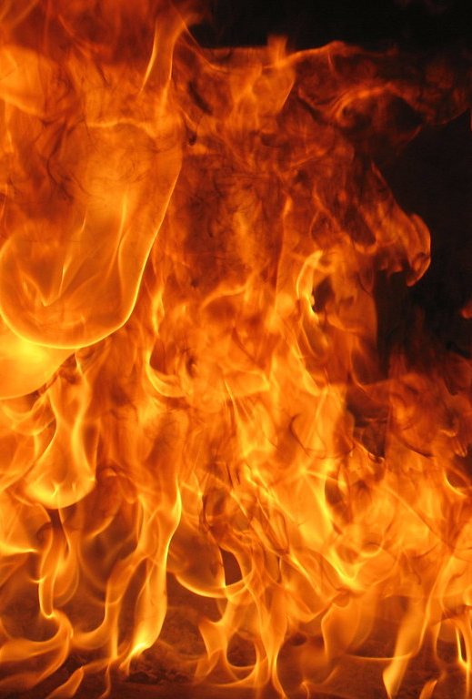
You’ve found a fire!
What should you do?
Tell a grown up straight away
Leave the building as quickly as possible
Don’t go back inside!
Telephone 999 and ask for the fire service
You will need to know your address for the firefighters to find you
Notes:
So, you’re at home and you’ve found a fire. What should you do? Have a think about what would be appropriate.
(Note to leaders: click through to the answers after the participants have had a chance to think about it. The emphasis is on what would be appropriate for a child to do – obviously this will not be the same as what an adult should do. If anyone says “Pour water on the fire” or similar, gently steer them away from this idea. State that this could be a bad idea, depending on what sort of fire it is, and that it could actually make things worse. There is a video coming up which shows this! Firefighting should be left to the grownups.)
Can everyone recite their address?

Slide 12
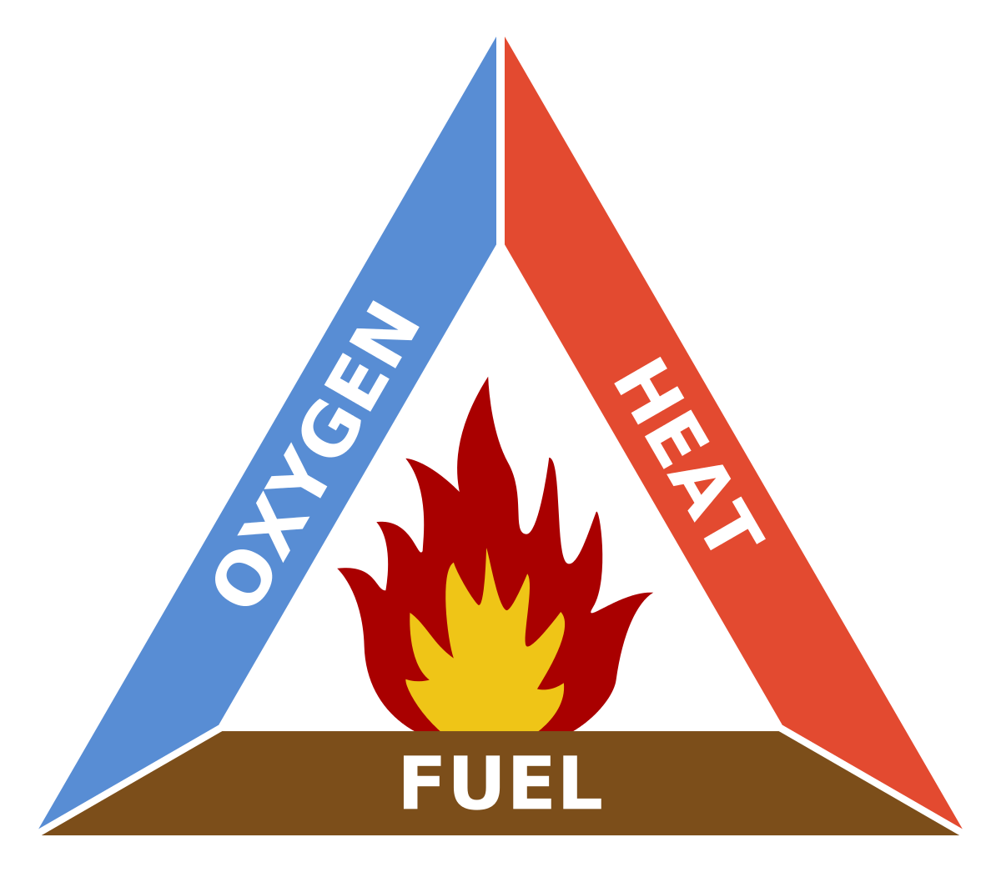
How can we put out fires?
Ask a grownup!
Remember the fire triangle
What have you got in your house that you could use?
Notes:
It’s not a good idea for a child to try and put out a fire – it’s always better to fetch a grownup!
Remember the fire triangle, and the idea that you take away one of the sides to put out a fire – removing the heat, fuel or oxygen.
Do you have anything in your house that could be useful? A fire blanket or fire extinguisher?

Slide 13
Never use water to put out a grease fire!
Notes:
This video shows why it’s important to know what to do with different kinds of fires. Using the wrong method to put out a fire could be catastrophic.

Slide 14
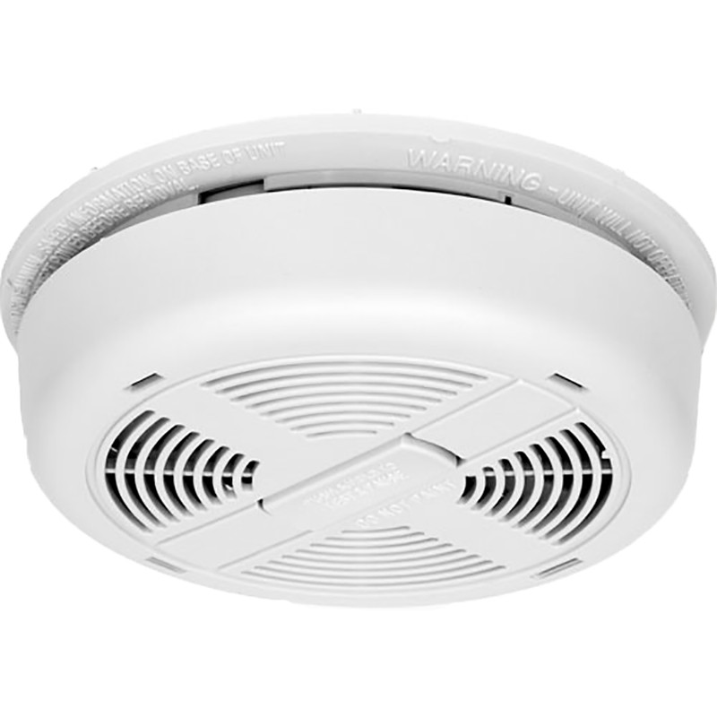
What else can you do to be safe?
Never leave a fire unattended
BBQ
Candles
Never play with matches or lighters
Have a smoke alarm, and test it – go and test yours now!
Notes:
There are lots of other things that can be done to be fire-safe, but these are three of the main ones for Beavers to think about. You could also talk to your parents or carers about how you would get out of the house if there was a fire.

Slide 15
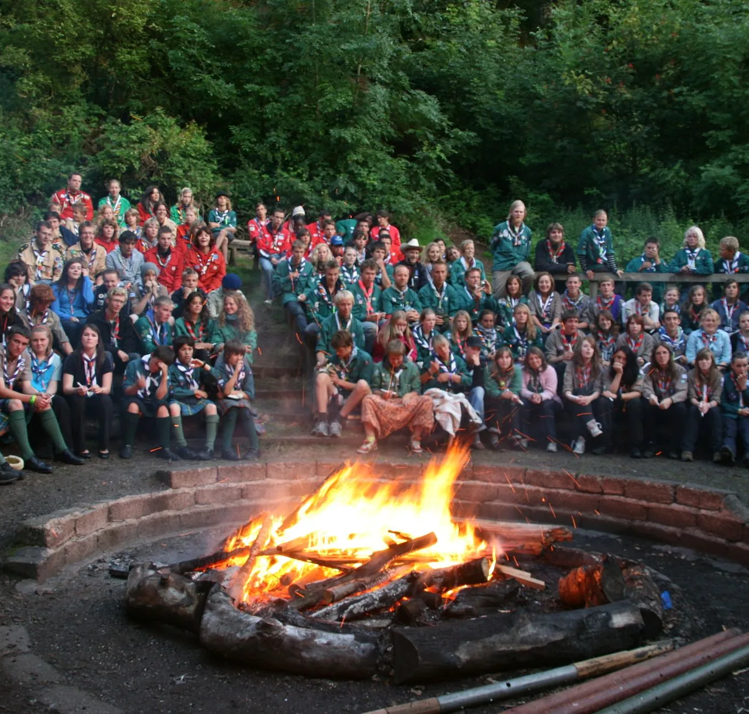
Using fire safely
Think of some rules to make sure that everyone stays safe and has fun around a fire outdoors
Can you think of times where you shouldn’t have a fire outdoors?
Notes:
In Scouting, we love campfires and barbecues! So it’s important to know how to be safe around them, so that we can continue to enjoy ourselves.
Using a sheet of paper and some pens or pencils, please create a poster with a short set of rules for everyone to follow for an outdoors campfire. You might think about how people should move around the fire, and who is allowed to put fuel on it.
Also have a think about when it’s not a good idea to have a fire or barbecue outdoors (consider windy weather, or where it’s going to be positioned – have the conditions been very dry, for example?)

Slide 16
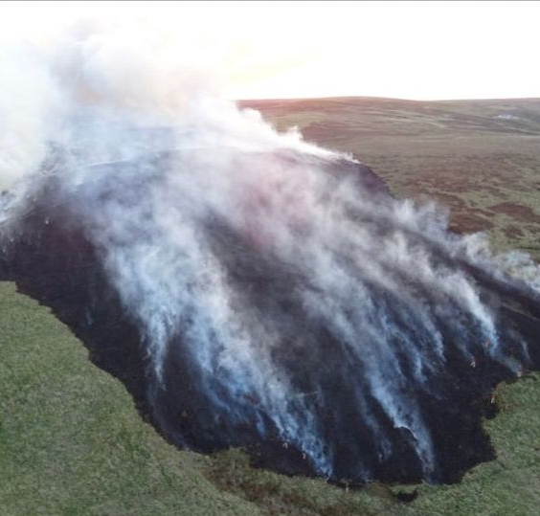
Don’t be careless outdoors!
This is a fire on moorland just outside Bolton in the north of England. It happened in May 2020.
It was probably started by a disposable BBQ.
(Image: Lancashire Fire and Rescue Service)
Notes:
Peat fires on moorland and other areas are a particular hazard in the UK, especially after hot dry weather. Disposable barbecues in particular are a big problem – the ground underneath them starts to smoulder, and while it might not look like it’s burning, the fire can spread underground and then pop up some distance away. It’s important to remember that some kinds of soil can be fuel for a fire.
Even fire pits can be a problem if they are placed over a surface that will burn – the heat radiates downward from the fire pit.
If you want to have a fire outdoors, the best place to have it is either in a special safe fire area (like a campfire circle), or raised off the ground with a fireproof surface underneath, like concrete. And keep away from moorlands and peaty soils!

Slide 17
Home safety games
http://www.essex-fire.gov.uk/homesafety/

