Slide 1
Beavers Spy Missions -codes

Slide 2
Code 1 – Switching code
Spy rating 1/5
Swap the first and last letter of each word
Dog = God
I saw a dog = I was a God
Beaver Leader Dave said hello = Reaveb readel Eavd dais oellh
Nac uoy kracc eht tecres eodc?
= Can you crack the secret code?

Slide 3
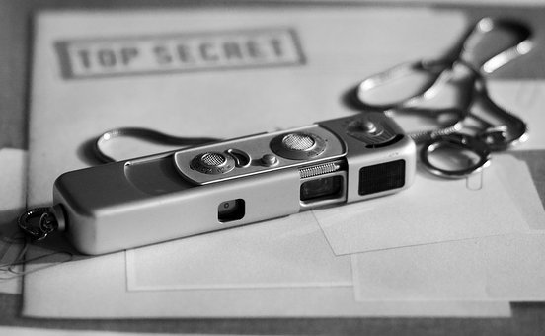
Code 2 – Letter grouping
Spy rating 2/5
Group letters in groups of three
Make each group begin with a Capital letter
Add random letters on the end to make the last group 3
Thi Sis Let Ter Gro Upi Nga = This is letter grouping
Dog = dog
Isa Wad Oge = I saw a dog
Bea Ver Lea Der Dav Esa Idh Ell Oms = Beaver Leader Dave said hello
Yes Ica Ncr Ack Thi Sco Dez
= Yes I can crack this code!

Slide 4
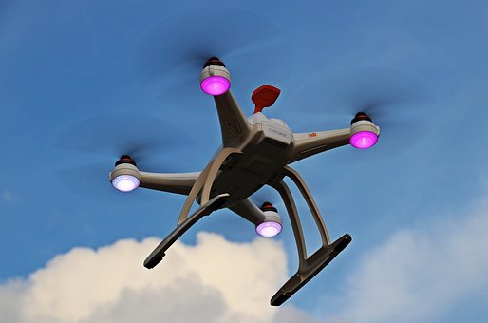
Code 3 – Pig Pen
Spy rating 3/5
Uses symbols instead of letters
Easy once you have learnt the cypher
Dog
I saw a dog
Beaver Leader Dave said hello
= Beavers make good spys

Slide 5
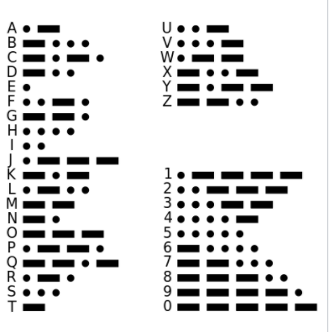
Code 4 – Morse Code
Spy rating 4/5
-.. --- --.
dog
.. / ... .- .-- / .- / -.. --- --.
I saw a dog
-... . .- ...- . .-. / .-.. . .- -.. . .-. / -.. .- ...- . / ... .- .. -.. / .... . .-.. .-.. ---
Beaver Leader Dave said hello
.-- . / .- .-. . / -... . .- ...- . .-. ...
= We are beavers

Slide 6
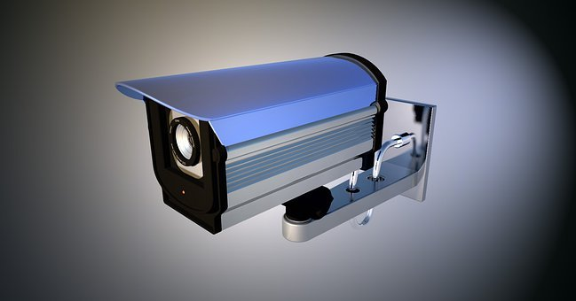
Code 5 – Caesar Cypher
Spy rating 5/5
A | B | C | D | E | F | G | H | I | J | K | L | M | N | O | P | Q | R | S | T | U | V | W | X | Y | Z
C | D | E | F | G | H | I | J | K | L | M | N | O | P | Q | R | S | T | U | V | W | X | Y | Z | A | B
Dog = FQI
I saw a dog = K UCY C FQI
Beaver Leader Dave said hello = DGCXGT NGFGT FCXG UCKF JGNNQ
Can you crack the final code?
ITGCV YQTM URA DGCXGTU
= Great work spy beavers

