Slide 1
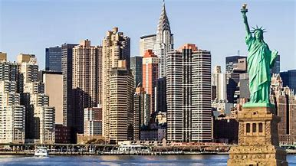
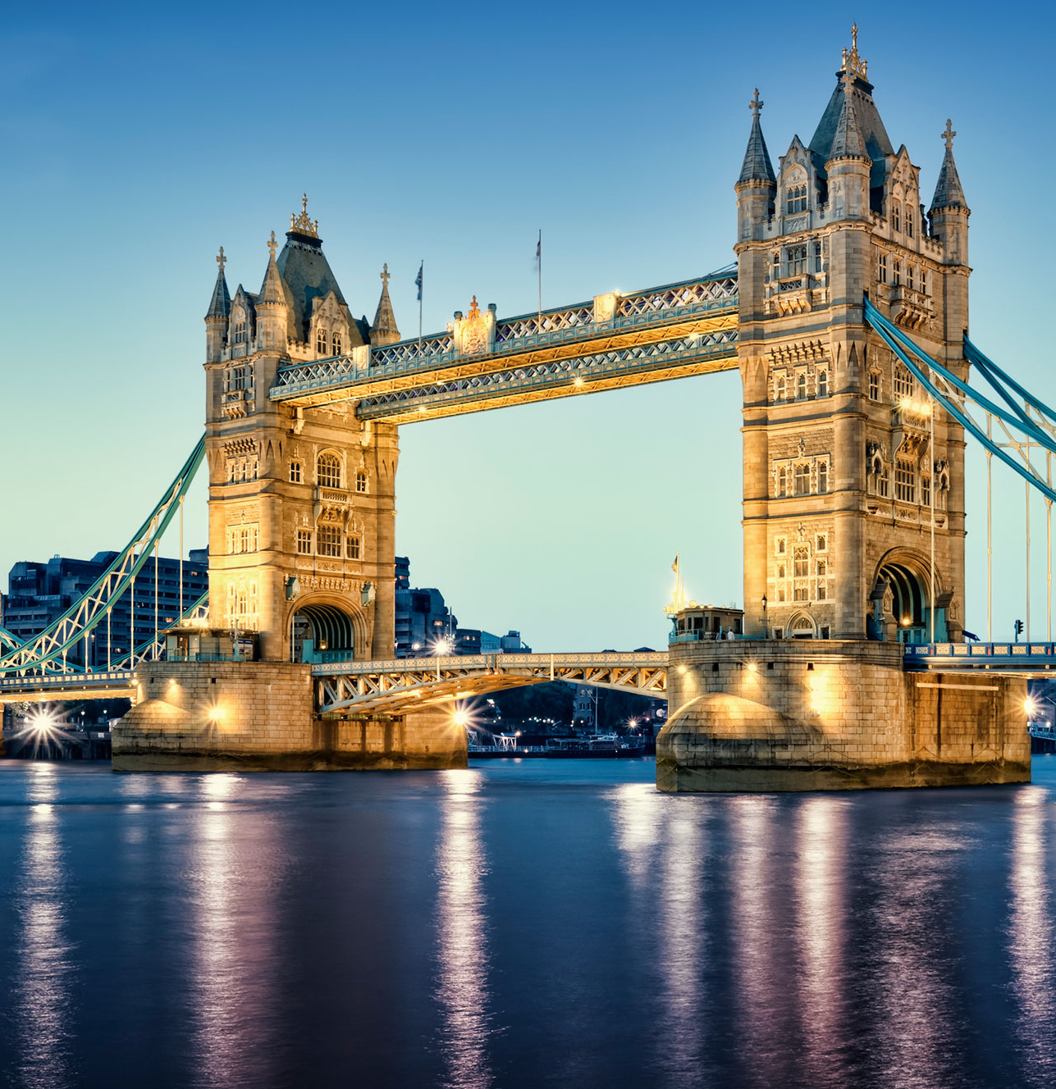
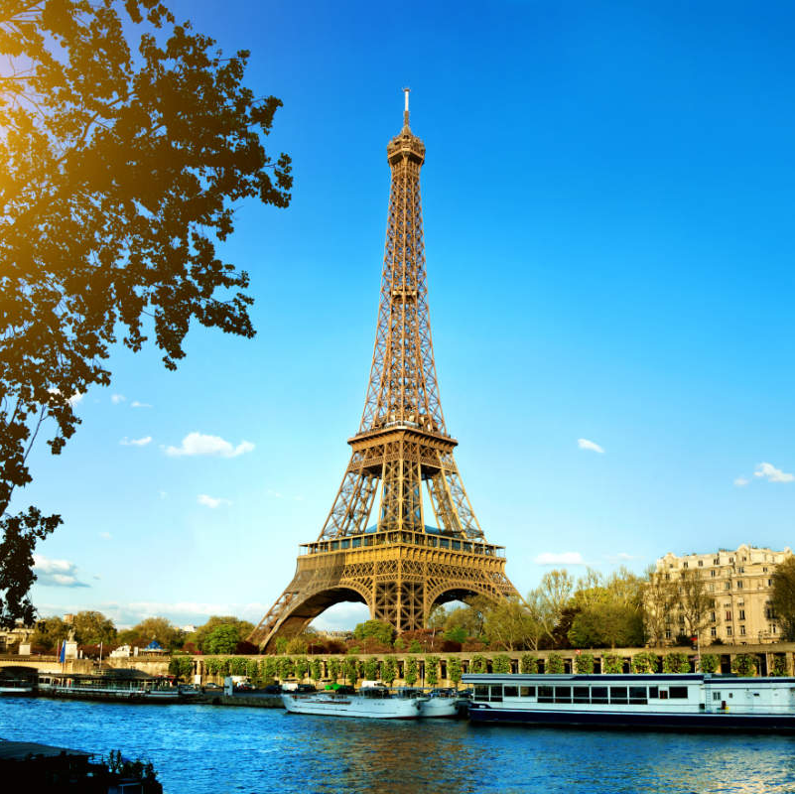
Capital Cities

Slide 2
Can you name the capital cities from the picture clues?

Slide 3
New Zealand

Slide 4
New Zealand - Wellington

Slide 5
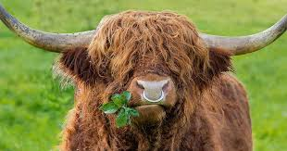
Afghanistan

Slide 6
Afghanistan - Kabul
Car Bull

Slide 7
Iraq

Slide 8
Iraq - Baghdad
Bag Dad

Slide 9
Hungary

Slide 10
Hungary - Budapest
Buddah Pest

Slide 11
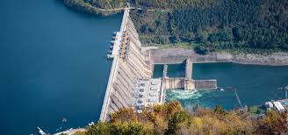
Netherlands

Slide 12
Netherlands - Amsterdam
Hamster Dam

Slide 13
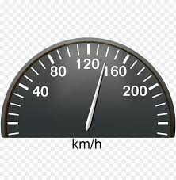
Northern Ireland

Slide 14
Northern Ireland - Belfast
Bell Fast

Slide 15
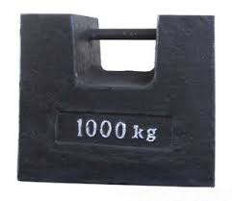
USA

Slide 16
USA - Washington
Washing Ton

Slide 17
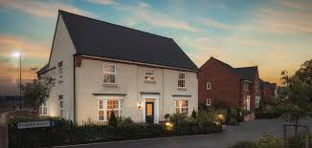
Sweden

Slide 18
Sweden - Stockholm
Stock Home

Slide 19
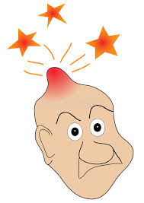
Malaysia

Slide 20
Malaysia – Kuala Lumpur
Koala Lump

Slide 21
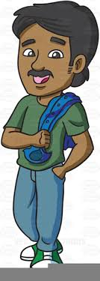
Nepal
ACTION

Slide 22
Nepal - Kathmandu
ACTION
Cat Man Do

Slide 23
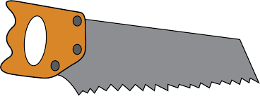
Poland

Slide 24
Poland - Warsaw
War Saw

Slide 25
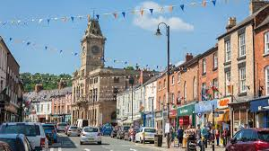
Barbados

Slide 26
Barbados - Bridgetown
Bridge Town

Slide 27
Belgium

Slide 28
Belgium - Brussels

Slide 29
Japan

Slide 30
Japan - Tokyo
Toe Key

Slide 31
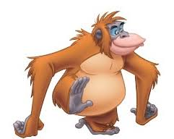
Mauritius

Slide 32
Mauritius – Port Louis
Port (King) Louie

Slide 33
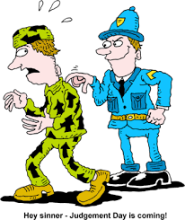
Romania

Slide 34
Romania - Bucharest
Book Arrest

Slide 35
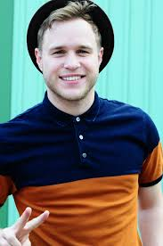
Libya

Slide 36
Libya - Tripoli
Trip Olly

Slide 37
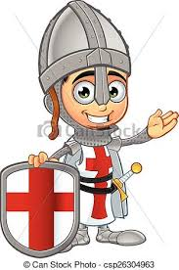
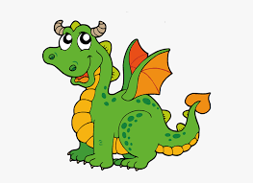
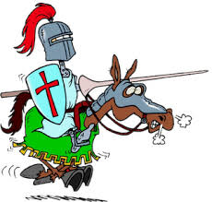
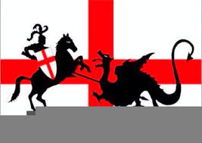
Grenada

Slide 38
Grenada – St George’s

Slide 39
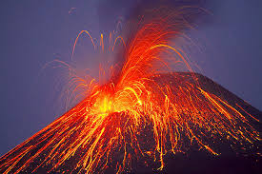
Slovakia

Slide 40
Slovakia - Bratislava
Brat Lava

Slide 41
Switzerland

Slide 42
Switzerland - Bern
Burn

Slide 43
Capital Cities

