Slide 1
UK and Irish Beaver Scouts
Age 6 - 8

Slide 2
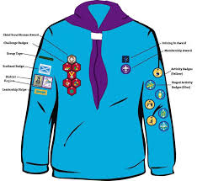
UK Beavers Scouts

Slide 3
Irish Beaver Scouts

Slide 4
What badges are these?
Notes:
UK Challenge badges :
Our world
Our skills
Our Outdoor
Our Skills
Teamwork
Team leader
Personal Challenge

Slide 5
Teamwork
Personal
Challenge
Our World
Outdoor
Challenge
Skills Cllanege
Adventure
Notes:
UK Challenge badges :
Our world
Our skills
Our Outdoor
Our Skills
Teamwork
Team leader
Personal Challenge

Slide 6
Irish cub scouts special Interest badges
Notes:
Irish special interest badges: Personal Skill.
Physical Recreation.
Adventure Journey.
Community Involvement.
Environment

Slide 7
Irish cub scouts special Interest badges
Notes:
Irish special interest badges: Personal Skill.
Physical Recreation.
Adventure Journey.
Community Involvement.
Environment

Slide 8
What badge is this?
How can you earn it?
Notes:
UK Chief Scouts award – Bronze
Earned when all challenge badges are completed

Slide 9
UK Chief Scout’s Silver Award
Awarded when all challenge badges have been earned
Notes:
UK Chief Scouts award – silver
Earned when all challenge badges are completed

Slide 10
Irish Chief Beaver Scouts Award
Notes:
Irish Chief Scout award

Slide 11
What is the UK Beaver Scout promise?

Slide 12
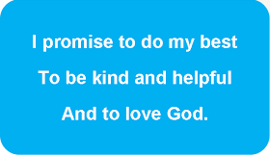

Slide 13
Irish Beaver Scout Promise

Slide 15
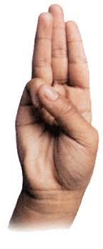
The Beaver Scout Salute

Slide 16
The world membership badge

