Slide 1
UK and Irish Cub Scouts

Slide 2
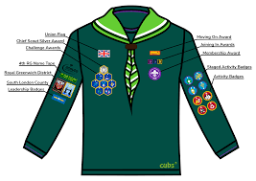
UK Cub Scouts

Slide 3
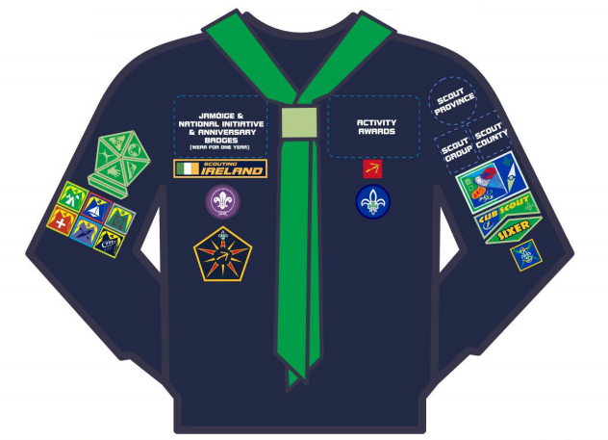
Irish Cub Scouts

Slide 4
What badges are these?
Notes:
UK Challenge badges :
Our world
Our skills
Our Outdoor
Our Skills
Teamwork
Team leader
Personal Challenge

Slide 5
Teamwork
Team Leader
Personal
Challenge
Our World
Our Adventure
Our Outdoor
Our Skills
Notes:
UK Challenge badges :
Our world
Our skills
Our Outdoor
Our Skills
Teamwork
Team leader
Personal Challenge

Slide 6
Irish cub scouts special Interest badges
Notes:
Irish special interest badges: Personal Skill.
Physical Recreation.
Adventure Journey.
Community Involvement.
Environment

Slide 7
Irish cub scouts special Interest badges
Environment
Communiy
Adventure
Physical
Personal Skill
Notes:
Irish special interest badges: Personal Skill.
Physical Recreation.
Adventure Journey.
Community Involvement.
Environment

Slide 8
What badge is this?
How can you earn it?
Notes:
UK Chief Scouts award – silver
Earned when all challenge badges are completed

Slide 9
UK Chief Scout’s Silver Award
Awarded when all challenge badges have been earned
Notes:
UK Chief Scouts award – silver
Earned when all challenge badges are completed

Slide 10
Irish Chief Scouts Award
Notes:
Irish Chief Scout award

Slide 11
What is the UK cub scout promise?

Slide 12
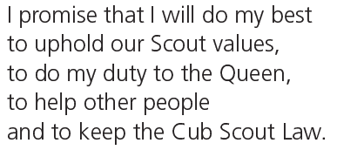
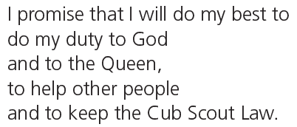

Slide 13
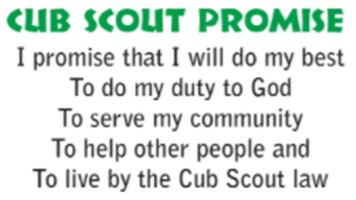

Slide 15
What is the UK cub scout law?

Slide 16
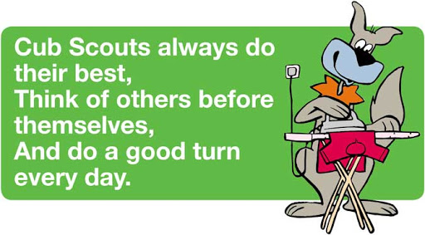
The cub scout law

Slide 17
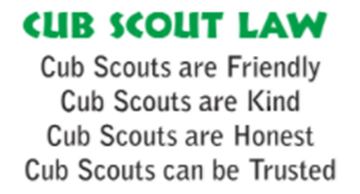
The cub scout law

Slide 19
The world membership badge

